Slide 1




Parallel Bug-finding in
Concurrent Programs via Reduced Interleaving Instances
Truc L. Nguyen¹, Peter Schrammel², Bernd Fischer³, Salvatore La Torre⁴, Gennaro Parlato¹
¹ University of Southampton, United Kingdom
² University of Sussex, United Kingdom
³ Stellenbosch University, South Africa
⁴ Universita degli Studi di Salerno, Italy
Notes:
Joint work with…

Slide 2
Concurrency makes bug finding harder.
State space explosion (i.e., large number of interleavings):
(… and many more)
Problem: modern hardware means concurrency is everywhere
⇒ software is increasingly concurrent
x = *;
y = 0;
if(x != y)
x = x-y;
x = x + 1;
z = x * y;
y = *;
x = 0;
if(x != y)
y = y-x;
y = y + 1;
z = x * y;
Notes:
Conventional wisdom is that concurrency makes bug finding harder, because of sse

Slide 3


Concurrency makes bug finding easier.
Concurrent hardware allows us to run many (smaller) analysis tasks in parallel:
SMALLER
TASK
SMALLER
TASK
ANALYSIS
TASK
SMALLER
TASK
SMALLER
TASK
SMALLER
TASK
SMALLER
TASK
Notes:
We show how concurrency can make bug finding easier, by using concurrency to fight concurrency (if life gives you lemons, you make lemonad)

Slide 4
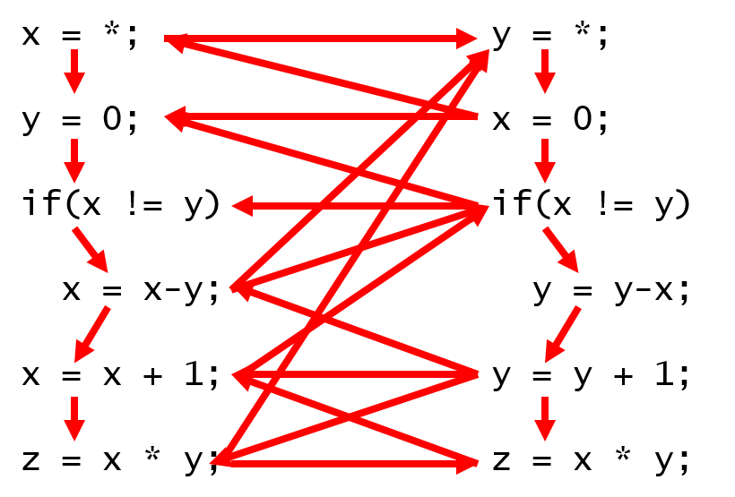
Concurrency makes bug finding easier.
Concurrent hardware allows us to run many (smaller) analysis tasks in parallel:
How can we partition a task into independent smaller tasks?
???
???
???
???
???
???
Notes:
Main problem is to partition into *independent* tasks, because communication would kill all benefits

Slide 5
Strategy competition vs. task competition
Strategy competition: run different settings on same task
(first counterexample “wins” and aborts other tasks)
This work:
Task competition: run same prover (setting) on different tasks
⇒ How can we partition a task into independent smaller tasks?
“anticipate the appearance of systems with large numbers of CPU cores, but without matching increases in clockspeeds… describe a model checking strategy that leverages this trend”
Notes:
Highlight task competition as new contribution

Slide 6
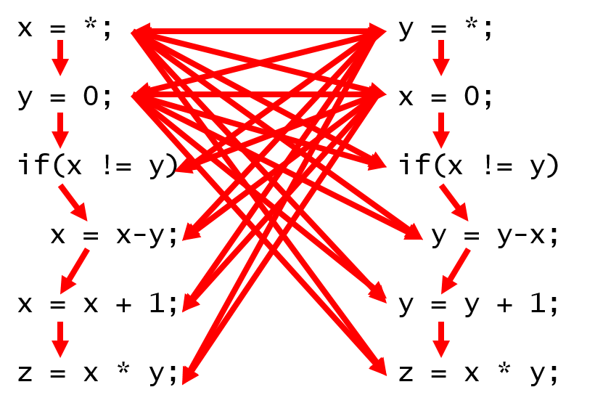
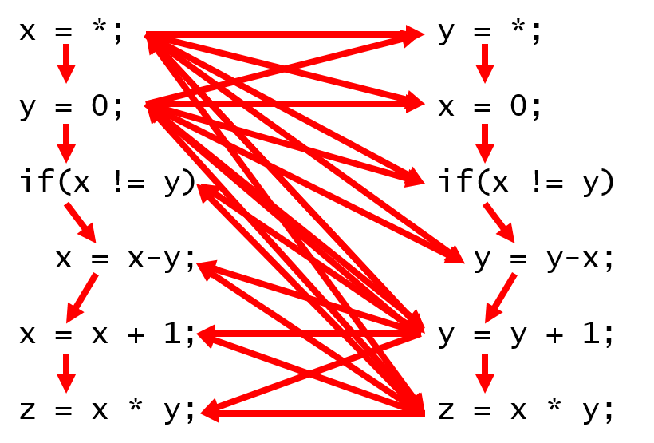
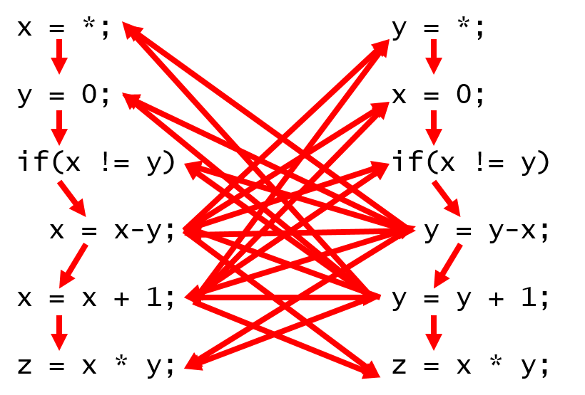
Reduced interleaving instances
Our goal:
Our solution:
Split set of interleavings I_{k}(P) into subsets that can be analyzed symbolically and independently.
…
Derive program variants P_{ϑ} that allow context switches only in subsets of statements (tiles) s.t. I_{k}(P) = U_{ϑ} I_{k}(P_{ϑ}).
Notes:
P is program, k is number of context switches, Ik is set of interleavings with at most k context switches. Note that Pϑ allows more than k context switches, but each k-context switch interleaving of P can be simulated by a run of one Pϑ

Slide 7
Reduced interleaving instances
Our goal:
Our solution:
Split set of interleavings I_{k}(P) into subsets that can be analyzed symbolically and independently.
…
Derive program variants P_{ϑ} that allow context switches only in subsets of statements (tiles) s.t. I_{k}(P) = U_{ϑ} I_{k}(P_{ϑ}).
Notes:
So union of all interleavings of all r.i.l’s gives all interleavings of original program

Slide 8
Tiling Threads

Slide 9
Tiling threads
Assumption: bounded concurrent programs
finite #threads, fixed (but arbitrary) schedule
captures all bounded round-robin computations for given bound
bugs manifest within very few rounds [Musuvathi, Qadeer, PLDI’07]
round 1
round 2
round 3
main()
T₀
…
T₁
T_{N-1}
T_{N}
round k
Notes:
Assumption makes presentation easier, and our current implementation is also based on this, but the approach is more general because we reuse the verification backend off the shelf

Slide 10
Tiling threads
Assumption: bounded concurrent programs
finite #stmts
control can only go forward
simplifies analysis and tiling
T₀
T₁
T_{N-1}
T_{N}
stmt₁;
stmt₂;
...
stmt_{s-1};
stmt_{s};
stmt₁;
stmt₂;
...
stmt_{t-1};
stmt_{t};
stmt₁;
stmt₂;
...
stmt_{u-1};
stmt_{u};
stmt₁;
stmt₂;
...
stmt_{v-1};
stmt_{v};
…

Slide 11
Tiling threads
Tiles:
tile: (contiguous) subset of visible statements
other tile types possible: random subsets, data-flow driven, …
tiling: partition of program into tiles
uniform window tiling: all tiles have same size
number of visible statements
T₀
T₁
T_{N-1}
T_{N}
stmt₁;
stmt₂;
...
stmt_{s-1};
stmt_{s};
stmt₁;
stmt₂;
...
stmt_{t-1};
stmt_{t};
stmt₁;
stmt₂;
...
stmt_{u-1};
stmt_{u};
stmt₁;
stmt₂;
...
stmt_{v-1};
stmt_{v};
…
Notes:
Tiles, as in compiler classes

Slide 12
Tiling threads
Tile selection:
z-selection: subset of z tiles for each thread
context switches are only allowed from selected tiles
context switches can only go into other selected tiles (or first thread statement)
each z-selection specifies a reduced interleaving instance
T₀
T₁
T_{N-1}
T_{N}
stmt₁;
stmt₂;
...
stmt_{s-1};
stmt_{s};
stmt₁;
stmt₂;
...
stmt_{t-1};
stmt_{t};
stmt₁;
stmt₂;
...
stmt_{u-1};
stmt_{u};
stmt₁;
stmt₂;
...
stmt_{v-1};
stmt_{v};
…
…

Slide 13
Tiling threads
Completeness of selections:
each interleaving with k context switches can be covered by a ⌈k/2⌉-selection ϑ ϵ Θ_{P}
each thread can only switch out at most ⌈k/2⌉ times
set of all ⌈k/2⌉-selections together covers all interleavings with k context switches: I_{k}(P) = U_{ϑ} I_{k}(P_{ϑ})
T₀
T₁
T_{N-1}
T_{N}
stmt₁;
stmt₂;
...
stmt_{s-1};
stmt_{s};
stmt₁;
stmt₂;
...
stmt_{t-1};
stmt_{t};
stmt₁;
stmt₂;
...
stmt_{u-1};
stmt_{u};
stmt₁;
stmt₂;
...
stmt_{v-1};
stmt_{v};
…
…
Notes:
thread can only switch out of each thread at most k/2 times, so don’t need k tiles

Slide 14
Tiling threads
Completeness of selections:
number of selections grows exponentially
sampling
T₀
T₁
T_{N-1}
T_{N}
stmt₁;
stmt₂;
...
stmt_{s-1};
stmt_{s};
stmt₁;
stmt₂;
...
stmt_{t-1};
stmt_{t};
stmt₁;
stmt₂;
...
stmt_{u-1};
stmt_{u};
stmt₁;
stmt₂;
...
stmt_{v-1};
stmt_{v};
…
…
Notes:
thread can only switch out of each thread at most k/2 times, so don’t need k tiles

Slide 15
VERISMART
(Verification Smart)
Notes:
Should be called very simple or even very stupid

Slide 16
VERISMART implements swarm verification by task competition for multi-threaded C.
Target:
C programs with “rare” concurrency bugs, i.e.,
“large” number of interleavings
“few” interleavings lead to a bug
automatic bug-finding (bounded analysis, not complete)
reachability
assertion failure
out-of-bound array, division-by-zero, …
linearizability → reachability [Bouajjani et al., POPL’15, ICALP’15]
Approach:
source-to-source translation to generate instances (for tiling)
instances are bounded concurrent programs
use cluster to run Lazy-CSeq over instances [Inverso et al., CAV’14]
Notes:
Independent of back-end analysis, but current implementation optimized for lazy-cseq

Slide 17
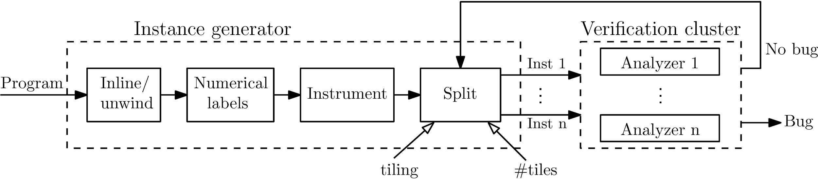
VERISMART architecture
Inline/unwind module:
concurrent program ⟶ bounded concurrent program
Numerical labels module:
inject numerical labels at each visible statement
Instrument module:
instrument the code with guarded commands (yield) that can enable/disable context switch points at numerical labels
Split module:
generate variants with configuration from tiling and #tiles
randomize number of generated variants when #variants is large

Slide 18
Why does this work?
Remember:
Each P_{ϑ} allows only a (small) subset of P’s interleavings
We assume bugs are rare,
so for most ϑ, P_{ϑ} does not exhibit the bug…
… and the analysis will run out of time
but if P_{ϑ} does exhibit the bug…
… the analysis will find it quick(er)
Hence,
overall CPU time consumption goes (way) up…
… but with enough cores CPU time is free and…
mean wall clock time to find failure goes down
Notes:
Remember “reduced interleavings instance”

Slide 19
Experimental Evaluation
Notes:
Used two very hard examples (couldn’t find anything else…)

Slide 20
Experiments on lock-free data structures
eliminationstack:
ABA problem: requires 7 threads for exposure
Lazy-CSeq can find bug in ~13h and 4GB
#unwind=1, #rounds=2, #threads=8, size=52 visible stmts
all other tools fail
safestack:
ABA problem: requires context bound of 5
Lazy-CSeq can find bug in ~7h and 6.5GB
#unwind=3, #rounds=4, #threads=4, size=152 visible stmts
all other tools fail
Notes:
Rounds is one lower than required round bound (funny way we handle the params)

Slide 21
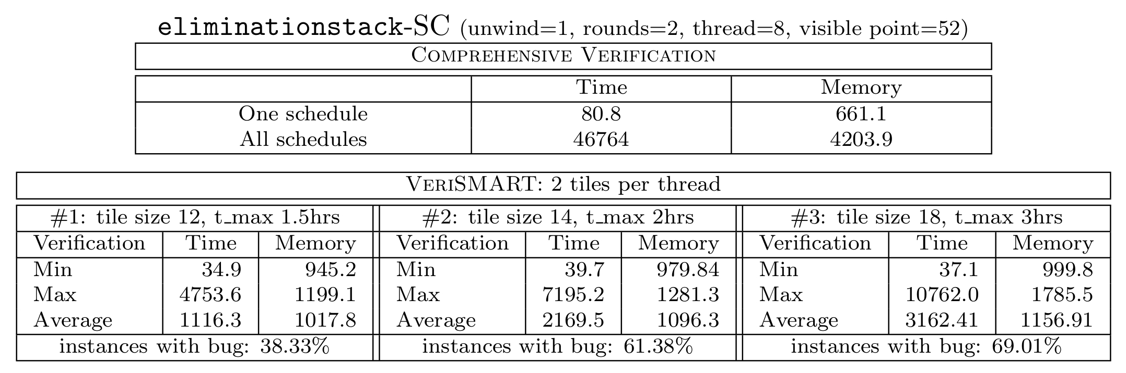
eliminationstack: Results
Lazy-CSeq: 46764 sec, 4.2 GB
CBMC (sequential): 80.8 sec, 0.7 GB
average over 3000 interleavings, bug not found
fastest instances very fast – 1000x
reduced memory consumption – 4x
average still very fast – 40x
some slowdown for larger tile sizes – 10x
high fraction of bug-exposing instances
Notes:
Note: cbmc looks at one interleaving only, verismart at a sub-set

Slide 22
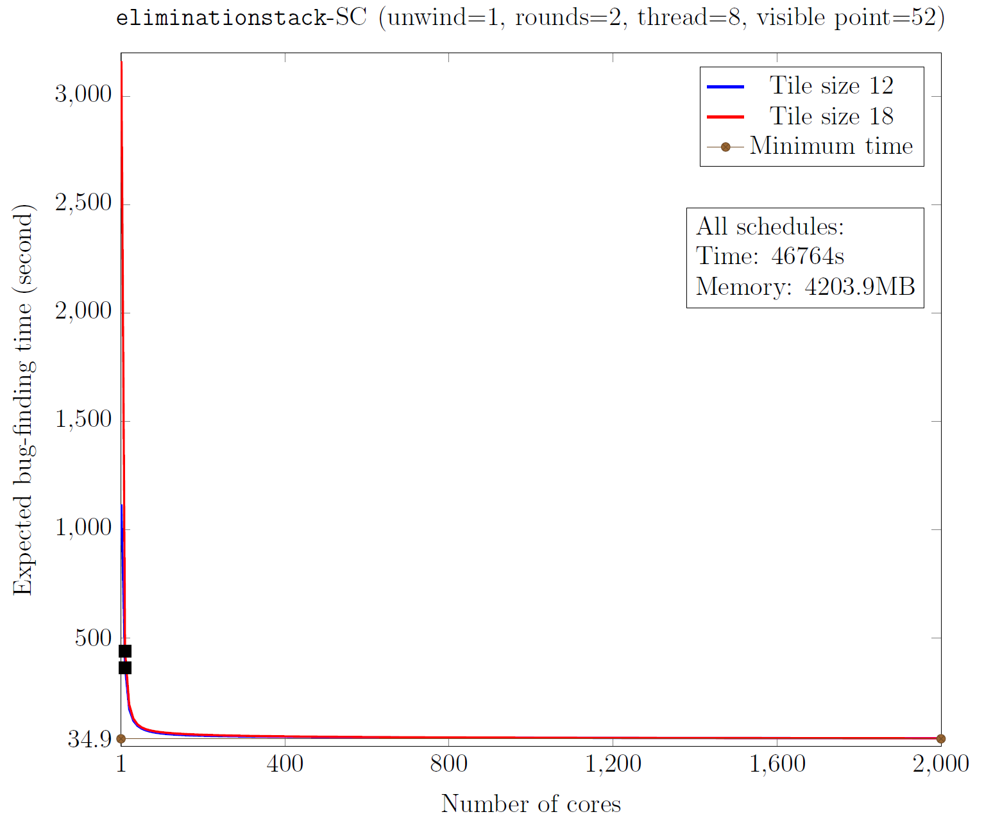
eliminationstack: Expected bug finding time
100x speed-up!
bug found with 99% probability, 5 cores, < 500sec
Notes:
Sample size 8000 instances, sample size calculator says 6000 for 99%

Slide 23
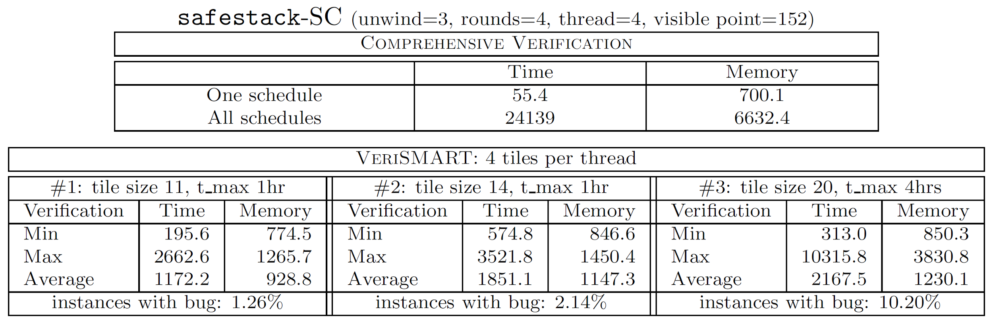
safestack (SC): Results
Lazy-CSeq: 24139 sec, 6.6 GB
CBMC (sequential): 55.4 sec, 0.7 GB
average over 3000 interleavings, bug not found
similar picture, but less advantage for VERISMART
lower fraction of bug-exposing instances than eliminationstack
…but boosted with larger tile sizes

Slide 24
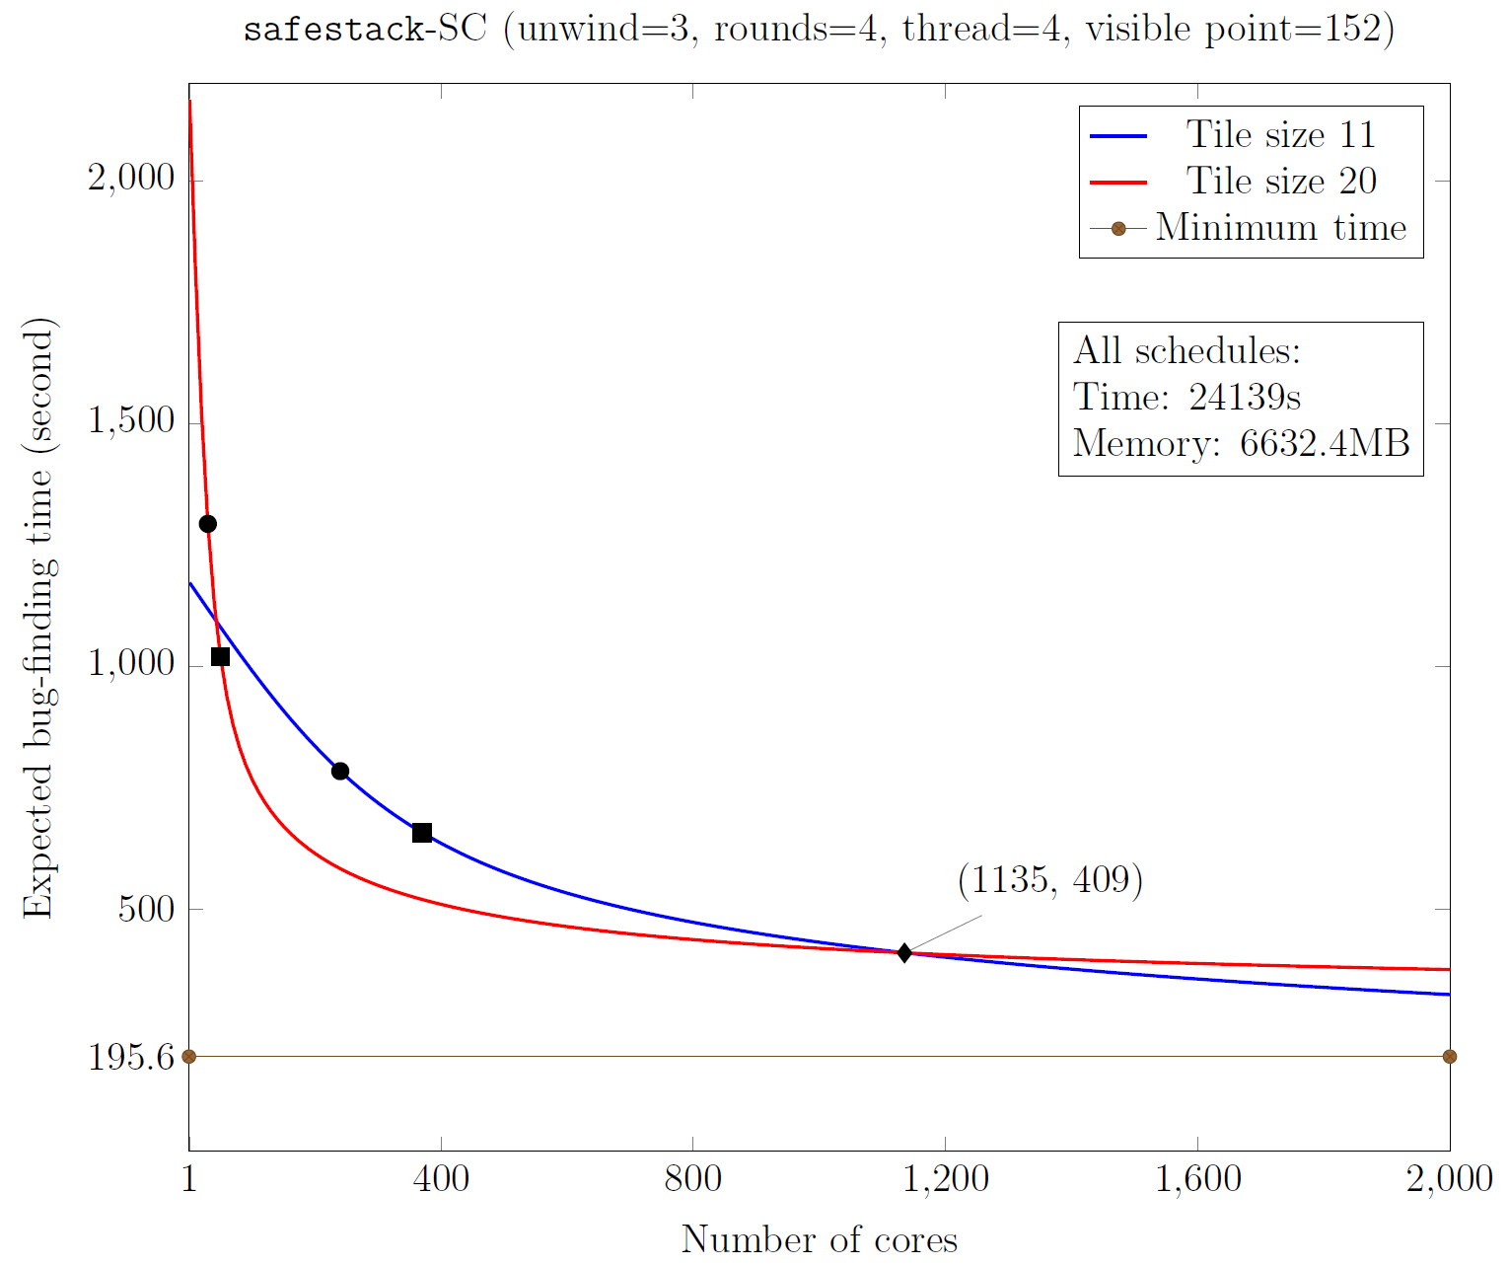
safestack (SC): Expected bug finding time
bug found with 95% probability, ~32 cores, ~1300sec
25x speed-up!
smaller tiles take longer
Notes:
based on Treiber’s stack

Slide 25
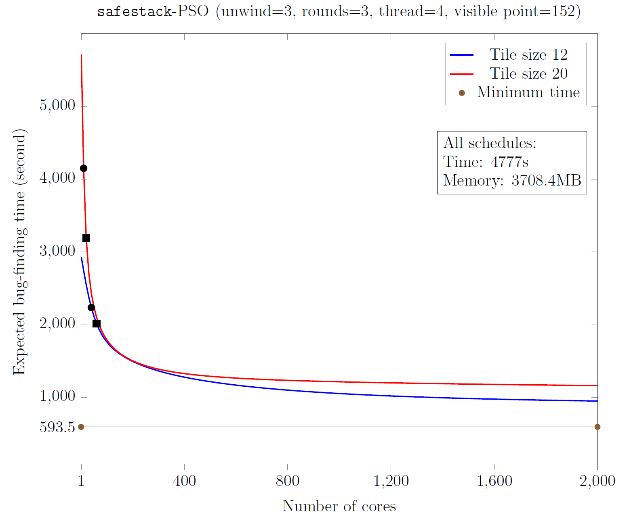
safestack (PSO): Expected bug finding time
PSO easier than SC
get some speed-up (2x), even though average time per instance is higher than full analysis time
Notes:
Easier because we only need three rounds….
Can play with the numbers of cores to conjure up wall-clock speed-up.

Slide 26
Conclusions
first task-competitive swarm verification approach
exploits availability of many cores to reduce mean wall clock time to find failure
allows us to handle very hard problems
high speed-ups already for 5-50 cores
reduced interleaving instances boost bug-finding capabilities
Future Work
production-quality implementation based on LLVM
other backends (testing)
other tiling styles
fast over-approximations to filter out safe instances

