Slide 1


CSeq: A Concurrency Pre-processor for Sequential C Verification Tools
Bernd Fischer¹, Omar Inverso², Gennaro Parlato²
¹ Stellenbosch University, South Africa
² University of Southampton, United Kingdom

Slide 2
Sequentialization of Concurrent Programs
Basic Idea:
General Approach:
replace the program’s control non-determinism by data non-determinism
P' simulates all computations (within certain bounds) of P
P' only requires sequential analysis
source-to-source transformation: T₁ ∥ T₂ ↝ T̕₁ ; T̕₂ ; C
allows direct re-use of existing sequential verification tools
checker C resolves non-determinism
convert concurrent programs into sequential programs such that reachability is preserved

Slide 3
Lal/Reps Sequentialization
considers only round-robin schedules with k rounds
...
...
...
...
...
T0
T1
Tn

Slide 4
Lal/Reps Sequentialization
...
considers only round-robin schedules with k rounds
thread → function, run to completion
...
...
...
...
...
T0
T1
Tn

Slide 5
Lal/Reps Sequentialization
...
considers only round-robin schedules with k rounds
thread → function, run to completion
global memory copy for each round
scalar → array
S0,0
S0,1
...
S0,n
S1,0
S1,1
...
S1,n
S2,0
S2,1
...
S2,n
...
...
Sk,0
Sk,1
Sk,n
T0
T1
Tn

Slide 6
Lal/Reps Sequentialization
...
considers only round-robin schedules with k rounds
thread → function, run to completion
global memory copy for each round
scalar → array
context switch → round counter++
S0,0
S0,1
...
S0,n
S1,0
S1,1
...
S1,n
S2,0
S2,1
...
S2,n
...
...
Sk,0
Sk,1
Sk,n
T0
T1
Tn

Slide 7
Lal/Reps Sequentialization
...
considers only round-robin schedules with k rounds
thread → function, run to completion
global memory copy for each round
scalar → array
context switch → round counter++
first thread starts with non-deterministic memory contents
other threads continue with content left by predecessor
S0,0
S0,1
...
S0,n
S1,0
S1,1
...
S1,n
S2,0
S2,1
...
S2,n
...
...
Sk,0
Sk,1
Sk,n
T0
T1
Tn

Slide 8
Lal/Reps Sequentialization
...
considers only round-robin schedules with k rounds
thread → function, run to completion
global memory copy for each round
scalar → array
context switch → round counter++
first thread starts with non-deterministic memory contents
other threads continue with content left by predecessor
checker prunes away inconsistent simulations
assume(Sk+1,0 == S k,n);
requires second set of memory copies
errors can only be checked at end of simulation
requires explicit error checks
S0,0
S0,1
...
S0,n
S1,0
S1,1
...
S1,n
S2,0
S2,1
...
S2,n
...
...
Sk,0
Sk,1
Sk,n
T0
T1
Tn

Slide 9
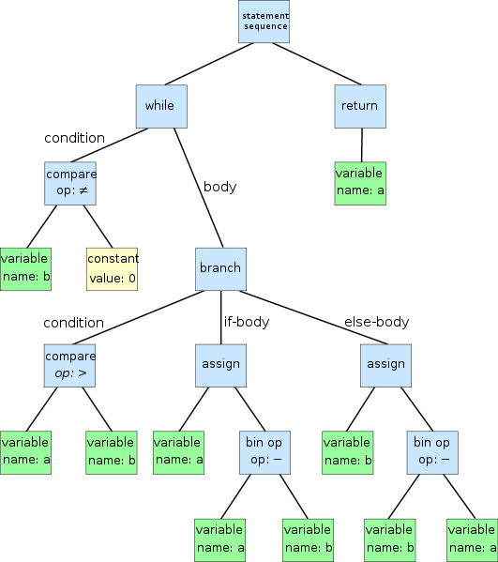

CSeq Tool Architecture
pycparser, AST traversal with unparsing
insert new type declarations, modify memory accesses
insert context switch simulation code at each sequence point
insert explicit error checks
insert checker and boilerplate code for pthread functions
k, N
sequential
non-deterministic
C program
concurrent
C program
CSeq
SAFE
UNSAFE
sequential tool
P
P'

Slide 10
CSeq Tool Architecture
pycparser, AST traversal with unparsing
insert new type declarations, modify memory accesses
insert context switch simulation code at each sequence point
insert explicit error checks
insert checker and boilerplate code for pthread functions
SAFE
UNSAFE
k, N
CBMC
concurrent
C program
CSeq
SAFE
UNSAFE
ESBMC
P
SAFE
UNSAFE
LLBMC
format

Slide 11
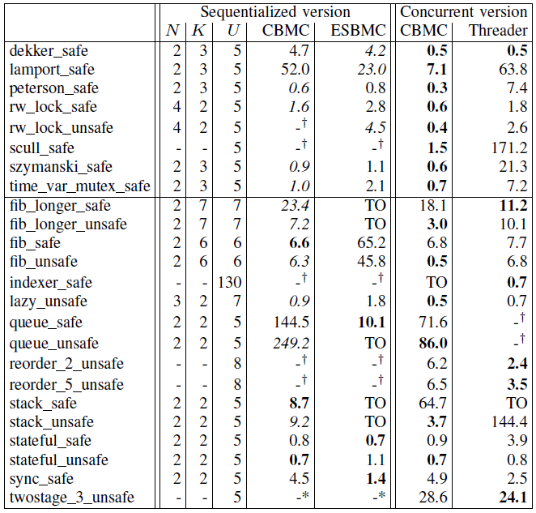
Performance and Availability
overall performance roughly equal to BMC with native concurrency handling
typically ~30-100% penalty
varies with backends
LLBMC very slow
some benchmarks faster
faster than ESBMC’s explicit schedule exploration
much faster version already under development
CSeq download at
http://users.ecs.soton.ac.uk/gp4/cseq.html

