Slide 1
Decidable Logics Combining Heap Structures and Data
Gennaro Parlato (LIAFA, Paris, France)
Joint work with
P. Madhusudan
Xiaokang Qie
University of Illinois at Urbana-Champaign

Slide 2
What is this talk about …
A new logic to reason with programs that manipulate heap + data using
deductive verification
SMT solvers
Program
…
new(x);
…
x->next=y->next->next;
…
y=nil;
…
x->data = y->data +1;
…
free(x);
…
157
75
14
5
15
23
1000
7
1
90

Slide 3
It’s a difficult problem!
One of the least understood class of theories
Both structures and data can be unbounded
This roles out immidiately classical combination of theories, like Nelson-Oppen scheme
Undecidable (even meaningful restrictions)

Slide 4
What would be desirable ?
A logic that is:
Decidable
Expressive enough to state useful properties
Efficient in practice on real-wold programs
We try to give a solution that has a good balance overall the goals!

Slide 5
Releted works
HAVOC (Lahiri, Qadeer: POPL’08)
Decidable: YES
Expressive: NO (doubly-linked lists cannot be expressed)
Efficient: YES on simple programs
CSL (Bouajjani, Dragoi, Enea, Sighireanu: CONCUR’09)
Decidable: YES
Expressive: NO
extends HAVAC to handle constraints on sizes of structures
still weak (properties of binary trees of unbounded depth cannot be expressed)
Efficient: ? (no implementation is provided)
The technique to decide the logic is encoded in the syntax
Hard to extend or generalize

Slide 6
STRAND Logic

Slide 7
Recursive data structures
Defines a set of graphs that which are interpreted over regular trees
R = ( ψ_{Tr}, validnode, {node_{a}}_{a∈ Lv} , {edge_{b}}_{b∈Le} )
Family of unary
predicates.
Lv is a finite set of
node labels
Family of binary
predicates
Le is a finite set of
edge labels
MSO formula
on k-ary Σ-lab
trees
Unary
predicate
R defines a class of graphs
For every tree T=(V,->) accepted by ψ_{Tr},
graph(T) = ( N, E, labnode_{a}, labedge_{b} )
{ v ∈ V | validnode(v) }
{(u,v) | b∈Le
& edge_{b}(u,v) }
labnode_{a}(v) =true
<=>
v∈ N ∧ node_{a}(v)=true
labedge_{b}(u,v) =true
<=>
u,v∈ N
∧ edge_{b}(u,v)=true

Slide 8
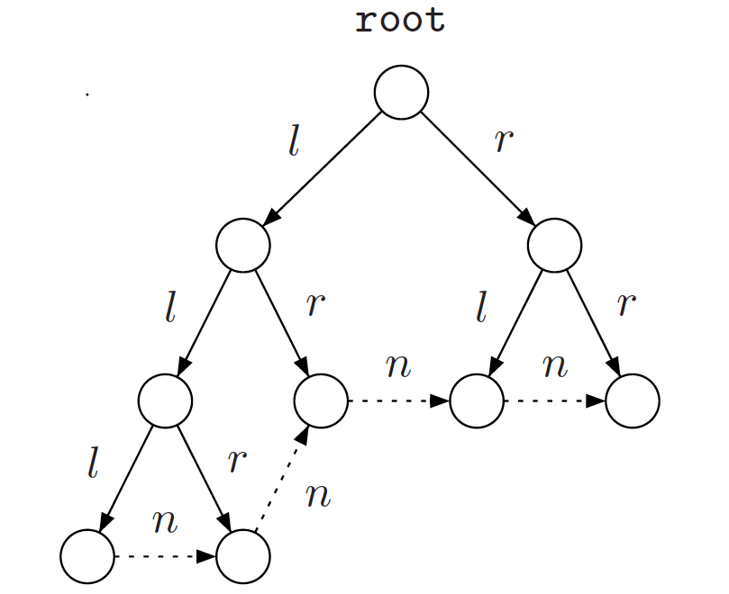
Examples of data stuctures
E_{n} (s,t)= leaf(s)
∧ leaf(t)
∧∃ z₁, z₂, z₃.
( E_{l}(z₃,z₁)
∧ RightMostPath( z₁, s)
∧ E_{r}(z₃,z₂)
∧ LeftMostPath( z₂, t)
)
z₃
z₁
z₂
t
s
Some data structures that can be expressed:
Nested lists
Cyclic and doubly-linked lists
Threaded trees

Slide 9
STRAND logic (STRucture ANd Data)
∃x_{n}. ∀y_{m}. φ(x_{n},y_{m})
φ is an Monadic Second Order (MSO) formula that combines
heap structures and
data, where the data-constraints are only allowed to refer to x_{n} and y_{m}
Syntax of STRAND
DATAExpression e::= data(x) | data(y) | c | g(e₁,...,e_{n})
φFormula φ::= γ(e₁,...,e_{n}) | α(v₁,...,v_{n})
| ¬φ | φ₁ ∧φ₂ | φ₁ ∨φ₂ | z ∈ S
| ∃z. φ | ∀z. φ | ∃S. φ | ∀S. φ
∀Formula ω::= φ | ∀y.ω
STRAND ψ::= ω|∃x.ψ

Slide 10
Expressing Binary Search Tree (BST)
left
right
left
right
right
left
right
left
right
left
right
left
right
leftbranch(y1, y2) ≡ ∃z. (left(y1, z) ∧ z →∗ y2)
rightbranch(y1, y2) ≡ ∃z. (right(y1, z) ∧ z →∗ y2)
ψ_{bst} ≡ ∀y1∀y2.
( leftbranch(y1,y2) ⇒ data(y2) < data(y1) )
∧ ( rightbranch(y1,y2) ⇒ data(y1) ≤ data(y2) )

Slide 11
Expressing data-structures in the VC (bst-search procedure)
bstSearch
(pre: ψ_{bst} ∧ ∃x.(key(root) = k))
Node curr = root;
(loop-inv: ψ_{bst} ∧∃x.(reach(curr,x)∧key(curr)=k))
while ( curr.key != k && curr != null ){
if (curr.key > k)
curr = curr.left;
else curr = curr.right;
}
(post: ψ_{bst} ∧ key(curr) = k)

Slide 12
Deciding STRAND fragments

Slide 13
Overview
Given
a linear block of statements s
a STRAND pre-condition P and a post-condition Q expressed as a Boolean combination of STRAND formulas of the form
∃x_{n}. φ(x_{n}), ∀y_{m}. φ( y_{m})
checking the validity of the Hoare triple {P} s {Q}
reduces to the satisfiability of STRAND
Satisfiability of STRAND is undecidable
We identify a decidable fragment of STRAND semantically defined by using the notion of satisfiability-preseving embeddings

Slide 14
Intuition
For two structure T, S (with no data)
S satisfiability-preservingly embeds into T w.r.t. ψ
if there is an embeddings of the nodes of S in T such that
no mutter how the data-logic constraints are interpreted
if T satisfies ψthen also S satisfies ψby inhering the data-values
T
S

Slide 15
Intuition (STRAND_{dec})
Checking the satisfiability
we ignore T and
check only S
Satisfiability is done only on the minimal models
STRAND_{dec} is the class of the formulas that has a finite set of minimal models
Satisfiability reduces to the satisfiability of the quantifier-free theory of the data-logic

Slide 16
Romoving existential quantifications
Let ψ=∃x_{n}. ∀y_{m}. φ(x_{n}, y_{m}) be a STRAND formula over a recursively data-structure R
define a new rec. data-structure R’ that encoperates the existentally quantified variables of x_{n} as pointers in R’ (unary predicate Val_{i} for the var x_{i} )
define
ψ’= ∀x_{n}∀y_{m}. ((∧_{i=1,…,n} Val_{i}(x_{i})) => φ(x_{n}, y_{m}))
Claim: ψ’ is satisfiable on R’ iff ψ is satisfiable on R

Slide 17
Abstracting data
Let ψ=∀y_{n}. φ(y_{n}) be a STRAND formula, and γ₁, …,γ_{r} be the atomic relational formulas of the data-logic.
Define the pure MSO formula
ψ’=∀y_{n.} ∃b₁, …, b_{r}. φ’ (y_{n}, b₁, …, b_{r})
where φ’ is obtained by φ replacing γ_{i} with the predicate b_{i}
Example:
ψ_{sorted} : ∀y₁,y₂. ( (y₁->*y₂ ) => data(y₁) ≤ data(y₂))
ψ’_{sorted} : ∀y₁,y₂. ( (y₁->*y₂ ) => b₁ )
Claim: if ψis satisfiable on a recursive data-structure R then ψ’ is also satisfiable on R.
The other direction does not hold OVER-APPROXIMATION

Slide 18
Submodels
Let T be a tree defining a graph of the given Rec. Data-structure
A subset S of nodes of T is valid :
Not-empty & least-ancestor closed
The subtree defined by S also defines a RDS
Submodels can be defined in MSO

Slide 19
MinModels & Satisfiability-Preserving Embeddings
S satisfiability-preservingly embeds in T iff no matter how T satisfies the formula using some valuation of the atomic data-relations, S will be able to satisfy the formula using the same valuation of the atomic data-relations
T
S
MinModel = \* pure MSO formula *\
∀y_{n.} ∃b₁, …, b_{r}. φ’ (y_{n}, b₁, …, b_{r})
∧
¬∃X. ( NonEmpty(X) ∧ ValidSubModel(X)
∧ (∀y_{m}. ∀b₁, …, b_{r}.
(∧_{i∈ [m]} (y∈ S) ∧ interpret( φ’ (y_{n}, b₁, …, b_{r}))
=> tailor(φ’ (y_{n}, b₁, …, b_{r}))
) )

Slide 20
Decision procedure
Transform MinModels to tree-automaton TA
Check finiteness for TA
Extract all trees accepted by TA: ρ₁, …, ρ_{t}
For each ρ_{i} build the finite graph g_{i}
Create a quantifier-free formula λ_{i} for g_{i}
Create a data-variable for each node
∀’s are “expanded” in conjunctions
∃’s are “expanded” in disjunctions
Data-constraints in STRAND are directly written in the data-logic
The quantifier-free formula ∨_{i=1,…,t} λ_{i} is a pure data-logic formula that is satisfiable iff the original formula ψ is satisfiable on R

Slide 21
Program Verification with STRAND

Slide 22
idea
Hoare-triples: ( (R, Pre), P, Post )
R
Pre ∈ STRAND∃,∀
P:
Node t = newhead;
newhead = head;
head = head.next;
newhead.next = t;
Post ∈ STRAND∃,∀
⇒ Is ψ ∈ Strand Satisfiable over R_{P} ?
Idea: capture the entire computation of P starting from a particular recursive data-structure R using a single data-structure R_{P}

Slide 23
The reduction to the satisfiability
Error = ∨_{i ∈[m]} (Pre_{Rp} ∧ ∧_{j∈[i −1]} π_{j} ∧ error_{i} )
Violate_{Post} = Pre_{Rp} ∧ ∧_{j∈[m]} π_{j} ∧¬Post_{Rp}
Theorem
The Hoare-triple (R, Pre, P, Post) does not hold iff the STRAND formula Error ∨ ViolatePost is satisfiable on the trail R_{P}

Slide 24
Evaluation

Slide 25
Experiments
Programs | Verification Condition | Structural Solving (MONA) |  |  |  |  | Data Constraint Solving (Z3)
 |  | In STRAND_{dec} ? | # states | Final BDD size | Time (sec) | Graph model Exists? | Bound #nodes | Formula size (kB) | Satisfiable ? | Time (sec)
sorted- list-search | before-loop in-loop after-loop | Yes Yes Yes | 67 131 67 | 264 585 264 | 0.34 0.59 0.18 | No No No | - - - | - - - | - - - | - - -
sorted- List-insert | before-head before-loop in-loop after-loop | Yes Yes Yes Yes | 73 259 1027 146 | 298 1290 6156 680 | 1.66 0.38 4.46 13.93 | Yes No No Yes | 5 - - 7 | 6.2 - - 14.5 | No - - No | 0.02 - - 0.02
sorted-list-insert -err | before-loop | Yes | 298 | 1519 | 0.34 | Yes | 7 | 9.5 | Yes | 0.02
sorted-list-reverse | before-loop in-loop after-loop | Yes Yes Yes | 35 513 129 | 119 2816 576 | 0.24 2.79 0.35 | No No No | - - - | - - - | - - - | - - -
Bst-search | before-loop in-loop after-loop | Yes Yes Yes | 52 160 52 | 276 1132 276 | 5.03 32.80 3.27 | No Yes No | - 9 - | - 7.7 - | - N0 - | - 0.02 -
Bst-insert | before-loop in-loop after-loop | Yes Yes Yes | 36 68 20 | 196 452 84 | 1.34 9.84 1.76 | No No No | - - - | - - - | - - - | - - -

Slide 26
bst-search procedure
bstSearch
(pre: ψ_{bst} ∧ ∃x.(key(root) = k))
Node curr = root;
(loop-inv: ψ_{bst} ∧∃x.(reach(curr,x)∧key(curr)=k))
while ( curr.key != k && curr != null ){
if (curr.key > k)
curr = curr.left;
else curr = curr.right;
}
(post: ψ_{bst} ∧ key(curr) = k)

Slide 27
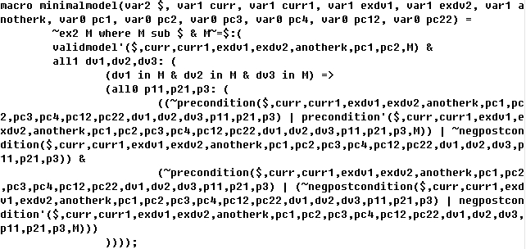
MONA formula for bst-search

Slide 28
Webpage of STRAND
http://cs.uiuc.edu/~qiu2/strand/
Code
Experiments
Table of the experiments

Slide 29
Conclusions & Future Work

Slide 30
Conclusions
We have presented STRAND a logic for reasoning about structures and data which has good balance among
Decidability
Expressiveness
Efficiency
We believe this work
breaks new ground in combining structures and data
may pave the way for defining decidable fragments of other logics

Slide 31
Future Work
Powerful and decidable syntactic fragments
Back-and-forth connection between the structural part and the data part
Extend Separation logic with data

