Slide 1
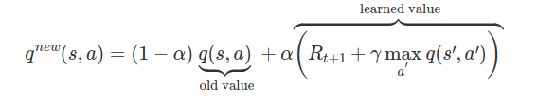

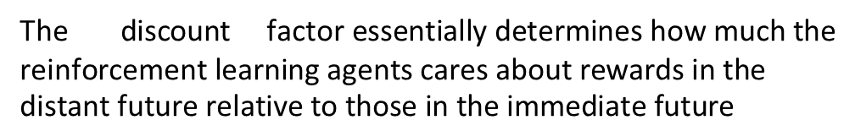
Reinforcement learning based on Q-learning algorithm
Bellman optimality equation
Q-learning is a model free reinforcement learning algorithm which goal is to learn iteratively the optimal Q-value function using the Bellman Optimality Equation
$$α −learning rate$$
Advantages of Q-learning:
Better learning
Low variance
Thorough environment exploration
$$γ − discount factor.$$
The discount$\text{factor} \text{essentially} \text{determines} \text{how} \text{much} \text{the} \text{reinforcement} \text{learning} \text{agents} \text{cares} \text{about} \text{rewards} \text{in} \text{the} \text{distant} \text{future} \text{relative} \text{to} \text{those} \text{in} \text{the} \text{immediate} \text{future}$

Slide 2

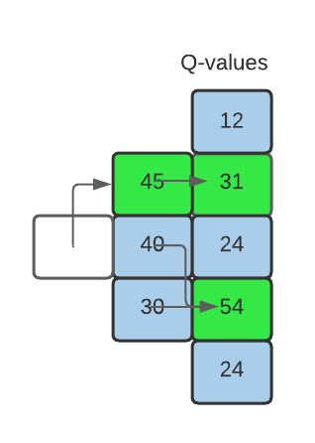
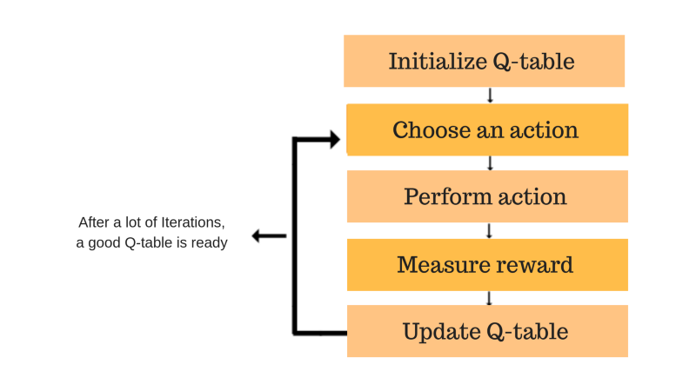
Reinforcement learning based on Q-learning algorithm

Slide 3
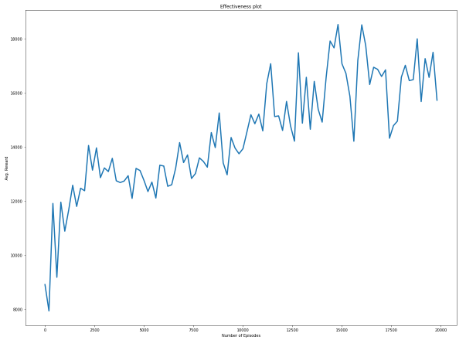
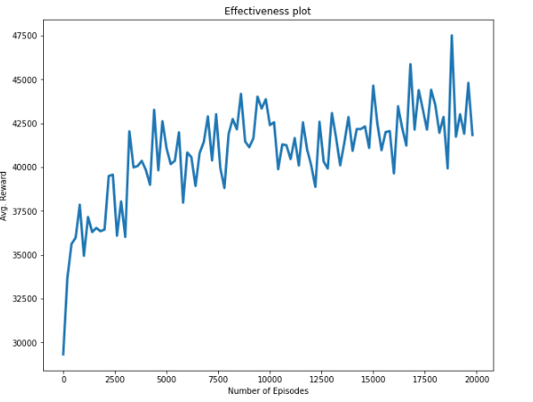
Problem statement
Action space:
Up [1,1]
Forward [1,0]
Down [1,-1]
State:
Position in a productivity map grid
Agent:
Trajectory planner
Reward function (system dynamics):
Every step sums the value of productivity map
Penalty for escaping the pay zone
Reward for reaching the goal (end of the pay zone)
Reward plot on 2 dataset
Reward plot on 3 dataset

Slide 4
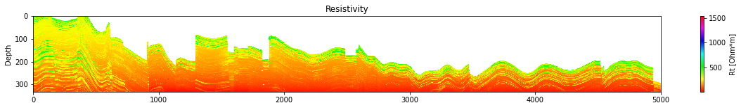
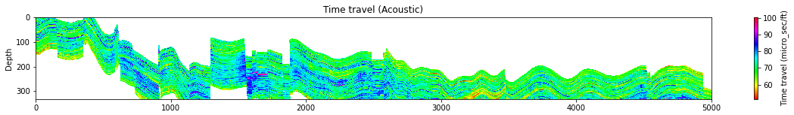
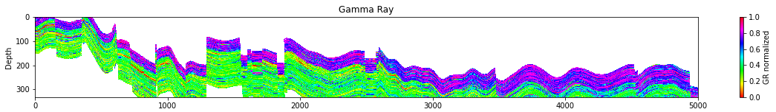
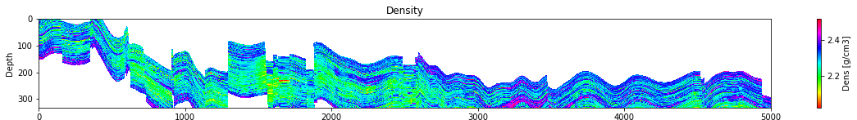
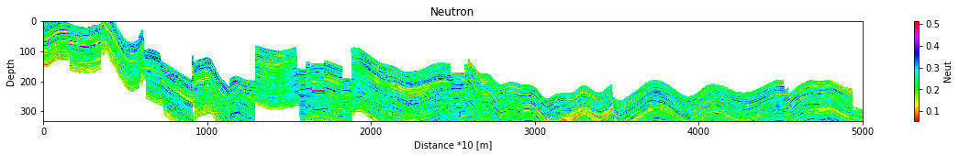






Calculated Properties: 3rd dataset
$$S_{w}^{n}=\frac{R_{w}}{\left(φ^{m}⋅R_{t}\right)}$$
(Archi, 1952)
$φ$ = $\frac{Δt−Δt_{ma}}{Δt_{f}−Δ_{t_{ma}}}−V_{sh}⋅\frac{Δt_{sh}−Δt_{ma}}{Δt_{f}−Δt_{ma}}$
(Dress Atlas, 1979)
$$V_{sh}=1.7−\sqrt{3.38−{\left(I_{GR}+0.7\right)}^{2}}$$
(Clavier, 1971)
$φ=\frac{ρ_{ma}−ρ_{b}}{ρ_{ma}−ρ_{f}}$;
$$ρ_{ma}=\left(1−V_{sh}\right)ρ_{ss}+V_{sh}⋅ρ_{sh}$$
$$φ=N_{m}−k⋅v_{sh}$$

Slide 5
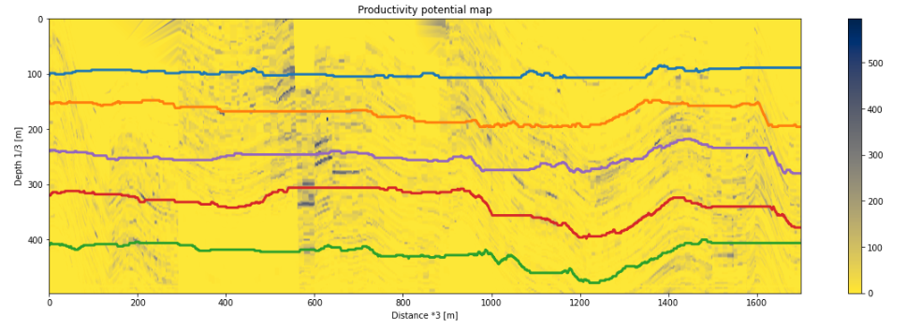
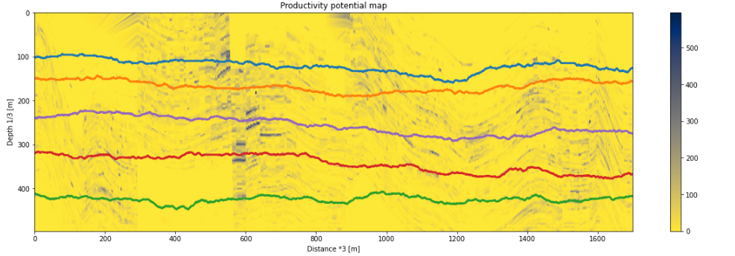
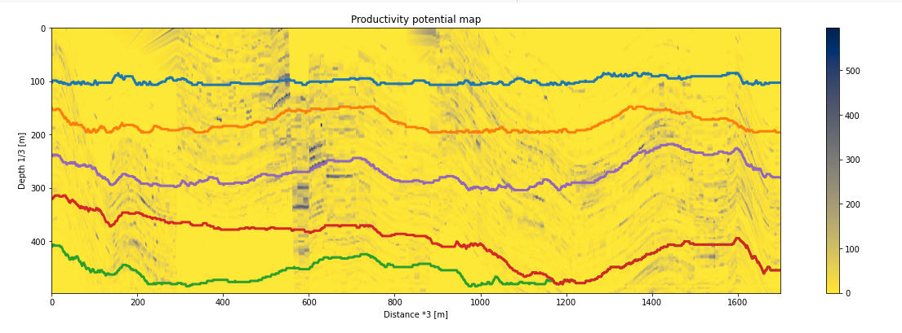
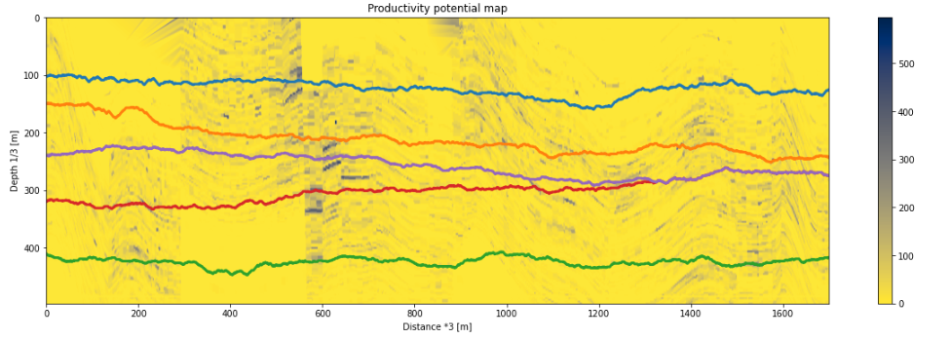
Comparison with greedy algorithm. 3rd dataset
Greedy
Q-learning
Sum OFV = 162993
With angle constraint
Sum OFV = 237597
Sum OFV = 246140
Without angle constraint
Sum OFV = 253803

Slide 6
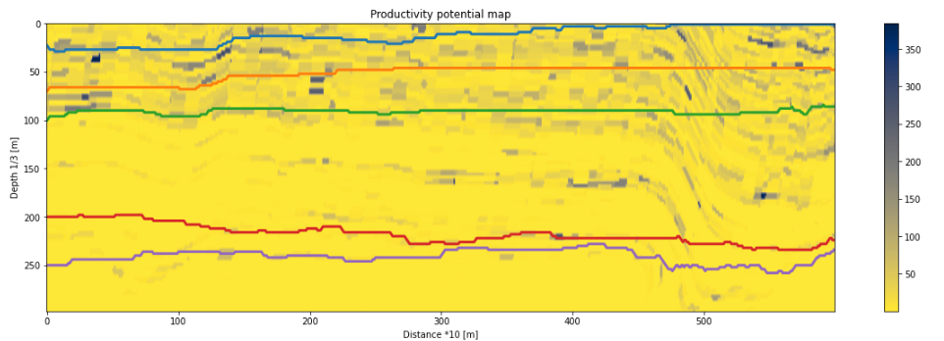
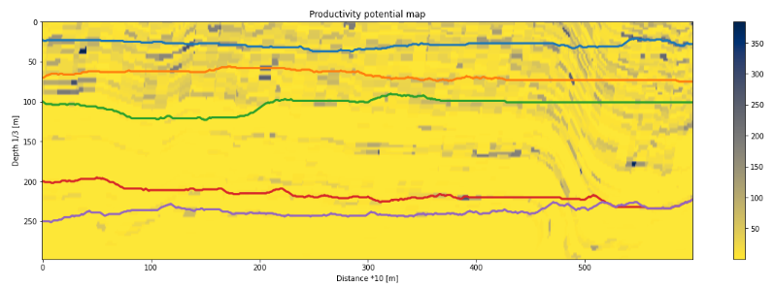
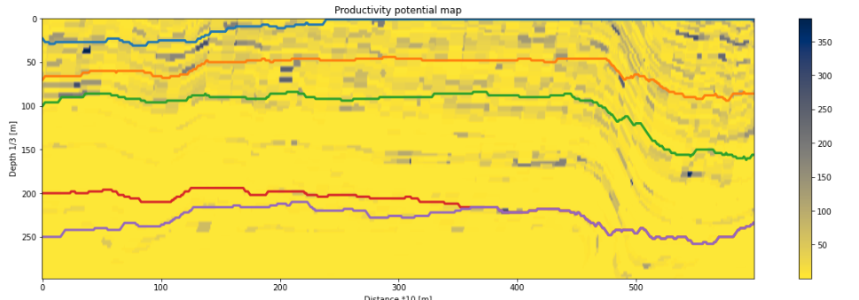
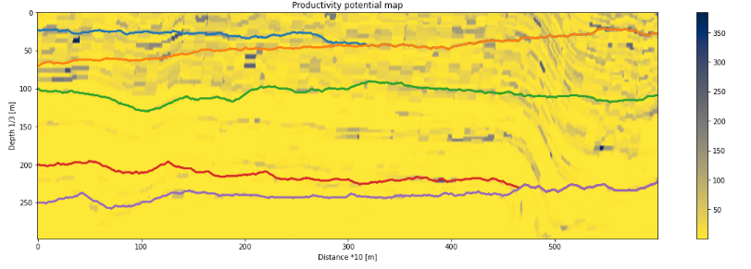
Comparison with greedy algorithm. 2nd dataset
Greedy
Q-learning
Sum OFV = 34066
With angle constraint
Sum OFV = 81831
Sum OFV = 72053
Without angle constraint
Sum OFV = 93834

Slide 7
Results

Slide 8
Backup slides

Slide 9
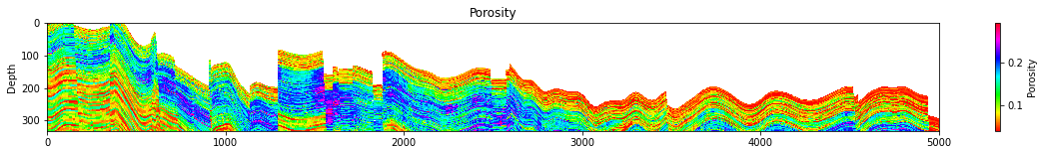
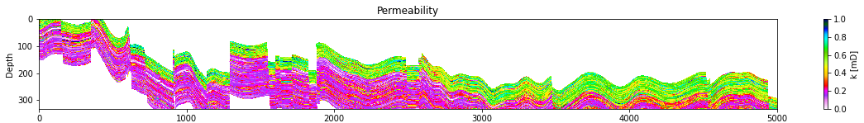
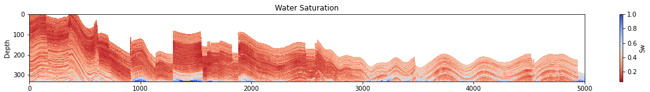
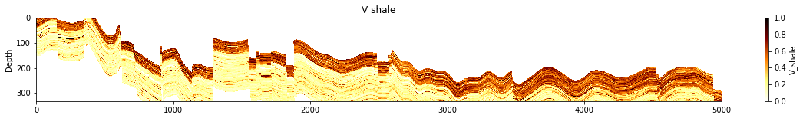
Processed in Python data: section of well_3
Nodes:
5000 × 333
[m]
[m]
[m]
[m]
Distance *10 [m]

