Slide 1
CIFAR-10 Image Classification
with a Convolutional Neural Network
Geno Owor Joshua
Reg. No. M23B23/006
Uganda Christian University
CSC3218 — Deep Learning

Slide 2
Problem & CIFAR-10 data
Task: classify 32×32 RGB images into 10 classes (logits → softmax; train with cross-entropy).
CNNs: local filters, hierarchy of features, pooling — suited to natural images.
50k train / 10k test (official); we use 90% train / 10% val from the 50k; test only for final metrics.
Normalize with CIFAR mean/std; train aug: RandomCrop+padding, horizontal flip — not on val/test.

Slide 3
Model & training
3× stages: two Conv3×3+BN+ReLU → MaxPool → dropout; channels 64→128→256; spatial 32→4.
Global average pool → head: Linear→BN→ReLU→Dropout→Linear (10 classes).
AdamW (lr=0.0003, weight_decay=0.0001); ReduceLROnPlateau on val acc (×0.5, patience 4).
Early stopping patience 12 epochs; best val checkpoint → reload before test eval.
Regularization: dropout 0.3, weight decay, augmentation; test set used once.

Slide 4
Setup & results
Setting | Value
Epochs (completed / max) | 80 / 80
Batch size | 128
Learning rate / weight decay | 0.0003 / 0.0001
Dropout / early-stop patience | 0.3 / 12
Device / runtime | cpu · ~18.5 h
Test accuracy 91.67% · test loss 0.263 · macro P/R/F1 91.6% / 91.7% / 91.6%
Best checkpoint: train 98.18% · val 92.16% (train–val gap → mild overfitting).
Hardest F1: cat (0.82), dog (0.87); strongest: automobile (0.96), ship (0.95).
Val ≈ test accuracy → validation split was representative.

Slide 5
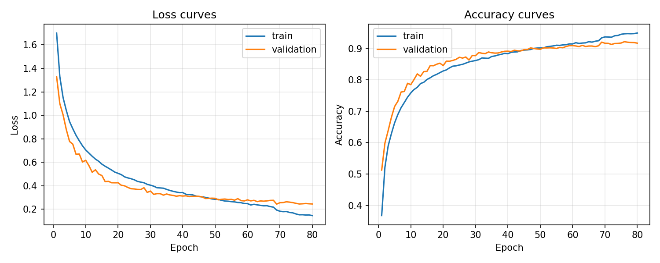
Training / validation loss and accuracy

Slide 6
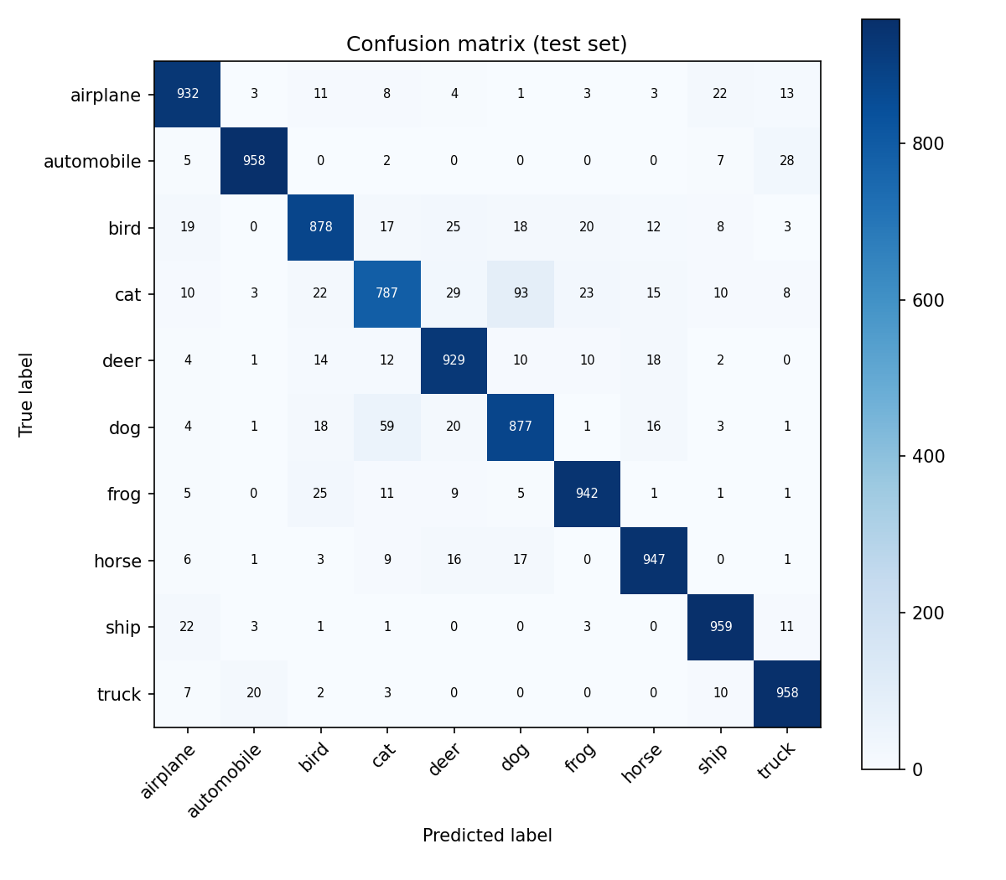
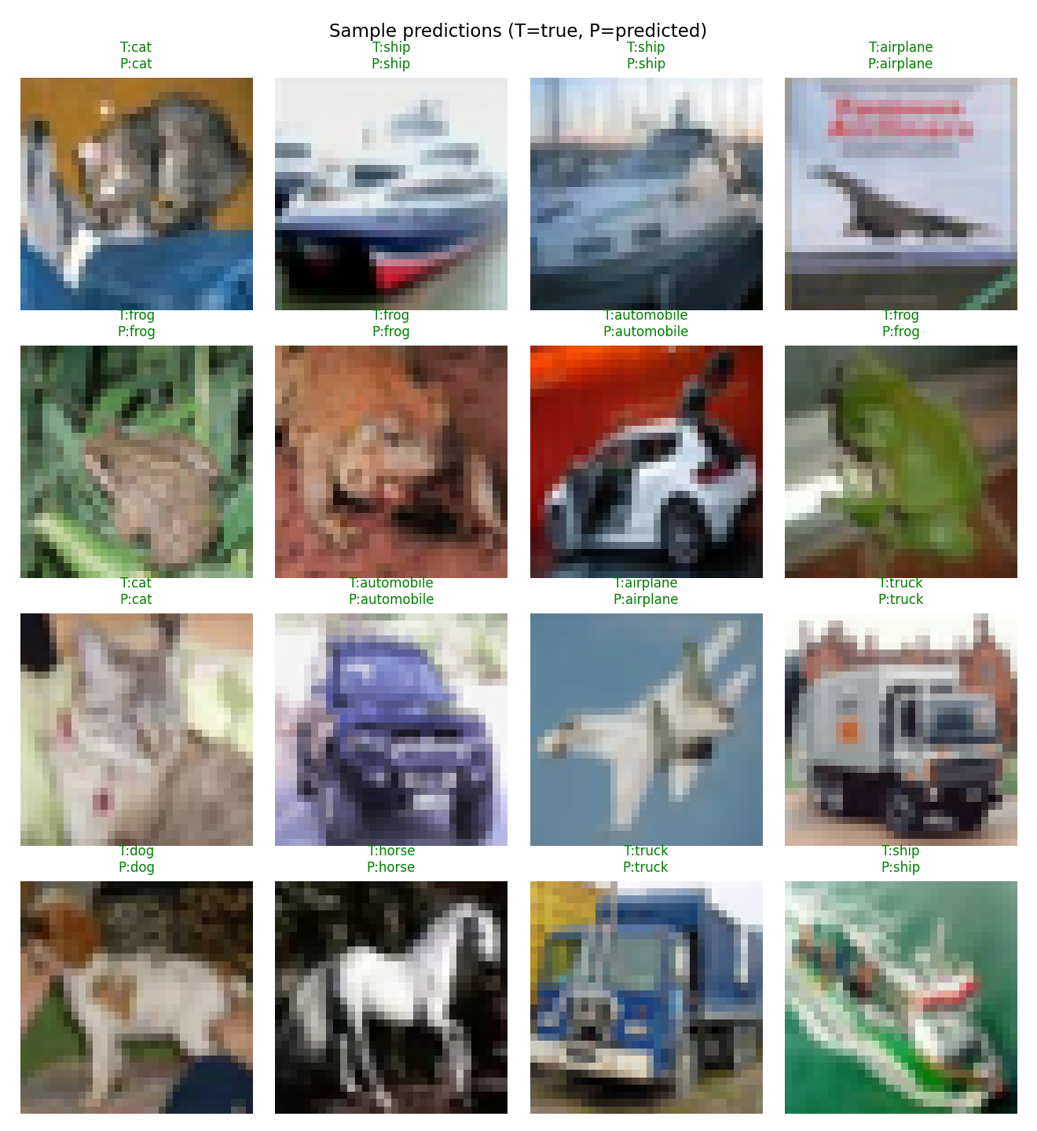
Test confusion matrix & sample predictions
Confusion matrix (counts)
Green = correct, red = wrong

Slide 7
Discussion & conclusion
Curves: training improves faster than validation; LR drops when val acc plateaus.
Matrix: off-diagonal mass shows cat/dog and similar classes; vehicles/ships often cleaner.
Limits: moderate-depth CNN; no TTA/ensemble; low-res images — ResNet / stronger aug could help.
Summary: BN + dropout + GAP CNN achieves 91.67% on CIFAR-10 with proper train/val/test practice.

Slide 8
Thank you
Questions?

