Slide 1
Final Project Presentation
Made By : Group 3
Joran van de Moosdijk - 4220923
Matija Mandarelo - 4279425
Shanessa Kostaman - 450080
Tobias Haloman - 4252861

Slide 2
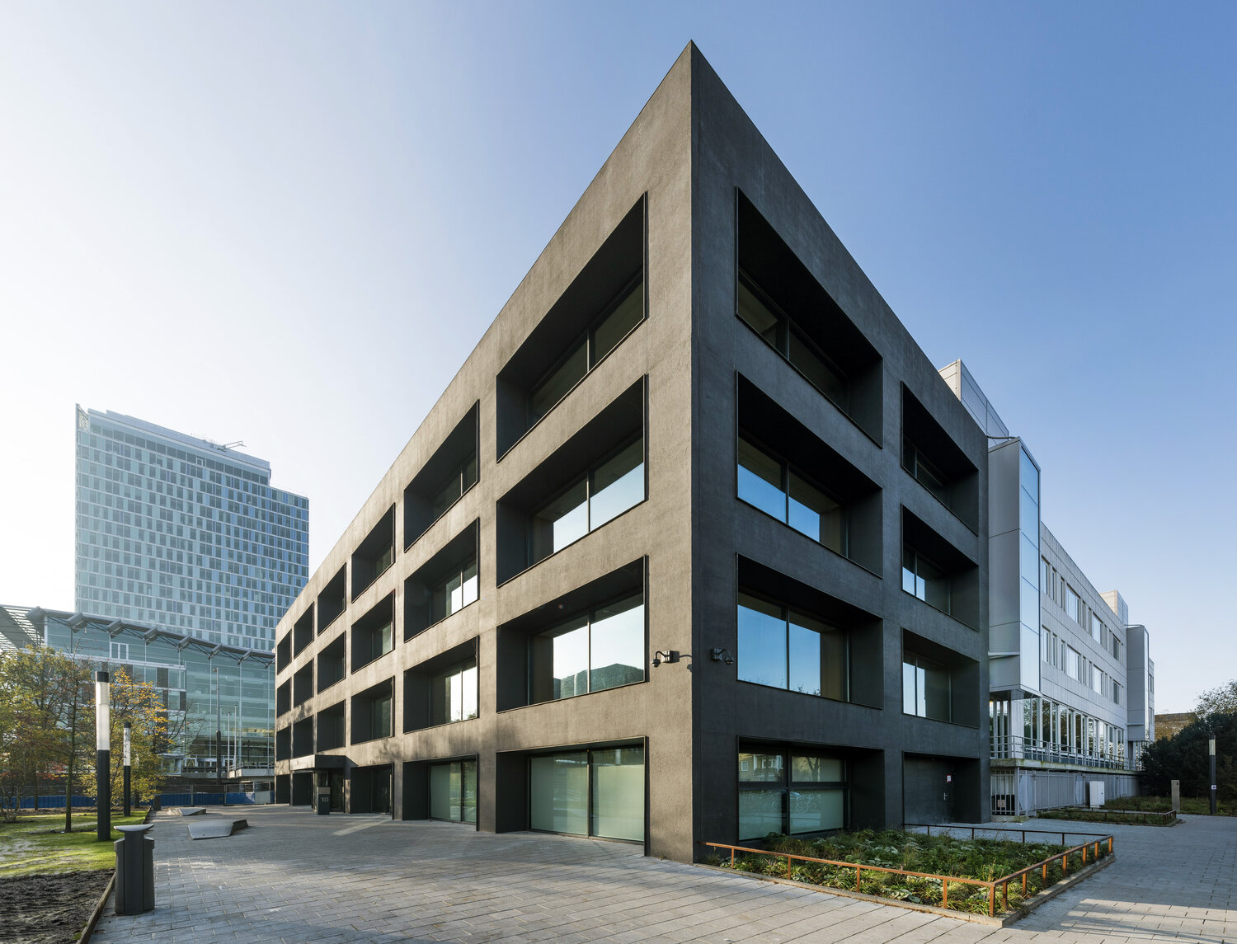
Introduction
Student Housing BV is a company that serve houses for students to stay during their studies in the country (Netherlands).
Our stakeholder has received multiple complaints from their clients.
The stakeholder is trying to find a way to easily add in new housing rules for their multiple buildings.
And we’re the consultant team that has a stake in this company and were tasked to implement software solutions to their problems.

Slide 3
Implementation
Project Description
Provide clients / students the ability to post day-to-day arrangements to manage everything.
Provide stakeholder/admin the ability to receive anonymous complaints from their clients/students.
The stakeholder/admin also can add and remove the students or other admin.
Only the stakeholder/admin can add and remove the rules.
The page also includes a box where you can post anonymous complaints as to be received and acted upon by the stakeholder/admin.
The application will be made private using a security page where the clients/students or the stakeholder/admin need to log in with their username and password to enter the next page.

Slide 4
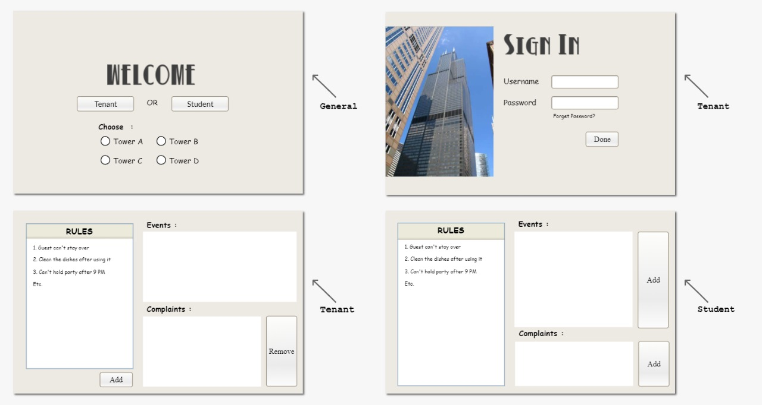
Implementation
Project Description
Mock - Up

Slide 5
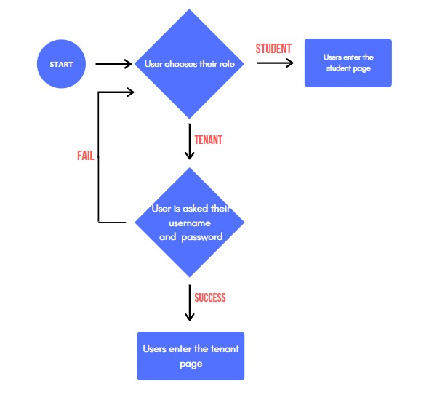
Flow Chart
Implementation
Project Description

Slide 6
Implementation
The project will be done by our group through division of work
We’ve sent each other’s code using Github.
The focus for the project will be providing the functionality in the Student page and the Tenant page.
Due to the coronavirus pandemic, the amount of times we can meet up in person will be severely mitigated, thus impeding our productivity in implementing the software.
We’ve decided by meeting up online and using Github to check on each group member’s work.
Group Work Division

Slide 7
Week | Date | Time | Activities
Week 13 | Tue, 1 Dec 2020 | 13.00 - 16.00 | Have small meeting with our group to discuss about project analysis
 |  |  | (Online)
 | Wed, 2 Dec 2020 | 09.00 - 12.00 | Have small meeting with the teacher to share about our idea and show
 |  |  | our project analysis (Online)
 | Fri, 4 Dec 2020 | 13.00 - 16.00 | Discussed how we should divided the work (R 10 - OIL 0.30)
Week 14 | Tue, 8 Dec 2020 | 13.00 - 16.00 | Start working on our own division (Online)
 | Wed, 9 Dec 2020 | 09.00 - 12.00 | Have small meeting with our group to show each other progress (Online)
 | Fri, 11 Dec 2020 | 13.00 - 16.00 | Show the teacher about our progress and do the project based
 |  |  | on work division (R 10 - OIL 0.30)
Week 15 | Tue, 15 Dec 2020 | 13.00 - 16.00 | Have small meeting with the teacher to show the progress that we've
 |  |  | made (Online)
 | Wed, 16 Dec 2020 | 09.00 - 12.00 | Working on our own division (Online)
Week 16 | Tue, 5 Jan 2021 | 13.00 - 16.00 | Working on our own division (Online)
 | Wed, 6 Jan 2021 | 09.00 - 12.00 | Working on our own division and push all the final code to github (Online)
 | Fri, 8 Jan 2021 | 13.00 - 16.00 | Have small meeting with our group to collect all the code together from
 |  |  | github and try to merge all of the code (Online)
Week 17 | Tue, 12 Jan 2021 | 13.00 - 16.00 | Do the the connecting form for student page and admin page and start
 |  |  | making the presentation (Online)
 | Wed, 13 Jan 2021 | 09.00 - 12.00 | Do the the connecting form for login page with student page and admin
 |  |  | page, also making the final report (Online)
 | Fri, 15 Jan 2021 | 13.00 - 16.00 | Touch up with everything (Presentation, Report, Application) (Online)
Week 18 | Mon, 18 Jan 2021 | 10.00 - 11.15 | Project Final Presentation (Online)
Implementation
Time Division

Slide 8
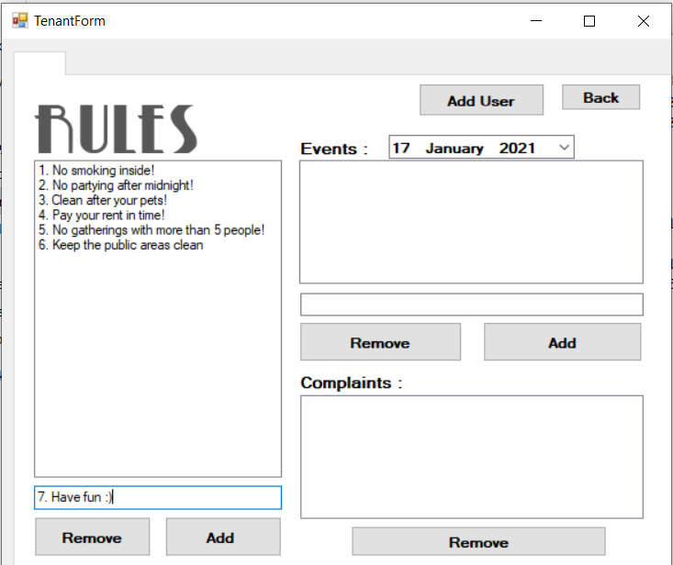
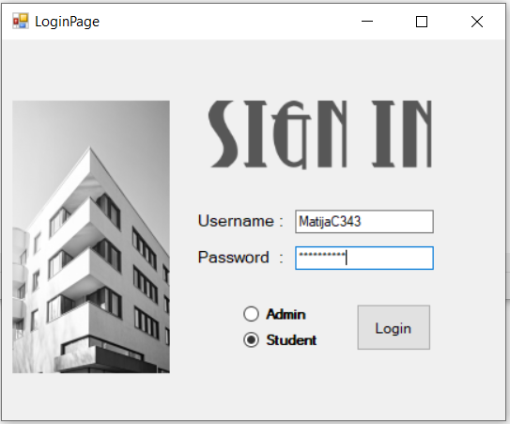

Slide 9
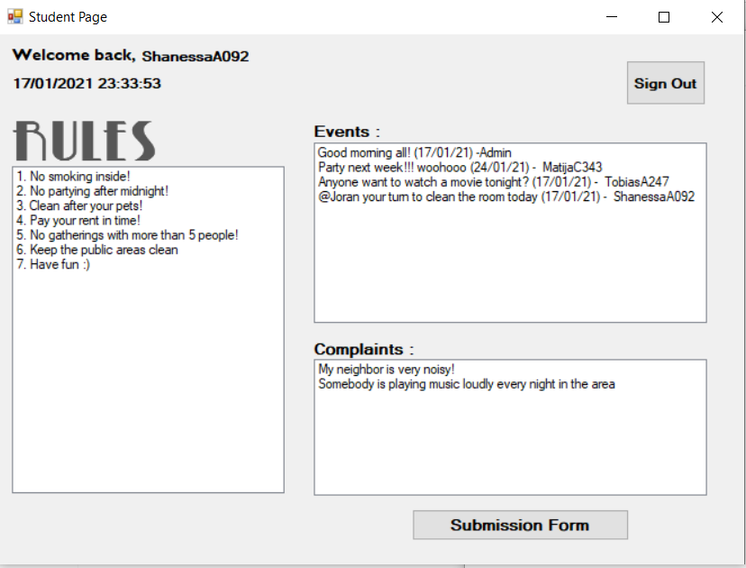

Slide 10
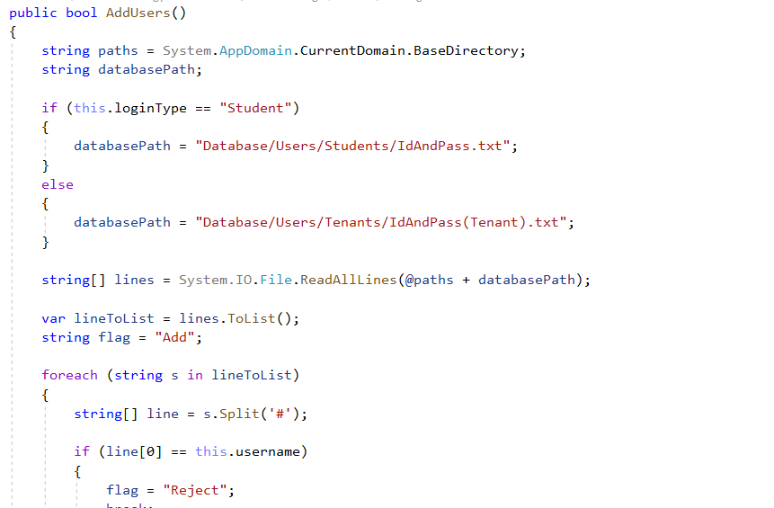
Use of Database

Slide 11
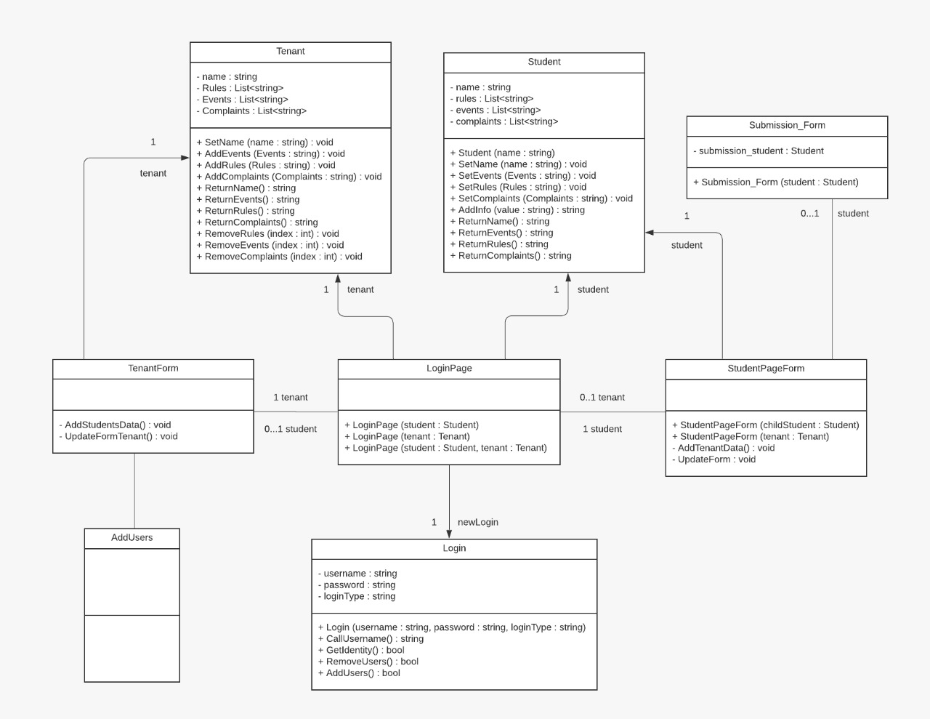
UML
1
AddUser

Slide 12
Problems
Unable to fully close every form, we decided to minimize some forms instead.
There might be a more efficient way to transfer data through multiple forms
Inconsistent names
Solutions might be outside the scope of the current course

Slide 13
Thank you!
Any questions?

