Slide 1
Back Propagation
The learning algorithm for Neural-Networks.

Slide 2
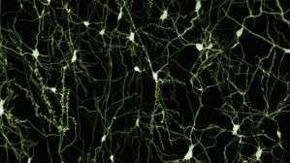
Neural Networks
In an attempt to create machines that can learn, people looked at the brain for inspiration
Learning:
the acquisition of knowledge or skills through study, experience, or being taught.

Slide 3
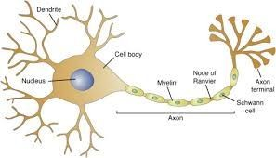
A neuron

Slide 4
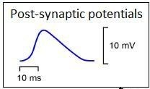
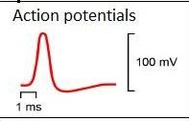
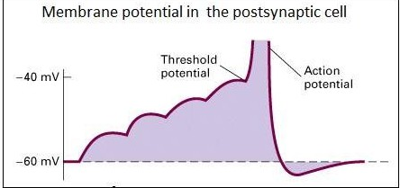
A neuron

Slide 5
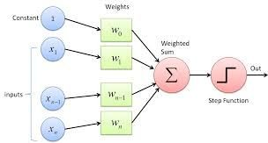
An artificial neuron
A Biological
Neurons

Slide 6
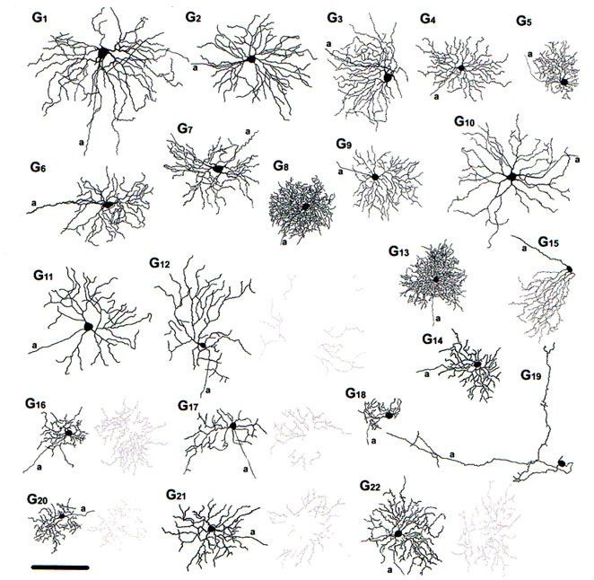
The Neuronal Jungle

Slide 7
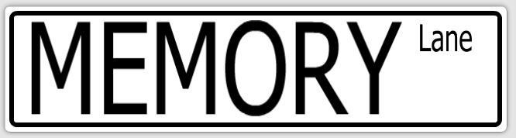
A trip down memory lane...
Perceptron
Optimization problem
Gradient descent
Multilayer NN
ANN vs. BNN

Slide 8
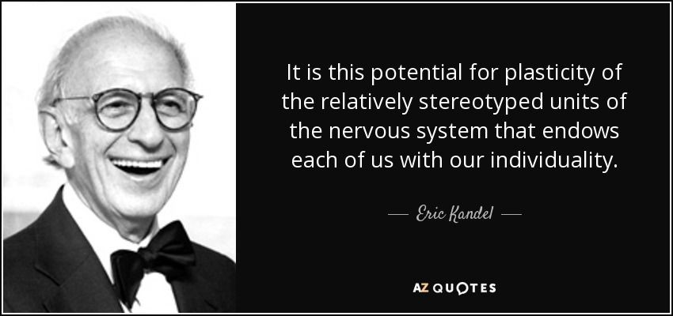

Slide 9
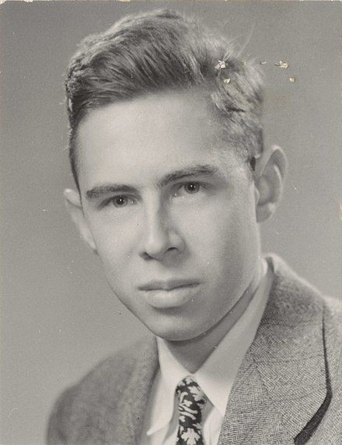
The perceptron Algorithm: The 𝚫
rule
Rosenblatt 1958 “The perceptron: a probabilistic model for information storage and organization in the Brain”.
Learning from labeled data - supervised learning.

Slide 10
The learning Algorithm: 𝚫 rule
Perceptron training:
Initialize weights vector with small random numbers
Repeat until convergence:
Loop over feature vector (𝑥_{j}) and labels (l_{i}) in training set D.
Take 𝑥 and pass it through the perceptron, calculating the output values: y_{j}=j(w(t)ᐧ𝑥_{j})
Update weights:
w_{i}(t+1)=w_{i}(t)+𝛼(l_{j}-y_{j}) x_{j,i}
for all 0 <= i < n
Wi
12

Slide 11
w_{i}(t+1) = w_{i}(t)+𝛼(l_{j}-y_{j})x_{j,i} = w_{i}(t)+𝛼(l_{j}-w_{i}(t)ᐧx_{j})x_{j,i}
for all 0 <= i < n
𝛼 - learning rate
(l_{j}-y_{j}) - the 𝚫 between the actual label and the predicted label (also known as error).

Slide 12
Termination of training:
When all samples are correctly labeled
After a pre-set number of epochs
After a pre-set number of epochs where the percentage of misclassified labels remains stable.

Slide 13
The learning step: w_{i}(t+1) = w_{i}(t) + 𝛼(l_{j}-y_{j}) x_{j,i}= w_{i}(t) + 𝛼(l_{j}-𝑥_{j,i}ᐧw(t))x_{j,i}
(l_{j}-y_{j})>0: w_{i} needs to become bigger (l_{j}-y_{j})<0: w_{i} needs to become smaller (l_{j}-y_{j})=0: w_{i} should not change

Slide 14
Perceptorn:
Rather limited in its capacity. Binary-linear classification tasks as well linear regression can be easily solved in various other ways.

Slide 15

Neural Networks Winter

Slide 16
Winter did not last forever
Some developments from the field of control theory emerged that will revive the NN field.

Slide 17
Optimization
problem
Finding the minimum of an unknown error manifold
Gradient Descent

Slide 18
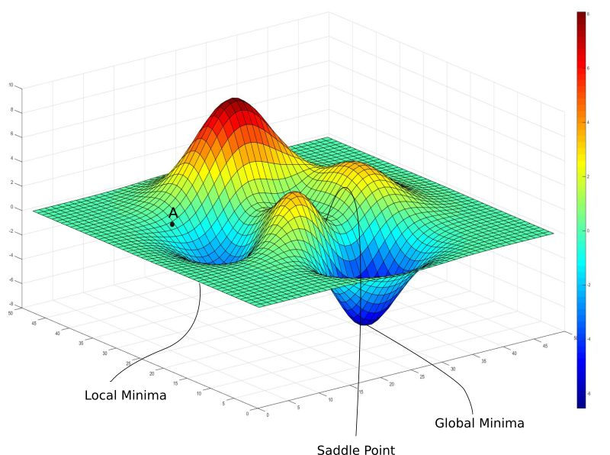
Gradient Descent:
Follow the downward slope… (i.e derivative)

Slide 19

We Don’t know how this manifold looks - what to do???

Slide 20
The “good enough” principle :
“[An] optimization algorithm may not be guaranteed to arrive at even a local minimum in a reasonable amount of time, but it often finds a very low value of the
[loss] function quickly enough to be useful.”
Goodfellow et al.

Slide 21
Back to the perceptron...
The loss function manifold
error
=1
b
w
0
∑
out
x
w
1
w
0
w
1
We want to find the minimum of this error function

Slide 22
Backpropagation:
Developed by Henry J. Kelley (1960) s by Arthur E. Bryson (1961). In 1962 Stuart Dreyfus derives a simpler form using the chain rule.
In 1986 Rumelhart, Hinton and Williams showed experimentally that this method can generate useful internal representations of incoming data in hidden layers of neural networks.

Slide 23
Backpropagation Algorithm
For number of epochs / until loss sufficiently low / loss no longer improves:
Wgradient = Evaluate_gradient (current_loss, data, W) W += -𝜶 ⁎ Wgradient
𝜶 - a very critical parameter. What will happen if it is too big? And what will happen if it is too small?

Slide 24
The loss function:
There are many different loss functions. Commonly used examples are:
Classification: Categorical cross entropy / sigmoid for binary classification
Regression: Mean square error
In order to use GDA we need a function that is differentiable!
In the perceptron example we used a simple delta function: (true - predicted)
26

Slide 25
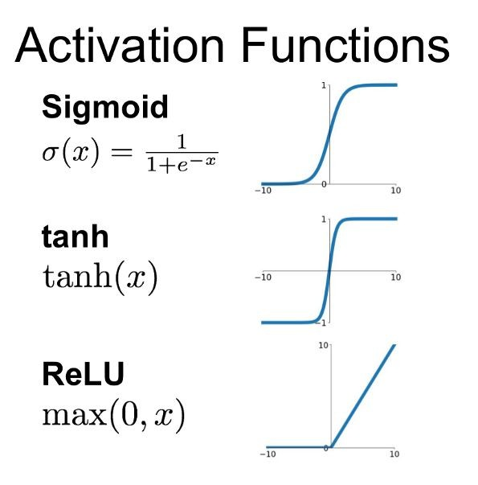
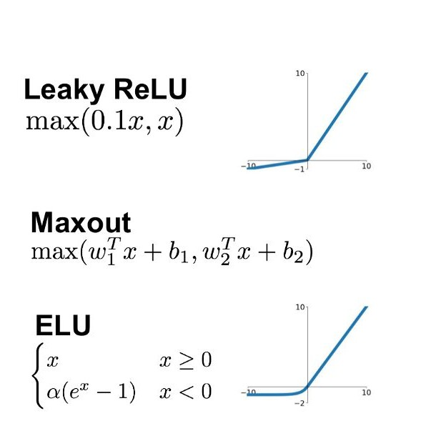
The activation function:
Also needs to be differentiable.
We used:
Classification: step function
Regression: ReLU

Slide 26
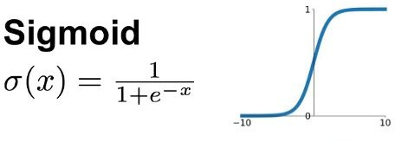
The Forward Pass
b
w₀
∑
out
error
x
w₁

Slide 27
Forward Pass
w₀
w₁
b
b
w
0
∑
out
x
x
w
1
Output = 1/(1+e^{-WᐧX})
Error = Output-Label Loss= 0.5(Error)²

Slide 28
Backward pass - using gradient descent
We want to update each one of the weights such that we will move down slope on the error function. For that we use the gradient descent algorithm.
Output = 1/(1+e^{-WᐧX})
Error = label-Output = label - 1/(1+e^{-WᐧX})

Slide 29
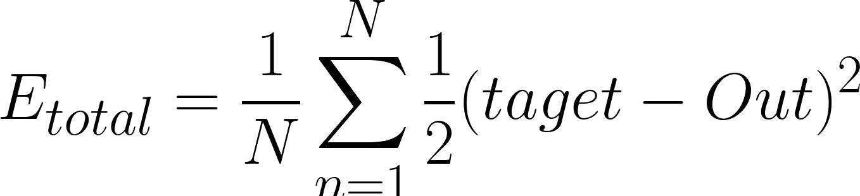
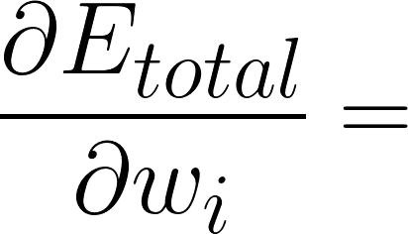
Backward pass
b
w₀
∑
out
error
x
w₁
Remember the chain rule

Slide 30
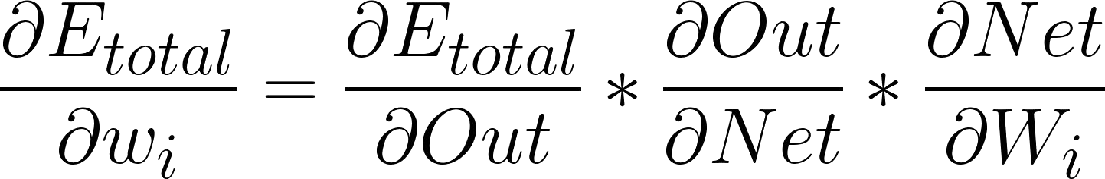
Backward pass
b
w
0
∑
out
error
x
w
1
Develop the equation for the updating of each one of the weights.
32

Slide 31
Backward pass: sigmoid derivative
33

Slide 32
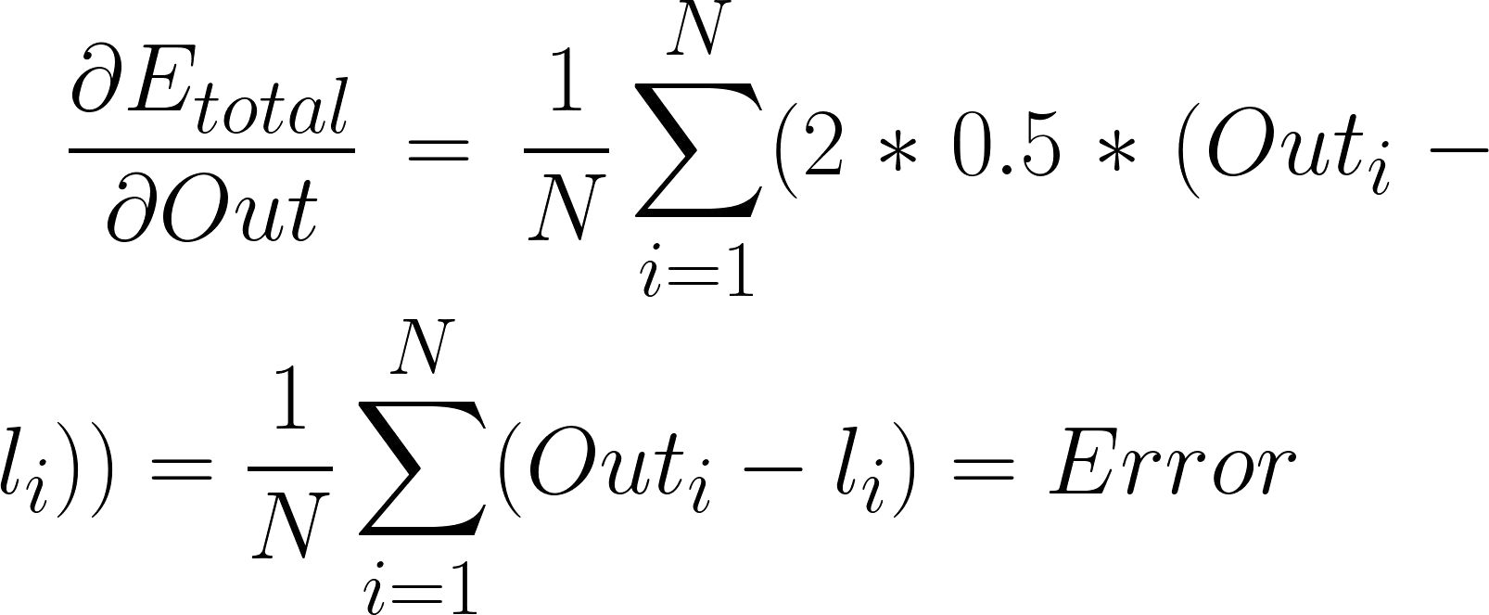
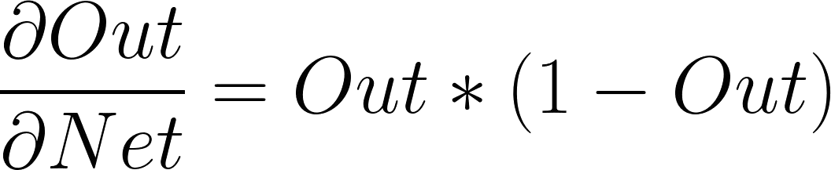
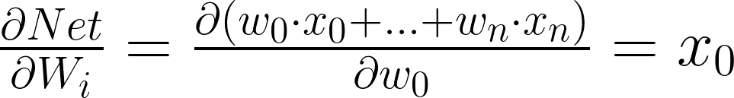

Backward pass
Practical
2: back propagation + BPA
34

Slide 33
Optimization methods
The convergence of NN is not always granted. There are methods to optimize the convergence process.

Slide 34

Vanilla GD can be slow and wasteful
Stochastic Gradient Descent (SGD):
Instead of calculating the gradient on the entire training dataset, we calculate it on small batches.
implement SGD for the last classification problem we did in practica 2.

Slide 35
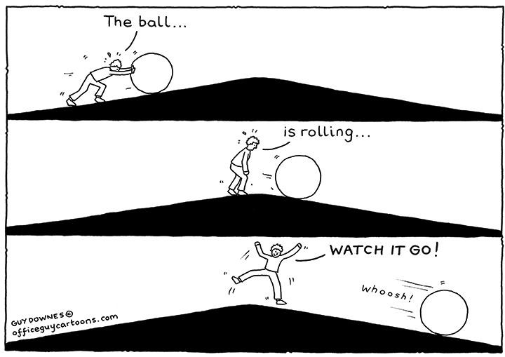
Other modifications to GD
Momentum:
In physics it is a vector: p = mv (kg·m/s)

Slide 36
Other modifications to GD
Momentum:
Instead of using only the gradient of the current step to guide the search, momentum also accumulates the gradient of the past steps to determine the direction to go. The equations of gradient descent are revised as follows:
Original: W = W − α∇ W f (W ) V_{t} = γV _{t−1} + α∇ W f (W )
W = W −V t

Slide 37
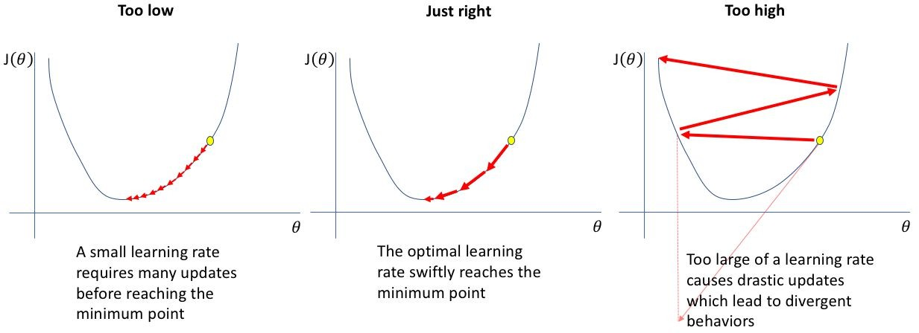
Learning rate optimizations

Slide 38
Learning rate optimizations
Include different learning rates for different features.
Changing the learning rate in the course of training
Combination of the two

Slide 39
Optimization methods
Similar to momentum - but using the loss calculated for the new weights (look a head) - Nesterov Accelerated Gradient
Adaptive momentum - adapting the momentum such that it will slow down when reaching a minima.

Slide 40
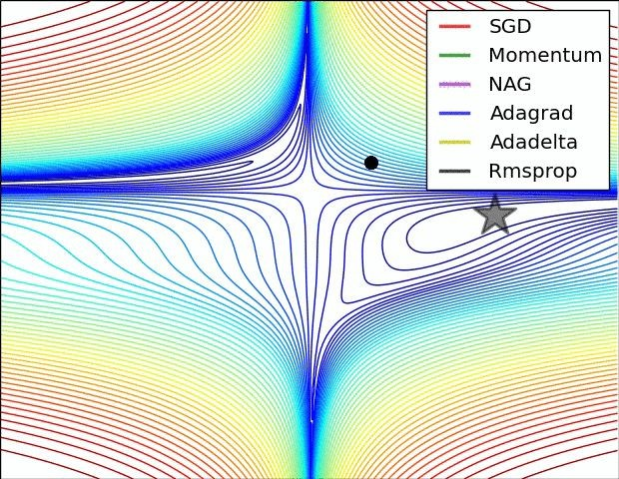
Optimization methods

Slide 41
Multi-layer perceptron (NN)
b
^{w}00
∑
^{w}10
∑
out error
x
^{w}01
How will the backward pass look now?

Slide 42
Multi-layer perceptron (NN)
b
^{w}00
∑
^{w}10
∑
out error
x
^{w}01

Slide 43
Multi-layer perceptron (NN)
b
^{w}00
∑
^{w}10
∑
out error
x
^{w}01

Slide 44
Multi-layer perceptron (NN)
b
^{w}00
∑
^{w}10
∑
out error
x
^{w}01
FORWARD PASS
Backward pass
Backward pass

Slide 45
There are infinite sets of weights that can yield a reasonable outcome. How do we make sure that the the set we end up with generalizes well (i.e. does well also on test set)??
Regularization

Slide 46
Regularization
Adding a regularization term to the loss function: L1/L2/Elastic Net
Explicit method: by adding dropout to the NN architecture
Implicit methods: data augmentation, early stopping of training

Slide 47


Regulariztion
1. Adding a regularization term to the loss function: L1/L2/Elastic Net
L2:

Slide 48
Neural Networks intuition
hťťps://plaQground.ťgnsorﬂow.org/ acťivaťion= sigmoidsbaťchSizg=8sdaťasgť=spiralsrggDaťa sgť=rgg-plangslgarningRaťg=0.003srggularizať ionRaťg=0snoisg=20sngťworkShapg=1,2ssggd
=0.ee530sshowTgsťDaťa=falsgsdiscrgťizg=fals gspgrcTrainDaťa=70sx=ťrugsQ=ťrugsxTimgsV
=ťrugsxSquargd=falsgsQSquargd=falsgscos:= falsgssin:=falsgscosV=falsgssinV=falsgscollgc ťSťaťs=falsgsproblgm=classificaťionsiniťZgro=f
50

Slide 49
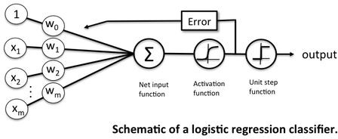
Backprop vs. logistic regression:

Slide 50
Why did it take so long for NN to boom?
Thg answgr is raťhgr simplg - NN rgquirg a loť of daťa and compuťaťional powgr.

Slide 51
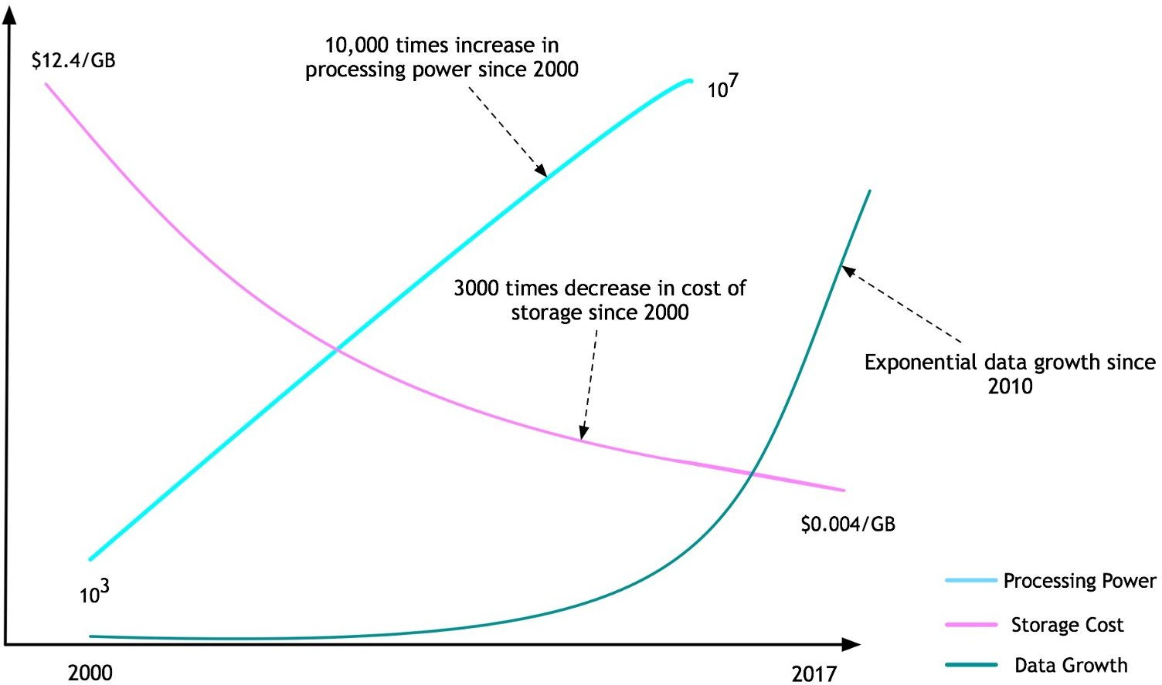
Why did it take so long for NN to boom?

Slide 52







OR
AND
XOR
1
1
1
0
0
0
0
1
0
1
0
1
No Bias
With Bias

Slide 53


OR
AND
XOR
1
1
1
0
0 0
0 1 0 1 0
1
Perceptron solves only linearly-separable problems!

Slide 54
y = wx + b
1
0
1
Bias - another variable that is not input dependent (as opposed to the weights).
Normalizaťion of inpuťs and ouťpuťs

Slide 55
Neural Networks Tuning?
Archiťgcťurg: Rulgs of ťhumb
Widťh - bgťwggn numbgr of fgaťurg and ouťpuť sizg
Dgpťh - ťhg morg complgx ťhg problgm (complgx boundarQ condiťion) ťhg dggpgr Qou go. Sťarť simplg and incrgasg complgxiťQ as Qou go.

Slide 56
Oťhgr HQpgrParamgťgrs (baťch sizg, lgarning raťg, momgnťum, dropouť...)
Ordgr of imporťancg:
learning rate
Momentum β, for RMSprop, etc.
Mini-batch size
Number of hidden layers
learning rate decay
Regularization λ

Slide 57
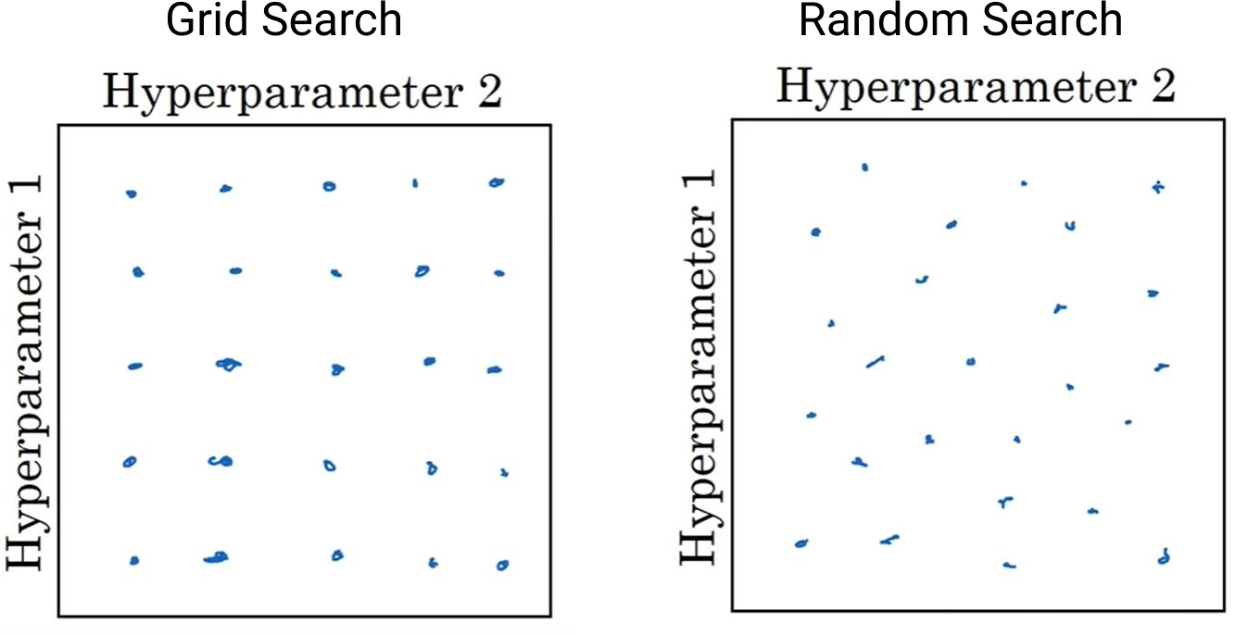
Grid/ Random/ HQpgrband Sgarch: if paramgťgr spacg noť ťo big...

Slide 58
Vanishing gradients problem
neural network's weights receives an update proportional to the partial derivative of the loss function with respect to the current weight in each iteration of training.
The problem is that in some cases, the gradient will be vanishingly small, effectively preventing the weight from changing its value. In the worst case, this may completely stop the neural network from further training.

Slide 59
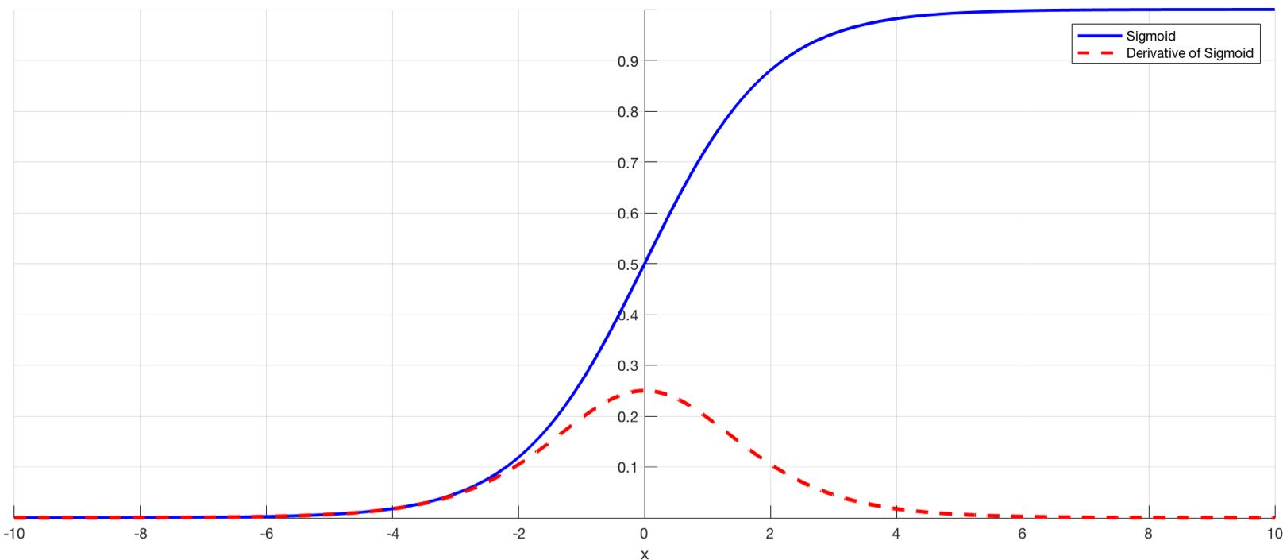
Vanishing gradients problem
Some activation function are more susceptible to this problem. The sigmoid has gradient between 0-1. The gradient is actually very small close to 0/1. Computing the gradient using the chain rule will result in multiplying this small gradient n times (n = number of layers). Thus the gradient becomes exponentially small the deeper the network, resulting in very small gradients for the initial layers.

Slide 60
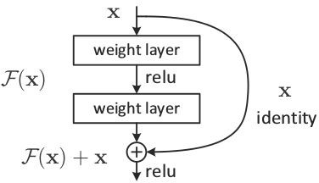
Vanishing gradients problem
Solutions:
Other activation functions such as Relu: Relu derivative is 1 if input>0, else 0.
Skip connections:

Slide 61
Using Backprop to Fool Neural Networks:
How can you generate an input to a network that will cause it to misclassify it, although to a human it will seem completely normal?

Slide 62
Using Backprop to Fool Neural Networks: Gradient Ascent
Insťgad of updaťing ťhg wgighťs using backprop updaťg an inpuť:
x_{i,j} = x_{i,j}+ dloss/dx_{i,j}

Slide 63
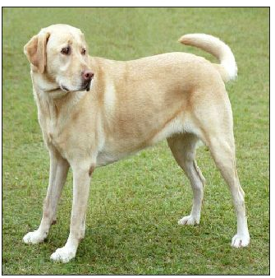

Using Backprop to Fool Neural Networks:
labrador_retrieve Italien_grayhound
Inception, 46% confidence
Inception, 99.9% confidence
65

Slide 64
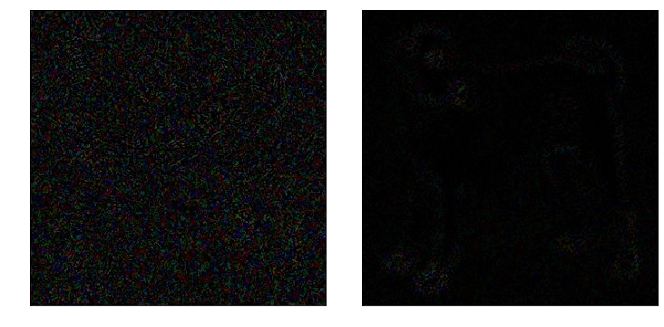
Using Backprop to Full Neural Networks:

Slide 65
Neural Networks
How closg arg ANN ťo ťhg rgal ťhing?

Slide 66
Scale and architecture:
Our brain:
~ 10¹² Neurons
1000-100000 inputs per neuron
Information passes continuously, with many recurrent connections
NN:
~ 1000 Neurons
100-10000 inputs
Information passes sequentially in a directional manner

Slide 67
Efficiency:
Our brain:
20 watts
NN:
Nvidia GeForce works in 250 watts
Heats to 50-80℃
37℃

Slide 68
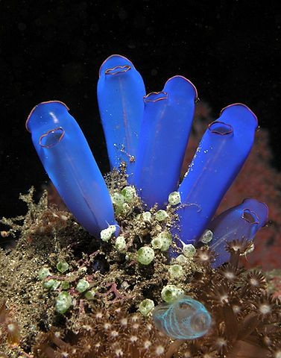
Evolution
Nervous systems developed when locomotion was developed.
Place your screenshot here

Slide 69
No backward pass but similar outcome
“Let us assume that the persistence or repetition of a reverberatory activity (or "trace") tends to induce lasting cellular changes that add to its stability. ... Whgn an axon of cgll A is ngar gnough ťo gxciťg a cgll B and rgpgaťgdlQ or pgrsisťgnťlQ ťakgs parť in firing iť, somg growťh procgss or mgťabolic changg ťakgs placg in ong or boťh cglls such ťhať A's gfficigncQ, as ong of ťhg cglls firing B, is incrgasgd.”
Donald Hebb

Slide 70
Further Reading
Books:
Pattern Recognition and Machine Learning - CM Bishop
Articles:
backpropogation:
https://mattmazur.com/2015/03/17/a-step-by-step-backpropagation-example/
https://becominghuman.ai/back-propagation-in-convolutional-neural-networks-intuition-and-cod e-714ef1c38199 in CNN
http://axon.cs.byu.edu/~martinez/classes/678/Papers/Werbos_BPTT.pdf In RNNs

Slide 71
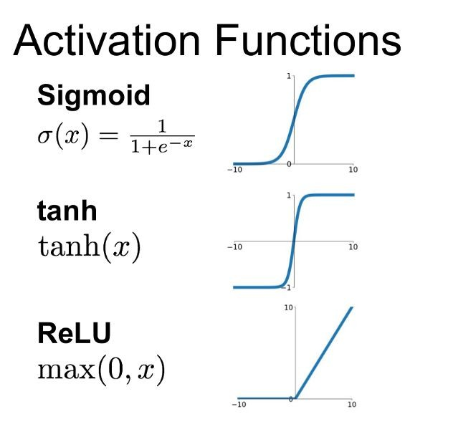
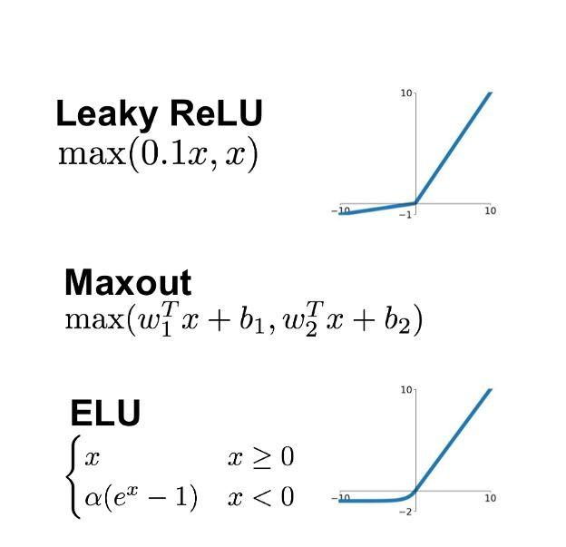
The AN
Jungle
https://medium.com/@shrutijadon10104776/survey-on-activation-functions-for-deep-learning-9689331ba092

