Slide 1
Figure 1
Image not yet available -- requires the web application screenshot and framework diagram (external assets, not generated in paper_analysis).
Fig. 1 | Overview of CREST-GV. a, Enrichment framework. Trait-associated variants (GWAS lead variants and LD proxies, or a user-provided variant set) and background variants (1000 Genomes Project) are intersected with the open chromatin regions of each cell type in the reference atlas or a user-provided collection. For each cell type, the observed overlap proportion is compared with the background proportion to compute an enrichment Z-score, standardised within each data collection and converted to a right-tailed P-value. b, The CREST-GV web application, providing access to precomputed results for 1,125 GWAS traits and analysis of user-provided variant sets and chromatin accessibility collections.

Slide 2
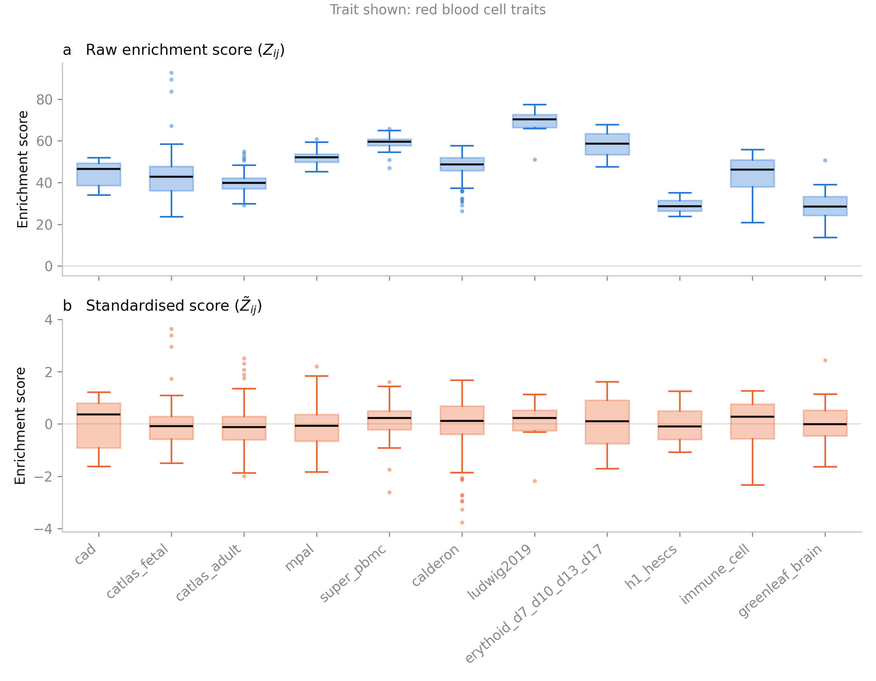
Figure 2
Fig. 2 | Cross-collection standardisation of enrichment scores. a, Distributions of raw enrichment scores (Z) for each chromatin accessibility collection, showing collection-specific differences in scale, for red blood cell traits (one of the four traits highlighted in Results; chosen for consistency with Figs. 3-4, which use the same four traits). b, Distributions of standardised enrichment scores (Z̃) after within-collection standardisation, same trait and cell types.

Slide 3
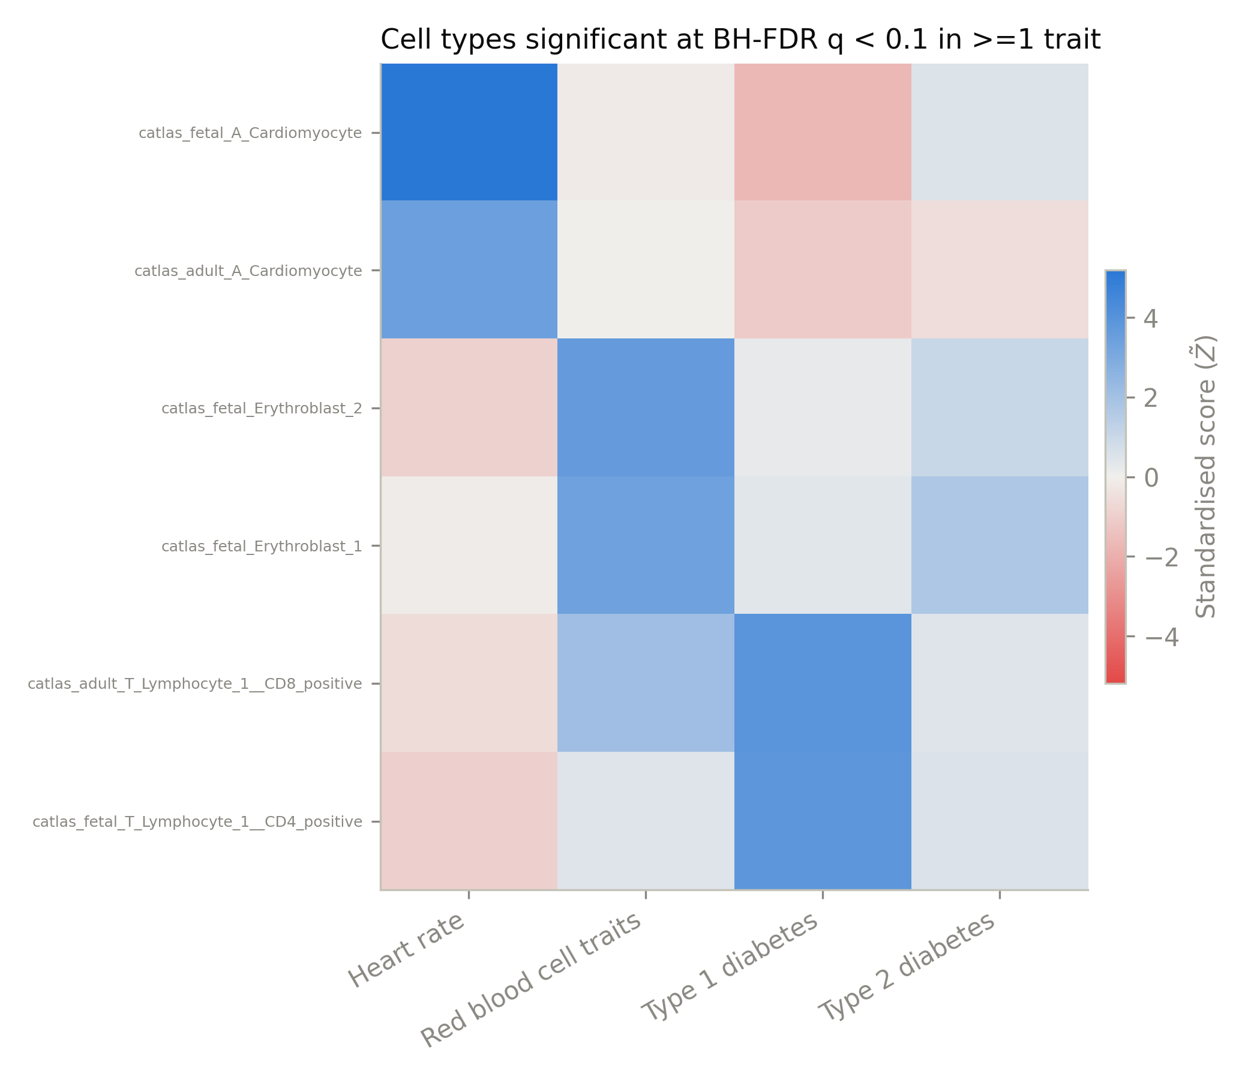
Figure 3
Fig. 3 | CREST-GV enrichment across four GWAS traits. Standardised CREST-GV enrichment scores (Z̃) for the cell types significantly enriched (Benjamini-Hochberg FDR q < 0.10) in at least one of heart rate, red blood cell traits, type 1 diabetes and type 2 diabetes. Rows are grouped by the trait in which each cell type is significant; values in each cell give the standardised score of that cell type for every trait.

Slide 4
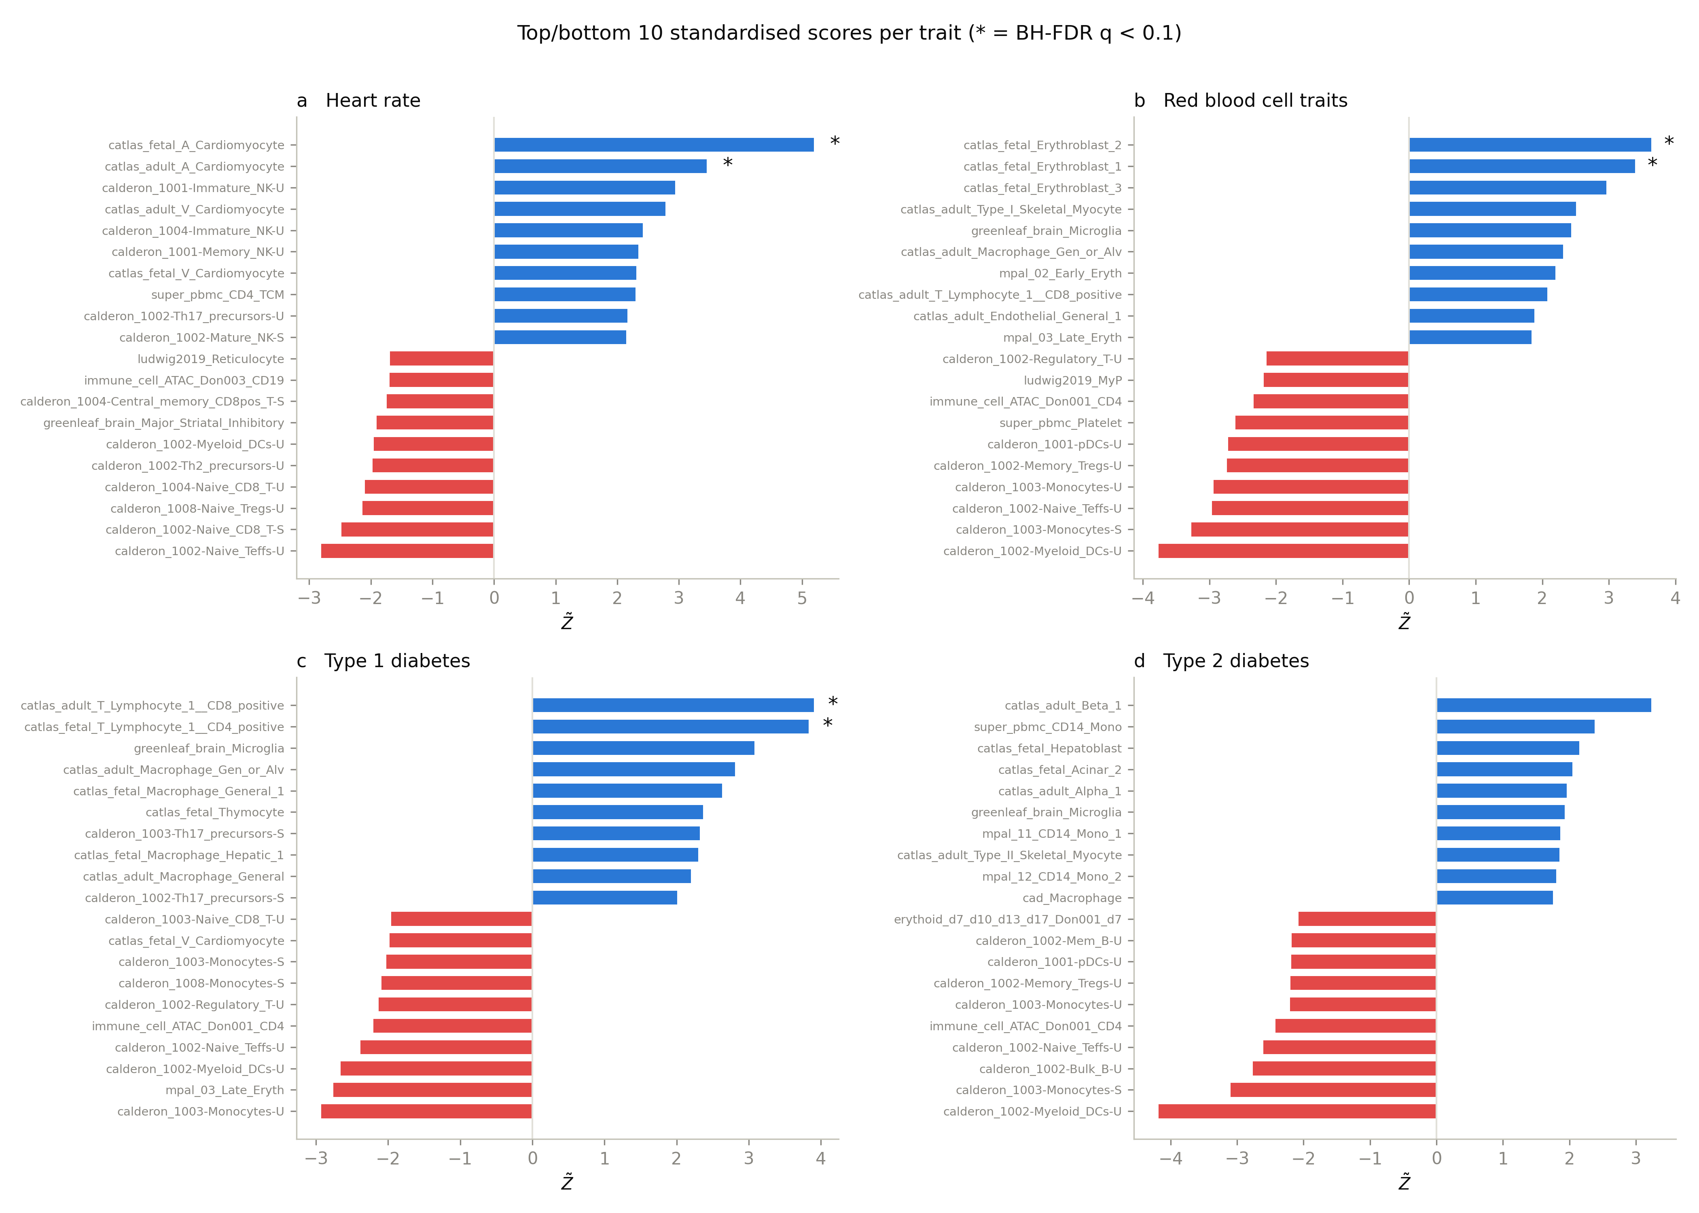
Figure 4
Fig. 4 | Cell type rankings for the four GWAS traits. Top and bottom 10 standardised enrichment scores (Z̃) across all collections for a, heart rate; b, red blood cell traits; c, type 1 diabetes; and d, type 2 diabetes. Bars are coloured by sign; asterisks mark cell types with Benjamini-Hochberg FDR q < 0.10.

Slide 5
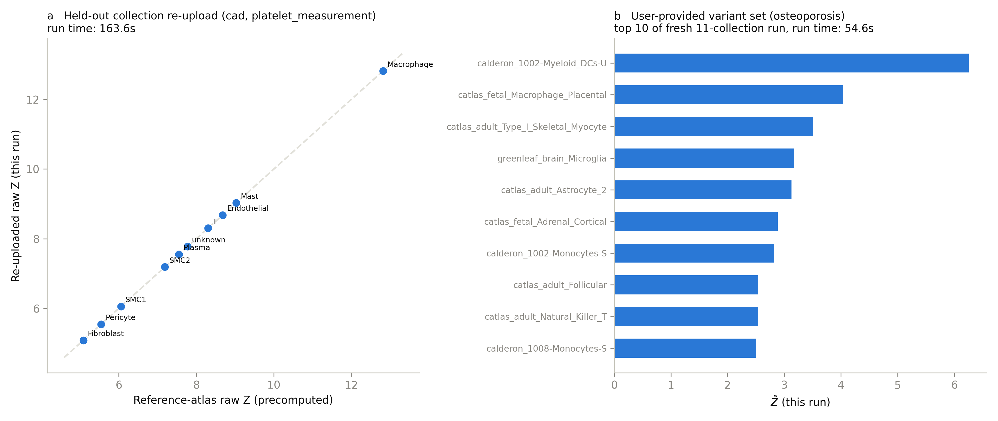
Figure 5
Fig. 5 | Analysis of user-provided data with CREST-GV. a, Held-out collection re-upload: the cad collection re-analysed through the in-house-collection code path (same bigWig tracks and peak calls, processed as if newly uploaded), compared against its precomputed reference-atlas enrichment score for platelet_measurement. Dashed line, y = x; each point is one of the ten cad cell types. b, User-provided variant set: a GWAS trait not among the four traits highlighted in Results (osteoporosis), run fresh against all 11 reference collections; top 10 standardised scores shown.

