Slide 1
Mining Adverse Drug Reactions from Unstructured Mediums at Scale
Hasham Ul Haq et al. 6 Jan 2022
John Snow Labs Inc

Slide 2
Abstract
In this paper we propose an NLP solution that detects ADR’s in such unstructured free-text conversations through three methods:
First, a new NER model obtains SOTA accuracy for ADR and Drug entity extraction on ADE, CADEC, and SMM4H (91.75, 78.76, 83.41)
Second, two RE models are introduced (based on BioBERT and FCNN) perform on par with existing SOTA models.
Third, a new text classification model for deciding if a convo includes an ADR is SOTA on CADEC (86.69)

Slide 3
The Problem
Approximately 2 million patients in the US are affected by adverse drug reactions (ADR/ADE) with roughly 100,000 fatalities. (4th leading cause)
ADR’s are hard to identify before a drug goes to market -> postmarketing pharmacovigilance addresses this
Can we use NLP and recent advances in Transformers to mine unstructured text for ADRs?
Use an end-to-end system based on Apache Spark ecosystem to process large quantities of unstructured text to mine ADRs

Slide 4
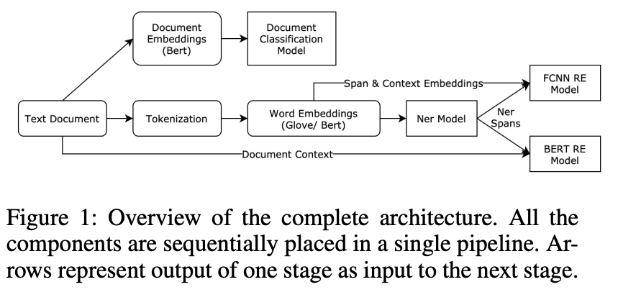
The Architecture

