Slide 1
These slides are available for use as teaching resources, under a CC-BY 4.0 licence. We request that if you use any of the slides, figures, or illustrations here, that you include a link to the Biodiversity Genomic Data Management Hub at https://genomicsaotearoa.github.io/data-management-resources/.
All the best for your data management journey!

Slide 2
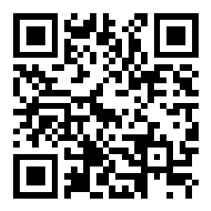
The What, Why, and How of Data Management Plans

Slide 3
What is data management?
The processes and practices associated with the documentation and storage of and access to data and associated metadata throughout the research lifecycle.
WHO?
WHERE?
Data management considers:
WHAT?
WHEN?
WHY?
HOW?
Notes:
Who - responsible? has access?
What - data types
Why - describing why there are these needs
Where - stored?
When - for how long stored?
How - can it be used?

Slide 4
What is a DMP?
A DMP is a Data Management Plan
This is a document describing the data that will be generated during a research project, and how it will be used, accessed, and stored during the research lifecycle and beyond

Slide 5
Why is a DMP useful?
It provides clarity to you the researcher as to how you can manage your data
It demonstrates that you are forward-thinking and switched on to the nuances of data management
It can be used to stimulate conversations around data aspirations with collaborators, Indigenous research partners, and stakeholders
It can be shared with eResearch and libraries support staff to provide them with the info they need to understand your needs, and identify any infrastructural constraints
It may be a requirement of your institute or the funding organisation you are applying to
Notes:
This can be governance aspirations, future research goals

Slide 6
So a DMP sounds handy.
But what’s it like in practice?

Slide 7
What’s the plan for:
Data types
Data formats and standards
Data roles & responsibilities
Data dissemination
Data sharing & access
Archiving & persistence
These are examples of aspects included in existing DMP templates required by funding organisations

Slide 8
Ok, but it feels like a lot.
Where do I start?

Slide 9
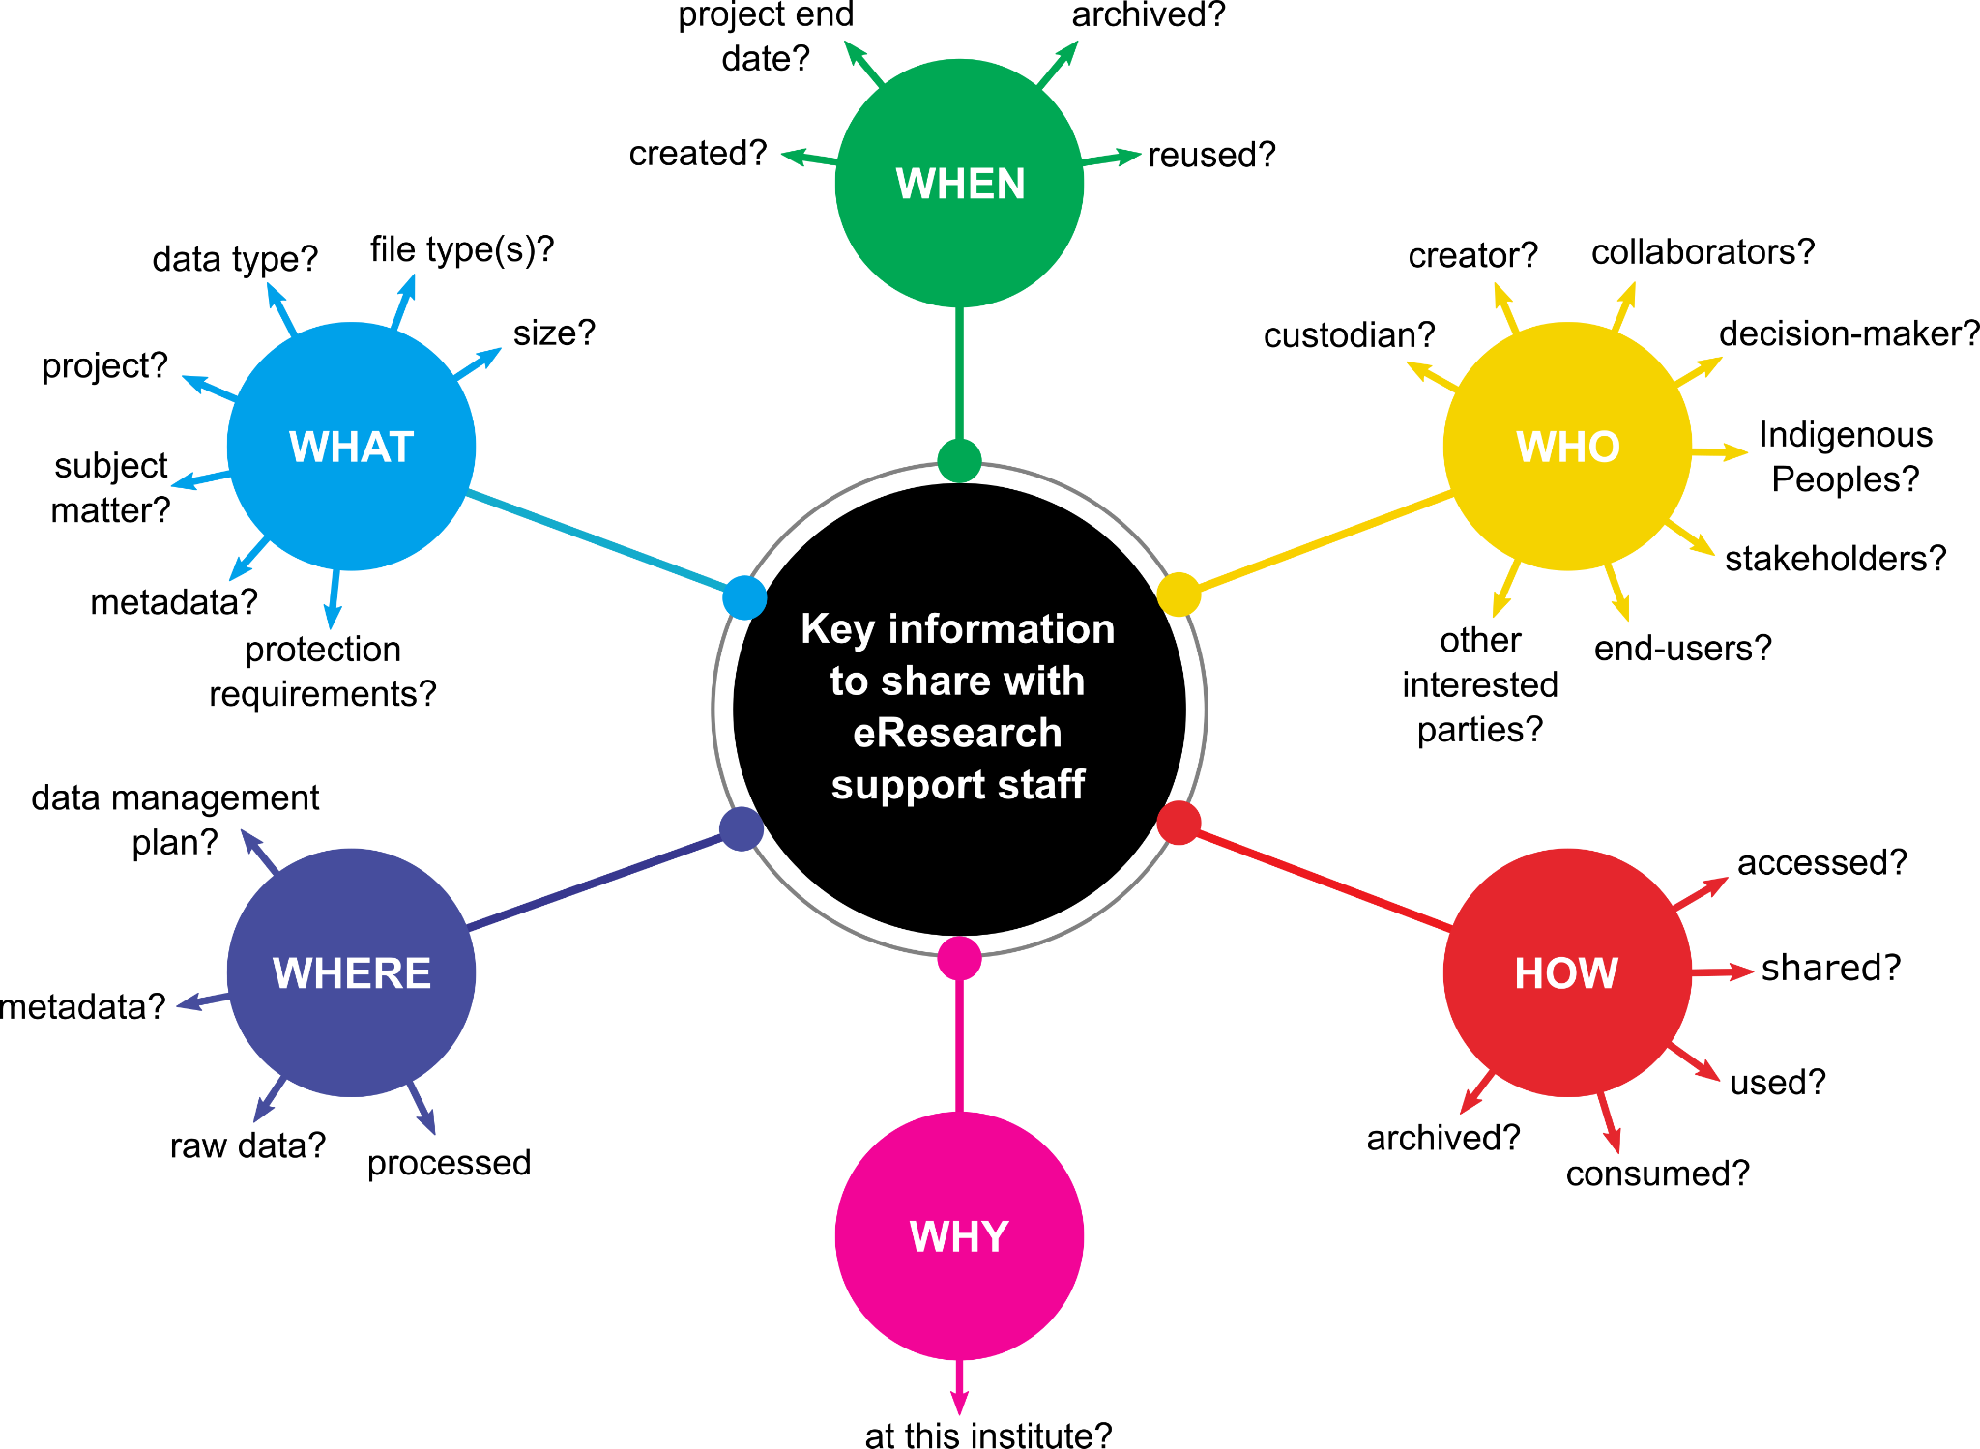
Key info for developing DMPs

Slide 10
Now it’s over to you!
tinyurl.com/DataMgmtHub
ds-wizard.org/data-management-plans

