Slide 1
These slides are available for use as teaching resources, under a CC-BY 4.0 licence. We request that if you use any of the slides, figures, or illustrations here, that you include a link to the Biodiversity Genomic Data Management Hub at https://genomicsaotearoa.github.io/data-management-resources/.
All the best for your data management journey!

Slide 2
What is data management?
The processes and practices associated with the documentation and storage of and access to data and associated metadata throughout the research lifecycle.
WHO?
WHERE?
Data management considers:
WHAT?
WHEN?
WHY?
HOW?

Slide 3
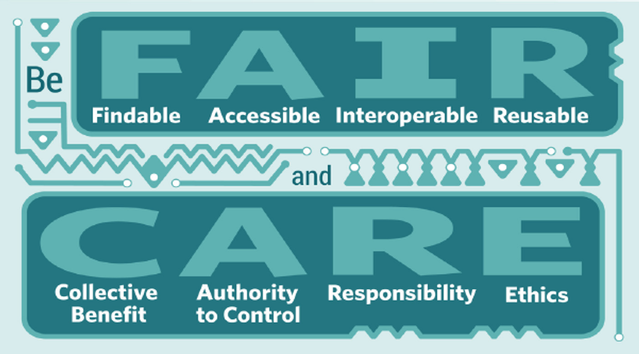
Be FAIR and CARE
FAIR data principles largely provide technical guidance
CARE data principles provide guidance on engaging with Indigenous data
Notes:
F: Globally unique persistent identifiers and rich metadata; Indexed in a searchable resource
A: Retrievable by their identifier using a standardised protocol
I: Formal, accessible, shared and broadly applicable language for knowledge representation
R: An actualisation of the FAI, attributes are accurate and relevant

Slide 4
The challenge
Researchers siloed from data management knowledge holders
Collaborative research becomes challenging
Increased risks of data loss and misuse
The volume of biodiversity genomic data is rapidly growing
Planning and managing research can be intimidating for emerging researchers
Employment precarity may direct research priorities away from data management

Slide 5
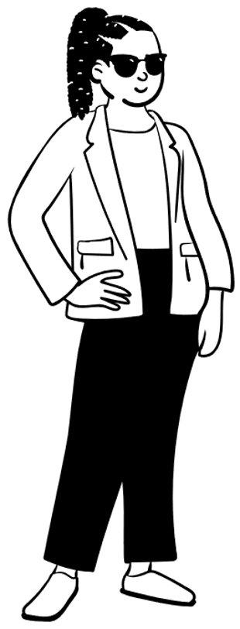
Taylor Smith
PhD student
New to biodiversity genomics
Taonga species genomics
Notes:
In the first of these scenarios we have PhD student Taylor Smith. They are new to the biodiversity genomics research space, and are applying these tools for taonga species. To be able to do her work, Taylor has a range of requirements, these include

Slide 6
Taylor Smith’s data management needs
Controlled data access to facilitate IDsov & uphold FAIR/CARE Guiding Principles
Support to determine computing needs
Information to guide development of a project-specific DMP
tinyurl.com/DataMgmtHub
Notes:
In the first of these scenarios we have PhD student Taylor Smith. They are new to the biodiversity genomics research space, and are applying these tools for taonga species. To be able to do her work, Taylor has a range of requirements, these include

Slide 7
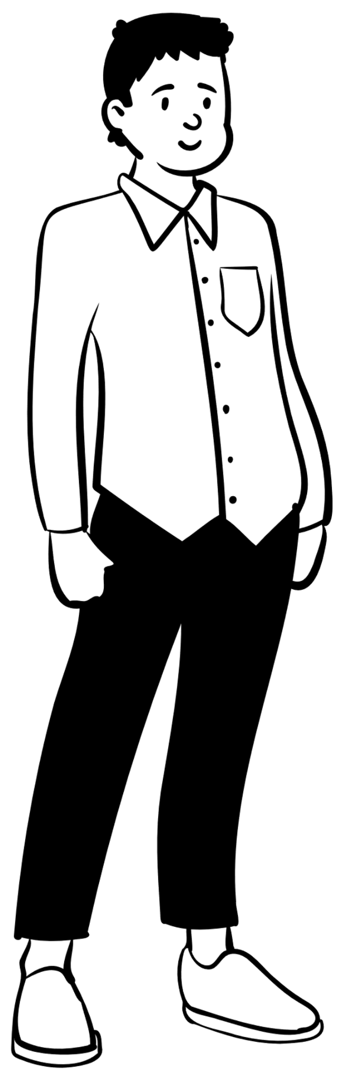
Dr Atsushi Sato
Postdoctoral researcher
Juggling several collaborative projects
Using multiple data types from various sources
Notes:
In the next scenario we have Dr Atsushi Sato, a postdoctoral researcher at a CRI. He is working across a number of collaborative projects that include both genomic and environmental data. He is viewing his work from a perspective of data reuse perspective.
His needs are similar but different from Taylor’s in that:

Slide 8
Dr Atsushi Sato’s data management needs
Regular & transparent communication with collaborators
Access to fast data transfer to facilitate collaborative research
Access to well-curated existing metadata
tinyurl.com/DataMgmtHub
Notes:
In the next scenario we have Dr Atsushi Sato, a postdoctoral researcher at a CRI. He is working across a number of collaborative projects that include both genomic and environmental data. He is viewing his work from a perspective of data reuse perspective.
His needs are similar but different from Taylor’s in that:

Slide 9
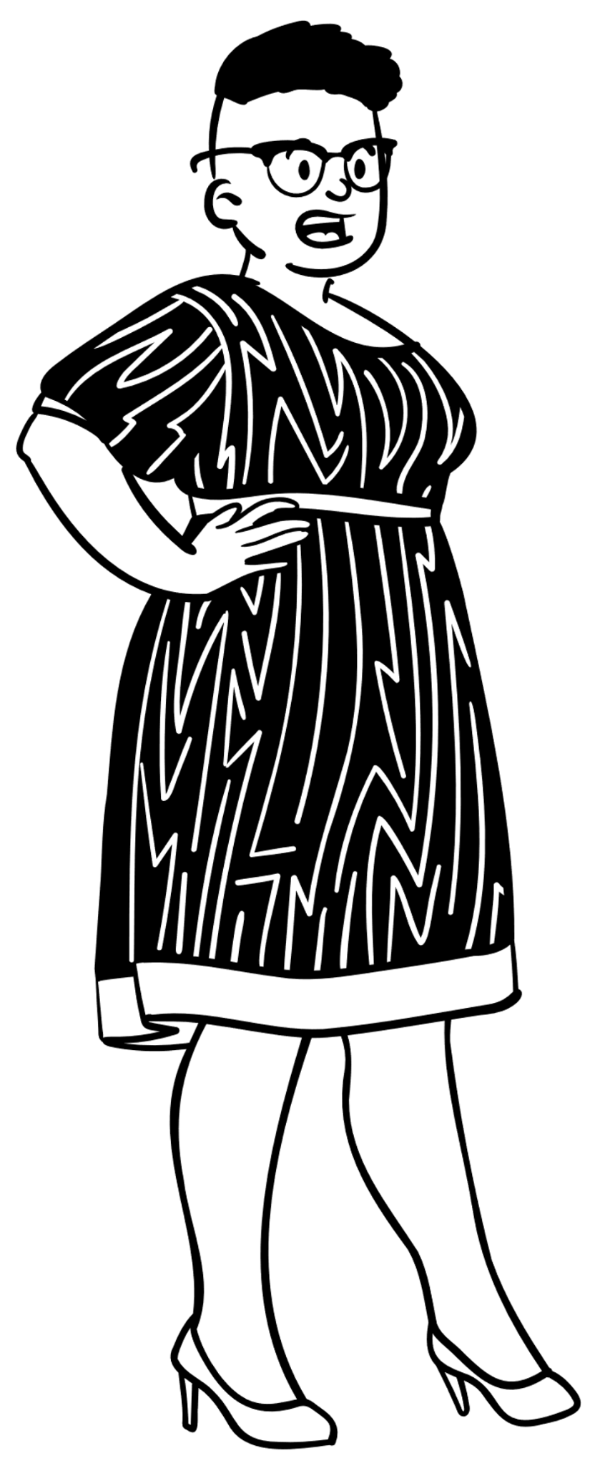
Professor Tehara Nepia
Research team leader
Liaising with advisors
Building and maintaining relationships with research partners
Facilitating the research
Notes:
Next up we have Prof Nepia who is a research team leader, overseeing a group of emerging researchers. Her role is in facilitation, and so she focuses on liaising with advisors, and building and maintaining relationships.

Slide 10
Professor Tehara Nepia’s data management needs
Support from eResearch & libraries staff
Oversight over data storage beyond the research life cycle
Transparent communication with research team, research partners, advisors, and consultants
tinyurl.com/DataMgmtHub
Notes:
Next up we have Prof Nepia who is a research team leader, overseeing a group of emerging researchers. Her role is in facilitation, and so she focuses on liaising with advisors, and building and maintaining relationships.

Slide 11
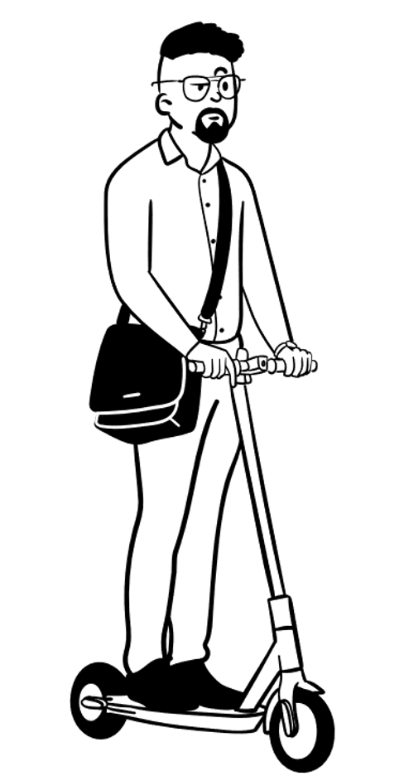
Darryl Baker
InstitutionaleResearch Manager
Oversees compute and data storage needs for diverse research projects
Notes:
We also present Darryl Baker, institutional eResearch Manager, who oversees the eResearch needs for a wide range of research projects.
To best support researchers, Darryl needs:

Slide 12
Darryl Baker’s needs when supporting researchers
Clarity on the expected data management needs across the research life cycle
Detail on storage needs in order to advise on appropriate tools/services
Background knowledge of national/institutional data management legislation and principles
tinyurl.com/DataMgmtHub
Notes:
We also present Darryl Baker, institutional eResearch Manager, who oversees the eResearch needs for a wide range of research projects.
To best support researchers, Darryl needs:

Slide 13
User experience personas

Slide 14
User experience personas
Professor Tehara Nepia
Dr Atsushi Sato
Taylor Smith
Darryl Baker
Research team leader
InstitutionaleResearch Manager
PhD student
Postdoctoral researcher

Slide 15
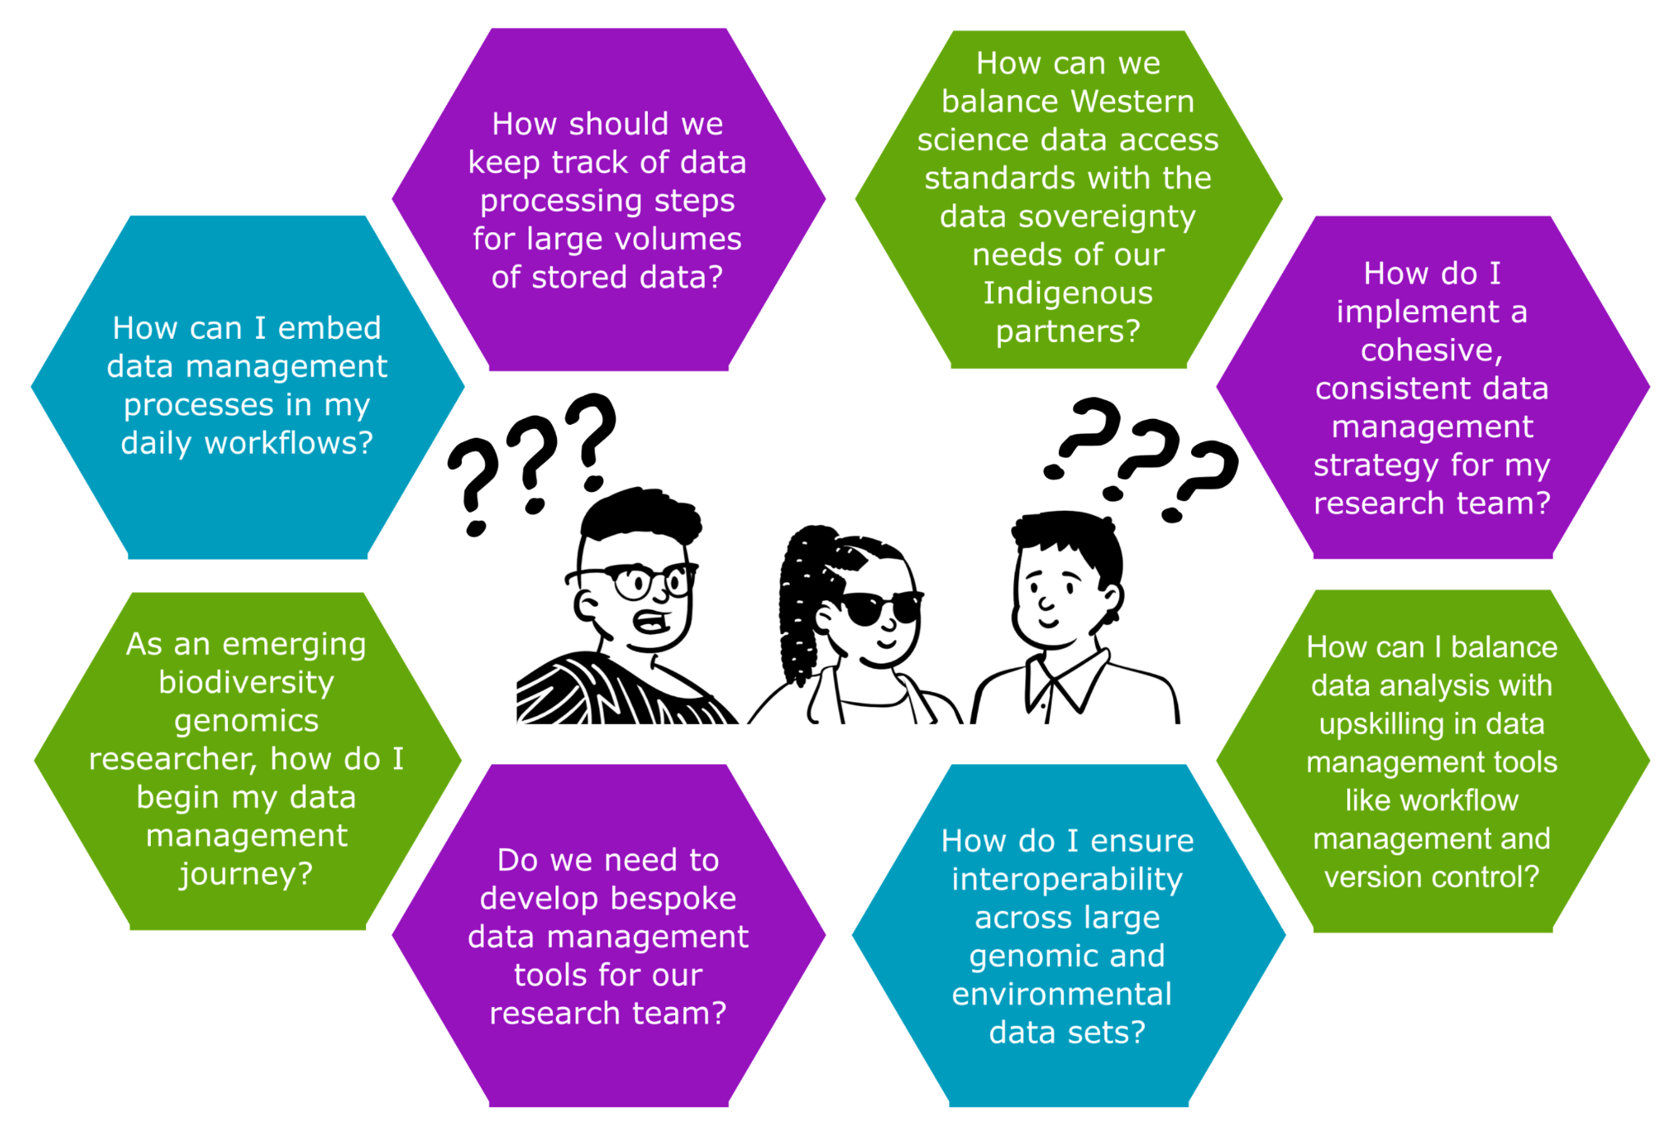
Notes:
How can I embed good data mgmt practices in my daily workflows?
How can we balance Western science data access standards with the data sov needs of our Indigenous partners?
Do we need to develop bespoke DM tools for our research team?

Slide 16



FAIR + CARE
Biodiversity Genomics Data Management Hub
tinyurl.com/DataMgmtHub
Notes:
Here we highlight some of the existing tools and resources to address these questions, including the use of version control and careful documentation, consultation with local and cross-institutional eResearch knowledge holders, and exploration of the existing scholarship and guidelines including the FAIR & CARE principles. These are being synthesised in the Hub (link on bottom right)
One stop shop to lauch DM journey

Slide 17
Data Management Plans
Describes the data that will be generated during a research project, and how it will be used, accessed, and stored during the research lifecycle and beyond.
Data types
Data formats and standards
Roles & responsibilities
Data dissemination
Data sharing & access
Archiving & persistence
Notes:
It provides clarity to you the researcher as to how you can manage your data
It demonstrates that you are forward-thinking and switched on to the nuances of data management
It can be used to stimulate conversations around data aspirations with collaborators, Indigenous research partners, and stakeholders
It can be shared with eResearch and libraries support staff to provide them with the info they need to understand your needs, and identify any infrastructural constraints
It may be a requirement of your institute or the funding organisation you are applying to

Slide 18
eResearch and libraries staff
I’m here to help!
Connect with your local Darryl early and often
Be prepared to put your project and needs in context
Know who’s going to be responsible for the data

Slide 19
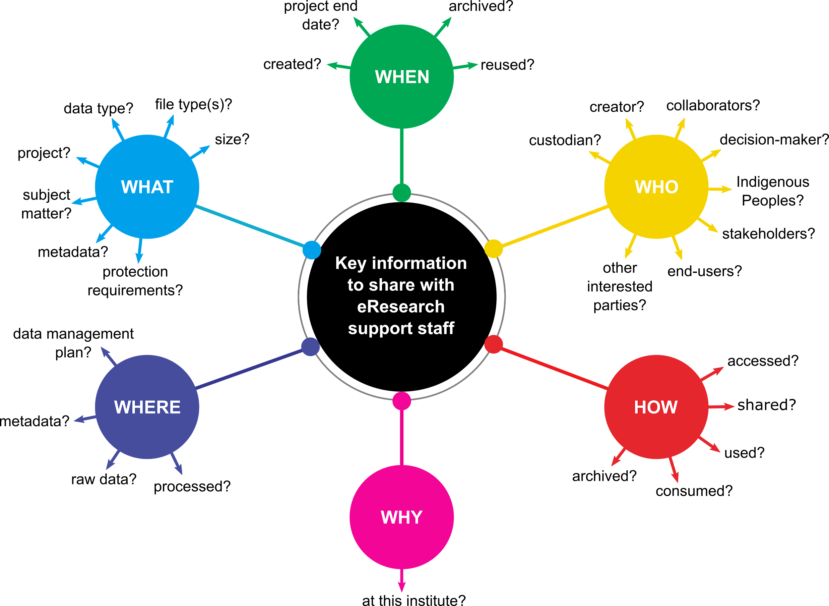
Helping others help you…
project end date?
archived?
created?
reused?
data type(s)?
file type(s)?
creator?
collaborators?
project?
size?
custodian?
reused?
Indigenous Research Partners?
subject matter?
stakeholders?
metadata?
Key information to share with eResearch support staff
protection requirements?
other interested parties?
end-users?
data management plan?
accessed?
shared?
metadata?
used?
raw data?
processed data?
archived?
consumed?
…and helping you help future you!
at this institute?

Slide 20
Data management culture - Be your own leader
You can be a data management champion!
Share learnings and encourage others often
Data management is a practice, not an event

Slide 21
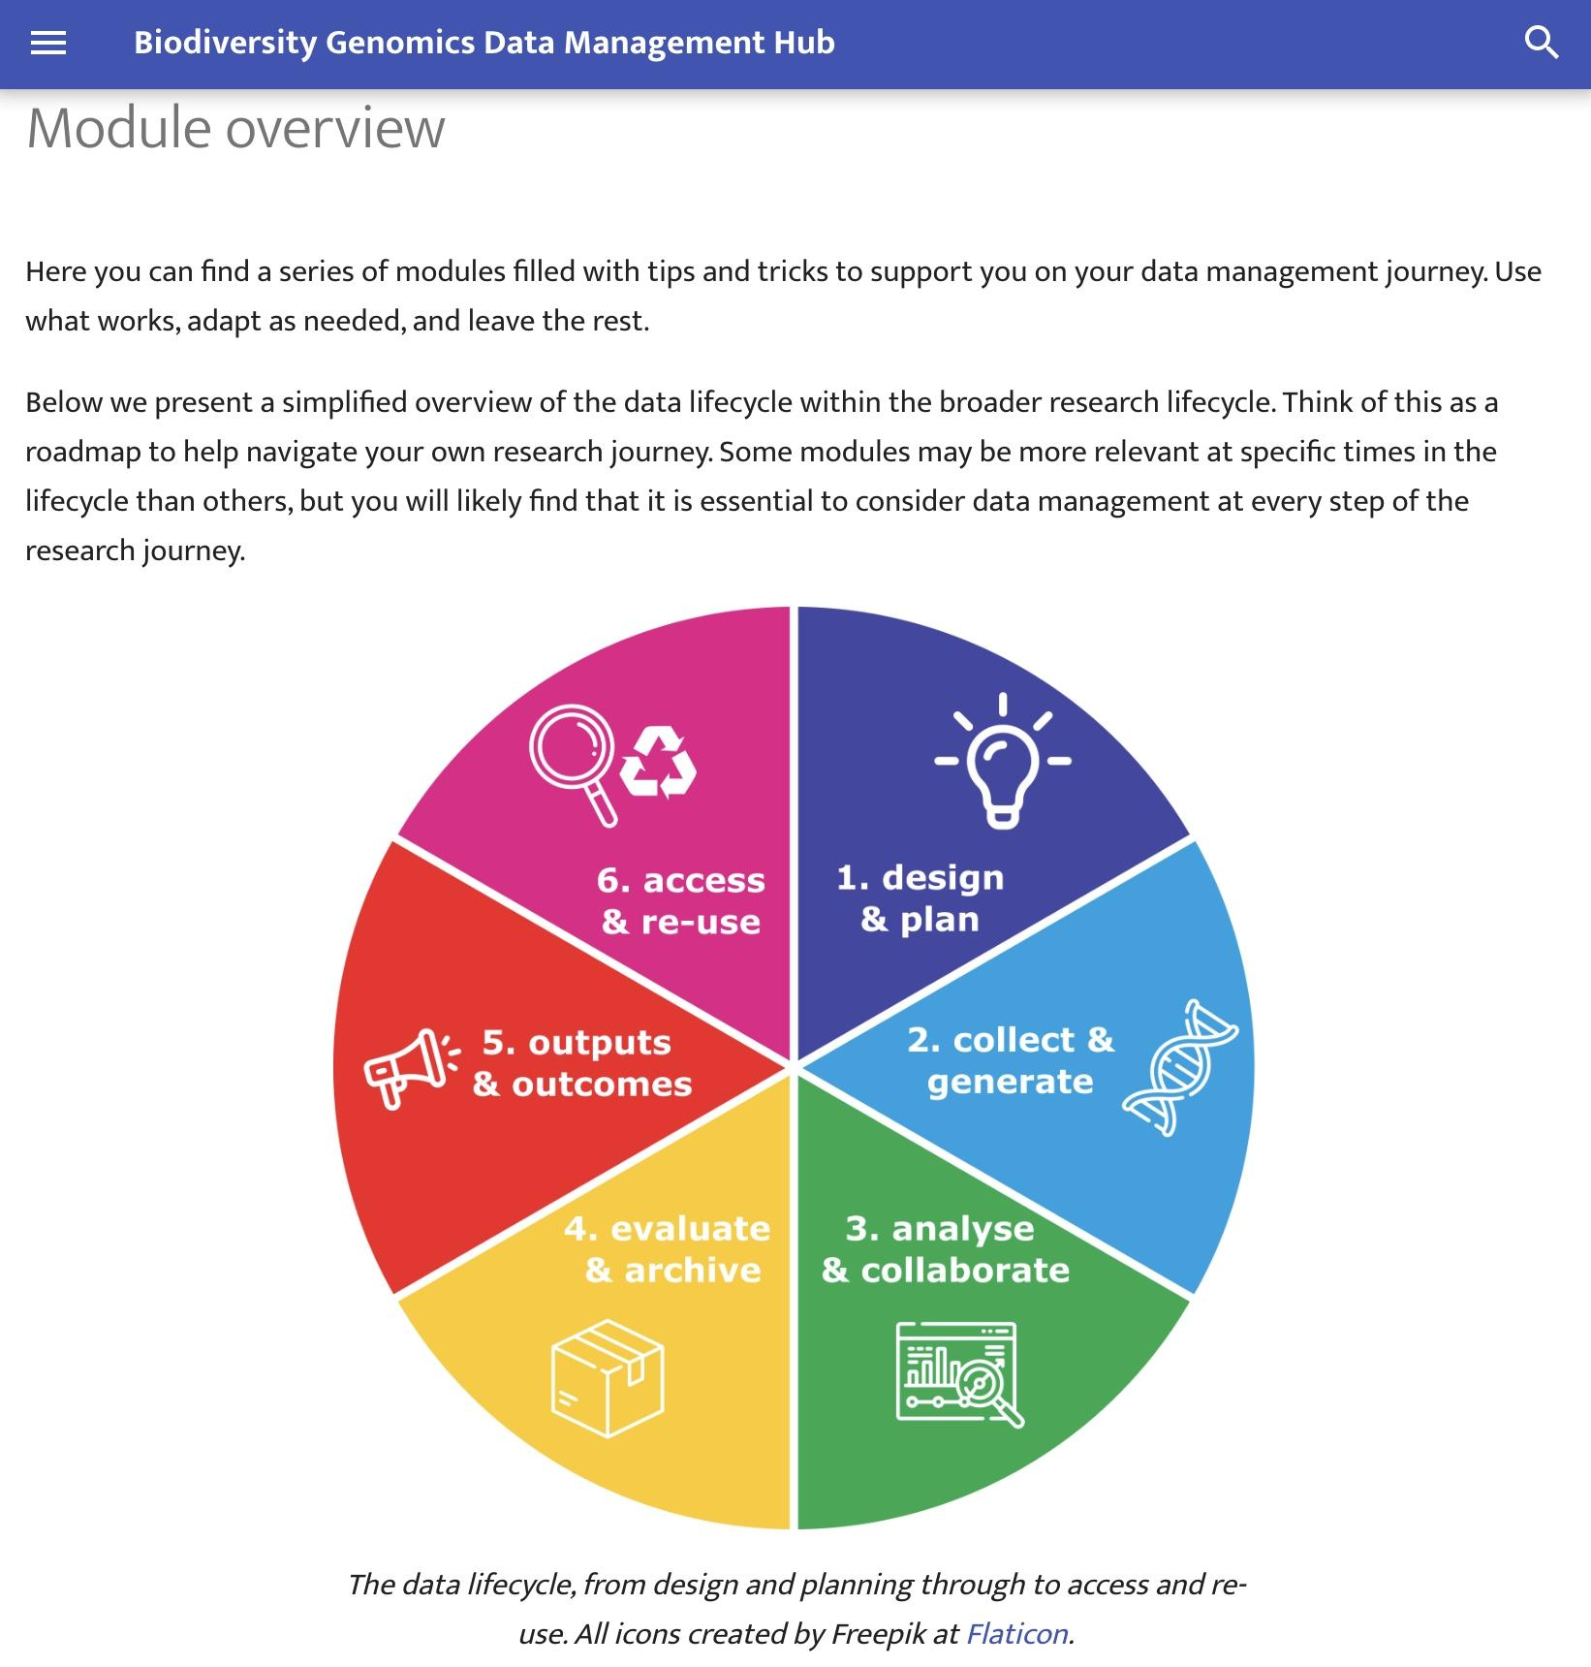
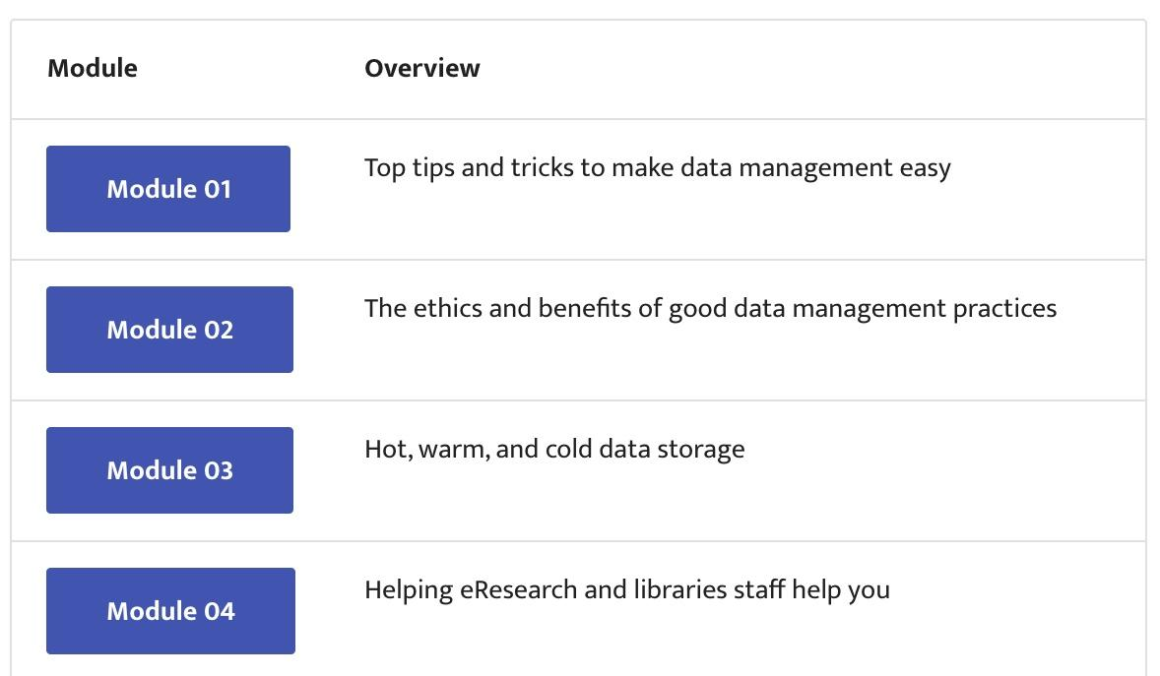
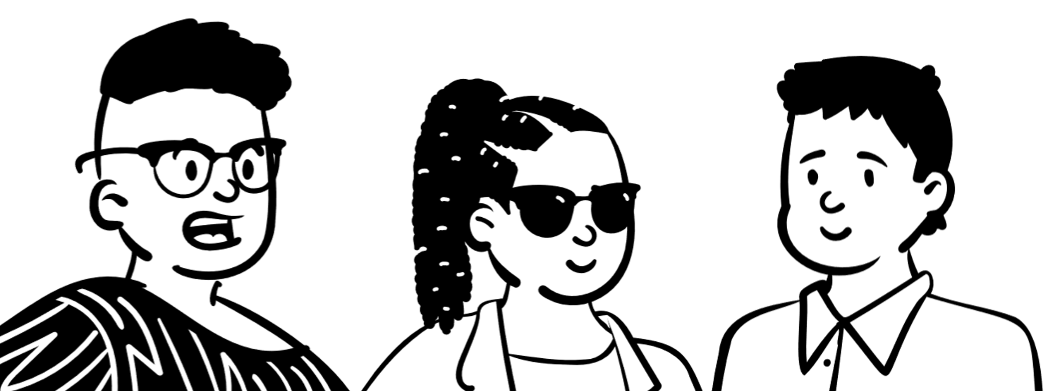

Biodiversity Genomics Data Management Hub
tinyurl.com/DataMgmtHub

Slide 22
Data Management is a journey,
we are all on the path striving toward best practice

