Slide 1
Introduction to genomics
Gábor Mészáros

Slide 2
Part 10: Genomic selection

Slide 3

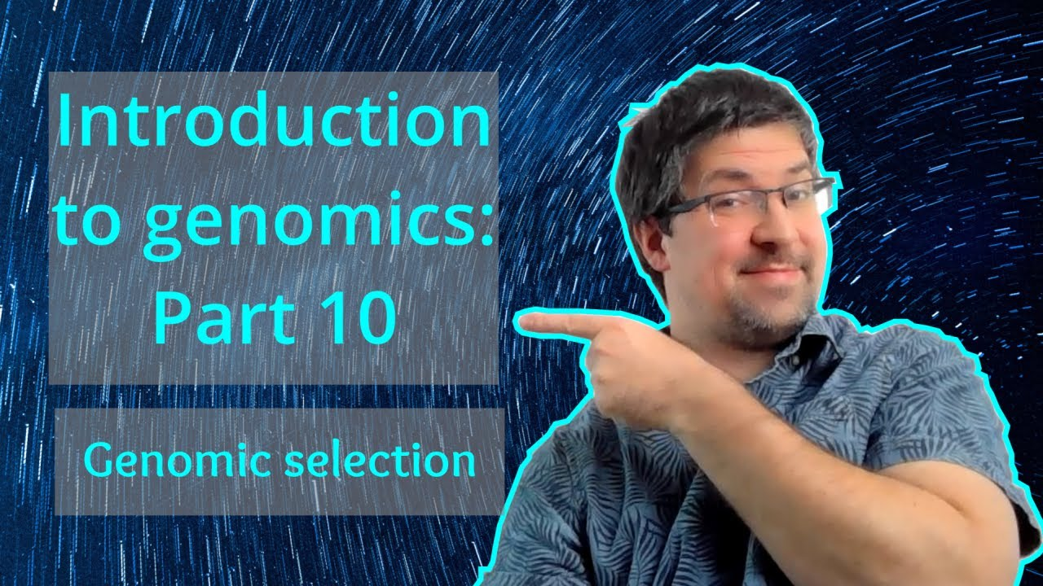
Watch on YouTube (Genomics Boot Camp)
Direct link to this lecture:
https://youtu.be/oAoRcgffCjk
Full playlist: https://youtube.com/playlist?list=PLdf-U83sN48MXs3EegQv2ripoBhLw6q6C

Slide 4
Partial summary from previous lectures
SNP continue to be a thing…
We analyze data based on SNP chips that cover the entire genome
LD characterizes the degree of relationships between nearby loci and SNP markers
Therefore with dense enough markers we have the entire genome covered, so that one or more SNPs are in high LD in at any given part of the genome

Slide 5
Introduction
It is possible to identify regions on the genome influencing the trait of interest
GWAS
Eventually narrow down regions to genes or loci
Detection of genes with small effect, typically influencing quantitative traits is problematic with GWAS
Quantitative trait loci - QTL

Slide 6
Introduction
Quantitative traits are important in animal breeding!
Almost all production, reproduction and functional traits are quantitative traits
i.e. influenced by a high number of genes, each with a very small effect
Classic example: production of milk

Slide 7
Introduction
The goal of animal breeding is, among others, to consistently improve populations to sustainably produce food to make the needs of the humankind
SDG 2: Zero hunger (Sustainable Development Goals, UN)
Question: How do we select individuals with 1000s of genes, with each gene contributing a tiny % to the trait?
Answer: Genetics.

Slide 8
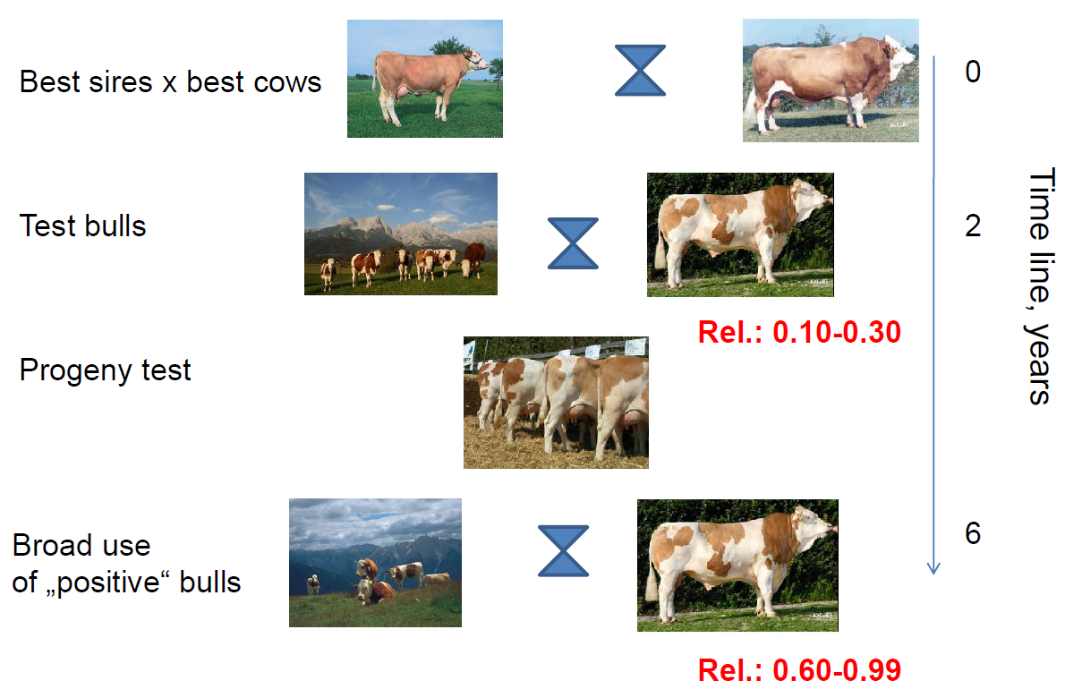
Traditional breeding programs with progeny testing

Slide 9
Traditional estimation of breeding value
Best Linear Unbiased Prediction (BLUP)
The animal model (AM)
y = Xb + Za + e
y= vector of records
b= fixed effects (herds, seasons etc.)
a= animal effect (random) ~ N(0,Aσ_{a}²)
A= relationship matrix – the fraction of genes shared between any two animals based on pedigree

Slide 10
The animal model
The estimated breeding value (EBV) of each animal is used to make decisions which sires and dams are the best. These are mated, producing an (on average) better follow-up generation.

Slide 11
Can we do better?
Yes. With genomics.

Slide 12
Marker Assisted Selection
An older method, not used any more
Mentioned just because of terminology
Marker assisted selection (MAS) ≠ Genomic selection (GS)
Two possibilities
Markers can trace inheritance of chromsome segments from parent to offspring
Markers ≠ QTL and not close to QTL
Marker allele is proxy for QTL allele
Markers ≈ QTL

Slide 13
MAS: Problems
Problems
Estimation of relatively few effects
The marker is not the QTL
Difficult to find high LD markers
An ’uneasy feeling’ that the selections is perhaps for the wrong allele
E.g. the linkage phase happens to be opposite in a particular animal/family

Slide 14
MAS: Problems
LD changes lead to wrong selection decisions
Over time
Over families
Over populations
In this case we do the direct opposite what is intended
But was easy to use, and easy to market
Commercially available products

Slide 15
Genomic Selection
The current state of art technique for breeding value estimation
Estimate breeding value based on SNP effects
Any time when DNA is available!
High-density genome wide SNP chips
Cattle, pigs, poultry: ~50,000 SNP chip
Costs: ca. 20 Euro per chip

Slide 16
Personal note on genomic selection
A very attractive, but not the only way to use genomics in animal (or plant) breeding
GS is often the first question from people/breeding organizations
Personally, I do not suggest to do GS in a population without prior experience with genomics
I see it as a follow up step in a process, when many previous steps were already made
Genomic selection is not “stand alone”
Needs supporting mechanisms, trait recording (!!!), and expertise

Slide 17
The idea of genomic selection
Use all SNP-chip markers without significance test
Dense SNP genotyping ensures LD markers
Small or unlocated QTLs are also be picked up
GS assumes that all QTL are explained by a combination of nearby markers
LD with the QTL

Slide 18
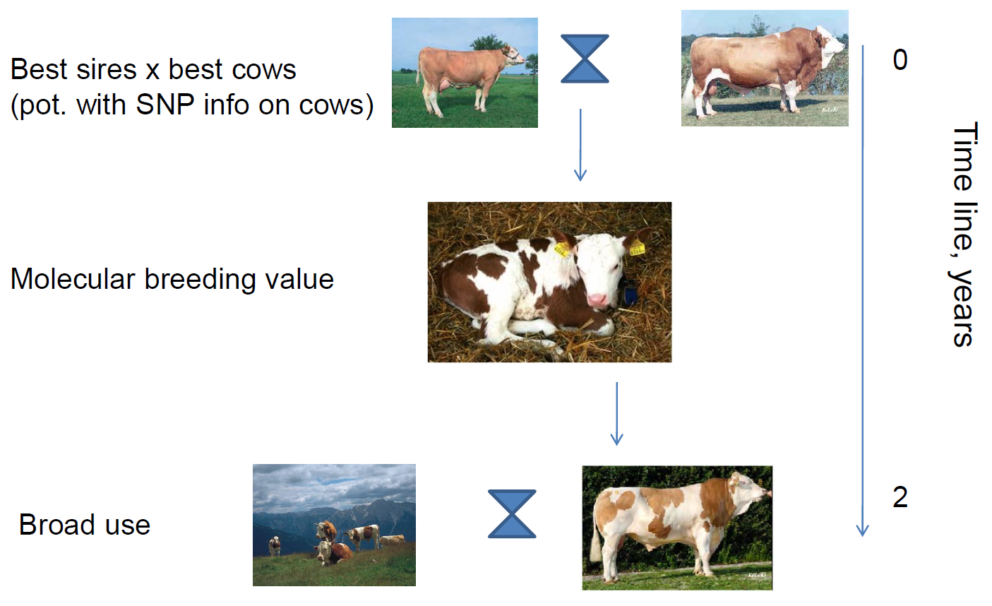
Genomic selection scheme

Slide 19
The idea of genomic selection
Many SNPs will not be linked to QTL but their effect will be estimated
Assumption is that the sum of all the estimated effects of these neutral markers is close to 0
Some have positive estimation error, some negative but sum is close to 0

Slide 20
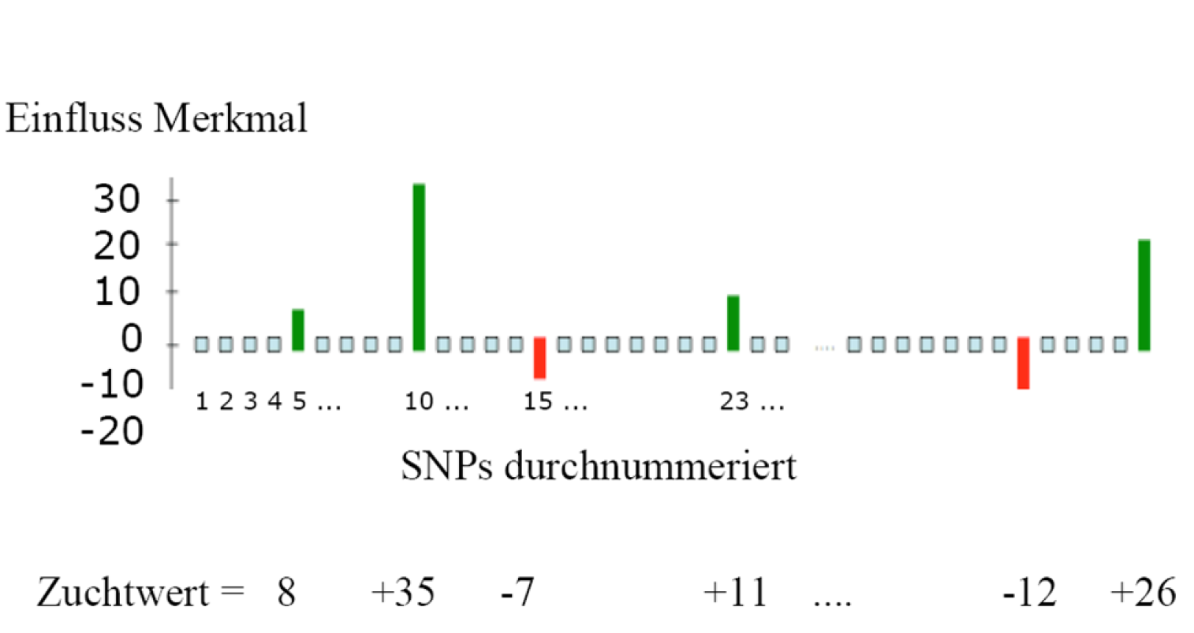
How genomic selection works
SNP effects
Breeding value

Slide 21
Genomic selection: the model
n= no. of SNPs (e.g. 50,000)
S_{j} is design matrix of SNP j
i.e. S_{ij} = number of ’1’ alleles of animal i for SNP j

Slide 22
Projected increase in genetic gain
i = intensity of selection
r = accuracy of selection
σ_{g} = genetic standard deviation
L = generation interval (in years)
Genomic selection affects
r (but this may be already high)
L (genotyping for GS: immediately at birth)
Halving L → doubles ΔG
L-effect may be more important than r increase
Notes:
intensity of selection is related to how many you select out of how many candidates. 10 out 100 candidates gives better intensity than 50 out of 100 or 10 out of 50.
σ_{g} is a measure of the size of the genetic differences (bigger genetic differences: more ΔG).
L measures how fast you do the selection. More selection-rounds per decade : more ΔG.
Reducing the generation interval is often what breeders makes enthusiastic about GS. But note: for some species the generation interval is already at its biological minimum eg. in pig breeding.

Slide 23
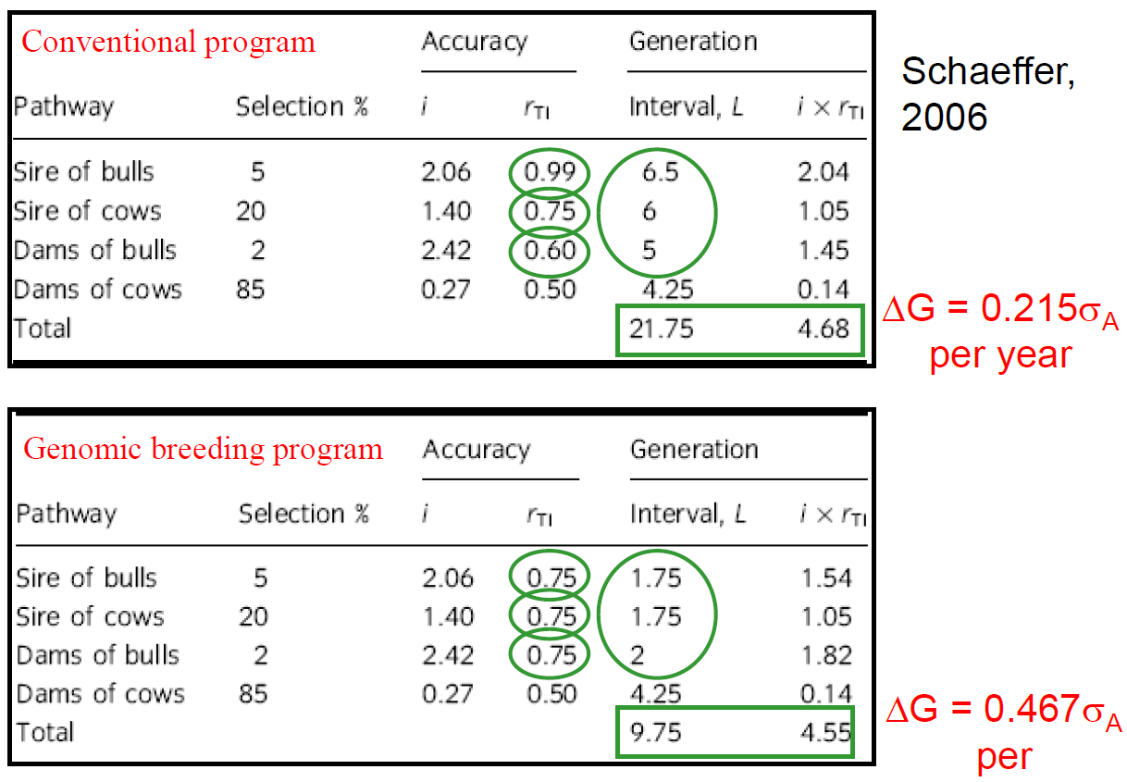
Projected increase in genetic gain

Slide 24
Why do we expect so much from GS
Direct selection at DNA level vs. indirect for phenotypes
Paradigm shift: new way of thinking about selection
Accurate GEBVs of animals without records
Traditionally animals without records have an EBV based on their relatives – usually not very accurate
Very important in some breeding schemes e.g. dairy bulls
Notes:
EBV = estimate of breeding value; GEBV = genomic (selection) estimated of breeding value
The ’accuracy of selection’ is the correlation between EBV and true breeding value (TBV).
Selection for phenotypes is often poorly understood because people do not understand the relationship between phenotype and genotype. But in principle the models are not so different:
Phenotypic selection : y = genotype + environment
Genomic selection : GEBV = genotype + estimation_error
We expect that estimation_error is smaller than environmental effects.
Traditional EBV of animals without records are based on the records of their parents, sibs or offspring.
Since bulls obviously do not have milk production records, selection of bulls in dairy cattle breeding is traditionally based on progeny testing, i.e. bulls obtain about 100 daughters, and their selection is based upon the performance of the daughters.

Slide 25

Steps in Genomic selection
Estimate SNP effects in a training data set (A)
Animals are genotyped & phenotyped (both A&B !)
Check how are the evaluations working by “masking” part of the population (B)
Validation population
Purely statistical approach

Slide 26

Steps in Genomic selection
Use the results by computing genomic breeding values for all
Animals are only genotyped (C)
Need not to be related to training animals
Also at birth

Slide 27
Methods and models
A large number of methods based on prior assumptions on marker effects
Lot of literature and discussions of technical details
Two most important sides
Genomic BLUP (GBLUP)
Bayesian models (a.k.a. Bayesian alphabet)
In simulations: some models might perform better
In real data: often not much difference

Slide 28
Single step genomic selection
Relationships can be obtained from pedigree (pedigree relationships, A) or from markers (genomic relationships, G)
We expect markers to be better than pedigree because they are more “real” but they are expensive…
We expect the Genomic Selection based on markers to be more efficient than based on pedigree

Slide 29
Single step genomic selection
Pedigrees in livestock
They are deep and connect most animals
However, only few animals are genotyped
Important animals such as bulls, also recent animals
MANY animals are not genotyped

Slide 30
Single step genomic selection
This makes us unhappy
A spans all animals, but has no marker information and it is less precise
G is more precise, but does not include all animals
Solution
Joint the two relationship matrices

Slide 31
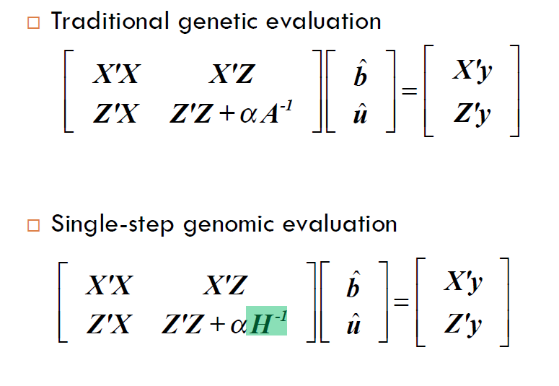
Single step genomic selection

Slide 32
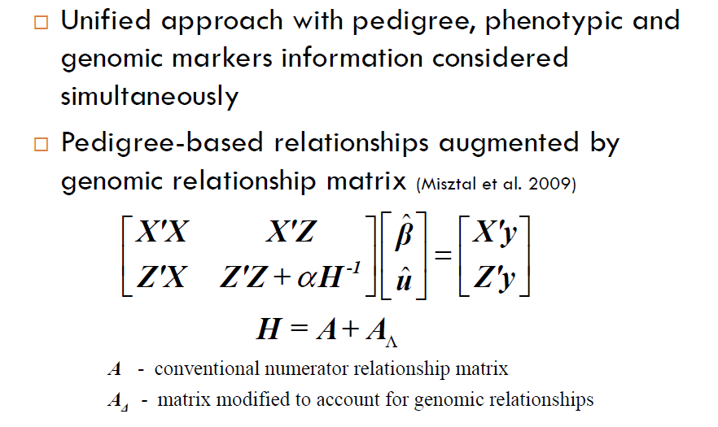
Single step genomic selection

Slide 33
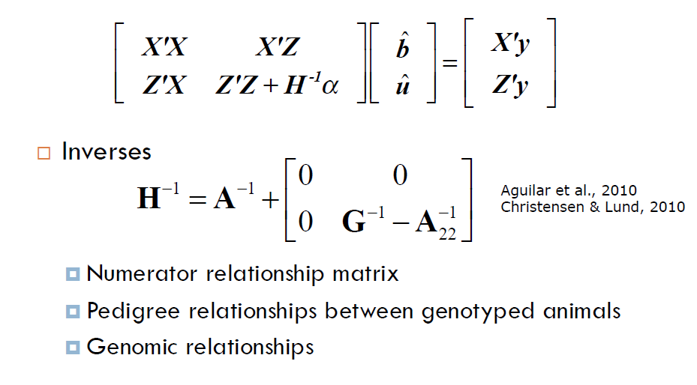
Single step genomic selection

Slide 34
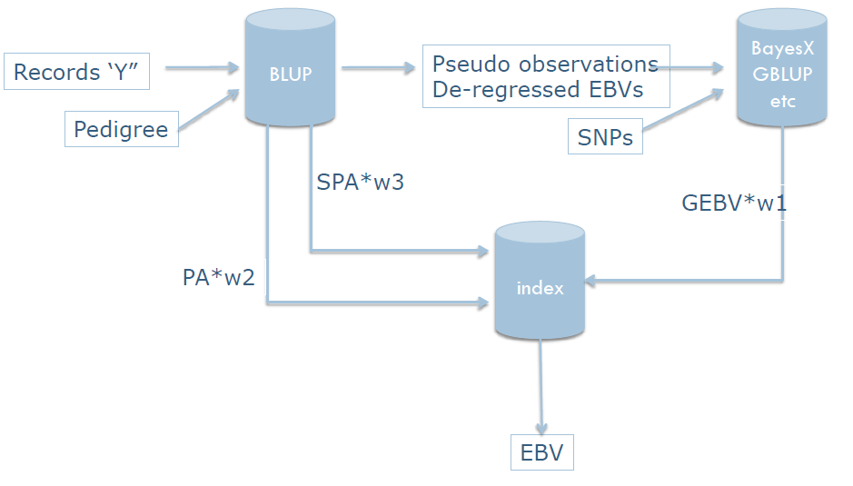
(Multi-step) Genomic selection

Slide 35
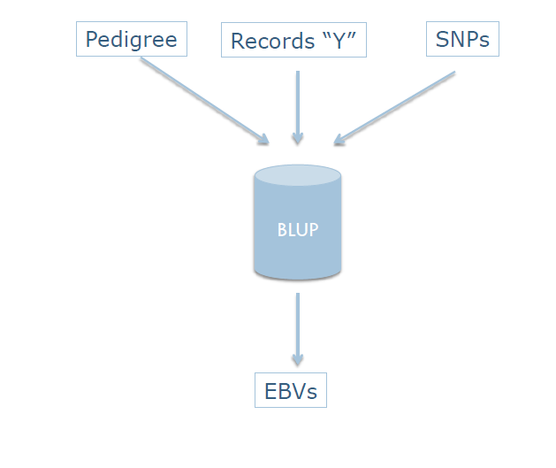
Single-step genomic selection

Slide 36
Acknowledgements
This presentations was partly based on the presentations and materials appearing in:

Slide 37
Marker Assisted – and Genomic Selection
Theo Meuwissen &
Trygve Solberg
NMBU, Norway

Slide 38
Non-linear models for genomic selection
Theo Meuwissen
NMBU, Norway

Slide 39
Application of Genomic Selection in breeding schemes
Theo Meuwissen
NMBU, Norway

Slide 40
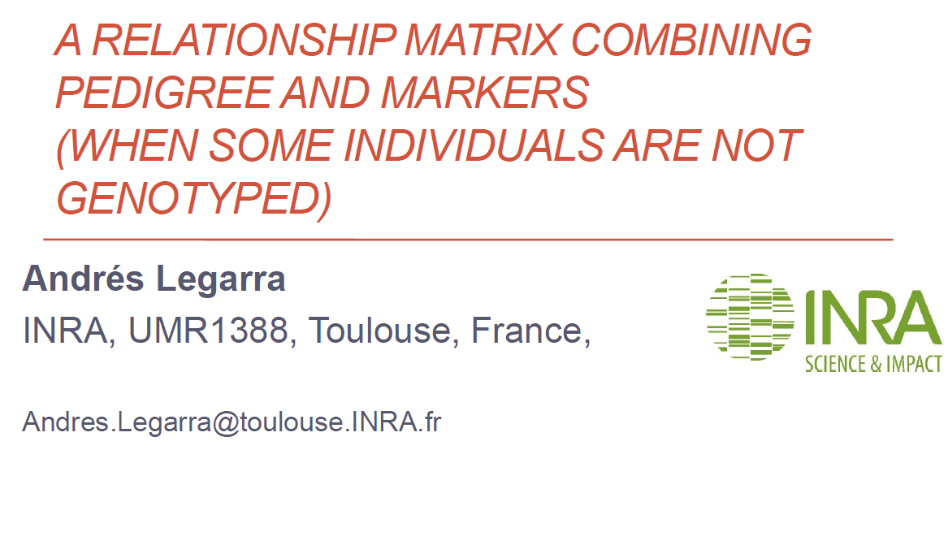

Slide 41

Vincent Ducrocq, INRAe Jouy-en-Josas, France

Slide 42
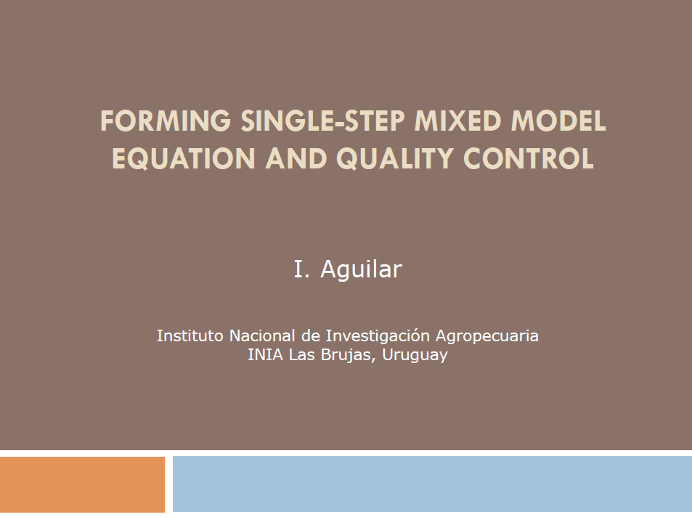

Slide 43

Summary
Thanks for your time!
Production traits are quantitative: influenced by many QTLs of small effect
These QTL are evaluated based on screening of SNPs on the whole genome
Important SNP are taken up, the non important ones cancel out
Genomic selection could be implemented whenever the DNA is available
Leads to increase of genetic gain due to decrease of generation intervals
Number of methodological approaches to derive genomic breeding values
Single-step genomic selection enables to evaluate genotyped and non-genotyped animals together

