Slide 1
Introduction to genomics
Gábor Mészáros

Slide 2
Part 2: SNP chips

Slide 3

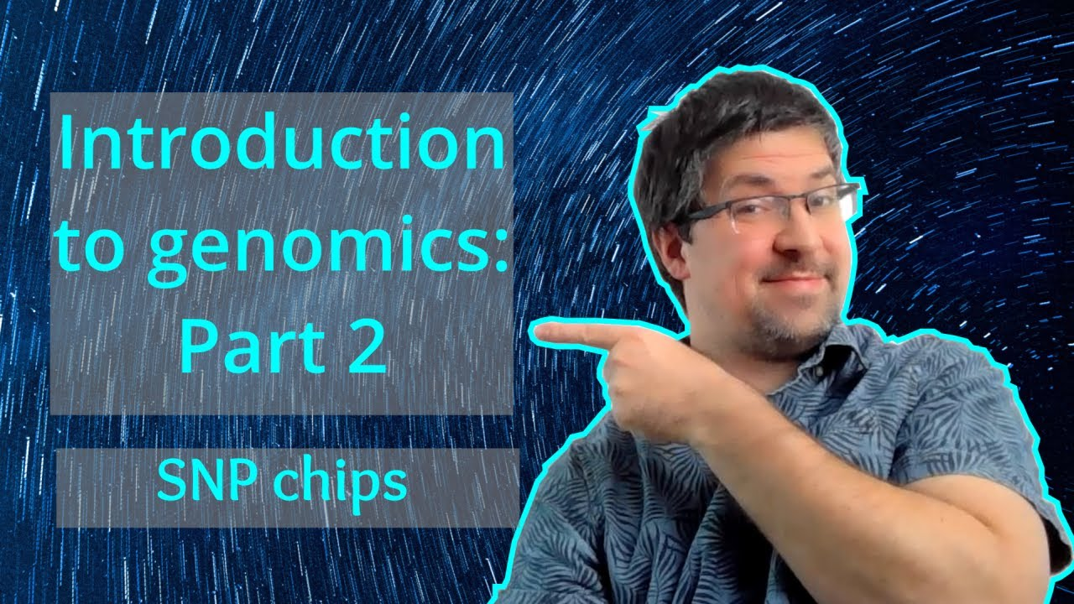
Watch on YouTube (Genomics Boot Camp)
Direct link to this lecture:
https://youtu.be/PeFOjLEJkrA
Full playlist: https://youtube.com/playlist?list=PLdf-U83sN48MXs3EegQv2ripoBhLw6q6C

Slide 4
Summary from previous lectures
The DNA structure is based on certain building blocks and a set of rules how they connect
If we can not look at everything at once, molecular markers are good surrogates
We know their genotype and position
They are connected to genomic regions of interest, e.g. genes
SNP markers are widely used (and currently the most important) marker types

Slide 5
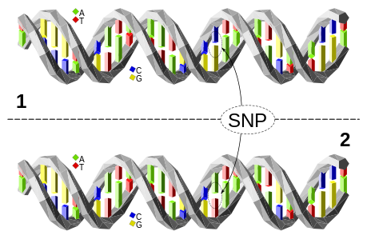
Single nucleotide polymorphism (SNP)
Single base pair positions in genomic DNA at which different sequence alternatives (alleles) exist
Image source: Wikipedia, https://commons.wikimedia.org/wiki/File:Dna-SNP.svg

Slide 6
Genomic data – SNP chip
In the BeadArray technology, targeted regions of DNA are immobilized on beads, and SNPs are visualized through fluorescent tags
The method is based on allele-specific primer extension followed by oligonucleotide ligation and generic PCR for signal amplification

Slide 7
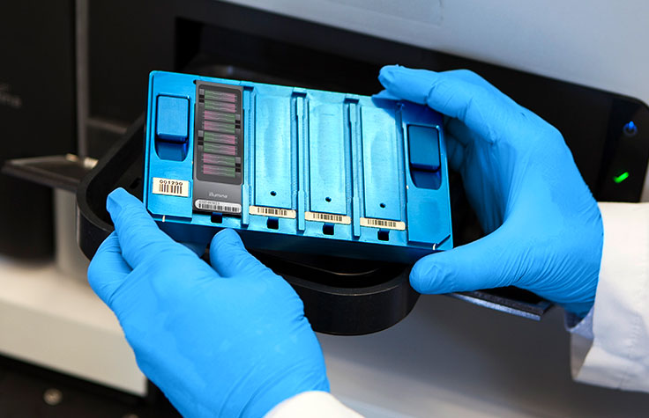
The Bead Chip / Bead Array / SNP chip
https://emea.illumina.com/science/technology/microarray.html

Slide 8
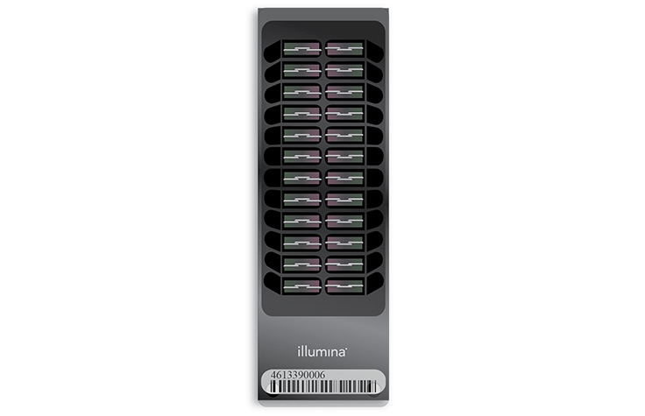
Microarray technology a.k.a. BeadArray technology a.k.a. SNP chip
SNPs on them are bi-allelic by design
Exactly 2 alleles, 3 genotypes, or missing
e.g. alleles A and B; genotypes: AA, AB, BB
Image source: https://www.illumina.com/products/by-type/microarray-kits/bovine-snp50.html

Slide 9
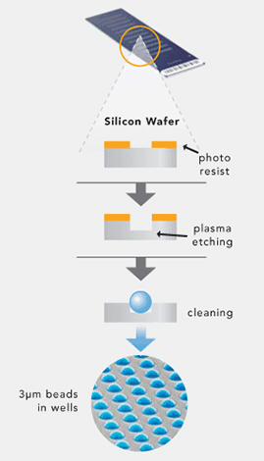
BeadChip / BeadArray structure
Hundreds of thousands to millions of tiny silica beads (wells)
Each coated with multiple copies of an oligonucleotide probe targeting a specific locus
Each genotypes targets a specific SNPs in the genome
https://emea.illumina.com/science/technology/microarray.html

Slide 10
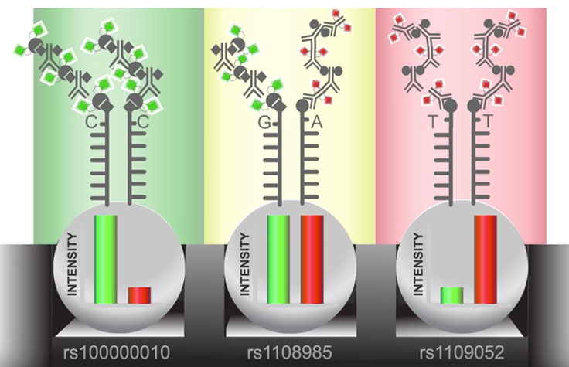
How does it work?
As DNA fragments pass over the BeadChip
Each probe binds to a complementary sequence in the sample DNA, stopping one base before the locus of interest
Single base extension that incorporates one of four labeled nucleotides
When excited by a laser, the nucleotide label emits a signal
The intensity of that signal conveys information about the allelic ratio at that locus
https://emea.illumina.com/science/technology/microarray.html

Slide 11
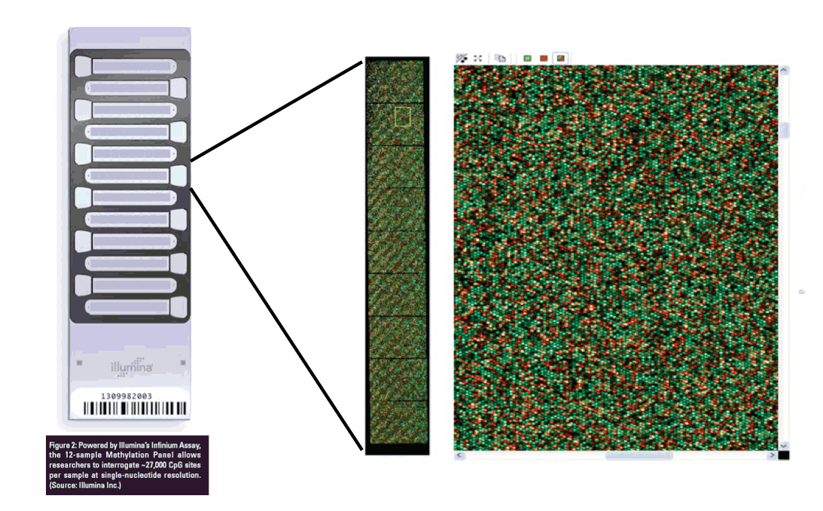
Genomic data – SNP chip

Slide 12
Genotyping clusters
Algorithm automatically clusters samples into two homozygous and one heterozygous group
The circles around each cluster (2 SD)
The shading delimits the area according to the GenCall – a type of quality control metric
Samples outside the shaded region are not given a genotype (typically GenCall < 0.25)

Slide 13
Genotyping clusters – good SNP
Source: Technical Note: Genotyping | Infinium® Genotyping Data Analysis

Slide 14
Genotyping clusters – bad SNP
Source: Technical Note: Genotyping | Infinium® Genotyping Data Analysis

Slide 15
The final step that starts it all
After the work with the genotyping is done, a text file is produced
The final report
Follow up analyses with PLINK or other software

Slide 16
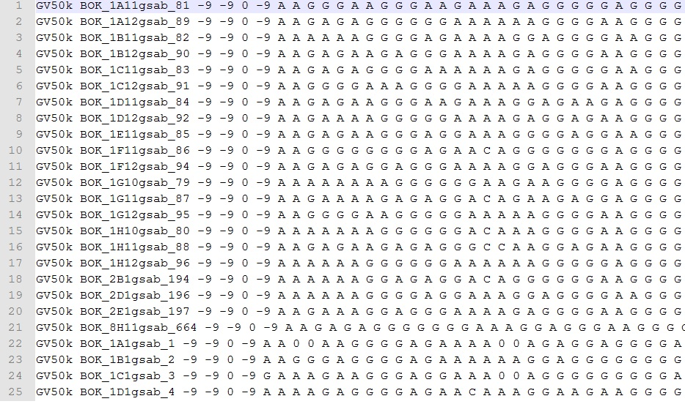
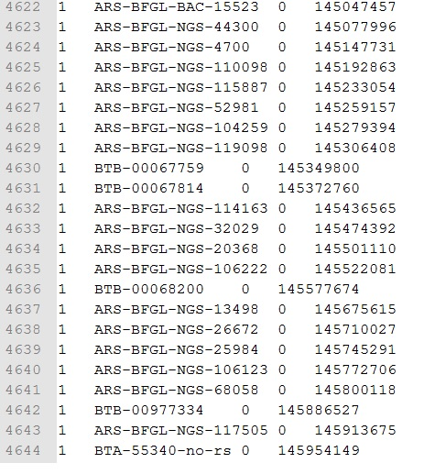
Genomic data – in silico

Slide 17
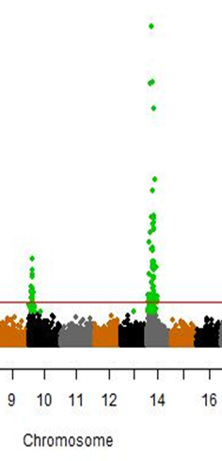
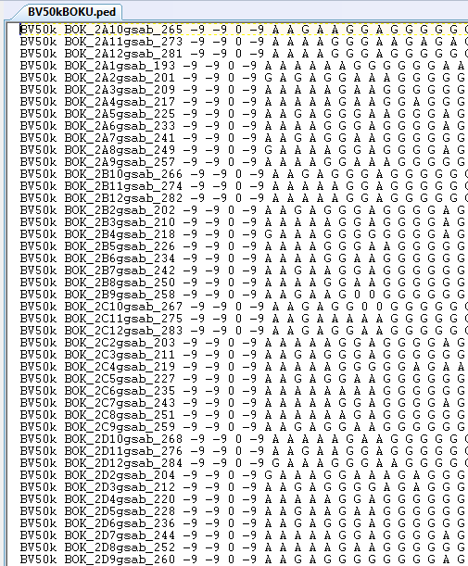

Slide 18
Handling of the genomic data
Correlated developments in information technologies
IT has become an essential part of research
Software
Not possible to analyze the data by hand
Programming skills essential for data handling
Own scripts vs established programs
Myriad of software solutions and programs

Slide 19
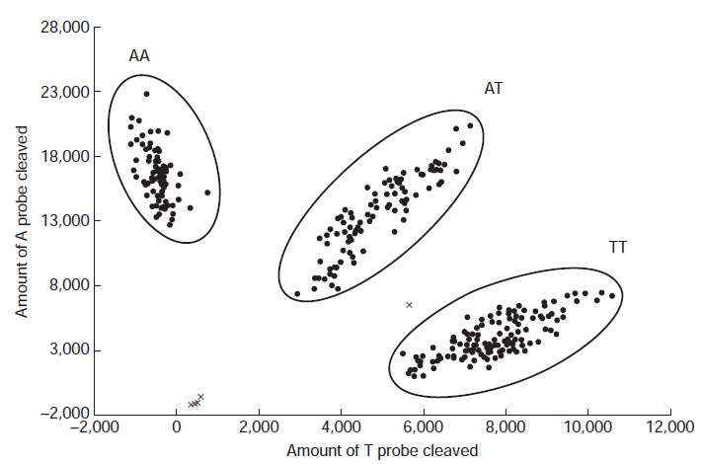

Slide 20
Allele and genotype codes
Nucleotide allele code (TOP): G-C-A-T
Nucleotide allele code (FORWARD): G-C-A-T
Character allele code: A-B
Numeric allele code: 1-2
Numeric allele code: 0-1
Missing allele: often denoted with 0 or anything else, needs specification
Genotype code: 0-1-2

Slide 21
Allele and genotype codes
Nucleotide coding
AA, AG, GG
AB coding
AA, AB, BB
Numeric coding
11, 12, 22
Genotype coding
0,1,2

Slide 22
Genotype density
Cattle
~54.000 SNPs >> Mid-density (50k)
~777.000 SNPs >> High density (HD)
~7.000 SNPs >> Low density (LD)
Custom SNP chips
SNP sets focusing on a specific region

Slide 23

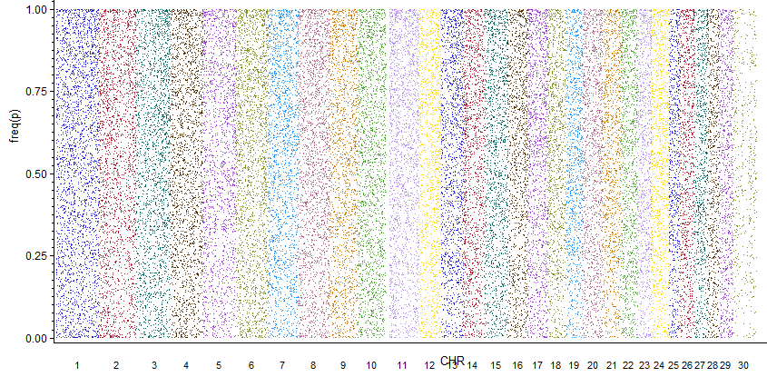

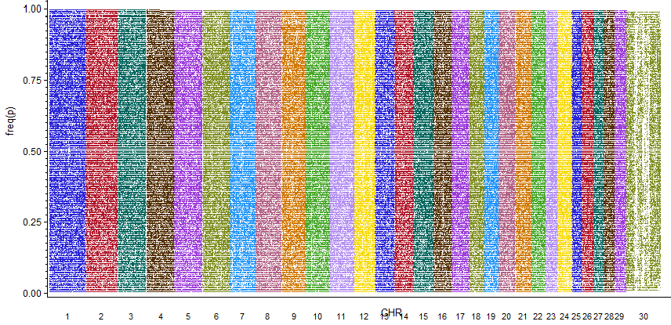
54K
777K

Slide 24
Genotype density
Human ~906,000 SNPs
Horses ~70,000 SNPs
Ovine ~54,000 SNPs
Porcine ~60,000 SNPs
Dogs ~230,000 SNPs
Mouse ~140,000 SNPs
Wheat ~660,000 SNPs
Strawberry ~95,000 SNPs

Slide 25
Genotype density
Different SNP chip types
More species
Human, horse, mouse, wheat, …
Different manufacturers
LOT of laboratories providing service
“In the age of genotypes the phenotype is the King!”

Slide 26
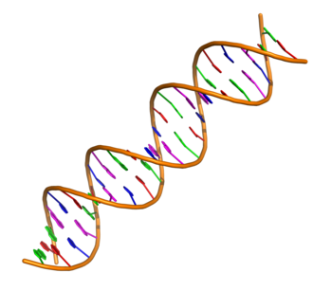
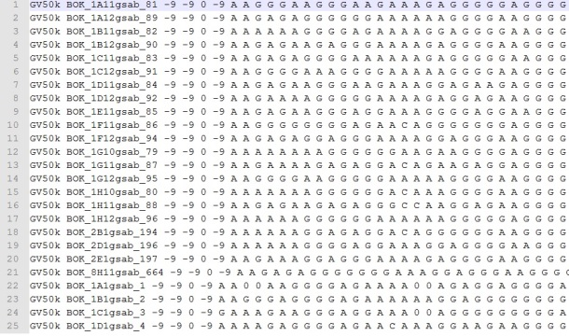
DNA
Lab
Results
Data
Image source (DNA helix): Wikipedia

Slide 27
Applications of genomic data
Many…
Main focus of the majority of research groups
Depends on personal interests
Most popular
Admixture
Relatedness
GWAS and selection signatures
Genomic selection

Slide 28
Summary
The SNP markers are genotyped based with high throughput machines, based on a set of rules
There are various ways to express the genotypes of the bi-allelic SNPs
Species specific SNP chips with different densities exist

