Slide 1
Introduction to genomics
Gábor Mészáros

Slide 2
Part 3: Genomic maps and recombination

Slide 3

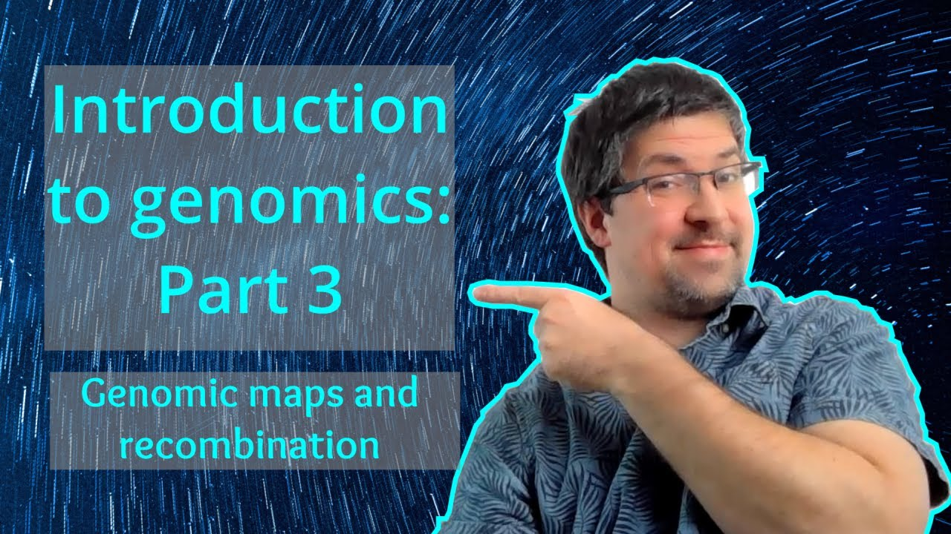
Watch on YouTube (Genomics Boot Camp)
Direct link to this lecture:
https://youtu.be/YngKajFCzMY
Full playlist: https://youtube.com/playlist?list=PLdf-U83sN48MXs3EegQv2ripoBhLw6q6C

Slide 4
Summary from previous lectures
SNP markers are widely used, and currently the most important marker types
There are various ways to express the genotypes of the bi-allelic SNPs
SNP chips with different densities for different species, covering the entire genome

Slide 5
Metrics and maps
Physical map – unit basepairs
Genetic map – unit Morgan

Slide 6
Metrics and maps
Physical map: length of the DNA counted in basepairs (bp), kilobasepairs (kb), megabasepairs (Mb)
Physical map length of the
Mammalian genome:
3 x 10⁹ bp = 3 mio kb = 3000 Mb = 3 Gb
Chicken genome: 1.2 x 10⁹

Slide 7
Genetic map length
Definition of the Morgan unit (T.H. Morgan, 1919):
For a chromosome segment of length one Morgan we expect one crossing over in one meiosis
1 Morgan (M) = 100 centiMorgan (cM)

Slide 8
Genetic map length
Rule of thumb for mammals:
Physical genome length: 3000 Mb
Genetic map length: 30M = 3000 cM
1 cM ~ 1 Mb ~ 1% recombination (θ = 0.01)
1 recombination ~ every 100 Mbp
E.g. if chromosome is 350 Mb long we expect 3.5 recombinations, on average

Slide 9
Recombination
Pieces of DNA broken and joined again, producing new combinations
Creates variability (diversity) on the level of genes
During meiosis the maternal and paternal chromosomes align, the arms overlap and temporarily fuse, causing a crossing-over
Result:
Exchange of genetic material between maternal and paternal chromosomes
Offspring can have different combination of alleles than their parents
https://www.nature.com/scitable/definition/recombination-226/

Slide 10
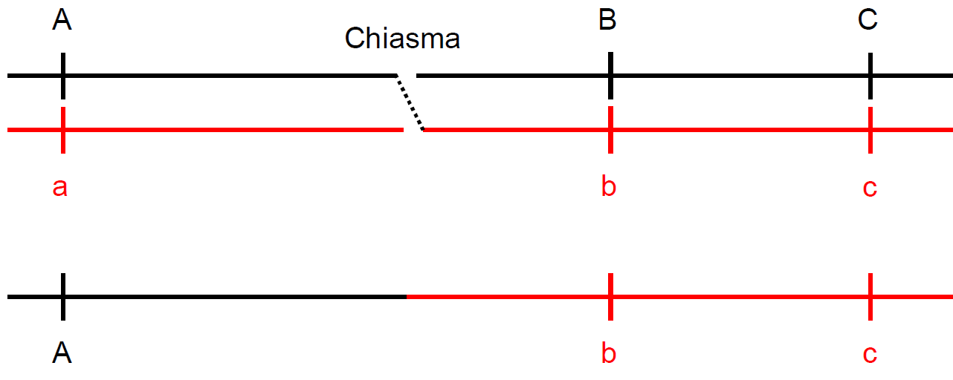
Recombination and crossing over

Slide 11
Recombination and crossing over
Two loci recombine, if between them an odd number of crossing-over events takes place
Crossing-overs are usually not directly observable
Crossing-over is not an ‚accident‘ in meiosis, but is a mechanism to generate and maintain variability

Slide 12
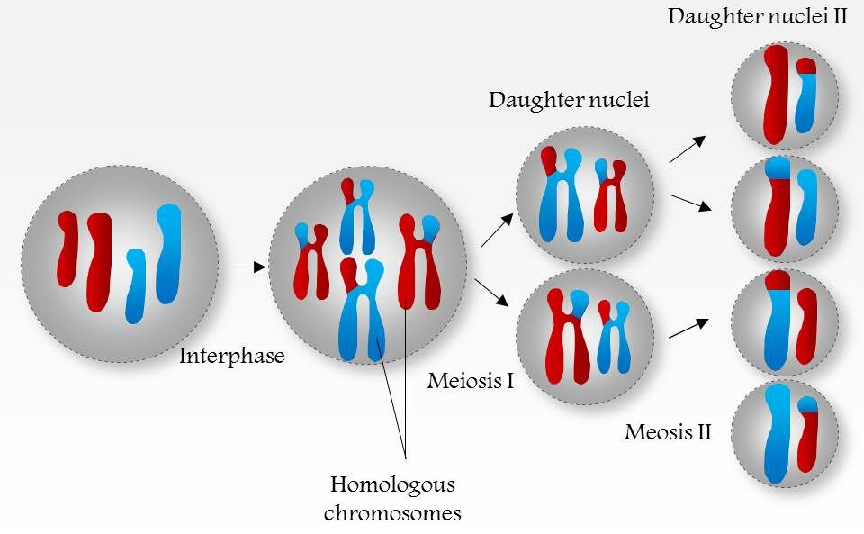
https://www.slideteam.net/0714-genetic-recombination-medical-images-for-powerpoint.html

Slide 13
Further aspects
Usually the recombination activity in the homogametic sex (females in mammals, males in birds) is increased, therefore the respective map is on average longer
In humans female : male map length ~ 2 : 1
Recombination activity varies along the genome
Hot spots, cold spots

Slide 14
Further aspects
Recombination activity is genetically regulated
Family differences, selection experiments
Domestication – more recombination in domesticated animals than their wild relatives
On short chromosomes (as e.g. the micro-chromosomes in chicken or the pseudoautosomal region on the heterosomes) one often assumes an ‚obligatory chiasma‘, so that the genetic length is much larger than the physical length

Slide 15
Summary
There is a number of ways how to determine positions on the genome
Some more straightforward than others
The physical map (base pairs) is the most often used
The recombination events are of major biological importance
They introduce variability and have major role in genomics

