Slide 1
Introduction to genomics
Gábor Mészáros

Slide 2
Part 4: Haplotypes and imputation

Slide 3

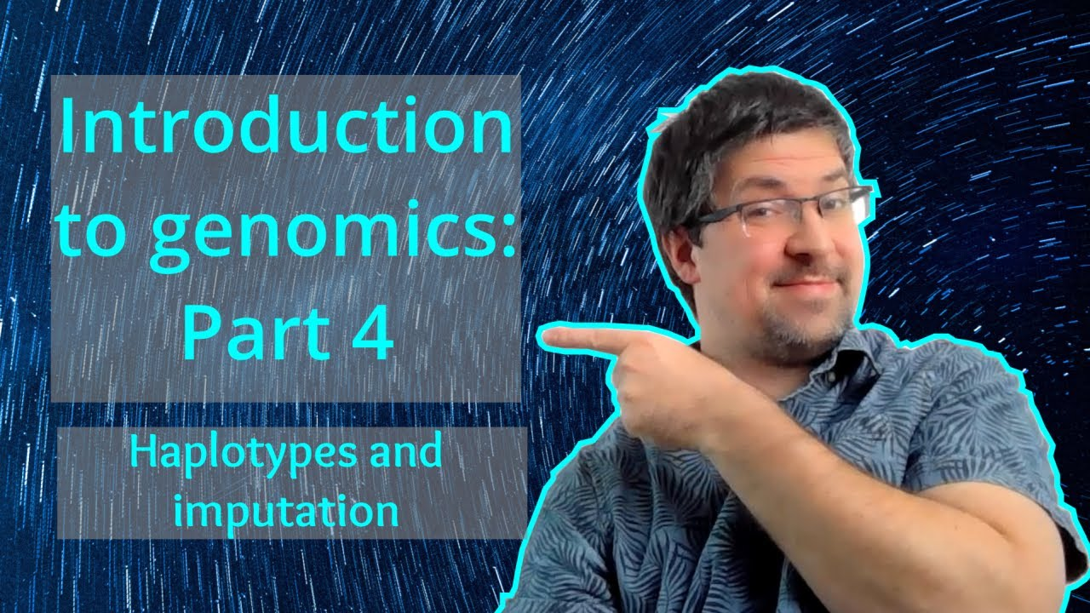
Watch on YouTube (Genomics Boot Camp)
Direct link to this lecture:
https://youtu.be/BlA8lXnnzAw
Full playlist: https://youtube.com/playlist?list=PLdf-U83sN48MXs3EegQv2ripoBhLw6q6C

Slide 4
Summary from previous lectures
SNP markers are widely used (and currently the most important) marker types, genotyped with high throughput machines
There are various ways to express the genotypes of the bi-allelic SNPs
Species specific SNP chips with different densities exist
There is a number of ways how to determine positions on the genome
The physical map (base pairs) is the most often used
The recombination events are of major biological importance
They introduce variability and have major role in genomics

Slide 5
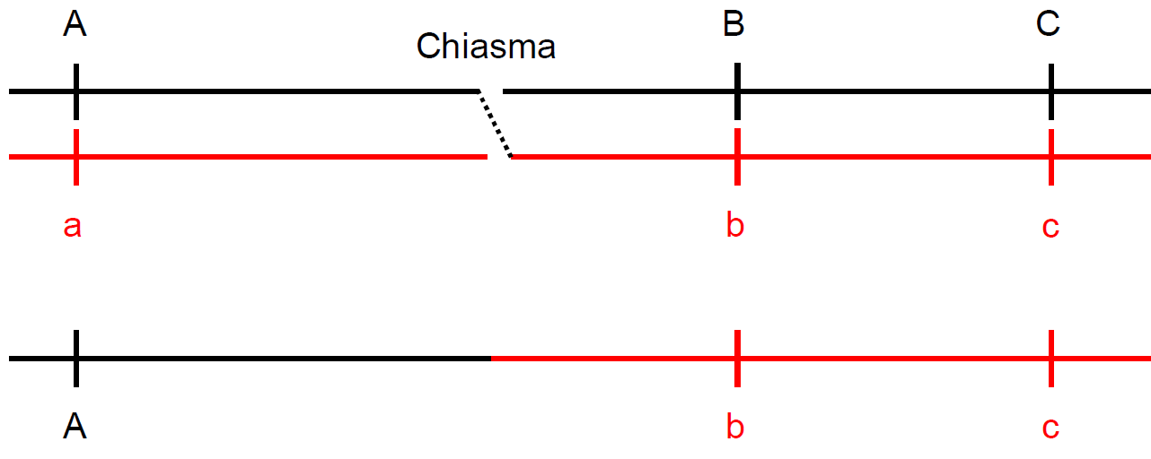
Recombination

Slide 6
Haplotypes
In reality a paternal and maternal chromosomes are joined during fertilization with their own set of alleles
Diploid organism with genotypes at 3 loci, e.g.
AA bb CC
Aa BB cc
aa Bb Cc
Aa Bb Cc

Slide 7
Haplotypes
We see here the summary only
What are the actual sets of alleles on each chromosome?
AA bb CC
AbC/AbC
Aa BB cc
ABc/aBc

Slide 8
Haplotypes
aa Bb Cc
aBC/abc or aBc/abC
Aa Bb Cc
???
Exercise for you!
…
ABC/abc, ABc/abC, aBc/AbC or aBC/Abc

Slide 9
Haplotypes
How to determine haplotypes in practice?
Computer software
The computation process is called phasing

Slide 10
Phasing
Phasing is the task or process of assigning alleles to the paternal and maternal chromosomes
Looking for haplotypes (phases) in large scale genotype data
Complex problem

Slide 11
Phasing
Easier for trios: sire – dam – offspring
Multi-generation trios even better: trios for multiple follow up generations
In case everybody is genotyped
Also possible for samples of „unrelated“ individuals of a population

Slide 12
Phasing
Specific software solutions
Some divide the genotype to small segments
e.g. 250 bases
Derive the haplotypes for these
Try to merge them properly

Slide 13
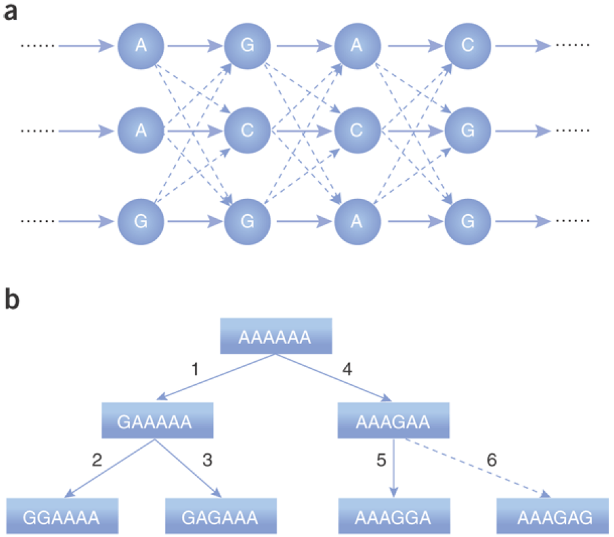
Phasing

Slide 14
Genotype imputation
Phasing is essential for the so called imputation procedures, i.e. make an “educated guess” what the missing genotypes could be
Imputation of sporadically missing SNPs
Imputation between SNP chips
E.g. impute from 50k chip to HD chip

Slide 15
Genotype imputation - sporadically missing
Genotyping errors occur quite frequently
If there are many errors, the SNPs or the individuals are removed from the analysis within the quality control
Sporadically missing SNPs can be fixed easily

Slide 16
Genotype imputation - sporadically missing
Let’s have an established haplotype in the population
Consider that for an another animal a genotyping error occurs
If every other SNP fits, we could easily fill in the right genotype
? ?

Slide 17
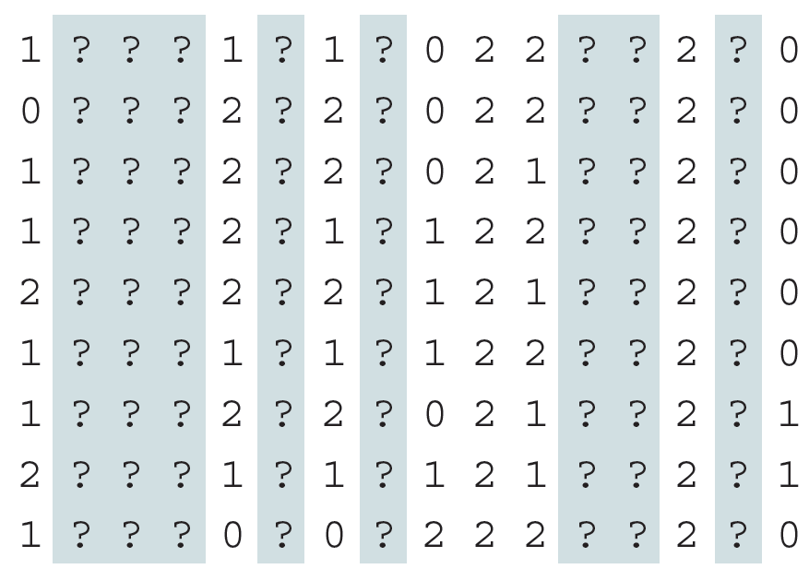
Genotype imputation – between SNP chips
Marchini, J., Howie, B. (2010) Nature Reviews Genetics, 11:499–511.

Slide 18
Genotype imputation – between SNP chips
Even in unrelated individuals short stretches of sequences will be identical by decent (IBD)
The local pattern of IBD can be described by an (unobserved) genealogical tree
Length of segment depends on recombination
Possibility to identify these segments (haplotypes) and use them to our advantage

Slide 19
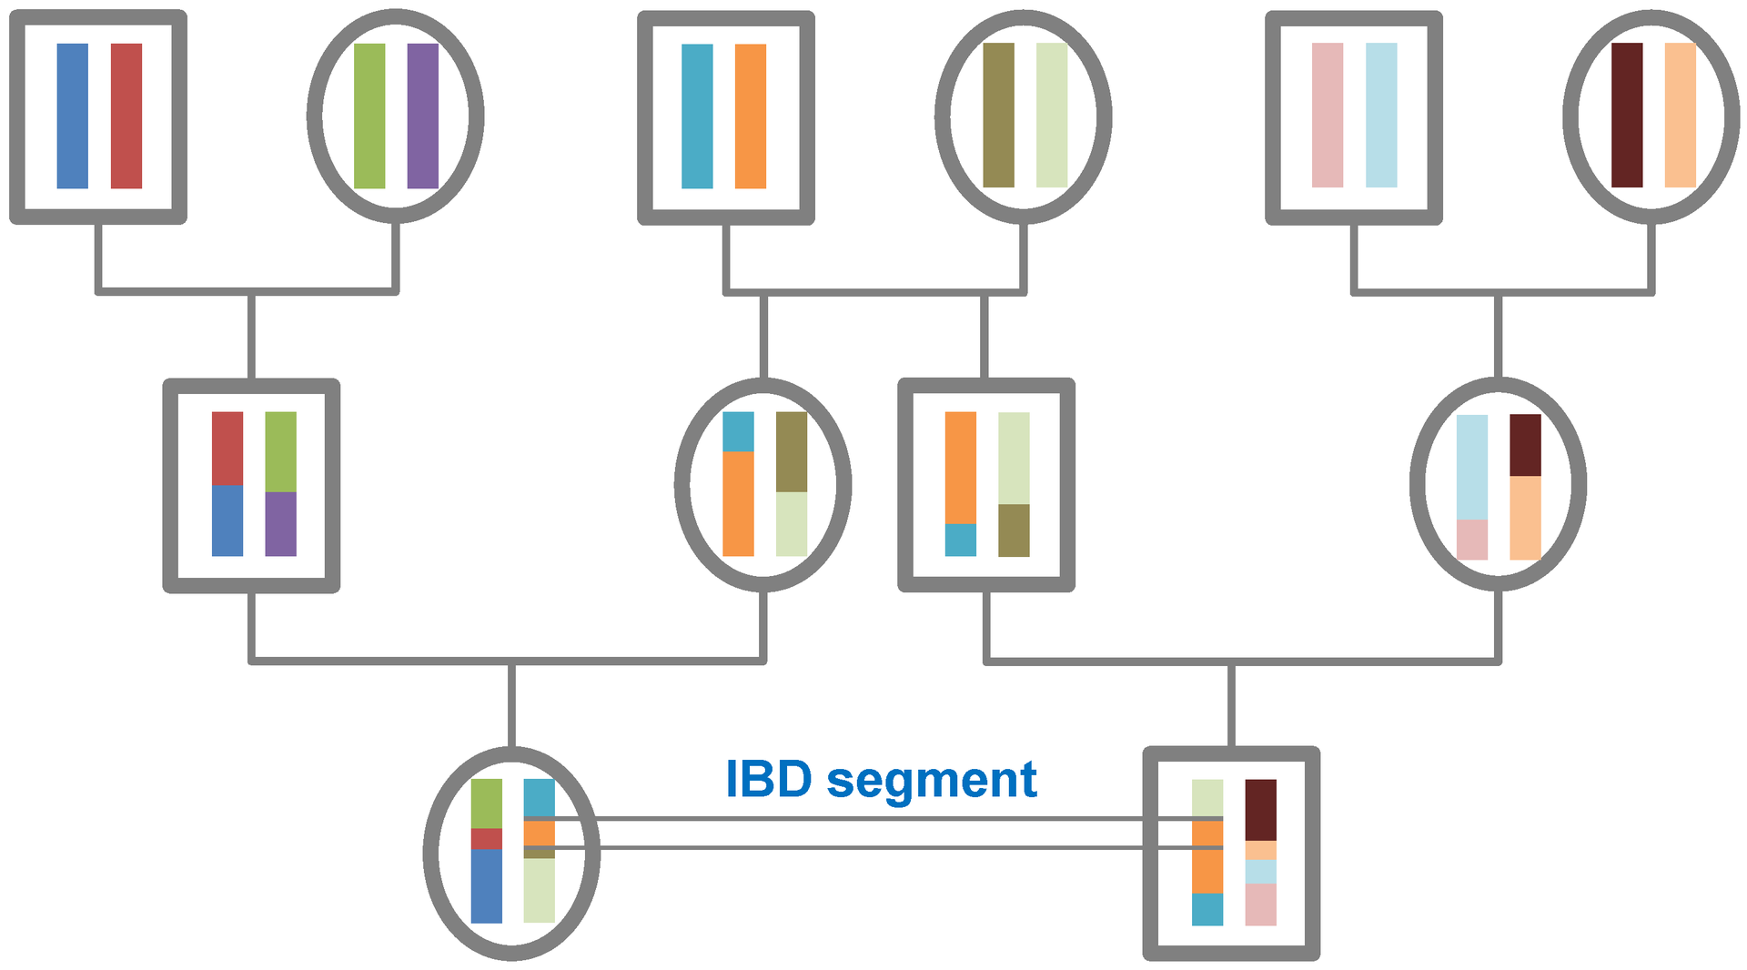
Identity by decent

Slide 20
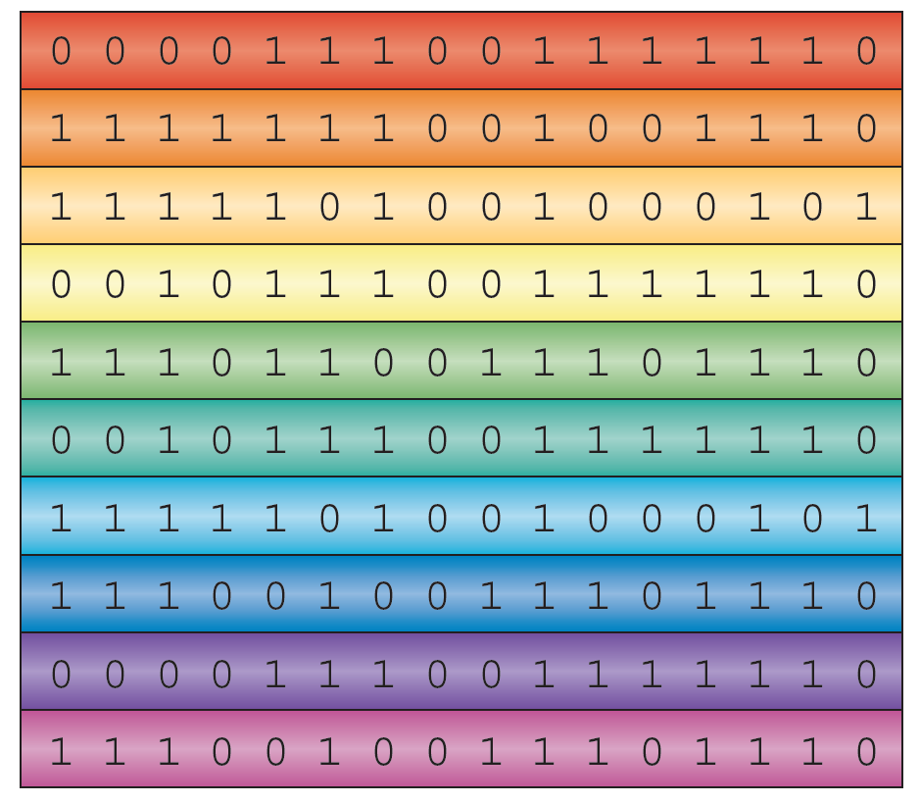
Genotype imputation – between SNP chips
Reference haplotypes
Marchini, J., Howie, B. (2010) Nature Reviews Genetics, 11:499–511.

Slide 21
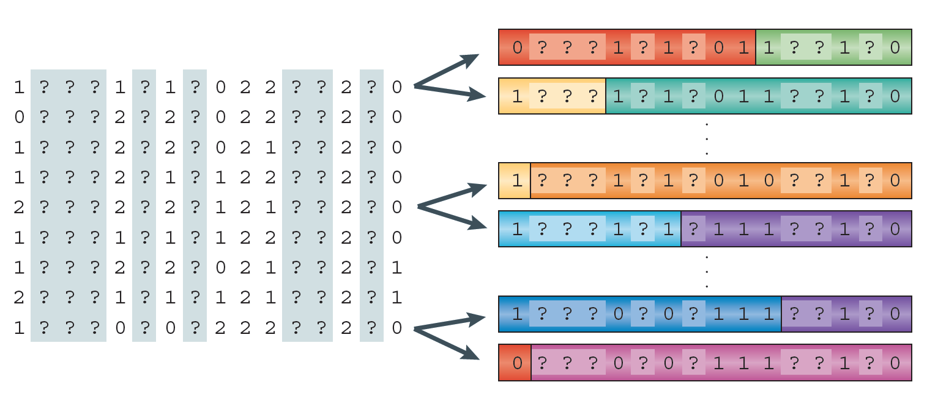
Genotype imputation – between SNP chips
Marchini, J., Howie, B. (2010) Nature Reviews Genetics, 11:499–511.

Slide 22
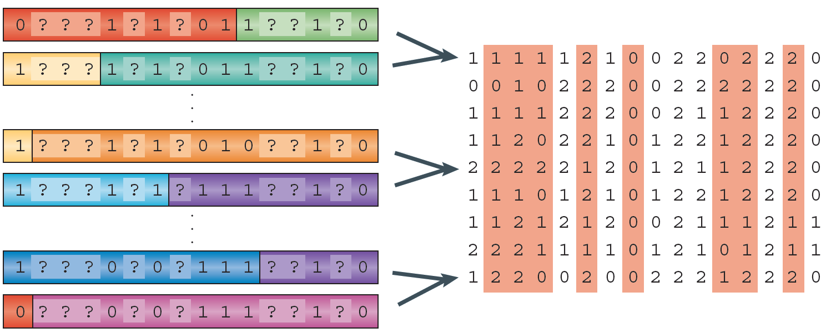
Genotype imputation – between SNP chips
Marchini, J., Howie, B. (2010) Nature Reviews Genetics, 11:499–511.

Slide 23
Genotype imputation – between SNP chips
Rationale
Lower density SNP chips cost less
If cost is an issue or you want to genotype many individuals
Haplotypes based on high density individuals
Imputation in silico with no additional cost

Slide 24
Genotype imputation – between SNP chips
Different software to do this
Imputation accuracy among others dependent on
Size of reference set
Data quality
Imputation accuracy usually >95%
Different methods to evaluate imputation accuracy
Simulation studies and genotype “masking” to test

Slide 25
Summary
A series of SNPs is called a haplotype
Clarifies which combination of alleles comes from which parent
On a large scale the haplotypes are computed with specialized software programs
The approach is called phasing
Imputation is an approach to fill in missing SNPs
Sporadically missing SNPs are filled in (imputed) based on haplotypes
Extension to a larger SNP set are filled in (imputed) based on haplotypes and information from larger/ denser SNP chips

