Slide 1
Introduction to genomics
Gábor Mészáros

Slide 2
Part 5: Linkage disequilibrium

Slide 3

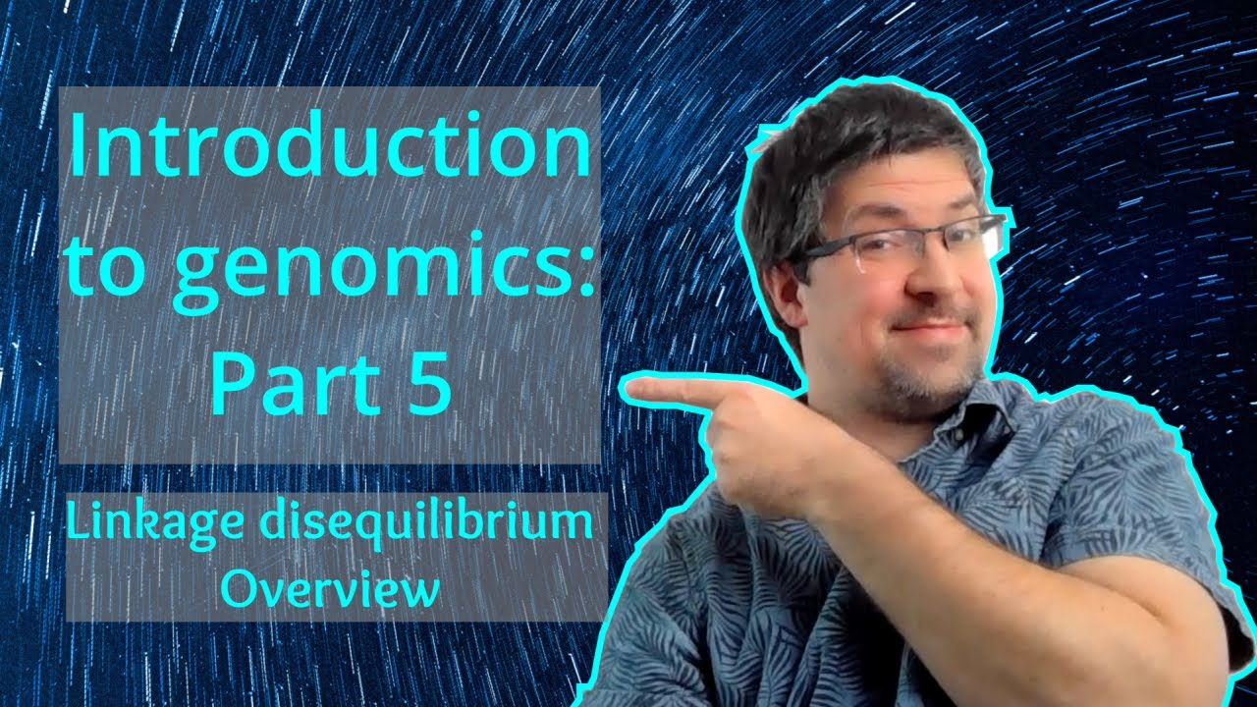
Watch on YouTube (Genomics Boot Camp)
Direct link to this lecture:
https://youtu.be/IW2b_rXxq6M
Full playlist: https://youtube.com/playlist?list=PLdf-U83sN48MXs3EegQv2ripoBhLw6q6C

Slide 4
Partial summary from previous lectures
SNP markers are widely used (and currently the most important) marker types, genotyped with high throughput machines
The recombination events are of major biological importance
They introduce variability and have major role in genomics
A series of SNPs is called a haplotype
Clarifies which combination of alleles comes from which parent
All genomic analyses are done with specialized software programs

Slide 5
Linkage disequilibrium (LD)
Non-random association of any two loci within the population
Degree of connectedness between two loci
Could be measured – e.g. correlation

Slide 6
Linkage disequilibrium (LD)
Alleles in near physical vicinity are not inherited independently, but as blocks (haplotypes)
Size of these blocks is related to recombination
But also historical events and evolution

Slide 7
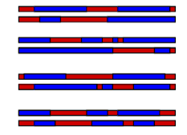
LD within segments

Slide 8
Independent segregation –Mendel’s laws
Genes do not influence each other with regard to the sorting of alleles into gametes
Every possible combination of alleles for every gene is equally likely to occur

Slide 9
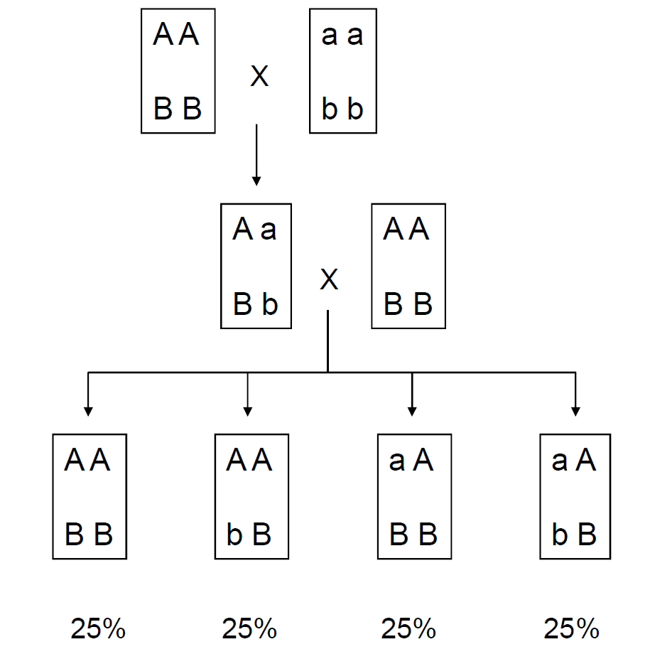
Independent segregation –Mendel’s laws

Slide 10
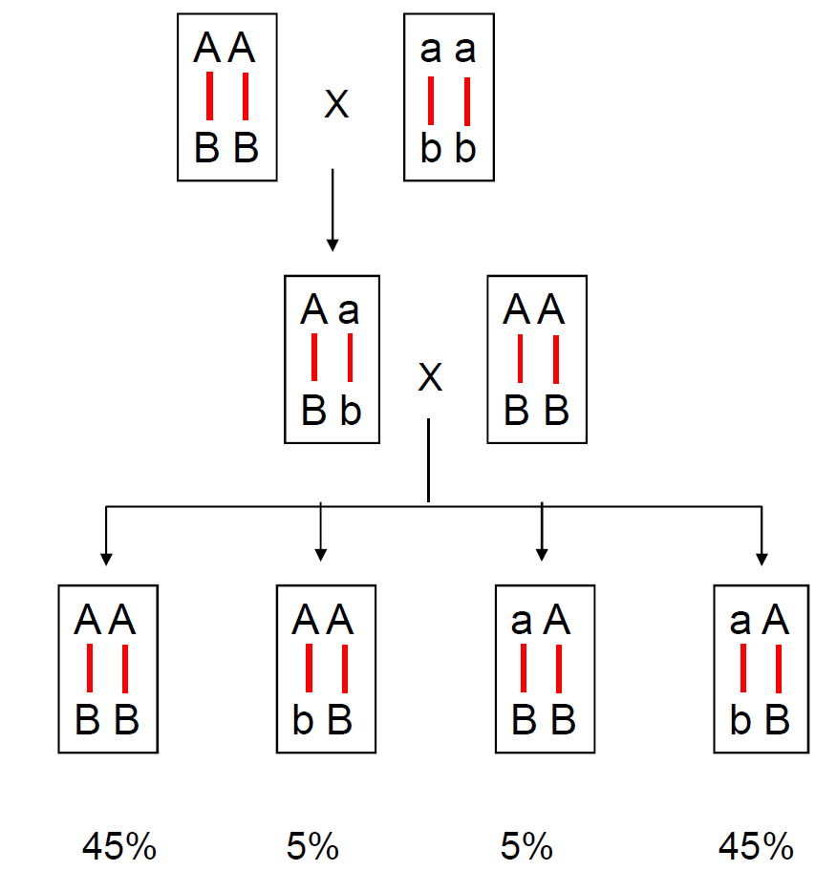
Non-independent segregation

Slide 11
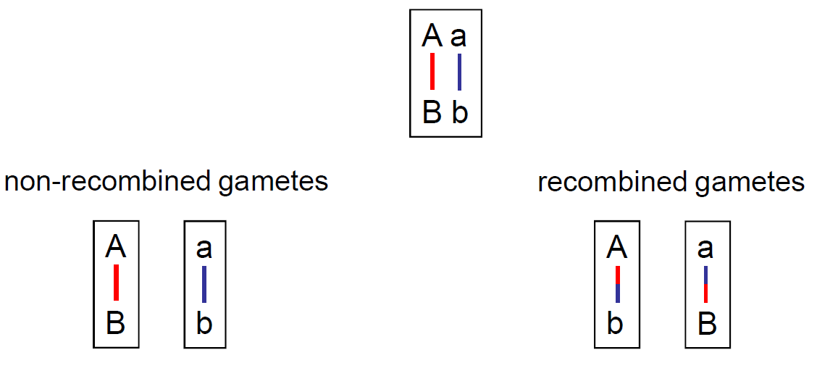
Non-independent segregation - Linkage

Slide 12
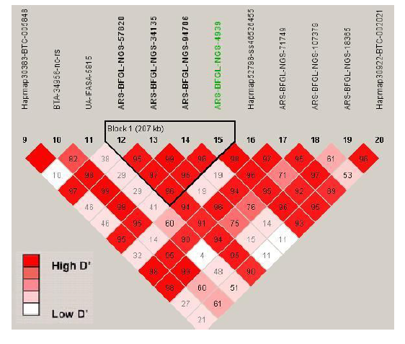
LD block structure

Slide 13
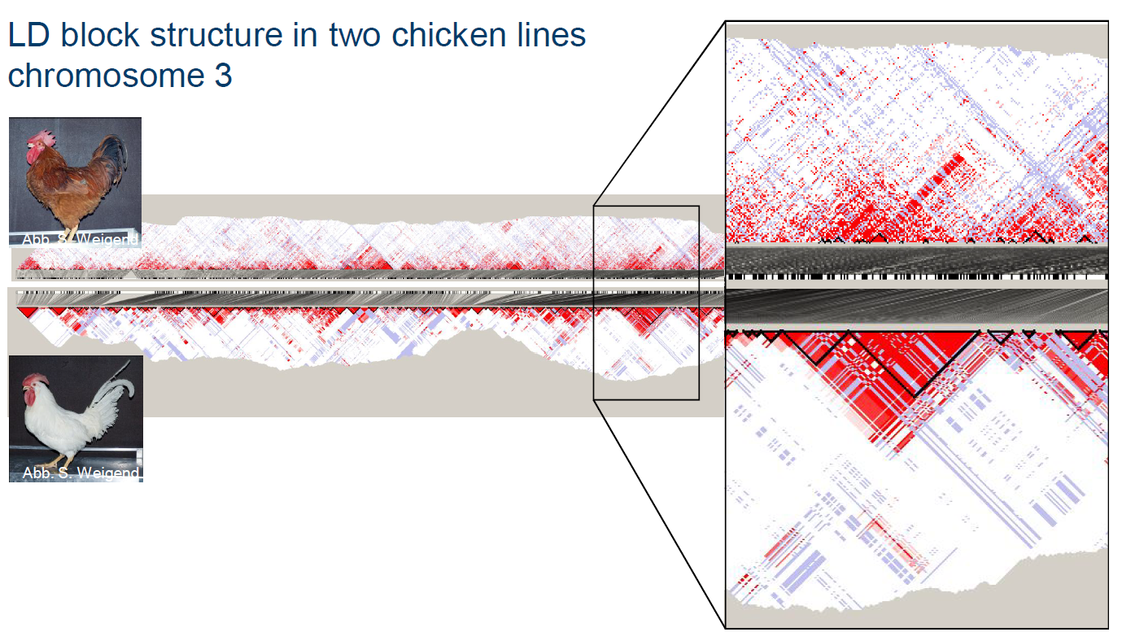
LD block structure

Slide 14
Significance
Gene of interest?
Chromosome

Slide 15
Significance
Gene of interest?
Region of interest!
Chromosome

Slide 16
Why is the LD important?
LD defines how far we are “allowed” to look from the detected markers, when looking for causality on the genome (genes or quantitative trait loci, QTL)
The LD shows the association strength between SNP and gene / QTL
Degree of LD tested in different species
Arbitrary values for “useful” LD - could be translated to physical distance (genome window in Mb)

Slide 17
Applications of LD
Evolutionary biology – reflections on past events and insight into evolutionary history
Genetic diversity – computation of effective population size
To detect selection – genetic hitch-hiking
Genome wide association studies – search for causal genes
Genomic selection – determine how many SNPs we need for a proper analysis

Slide 18
LD and genetic distance
Qanbari et al. (2010) Animal genetics, 41:346-356.

Slide 19
LD and genetic distance
Pérez O’Brien et al. (2014)
Genetics Selection Evolution, 46:19

Slide 20
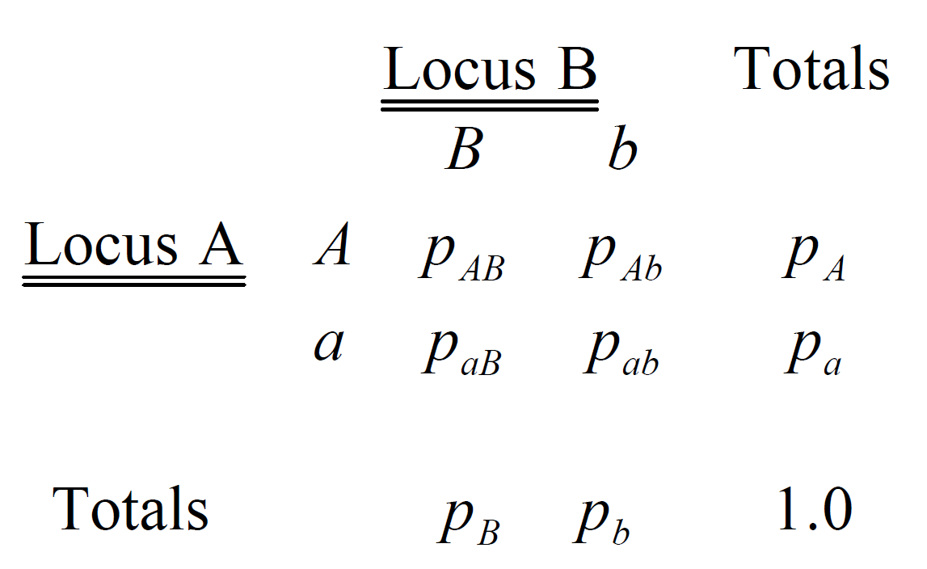
Linkage
The nonrandom association of alleles at different loci

Slide 21
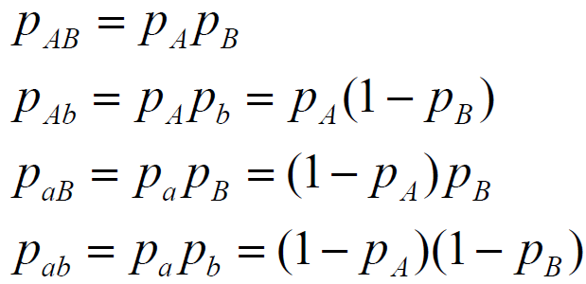
Linkage equilibrium

Slide 22
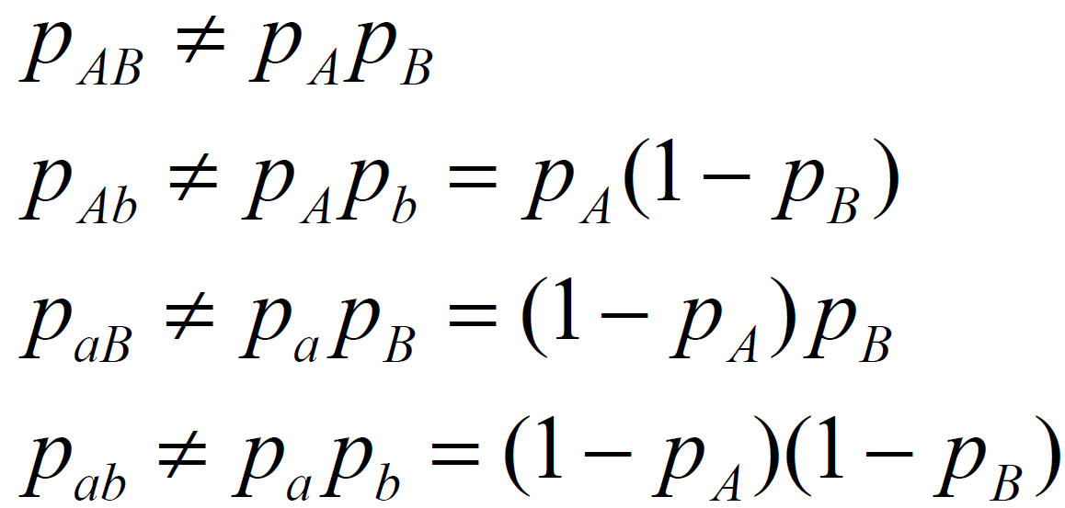
Linkage disequilibrium (LD)

Slide 23
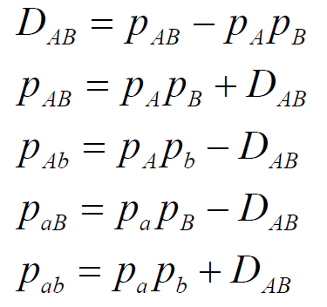
Disequilibrium coefficient

Slide 24
Disequilibrium coefficient
Hard to interpret
Sign is arbitrary
A common convention is to set A, B to be the common allele and a, b to be the rare allele

Slide 25
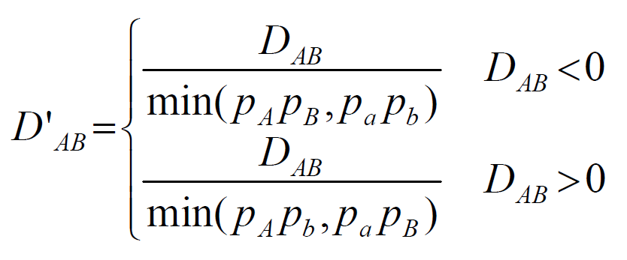
D’ – A scaled version of D
Range between -1 and +1
Extreme values imply at least one of haplotypes was not observed

Slide 26
D’ – A scaled version of D
Advantages:
D’ = 1 or D’ = -1 means that two SNPs are not separated by recombination (complete LD)
If allele frequencies are similar, high D’ means the markers are good surrogates for each other
Disadvantages:
D’ estimates inflated in small samples
D’ estimates inflated when one allele is rare

Slide 27
Is there more intuitive way?
Yes.
LD could be interpreted as a correlation
i.e. mutual relationship between alleles in two loci

Slide 28
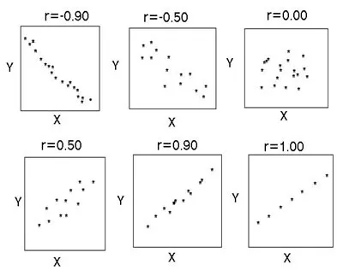
Correlation
Standardized abbreviation: r
Range: from -1 to 1

Slide 29
The LD as a correlation - r²
Squared correlation between markers
Range between 0 and 1
r² = 1 implies the markers provide exactly the same information
Measures loss in efficiency when marker A is replaced with marker B

Slide 30
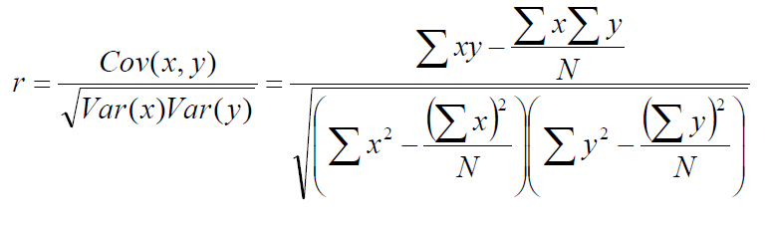
The LD as a correlation - r²
What is the correlation r between the realizations of the random variable at the two loci?

Slide 31
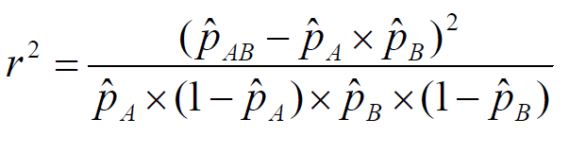
The LD as a correlation - r²
Derivation details left out

Slide 32
The LD in genomics
One of the basic concepts that is considered in almost all applications of genomic data
More details and pen-and-paper exercises on the channel
Computations for dense marker data with appropriate software tools – examples on the channel

Slide 33
Summary
LD characterizes the degree of relationship between nearby loci
Helps to interpret many other types of genomic analyses
The Disequilibrium coefficient (D or D’) is a metric used to quantify LD
Has disadvantages, though
The squared correlation is the usual way to assess LD
Range between 0 (no LD) to 1 (complete LD)
For practical purposes the computations done with computers (as everything else in genomics)

