Slide 1
Introduction to genomics
Gábor Mészáros

Slide 2
Part 6: Genome wide association studies (GWAS)

Slide 3

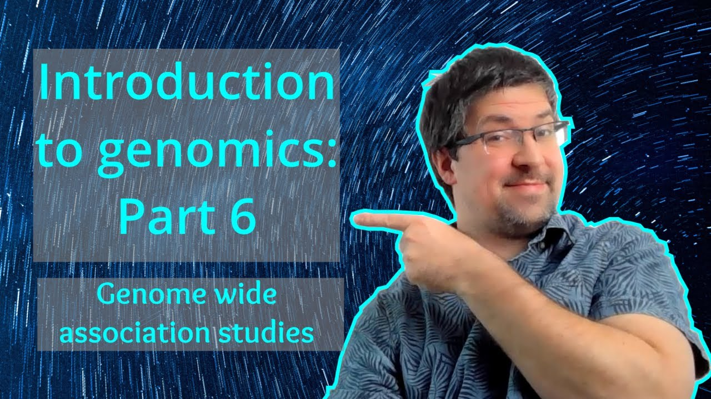
Watch on YouTube (Genomics Boot Camp)
Direct link to this lecture:
https://youtu.be/7iarFfxYxQc
Full playlist: https://youtube.com/playlist?list=PLdf-U83sN48MXs3EegQv2ripoBhLw6q6C

Slide 4
Partial summary from previous lectures
SNP markers are widely used (and currently the most important) marker types, genotyped with high throughput machines
LD characterizes the degree of relationship between nearby loci
Has major influence or helps to interpret different types of genomic analyses
Common way to express LD is r² with a range between 0 (no LD) to 1 (complete LD)

Slide 5
The status of genome research
Genomes are a big puzzle game
Search for a needle in a haystack
Search for a needle in a stack of needles
The playground is open…

Slide 6
Why is the LD important?
SNPs are mutations that we can see, but in most cases we are not interested in them
Regions or genes influencing a productive, reproductive or functional trait are those we are interested in, but can not see
Some SNPs might be associated with QTLs
The LD shows the association strength

Slide 7
LD in association studies
Until recently, studies limited to candidate genes or regions
A hit-and-miss approach…
Because SNP chip assay costs are decreasing genome-wide association studies are now possible

Slide 8
Genome wide association studies
In GWAS we search regions that influence the phenotype of interest
SNPs or sequences
Based on the location of associated markers we can “hunt for genes”
In an ideal scenario sequencing is involved

Slide 9
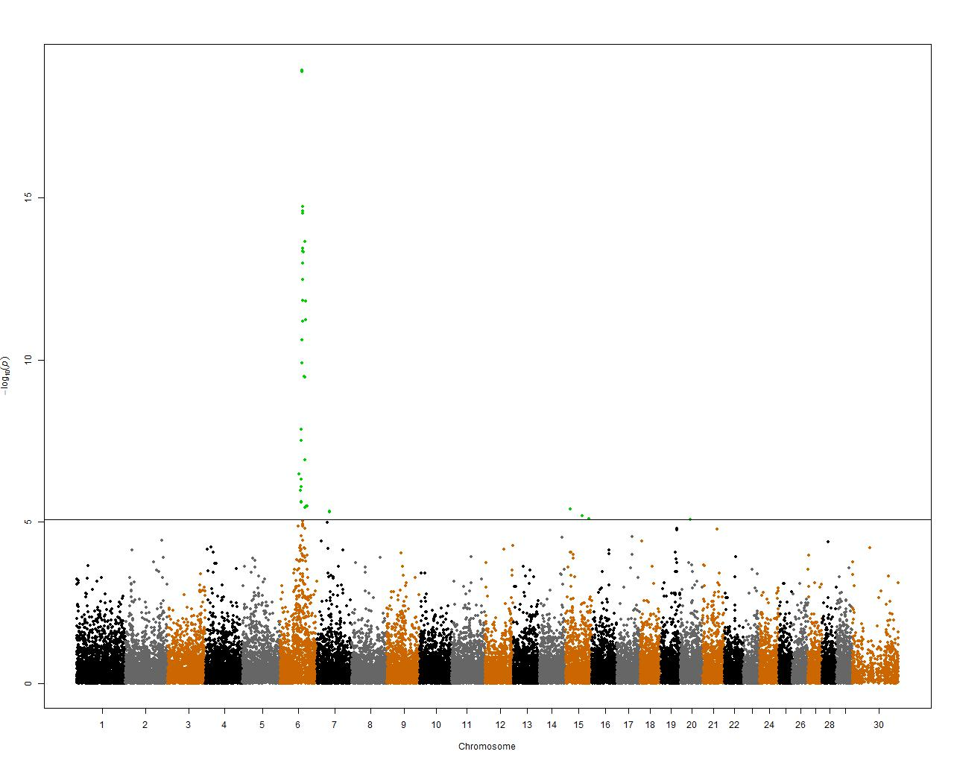

Slide 10
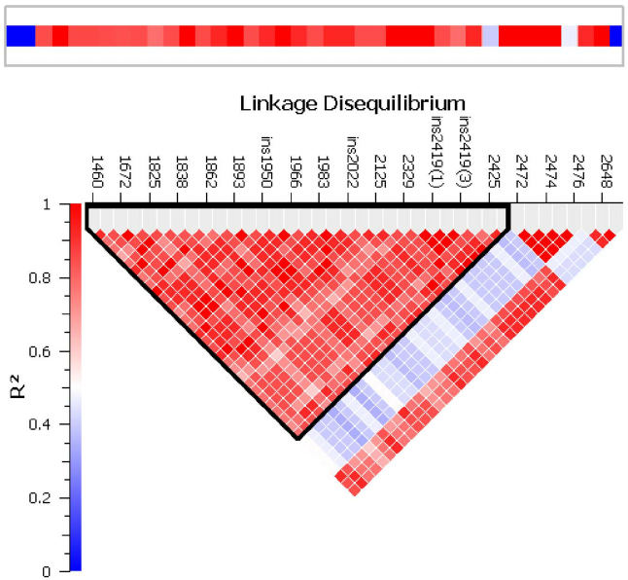
GWAS result in a haplotype

Slide 12
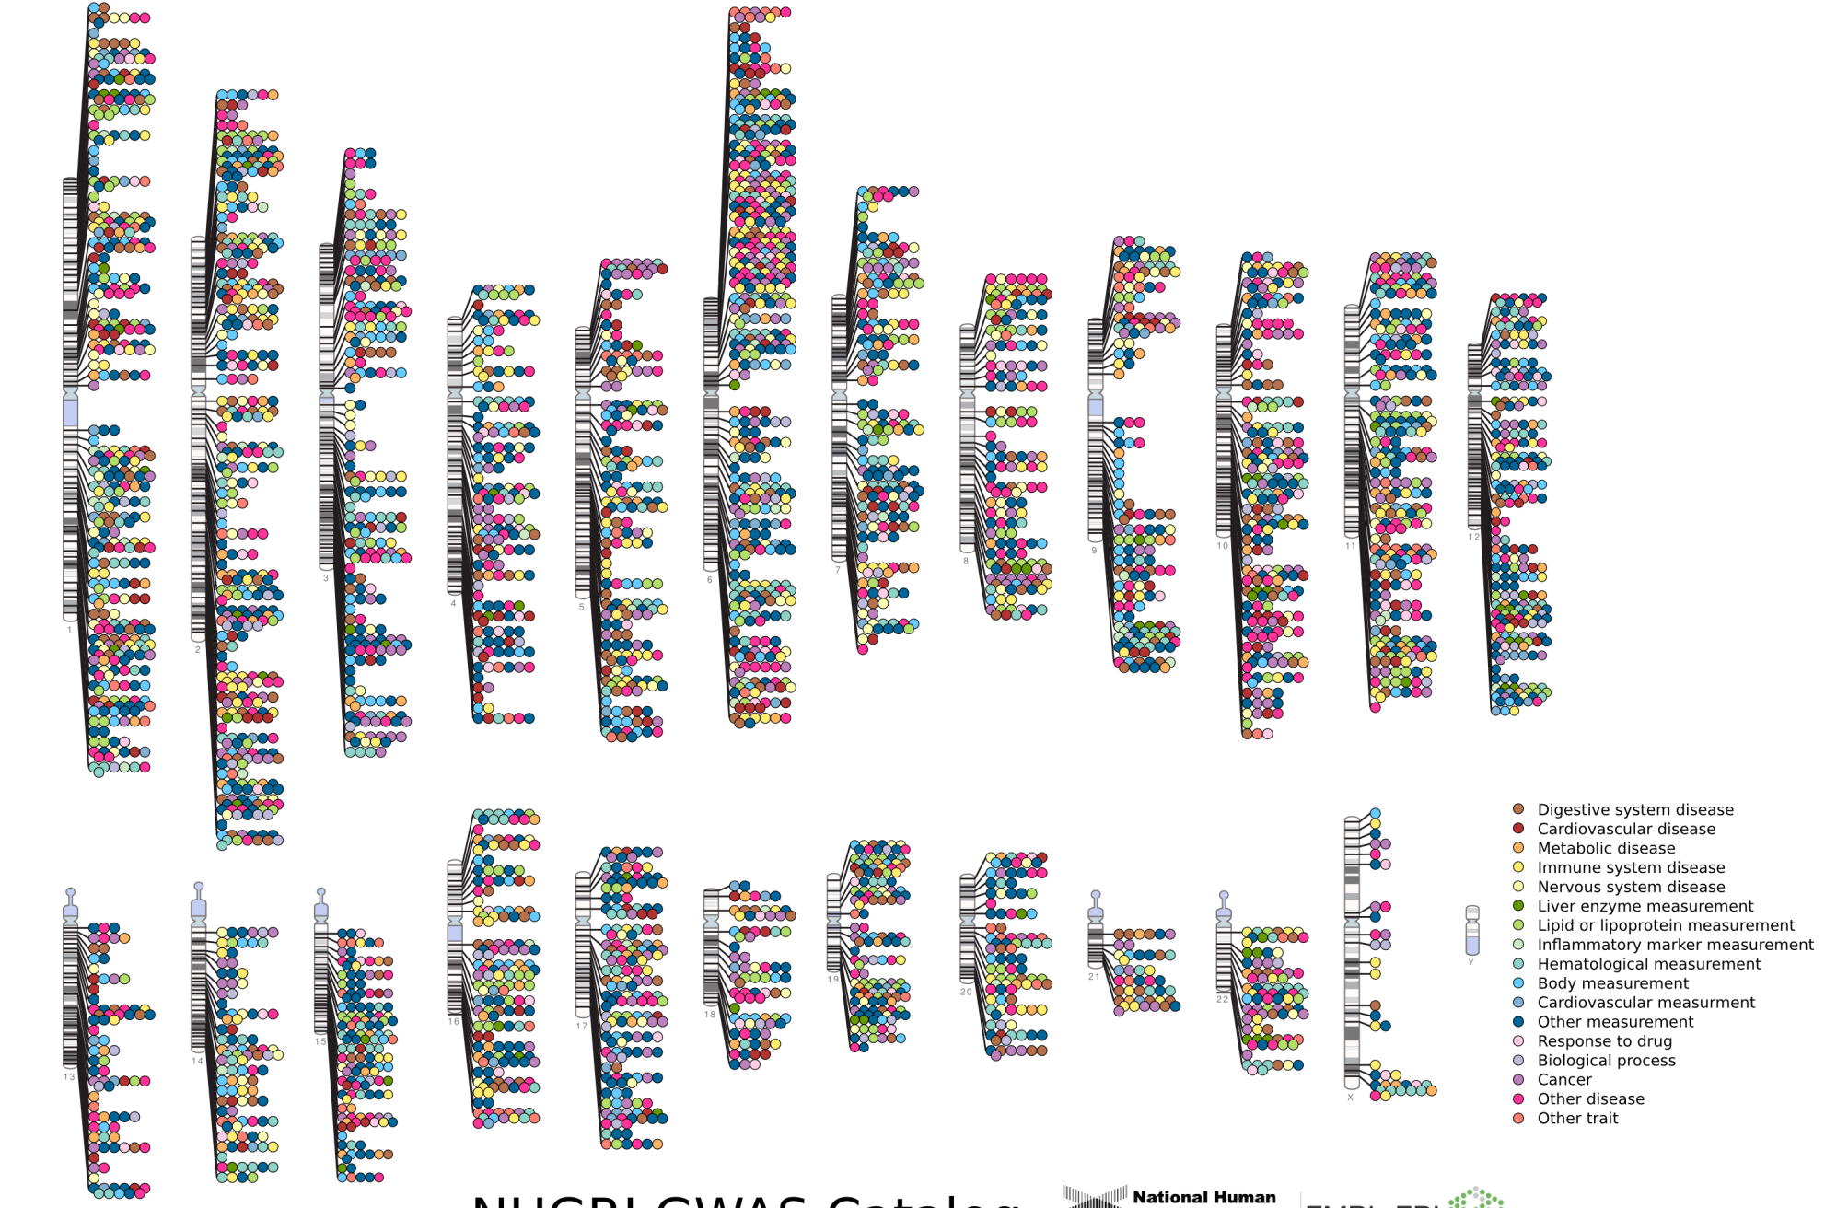

Published Genome-Wide Associations through 12/2013
Published GWA at p≤5X10⁻⁸ for 17 trait categories
NHGRI GWA Catalog
www.genome.gov/GWAStudies
www.ebi.ac.uk/fgpt/gwas/

Slide 13
Genome wide association studies
Estimate of SNP effects and significance
Many possibilities
Simple linear models ( )
Penalized multiple regressions – Lasso, Elastic net
Bayesian methods

Slide 14
Multiple testing adjustments
The null hypothesis is that a given SNP has no effect on a trait of interest, and the alternative hypothesis is that there is an association
The null is rejected if the p value is lower than a specified significance level, such as 5% (p = 0.05)

Slide 15
p = 0.05

Slide 16
Possible sources of error
False positive:
A false positive (type I error) occurs when a test statistic suggests that the null hypothesis should be rejected even though it is true
The SNP appears as significant, but it in reality it is not significant

Slide 17
Possible sources of error
False negative:
The false negative (type II error) that occurs when a test statistic suggests that the null hypothesis should not be rejected (i.e. tentatively accepting the null) even though its alternative is true
The SNP appears as not significant, but it in reality it is significant

Slide 18
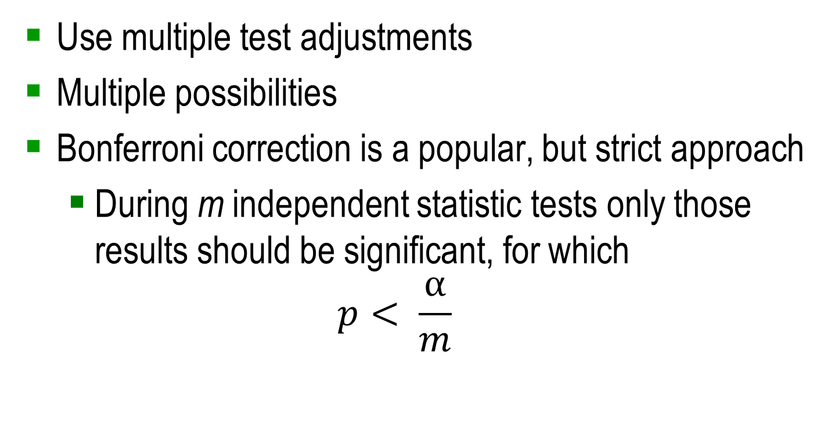
How to avoid false discovery
Use multiple test adjustments
Multiple possibilities
Bonferroni correction is a popular, but strict approach
During m independent statistic tests only those results should be significant, for which
$$p< \frac{α}{m}$$

Slide 19
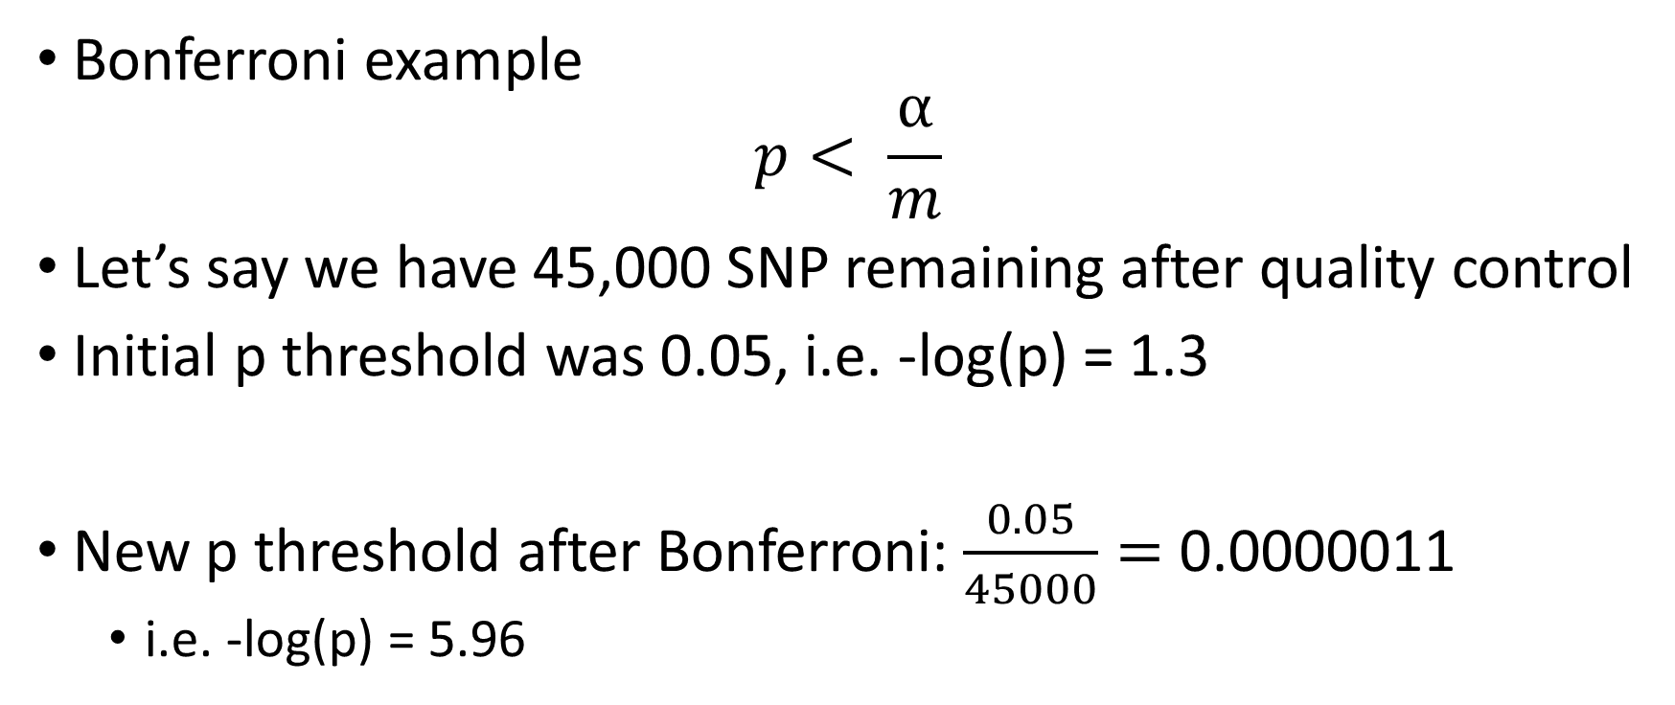
How to avoid false discovery
Bonferroni example
$$p< \frac{α}{m}$$
Let’s say we have 45,000 SNP remaining after quality control
Initial p threshold was 0.05, i.e. -log(p) = 1.3
New p threshold after Bonferroni: $\frac{0.05}{45000}=$ 0.0000011
i.e. -log(p) = 5.96

Slide 20
p = 0.05

Slide 21
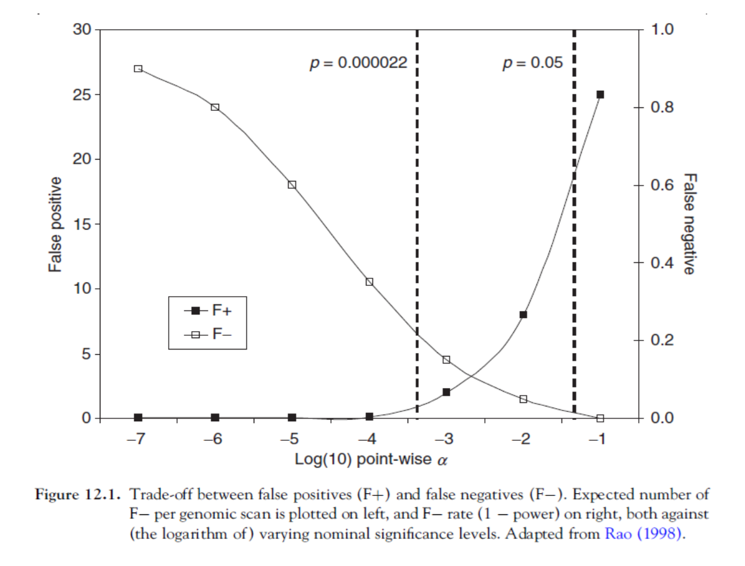
Multiple testing adjustments

Slide 22
GWAS and the population structure
The challenge in GWAS is to show differences in genome caused by the phenotype of interest
Individuals in the genotype pool could be different for many reasons (family structure, differences in breed)
Example: Ancestral origin and body weight in mice

Slide 23
GWAS and the population structure

Slide 26
Summary
Genome wide associations connect genotype and phenotype
Which regions of the genome are responsible for specific phenotypes?
Works well for common variants, less well for rare variants
SNPs indicate genomic region, causal genes could be found
False positive and false negative signals are an issue in GWAS studies
Tests could be implemented to accept true positive results, e.g. Bonferroni correction
Population structure can influence results
Corrections could be implemented to focus the attention on true signals

