Slide 1
Introduction to genomics
Gábor Mészáros

Slide 2
Part 7: Genomic admixture

Slide 3


Watch on YouTube (Genomics Boot Camp)
Direct link to this lecture:
https://youtu.be/xptm1ik_FSo
Full playlist: https://youtube.com/playlist?list=PLdf-U83sN48MXs3EegQv2ripoBhLw6q6C

Slide 4
Partial summary from previous lectures
SNP markers can be used to analyze characteristics of the populations or an individual, without the necessity of traditional written pedigree data
The inheritance from parent to offspring on the basis of chromosomes after recombination events
LD characterizes the degree of relationship within these chromosome segments - between nearby loci and SNP markers

Slide 5
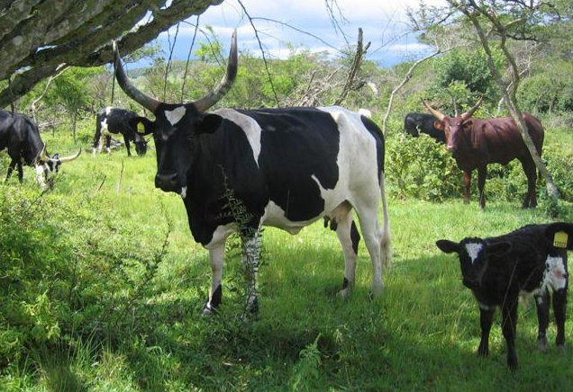
Admixture
Genetic admixture - when individuals from two or more previously separated populations begin interbreeding

Slide 6
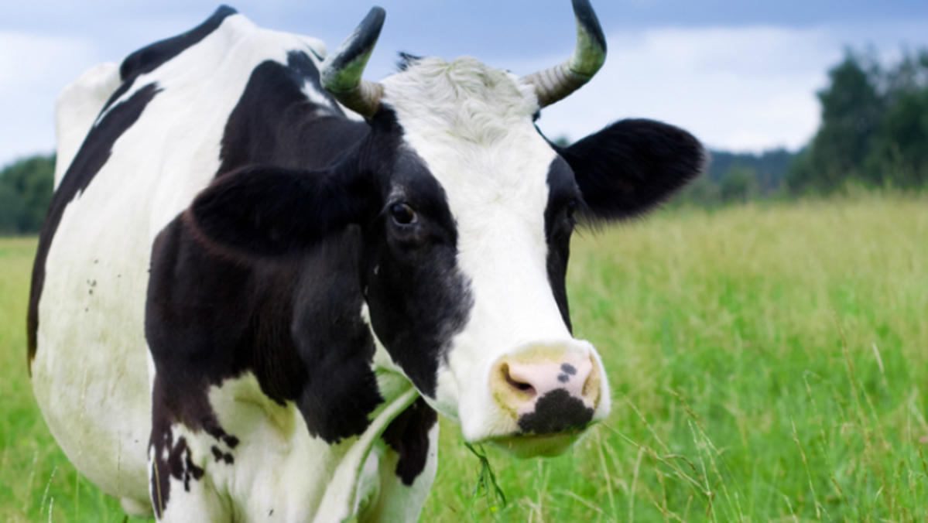

Slide 7
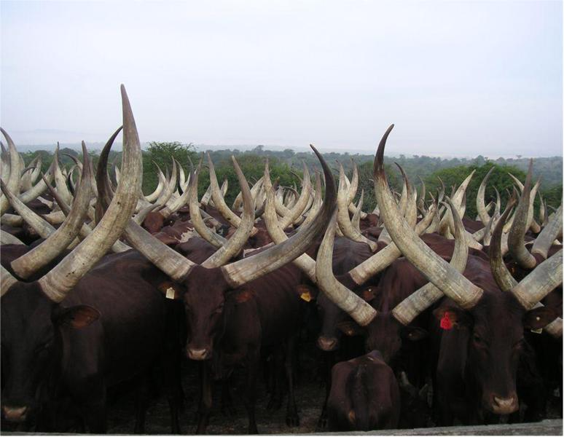

Slide 8
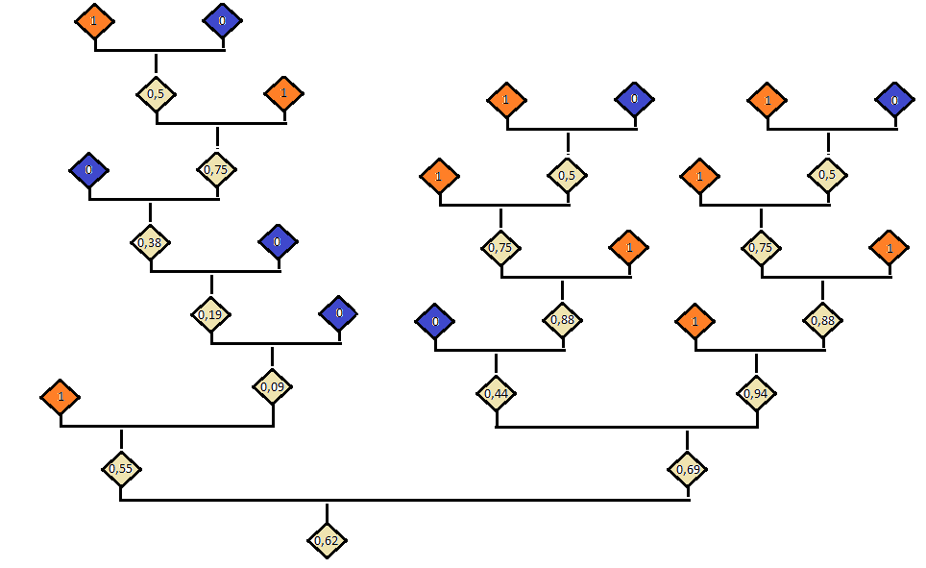

Slide 9
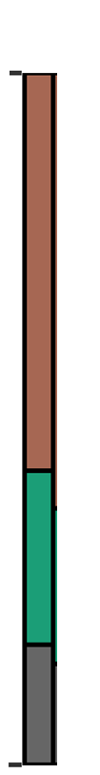
The genomics point of view
Population 1
Population 2
Population 3

Slide 10
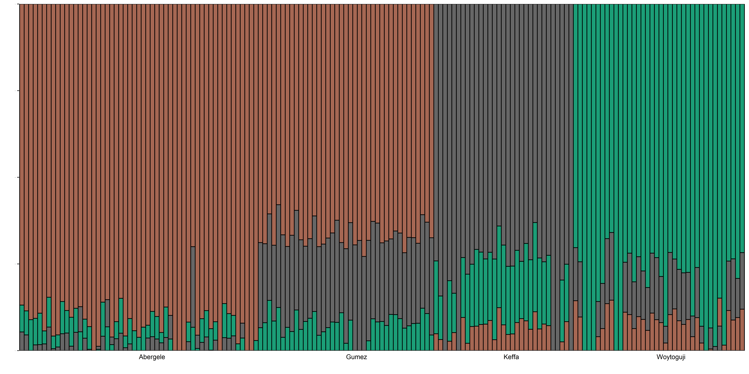

Slide 11
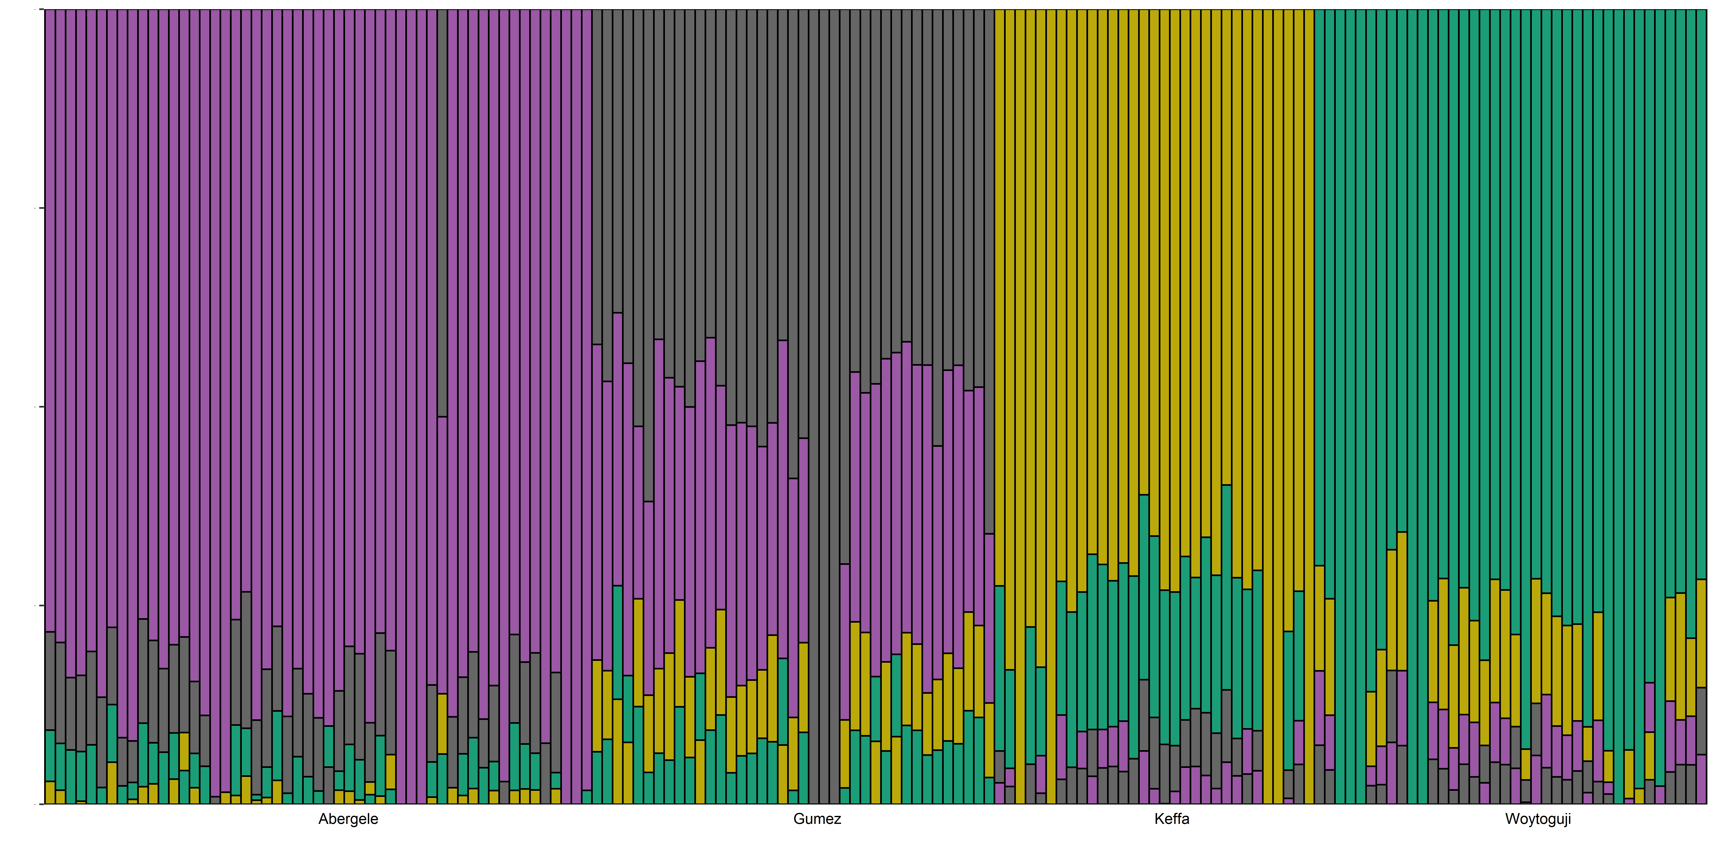

Slide 12
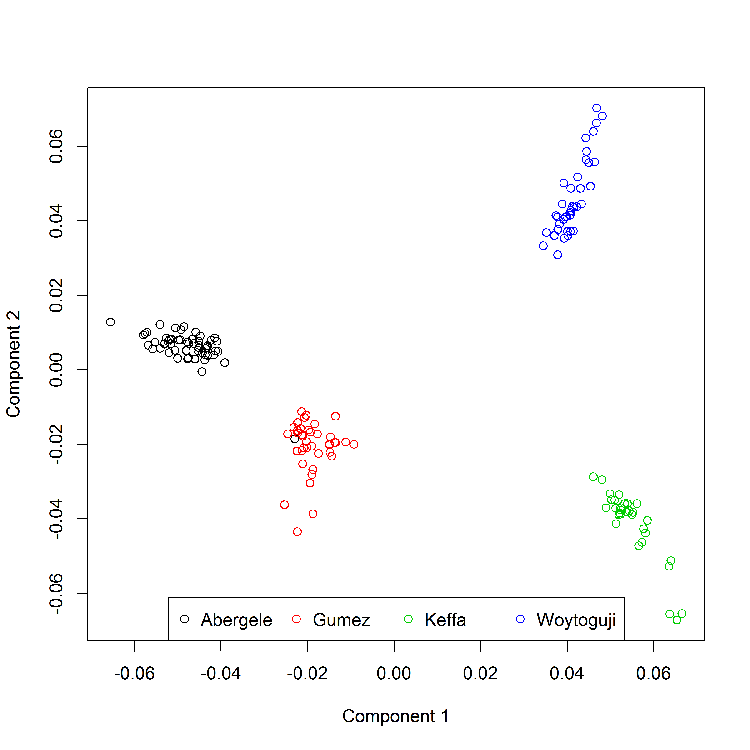
Sheep populations from Ethiopia

Slide 13
Admixture
Admixture results in the introduction of new genetic lineages into a population
Genetic admixture
Natural genetic admixture occurs when a geographic barrier separating populations disappears
May be also antropogenic

Slide 14
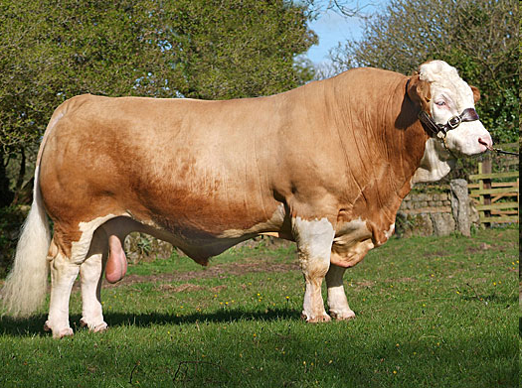
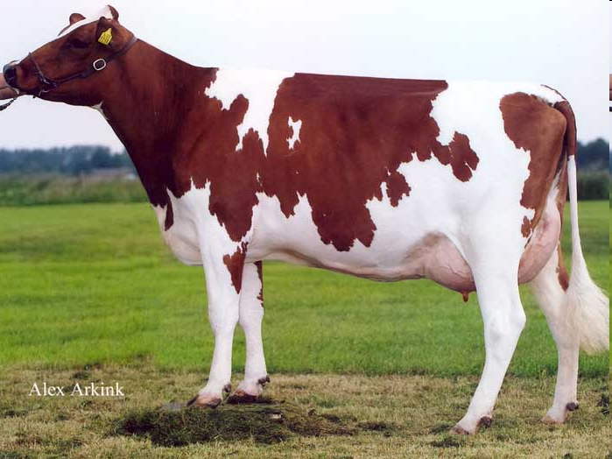
Another example
Swiss Fleckvieh - established 40 years ago, crossing Simmental x Red Holstein Friesian
Wide range of crosses

Slide 15
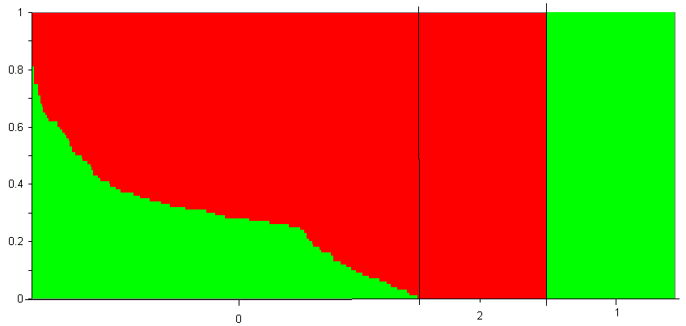
Pedigree results

Slide 16
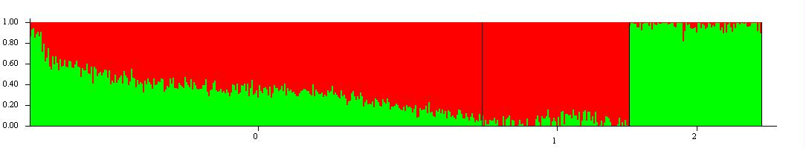
Admixture based on SNP data

Slide 17
Correlations with pedigree admixture
Number of SNP | STRUCTURE | PLSR | BayesB | LASSO
40492 | 0.972ª | 0.976ª | 0.974 ª | 0.934^{b}
20246 | 0.971 ª | 0.968 ª | 0.972 ª | 0.907^{b}
8098 | 0.969 ª | 0.968 ª | 0.966 ª | 0.907 ^{b}
4049 | 0.969 ª | 0.974 ª | 0.961 ª | 0.920 ^{b}
2024 | 0.950 ª | 0.966 ª | 0.890^{b} | 0.892 ^{b}
404 | 0.929 ª | 0.955 ^{b} | 0.860^{c} | 0.847 ^{c}

Slide 18
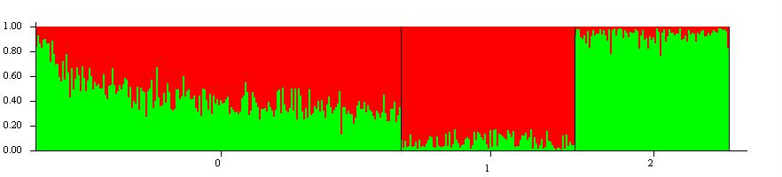
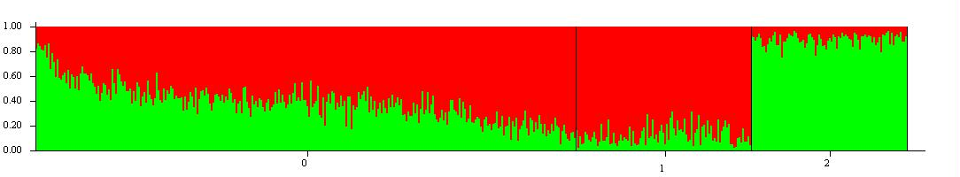
Admixture based on 1% of the SNPs

Slide 19
Ancestry informative SNP
SNPs with largely different allele frequencies in pure breeds
Use Fixation index F_{ST} from pure breed data as a criterion
Proportion of genetic diversity due to allele frequency differences among populations

Slide 20
Ancestry informative SNP
Xu & Jin, 2008

Slide 21
Correlations with pedigree admixture
Number of SNP | STRUCTURE | PLSR | BayesB | LASSO
5635 (F_{ST} > 0.25) | 0.971ª | 0.976 ª | 0.966 ª | 0.934^{b}
3904 (F_{ST} > 0.30) | 0.971 ª | 0.974 ª | 0.965 ª | 0.934 ^{b}
2620 (F_{ST} > 0.35) | 0.969 ª | 0.974 ª | 0.952 ^{b} | 0.934^{b}
1677 (F_{ST} > 0.40) | 0.968ª | 0.973 ª | 0.949^{b} | 0.934^{b}
1028 (F_{ST} > 0.45) | 0.966 ª | 0.968 ª | 0.967ª | 0.934 ^{b}
594 (F_{ST} > 0.50) | 0.961 ª | 0.957 ª | 0.955^{ab} | 0.934 ^{b}
96 (F_{ST} > 0.623) | 0.924 | 0.916 | 0.926 | 0.918
48 (F_{ST} > 0.651) | 0.907 | 0.903 | 0.906 | 0.903

Slide 22
Smaller sets of pure-breed animals
Relevant considering genotyping cost
Issues of selecting subsets that are not representative
Go down from 100:100 animals per pure-breed to
50:50
20:20
10:10

Slide 23
Correlations with pedigree admixture
Pure-breed animals | STRUCTURE | PLSR
100 | 0.971 | 0.974
50 | 0.971 | 0.973
20 | 0.971 | 0.971
10 | 0.970 | 0.970

Slide 24
Summary
It is possible to find out the proportion of pure breed genotypes in crossbred/admixed animals
More than two breed groups could be identified
Even a low number of SNPs selected based on Fst provide reasonably accurate results (Ancestry informative SNPs)
One does not need many purebred reference animals to achieve reasonable accurate results

