Slide 1
Introduction to genomics
Gábor Mészáros

Slide 2
Part 8: Selection signatures

Slide 3

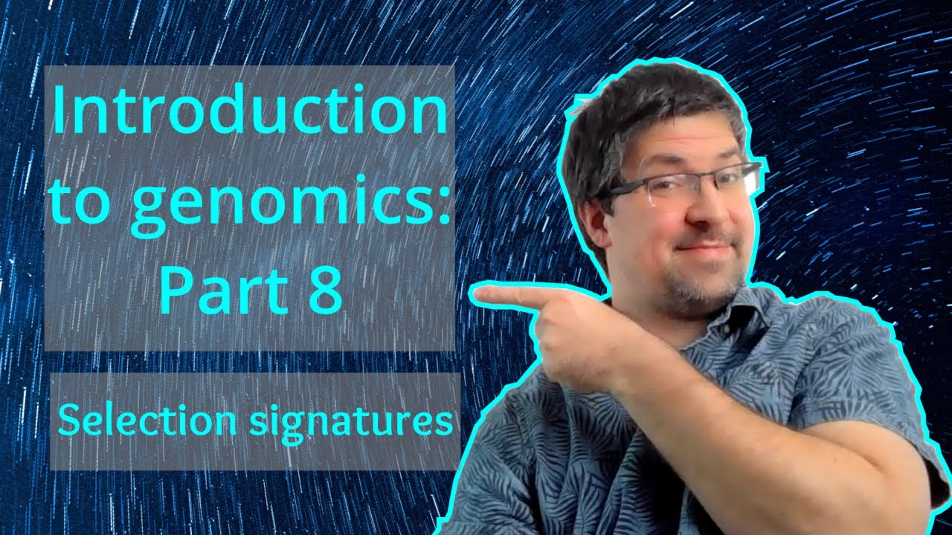
Watch on YouTube (Genomics Boot Camp)
Direct link to this lecture:
https://youtu.be/A8NsAKunXrI
Full playlist: https://youtube.com/playlist?list=PLdf-U83sN48MXs3EegQv2ripoBhLw6q6C

Slide 4
Partial summary from previous lectures
SNP markers still a thing…
The inheritance from parent to offspring on the basis of chromosomes after recombination events
LD characterizes the degree of relationship within these chromosome segments - between nearby loci and SNP markers
With GWAS we can identify which parts of the genome influence specific phenotypes

Slide 5
Signatures of selection
“…defined as regions of the genome that harbor functionally important sequence variants and therefore are or have been under either natural or artificial selection, leaving special patterns of DNA behind.”
(Qanbari S., Simianer H. (2014) LivestockScience166:133–143.)

Slide 6
Signatures of selection
Natural and/or artificial selection in all populations
The influence of selection is detectable on genomic level
Patterns of nucleotide variation on the genome

Slide 7
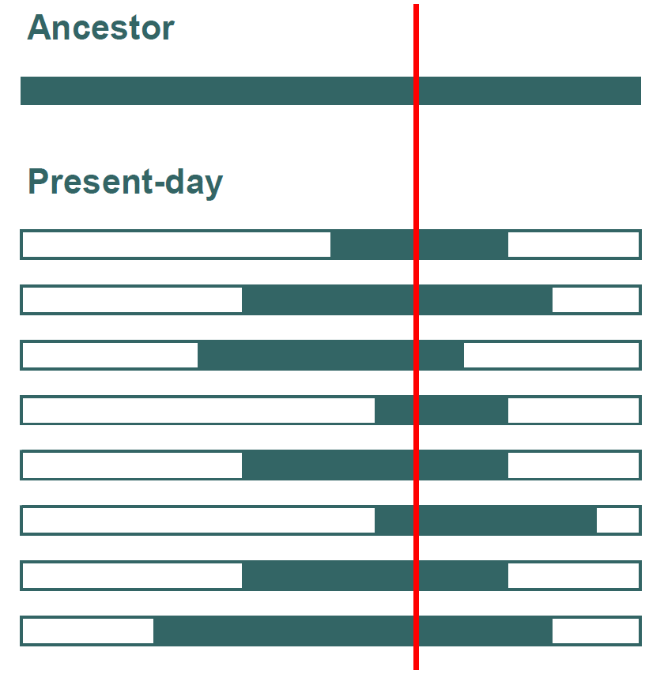
Signatures of selection
Important gene
Combinations of alleles at very close markers reflect ancestral haplotypes
Extent and conservation of haplotypes depends on
Recombination rate
Mutation rate
Population size
Natural selection

Slide 8
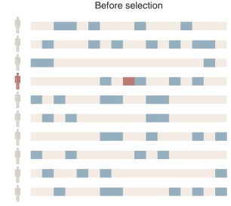
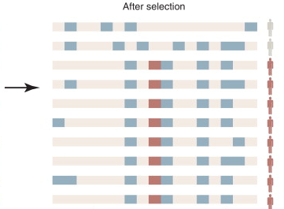

The genetic hitchhiking effect

Slide 9
Selection signature fixation possibilities
A). Hard/ classic selective sweep
B) Soft selective sweep due to
standing genetic variation
C) Multiple origin soft sweep
(due to recurrent
independent mutations)

Slide 11
Selection signatures
Works with microsatellites, SNPs and whole genome sequence data
Genetic map should be available
Unlike GWAS, selection signatures can detect fixed alleles, where selection was acting in the past
Phenotypes not necessary, but sometimes useful
Cumulative effect of the long term selection can produce detectable signals for fitness traits

Slide 12
Selection signatures
Specialized detection methods
Within and across populations
Individual and pooled DNA samples
Interpretation similar to GWAS

Slide 13
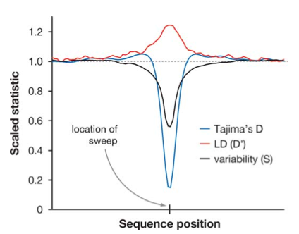
Selection signatures

Slide 14
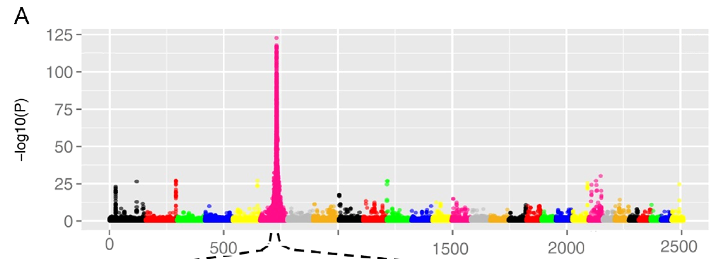
Selection signatures

Slide 15
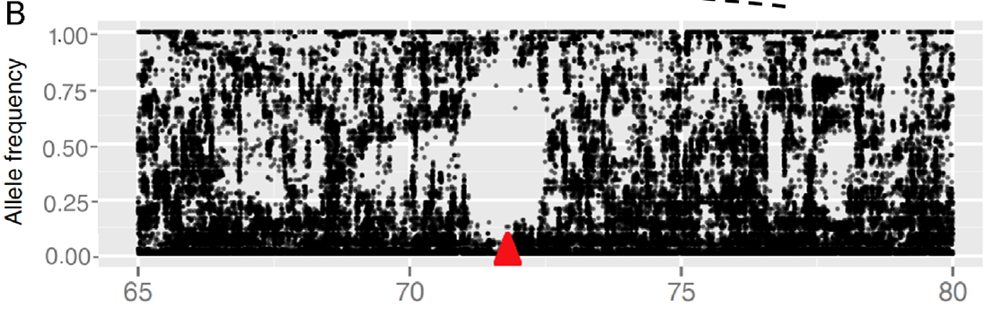
Selection signatures

Slide 16
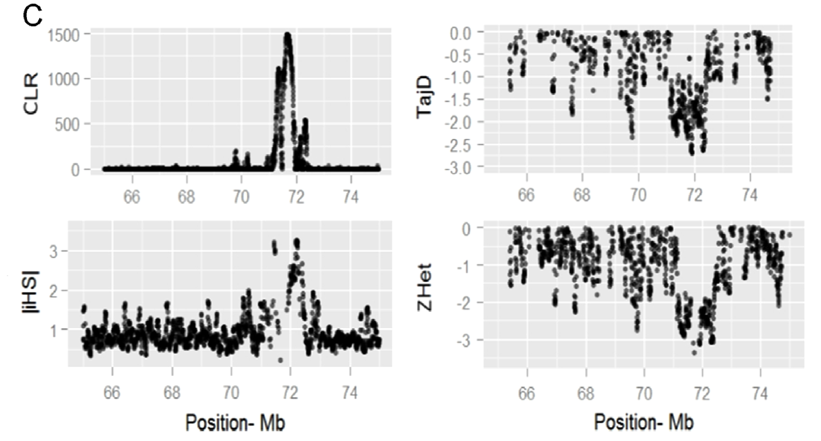
Selection signatures

Slide 17
Selections signatures based on runs of homozygosity

Slide 18
Selection signatures across populations

Slide 19
Summary
Selection leaves detectable signals on the genome
These signals usually center around beneficial gene(s), which drag along the surrounding regions
Due to LD
So called genetic hitchhiking effect
Various ways to detect selection signatures, mostly looking for homozygous regions throughout the population

