Slide 1
Introduction to genomics
Gábor Mészáros

Slide 2
Part 9: Genomic inbreeding – Runs of homozygosity

Slide 3

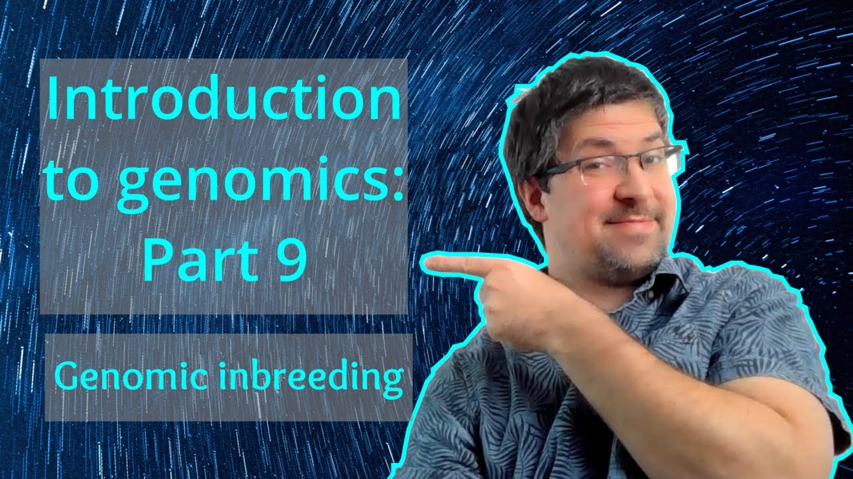
Watch on YouTube (Genomics Boot Camp)
Direct link to this lecture:
https://youtu.be/QUCtDwOwjMQ
Full playlist: https://youtube.com/playlist?list=PLdf-U83sN48MXs3EegQv2ripoBhLw6q6C

Slide 4
Partial summary from previous lectures
Single nucleotide polymorphism (SNP) markers throughout the genome
SNPs are bi-allelic
Genotypes: AA, AB, and BB
The inheritance from parent to offspring on the basis of chromosomes after recombination events

Slide 5
Inbreeding
Consequence of mating of related individuals
Related through common ancestry
Could be one or more common ancestors
Could be assessed via conventional pedigree records or genomic marker data
Inbreeding is a huge topic in genetic diversity studies
Only the genomic aspect is discussed here

Slide 6
Inbreeding
Inbreeding is the probability that alleles within an individual are identical by descent
Identity by descent (IBD)
Two or more alleles are IBD if they are identical copies of the same ancestral allele in a base population. IBD can be estimated for alleles at single loci in a diploid individual or between individuals.
Identity by state (IBS)
Refers to two or more alleles that ‘look’ the same. For example, if two individuals both carry a ‘T’ allele at a specific locus.
Powell et al. (2010) Nat Rev Genet, 11(11):800-5.

Slide 7
IBD vs IBS
!!!
Identical by descent (IBD)
Identical by state (IBS)
Powell et al. (2010) Nat Rev Genet, 11(11):800-5.

Slide 8
Consequences of inbreeding
Reduced genetic diversity
Increase in homozygosity, decline of heterozygosity
Lower possibilities of future adaptation
Possibility for some inherited disorders to manifest
Recessive alleles causing a disorder become homozygous
Inbreeding depression
Reduction in quantitative traits (production, reproduction, fitness)

Slide 9
Measurement of inbreeding
Inbreeding coefficient F
Values between 0 and 1 (or 0 and 100%)
0 = not inbred
1 = fully inbred (with no genetic variation)

Slide 10
Quantifying inbreeding
Pedigree data
Depends on pedigree depth and correctness
Mostly identifies recent inbreeding
Founders are assumed unrelated
Genomic data
Identifies the actual portion of the genome inherited from a common ancestor

Slide 11
Runs of homozygosity
“Runs of homozygosity” or ROH are regions of the genome where the copies inherited from the parents are identical
The two DNA copies are identical because the parents have inherited them from a common ancestor at some point in the past
Potentially tens of thousands to millions of nucleotides in length
We all carry ROH, because going far enough back in time we are all related

Slide 12
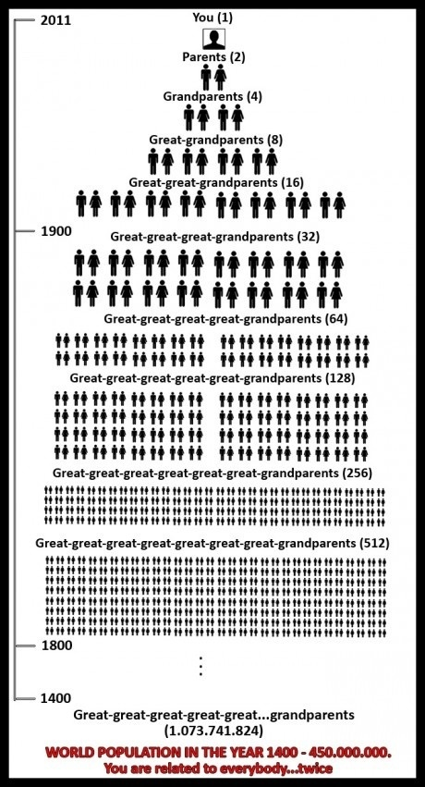

Slide 13
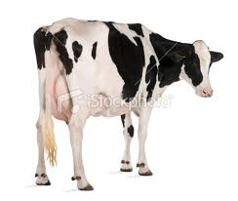
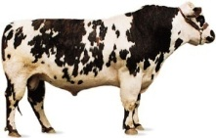
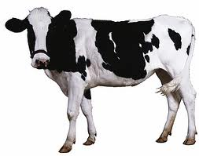
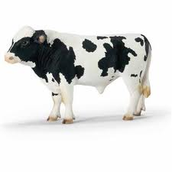
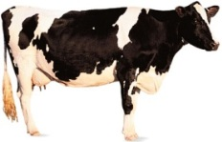
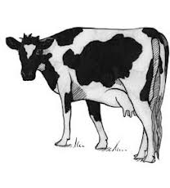
The individual inbreeding coefficient (F_{X}) is defined as:
B₁,B₂
A₁,A₂
C₁,C₂
a) the probability of a randomly sampled locus in the genome to be autozygous (IBD).
1/2
B, A
A, C
Pr(A) = 1/2
Pr(A) = 1/2
b) the proportion of an individual’s genome that is autozygous (IBD).
?, ?
F_{X} = Pr(A₁ ≡ A₁) or Pr(A₂ ≡ A₂)
F_{X} = 0.5³ = 0.125

Slide 14
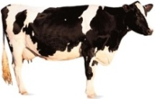
F
M
F
M
F
M
…atagatcgatcg…
…cggtagatcagt…
…atggcgcga|acg…
…ctgtagcttagg…
…agagatcgatct…
…ctatcgctc |agg…
F
M
...cggtagcg|atct…
F
M
…cgg|tagatcagt…
…atagatcg|atcg…
…atg|gcgcgaagg…
F
M
...cgg tagcgatcg…
...cgg gcgcgaagg…
F_{GENOMIC} = 0.25 (0.00 min. -1.00 max.)
F_{PEDIGREE} = 0.125

Slide 15
Runs of Homozygosity (ROH)
1st
Generation
2nd Generation
3rd Generation
Founders
F_{ROH}=0.48
F_{ROH}=0.25

Slide 16
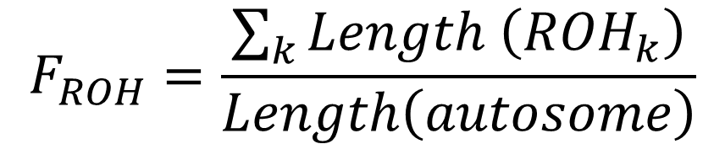
Calculating genomic inbreeding coefficient
F_{ROH} – genomic inbreeding coefficient
k – number of ROH segments for a particular individual
Definition: The genomic inbreeding coefficient is the proportion of the genome covered by ROH segments, i.e. those homozygous due to IBD.
$$F_{ROH}=\frac{\sum_{k}{Length \left({ROH}_{k}\right)}}{Length\left(autosome\right)}$$

Slide 17


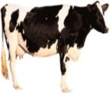

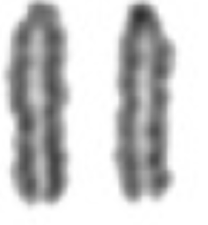
Longer IBD haplotypes → more recent ancestors
Longer homozygous haplotypes → higher IBD probability
IBD
IBD

Slide 18
ROH segment size
Points towards the elapsed time interval (in generations) between the individual and the common ancestor
The longer the detected ROH, the shorter the time interval to the common ancestor
Reason: The recombination did not have the opportunity to cut down the long segments with only a few meioses (i.e. recombination possibilities) between the two individuals
ROH ~ 1Mb: common ancestor ca. 50 generations ago
ROH ~ 16Mb: common ancestor ca. 3 generations ago

Slide 19
Runs of homozygosity islands

Slide 20
Homozygosity mapping
Region of the genome that is homozygous and identical for all cases - for identification of Mendelian or other recessive disorders
Charlier et al. (2008) Nat. Genet. 40, 449–454.

Slide 21
Summary
If the two parents are related through one or more common ancestors, their offspring will be inbred
This inbreeding is expressed and could be quantified via homozygous segments of various lengths – run of homozygosity (ROH)
The longer the ROH segment, the more recent the common ancestor
ROH could be used to compute the inbreeding coefficient, or to find selection signatures via so called ROH islands

