Slide 1
Episignature in patients with developmental disorders
Benjamin Huremagic
Laboratory for Cytogenetics and Genome Research
03/10/24

Slide 2
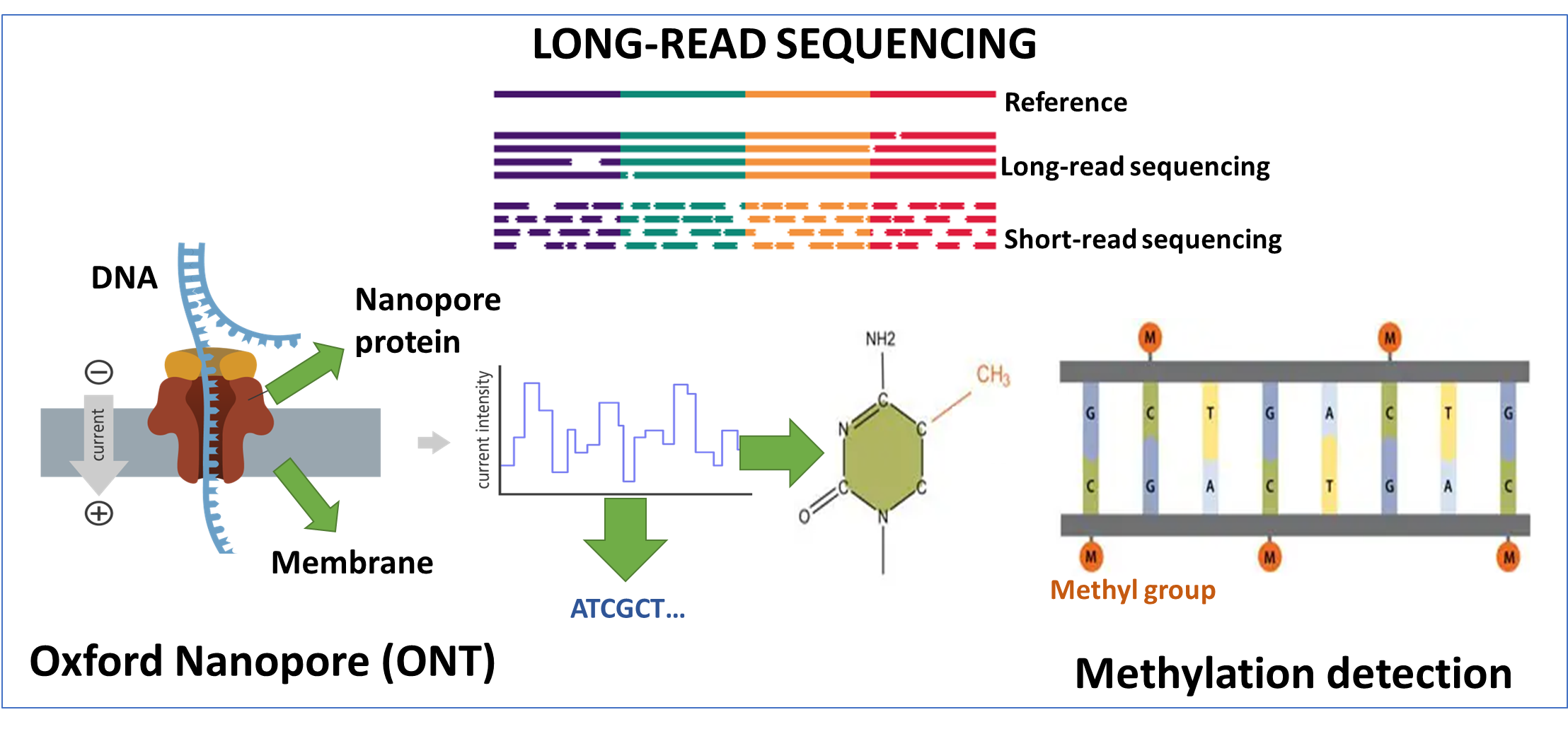

Slide 3





How did it start?
Ok
???Mhm???
???Mhm???
Interesting!!

Slide 4
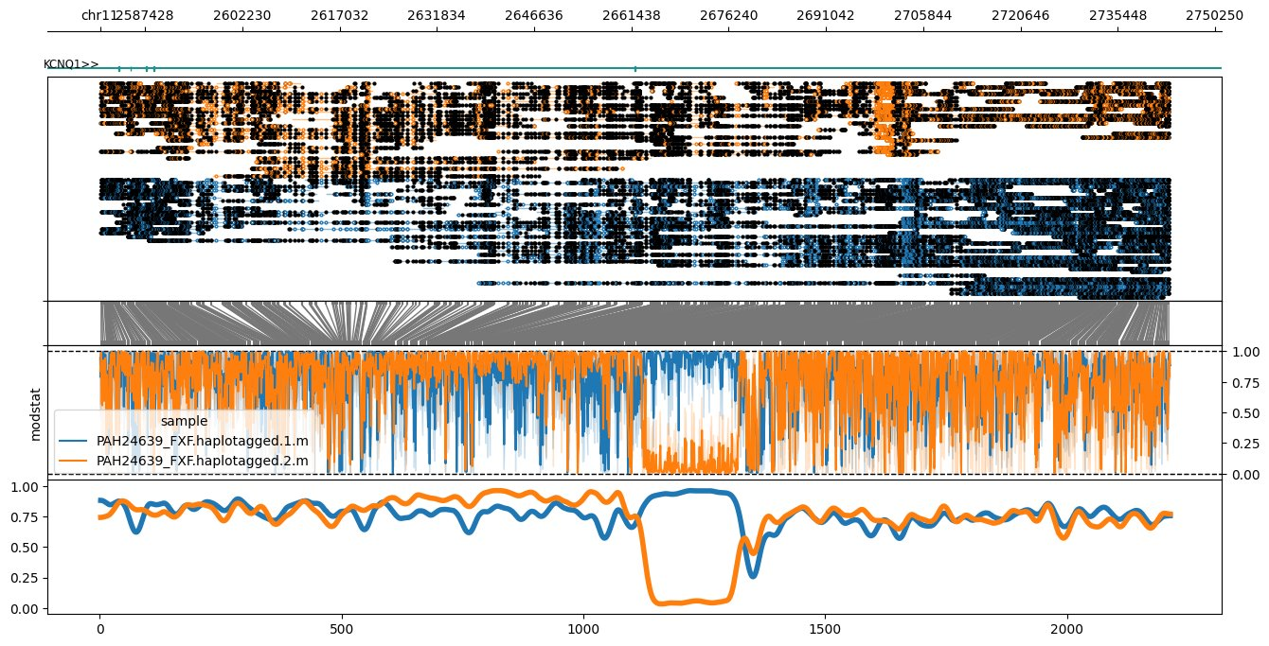
Why is methylation relevant?
Methylation play a critical role in the regulation of gene expression.
It is tissue specific
Varies during the lifespan of an individual
S6591

Slide 5

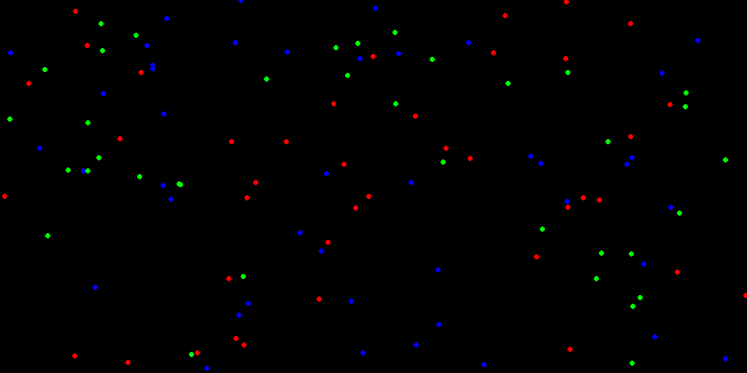
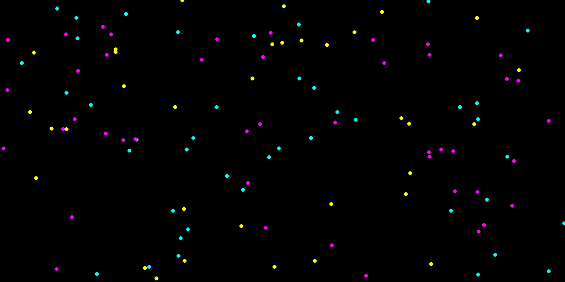
Chromatinopathies
S6591
Chromatinopathies: a class of neurodevelopmental disorders caused by mutations affecting proteins responsible for chromatin remodeling and transcriptional regulation.​
Many of these disorders exhibit unique genome-wide DNA methylation profiles, known as episignatures.
Selected Loci
Methylation values in case of disorder
Methylation values no disorder

Slide 6
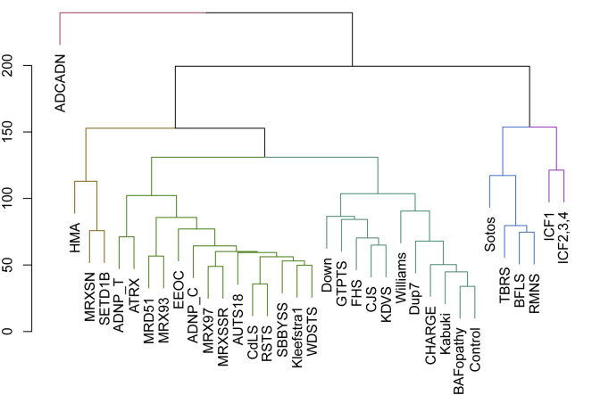
What did we know?​
S6591
Using Illumina Infinium EPIC arrays, several episignatures were identified
Between 80-150 CpGs
Publicly available 36 episignatures (CpGs + methylation values)
E. Aref-Eshghi, J. Kerkhof, V.P. Pedro, et al. Evaluation of DNA methylation episignatures for diagnosis and phenotype correlations in 42 Mendelian neurodevelopmental disorders

Slide 7
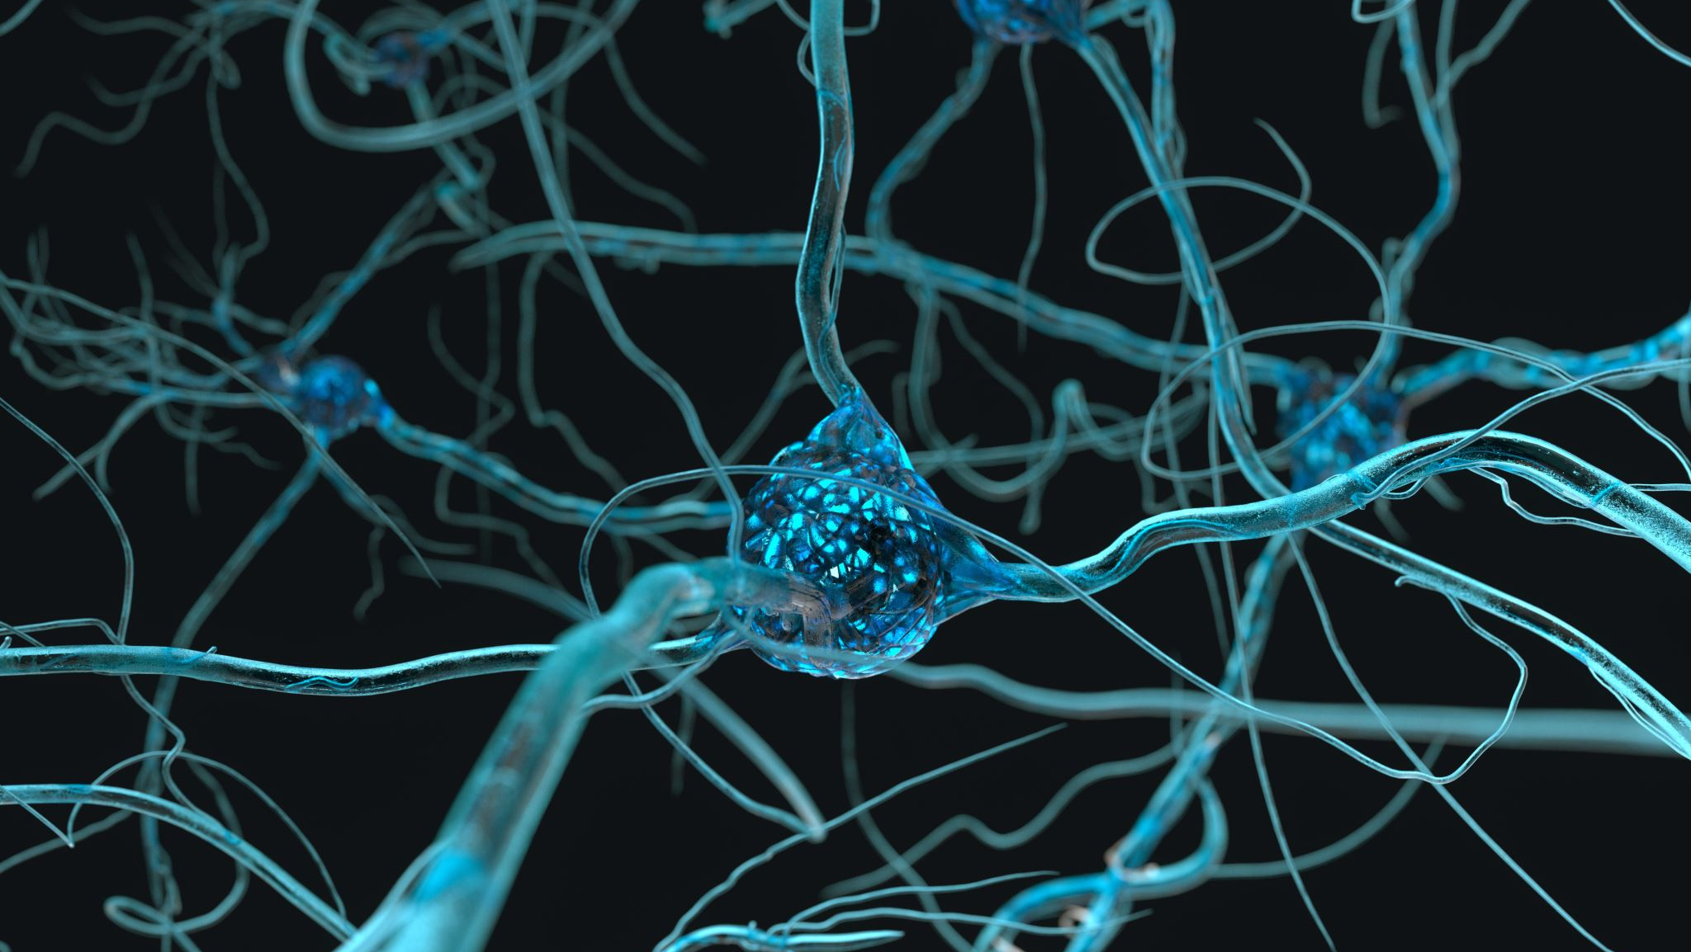
Can we use existing episignatures to diagnose individuals sequenced with ONT?

Slide 8
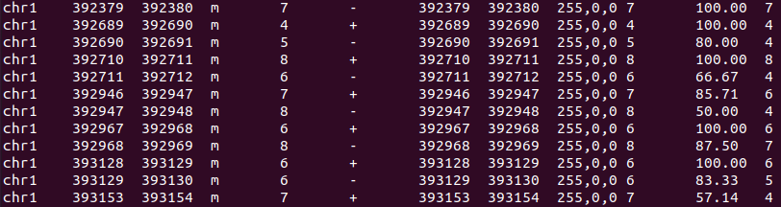
How did we start?
S6591
ONT RAW DATA – pod5s
7 samples, Nanopore WGS - LSK110 kit​
2 Sotos​
2 WS​
2 Kabuki
1 CdLS
Controls (5~10)
Dorado
Modified base calling
Minimap2
BAM files
modkit
BEDMETHYL

Slide 9
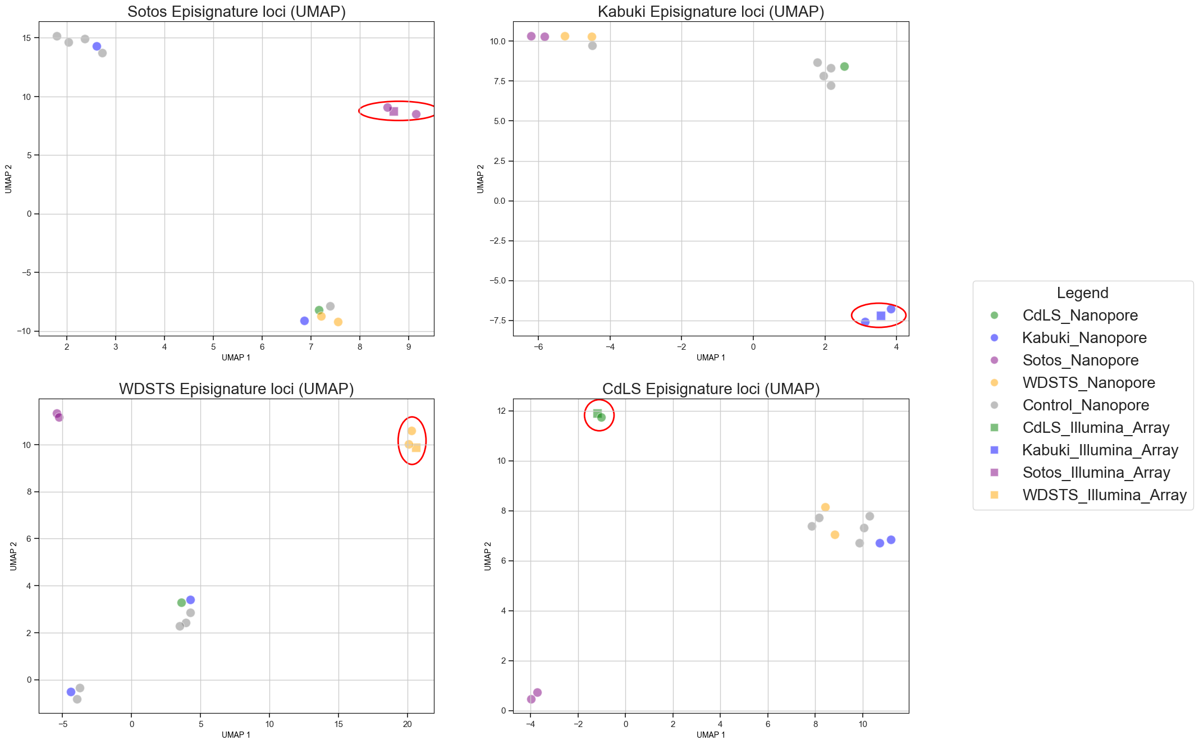
How do Nanopore episignatures compare the Illumina array-based reference?

Slide 10
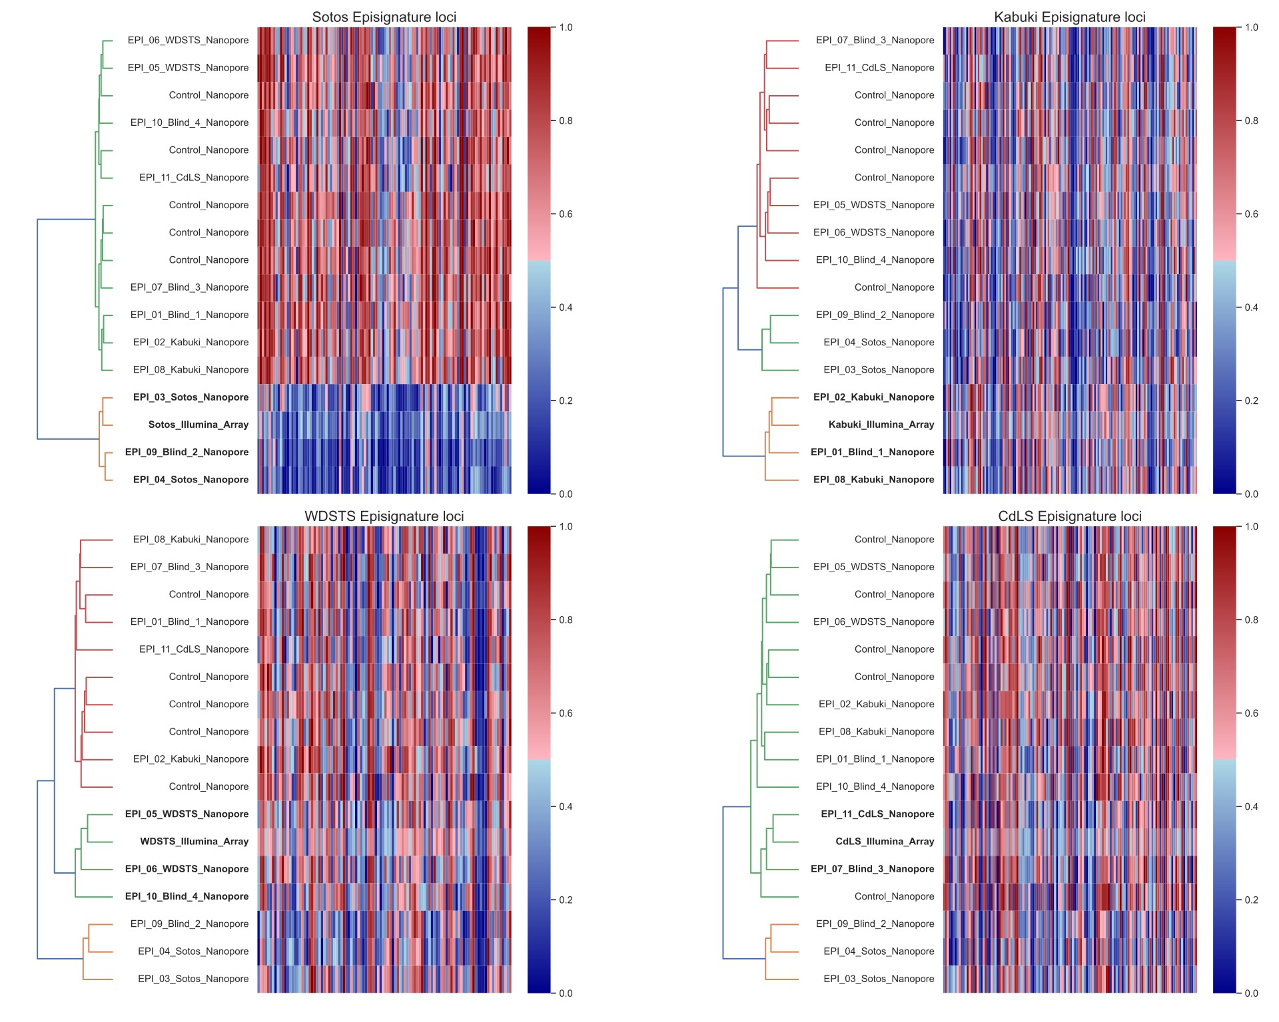
4 samples, Nanopore WGS - LSK110 kit​
1 Sotos​
1 WS​
1 Kabuki
1 CdLS

Slide 11
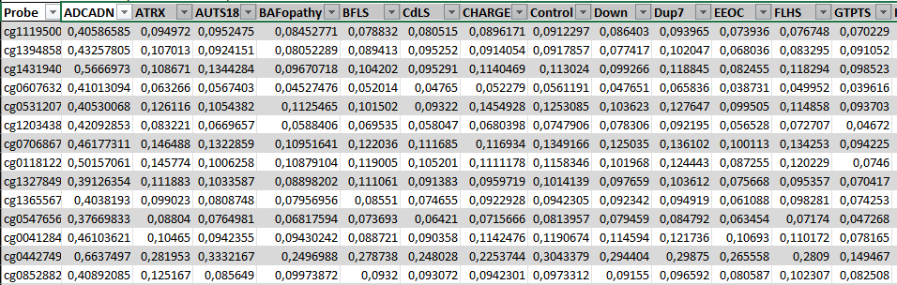
36 available episignatures – 42 disorders
For each episignature:
Average beta values in CpGs that are disorder specific
Average beta values in same CpGs but for other disorders
This translates into:
1 positive example for every episignature
35 negative examples for every episignature

Slide 12
SVM Training
Liftover illumine array episignatures from hg19 to hg38
Using illumine array episignatures train 36 SVMs (1 per episignature)
Training set:
Disorder specific probes with values from all disorders
2 classes
Disorder values in probes (1 example)
Values in probes from other disorder (35 examples)

Slide 13
SVM Training
Training set with unbalanced classes
Solution – adjusted class weights
Increase the weight of positive class (real disorder values)
Class 1
Class 0

Slide 14
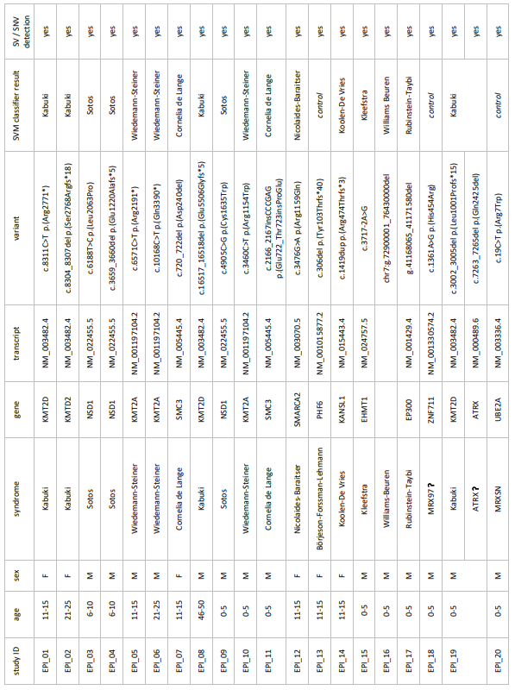
Classification

Slide 15
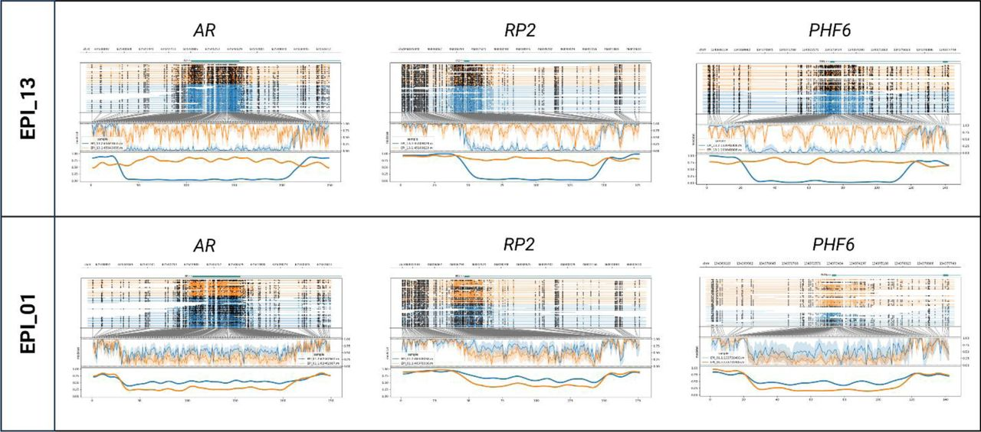
Why the episignature was not recognized in 3 samples?
EPI_13 (BFLS) – Functional mosaicism
EPI_18 (VUS) and EPI_20:
Limited training set used to identify the episignature
Different variant (missense) – potential sub-episignatures
Potential true negative (EPI18)
Commercial assay classified all 3 samples as controls (EpiSign)
EPI_13 X-chromosome inactivation skewing

Slide 16
Conclusion
Episignatures identified through Illumina arrays can be used on Nanopore data
Long read sequencing technologies can have significant impact on rare disease diagnosis (and not only) by offering simultaneous genome and epigenome analysis.

Slide 17

Acknowledgments
Prof. Joris Vermeesch
Prof. Kris Van Den Bogaert
Mathilde Geysens
Erika Souche
Tatjana Jetsenko
Stefania Tuveri
Thank you for you attention

