Slide 1
Introduction to Next Generation Sequencing
Bioinformatics Workshop 9 October 2019

Slide 2
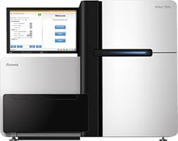


Overview
Sequencing
fastq
Sequence of nucleotides within a read?
bam
Genomic location of a read?
vcf
Genotype of a genomic location?

Slide 3
Sequence Alignment & Mapping
fastq
bam
vcf
Task:
look up read in reference sequence ….
… allowing mismatches

Slide 4
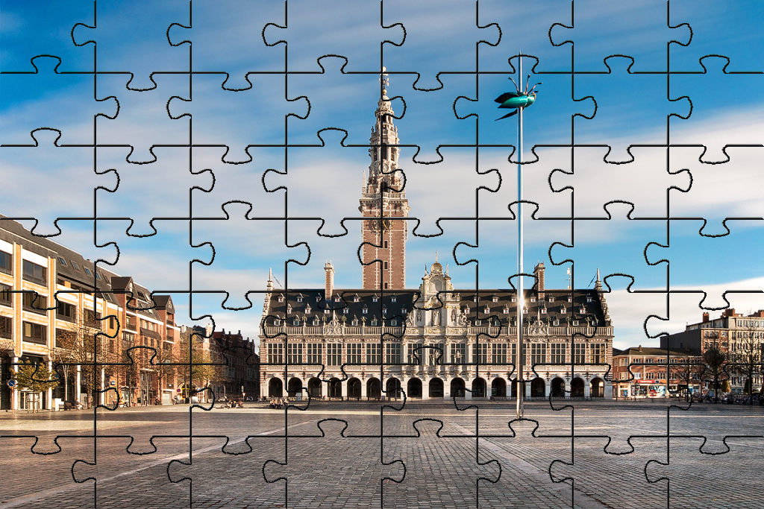

Slide 5







Sequence Alignment & Mapping look up read in reference sequence

Slide 6
Sequence Alignment & Mapping look up read in reference sequence
fastq
bam
A
A
C
A
vcf
A
A
C
C
T
T
G
T
C
A
C
T
T
C
A
A
A
G
G
G
A
C
T
DNA
G
G
T
T
T
T
G

Slide 7

Sequence Alignment & Mapping look up read in reference sequence
fastq
bam
A
A
C
A
vcf
A
A
C
C
T
T
G
T
C
A
C
T
T
C
A
A
A
G
G
G
A
C
T
DNA
G
G
T
T
T
T
G
T T A C A T G C A T C T
Fragment
A G A T G C A T G T A A

Slide 8
Sequence Alignment & Mapping look up read in reference sequence
fastq
bam
A
A
C
A
vcf
A
A
C
C
T
T
G
T
C
A
C
T
T
C
A
A
A
G
G
G
A
C
T
DNA
G
G
T
T
T
T
G
T T A C A T G C A T C T
Fragment
A G A T G C A T G T A A
Read1
T T A C A T G C A T C T
Read2
T T A C A T G C A T C T
A G A T G C A T G T A A
A G A T G C A T G T A A
T T A C
A G A T
G T A A
A T C T

Slide 9
Sequence Alignment & Mapping look up read in reference sequence
fastq
bam
A
A
C
A
vcf
A
A
C
C
T
T
G
T
C
A
C
T
T
C
A
A
A
G
G
G
A
C
T
DNA
G
G
T
T
T
T
G
T T A C A T G C A T C T
Fragment
A G A T G C A T G T A A
Read1
T T A C A T G C A T C T
Read2
T T A C A T G C A T C T
A G A T G C A T G T A A
A G A T G C A T G T A A
1
2
3
4
5
6
7
8
9
10
11
12
13
14
15
16
17
Reference
chrN
C G T T A C A T G C A T C T A A G
T T A C
A G A T
G T A A
A T C T

Slide 10
Sequence Alignment & Mapping look up read in reference sequence
fastq
bam
A
A
C
A
vcf
A
A
C
C
T
T
G
T
C
A
C
T
T
C
A
A
A
G
G
G
A
C
T
DNA
G
G
T
T
T
T
G
T T A C A T G C A T C T
Fragment
A G A T G C A T G T A A
Read1
T T A C A T G C A T C T
Read2
T T A C A T G C A T C T
A G A T G C A T G T A A
A G A T G C A T G T A A
Read1 chrN Forward 3
Read2 chrN Reverse 11
Bam-like minimal description
1
2
3
4
5
6
7
8
9
10
11
12
13
14
15
16
17
Reference
chrN
C G T T A C A T G C A T C T A A G
T T A C
A G A T
G T A A
A T C T

Slide 11
Sequence Alignment & Mapping look up read in reference sequence
fastq
bam
SYMMETRY
vcf
A
C
A
A
A
A
C
C
T
T
G
T
C
A
C
T
T
C
A
A
A
G
DNA
G
G
A
C
T
G
G
T
T
T
T
G
T T A C A T G C A T C T
Fragment
A G A T G C A T G T A A
Read1
T T A C A T G C A T C T
Read2
T T A C A T G C A T C T
A G A T G C A T G T A A
A G A T G C A T G T A A
Read2 chrN Forward 3
Read1 chrN Reverse 11
Bam-like minimal description
1
2
3
4
5
6
7
8
9
10
11
12
13
14
15
16
17
Reference
chrN
C G T T A C A T G C A T C T A A G
T T A C
A G A T
G T A A
A T C T

Slide 12
Sequence Alignment & Mapping look up read in reference sequence

Slide 13

Sequence Alignment & Mapping look up read in reference sequence
fastq
bam
A
A
C
A
vcf
A
A
C
C
T
T
G
T
C
A
C
T
T
C
A
A
A
G
G
G
A
C
T
DNA
G
G
T
T
T
T
G
A T G C A T C T A A G
Fragment
C T T A G A T G C A T
Read3
A T G C A T C T A A G
A T G C
C T T A G A T G C A T
G C A T
1
2
3
4
5
6
7
8
9
10
11
12
13
14
15
16
17
Reference
chrN
C G T T A C A T G C A T C T A A G

Slide 14
Sequence Alignment & Mapping look up read in reference sequence
fastq
bam
A
A
C
A
vcf
A
A
C
C
T
T
G
T
C
A
C
T
T
C
A
A
A
G
G
G
A
C
T
DNA
G
G
T
T
T
T
G
A T G C A T C T A A G
Fragment
C T T A G A T G C A T
Read3
A T G C A T C T A A G
Read3 chrN Forward 7
Or ?
C T T A G A T G C A T
Read3 chrN Reverse 9
1
2
3
4
5
6
7
8
9
10
11
12
13
14
15
16
17
Reference
chrN
C G T T A C A T G C A T C T A A G
No unique mapping
How can we improve mapping quality?
A T G C
Read3 chrN Forward 7 lowMQual
G C A T
A T G C
G C A T

Slide 15
Sequence Alignment & Mapping look up read in reference sequence
fastq
bam
A
A
C
A
vcf
A
A
C
C
T
T
G
T
C
A
C
T
T
C
A
A
A
G
G
G
A
C
T
DNA
G
G
T
T
T
T
G
A T G C A T C T A A G
Fragment
C T T A G A T G C A T
Read4
A T G C A T C T A A G
A T G C A T C
C T T A G A T G C A T
G A T G C A T
1
2
3
4
5
6
7
8
9
10
11
12
13
14
15
16
17
Reference
chrN
C G T T A C A T G C A T C T A A G
How can we improve mapping quality?
Strategy 1: READ ON

Slide 16
Sequence Alignment & Mapping look up read in reference sequence
fastq
bam
A
A
C
A
vcf
A
A
C
C
T
T
G
T
C
A
C
T
T
C
A
A
A
G
G
G
A
C
T
DNA
G
G
T
T
T
T
G
A T G C A T C T A A G
Fragment
C T T A G A T G C A T
Read4
A T G C A T C T A A G
C T T A G A T G C A T
1
2
3
4
5
6
7
8
9
10
11
12
13
14
15
16
17
Reference
chrN
C G T T A C A T G C A T C T A A G
How can we improve mapping quality?
A T G C A T C
G A T G C A T
Strategy 1: READ ON
Read3 chrN Forward 7 highMQual

Slide 17

Sequence Alignment & Mapping look up read in reference sequence

Slide 18
Sequence Alignment & Mapping look up read in reference sequence
fastq
bam
A
A
C
A
vcf
A
A
C
C
T
T
G
T
C
A
C
T
T
C
A
A
A
G
G
G
A
C
T
DNA
G
G
T
T
T
T
G
A T G C A T C T A A G
Fragment
C T T A G A T G C A T
Read5a
A T G C A T C T A A G
Read5b
C T T A G A T G C A T
1
2
3
4
5
6
7
8
9
10
11
12
13
14
15
16
17
Reference
chrN
C G T T A C A T G C A T C T A A G
How can we improve mapping quality?
A T G C
C T T A
G C A T
T A A G
Strategy 2: READ BOTH SIDES

Slide 19
Sequence Alignment & Mapping look up read in reference sequence
fastq
bam
A
A
C
A
vcf
A
A
C
C
T
T
G
T
C
A
C
T
T
C
A
A
A
G
G
G
A
C
T
DNA
G
G
T
T
T
T
G
A T G C A T C T A A G
Fragment
C T T A G A T G C A T
Read5a
A T G C A T C T A A G
Read5b
C T T A G A T G C A T
1
2
3
4
5
6
7
8
9
10
11
12
13
14
15
16
17
Reference
chrN
C G T T A C A T G C A T C T A A G
How can we improve mapping quality?
A T G C
C T T A
G C A T
T A A G
Insert size
Strategy 2: READ BOTH SIDES
Read5 chrN F,Paired,PairMapped,First 7 hiMQ chrN 14 11
Read5 chrN R,Paired,PairMapped,Second 14 hiMQ chrN 7 -11

Slide 20
Sequence Alignment & Mapping look up read in reference sequence

Slide 21
Sequence Alignment & Mapping look up read in reference sequence

Slide 22
Sequence Alignment & Mapping look up read in reference sequence

Slide 23
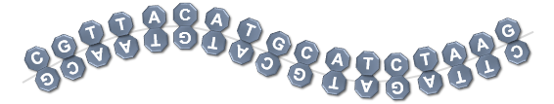
Sequence Alignment & Mapping look up read in reference sequence
1
2
3
4
5
6
7
8
9
10
11
12
13
14
15
16
17
chrN
C G T T A C A T G C A T C T A A G
Read5a
A T G C A T C T A A G
A T G C
C T T A
Read5b
C T T A G A T G C A T
G C A T
T A A G
Read6a
T T A G A T G C A T G T A A C
G T T A
T T A G
Read6b
G T T A C A T G C A T C T A A
T A A C
C T A A
Read7a
C G T T
G A T G
C G T T A C A T G C A T C
Read7b
G A T G C A T G T A A C G
A A C G
C A T C
Read5 chrN F,Paired,PairMapped,First 7 hiMQ chrN 14 11
Read5 chrN R,Paired,PairMapped,Second 14 hiMQ chrN 7 -11
Read6 chrN R,Paired,PairMapped,Second 13 hiMQ chrN 2 -15
Read6 chrN F,Paired,PairMapped,First 2 hiMQ chrN 13 15
Read7 chrN F,Paired,PairMapped,First 1 hiMQ chrN 10 13
Read7 chrN R,Paired,PairMapped,Second 10 hiMQ chrN 1 -13

Slide 24
Sequence Alignment & Mapping … allowing mismatches

Slide 25
Sequence Alignment & Mapping … allowing mismatches
fastq
bam
Variant
A
G
C
A
vcf
A
A
C
C
T
C
G
T
C
A
C
T
T
C
A
A
A
G
G
G
A
C
T
DNA
G
G
T
T
T
T
G
T T G C A T G C A T C T
Fragment
A G A T G C A T G C A A
Read8
T T G C A T G C A T C T
A G A T G C A T G C A A
1
2
3
4
5
6
7
8
9
10
11
12
13
14
15
16
17
chrN
C G T T A C A T G C A T C T A A G
T T G C
G C A A
4 Matches or Mismatches
Read8 chrN Forward 3 hiMQ 4M 3A>G
CIGAR string
Compact Ideosyncratic Gapped Alignment Report

Slide 26
Sequence Alignment & Mapping … allowing mismatches
fastq
bam
Deletion
A
C
A
vcf
A
A
C
C
T
G
T
C
A
C
T
T
C
A
A
A
G
G
G
A
C
T
DNA
G
G
T
T
T
T
G
T T C A T G C A T C T
Fragment
A G A T G C A T G A A
Read9
T T C A T G C A T C T
A G A T G C A T G A A
1
2
3
4
5
6
7
8
9
10
11
12
13
14
15
16
17
chrN
C G T T A C A T G C A T C T A A G
T T - C A
2 Matches or Mismatches
1 Deletion
2 Matches or Mismatches
T G - A A
Read9 chrN Forward 3 hiMQ 2M1D2M
CIGAR

Slide 27
Sequence Alignment & Mapping … allowing mismatches
fastq
bam
Insertion
C
A
C
A
vcf
A
A
C
A
G
T
G
T
C
A
C
T
T
C
A
A
A
G
C
T
G
A
C
T
DNA
G
G
T
T
T
G
T
G
T T G A C A T G C A T C T
Fragment
A G A T G C A T G T C A A
Read10
T T G A C A T G C A T C T
A G A T G C A T G T C A A
1
2
3
4
5
6
7
8
9
10
11
12
13
14
15
16
17
chrN
C G T T - A C A T G C A T C T A A G
T T G A
2 Matches or Mismatches
1 Insertion
1 Match or Mismatch
T C A A
Read10 chrN Forward 3 hiMQ 2M1I1M
CIGAR

Slide 28
fastq
Sequence Alignment & Mapping … allowing mismatches
bam
A
A
C
A
vcf
A
A
C
C
T
T
G
T
C
A
C
T
T
C
A
A
A
G
G
G
A
C
T
DNA
G
G
T
T
T
T
G
Fragment with
sequencing artefact
(e.g; adapter)
G G G G A T G C A T C T A A G
C T T A G A T G C A T C C C C
Read11
G G G G A T G C A T C T A A G
C T T A G A T G C A T C C C C
1
2
3
4
5
6
7
8
9
10
11
12
13
14
15
16
17
Reference
chrN
C G T T A C A T G C A T C T A A G
G G G G A T G C
4 Soft clipped
4 Matches or Mismatches
G C A T C C C C
Read11 chrN Forward 7 hiMQ 4S4M
CIGAR

Slide 29
Sequence Alignment & Mapping SAM – BAM (CRAM)
fastq
bam
BAM files are compressed SAM files
Not human readable, convert to SAM or use viewer (eg,IGV)
For archiving BAM: additional compression to CRAM
SAM format
vcf
Alignment scores
AS:best, XS:2nd best
Chr1
Mapping Quality
Sequence, Quality
Read id
position
CIGAR
Mismatch info
Read pair info
163: Forward,Paired,PairMapped,Second
83: Reverse,Paired,PairMapped,First
99: Forward,Paired,PairMapped,First
147: Reverse,Paired,PairMapped,Second
https://broadinstitute.github.io/picard/explain-flags.html
bio-bwa.sourceforge.net
samtools.sourceforge.net

Slide 30
Overview
Sequencing
fastq
Sequence of nucleotides within a read?
bam
Genomic location of a read?
vcf
Genotype of a genomic location?

Slide 31
Genotype of genomic location
fastq
bam
A
A
C
A
A
G
A
C
C
T
T
T
C
A
C
T
T
C
?
A
A
G
G
G
A
C
T
vcf
G
G
?
T
T
C
C
T
G
A
A
A
A
G
A
G
C
A
A
A
T
T
T
C
?
A
C
T
C
T
G
T
T
2 alleles
C
T
G
?
T
G
G
G
1
2
3
4
5
6
7
8
9
10
11
12
13
14
15
16
17
Reference
chrN
C G T T A C A T G C A T C T A A G
A
Homozygous
Reference
A
Heterozygous
Variant
C
Homozygous
Variant
T
T
G
A
A
A
or
C
A
C
or
C
C
C
T
G
G

Slide 32
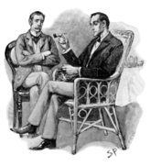
"When you have eliminated all which is impossible,
then whatever remains, however improbable,
must be the truth.“ —Sherlock Holmes
“In essence, a major flaw in this line of reasoning is that there may be explanations that you simply have not thought of.” https://rationalwiki.org/wiki/Holmesian_fallacy

