Slide 1
RNASeq: Differential Gene Expression Analysis
Alvaro Cortes Calabuig
November 2022
Notes:
1

Slide 2
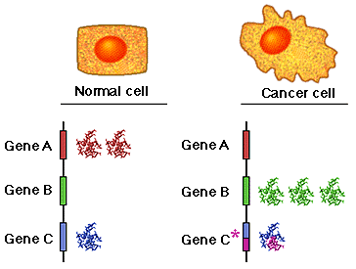
RNA-Seq: Differential Gene Expression
Discover changes in RNA abundance between conditions

Slide 3
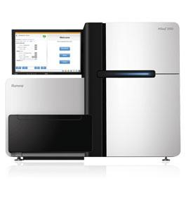
RNA-Seq
Sequencer produces millions of reads
and a qualification for each base call
What reads have to do with differential expression of genes?
Read count is linearly related to the abundance of the target transcript

Slide 4
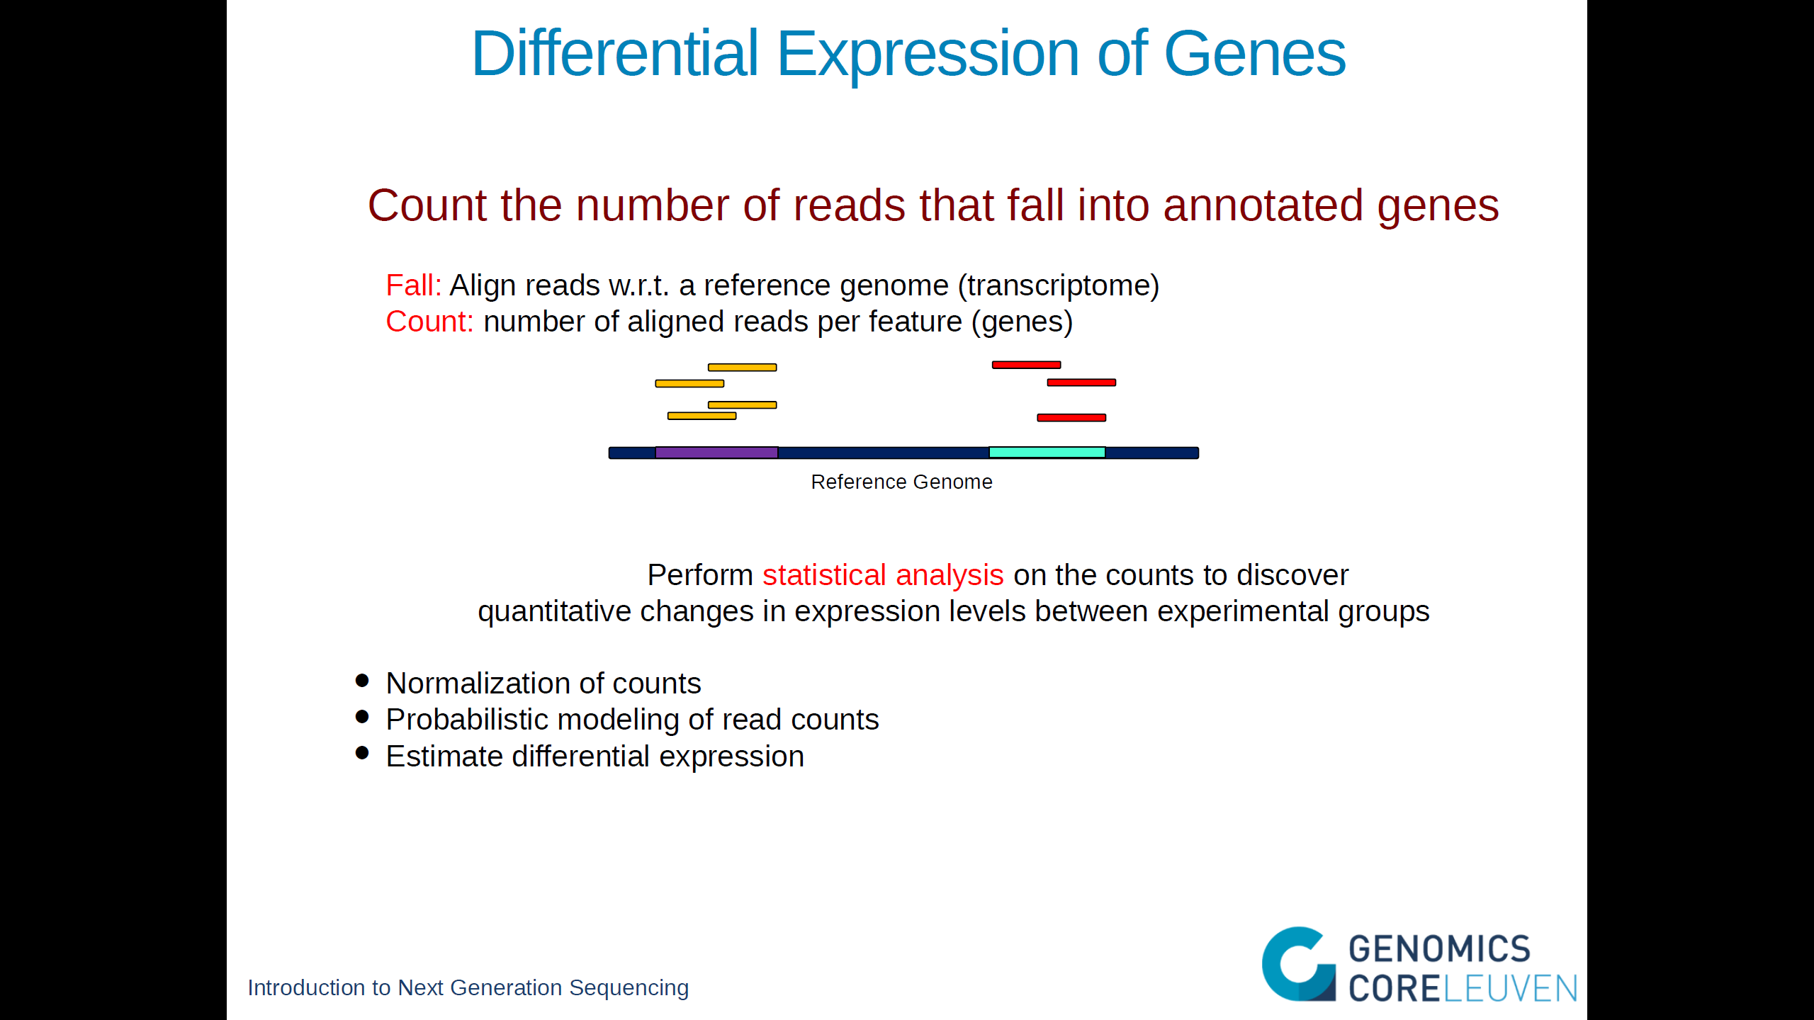

Slide 5
From Raw Reads to Alignment
Reference genome
RNA-Seq reads
Alignment

Slide 6
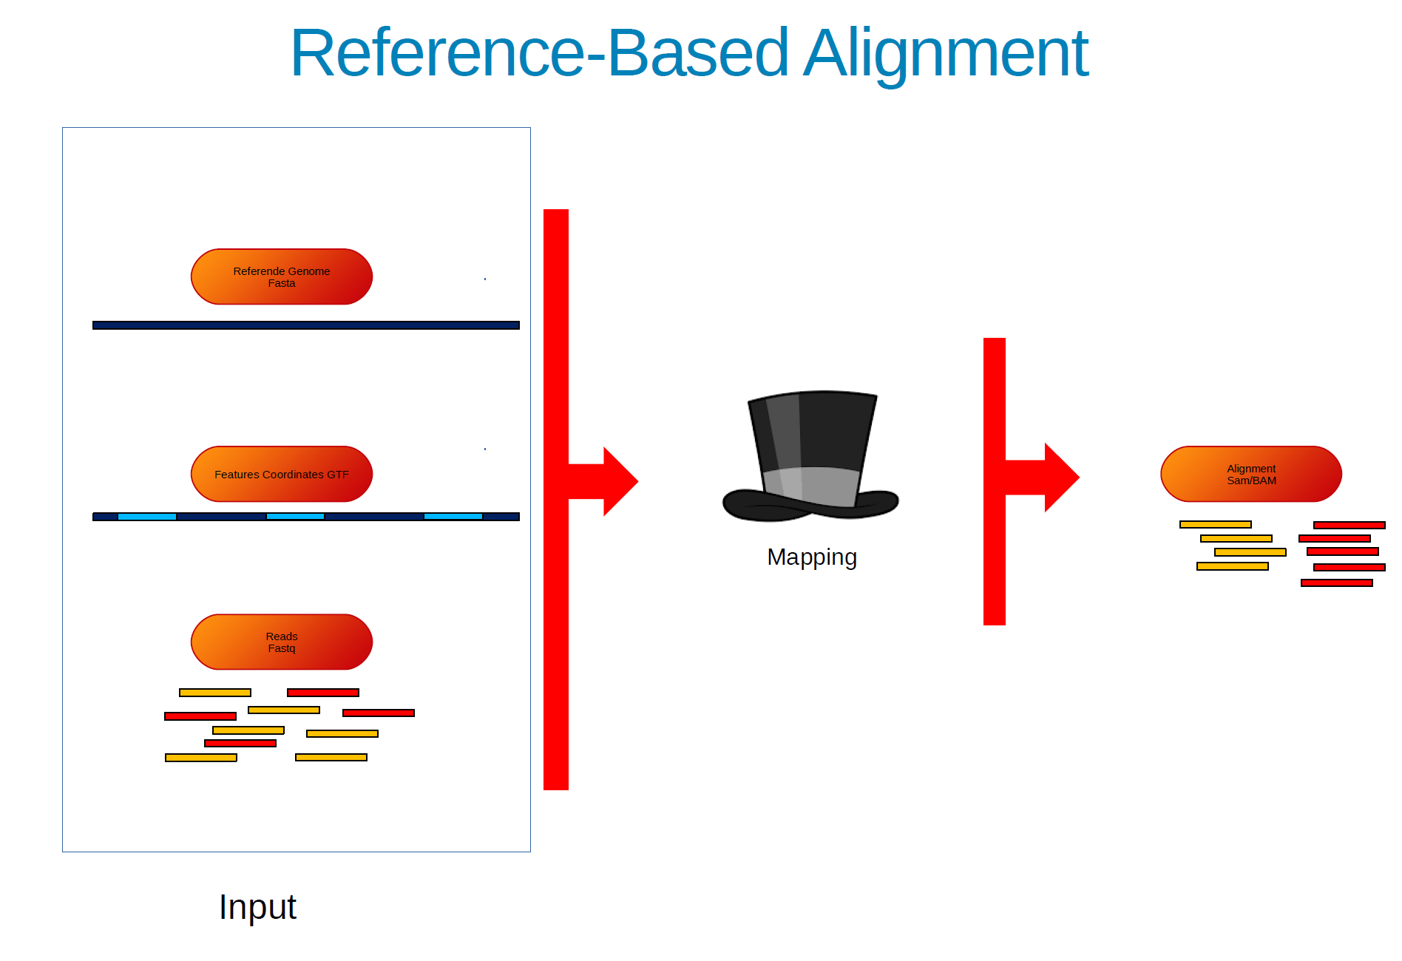

Slide 7

Splice-Aware Alignment
Individual reads are aligned to a reference genome
RNA-seq read alignment differs from standard aligment:
If an RNA-Seq read spans an exon boundary, part of the map will not map contiguosly to the reference
This causes the standard mapping procedure to fail
E2
E3
E1
E2
E3
E4
E5
Gene

Slide 8
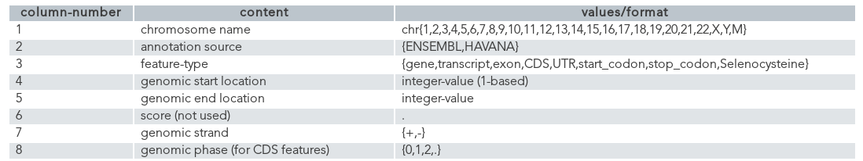
GTF Files: Gene Transfer Format

Slide 9
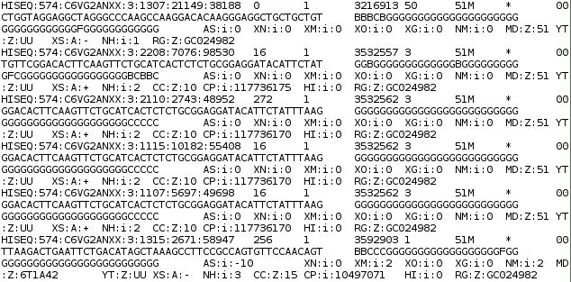
RNA-Seq BAM/SAM
Extract SAM (Sequence Alignment Map) file
Reference Genome
BAM files are machine-readable versions of SAM files

Slide 10
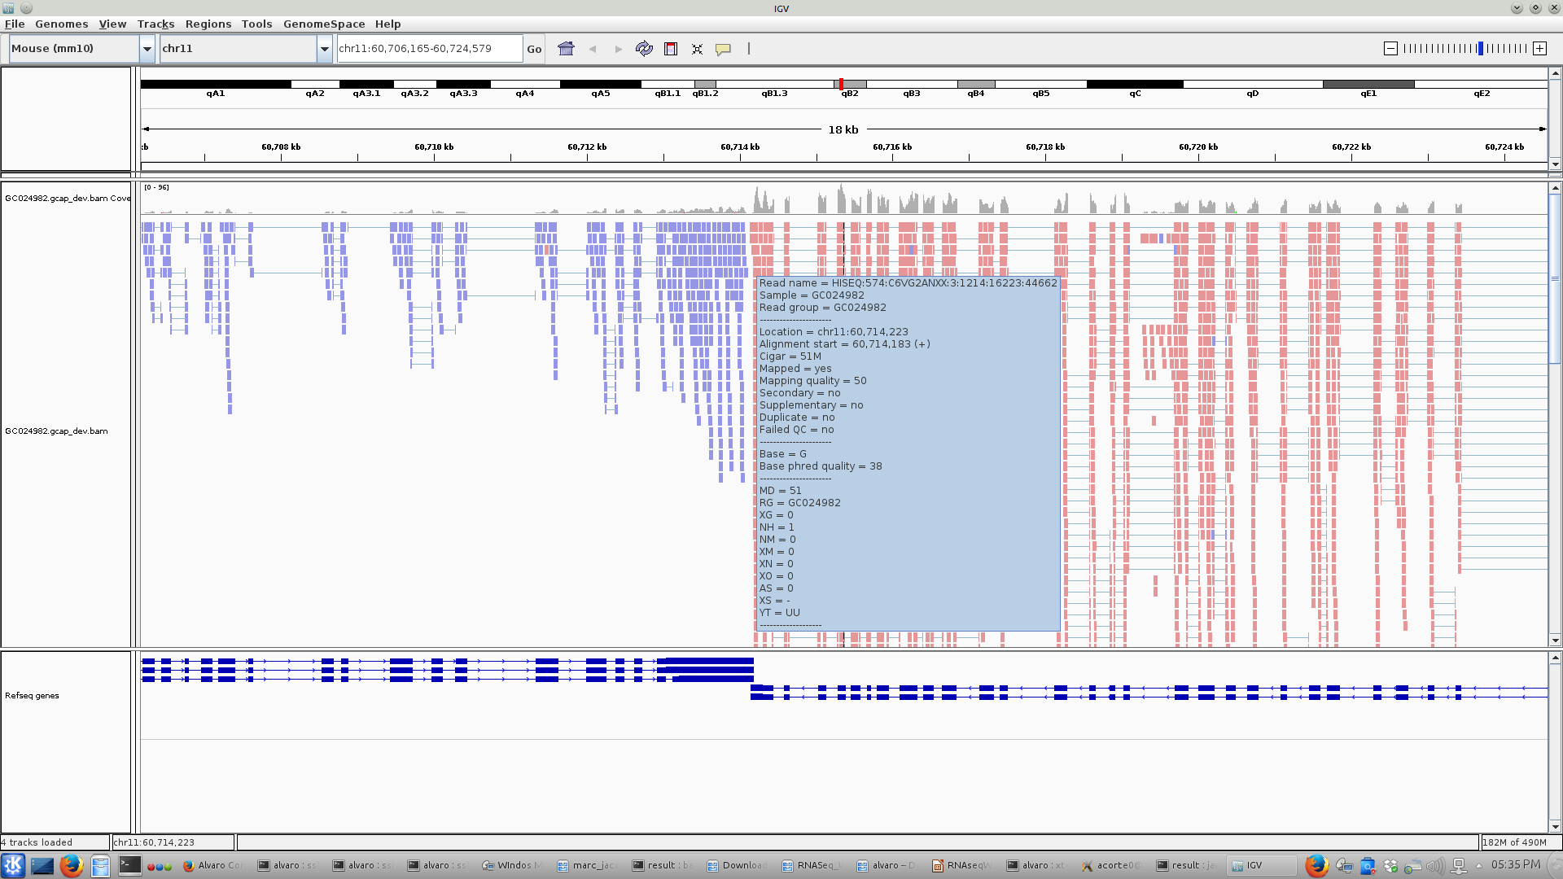
RNA-Seq BAM/SAM

Slide 11
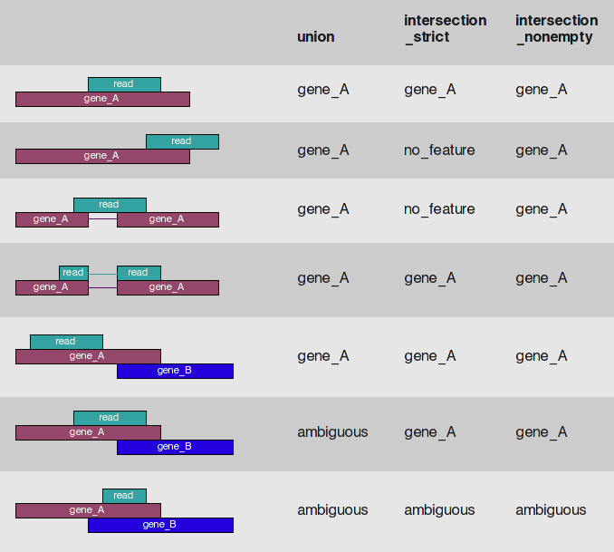
Counting Reads in HTSeq
Method:
Count each read only once
Multi-mapping reads and reads overlapping
multiple features discarded
1,2,3,4
1,2,3
Simon Anders

Slide 12
Counting Reads in HTSeq(*)
Resulting table of absolute counts for each sample and feature:
GeneID Sample 1 Sample 2 Sample 3 Sample 4
FBgn0000003 0 0 0 1
FBgn0000008 76 70 88 70
FBgn0000014 0 0 0 0
FBgn0000015 1 2 0 0
FBgn0000017 3564 3150 3072 3334
FBgn0000018 245 310 299 308
But!
1
2
3
4
Library sizes

Slide 13
Normalization of Counts: Impact Library Size
Library 1
Library 2
A bigger library produces more reads...But in slide 3:
“Read Counts is linearly related to the abundance of the target transcript”

Slide 14
Normalization of Counts: Size Factors
Adjust for library sizes to produce count values in a common scale:
Sample 1 Sample 2 Sample 3 Sample4
0.873 1.011 1.022 1.115
Sample 1 Sample 2 Sample 3 Sample4
FBgn0000003 0 0 0 1
FBgn0000008 76 70 88 70
FBgn0000014 0 0 0 0
FBgn0000015 1 2 0 0
FBgn0000017 3564 3150 3072 3334
FBgn0000018 245 310 299 308
Normalized counts
Sample 1 Sample 2 Sample 3 Sample4
FBgn0000003 0.00 0.00 0.0 0.897
FBgn0000008 87.05 69.27 86.1 62.803
FBgn0000014 0.00 0.00 0.0 0.000
FBgn0000015 1.15 1.98 0.0 0.000
FBgn0000017 4082.02 3116.93 3004.5 2991.238
FBgn0000018 280.61 306.75 292.4 276.335
Size factors
1
2
3
4
Library sizes
76/0.873 = 87.05

Slide 15
Differential Expression
Statistical test: Decide whether for a given gene, an observed difference in reads counts is significant
Comparison between different biological conditions
Read counts per gene are modeled by a probability distribution

Slide 16
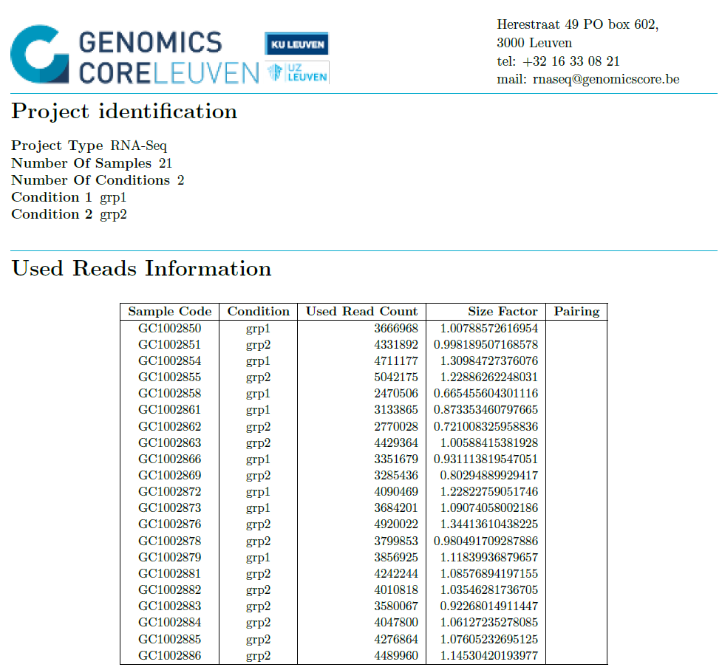
DE Report: Used Reads

Slide 17
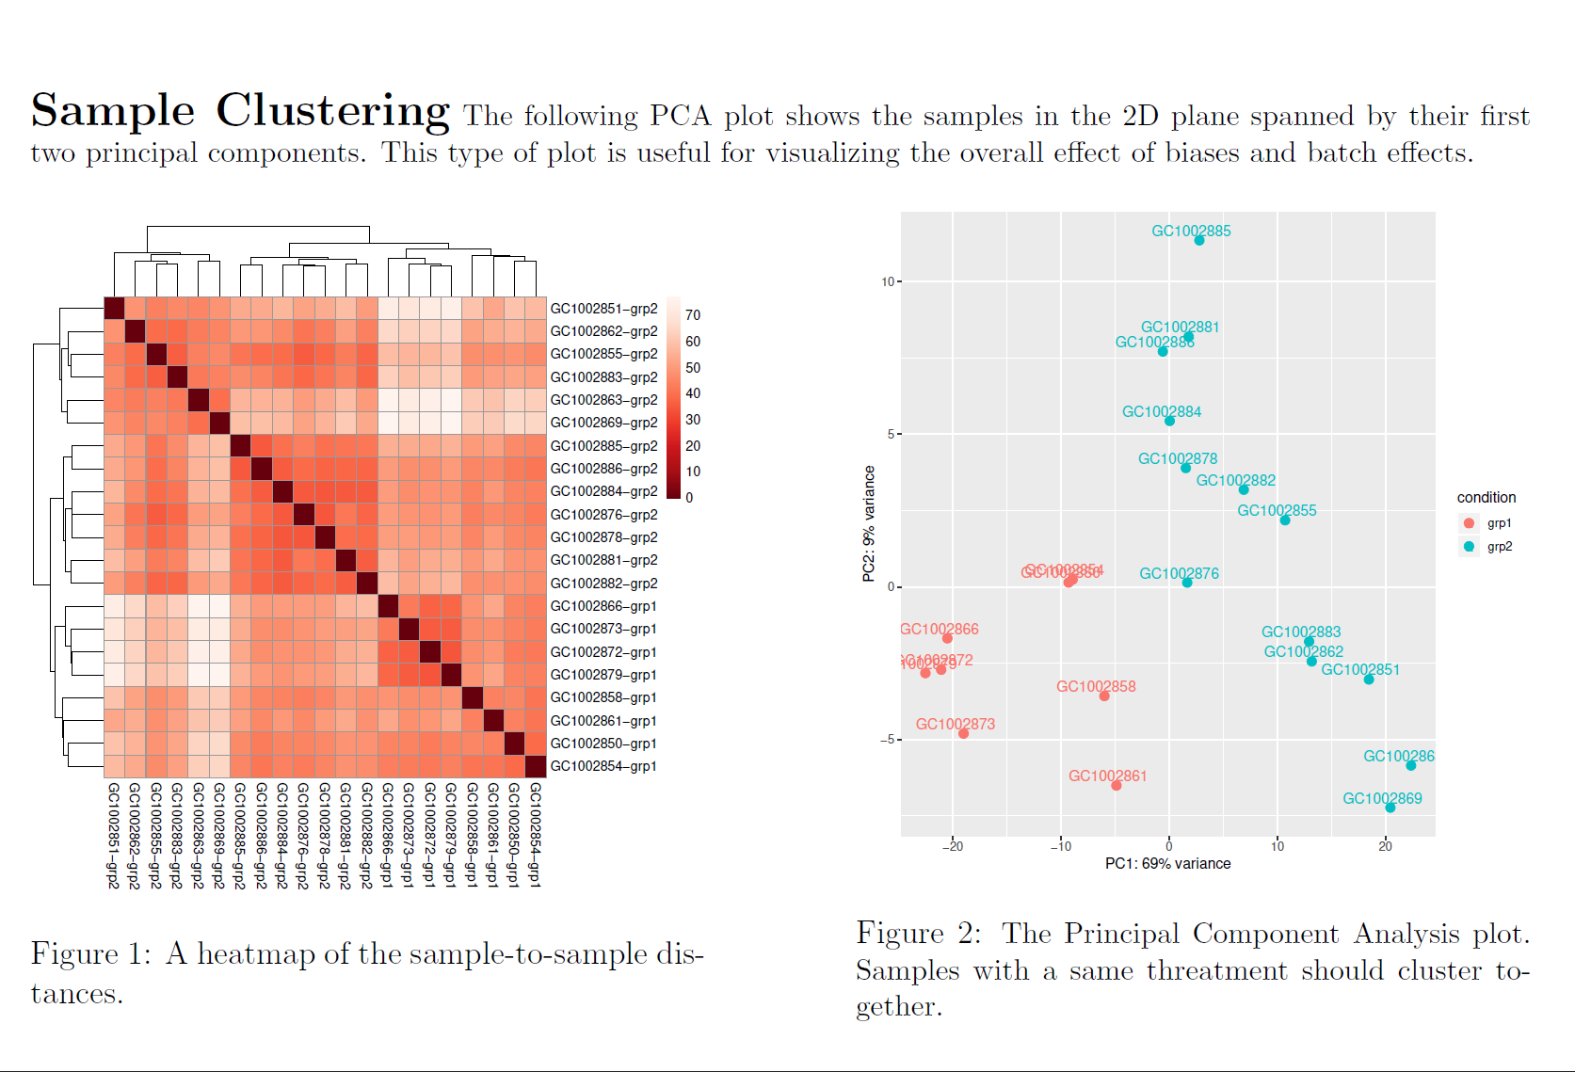
DE Report: Used Reads

Slide 18
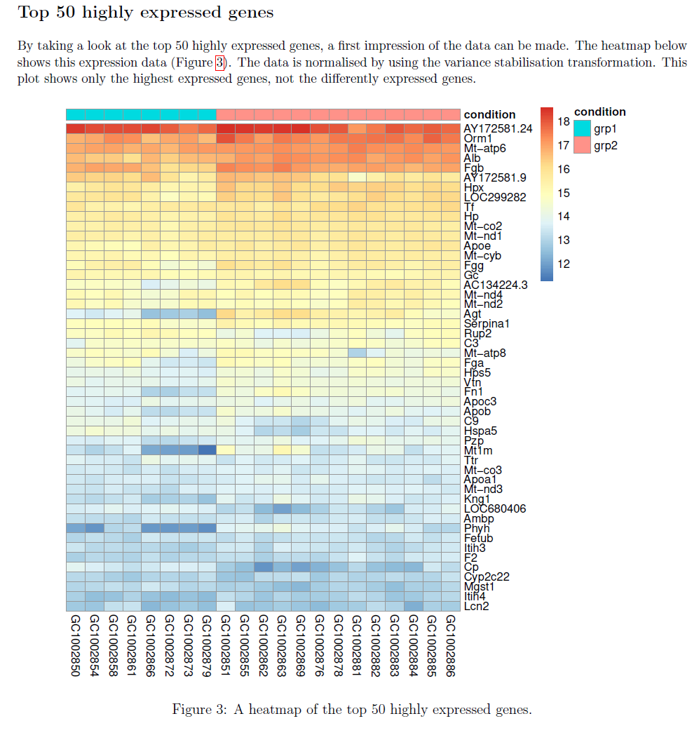
DE Report: Used Reads

Slide 19
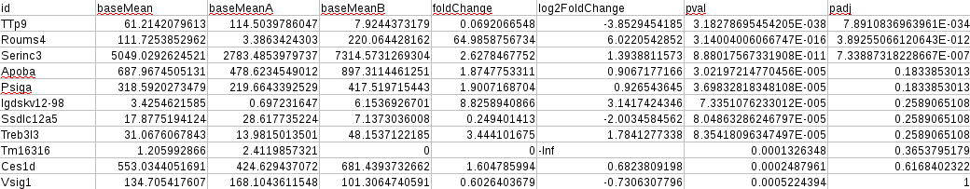
Differential Expression Table (DeSeq)

Slide 20
RNASeq is more than DE only
Analysis of fusion genes
Alternative splicing (Pacbio)
Expression miRNA and lncRNA
Cell velocity (single cell)
De novo Assembly

Slide 21
Thanks!

