Slide 1
NGS Data Management
Introduction to Next Generation Sequencing
2023 Workshop
Wouter Bossuyt

Slide 4
Overview
Generating Data
Data Flow
Typical Datasets
Some Numbers
Delivering Data - Tier Based
Silver Tier
Gold Tier
Dos and Don'ts with Data
NGS Data Management

Slide 5

Data flow*
Lab Operations
POOL
PRM
Data Transfer
UZ
...
Pipeline
GC
...
DX
...
KUL
...
...
(*) illumina device workflow
Bio-IT Operations
1. Generating Data

Slide 6
In other words…
🧬
NGS
💾
Synthetic DNA »
1. Generating Data
Notes:
Sequencing can be seen as data conversion, from the superior biological storage system to inferior digital storage system. Hence, requesting an NGS experiments means generating data, and depending on different parameters, it can be quite a lot.
Fun note https://en.wikipedia.org/wiki/DNA_digital_data_storage

Slide 7



Typical Datasets
Device Output
BCL
CCS Reads
FAST5 / FASTQ
FASTQ
Demultiplexed
Pipeline output
Pipeline output
Pipeline output
Pipeline
1. Generating Data

Slide 8
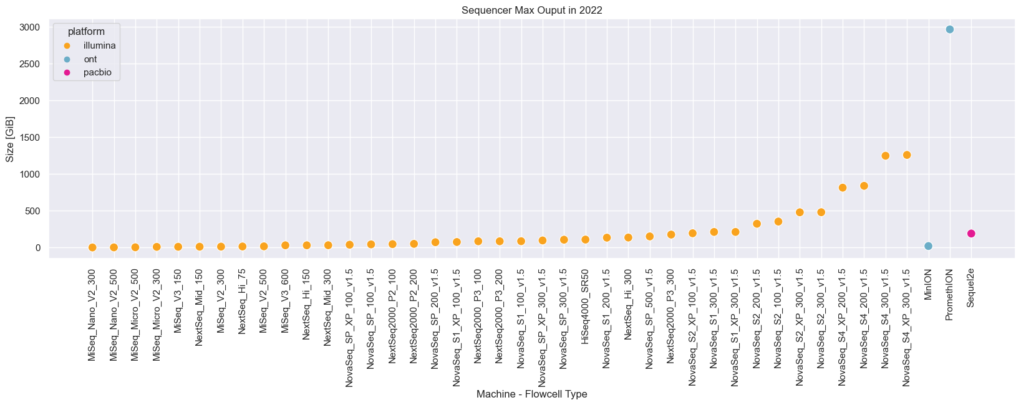
Some Numbers
NOVASEQ
NEXTSEQ
NEXTSEQ2000
MISEQ
1. Generating Data

Slide 9
Some Numbers: Example
Device Output
Demultiplexed
Pipeline Output
BCL
FASTQ
Pipeline output
2 TB / 4 lanes ~= 500 GB
2 TB
?
NovaSeq S4 2 x 150 bp »
1. Generating Data

Slide 10
🔑
You Request DATA
We Generate & Deliver DATA
2. Delivering Data

Slide 11
Overview
Generating Data
Data Flow
Typical Datasets
Some Numbers
Delivering Data - Tier Based
Silver Tier
Gold Tier
Dos and Don'ts with Data
NGS Data Management

Slide 12
Data Delivery: A Tier Based Service
TIER | Silver (default) | Gold
DELIVERY | Download link | Google Cloud Bucket
ACCESS | Through PRM | Through share accounts (@share.uzleuven.be)
POLICY | Valid for 90 days | Custom - Customer Controlled
PRICING | Included in Project | Billed Quarterly
Modify Tier → info@genomicscore.be Set / Modify Storage Policy → www.genomicscore.be/request» > Login > My Data > Bucket Info
2. Delivering Data

Slide 13
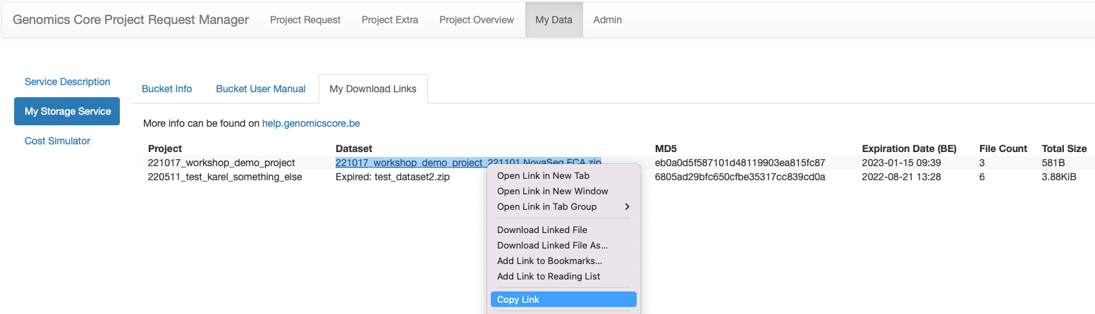
Silver Tier: Where?
2. Delivering Data
help.genomicscore.be »

Slide 14
Gold Tier: What?
Google Cloud
Virtual data "container"
A dedicated bucket per pi
Under GC's administration
Access through share accounts (@share.uzleuven.be + 2FA enforced)
Archiving capabilities - Set through PRM
STANDARD (HOT)
NEARLINE
COLDLINE
ARCHIVE (COLD)
BUCKET
2. Delivering Data

Slide 15
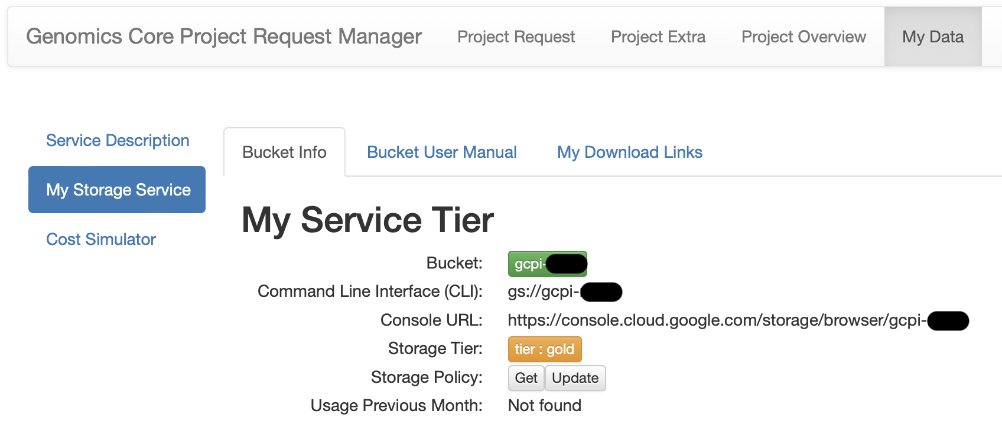
Gold Tier: Where?
2. Delivering Data
help.genomicscore.be »

Slide 16
Gold Tier: Why?
Virtually unlimited in size
Cost is the limiting factor!
Reduction in storage admin
Avoids local infrastructure admin
Increased flexibility
Partial downloads
Uploads
Cloud based analyses
Faster transfers
BUCKET
2. Delivering Data

Slide 17
Gold Tier: Pricing & Policy
Prices may differ slightly due to precision,
, GB <> GiB (base 10 vs base 2)
and excludes VAT
STORAGE CLASS | STORAGE COST EUR/GB.month | RETRIEVAL COST EUR/GB | DOWNLOAD COST EUR/GB | MINIMUM RETENTION DAYS
STANDARD (STD) | 0.02 | 0 | 0.13 | 0
NEARLINE (NL) | 0.01 | 0.01 | 0.13 | 30
COLDLINE (CL) | 0.0034 | 0.03 | 0.13 | 90
ARCHIVE (ARC) | 0.0017 | 0.07 | 0.13 | 365
2. Delivering Data
www.genomicscore.be/request» > Login > My Data > Cost Simulator

Slide 18
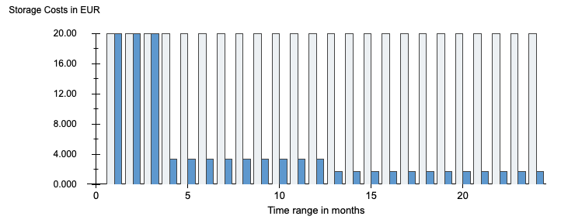

Size: 1 TB
Time: 2 years
STD
COLDLINE
ARCHIVE
 |  | STORAGE | RETRIEVAL | DOWNLOAD | TOTAL
NO POLICY | 24 months of standard | € 480
USER POLICY | 3 months of standard > 9 months of coldline > 12 months of archive | € 110
2. Delivering Data: Gold Tier Policy
www.genomicscore.be/request» > Login > My Data > Cost Simulator

Slide 19
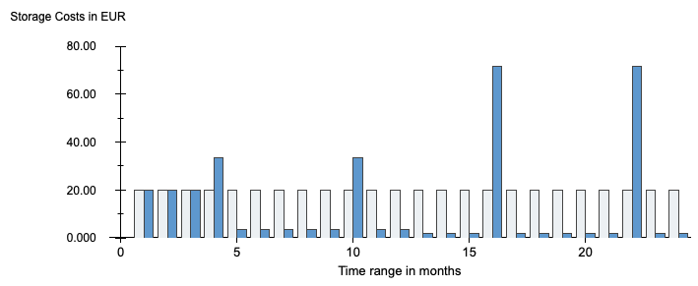
Size: 1 TB
Time: 2 years
Full Downloads: 5 (1 STD, 2 in CL, 2 in ARC)
STD
COLDLINE
ARCHIVE
 |  | STORAGE | RETRIEVAL | DOWNLOAD | TOTAL
NO POLICY | 24 months of standard | € 480 | NA | 5 x € 130 | € 1130
USER POLICY | 3 months of standard > 9 months of coldline > 12 months of archive | € 110 | CL 2 x € 30 + ARC 2 x € 70 | 5 x € 130 | € 960
2. Delivering Data: Gold Tier Policy
www.genomicscore.be/request» > Login > My Data > Cost Simulator

Slide 20
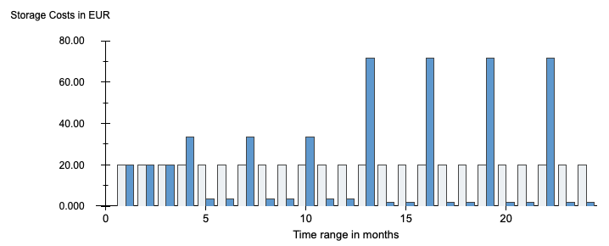
Size: 1 TB
Time: 2 years
Full Downloads: 8 (1 STD, 3 in CL, 4 in ARC)
STD
COLDLINE
ARCHIVE
 |  | STORAGE | RETRIEVAL | DOWNLOAD | TOTAL
NO POLICY | 24 months of standard | € 480 | NA | 8 x € 130 | € 1520
USER POLICY | 3 months of standard > 9 months of coldline > 12 months of archive | € 110 | CL 3 x € 30 + ARC 4 x € 70 | 8 x € 130 | € 1520
2. Delivering Data: Gold Tier Policy
www.genomicscore.be/request» > Login > My Data > Cost Simulator

Slide 21
🔑
If Gold Tier → setup bucket policy!
Cost can be reduced significantly, especially if you perform many NGS experiments
Visit www.genomicscore.be/request » > Login > My Data > Cost Simulator
REMARK: Objects can only go down in storage class, not up!
2. Delivering Data

Slide 22
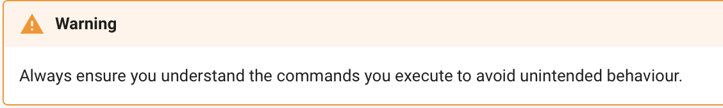
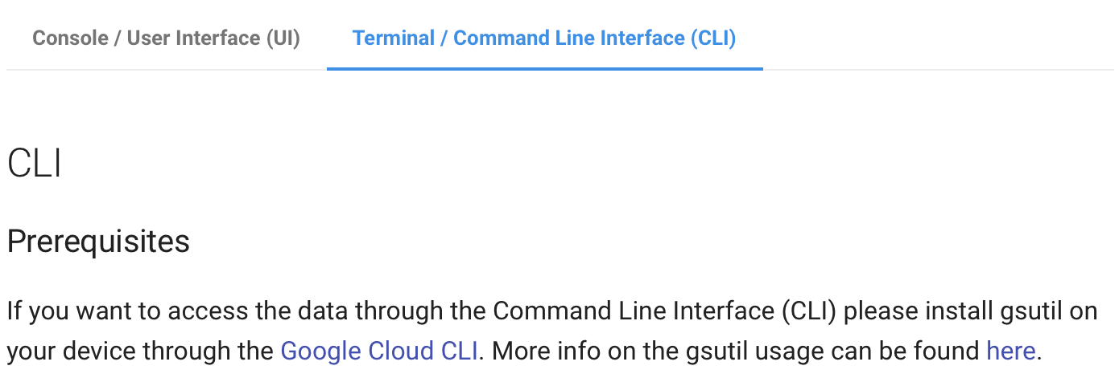
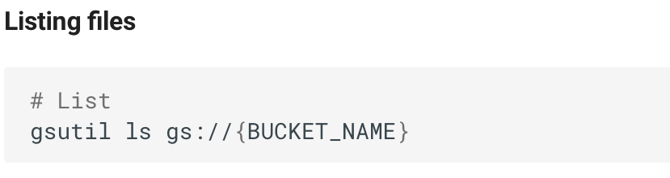
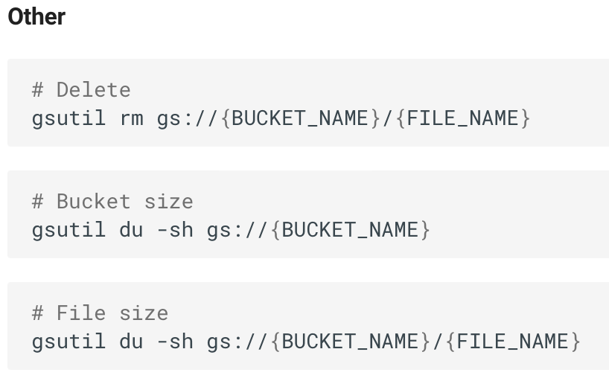
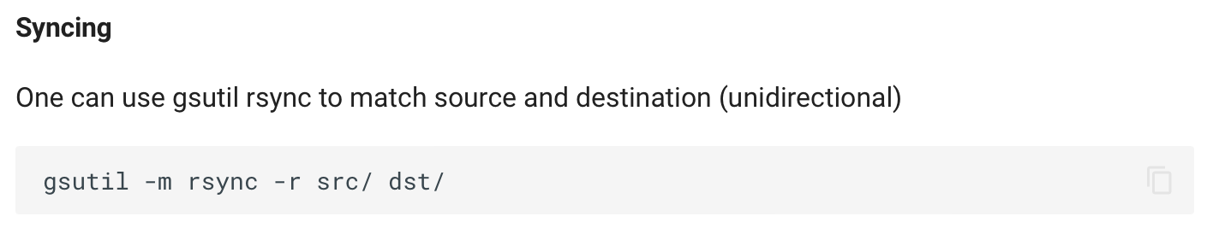
Gold Tier: How?
2. Delivering Data
help.genomicscore.be »

Slide 23
Overview
Generating Data
Data Flow
Typical Datasets
Sequencers Overview
Delivering Data - Tier Based
Silver Tier
Gold Tier
Dos and Don'ts with Data
NGS Data Management

Slide 24
Dos and Don'ts with Data
Please DON'T 🙅 …
Rather DO 👌 …
… download data at home
… download on your personal computer
… rely on GC for backups … choose Gold Tier without cost reducing policy
… download at the office
… download on a server or server like machine with ample storage capacity
… devise a data management strategy + infrastructure
→ store your data in a structured manner with scalability in mind and with the appropriate access/permission
3. Dos and Don'ts with Data

Slide 25
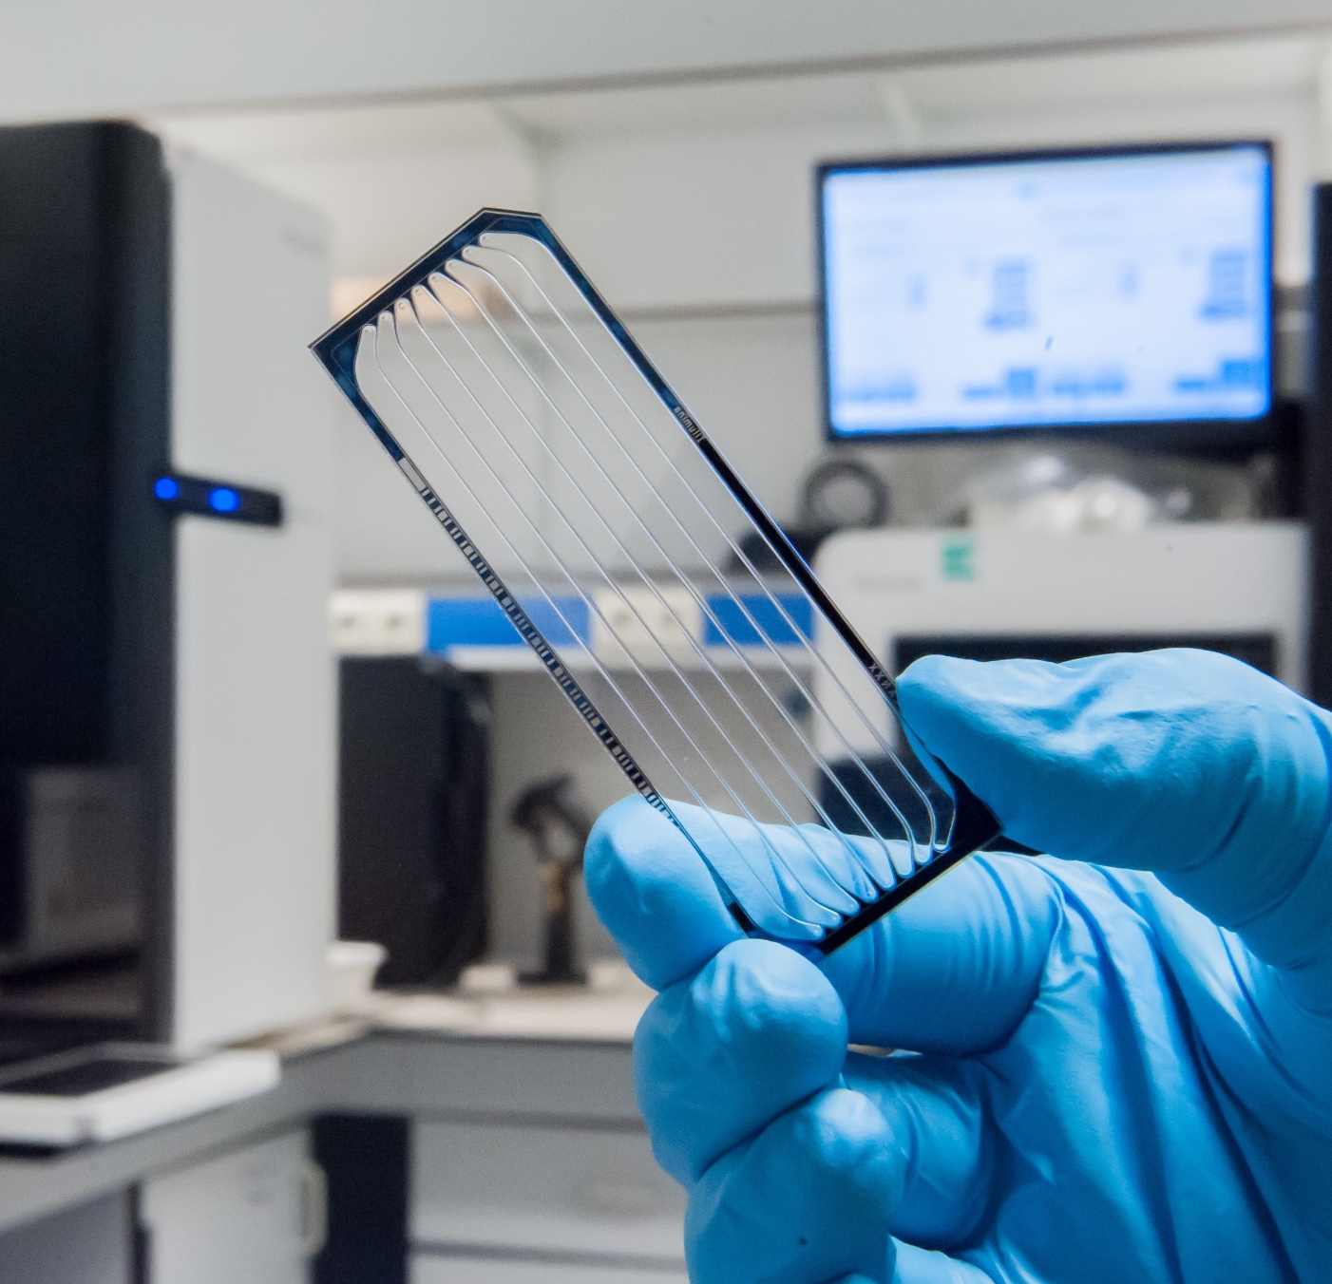
Conclusion
📧 info@genomicscore.be
🌐 www.genomicscore.be
🐦 @GC_Leuven ⛳ Centre for Human Genetics
UZ – KU Leuven
Herestraat 49 PO box 606
B-3000 Leuven
Belgium
You request, we generate data
We deliver data
Silver Tier (Download Link)
Gold Tier (Google Cloud Bucket)
For technical support: help.genomicscore.be 🚀

