Slide 1
Introduction to Next Generation Sequencing
25 October 2023

Slide 2
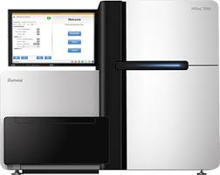


Overview
Sequencing
fastq
Sequence of nucleotides within a read?
bam
Genomic location of a read?
vcf
Genotype of a genomic location?

Slide 3
Sequence Alignment & Mapping
fastq
bam
vcf
Task:
look up read in reference sequence ….
… allowing mismatches

Slide 4
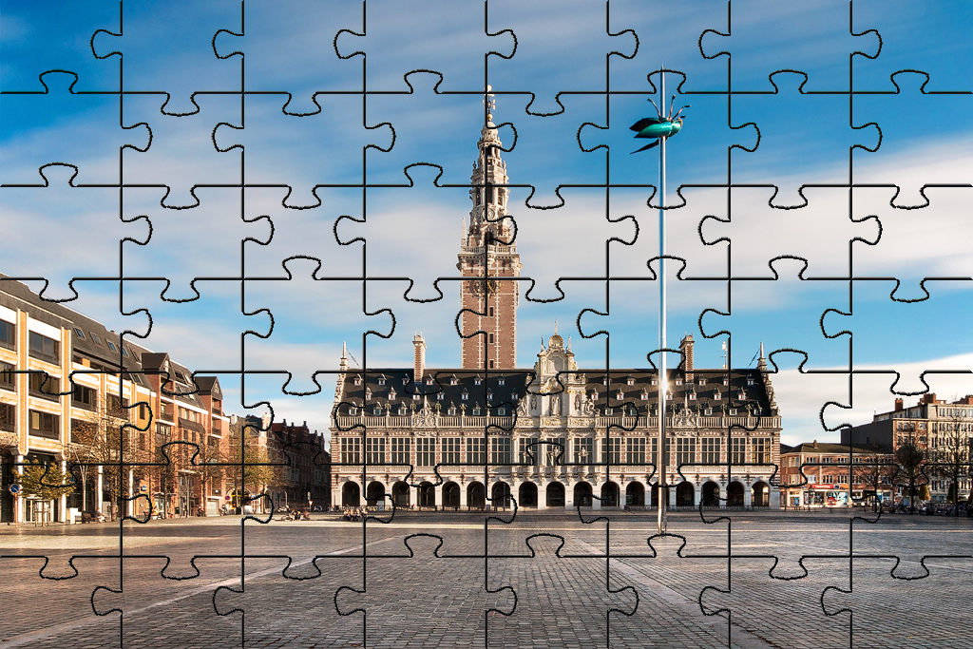

Slide 5







Sequence Alignment & Mapping look up read in reference sequence

Slide 6
Sequence Alignment & Mapping look up read in reference sequence
fastq
bam
A
A
C
A
vcf
A
A
C
C
T
T
G
T
C
A
C
T
T
C
A
A
A
G
G
G
A
C
T
DNA
G
G
T
T
T
T
G

Slide 7

Sequence Alignment & Mapping look up read in reference sequence
fastq
bam
A
A
C
A
vcf
A
A
C
C
T
T
G
T
C
A
C
T
T
C
A
A
A
G
G
G
A
C
T
DNA
G
G
T
T
T
T
G
T T A C A T G C A T C T
Fragment
A G A T G C A T G T A A

Slide 8
Sequence Alignment & Mapping look up read in reference sequence
fastq
bam
A
A
C
A
vcf
A
A
C
C
T
T
G
T
C
A
C
T
T
C
A
A
A
G
G
G
A
C
T
DNA
G
G
T
T
T
T
G
T T A C A T G C A T C T
Fragment
A G A T G C A T G T A A
Read1
T T A C A T G C A T C T
Read2
T T A C A T G C A T C T
A G A T G C A T G T A A
A G A T G C A T G T A A
T T A C
A G A T
G T A A
A T C T

Slide 9
Sequence Alignment & Mapping look up read in reference sequence
fastq
bam
A
A
C
A
vcf
A
A
C
C
T
T
G
T
C
A
C
T
T
C
A
A
A
G
G
G
A
C
T
DNA
G
G
T
T
T
T
G
T T A C A T G C A T C T
Fragment
A G A T G C A T G T A A
Read1
T T A C A T G C A T C T
Read2
T T A C A T G C A T C T
A G A T G C A T G T A A
A G A T G C A T G T A A
1
2
3
4
5
6
7
8
9
10
11
12
13
14
15
16
17
Reference
chrN
C G T T A C A T G C A T C T A A G
T T A C
A G A T
G T A A
A T C T

Slide 10
Sequence Alignment & Mapping look up read in reference sequence
fastq
bam
A
A
C
A
vcf
A
A
C
C
T
T
G
T
C
A
C
T
T
C
A
A
A
G
G
G
A
C
T
DNA
G
G
T
T
T
T
G
T T A C A T G C A T C T
Fragment
A G A T G C A T G T A A
Read1
T T A C A T G C A T C T
Read2
T T A C A T G C A T C T
A G A T G C A T G T A A
A G A T G C A T G T A A
Read1 chrN Forward 3
Read2 chrN Reverse 11
Bam-like minimal description
1
2
3
4
5
6
7
8
9
10
11
12
13
14
15
16
17
Reference
chrN
C G T T A C A T G C A T C T A A G
T T A C
A G A T
G T A A
A T C T

Slide 11
Sequence Alignment & Mapping look up read in reference sequence
fastq
bam
SYMMETRY
vcf
A
C
A
A
A
A
C
C
T
T
G
T
C
A
C
T
T
C
A
A
A
G
DNA
G
G
A
C
T
G
G
T
T
T
T
G
T T A C A T G C A T C T
Fragment
A G A T G C A T G T A A
Read1
T T A C A T G C A T C T
Read2
T T A C A T G C A T C T
A G A T G C A T G T A A
A G A T G C A T G T A A
Read2 chrN Forward 3
Read1 chrN Reverse 11
Bam-like minimal description
1
2
3
4
5
6
7
8
9
10
11
12
13
14
15
16
17
Reference
chrN
C G T T A C A T G C A T C T A A G
T T A C
A G A T
G T A A
A T C T

Slide 12
Sequence Alignment & Mapping look up read in reference sequence

Slide 13

Sequence Alignment & Mapping look up read in reference sequence
fastq
bam
A
A
C
A
vcf
A
A
C
C
T
T
G
T
C
A
C
T
T
C
A
A
A
G
G
G
A
C
T
DNA
G
G
T
T
T
T
G
A T G C A T C T A A G
Fragment
C T T A G A T G C A T
Read3
A T G C A T C T A A G
A T G C
C T T A G A T G C A T
G C A T
1
2
3
4
5
6
7
8
9
10
11
12
13
14
15
16
17
Reference
chrN
C G T T A C A T G C A T C T A A G

Slide 14
Sequence Alignment & Mapping look up read in reference sequence
fastq
bam
A
A
C
A
vcf
A
A
C
C
T
T
G
T
C
A
C
T
T
C
A
A
A
G
G
G
A
C
T
DNA
G
G
T
T
T
T
G
A T G C A T C T A A G
Fragment
C T T A G A T G C A T
Read3
A T G C A T C T A A G
Read3 chrN Forward 7
Or ?
C T T A G A T G C A T
Read3 chrN Reverse 9
1
2
3
4
5
6
7
8
9
10
11
12
13
14
15
16
17
Reference
chrN
C G T T A C A T G C A T C T A A G
No unique mapping
How can we improve mapping quality?
A T G C
Read3 chrN Forward 7 lowMQual
G C A T
A T G C
G C A T

Slide 15
Sequence Alignment & Mapping look up read in reference sequence
fastq
bam
A
A
C
A
vcf
A
A
C
C
T
T
G
T
C
A
C
T
T
C
A
A
A
G
G
G
A
C
T
DNA
G
G
T
T
T
T
G
A T G C A T C T A A G
Fragment
C T T A G A T G C A T
Read4
A T G C A T C T A A G
A T G C A T C
C T T A G A T G C A T
G A T G C A T
1
2
3
4
5
6
7
8
9
10
11
12
13
14
15
16
17
Reference
chrN
C G T T A C A T G C A T C T A A G
How can we improve mapping quality?
Strategy 1: READ ON

Slide 16
Sequence Alignment & Mapping look up read in reference sequence
fastq
bam
A
A
C
A
vcf
A
A
C
C
T
T
G
T
C
A
C
T
T
C
A
A
A
G
G
G
A
C
T
DNA
G
G
T
T
T
T
G
A T G C A T C T A A G
Fragment
C T T A G A T G C A T
Read4
A T G C A T C T A A G
C T T A G A T G C A T
1
2
3
4
5
6
7
8
9
10
11
12
13
14
15
16
17
Reference
chrN
C G T T A C A T G C A T C T A A G
How can we improve mapping quality?
A T G C A T C
G A T G C A T
Strategy 1: READ ON
Read4 chrN Forward 7 highMQual

Slide 17

Sequence Alignment & Mapping look up read in reference sequence

Slide 18
Sequence Alignment & Mapping look up read in reference sequence
fastq
bam
A
A
C
A
vcf
A
A
C
C
T
T
G
T
C
A
C
T
T
C
A
A
A
G
G
G
A
C
T
DNA
G
G
T
T
T
T
G
A T G C A T C T A A G
Fragment
C T T A G A T G C A T
Read5a
A T G C A T C T A A G
Read5b
C T T A G A T G C A T
1
2
3
4
5
6
7
8
9
10
11
12
13
14
15
16
17
Reference
chrN
C G T T A C A T G C A T C T A A G
How can we improve mapping quality?
A T G C
C T T A
G C A T
T A A G
Strategy 2: READ BOTH SIDES

Slide 19
Sequence Alignment & Mapping look up read in reference sequence
fastq
bam
A
A
C
A
vcf
A
A
C
C
T
T
G
T
C
A
C
T
T
C
A
A
A
G
G
G
A
C
T
DNA
G
G
T
T
T
T
G
A T G C A T C T A A G
Fragment
C T T A G A T G C A T
Read5a
A T G C A T C T A A G
Read5b
C T T A G A T G C A T
1
2
3
4
5
6
7
8
9
10
11
12
13
14
15
16
17
Reference
chrN
C G T T A C A T G C A T C T A A G
How can we improve mapping quality?
A T G C
C T T A
G C A T
T A A G
Insert size
Strategy 2: READ BOTH SIDES
Read5 chrN F,Paired,PairMapped,First 7 hiMQ chrN 14 11
Read5 chrN R,Paired,PairMapped,Second 14 hiMQ chrN 7 -11

Slide 20
Sequence Alignment & Mapping look up read in reference sequence

Slide 21
Sequence Alignment & Mapping look up read in reference sequence

Slide 22
Sequence Alignment & Mapping look up read in reference sequence

Slide 23
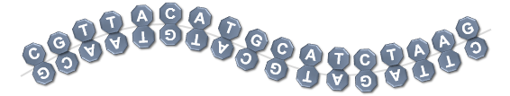
Sequence Alignment & Mapping look up read in reference sequence
1
2
3
4
5
6
7
8
9
10
11
12
13
14
15
16
17
chrN
C G T T A C A T G C A T C T A A G
Read5a
A T G C A T C T A A G
A T G C
C T T A
Read5b
C T T A G A T G C A T
G C A T
T A A G
Read6a
T T A G A T G C A T G T A A C
G T T A
T T A G
Read6b
G T T A C A T G C A T C T A A
T A A C
C T A A
Read7a
C G T T
G A T G
C G T T A C A T G C A T C
Read7b
G A T G C A T G T A A C G
A A C G
C A T C
Read5 chrN F,Paired,PairMapped,First 7 hiMQ chrN 14 11
Read5 chrN R,Paired,PairMapped,Second 14 hiMQ chrN 7 -11
Read6 chrN R,Paired,PairMapped,Second 13 hiMQ chrN 2 -15
Read6 chrN F,Paired,PairMapped,First 2 hiMQ chrN 13 15
Read7 chrN F,Paired,PairMapped,First 1 hiMQ chrN 10 13
Read7 chrN R,Paired,PairMapped,Second 10 hiMQ chrN 1 -13

Slide 24

Sequence Alignment & Mapping … allowing mismatches

Slide 25
Sequence Alignment & Mapping … allowing mismatches
fastq
bam
Variant
A
G
C
A
vcf
A
A
C
C
T
C
G
T
C
A
C
T
T
C
A
A
A
G
G
G
A
C
T
DNA
G
G
T
T
T
T
G
T T G C A T G C A T C T
Fragment
A G A T G C A T G C A A
Read8
T T G C A T G C A T C T
A G A T G C A T G C A A
1
2
3
4
5
6
7
8
9
10
11
12
13
14
15
16
17
chrN
C G T T A C A T G C A T C T A A G
T T G C
G C A A
4 Matches or Mismatches
Read8 chrN Forward 3 hiMQ 4M 3A>G
CIGAR string
Compact Ideosyncratic Gapped Alignment Report

Slide 26
Sequence Alignment & Mapping … allowing mismatches
fastq
bam
Deletion
A
C
A
vcf
A
A
C
C
T
G
T
C
A
C
T
T
C
A
A
A
G
G
G
A
C
T
DNA
G
G
T
T
T
T
G
T T C A T G C A T C T
Fragment
A G A T G C A T G A A
Read9
T T C A T G C A T C T
A G A T G C A T G A A
1
2
3
4
5
6
7
8
9
10
11
12
13
14
15
16
17
chrN
C G T T A C A T G C A T C T A A G
T T - C A
2 Matches or Mismatches
1 Deletion
2 Matches or Mismatches
T G - A A
Read9 chrN Forward 3 hiMQ 2M1D2M
CIGAR

Slide 27
Sequence Alignment & Mapping … allowing mismatches
fastq
bam
Insertion
C
A
C
A
vcf
A
A
C
A
G
T
G
T
C
A
C
T
T
C
A
A
A
G
C
T
G
A
C
T
DNA
G
G
T
T
T
G
T
G
T T G A C A T G C A T C T
Fragment
A G A T G C A T G T C A A
Read10
T T G A C A T G C A T C T
A G A T G C A T G T C A A
1
2
3
4
5
6
7
8
9
10
11
12
13
14
15
16
17
chrN
C G T T - A C A T G C A T C T A A G
T T G A
2 Matches or Mismatches
1 Insertion
1 Match or Mismatch
T C A A
Read10 chrN Forward 3 hiMQ 2M1I1M
CIGAR

Slide 28
fastq
Sequence Alignment & Mapping … allowing mismatches
bam
A
A
C
A
vcf
A
A
C
C
T
T
G
T
C
A
C
T
T
C
A
A
A
G
G
G
A
C
T
DNA
G
G
T
T
T
T
G
Fragment with
sequencing artefact
(e.g; adapter)
G G G G A T G C A T C T A A G
C T T A G A T G C A T C C C C
Read11
G G G G A T G C A T C T A A G
C T T A G A T G C A T C C C C
1
2
3
4
5
6
7
8
9
10
11
12
13
14
15
16
17
Reference
chrN
C G T T A C A T G C A T C T A A G
G G G G A T G C
4 Soft clipped
4 Matches or Mismatches
G C A T C C C C
Read11 chrN Forward 7 hiMQ 4S4M
CIGAR

Slide 29
Sequence Alignment & Mapping SAM – BAM (CRAM)
fastq
bam
BAM files are compressed SAM files
Not human readable, convert to SAM or use viewer (eg,IGV)
For archiving BAM: additional compression to CRAM
SAM format
vcf
Alignment scores
AS:best, XS:2nd best
Chr1
Mapping Quality
Sequence, Quality
Read id
position
CIGAR
Mismatch info
Read pair info
163: Forward,Paired,PairMapped,Second
83: Reverse,Paired,PairMapped,First
99: Forward,Paired,PairMapped,First
147: Reverse,Paired,PairMapped,Second
https://broadinstitute.github.io/picard/explain-flags.html
bio-bwa.sourceforge.net
samtools.sourceforge.net

Slide 30
Overview
Sequencing
fastq
Sequence of nucleotides within a read?
bam
Genomic location of a read?
vcf
Genotype of a genomic location?

Slide 31
Genotype of genomic location
fastq
bam
A
A
C
A
A
G
A
C
C
T
T
T
C
A
vcf
C
T
T
C
?
A
A
G
G
G
A
C
T
G
G
?
T
T
C
C
T
G
A
A
A
A
G
A
G
C
A
A
A
T
T
T
C
?
A
C
T
2 alleles
C
T
G
T
T
C
T
G
?
T
G
G
G
1
2
3
4
5
6
7
8
9
10
11
12
13
14
15
16
17
Reference
chrN
C G T T A C A T G C A T C T A A G
?
Homozygous
Reference
Heterozygous
Variant
Homozygous
Variant
A
A
C
T
T
G
A
A
or
C
A
C
or
C
C
A
C
T
G
G

Slide 32
Genotype of genomic location
fastq
bam
Homozygous
Reference (R)
Heterozygous
Variant (H)
Homozygous
Variant (V)
or
or
vcf
A
A
A
C
C
C
Strategy 1: probabilistic method (e.g. GATK)
Which genotype maximizes the likelihood of the observed reads?
Strategy 2: machine learning (e.g. DeepVariant)
Which genotype is most consistent with millions of examples?

Slide 33

Genotype of genomic location
fastq
bam
Homozygous
Reference (R)
Heterozygous
Variant (H)
Homozygous
Variant (V)
or
or
vcf
A
A
A
C
C
C
Strategy 1: probabilistic method (e.g. GATK)
Which genotype maximizes the likelihood of the observed reads?
"When you have eliminated all which is impossible,
then whatever remains, however improbable,
must be the truth.“ —Sherlock Holmes

Slide 34
Genotype of genomic location
fastq
bam
Homozygous
Reference (R)
Heterozygous
Variant (H)
Homozygous
Variant (V)
or
or
vcf
A
A
A
C
C
C
Strategy 2: machine learning (e.g. DeepVariant)
Which genotype is most consistent with millions of examples?
Train convolutional neural network to recognize genotype
Similar to image classification which uses 3 input channels: RGB
DeepVariant uses 6 input channels:
Read base
Base quality
Mapping quality
Strand of alignment
Read supports variant
Base differs from ref

Slide 35
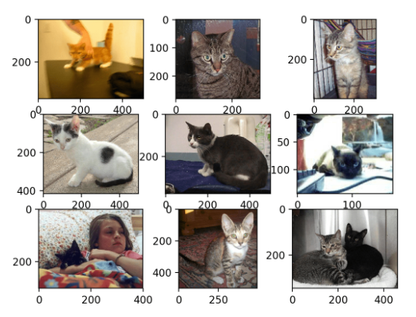
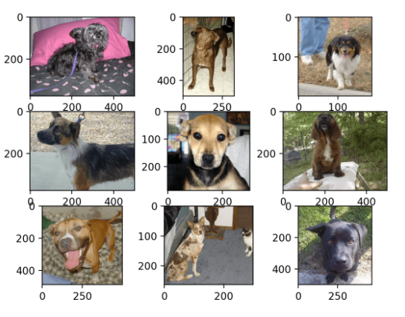
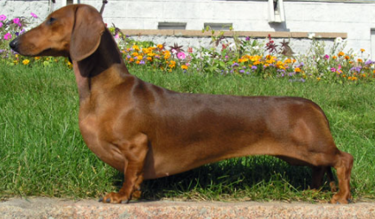
Examples of cats
Examples of dogs
Deep Learning
training
?
Dog vs cat
classifier
DOG

Slide 36




Source: https://google.github.io/deepvariant/posts/2020-02-20-looking-through-deepvariants-eyes/
Examples of HomRef
Examples of HetVar
Examples of HomVar
Deep Learning
training
HomRef vs HetVar vs HomVar
classifier
?
HetVar

Slide 37
Overview
Sequencing
fastq
Sequence of nucleotides within a read?
bam
Genomic location of a read?
vcf
Genotype of a genomic location?

