Slide 1


From Sample Preparation to Sequencing:
Experimental Design, Library Preparation
and Sequencing: 10x and SMART-Seq
Annelien Verfaillie
25th Feb 2021

Slide 2
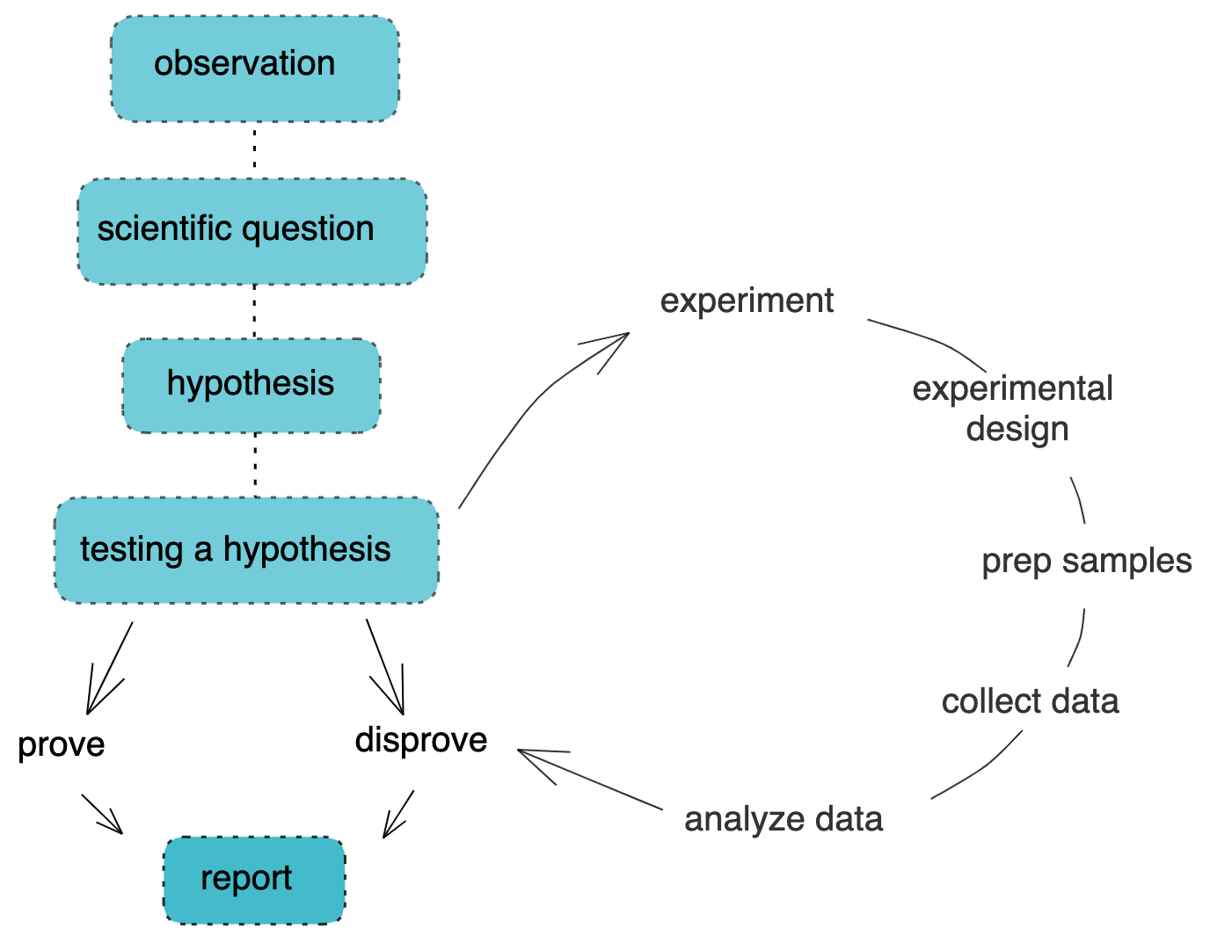
Notes:
You have a biological question and you are looking for the best way to answer. We are here today to give you an insight in how RNA-seq works and how it might fit into your scientific work and help you get some of your answers to your questions.
Just like any experiment RNA-seq starts with a good experimental design. Once you have this in place you can move into preparing and executing the experiments to gather your data. You then proceed to analysing this data to look at what answers you can find with regards to your question.

Slide 3
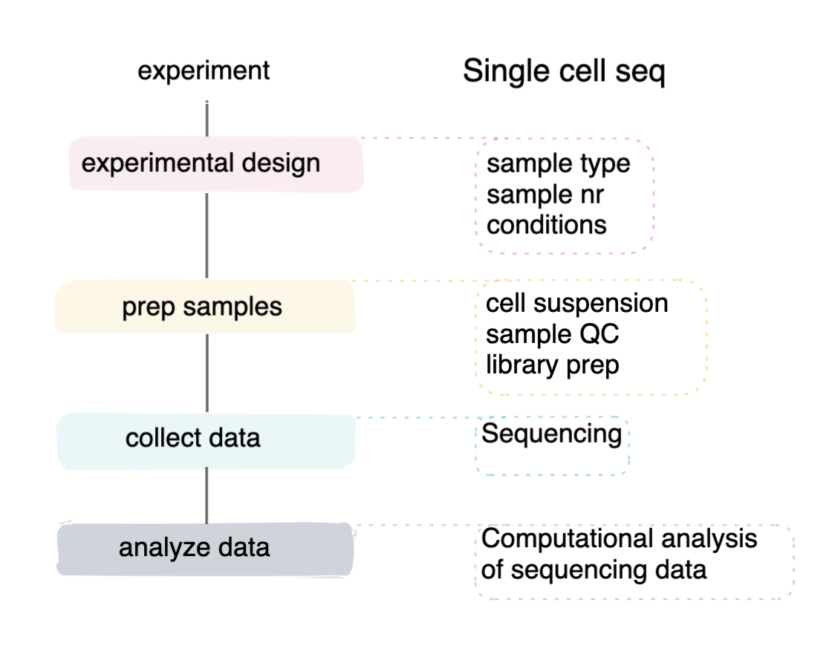

Slide 4
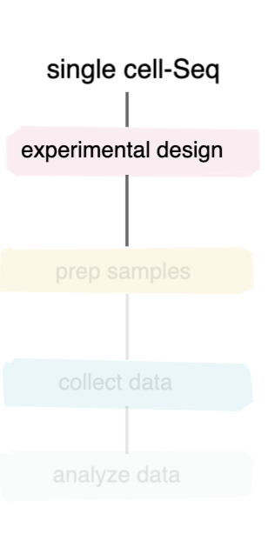
What is my scientific question?
Notes:
There are many single cell techniques being developed, some more experimental than others.

Slide 5
What is my scientific question?
retaining spatial information
yes
no
10x visium
interested in DNA or RNA
Notes:
Implication on input material, cost and time of your experiment.

Slide 6
What is my scientific question?
retaining spatial information
yes
no
10x visium
interested in DNA or RNA
DNA
Interested in epigenetics
Notes:
Implication on input material, cost and time of your experiment.

Slide 7
What is my scientific question?
retaining spatial information
yes
no
10x visium
interested in DNA or RNA
DNA
Interested in epigenetics
yes
no
10x ATAC
scDNA seq
scBS seq
Cut and run
Methylation
…
Notes:
Implication on input material, cost and time of your experiment.

Slide 8
What is my scientific question?
retaining spatial information
yes
no
10x visium
interested in DNA or RNA
DNA
RNA
Interested in epigenetics
3’ vs 5’ mRNA
yes
no
10x ATAC
scDNA seq
scBS seq
Cut and run
Methylation
…
Notes:
Implication on input material, cost and time of your experiment.

Slide 9
What is my scientific question?
retaining spatial information
yes
no
10x visium
interested in DNA or RNA
DNA
RNA
Interested in epigenetics
3’ vs 5’ mRNA
yes
no
3’
5’
10x ATAC
scDNA seq
Full
transcript?
10x 5’ immune profiling
scBS seq
Cut and run
Methylation
…
Notes:
Implication on input material, cost and time of your experiment.

Slide 10
What is my scientific question?
retaining spatial information
yes
no
10x visium
interested in DNA or RNA
DNA
RNA
Interested in epigenetics
3’ vs 5’ mRNA
yes
no
3’
5’
10x ATAC
scDNA seq
Full
transcript?
10x 5’ immune profiling
scBS seq
Cut and run
Methylation
…
yes
no
SMART-seq
10x RNA seq
Notes:
Implication on input material, cost and time of your experiment.

Slide 11
What is my scientific question?
retaining spatial information
yes
no
10x visium
interested in DNA or RNA
DNA
RNA
Interested in epigenetics
3’ vs 5’ RNA
yes
no
3’
5’
10x ATAC
scDNA seq
Full
transcript?
10x 5’ immune profiling
scBS seq
Cut and run
Methylation
…
yes
no
SMRT-seq
10x RNA seq
Notes:
Implication on input material, cost and time of your experiment.

Slide 12
SMART-seq vs 10x 3’ RNA seq
 | SMART seq | 10x 3’ RNA
RNA type | mRNA* | mRNA
transcript | full | 3’ end
sensitivity | high | medium
sequencing | deep | shallow
Cost per cell | high | medium
Single cell “seperation” | 96-well plate | droplet formation
throughput | Low | high
Detecting heterogeneity | low | high
Specific properties | Focus on subpopulations via FACS sorting | Feature barcoding
* There is now an experimental protocol aiming for total RNA
Notes:
Implication on input material, cost and time of your experiment.

Slide 13
My scientific question is “and” and not “or”
Multi-omics in single cell sequencing
genome
epigenome
G&T seq
+ATAC
M&T seq
NMT seq
transcrip tome
CITE-seq
proteome
Notes:
single-cell nucleosome, methylation and transcription sequencing

Slide 14
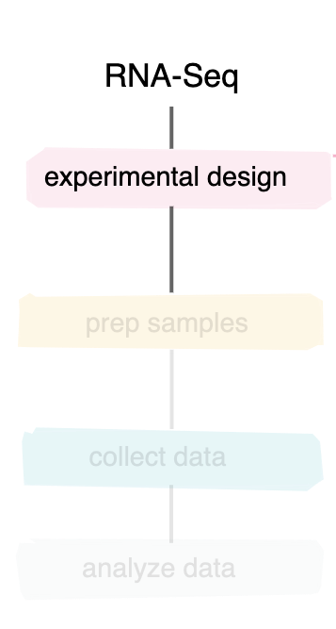
What do I need?
Starting material
Single cell or nuclei suspension
Cell lines > Fresh tissue > Frozen tissue
Avoid frozen or fixed cell suspension if possible
Consider timing and processing

Slide 15
What do I need?
Starting material
Single cell or nuclei suspension
Cell lines > Fresh tissue > Frozen tissue
Avoid frozen or fixed cell suspension if possible
Consider timing and processing
Sufficient conditions to draw your conclusions
drug vs no drug , cancer vs normal
note that the experimental question is crucial
do you want to explore (what is my tissue made up of)
do you want to link presence/absence of clusters/cell types to your condition

Slide 16
What do I need?
Starting material
Single cell or nuclei suspension
Cell lines > Fresh tissue > Frozen tissue
Avoid frozen or fixed cell suspension if possible
Consider timing and processing
Sufficient conditions to draw your conclusions
drug vs no drug , cancer vs normal
note that the experimental question is crucial
do you want to explore (what is my tissue made up of)
do you want to link presence/absence of clusters/cell types to your condition
What about replicates?

Slide 17
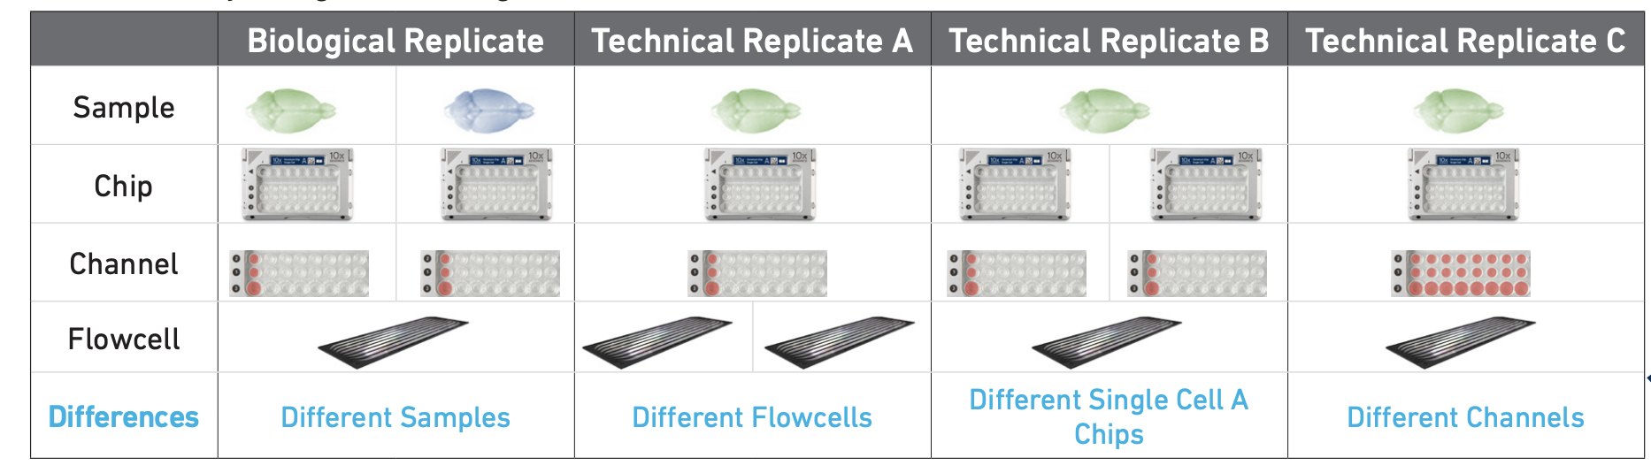
Single cell and replicates
Technical
Correct for variation due to sample handling
Biological
Correct for variation in the population
https://assets.ctfassets.net/an68im79xiti/3Q2nLWJ3hu6oIQWu8u66kQ/c2f2d89c1487131abc9a60cf89d00766/CG000170_TechNote_BiologicalandTechnicalVariationinSingleCell3_GeneExpressionExperiments_RevA_.pdf
Notes:
However is this what a replicate means in a single cell experiment

Slide 18
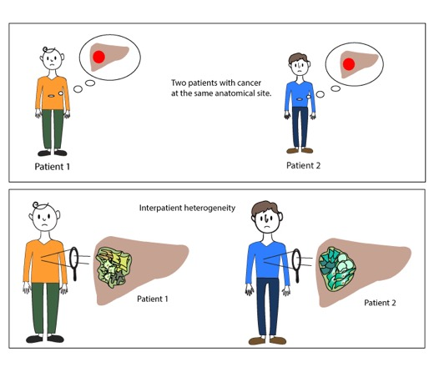
Single cell and replicates
What does “biological replicate” mean in single cell
Within one sample → cells of a similar type can be considered a replicate of each other
Biological replicates can show different clustering when driven by genetic background and not by altered gene expression

Slide 19
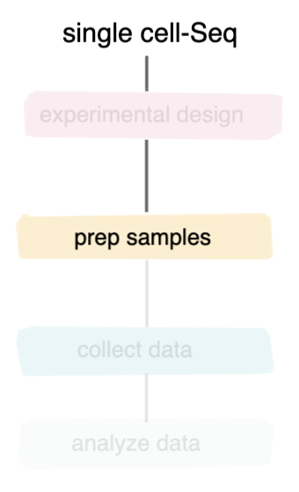
Set up experiment
generate single cell suspensions
You
QC
the genomics core (or you)
Library prep

Slide 20
Set up experiment
generate single cell suspensions
You
QC
the genomics core (or you)
Library prep

Slide 21
Preparing single cell suspensions
Fresh material
Frozen material
tissue specific methodology
Requires optimization
Mechanical and/or enzymatic dissociation
cells
nuclei

Slide 22
Preparing single cell suspensions
Fresh material
Frozen material
Mechanical and/or enzymatic dissociation
cells
nuclei

Slide 23
Preparing single cell suspensions
Fresh material
Frozen material
tissue specific methodology
Requires optimization
Mechanical and/or enzymatic dissociation
cells
nuclei

Slide 24
Preparing single cell suspensions
Fresh material
Frozen material
tissue specific methodology
Requires optimization
Mechanical and/or enzymatic dissociation
cells
nuclei
Process right away
Storing cell suspension
“unmodified”
“modified”
Cell hashing
Antibody labeling
…
DMSO based freezing
Fixation methods:
Methanol, paraformaldehyde

Slide 25
QC single cell suspensions
viability
debris
clumps
Sufficient cells

Slide 26
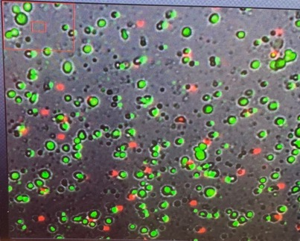
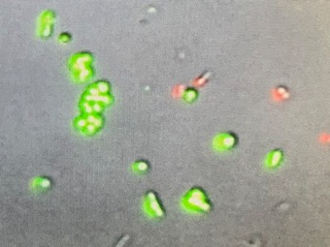


QC single cell suspensions
viability
debris
clumps
Sufficient cells

Slide 27
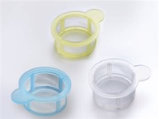
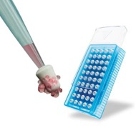
QC single cell suspensions
Filtering: a balance of time, removal and cleanliness
Simple filters:
+ Fast
+ Good for large debris and clumps
doesn’t remove ambient material or small debris
Can cause cloggs and cell loss
FACS sorting
+ Good for smaller debris and ambient material
- Time consuming
- Dilution of sample volume
Centrifugation gradient, specialized columns, dead cell removal kits, RBC lysis

Slide 28
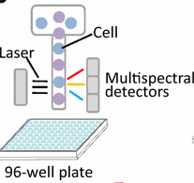
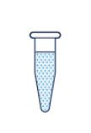
Preparing single cell suspensions
SMART-seq
10x
FACS sorting into 96 well plate
1 cell per well
Directly into lysis buffer
Positive controls
Negative controls
Tube with at least 50,000 cells/50 µl
PBS with low BSA content
Clump and debris free
Tagged or treated (feature barcoding)

Slide 29
Set up experiment
generate single cell suspensions
You
QC
the genomics core (or you)
Library prep

Slide 30
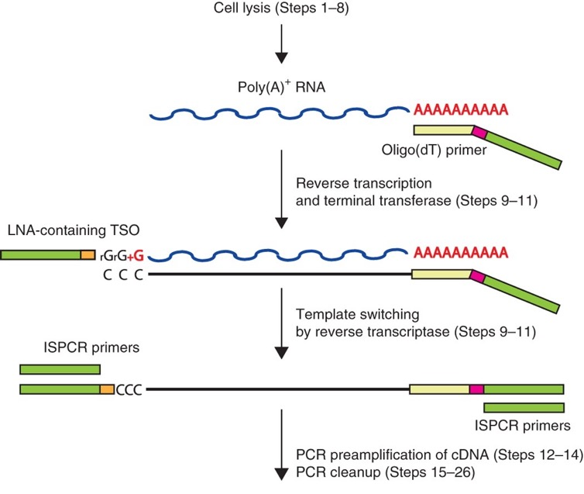
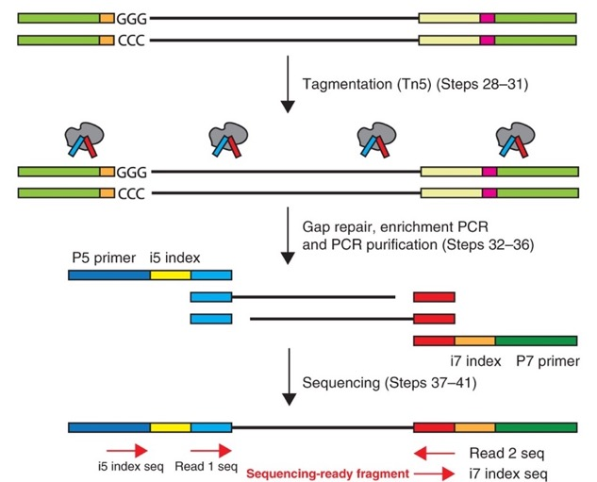
Library prep: SMART-seq

Slide 31
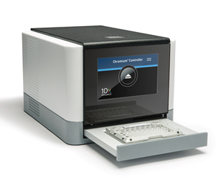
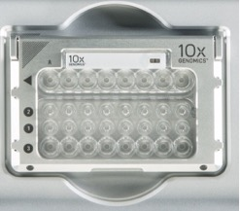
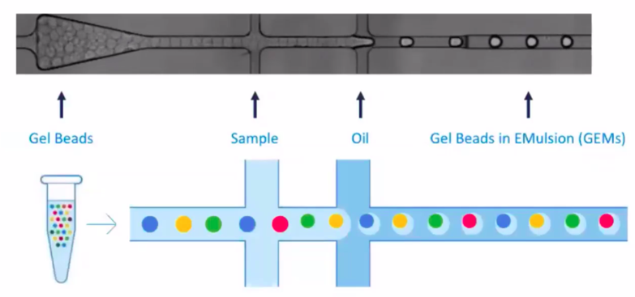
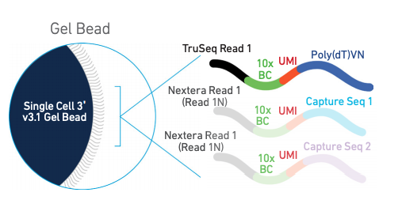
Library prep: 10x 3’ RNA-seq
Cell suspension

Slide 32
Library prep: 10x 3’ RNA-seq
Loading vs recovering
1) Volume and cell concentration

Slide 33
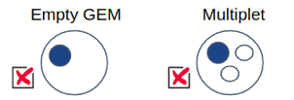
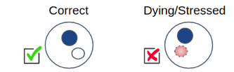
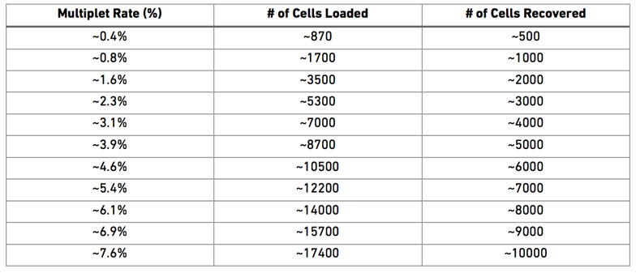
Library prep: 10x 3’ RNA-seq
Loading vs recovering
1) Volume and cell concentration
2) droplet formation
Not all gems have a cell
60-70% recovery

Slide 34
Library prep: 10x 3’ RNA-seq
Loading vs recovering
1) Volume and cell concentration
2) droplet formation
Not all gems have a cell
60-70% recovery
3) Overloading → doublets

Slide 35
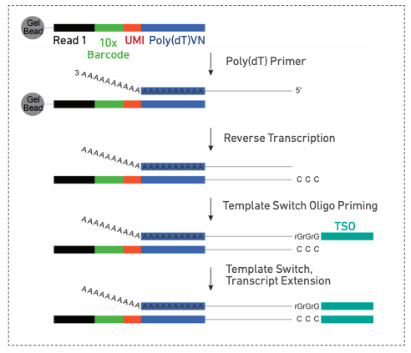
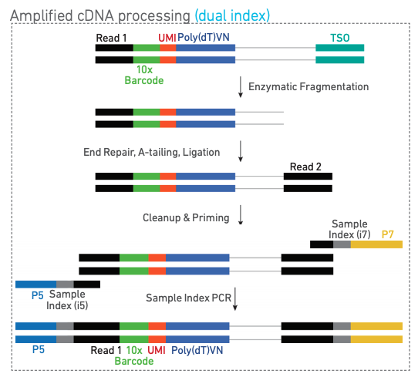
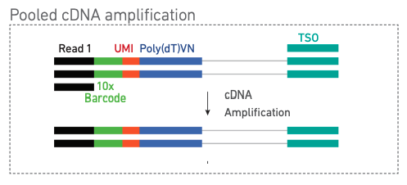
Library prep: 10x 3’ RNA-seq

Slide 36
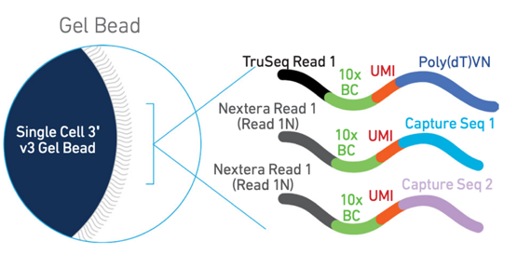
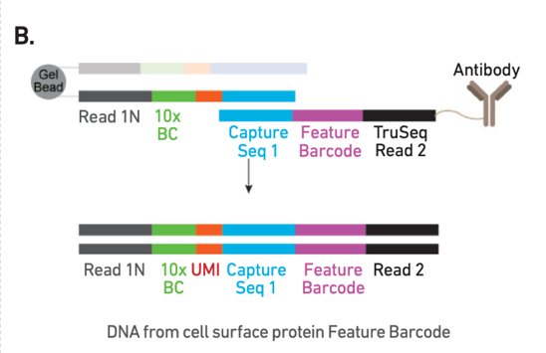
Library prep: 10x feature barcoding

Slide 37
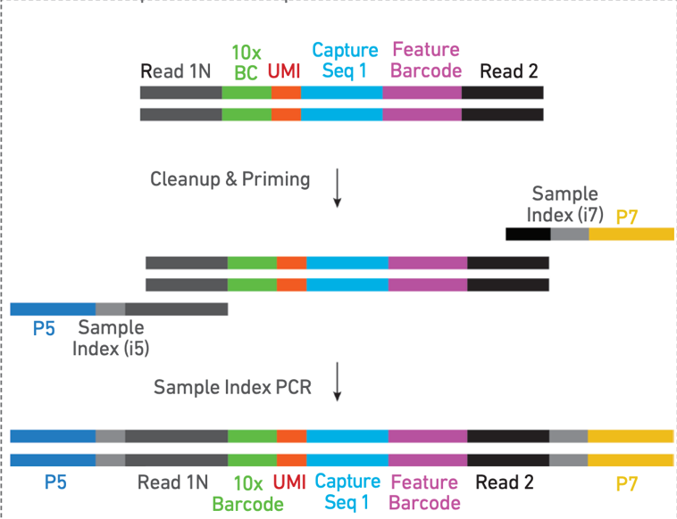
Library prep: 10x feature barcoding

Slide 38
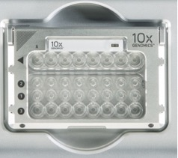
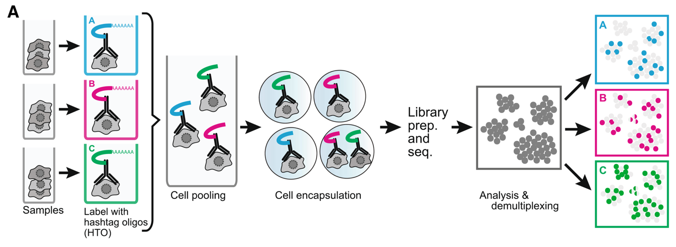
Library prep: cell hashing
1 channel = 1 library = ~10,000 cells

Slide 39
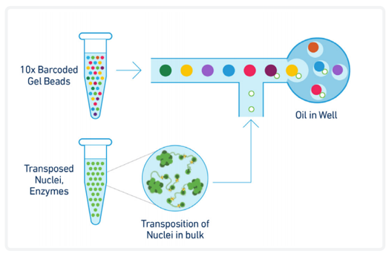
Library prep: 10x ATAC seq

Slide 40
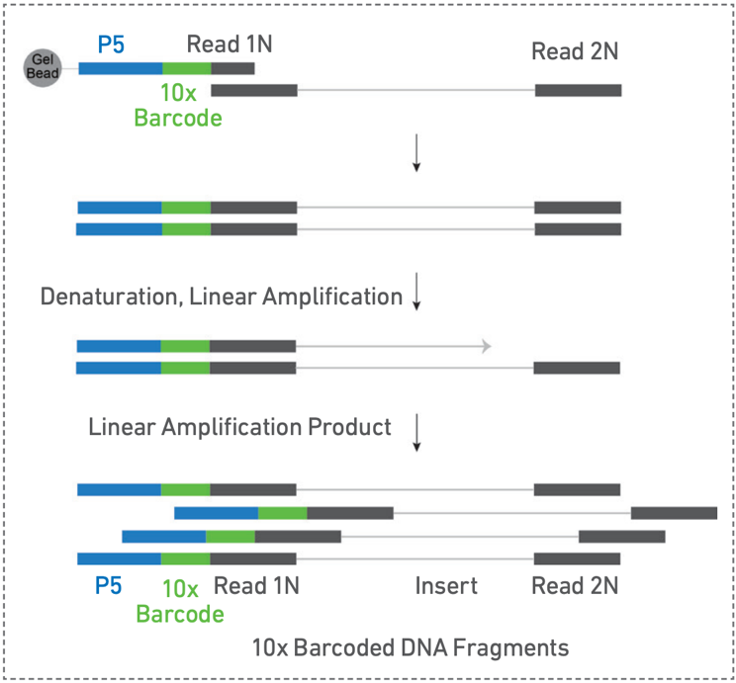
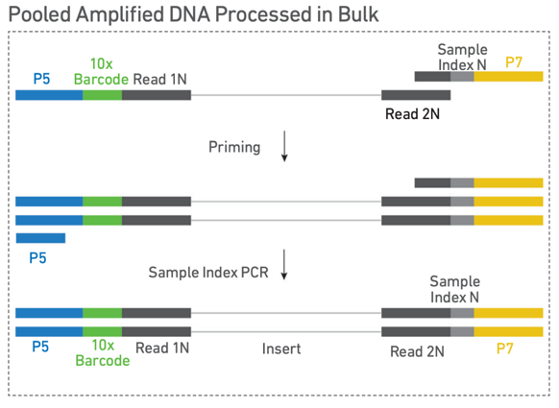
Library prep: 10x ATAC seq

Slide 41
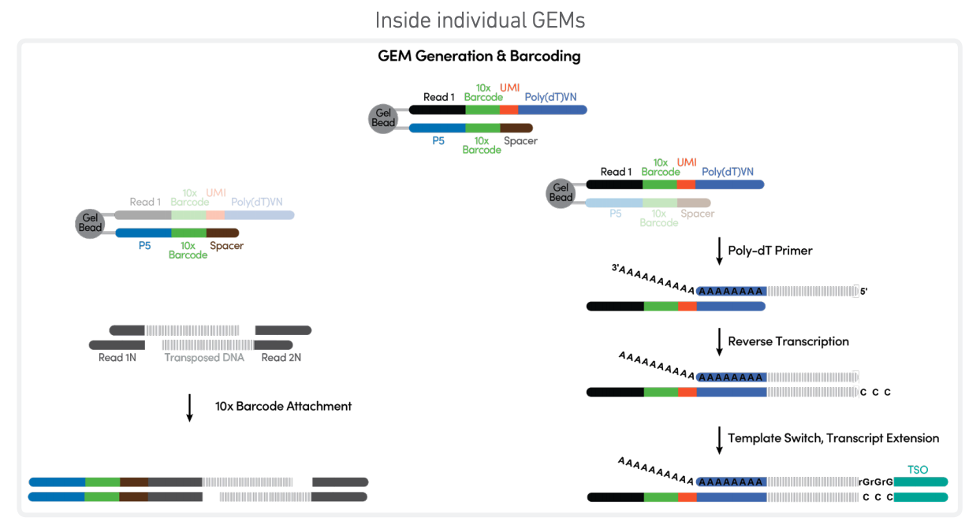
Library prep: 10x ATAC + RNA seq
1 sample but 2 libraries

Slide 42
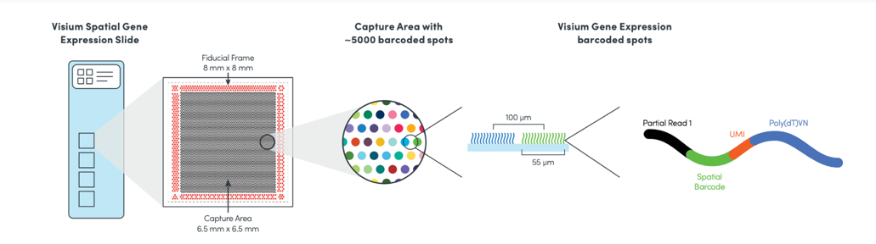
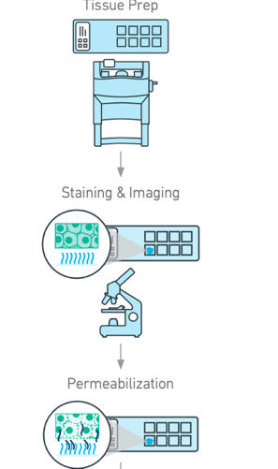
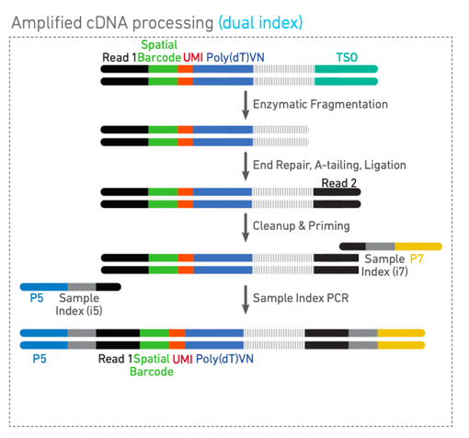
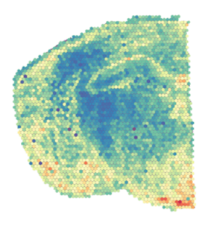
Library prep: 10x visium

Slide 43
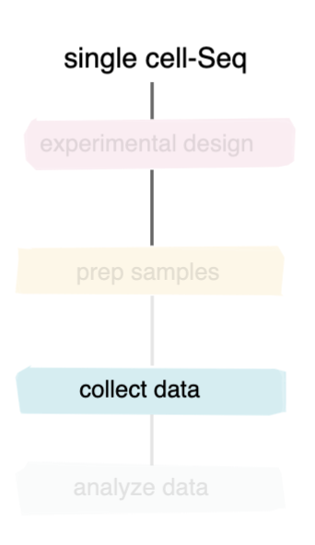
Sequencing

Slide 44
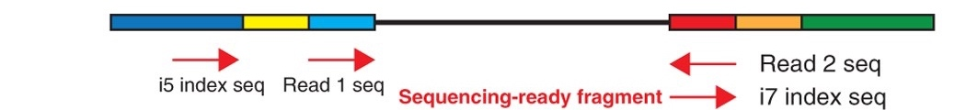
Sequencing
SMART seq
Single read 50 bp is sufficient
Unique cell identifier info is in the standard indexing
1-2M reads per cell is sufficient

Slide 45
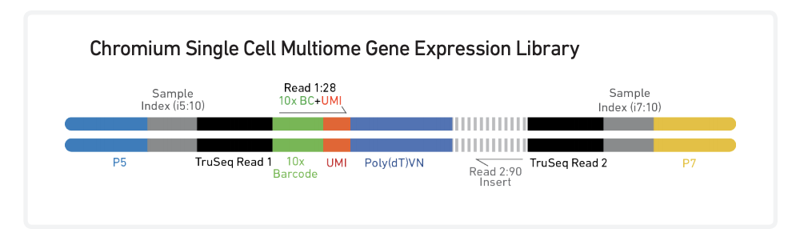
Sequencing
10x RNA seq
Unique cell identifier info is in read 1
Unique configuration: 28-8-8-91
25000 reads per cell
Feauture barcoding and cell hashing
identical configuration
Less reads per cell

Slide 46

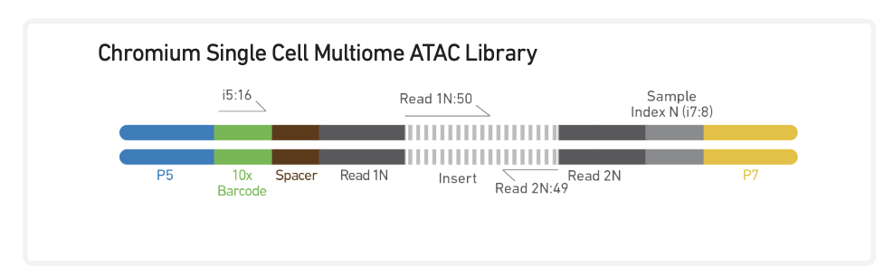
Sequencing
10x RNA seq
Unique cell identifier info is in read 1
Unique configuration: 28-8-8-91
25000 reads per cell
Feauture barcoding and cell hashing
identical configuration
Less reads per cell
10x ATAC seq
25000 reads per cell
unique cell identifier info is in index2
Configuration is 150-8-16-150

Slide 47
Sequencing
10x staggered sequencing approach:
How successful is my library?
QC of a library does not reveal all

Slide 48
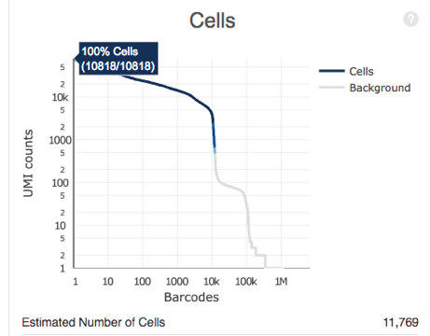
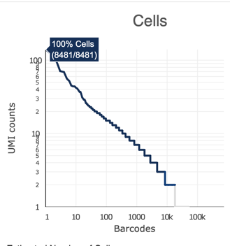
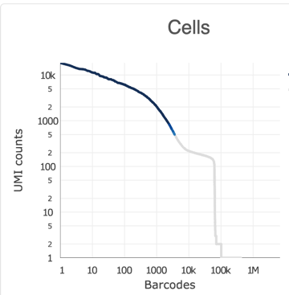
Sequencing
10x staggered sequencing approach:
How successful is my library?
QC of a library does not reveal all
1) degraded RNA → library profile is fine but TSO primer
2) ambient RNA → library profile ok but no clear cell distinction
3) nr of cells captured
4) saturation level

Slide 49
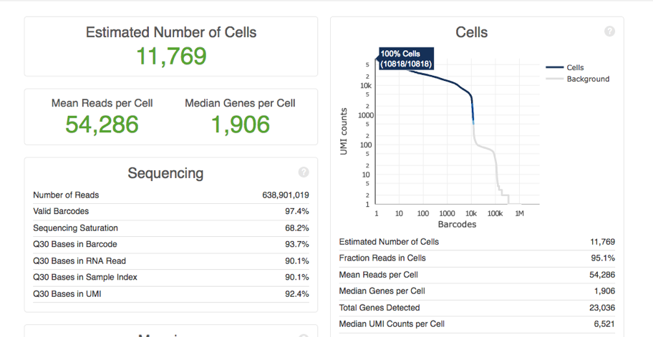
Sequencing
10x staggered sequencing approach:
Shallow seq: 3000-5000 reads per cell (~20% of recommended)
1) good estimate of true captured cells
2) Indication of required depth (ie saturation level)
We can combine several projects on a shallow run to make it more price efficient.

Slide 50
Sequencing
10x staggered sequencing approach:
Shallow seq: 3000-5000 reads per cell (~20% of recommended)
1) good estimate of true captured cells
2) Indication of required depth (ie saturation level)
B. Deep sequencing:
based on the above results → re-estimate the true required reads needed
samples that do not generate reliable data can be eliminated

Slide 51
Interesting literature
Sample prep, replicates and experimental set up
https://www.nature.com/articles/s41591-020-0844-1/#Sec1
https://www.nature.com/articles/s12276-018-0071-8
https://genomemedicine.biomedcentral.com/articles/10.1186/s13073-017-0467-4
https://www.onlinelibrary.wiley.com/doi/full/10.1002/cyto.a.23690
https://assets.ctfassets.net/an68im79xiti/3Q2nLWJ3hu6oIQWu8u66kQ/c2f2d89c1487131abc9a60cf89d00766/CG000170_TechNote_BiologicalandTechnicalVariationinSingleCell3_GeneExpressionExperiments_RevA_.pdf
https://www.10xgenomics.com/resources/support-documentation/
https://www.nature.com/articles/s41591-018-0096-5
Overview of interesting single cell techniques
https://science.sciencemag.org/content/358/6359/69.full
https://www.whatisepigenetics.com/overview-single-cell-epigenomics-methods/
https://www.nature.com/news/single-cell-sequencing-made-simple-1.22233

Slide 52
You are all set to start your first single cell sequencing experiment!
Still not sure on how to proceed?
Contact the Genomics Core for more info
info@genomicscore.be

