Slide 1


RNA-Seq @ Genomics Core
From Fastq Files to Differentially Expressed Genes
Alvaro Cortés C. & Koen Herten

Slide 2

Why this presentation?
Yes: 12
No: 30

Slide 3
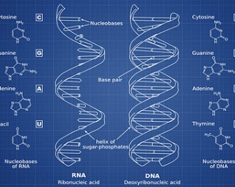
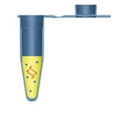
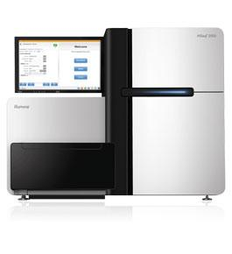

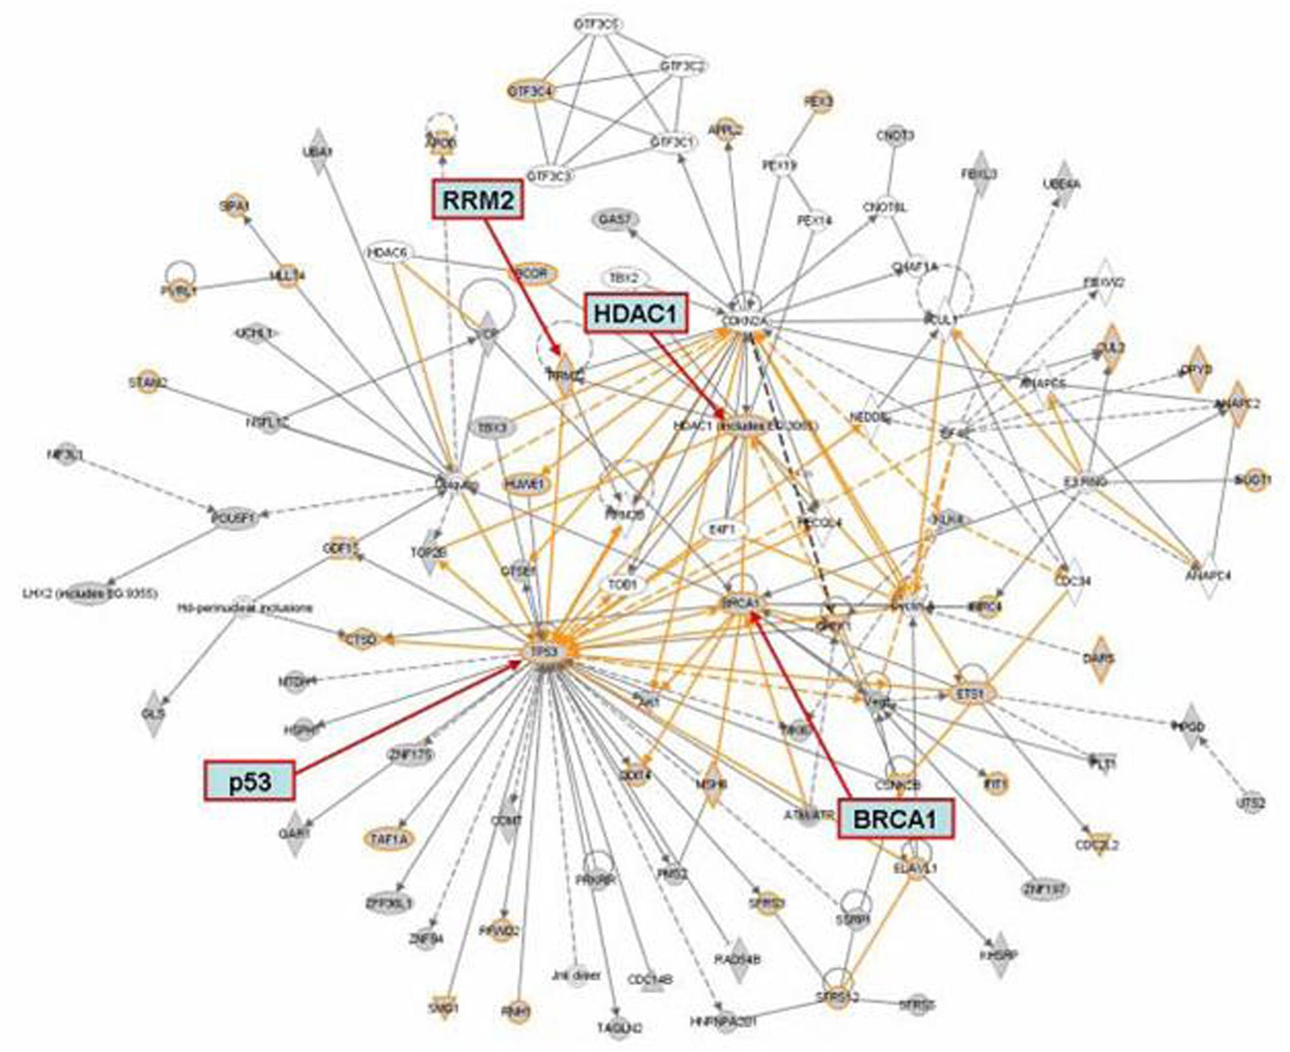
From RNA Molecules to Differential Expression of Genes
Experimental Design
Downstream Analysis
Sequencing
Library Preparation
Bioinformatics

Slide 4
Reads and RNA Abundance
Sequencer produces millions of reads and a qualification for each base call
How reads relate to expression of genes?
  Observations: read (counts)
  Goal: discover changes in abundance between conditions
Read count is linearly related to the abundance of the target transcript

Slide 5
Estimating Differential Expression of Genes I
Count the number of reads that map into annotated genes
  Map: Align reads w.r.t. a reference genome (transcriptome)
  Count: number of aligned reads per feature (genes).
4
Reference Genome

Slide 6
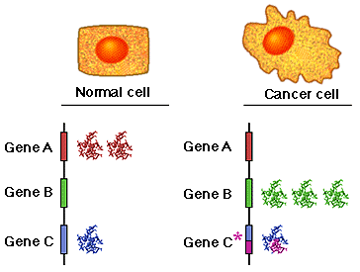
Estimating Differential Expression of Genes II
Perform statistical analysis on the counts, to discover:
quantitative changes in expression levels between experimental groups
Normalization of counts
Probabilistic modeling of read counts
Estimate differential expression

Slide 7
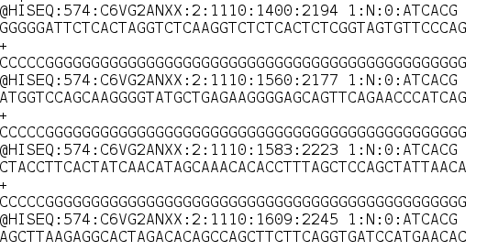
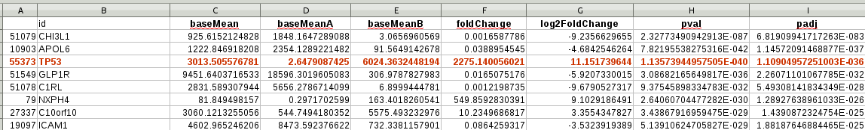
Data Flow
Reference genome
Fastq: reads
Alignment: SAM/BAM
1,2,3,4
1,2,3
.counts files: reads per gene
(Excel) DE table: reads per gene

Slide 8
KOEN SLIDES

Slide 9
Counting Reads in HTSeq(*)
(*) Simon Anders, Wolfgang Huber (EMBL)
Resulting table of absolute counts for each sample and feature:
Sample 1 Sample 2 Sample 3 Sample4
FBgn0000003 0 0 0 1
FBgn0000008 76 70 88 70
FBgn0000014 0 0 0 0
FBgn0000015 1 2 0 0
FBgn0000017 3564 3150 3072 3334
FBgn0000018 245 310 299 308
1
2
3
4
Library sizes

Slide 10
Normalization of Counts: Impact Library Size
Library 1
Library 2
A bigger library produces more reads...But in slide 3:
“Read Counts is linearly related to the abundance of the target transcript”

Slide 11
Normalization of Counts: Size Factors
Adjust for library sizes to produce count values in a common scale:
Sample 1 Sample 2 Sample 3 Sample4
0.873 1.011 1.022 1.115
Sample 1 Sample 2 Sample 3 Sample4
FBgn0000003 0 0 0 1
FBgn0000008 76 70 88 70
FBgn0000014 0 0 0 0
FBgn0000015 1 2 0 0
FBgn0000017 3564 3150 3072 3334
FBgn0000018 245 310 299 308
Normalized counts
Feature Sample 1 Sample 2 Sample 3 Sample4
FBgn0000003 0.00 0.00 0.0 0.897
FBgn0000008 87.05 69.27 86.1 62.803
FBgn0000014 0.00 0.00 0.0 0.000
FBgn0000015 1.15 1.98 0.0 0.000
FBgn0000017 4082.02 3116.93 3004.5 2991.238
FBgn0000018 280.61 306.75 292.4 276.335
Size factors
1
2
3
4
Library sizes
76/0.873 = 87.05

Slide 12
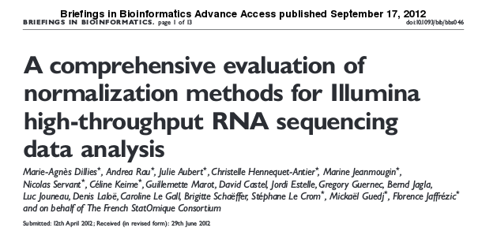
More on Counting and Normalization
Possible extra normalization:
  Longer transcripts are more likely to have sequences mapped to their genes
    Higher counts, biasing comparisons between transcripts of different lengths.
  RPKM - Reads per kilo base per million mapped reads
“based on three real mRNA and one miRNA-seq datasets,we confirm previous observations that RPKM and TC, both of which are still widely in use [40,41], are ineffective and should be definitively abandoned
in the context of differential analysis”

Slide 13
Differential Expression
Statistical test: Decide whether for a given gene, an observed difference in reads counts is significant
Comparison between different biological conditions
  Read counts per gene are modeled by a probability distribution

Slide 14
Grouping Samples Per condition
GC037126
GC037130
GC037131
GC037127
GC037131
GC037132
GC037128
GC037129
GC037133
Control
Condition 1

Slide 15
Differential Expression at Genomic Core?
Method | Normalization | Read Count Distribution Assumption
EdgeR | TMM (Trimmed Mean of M values) Upper quartile | Negative binomial distribution
DESeq | DESeq sizeFactors | Negative binomial distribution
Cuffdiff2 (CuffLinks) | Geometric Quartile Classic-FPKM | Beta negative binomial distribution

Slide 16
https://github.com/GenomicsCoreLeuven/rnaseq_workshop

Slide 17
Interpreting DE Result
Open in Excel (or text editor) file:
Normal_vs_Condition1.significant_genes_result_table.ordered_by_significantly_differentially_expressed.csv

Slide 18
Interpreting DE Results
Means between conditions of normalized nr reads
Fold Change
2275 x 2,64 = 6024
P-value
Log2 Fold Change
2^11.15 = 2275
Adjusted P-value (or q value)
Mean of normalized reads in samples per group
Gene Name
Gene Name

Slide 19
Interpreting DE Results DESeq
Adjusted p-value for FDR control:
If one takes all genes with an adjusted p value below a threshold f,
then the list of these genes contains (in expectation) at most a proportion f of false positives,
thresholding adjusted p values at f controls the FDR at f.

Slide 20
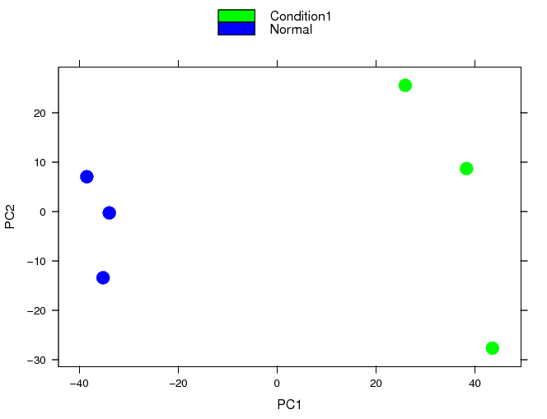
Principal Components Analysis DESeq

Slide 21
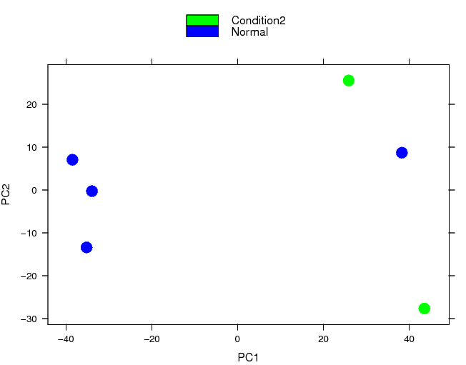
Principal Components Analysis DESeq

Slide 22
Principal Components Analysis DESeq

Slide 23
RNA-Seq at Genomics Core
Project Management & Experimental Design
  Jeroen Van Houdt
  jeroen.vanhoudt@uzleuven.be
  Celine Hermoortsel
celine.helsmoortel@uzleuven.be
Alvaro Cortés Calabuig
alvaro.cortes@uzleuven.be
Laboratory Support IPA Analysis
Vanessa Brys Julio Finalet F.
vanessa.brys@uzleuven.be julio.finaletferreiro@kuleuven.be
Bioinformatics Analysis & Reporting
Koen Herten Álvaro Cortés Calabuig
koen.herten@uzleuven.be alvaro.cortes@uzleuven.be
koen.herten@kuleuven.be

