Slide 1

The 18th Workshop of the Genomic Standards Consortium (GSC)
Coordinating Metadata Standards and
“putting the standards into action”
June 12-15th, 2016
Hellenic Center for Marine Research
Local Hosts and Organizers
Georgios Kotoulas, Vangelis Pafilis, Melina Stavroulaki
http://gensc.org/

Slide 2
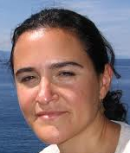
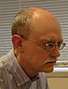
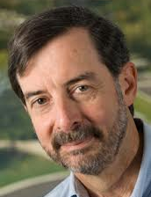
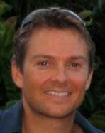
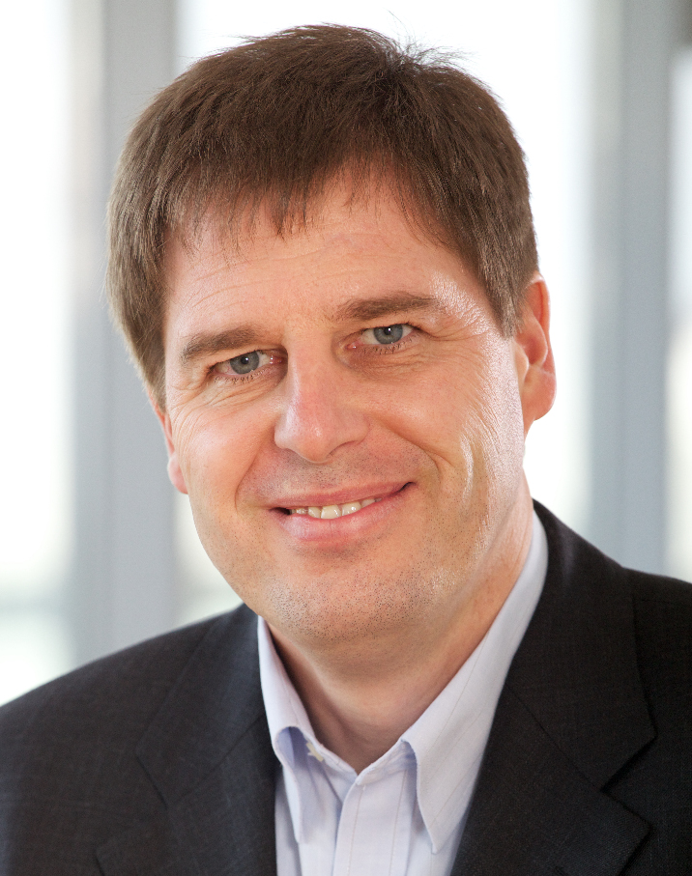
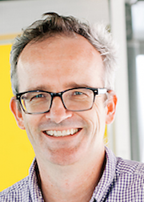
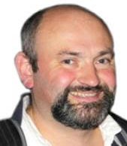
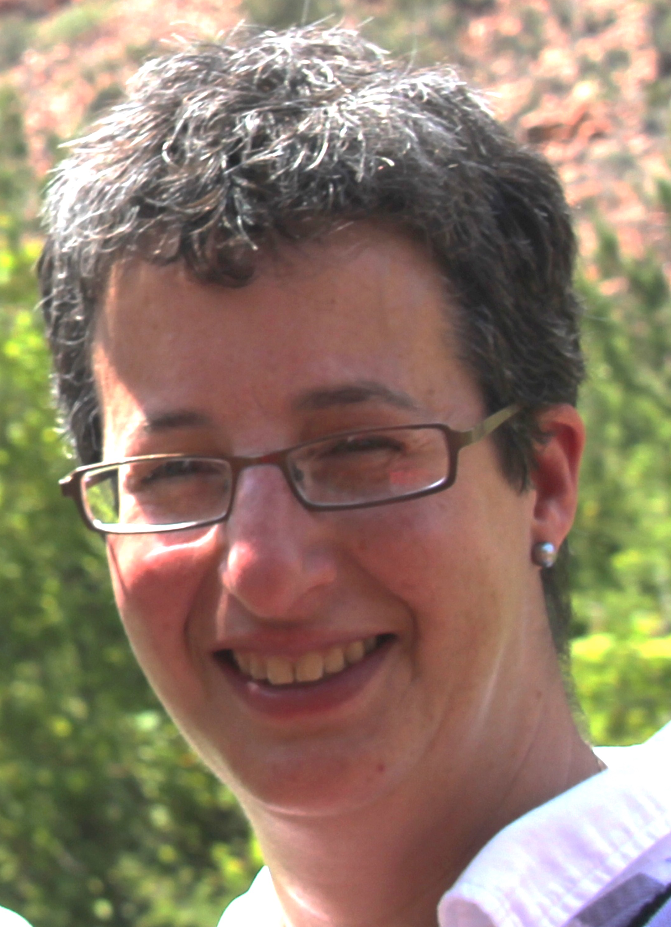
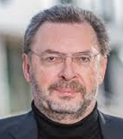
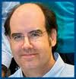
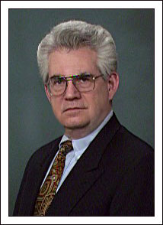
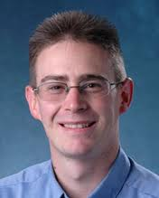
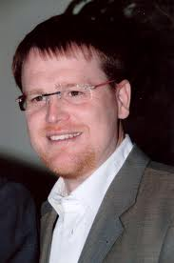
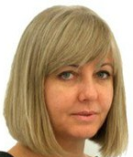
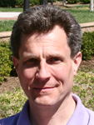
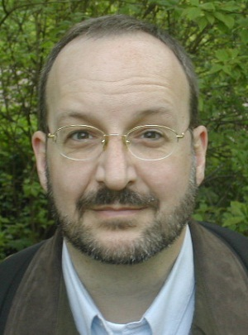
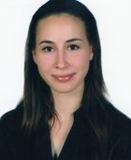
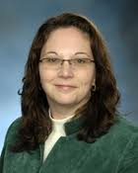
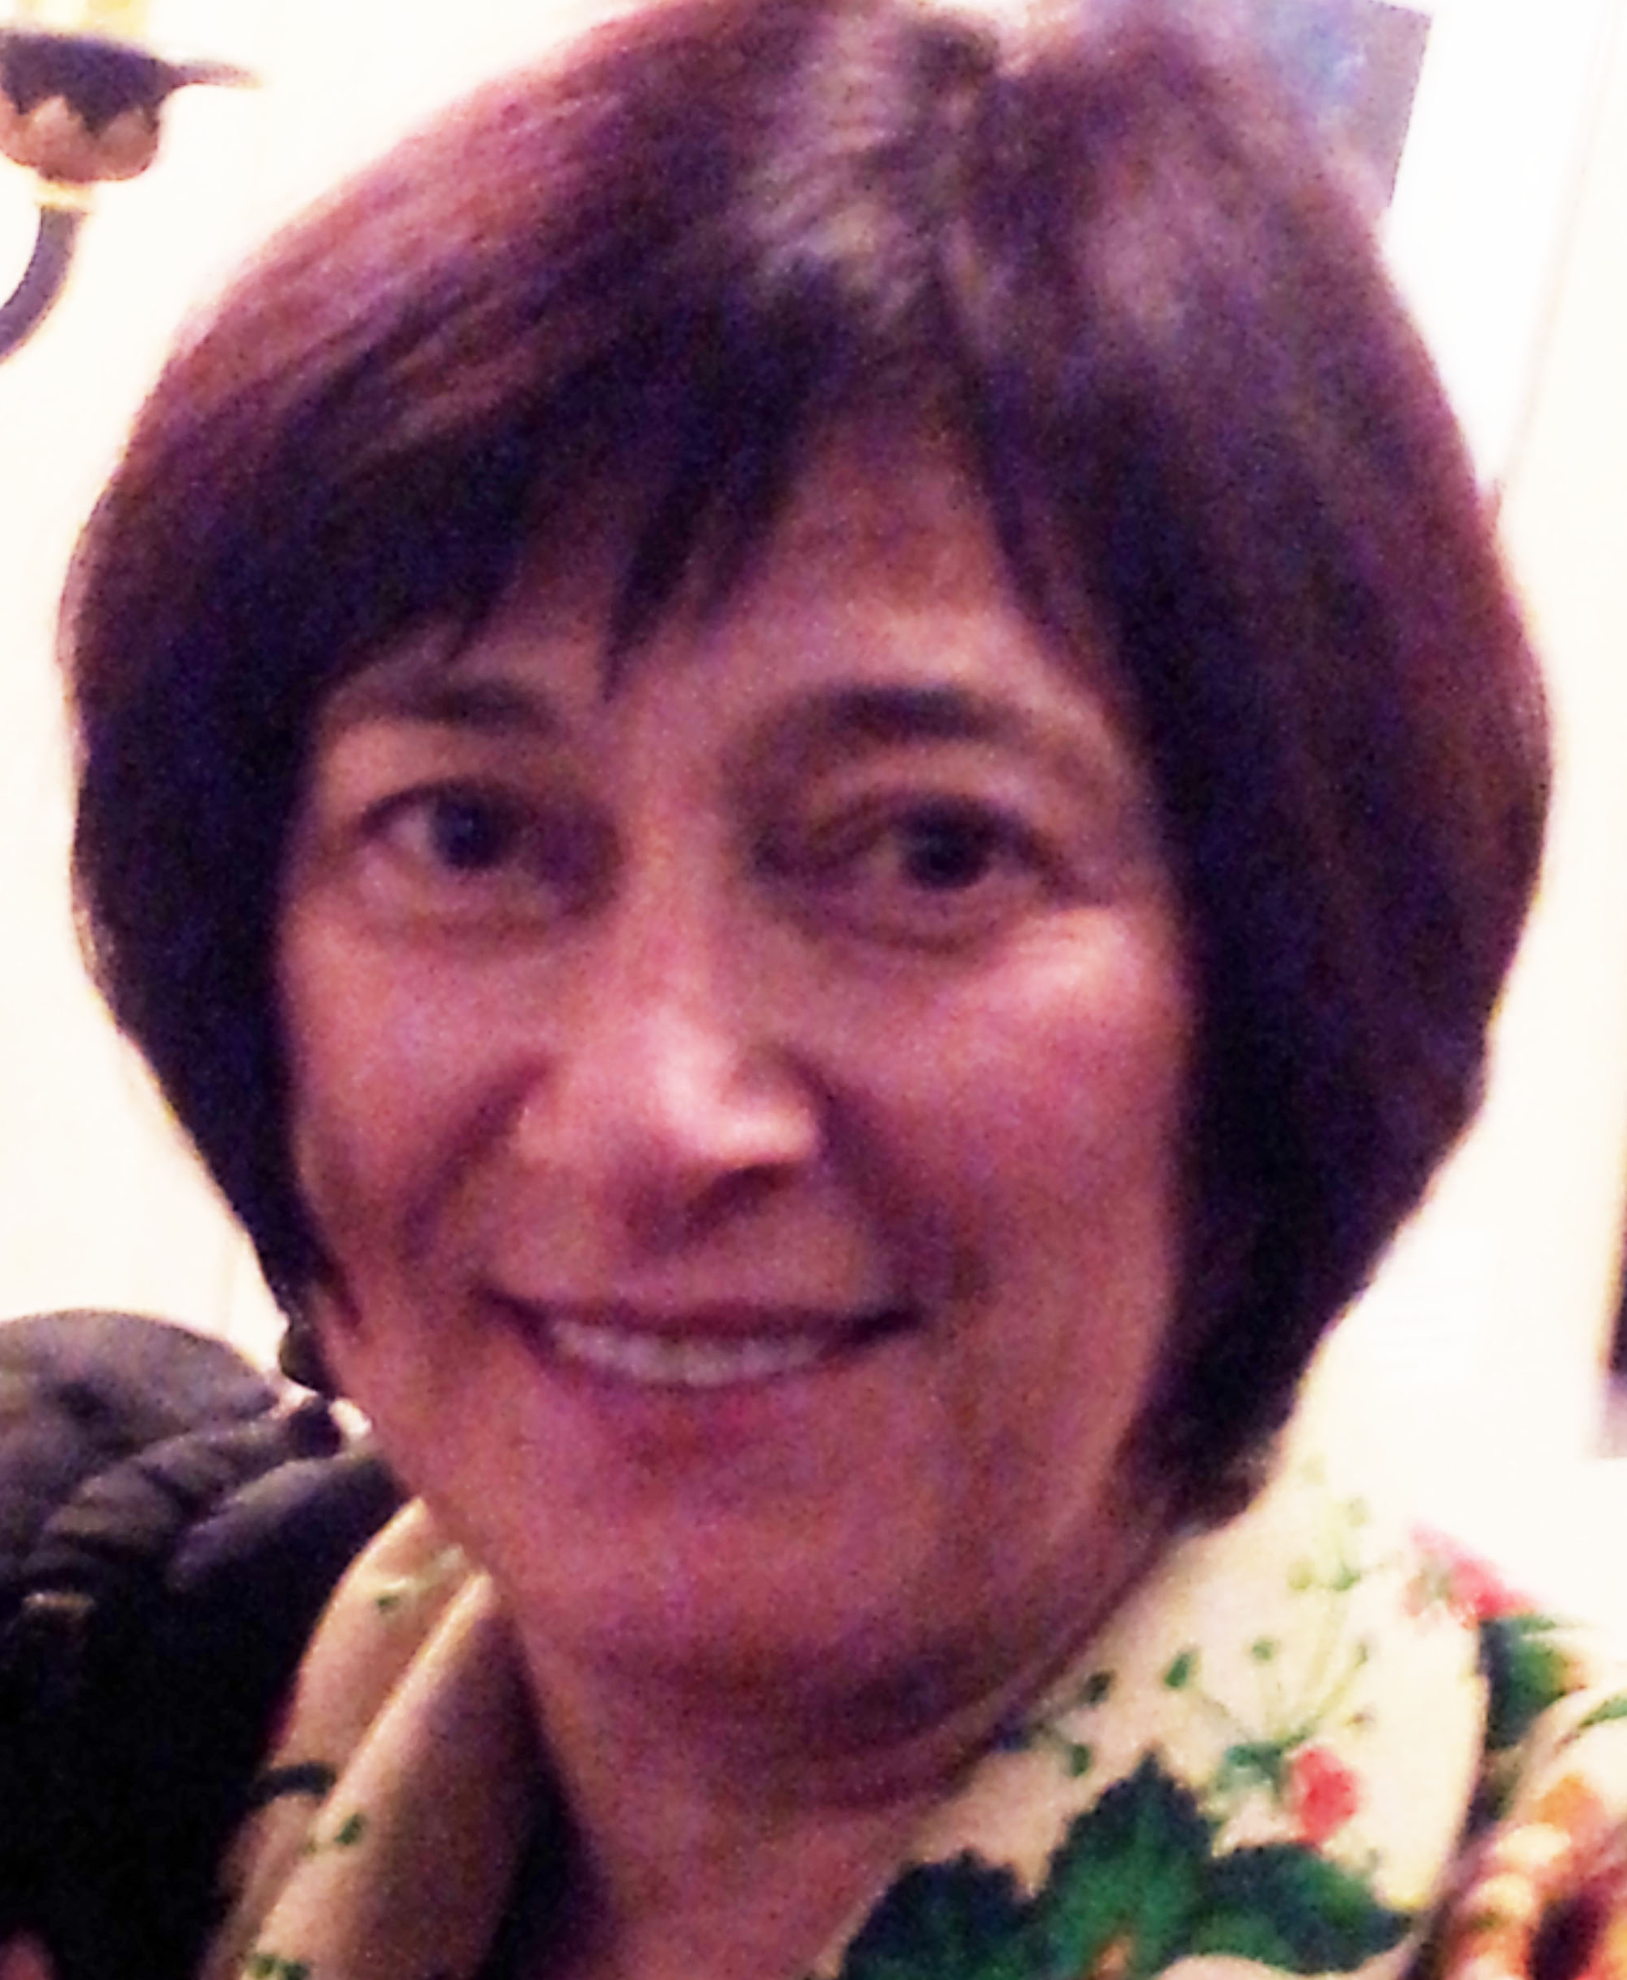
Linda Amaral Zettler
James Cole
George Garrity
Frank Oliver
Glöckner
Philip
Hugenholtz
Guy Cochrane
Neil Davies
Hans Peter
Klenk
Nikos Kyrpides
Ilene Mizrachi
Rob Knight
Folker Meyer
Robert Robbins
Susanna-Assunta
Sansone
Granger Sutton
David Ussery
Pelin Yilmaz
Lynn Schriml
Tatiana Tatusova

Slide 3
GSC18 Agenda
Day 1: Sunday June 12th
Global to local: standards development and application, use cases and feedback
Day 2: Monday June 13th
Exploring standards across research initiatives
Day 3: Tuesday June 14th
Local Initiatives and Standards Uptake, GSC 19 and Outreach
Day 4: Wednesday, June 15th GSC18 Island Sampling Day (ISD)

Slide 4
Day 1: June 12th, Sunday
Theme: Global to local: standards development and application, use cases and feedback
09:00 Meeting Kickoff: Local Host: Georgios Kotoulas, GSC President: Lynn Schriml
09:30-11:00 Session 1: Global and local view on standards
11:30-12:30 Round Table Discussion 1: Role of Standards and Coordination across in Large Research Projects
13:30-14:00 Keynote 1: Arianna Broggiato - The Nagoya Protocol: sampling and research in compliance with new legislations - what scientists have to do
14:00-15:30 Session 2: Large Scale Genomics and Microbiome Initiatives
16:30-17:30 Breakout Sessions
Computational Tools, data set harmonization and reproducibility
GSC Standards Working Session

Slide 5
Day 2: June 13th, Monday
Theme: Exploring standards across research initiatives
09:15-09:45 Keynote 2: Sumir Panji: Standards Initiatives in H3ABioNet
09:45-10:45 Session 3: Exploring standards across research Initiatives
11:15-12:30 Session 4: Understanding Standards Needs Across Communities
13:30-14:00 Keynote 3: Phil Hugenholtz: Genomic taxonomy, from genus to domain.
14:00-15:30 Session 5: New standards and updates
16:00-17:00 Session 6: Application and Need for Standards
17:00-17:30 Round Table Discussion 2: Methods impacting Standards, Need for Standards
17:30-18:15 Breakout Sessions
MIxS Compliance and Interoperability Working Group
NEON-CZ-metadata

Slide 6
Day 3: June 14th, Tuesday
Theme: Local Initiatives and Standards Uptake, GSC 19 and Outreach
09:15-09:45 Keynote 4: Christos Ouzounis: Microbial Ecology in Greece and Bioinformatics
09:45-10:45 Session 7: Greek Microbial Ecology
11:15-12:30 Session 8: Tara, NEON, Fish pathogens and Plant growth promoters
13:30-14:00 Keynote 5: Daniele Daffonchio - Ecology of microbial hydrocarbon degraders in the
oceans
Handoff - GSC-19 - Down Under - April 2017 Brisbane, Australia
15:00-16:00 Session 9: Introduction to Crete Island Sampling Day - HCMR sampling training

