Slide 1

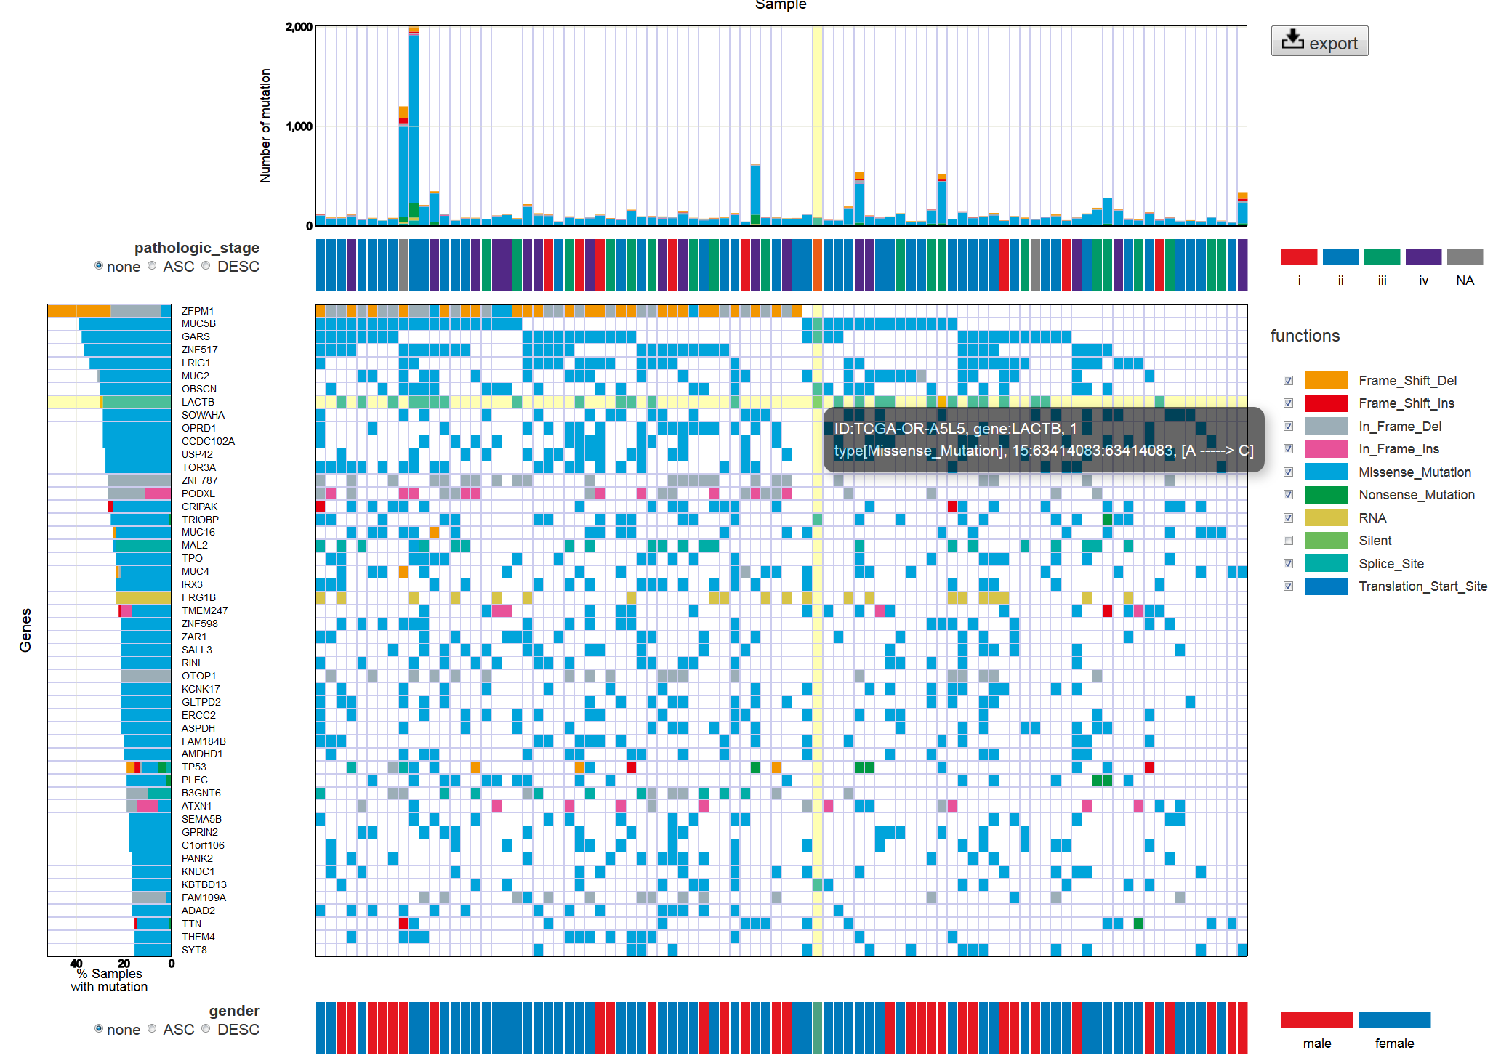
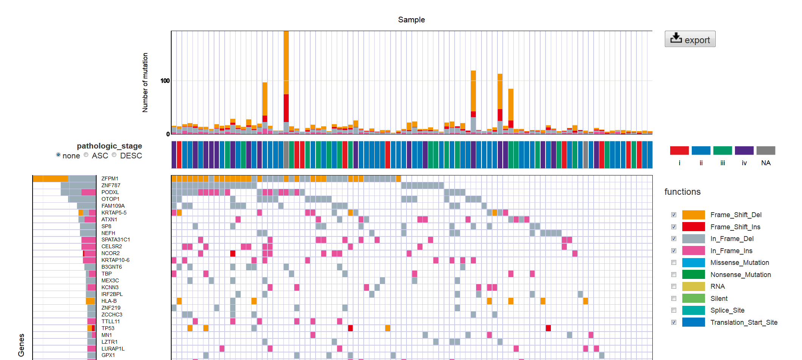
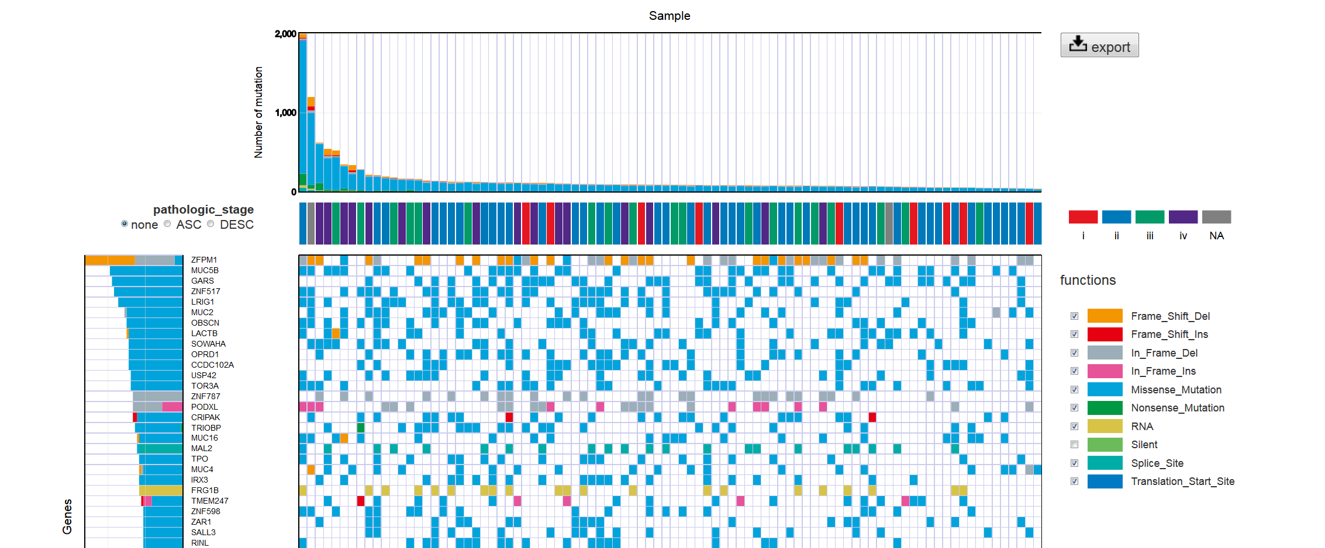
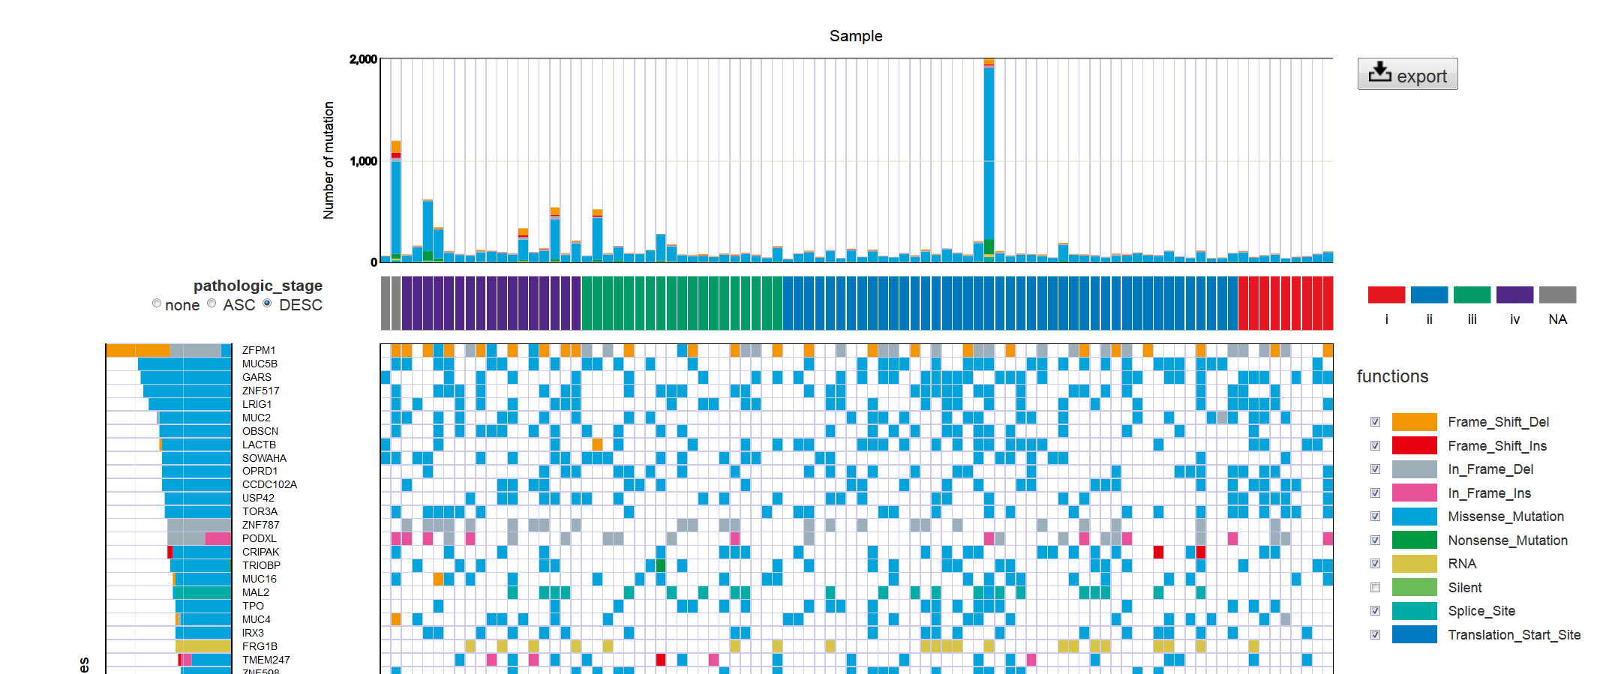
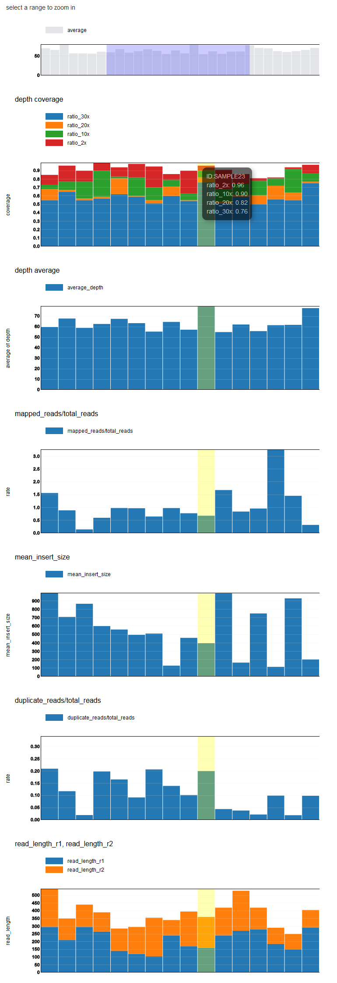




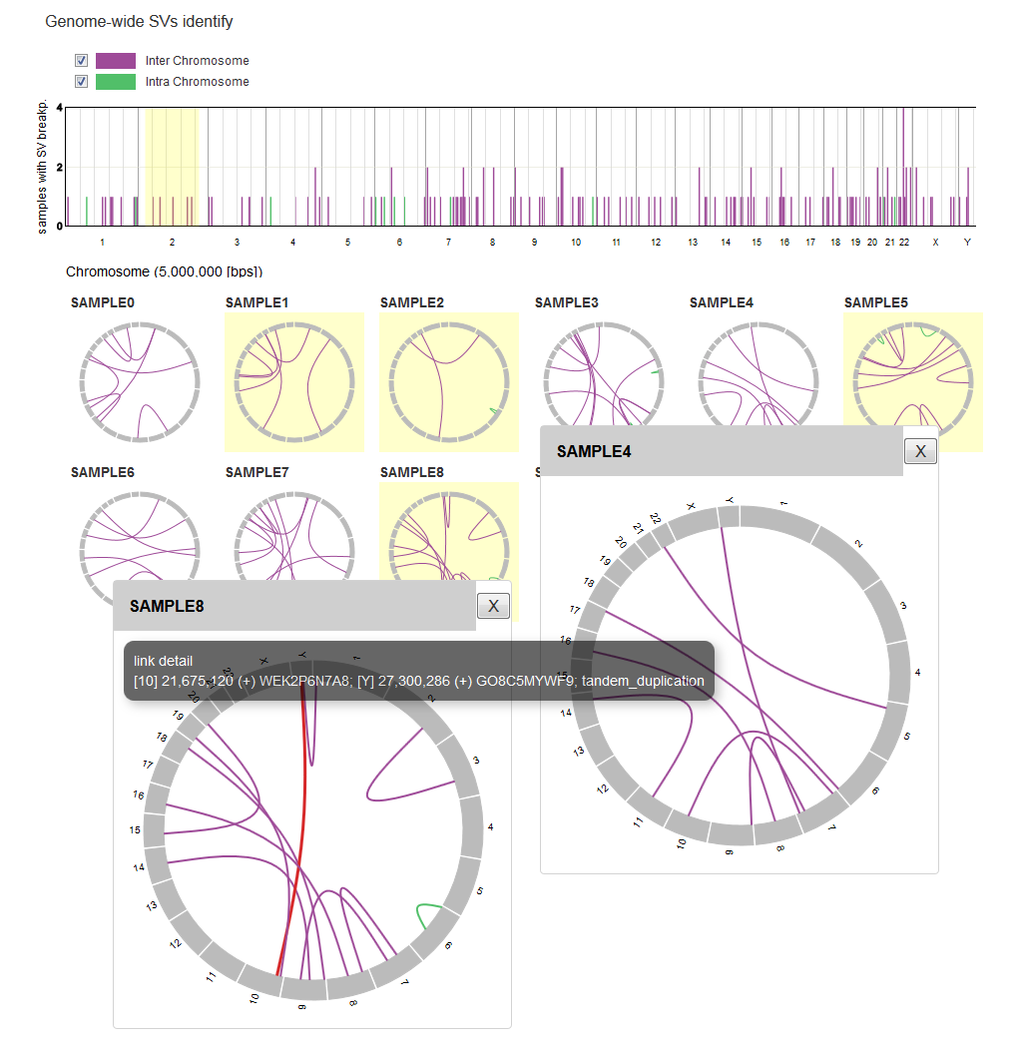

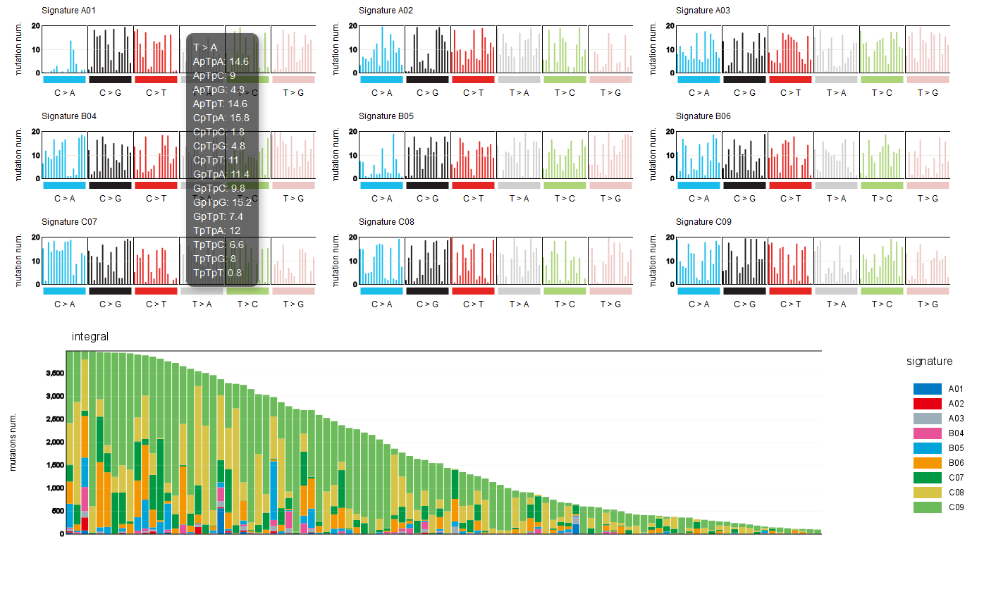
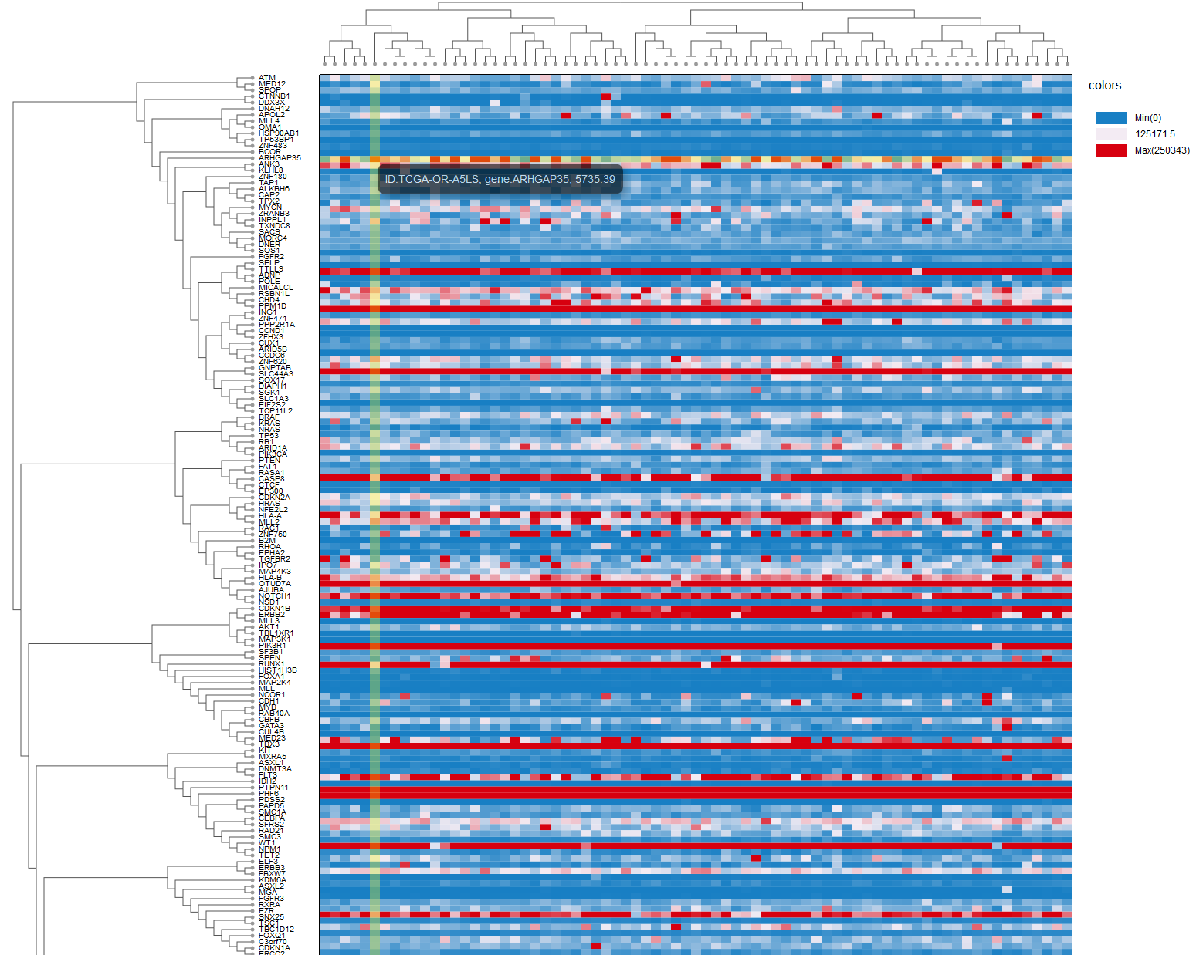

paplot
Automatic generation of cancer genome interactive report via paplot.
Ai Okada(1), Yuichi Shiraishi(1), Kenichi Chiba(1), Satoru Miyano(1)
Human Genome Center, Institute of Medical Science, The University of Tokyo
What is INTERACTIVE ?
extract mutaion type
Visualization and interpretation of genomic analysis results often demand us further laborious efforts such as formatting and organizing the result with additional scripting.
Here, we introduce Post Analysis PLOT (paplot).
paplot outputs files described by javascript (use D3.js, https://d3js.org/ ) and HTML.
These interactive figures allow users to enjoy filtering, focusing and sorting the visualized contents as their necessity, without re-executing drawing tools with different parameters.
Furthermore, by moving the mouse, the user can efficiently obtain various information.
change sort order
All Charts are available to save image (SVG, PNG).
Various plots
This demo data is TCGA-ACC, downloaded from http://gdac.broadinstitute.org/
How to use
QC (Quality Control) graphs
Plots QC values each sample’s bam file.
Items for plot can be customized.
CA (Chromosomal Aberration) graphs
With Circular plots, view chromosomal aberrations for Structural Variation (SV) etc.
Each circular plots expands with click.
Expanded plot is movable and shows pop-up window for more information with on mouse.
With bar plot, view of the entire distribution.
paplot is open source. Please try freely.
1. First, install paplot in your machine.
2. Next, prepare configure file for your data format.
3. Then, you just type:
4. Open ‘index.html’ in your browser.
> git clone https://github.com/Genomon-Project/paplot.git
> cd paplot
> python setup.py build install
> pa_plot qc {input_files} {output_dir} {name} --config_file {config_file}
 {output_dir}
 {name}
 graph_ca.html
 graph_mut.html
 graph_qc.html
 js
 layout
 lib
 style
 index.html  Open your browser!!
Next schedule
Infomation
Genomic signature
paplot is published on github
 https://github.com/Genomon-Project/paplot
Demo
 http://genomon-project.github.io/paplot
Please contact: Genomon developper team
 genomon.devel@gmail.com
COI Disclosure Information
RNA expression
Lead Presenter: Ai Okada
Responsible Researcher: Yuichi Shiraishi
Coming out soon!!
We have no financial relationships to disclose.

