Slide 1
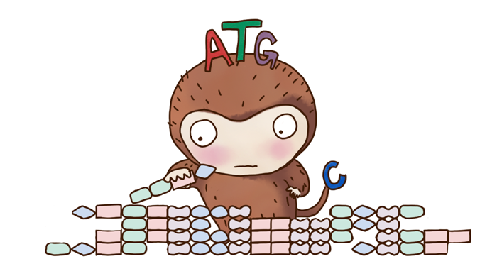



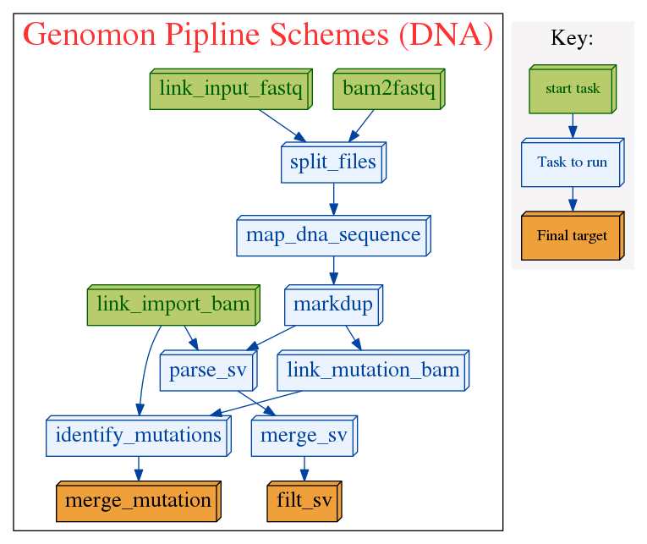
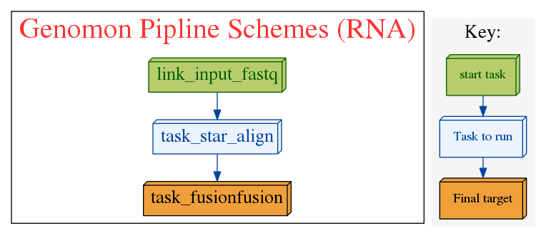
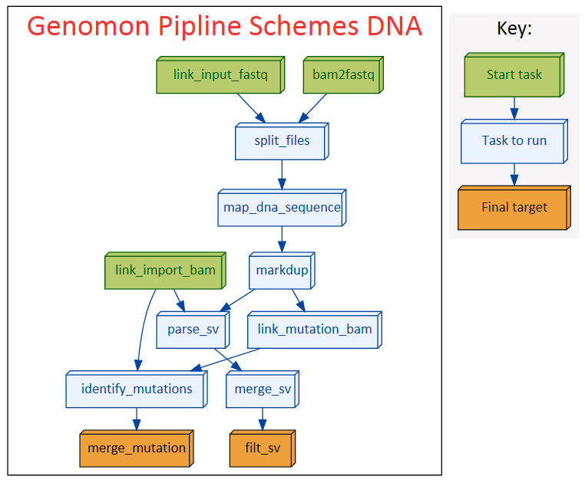
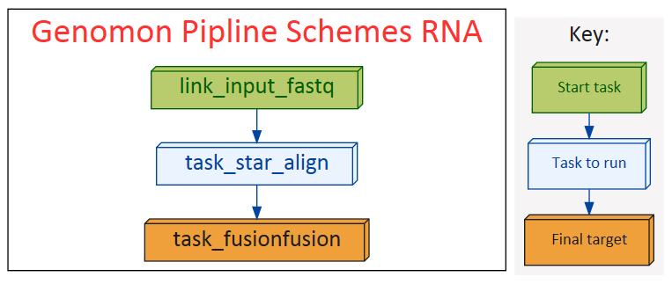
COI Disclosure Information Eigo Shimizu
Genomon
a new framework for analyzing massive whole genome sequencing data
Eigo Shimizu(1), Kenichi Chiba(1), Yuichi Shiraishi(1), Mitsuhiro Komura(1), Hiroko Tanaka, Satoshi Ito, Kotoe Katayama, Atsushi Niida(1), Rui Yamaguchi(1), Seiya Imoto(1), Seishi Ogawa(2), Satoru Miyano(1)
(1) Laboratory of DNA Information Analysis, Human Genome Center, Institute of Medical Science, The University of Tokyo,
(2) Cancer Genomics Project, Graduate School of Medicine, The University of Tokyo
The Zen of
Cancer Genome
Analysis
Easy to use!
Large scale analysis!
Flexible!
Genomon is now easier than ever to use.
Your need to prepare the path of input files and just type:
Genomon is now highly optimized and adopt ruffus package for job scheduling. You can analyze several hundreds of genomic and transcriptome sequencing data simultaneously.
Genomon is extensible. So you can easily incorporate your favorite module. Also You can deploy Genomon to your own cluster.
genomon_pipeline dna input.csv output_dir
DNA sequence analysis pipeline
RNA sequence analysis pipeline
We renovated gene fusion detection (from Genomon-Fusion)
New approach fusionfusion
Filtering chimeric read generated by STAR.
Computationally efficient compared to Genomon-Fusion (~200 holds)
Sensitive even for short read length (~50bp).
Can start from both bam and fastq files.
Suitable for whole genome sequencing analysis (as well as exome sequencing analysis).
Carefully devised mutation filtering steps enables sensitive and accurate somatic mutation detection (see poster ??).
GenomonSV detects mid-range indels (10bp – 1000bp) such as FLT3-ITD as well as long range structural variations.
Integrative analysis with DNA and RNA sequence data (e.g., detecting somatic mutation causing splicing change) is coming soon!!
Info
Genomon2 will be coming out in late October!!
We are seeking for early evaluator for Genomon2
We will fully support the analysis early evaluators!!
Please contact: yshira@hgc.jp
I have no financial relationships to disclose.

