Slide 1

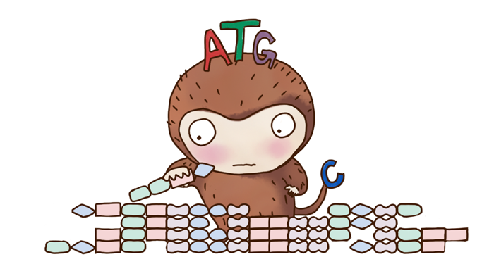


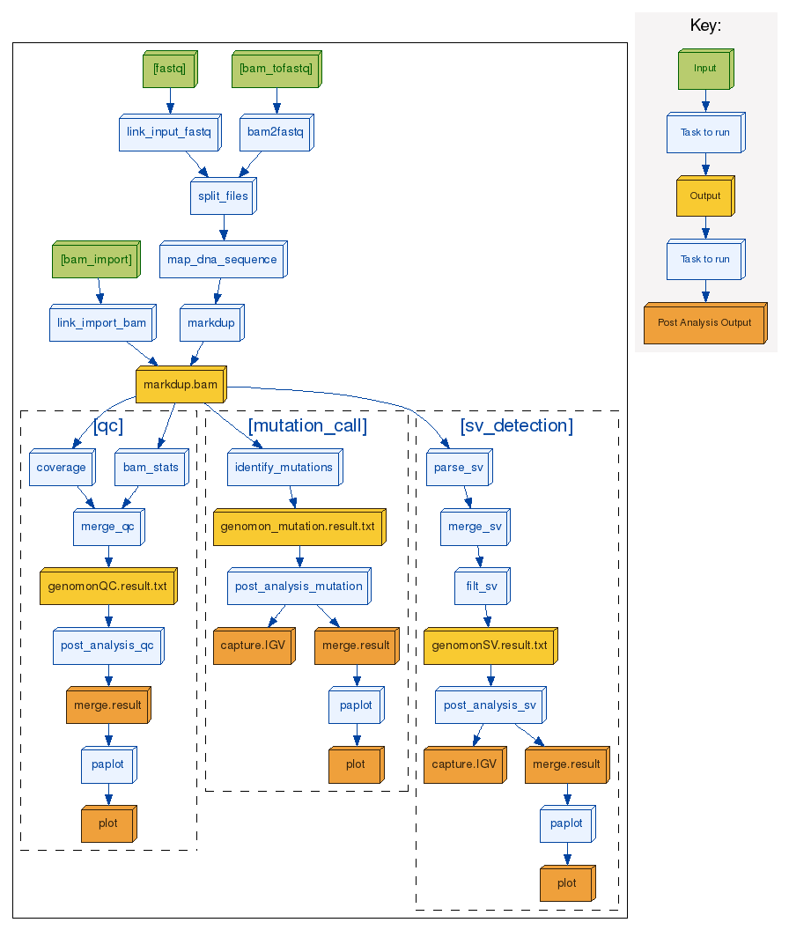
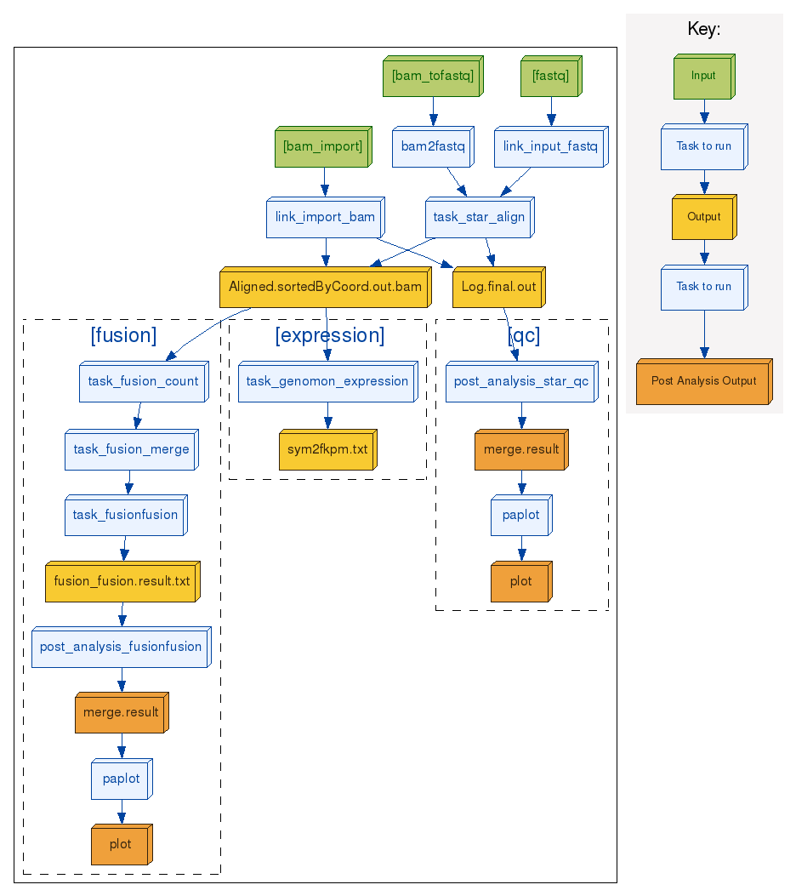
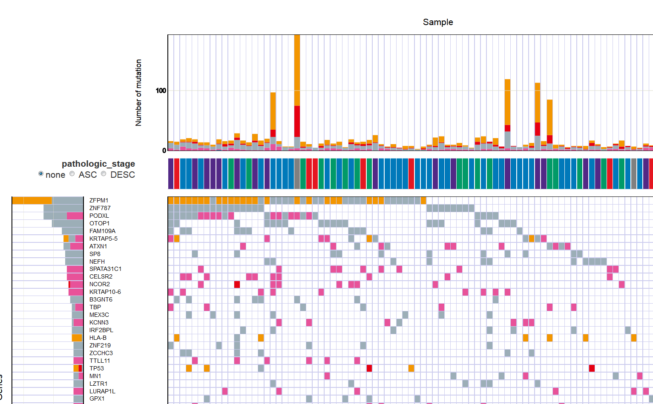
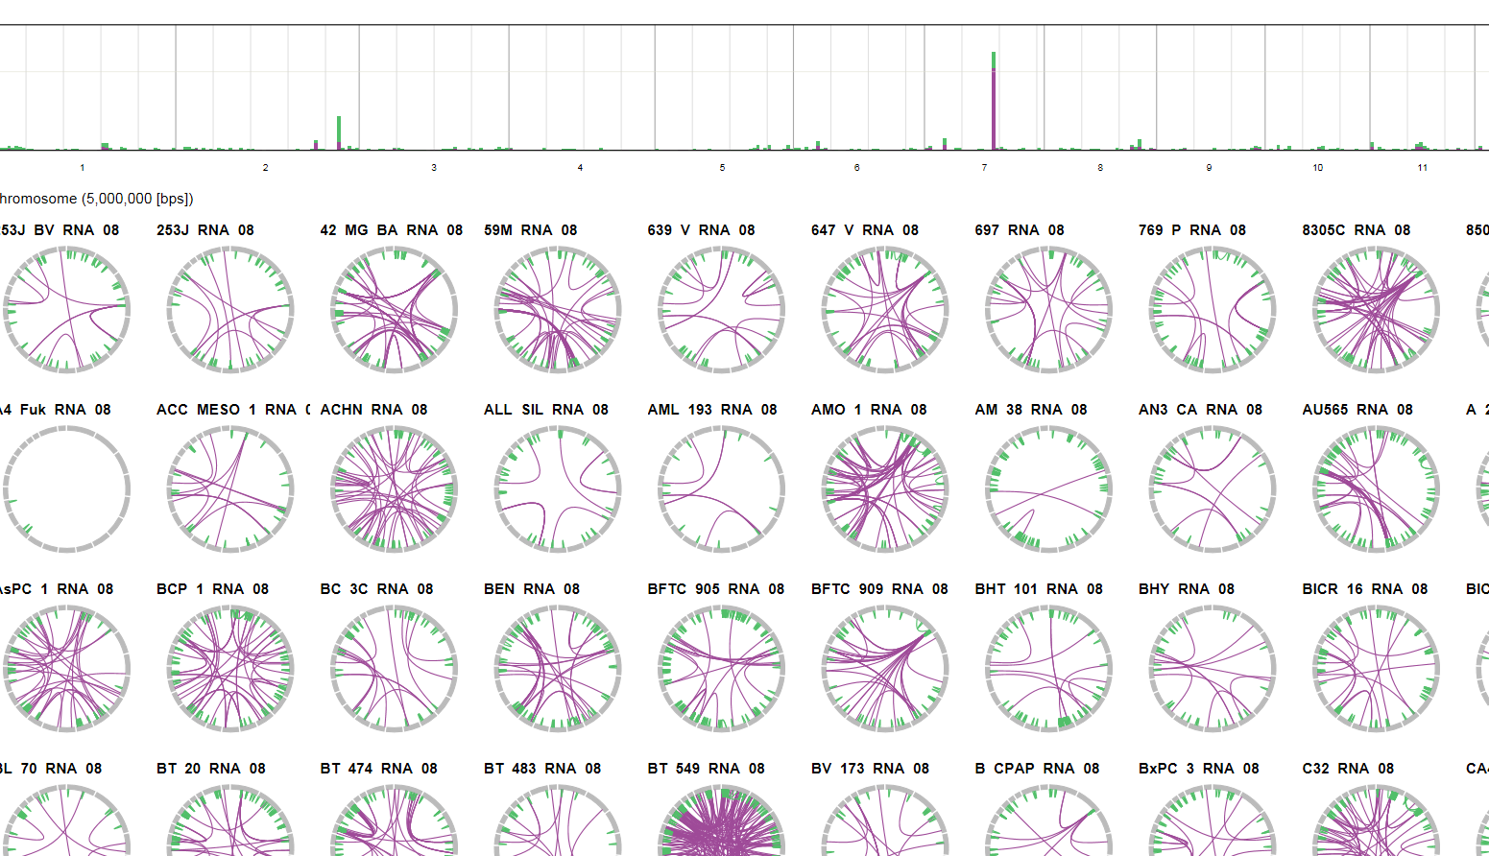
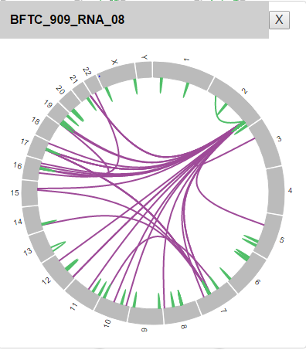

Genomon a high-integrity pipeline for cancer genome and transcriptome sequence analysis Kenichi Chiba(1), Yuichi Shiraishi(1), Ai Okada(1), Hiroko Tanaka(1), Seishi Ogawa(2), Satoru Miyano(1) (1)Human Genome Center, Institute of Medical Science, The University of Tokyo,
(2)Department of Pathology and Tumor Biology, Graduate School of Medicine, Kyoto University
The Zen of
Cancer Genome Analysis
Genomon is now easier than ever to use.
You just need to prepare list of input sequence data paths and just type:
Easy to use!
genomon_pipeline dna/rna input.csv output_dir
Genomon is now highly optimized and efficiently utilizes ruffus package for job scheduling. You can analyze several hundreds of genomic and transcriptome sequencing data simultaneously.
Large scale analysis!
Genomon is extensible. So you can easily incorporate your favorite modules into Genomon. Also You can easily deploy Genomon to your own cluster other than HGC supercomputer.
Flexible!
DNA sequence analysis pipeline
RNA sequence analysis pipeline
Figure 1: Genomon automatically produces rich dynamic analytical reports describing summary of detected variants.
Figure 2: Please refer to “P-3379" section for details.
Figure1
Figure 2
Can start from both bam and fastq files.
Genomon enables us to perform detection of gene fusions and expression analysis.
Integrative analysis with DNA and RNA sequence data (e.g., detecting somatic mutations causing splicing changes) is coming out soon!!
Carefully devised mutation filtering steps enables sensitive and accurate somatic mutation detection.
Genomon detects mid-range indels (30bp – 300bp) such as FLT3-ITD as well as long range structural variations.
Evaluation of the performance of Genomon Somatic Mutation Call
Cancer Genomics Hub
Broad GDAC Firehose
WES SNV
CTNNB1 exon SNV
TP53 exon SNV
MEN1 exon SNV
Total 90 samples
TCGA-ACC Exome sequencing data
TCGA-ACC MAF
Total 90 samples
version: stddata_2016_01_28
Somatic mutation detection using Genomon
WES INDEL
MEN1 exon INDEL
Filtering:
P‐value(Fisher) < 1.0
P‐value(EBCall) < 4.0
#mutant reads in tumor < 4
#mutant reads in normal > 2
CTNNB1 exon INDEL
TP53 exon INDEL
Comparison of Filtered candidates using Genomon and MAF.
Workflow for comparing Genomon and Firehose mutation annotation format (MAF) files.
Barcode | Gene | Chr | Start | End | Type | Ref | ALT
TCGA-OR-A5J5-01 | MEN1 | 11 | 64572093 | 64572093 | DEL | G | -
The results of a comparison of two somatic mutation files.
COI Disclosure Information
MEN1 mutation that could not be detected using Genomon Somatic Mutation Call because normal sample depth = 1.
Lead Presenter: Kenichi Chiba
Responsible Researcher: Satoru Miyano
Genomon Pages ( http://genomon-project.github.io/GenomonPages/ )
We have no financial relationships to disclose.

