Slide 1
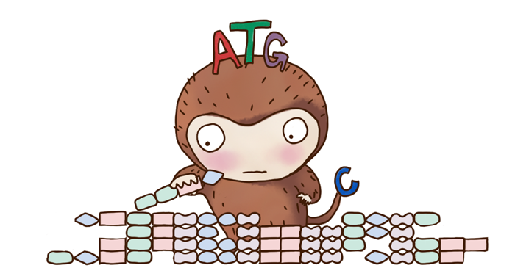



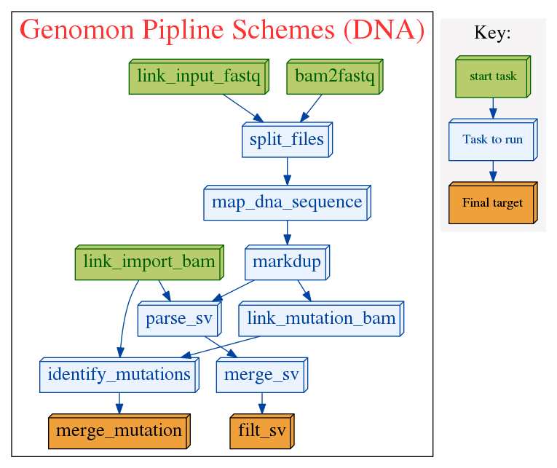
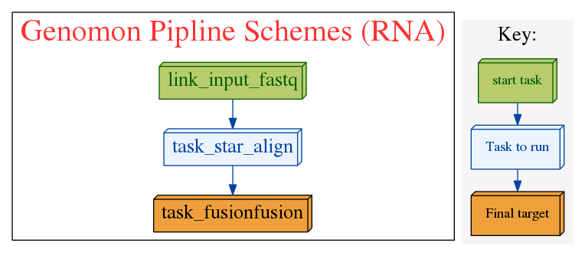
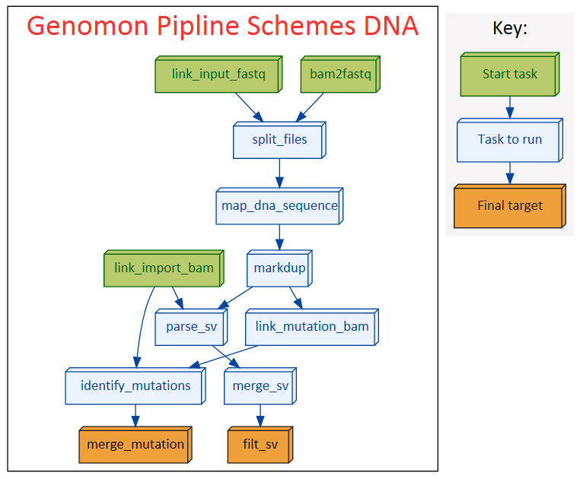
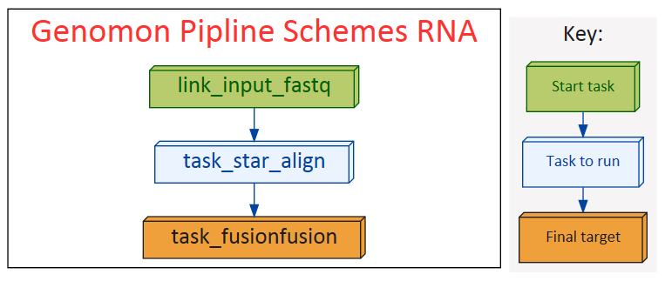

COI Disclosure Information Eigo Shimizu
Genomon
a new framework for analyzing massive whole genome sequencing data
Eigo Shimizu(1), Kenichi Chiba(1), Yuichi Shiraishi(1), Mitsuhiro Komura(1), Hiroko Tanaka(1), Satoshi Ito(1), Kotoe Katayama(1), Atsushi Niida(1), Rui Yamaguchi(1), Seiya Imoto(1), Seishi Ogawa(2), Satoru Miyano(1)
Human Genome Center, Institute of Medical Science, The University of Tokyo,
Department of Pathology and Tumor Biology, Graduate School of Medicine, Kyoto University
The Zen of
Cancer Genome
Analysis
Easy to use!
Large scale analysis!
Flexible!
Genomon is now easier than ever to use.
You just need to prepare list of input sequence data paths and just type:
Genomon is now highly optimized and efficiently utilizes ruffus package for job scheduling. You can analyze several hundreds of genomic and transcriptome sequencing data simultaneously.
Genomon is extensible. So you can easily incorporate your favorite modules into Genomon. Also You can easily deploy Genomon to your own cluster other than HGC supercomputer.
genomon_pipeline dna input.csv output_dir
DNA sequence analysis pipeline
RNA sequence analysis pipeline
We renovated gene fusion detection (from Genomon-Fusion) to a new approach fusionfusion
Filtering chimeric read generated by STAR.
Computationally far more efficient compared to Genomon-Fusion (~200 holds)
Sensitive even for short read length (~50bp).
Can start from both bam and fastq files.
Suitable for whole genome sequencing analysis (as well as exome sequencing analysis).
Carefully devised mutation filtering steps enables sensitive and accurate somatic mutation detection.
GenomonSV detects mid-range indels (30bp – 300bp) such as FLT3-ITD as well as long range structural variations.
Can easily change to other alignment tools (such as map-splice2, tophat2) by option.
Integrative analysis with DNA and RNA sequence data (e.g., detecting somatic mutations causing splicing changes) is coming out soon!!
Info
Genomon2 will be coming out in late October!!
We are seeking for early evaluator for Genomon2
We will fully support the analysis early evaluators!!
Please contact: Yuichi Shiraishi (yshira@hgc.jp)
I have no financial relationships to disclose.

