Slide 1
Building a Data Management Architecture Using Amazon Web Services
Downloadable Figures
Mayank Talwar, Zain Khan
Notes:
Presenter's Name
Presenter's Name

Slide 2
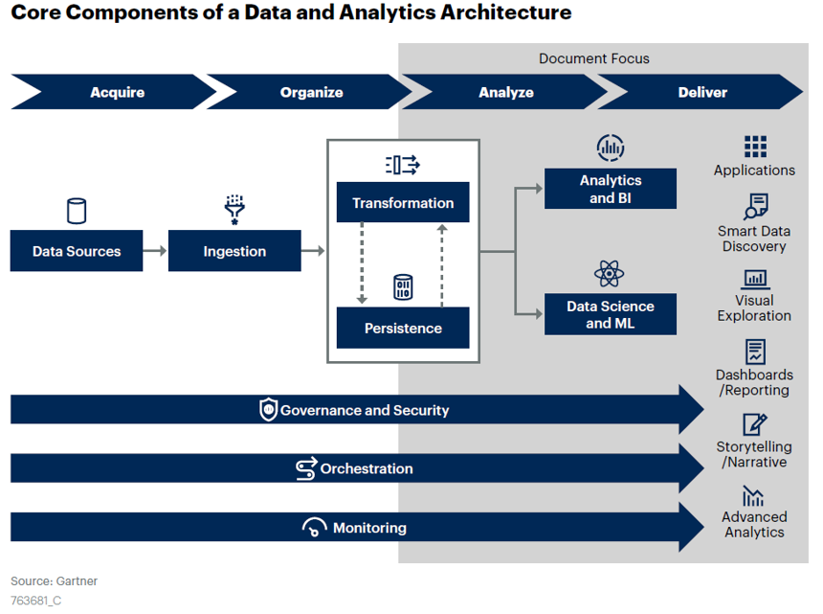
Figure 1

Slide 3
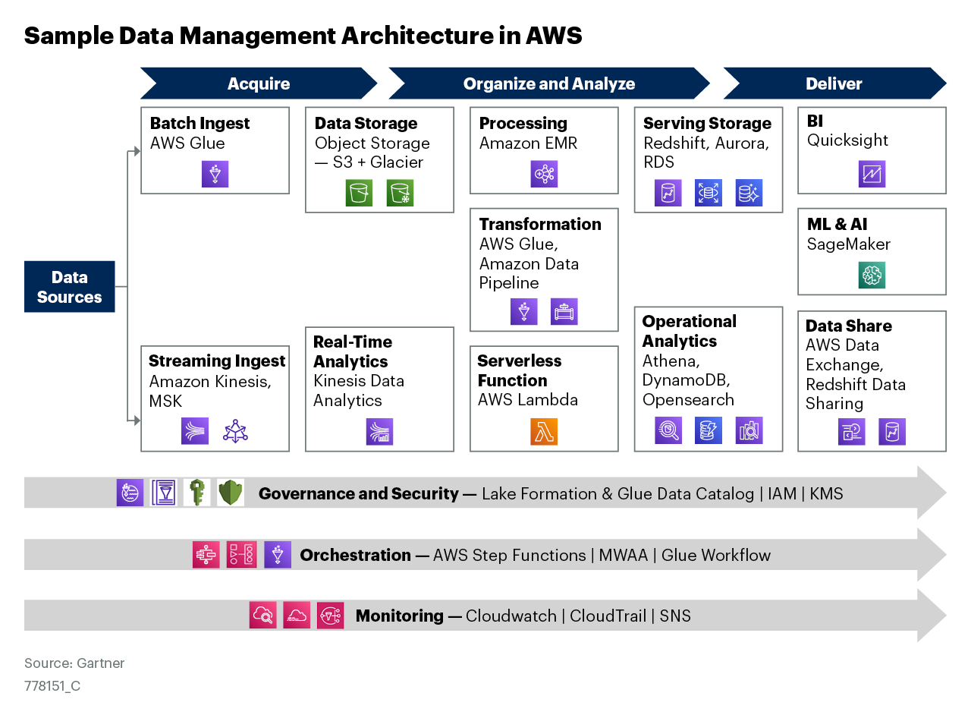
Figure 2

Slide 4
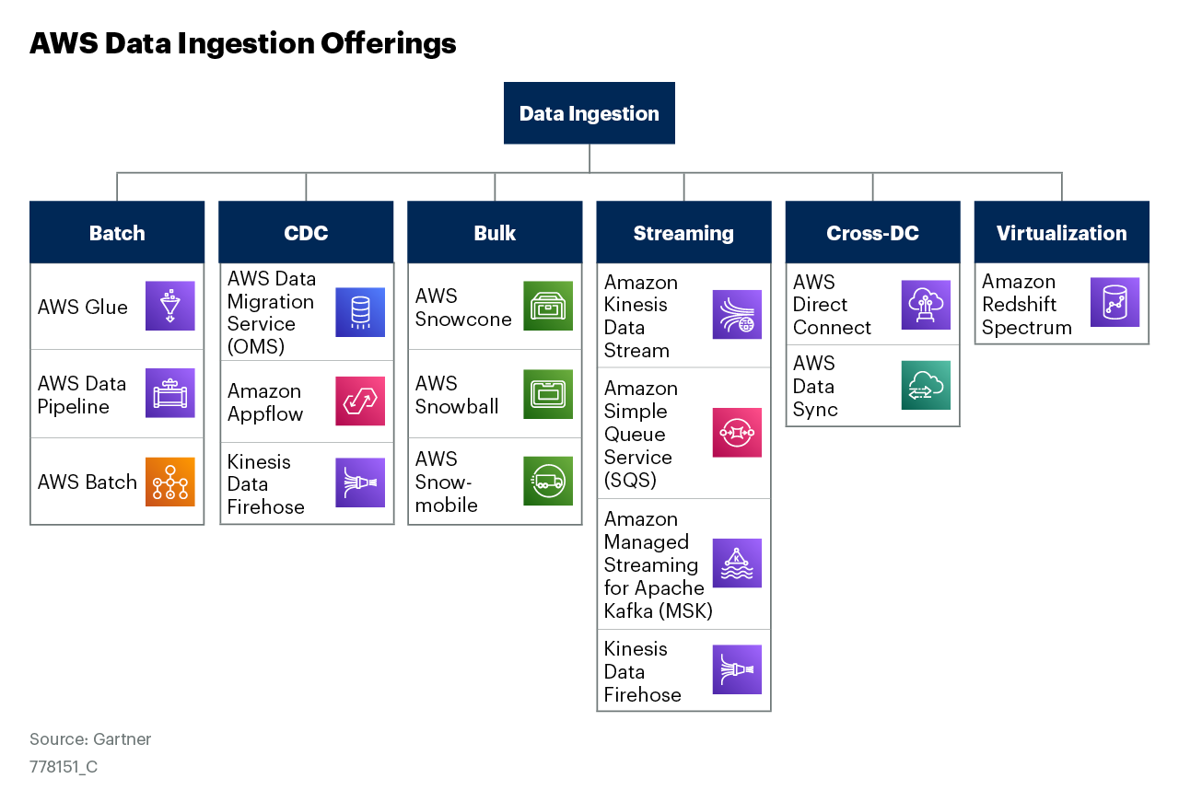
Figure 3

Slide 5
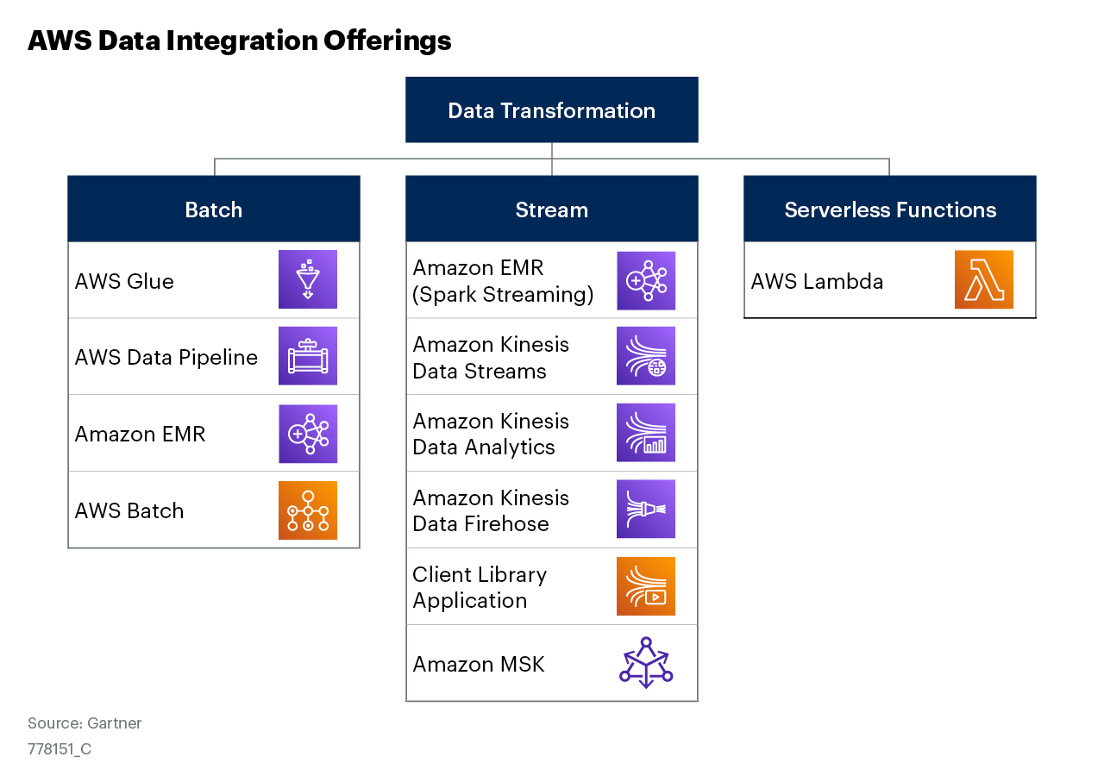
Figure 4

Slide 6
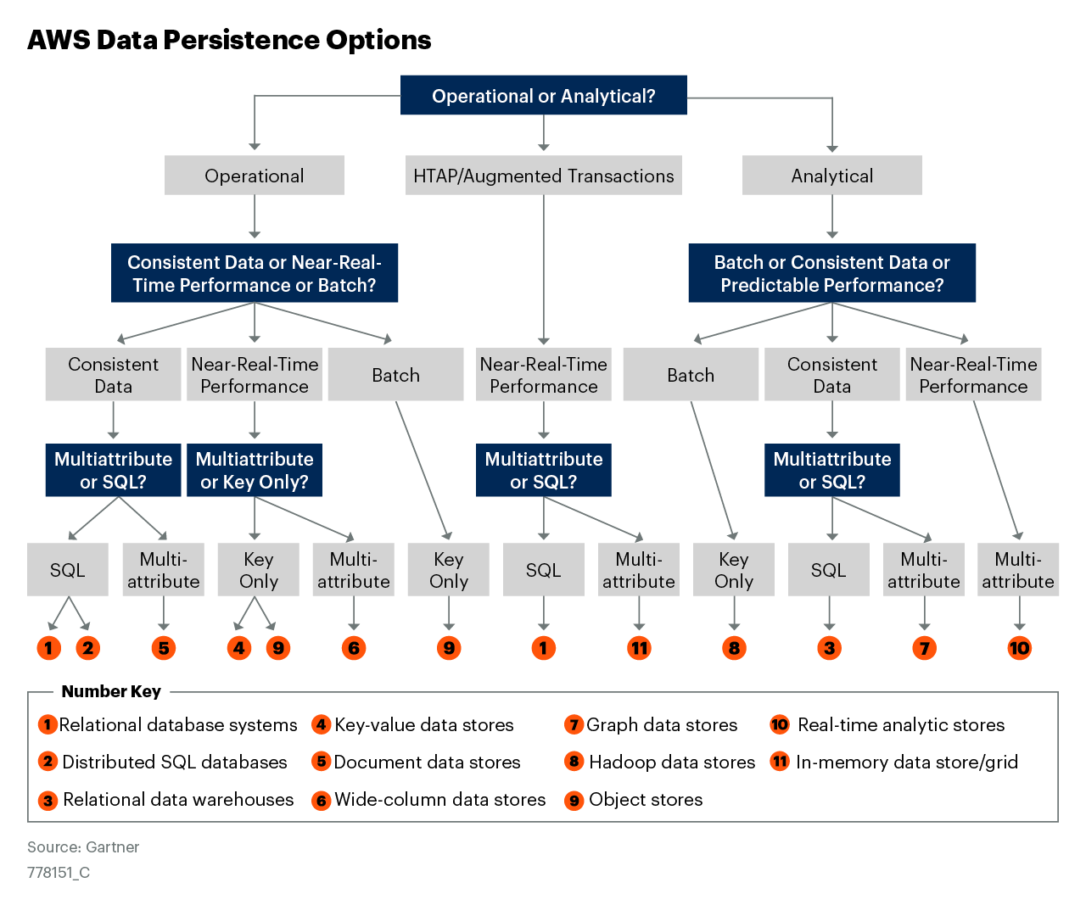
Figure 5

Slide 7
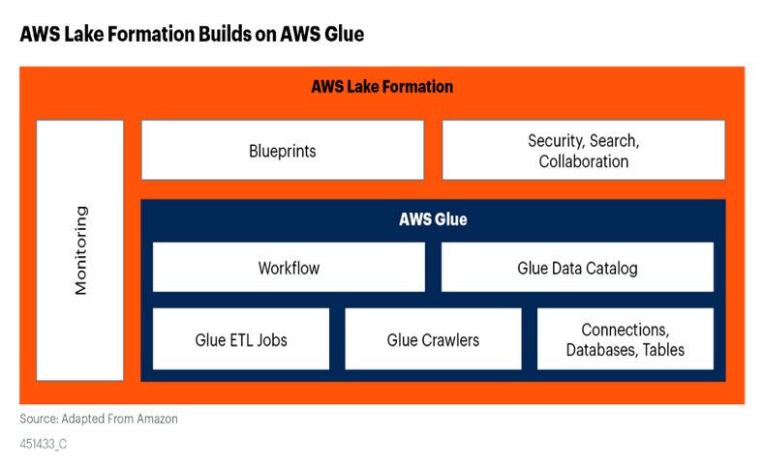
Figure 6

Slide 8
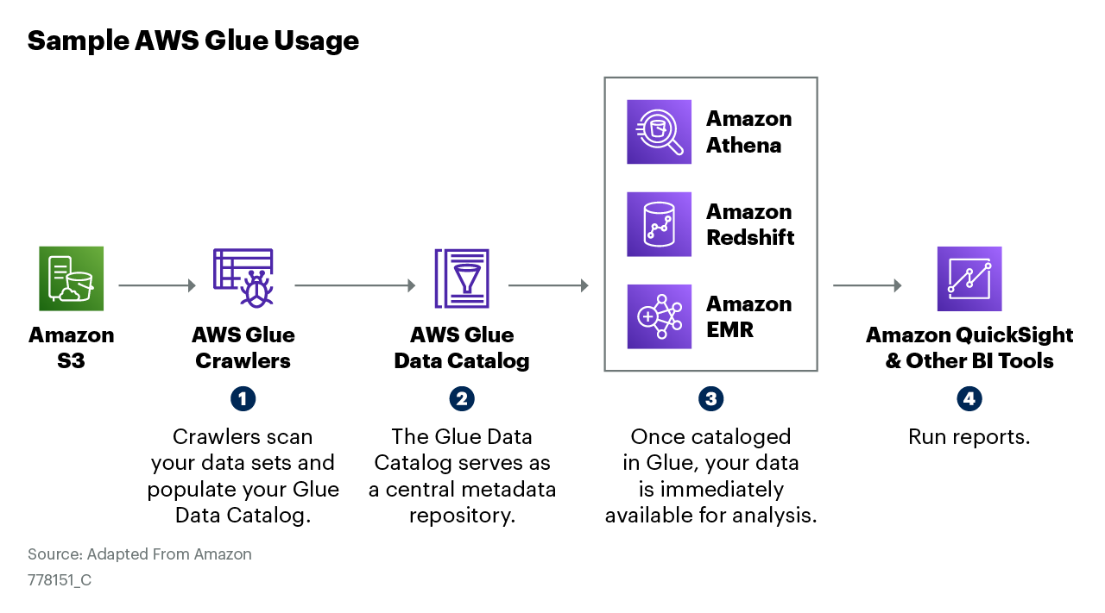
Figure 7

