Slide 1
Generative AI Tech Platform Offering Comparison
Amazon, Google, IBM, Meta, Microsoft, OpenAI
Notes:
Presenter's Name
Presenter's Name

Slide 2
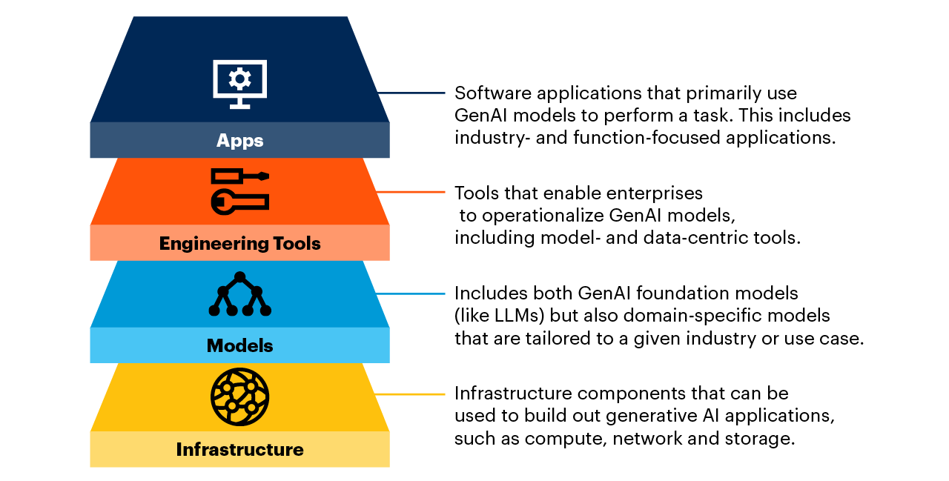
Four Generative AI Technology Stack Layers

Slide 3
Vendor Comparison by Technology Stack Layer

Slide 4
Generative AI Applications
Vendor | GenAI Applications
Amazon | Amazon CodeWhisperer, Alexa, Amazon Lex
Google | Google Bard, Google Bard Extensions, Google Workspace, Gen App Builder, Duet AI for Google Workspace, Duet AI for Google Cloud, Duet AI for Chronicle Security Operations (Preview), Mandiant Threat Intelligence (Preview), Security Command Center (Preview), Duet AI in BigQuery, Looker, Database Migration Service (Preview)
IBM | Watson Assistant, Watson Orchestrate, Watson Code Assistant
Meta | None
Microsoft | Bing Chat, Bing Chat Enterprise, Microsoft 365 Copilot, Microsoft 365 Copilot plugins, Security Copilot, GitHub Copilot X, Dynamics 365 Copilot, Sales Copilot, Power Platforms Copilot
OpenAI | ChatGPT, ChatGPT Plus, ChatGPT Enterprise

Slide 5
Generative AI Engineering Tools
Vendor | GenAI Engineering Tools
Amazon | Amazon SageMaker, Amazon SageMaker Jumpstart, Amazon Bedrock, Agents for Amazon Bedrock
Google | Vertex AI (Search, Conversation), Model Garden, Generative AI Studio, Generative AI App Builder, Document AI
IBM | Watsonx.ai (Prompt Lab, Tuning Studio)
Meta | Code Llama, KILT Benchmarking, AudioCraft
Microsoft | Cognitive Search, Semantic Kernel, Prompt Flow, Azure AI Studio, Azure OpenAI Service
OpenAI | OpenAI Playground

Slide 6
Generative AI Models
Vendor | In-House GenAI Models | Partnership GenAI Models | Open-Source Models
Amazon | Titan Text, Titan Embeddings, HealthScribe, AlexaTM 20B | AI21 Labs, Cohere, Anthropic, LightOn | Hugging Face, Stability.AI
Google | PaLM 2, Codey (code completion), Imagen (text to image), Med-PaLM 2 | Sec-PaLM, Chirp (speech to text), PaLM (text/chat), Phenaki, MusicLM | AI21 Labs, Cohere, Midjourney (image generation), Anthropic Claude 2, Osmo | BERT, FLAN-T5, ViT (vision transformer), EfficientNet, Llama 2, Falcon
IBM | Granite, Sandstone, Obsidian, Slate | None | Hugging Face, Llama 2, StarCoder, FLAN
Meta | None | None | Llama 2, Fairseq, VizSeq, SeamlessM4T
Microsoft | Kosmos 2 (Research), Gorilla (Research) | Exclusive partnership with OpenAI: GPT-4, GPT-3.5 Turbo, Embedding models (Ada), Codex (code generation), Embeddings, DALL-E (text to image) | Llama 2
OpenAI | GPT-4, GPT-3.5 Turbo, Fine-Tuning models (Ada, Babbage, Curie, DaVinci), Codex (code generation), Whisper (voice transcription), Embedding models (Ada v2), DALL-E (text to image) | None | None

Slide 7
Generative AI Infrastructure
Vendor | Proprietary Infrastructure | Available Infrastructure
Amazon | Inferentia, Inferentia 2, Trainium, Elastic Inference, AWS Direct Connect | Graviton | Elastic Fabric Adapter | NVIDIA GPUs (A100, H100), Intel Habana
Google | Google’s TPUs (Tensor Processing Unit TPUv4, TPUv5), Jupiter, AlloyDB AI (Preview) | NVIDIA GPUs (A100), H100 A3 VM (GA September 2023)
IBM | Vela | NVIDIA A100
Meta | None externally available | None
Microsoft | None | NVIDIA GPUs (A100, H100), NVIDIA Infiniband networking
OpenAI | None | None

Slide 8
Individual Vendor Technology Stacks

Slide 9
Amazon
Amazon CodeWhisperer | Alexa | Amazon Lex
Generative AI Apps
Amazon SageMaker | Amazon SageMaker JumpStart | Amazon Bedrock | Agents for Amazon Bedrock
Generative AI Engineering Tools
In-House Models: Amazon Titan (Text, Embeddings) | AlexaTM 20B | HealthScribe
Partnership Models: AI21 Labs (Jurassic 2) | Cohere | Anthropic (Claude) | LightOn
Open-Source Models: Hugging Face | Stability AI (Stable Diffusion)
Generative AI Models
Proprietary Infrastructure: Inferentia | Inferentia 2 | Trainium | Elastic Inference | AWS Direct Connect | AWS Graviton | Elastic Fabric Adapter
Available Infrastructure: NVIDIA GPUs (H100, A100) | Intel Habana
Infrastructure

Slide 10
Google
Generative AI Apps
Google Bard | Google Bard extensions | Google Workspace | Gen App Builder | Duet AI in BigQuery, Looker, Database Migration Service (Preview)
Duet AI for Google Workspace | Duet AI for Google Cloud | Duet AI for Chronicle Security Operations (Preview), Mandiant Threat Intelligence (Preview), Security Command Center (Preview)
Generative AI Engineering Tools
Vertex AI (Search, Conversation) | Model Garden | Generative AI Studio | Generative AI App Builder | Document AI
Generative AI Models
In-House Models: PaLM 2 | Codey (code completion) | Imagen (text to image) | Med-PaLM 2 | Sec-PaLM | Chirp (speech to text) | PaLM (Text / Chat) | Phenaki | MusicLM
Partner Models: AI21Labs | Cohere | Midjourney | Anthropic Claude 2 | Osmo
Open-Source Models: BERT | FLAN-T5 | ViT (vision transformer) | EfficientNet | Llama 2 | Falcon
Infrastructure
Proprietary Infrastructure: Google’s TPUs (Tensor Processing Unit TPUv4, TPUv5e) | Jupiter | AlloyDB AI (Preview)
Available Infrastructure: NVIDIA GPUs (A100), H100 A3 VM (GA September 2023)

Slide 11
IBM
Generative AI Apps
Watson Assistant | Watson Orchestrate | Watson Code Assistant
watsonx.ai | Prompt Lab | Tuning Studio
Generative AI Engineering Tools
In-House Models: Granite | Sandstone | Obsidian | Slate
Open-Source Models: Hugging Face | Llama 2 | StarCoder | FLAN
Generative AI Models
Available Infrastructure: NVIDIA A100 | Vela
Infrastructure

Slide 12
Meta
None
Generative AI Apps
Code Llama | KILT Benchmarking | AudioCraft
Generative AI Engineering Tools
Llama | Fairseq | VizSeq
Generative AI Models
None externally available
Infrastructure

Slide 13
Microsoft
Generative AI Apps
Bing Chat | Bing Chat Enterprise | Microsoft 365 Copilot | Microsoft 365 Copilot Plugins |
Security Copilot | GitHub Copilot X | Dynamics 365 Copilot | Sales Copilot | Power Platforms Copilot
Cognitive Search | Semantic Kernel | Prompt Flow | Azure AI Studio | Azure OpenAI Service
Generative AI Engineering Tools
Generative AI Models
Exclusive OpenAI Partnership: GPT-4 | GPT-3.5 Turbo | Embedding models (Ada) |
Codex (code generation) | Embeddings | DALL-E (text to image)
Open-Source Models: Llama 2
Available Infrastructure: NVIDIA GPUs (A100, H100) | NVIDIA Infiniband | NPU
Infrastructure

Slide 14
OpenAI
Generative AI Apps
ChatGPT | ChatGPT Plus |
ChatGPT Enterprise
OpenAI Playground
Generative AI Engineering Tools
In-House Models: GPT-4 | GPT-3.5 Turbo (fine-tune-able) Fine-Tuning models (Ada, Babbage, Curie, DaVinci) | Codex (code generation) | Whisper (voice transcription) | Embedding models (Ada v2) | DALL-E (text to image)
Generative AI Models
OpenAI doesn’t currently offer infrastructure services
Infrastructure

Slide 15
How to Evaluate GenAI Vendor Fit

Slide 16
Generative AI Vendor Fit Criteria
Criteria | Description
Business fit | Models may be domain-specific, while others may be for general use. For infrastructure such as GPUs/TPUs, ensure this hardware meets your performance requirements. Also evaluate how the product will fit based on your organization’s technology maturity and adoption levels.
Data security/privacy needs | Ensure your selected vendor has usage policies that are aligned with your organization’s requirements. How is the vendor going to handle and manage your data?
Scalability | As you move from pilot projects into fully productionalized environments, select the offering that will enable you to build and expand at scale.
Data requirements | Determine what kind of data will be needed to support the generative AI offering. What kind of data do you have? (How sensitive is the data? Do you have a sufficient amount of it for training?)
Integrability | Does the offering fit within your preexisting technology stack/ecosystem? How well can it be integrated or complemented by other associated technologies that will interact with the generative AI offering?
Commercial plans, trials, licensing | Before investing in a generative AI offering, determine if the vendor/product has free/low-cost “trial” plans. This will help you determine whether that offering is the right one for you, without needing to invest a large amount of resources first.

Slide 17
Additional Slides - Will Not Publish

Slide 18
NVIDIA (V3 Vendor)
Generative AI Apps
None
NeMo | BioNeMo | Picasso
Generative AI Engineering Tools
Generative AI Models
GPUs | CUDA | DGX
Infrastructure

Slide 19
Adobe (V3 Vendor)
Generative AI Apps
Firefly | Sensei | Premier Pro | Photoshop | Illustrator | After Effects | Acrobat
Generative AI Engineering Tools
Generative AI Models
Infrastructure

Slide 20
Salesforce (V3 Vendor)
Generative AI Apps
Sales GPT | Slack GPT | Flow GPT | Marketing GPT | Service GPT | Commerce GPT | Tableau GPT | Apex GPT
Einstein Studio
Generative AI Engineering Tools
Codegen
Generative AI Models
None
Infrastructure

