Slide 1
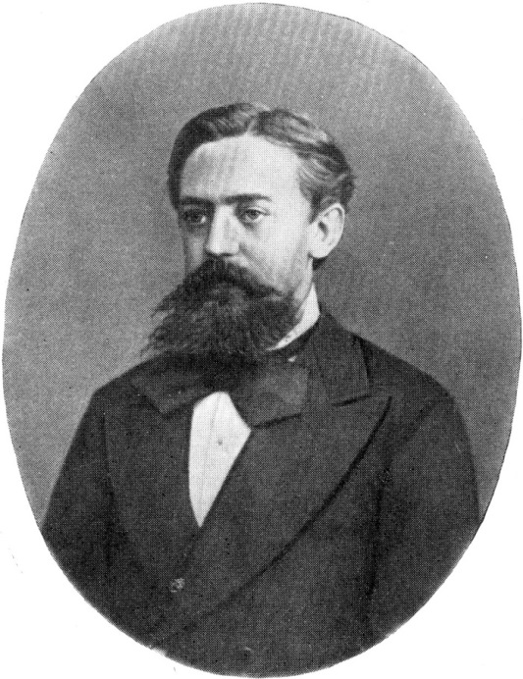

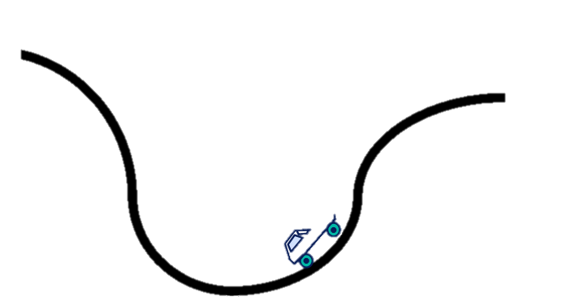
Reinforcement Learning and Understanding AlphaGo
Ms. Hadar Gorodissky
Mr. Niv Haim

Slide 2
Check that there are board markers!
Write topics on the board

Slide 3
Lecture I Flow
MDP (review of Ng lecture)
Model parameters
Solution concepts
Value iteration
Policy iteration
Q-Learning
RL in Neural Networks
Approximating functions: policy, V, Q
How to train policy network
How to train value network

Slide 4
Motivation
Classic: Inverted pendulum
Helicopter control
AlphaGo
Playing Attari
SpaceX landing (Modern inverted pendulum)
https://www.youtube.com/watch?v=RPGUQySBikQ

Slide 5
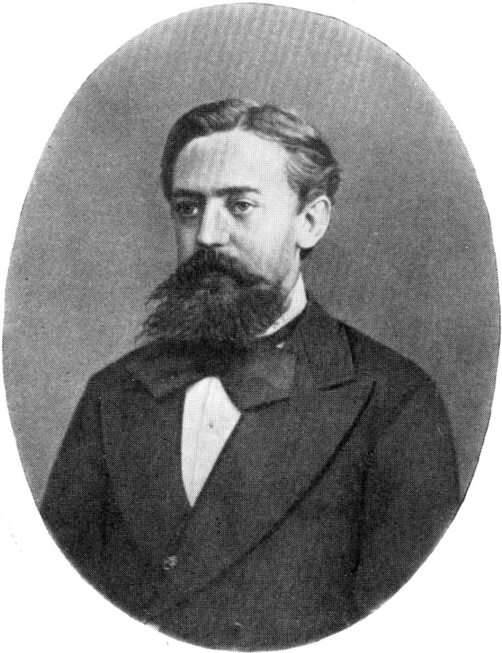

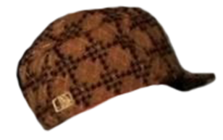
MDP
Stands for: Markov Decision Process

Slide 6
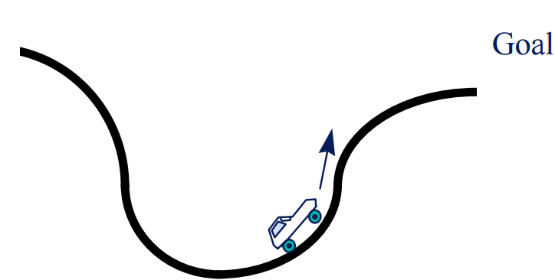
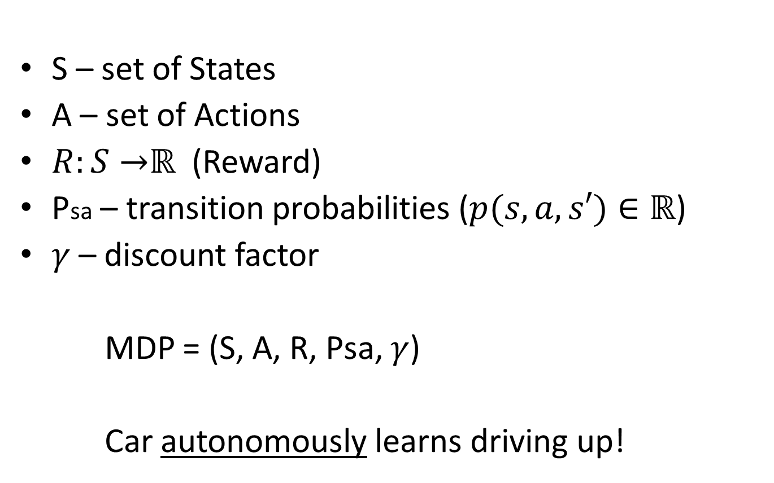
MDP (Simple example)
S – set of States
A – set of Actions
$R:S→$ℝ (Reward)
Psa – transition probabilities ($p(s,a,s′)∈\text{ℝ}$)
$γ$ – discount factor
MDP = (S, A, R, Psa, $γ$)
Car autonomously learns driving up!

Slide 7



MDP (Robot example)
4 | 3 | 2 | 1
 |  |  |  | 1
 |  |  |  | 2
 |  |  |  | 3

Slide 8



MDP (Robot example)
4 | 3 | 2 | 1
 |  |  |  | 1
 |  |  |  | 2
 |  |  |  | 3
S = squares
A = {N, S, W, E}

Slide 9

MDP (Robot example)
4 | 3 | 2 | 1
+1 | 0 | 0 | 0 | 1
-1 | 0 |  | 0 | 2
0 | 0 | 0 | 0 | 3
Reward - $R:S→$ℝ

Slide 10
MDP (Robot example)
4 | 3 | 2 | 1
+1 | -0.02 | -0.02 | -0.02 | 1
-1 | -0.02 |  | -0.02 | 2
-0.02 | -0.02 | -0.02 | -0.02 | 3
Reward - $R:S→$ℝ

Slide 11




MDP (Robot example)
4 | 3 | 2 | 1
 |  |  |  | 1
 |  |  |  | 2
 |  |  |  | 3
Transition Psa - ?
$$P_{\left(3,3\right),N}\left(\left(2,3\right)\right)=0.8$$
$$P_{\left(3,3\right),N}\left(\left(3,4\right)\right)=0.1$$
$$P_{\left(3,3\right),N}\left(\left(3,2\right)\right)=0.1$$
$$P_{\left(3,3\right),N}\left(\left(1,3\right)\right)=0$$
$$⋮$$

Slide 12
MDP vs. Graph search
If P is deterministic – can be done by A* etc.

Slide 13



MDP - Dynamics
4 | 3 | 2 | 1
 |  |  |  | 1
 |  |  |  | 2
 |  |  |  | 3
Start from state $S_{0}$
Choose action $A_{0}$
Transit to $S_{1}\sim P_{s_{0}a_{0}}$
Continue…
Total payoff:

Slide 14

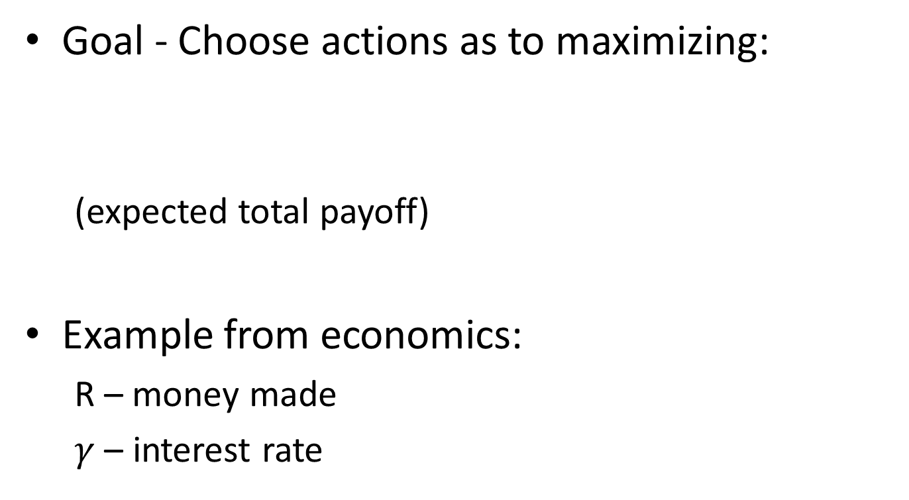
MDP - Dynamics
Goal - Choose actions as to maximizing:
(expected total payoff)
Example from economics:
R – money made
$γ$ – interest rate

Slide 15


MDP - Solution concepts
Policy
$$π:S→A$$
4 | 3 | 2 | 1
+1 |  |  |  | 1
-1 |  |  |  | 2
 |  |  |  | 3

Slide 16

MDP – Value function
Value function - $V:S→$ℝ
Expected sum of discounted rewards

Slide 17

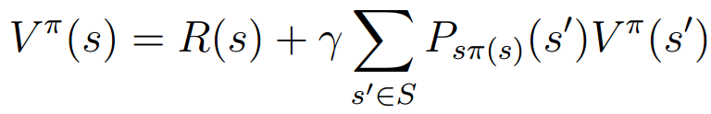

MDP - Value function
$$⇒V^{π}\left(s\right)=E\left[R\left(s_{0}\right)\right]+E\left[γR\left(s_{1}\right)+γ^{2}R\left(s_{2}\right)+…\right]$$
$$V^{π}\left(s\right)=R\left(s\right)+γE_{s^{′}\sim P_{s,π(s)}}\left[V(s′)\right]$$
Bellman’s equation:

Slide 18



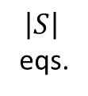
MDP - Value function
$V_{1}=R\left(1\right)+γP_{1,S}$(2) $V_{2}$ + …
$V_{2}=$ …
…
$$V_{10}=R\left(10\right)+γ(P_{10,N}\left(6\right)V_{6}+$$
$P_{10,N}\left(9\right)V_{9}+$
$P_{10,N}\left(11\right)V_{11}$)
…
4 | 3 | 2 | 1
4 | 3 | 2 | 1 | 1
7 | 6 |  | 5 | 2
11 | 10 | 9 | 8 | 3
$$\left|S\right|$$
eqs.
4 | 3 | 2 | 1
+1 |  |  |  | 1
-1 |  |  |  | 2
 |  |  |  | 3

Slide 19



MDP - Solution concepts
Optimal value function
Optimal policy
Bellman:

Slide 20
MDP – Solution concepts
Optimal policy for robot
4 | 3 | 2 | 1
+1 |  |  |  | 1
-1 |  |  |  | 2
 |  |  |  | 3

Slide 21
MDP – Solving
Value iteration
Policy iteration
Q-Learning

Slide 22
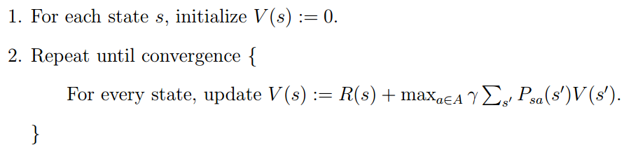
MDP – Solving
Value iteration

Slide 23
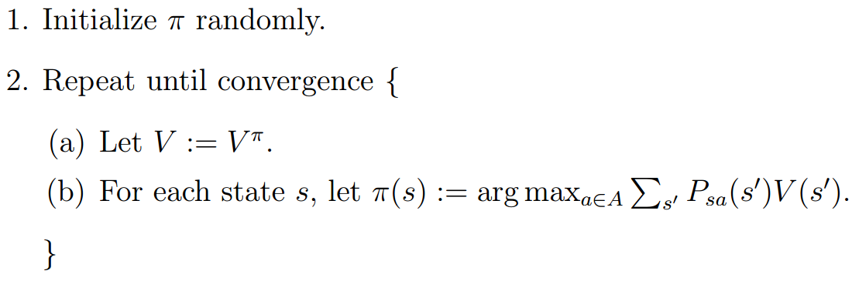
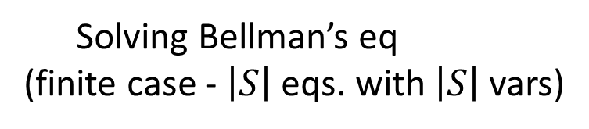
MDP – Solving
Policy iteration
Solving Bellman’s eq
(finite case - $\left|S\right|$ eqs. with $\left|S\right|$ vars)

Slide 24
MDP – Q-Learning
Value iteration
Policy iteration
Q-Learning – model-free
Both assumed domain knowledge:
Accurately knowing P and R
(not model-free)

Slide 25
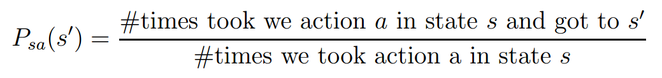
MDP – Using Experience
Infer P and R:
R – average reward observed in state s

Slide 26
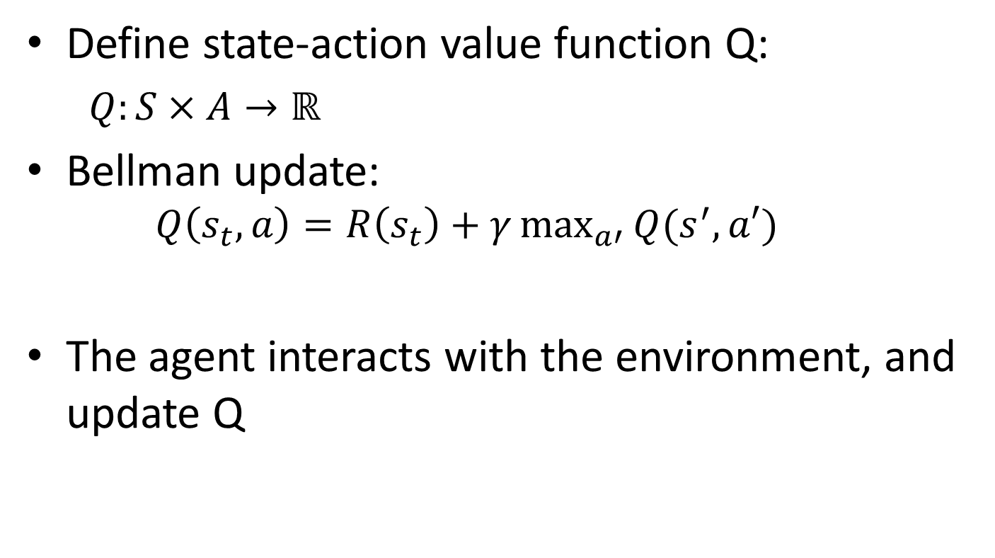
MDP – Q-Learning
Define state-action value function Q:
$Q:S×A→\text{ℝ}$
Bellman update:
$$Q\left(s_{t}, a\right)=R\left(s_{t}\right)+γ\max_{a′}^{}{Q(s^{′},a′)}$$
The agent interacts with the environment, and update Q

Slide 27
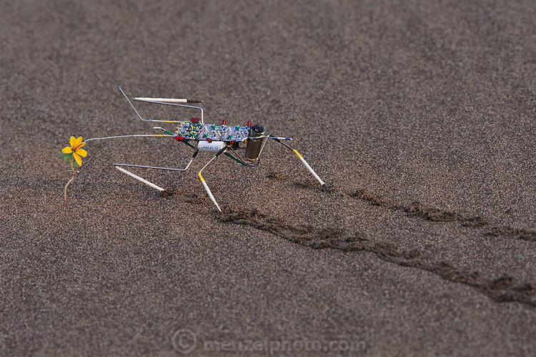
MDP – Q-Learning
Importance of storing values for state-action (vs. just state values):

Slide 28
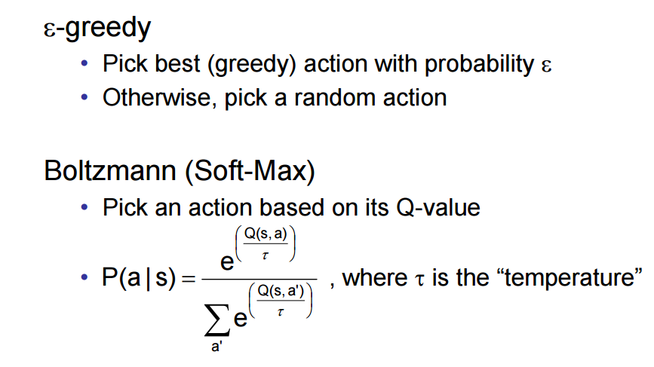
Q-Learning – Choosing actions

Slide 29
RL – classic summary
https://www.youtube.com/watch?v=XiigTGKZfks

Slide 30

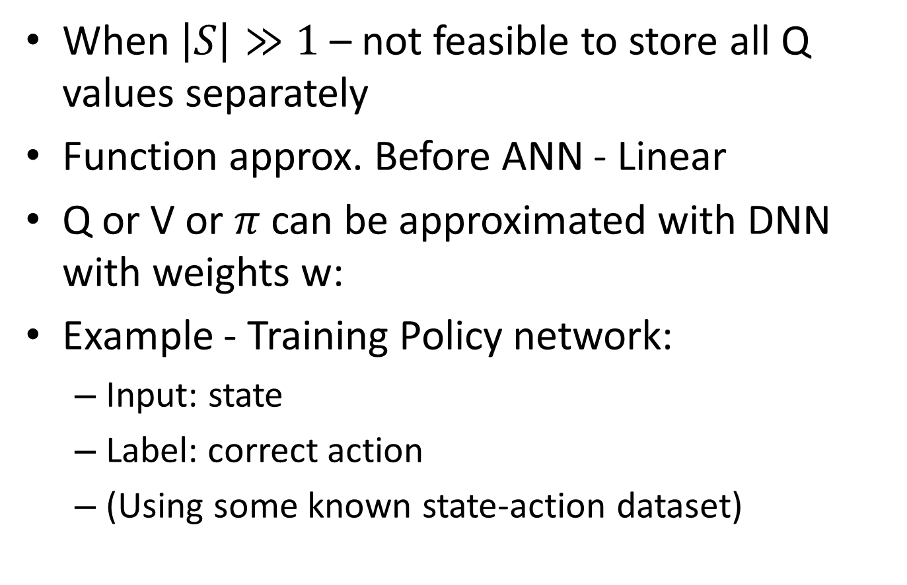
RL in DNN
When $\left|S\right|≫1$ – not feasible to store all Q values separately
Function approx. Before ANN - Linear
Q or V or $π$ can be approximated with DNN with weights w:
Example - Training Policy network:
Input: state
Label: correct action
(Using some known state-action dataset)

Slide 31
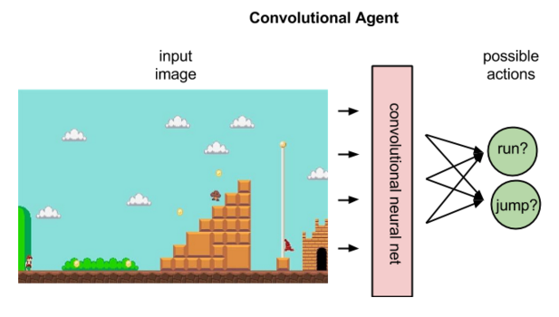
Policy network example

Slide 32
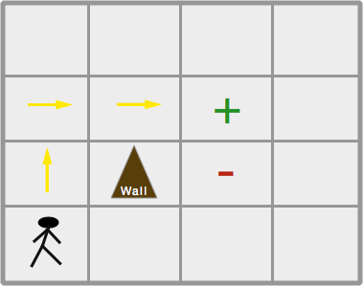
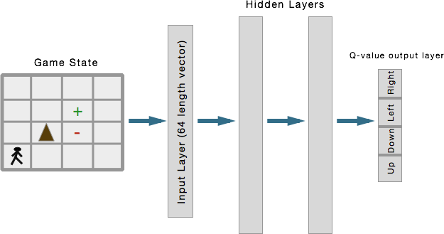
Policy network example

Slide 33
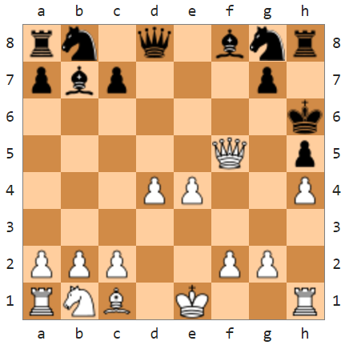
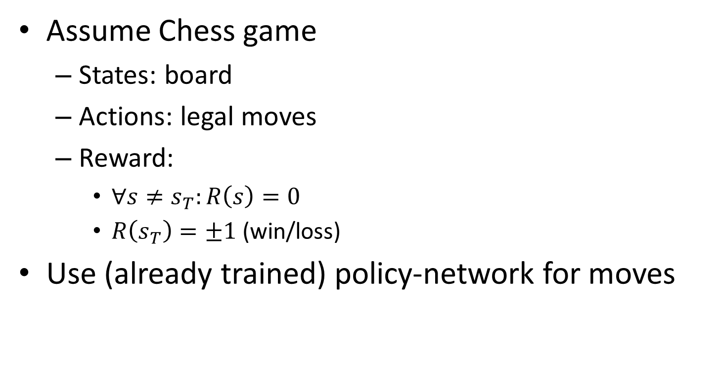
How to train a Value Network
Assume Chess game
States: board
Actions: legal moves
Reward:
$∀s≠s_{T}:R\left(s\right)=0$
$R\left(s_{T}\right)=±1$ (win/loss)
Use (already trained) policy-network for moves

Slide 34
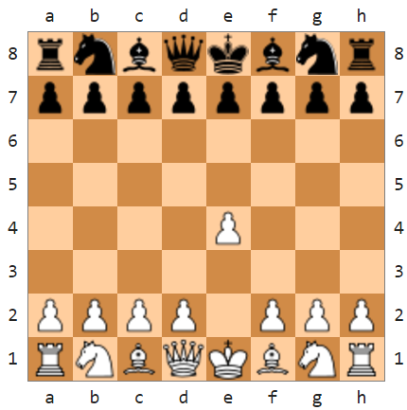
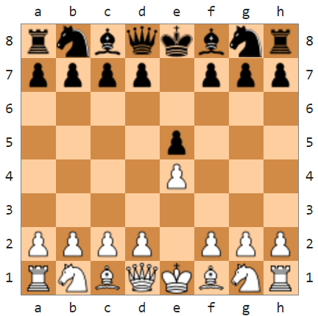
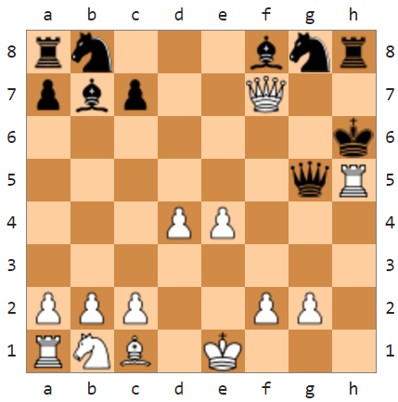



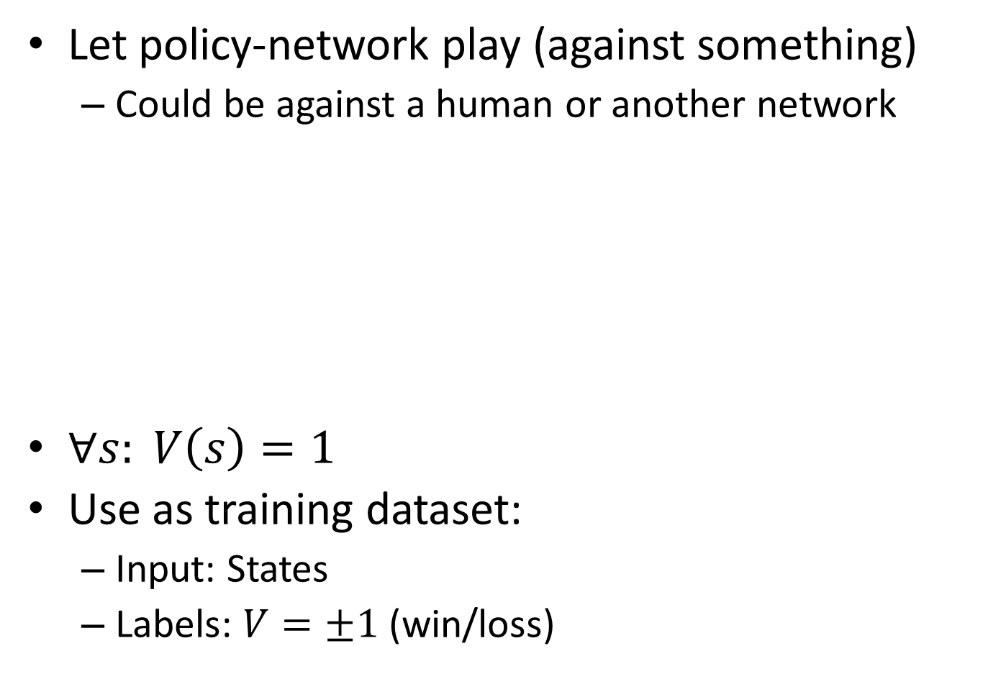

How to train a Value Network
Let policy-network play (against something)
Could be against a human or another network
$∀s: V\left(s\right)=1$
Use as training dataset:
Input: States
Labels: $V=±1$ (win/loss)
White wins!
$$R(s)=0$$
$$R(s)=0$$
$$R(s_{T})=1$$
14 states

Slide 35
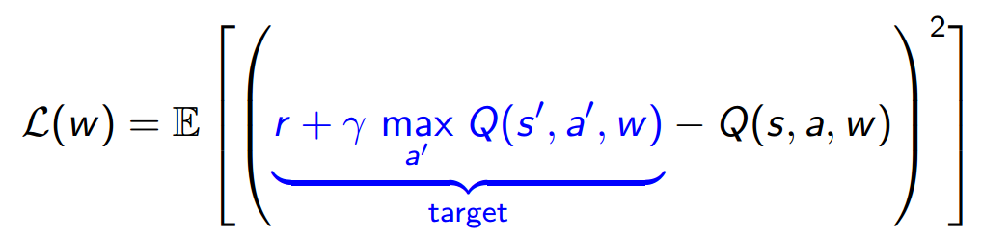
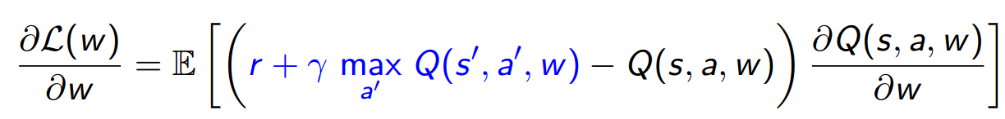
RL in DNN
Objective function:
Following gradients:

Slide 36
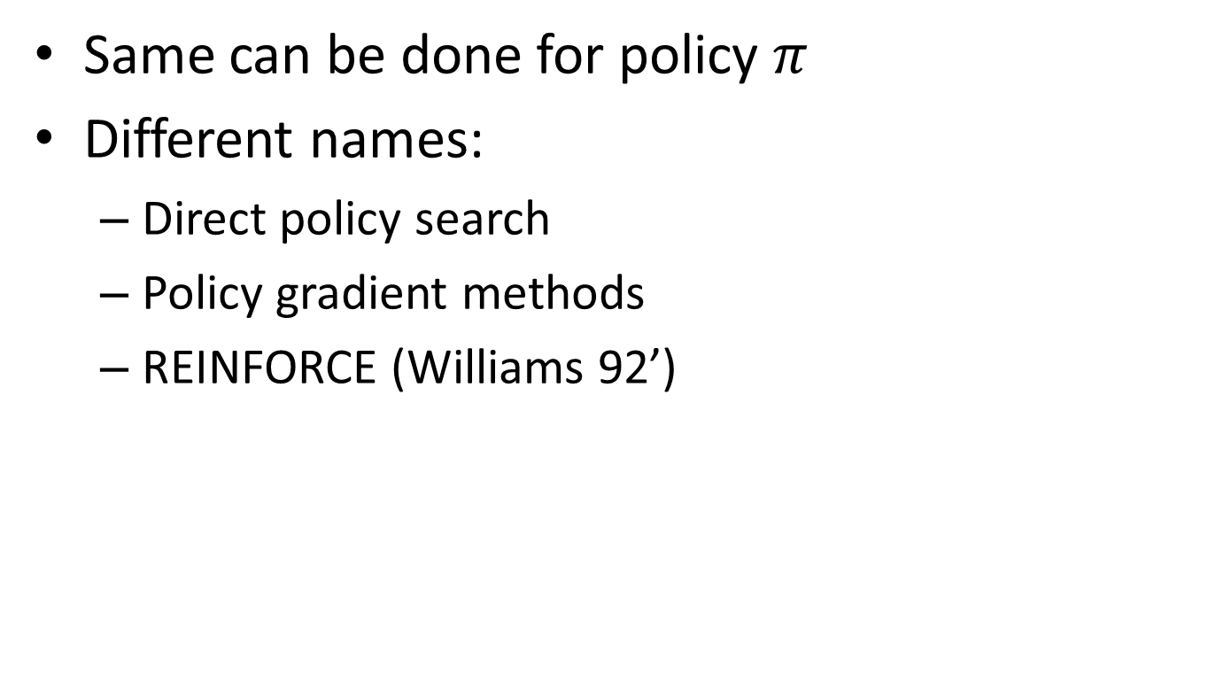
RL in DNN
Same can be done for policy $π$
Different names:
Direct policy search
Policy gradient methods
REINFORCE (Williams 92’)

Slide 37
DQN - Playing Atari
Human-level control through deep reinforcement learning (Mnih et al. 2015)

Slide 38

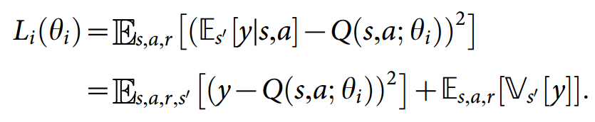
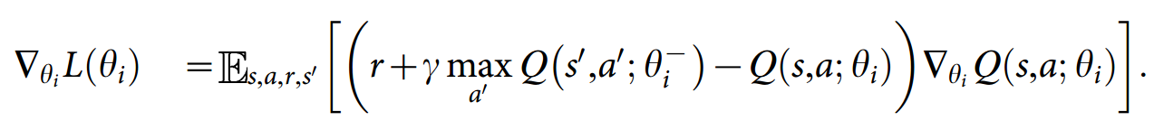
DQN - Playing Atari
Action-value:
Loss function:
Gradient:

Slide 39
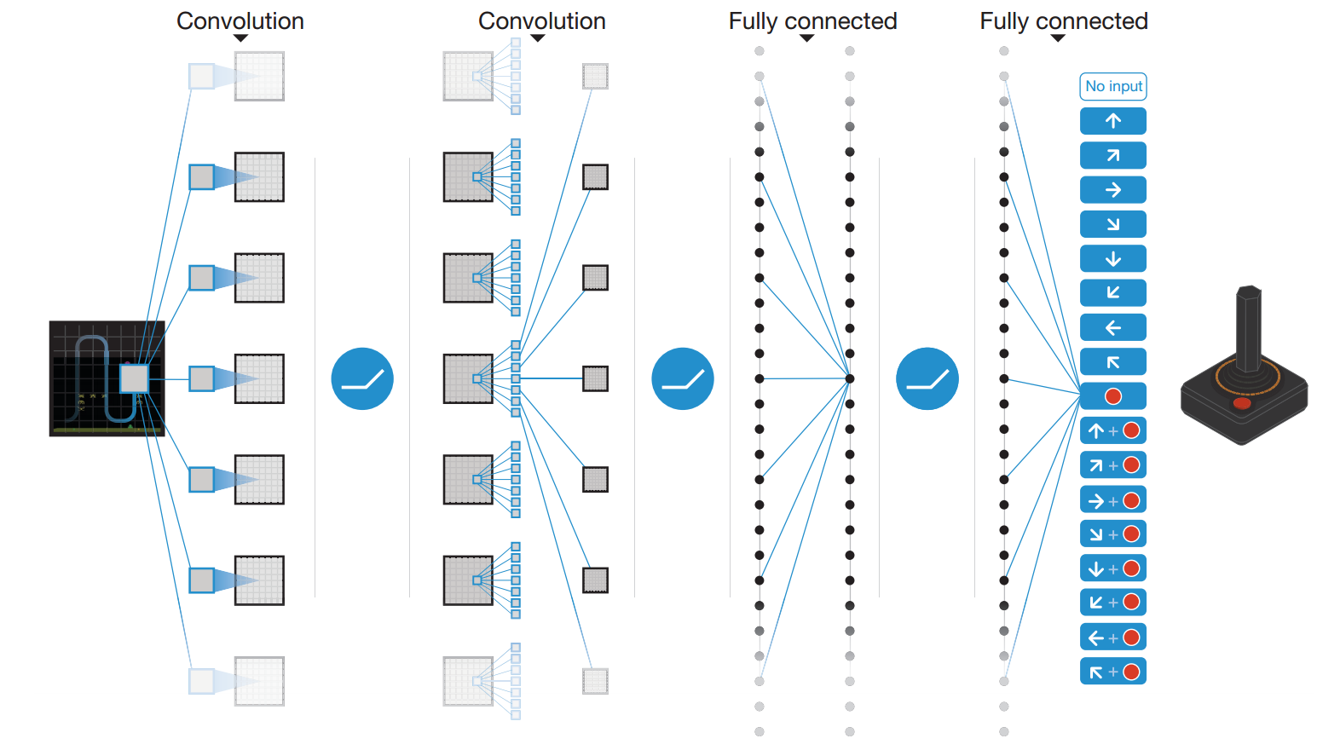
DQN - Playing Atari

Slide 40
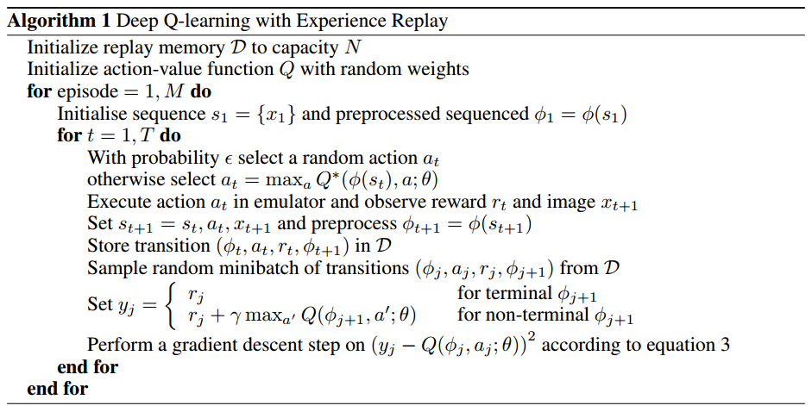
DQN - Playing Atari

Slide 41
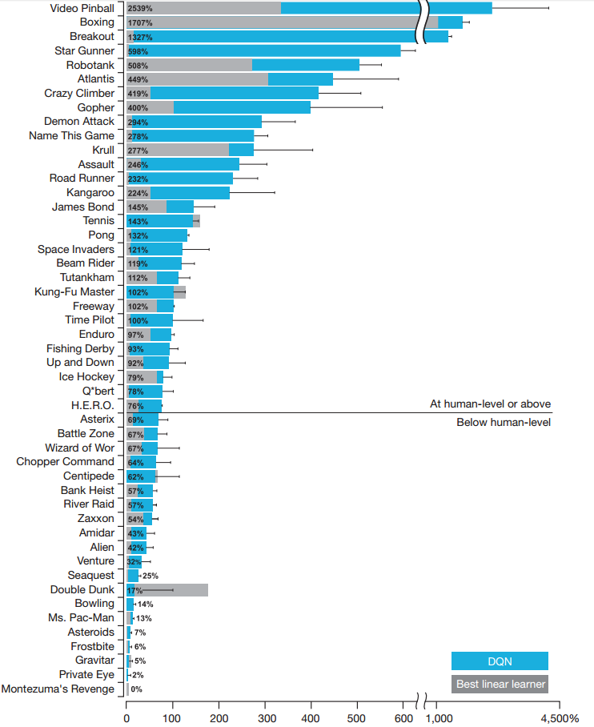

Slide 42
References
CS229 Lecture notes - Andrew Ng
Reinforcement Learning: A Tutorial - Harmon
Simple Statistical Gradient-Following Algorithms for Connectionist Reinforcement Learning - Williams
Human-level control through deep reinforcement learning - Mnih et al.
http://www.iclr.cc/lib/exe/fetch.php?media=iclr2015:silver-iclr2015.pdf
http://uhaweb.hartford.edu/compsci/ccli/projects/QLearning.pdf
http://www2.econ.iastate.edu/tesfatsi/RLUsersGuide.ICAC2005.pdf
https://webdocs.cs.ualberta.ca/~sutton/book/ebook/the-book.html - Sutton RL book

