Slide 1
Supervised Pretraining
Jia-Bin Huang
Virginia Tech
ECE 6554 Advanced Computer Vision

Slide 2
Administrative stuffs
Project proposal due March 2nd
1-page summary of
Feedback on paper summary
Explicit structure

Slide 3
Discussion – Think-pair-share
Discuss
strength,
weakness, and
potential extension
Share with class

Slide 4
Today’s class
Training tricks for CNN
Transfer learning via supervised pretraining

Slide 5
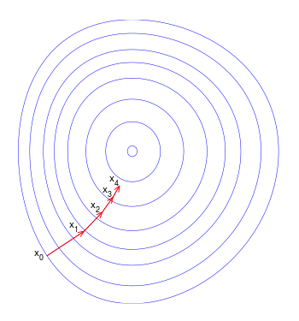
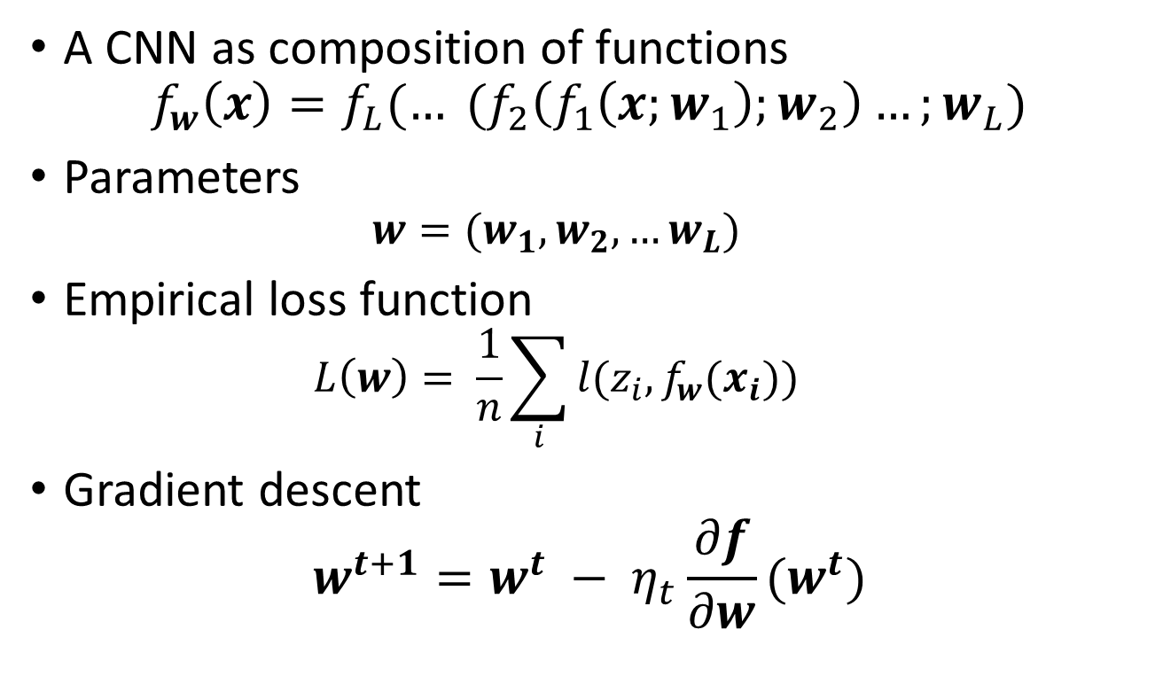
Training CNN with gradient descent
A CNN as composition of functions
$$f_{w}\left(x\right)={f_{L}(… (f}_{2}\left(f_{1}\left(x;w_{1}\right);w_{2}\right)…;w_{L})$$
Parameters
$$w=(w_{1}, w_{2},…w_{L})$$
Empirical loss function
$$L\left(w\right)= \frac{1}{n}\sum_{i}{l(z_{i}, f_{w}(x_{i}))}$$
Gradient descent
$$w^{t+1}=w^{t} − η_{t}\frac{∂f}{∂w}(w^{t})$$
New weight
Old weight
Learning rate
Gradient

Slide 6
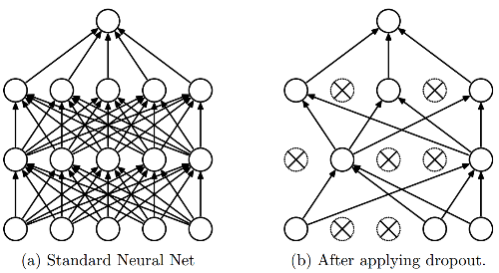
Dropout
Intuition: successful conspiracies
50 people planning a conspiracy
Strategy A: plan a big conspiracy involving 50 people
Likely to fail. 50 people need to play their parts correctly.
Strategy B: plan 10 conspiracies each involving 5 people
Likely to succeed!
Dropout: A simple way to prevent neural networks from overfitting [Srivastava JMLR 2014]

Slide 7
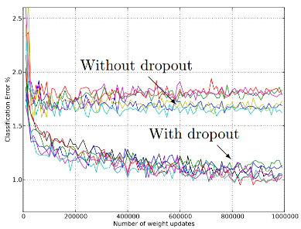
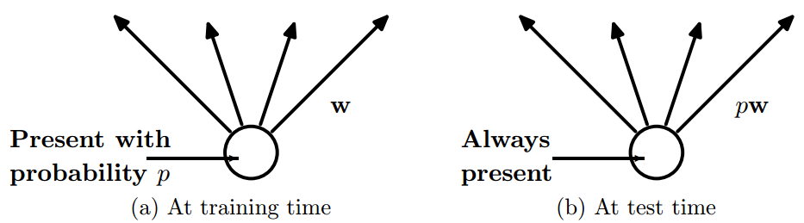
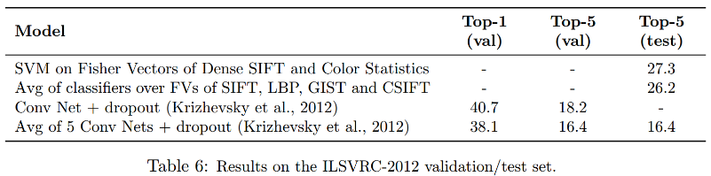
Dropout
Main Idea: approximately combining exponentially many different neural network architectures efficiently
Dropout: A simple way to prevent neural networks from overfitting [Srivastava JMLR 2014]

Slide 8
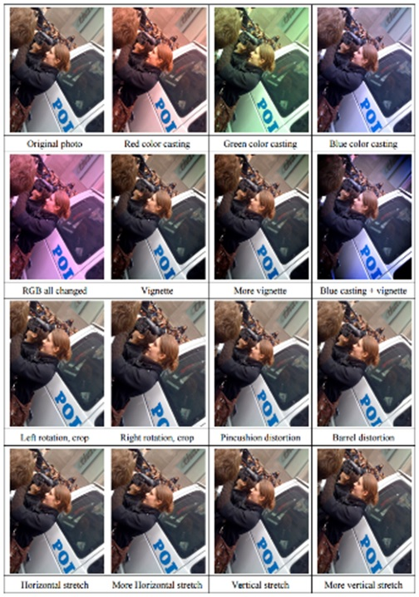
Data Augmentation (Jittering)
Create virtual training samples
Horizontal flip
Random crop
Color casting
Geometric distortion
Deep Image [Wu et al. 2015]

Slide 9
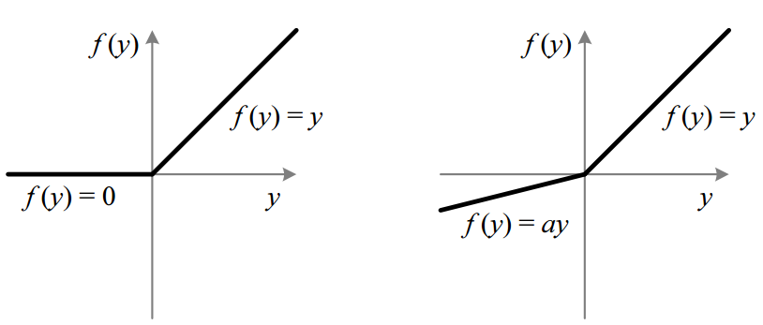
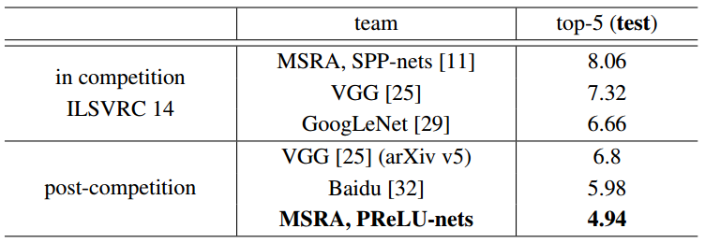
Parametric Rectified Linear Unit
Delving Deep into Rectifiers: Surpassing Human-Level Performance on
ImageNet Classification [He et al. 2015]

Slide 10
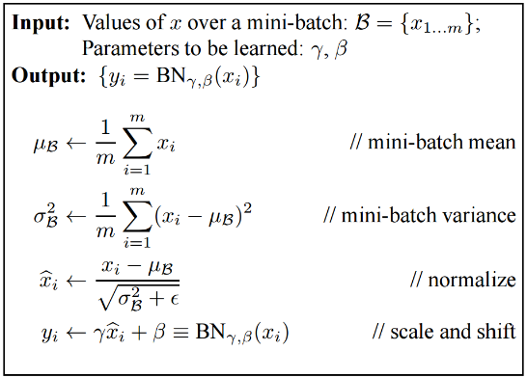
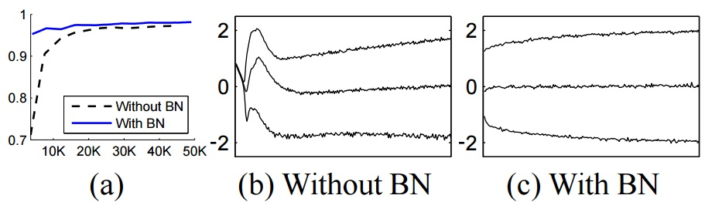
Batch Normalization
Batch Normalization: Accelerating Deep Network Training by
Reducing Internal Covariate Shift [Ioffe and Szegedy 2015]

Slide 11
Transfer Learning
Improvement of learning in a new task through the transfer of knowledge from a related task that has already been learned.
Weight initialization for CNN
Two major strategies
ConvNet as fixed feature extractor
Fine-tuning the ConvNet

Slide 12
When to finetune your model?
New dataset is small and similar to original dataset.
train a linear classifier on the CNN codes
New dataset is large and similar to the original dataset
fine-tune through the full network
New dataset is small but very different from the original dataset
SVM classifier from activations somewhere earlier in the network
New dataset is large and very different from the original dataset
fine-tune through the entire network

Slide 13
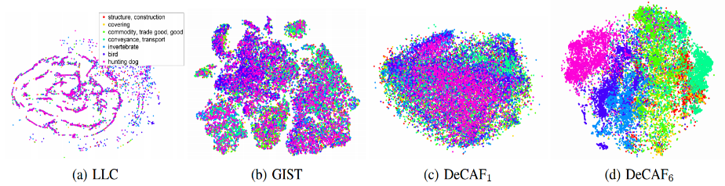
Convolutional activation features
[Donahue et al. ICML 2013]

Slide 14
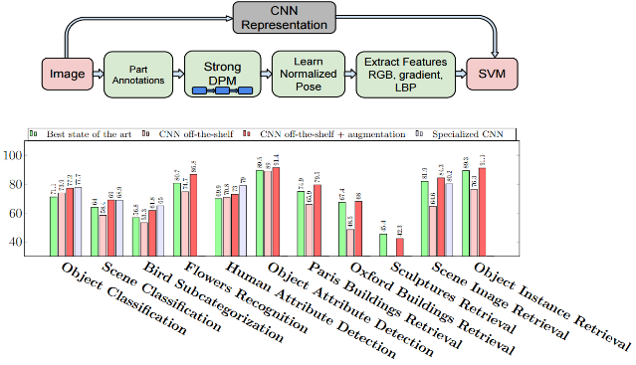
CNN Features off-the-shelf: an Astounding Baseline for Recognition [Razavian et al. 2014]

Slide 15
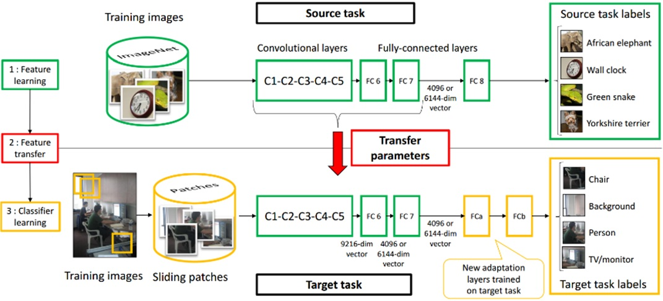
Learning and Transferring Mid-Level Image Representations using Convolutional Neural Networks [Oquab et al. CVPR 2014]

Slide 16
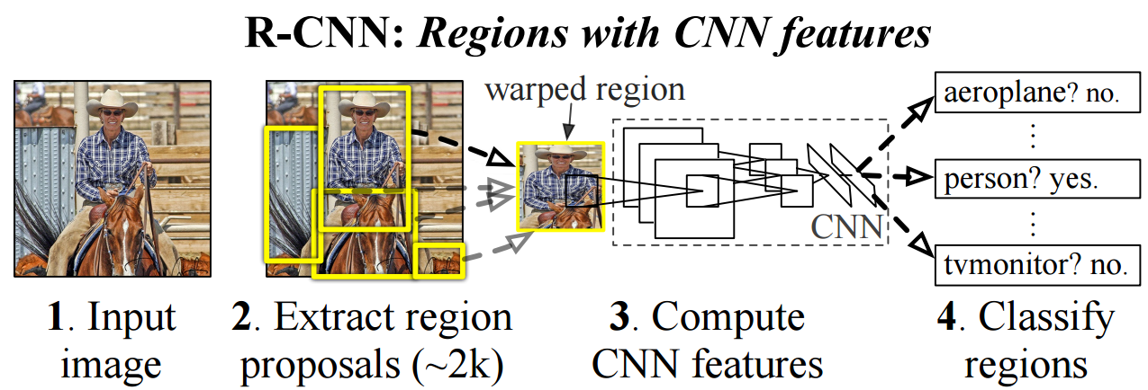
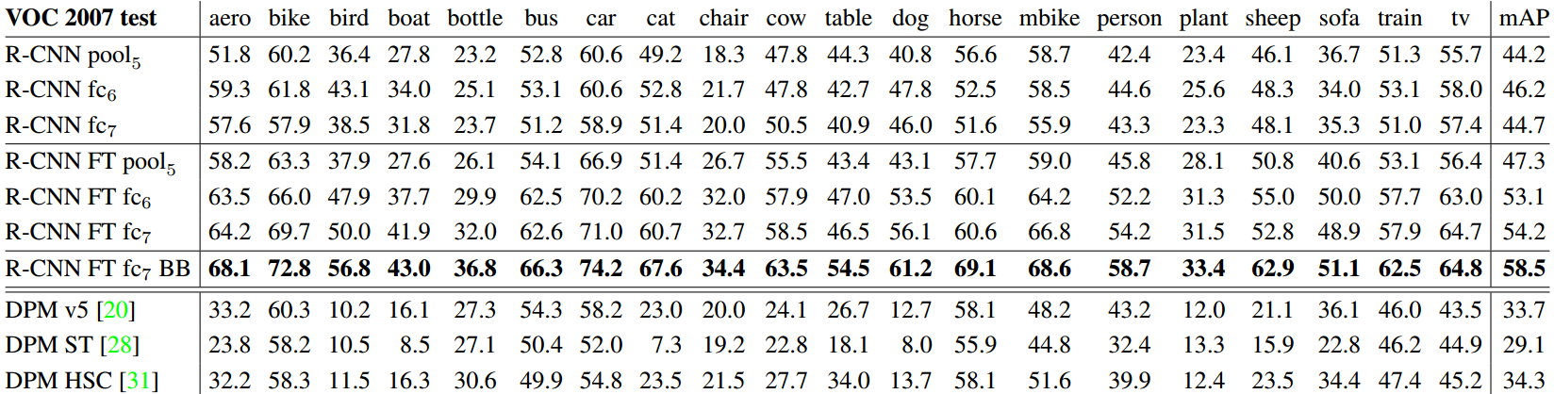
Rich feature hierarchies for accurate object detection and semantic segmentation, [Girshick et al. CVPR 2014]

Slide 17
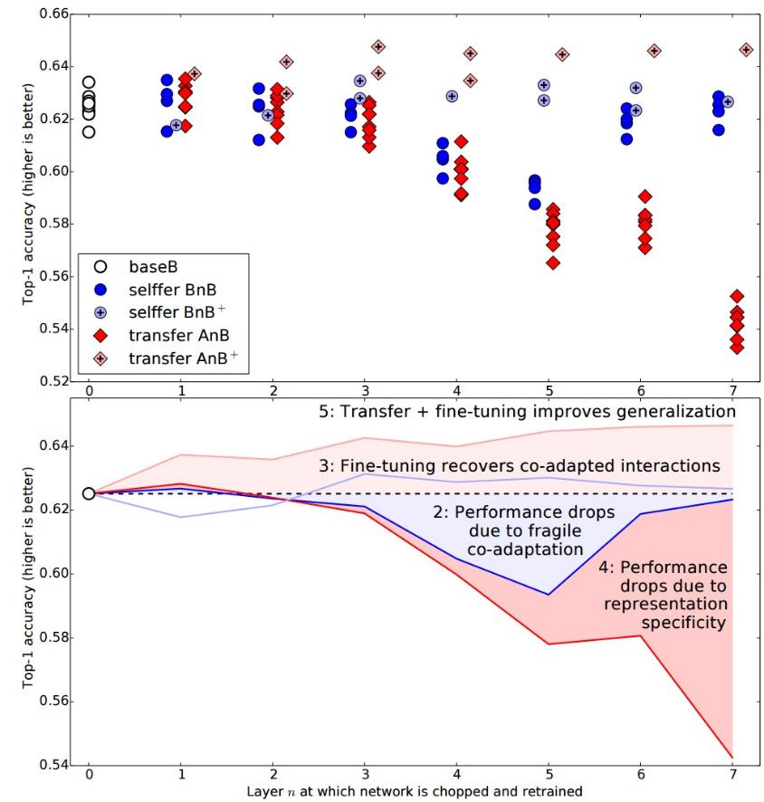
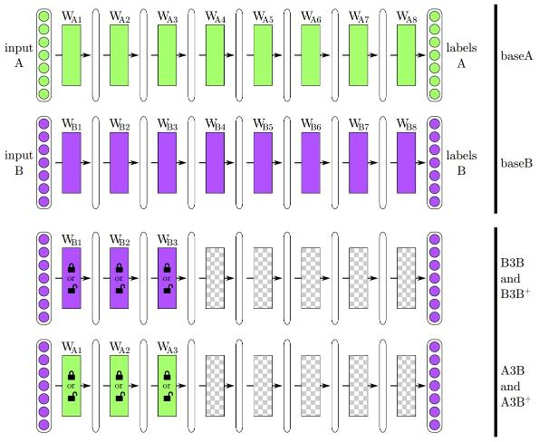
How transferable are features in CNN?
How transferable are features in deep neural networks [Yosinski NIPS 2014]

Slide 18
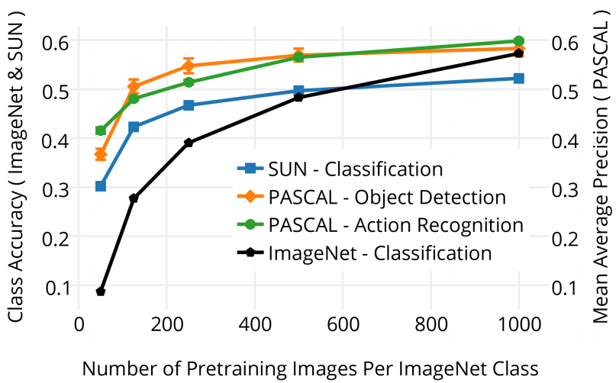
What makes ImageNet good for transfer learning? [Huh arXiv 2016]

Slide 19
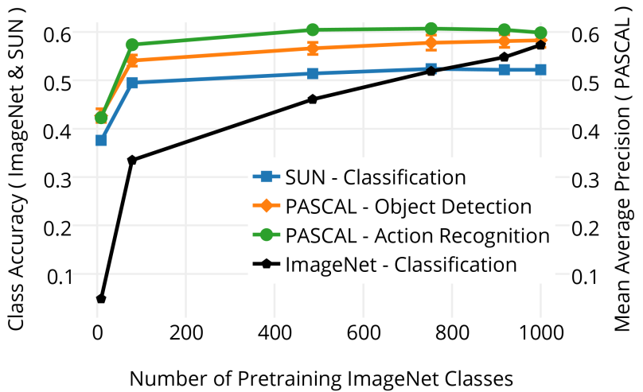
What makes ImageNet good for transfer learning? [Huh arXiv 2016]

Slide 20
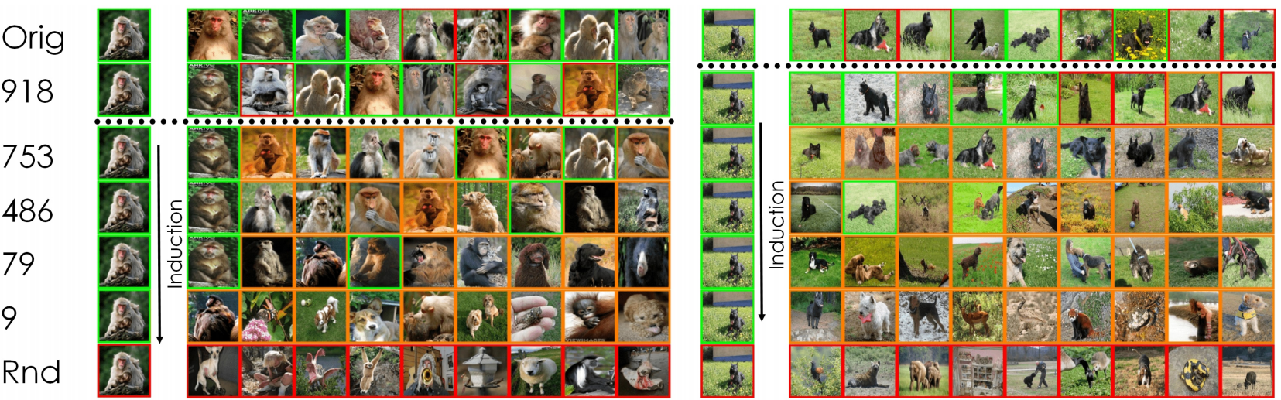
What makes ImageNet good for transfer learning? [Huh arXiv 2016]

Slide 21
Things to remember
Training CNN
Dropout
Data augmentation
Activaition
Batch normalization
Transfer learning
Two strategies
CNN code
Finetuning
When and how to transfer
Characteristics of transfer learning

