Slide 1

Draw a multicolor flower
Project designed and created by
M. Shajith Kumar

Slide 2
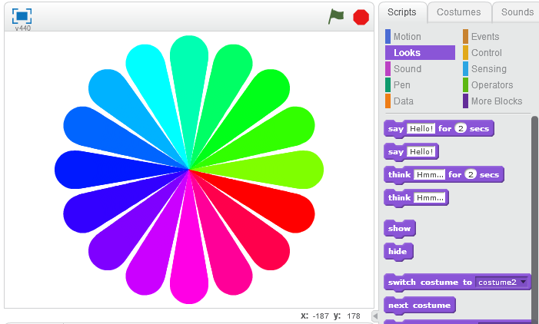
Draw a multicolor flower
In this project we build a multi-coloured flower like the one below using the Scratch Programming environment

Slide 3


Building our understanding of the problem
Let us first break up this problem into manageable parts:
In programming we call this “Decomposition”
The reason we decompose is to solve each individual smaller problems and then combine together those solutions to address and solve the larger problem.
In this flower project, we need to use a concept that computer scientist use very regularly :
“Pattern Recognition”
If you observe the flower closely, you find that it is made of individual arms (we call it petals) and each petal is identical except for the colour. You can also see a pattern in which the petals are arranged to create the flower.
So, if we can draw one petal, then we should be able to draw that flower… may not be that easy, but should definitely be possible.
Drawing the petal
If you examine the petal, it is thin and point sized at one end and thick and oval at the other.
So, if we have a pen which can grow in size as we draw, then we should be able to draw a petal.
Let us see how we create this in Scratch

Slide 4




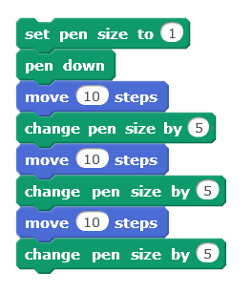
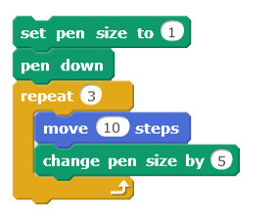

Steps for drawing one petal
STEP 1
Set the pen size to the lowest value 1
1
STEP 2
Now, put the pen down, ie. let it touch the screen
STEP 3
Let’s make the pen (i.e the cat) move. Let us try 10 steps first
10
STEP 4
Now the size of the pen should change by some value - Let’s say 5
5
We now repeat Step 3 and 4 a definite number of times. For example, if we repeat 3 times, our code should look like this
But, instead of writing the same
set of code again and again, we
can use, the
block from the “control” tab
in the “scripts” menu to repeat a finite number of times
Our code will now look like this
1 time
2 times
3 times
This is our
STEP 5

Slide 5
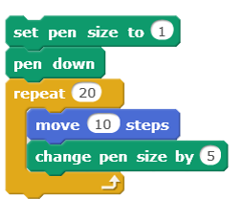
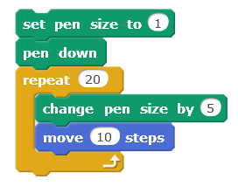
Test your Understanding
What will be the pen size at the end of repeating 20 times for the code below?
In this code, the blocks within the repeat loop has been interchanged. Will your answer to question 1 be the same in this case also?
Will the above two codes give the same result i.e will they draw the same thing?
Try to answer the questions only by looking at the code and then check your answer by trying it out in Scratch. This will help you improve your thinking skills and also code reading skills (i.e ability to understand by just looking at the code). For questions 1 & 2, it is not possible to test the answer using Scratch. So think smartly

Slide 6

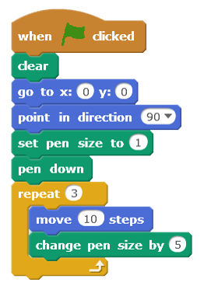




Steps for drawing one petal
The block gives us a short cut to save time. Imagine if we had to do the same set of blocks a 1000 times. We would have taken a whole day to arrange the blocks (or write the code if we were doing this in a text based programming language like Java, Python or C++).
The repeat block in Scratch is what we call in programming “Loops”
Loops are convenient as it allows us to repeat the same set of blocks any number of times we want to. In our example and are repeated 3 times. If we want to make it 50 times, we just have to type 50 inside the white oval area within the block
10
5
Getting back to our petal, lets see how our code works, but before that let us add a few more blocks just above the blocks we had created
Our petal code should now look like this
We will discuss why we add these blocks shortly

Slide 7
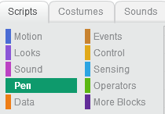
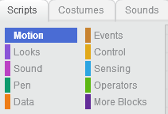
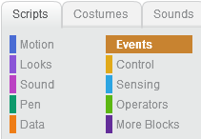
Why did we used additional blocks
Block
Why use this block
Block location
If there is something already drawn on the screen, this block will erase it. This block ensures that we start with a clean slate | “Pen” tab” in “Scripts” menu
The stage in Scratch is like a graph and has (x,y) co-ordinates. Setting it at (0,0) will put the sprite at the middle of the screen when it starts drawing the petal | “Motion” tab in “Scripts” menu
This is the direction which the sprite will face. 90 (face right), - 90 (face left), 0 (face up) and 180 (face down) | “Motion” tab in “Scripts” menu
For the entire script (all the blocks together) to work, the user (you) have to do something. It could be, clicking the mouse, pressing any button on the keyboard etc. In this case we have chosen clicking the green flag on the screen. Only then will Scratch execute all the other blocks below it | “Events” tab in “Scripts” menu

Slide 8
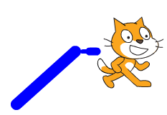
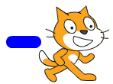
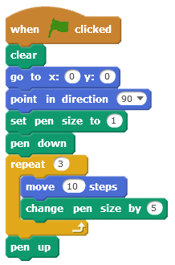
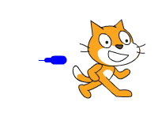

Up & Down with pen
Now, let us try running this script
Click on the green flag.
Can you see what happens?
Noting much changes, right?
To see what has happened, just pull the cat away using your mouse. You may see the below picture on the screen
Oops! The petal has become a weird design depending on where you dragged the cat. Why?
The reason this happens is that the pen is still down as cat travels from where it has been dragged after executing the block to the point (0,0) while executing
Cat dragged slightly to the right
Cat dragged bottom left
0
0
Therefore, we have to add a
block at the end of our script.
Now, try clicking the green flag again. If the same thing happens, click the green flag again. It will work.
Our revised script will be
A very small petal has been drawn. Let us see why that has happened.
But before that try clicking the green flag again.
Now, let’s try to make the petal to look like what we want to.

Slide 9
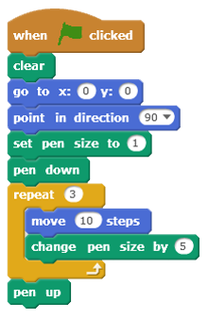


Tinkering the petal code
To get us our ideal petal we have to tinker around with 3 values within our repeat loop.
Quick Questions
In the script the repeat loop executes the block within the loop 3 times. What is the size of the pen after repeat loop is executed 1 time, 2 times and 3 times?
What is the total length of petal (in steps/ pixels) after the entire script is executed?
Try it yourself
Number of times to repeat the blocks in the loop
Change the values of the arguments and try to create your own version of a petal. See how changing each argument changes the shape, length and smoothness of the petal.
Steps to move in each repeat
Size by which the pen changes each time
To get the petal as in the flower in our opening page of this lesson, the arguments used are :
The values that we provide in the white oval spaces are called “Arguments” or “Parameters”.
So, if we change one or some or all the arguments, the petal should look different.
50
3
2

Slide 10
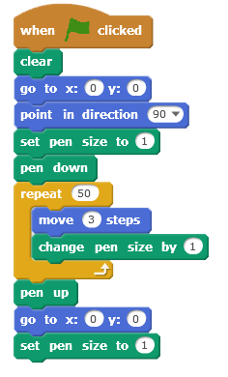

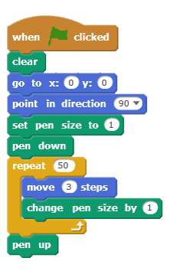

The final petal code
Think & answer
We have now finalised our code for the petal which should look like this
But our cat is at the end of the petal with the pen up.
What is the size of the pen after the cat completes drawing a petal?
Should we now change the size of the pen back to 1. Which block should we use to do that?
So, to draw the next petal, the cat has to be brought back to its initial position, i.e (0,0) using
and adding arguments 0 and 0 in the white oval space.
Now our cat is back to its initial position.
The size of the pen is so large that when it returns back to draw the next petal, we need to reset it to its lowest size. Otherwise, our next petal will be jumbo size. Our script will now look like this
Our cat is back to its original position

Slide 11
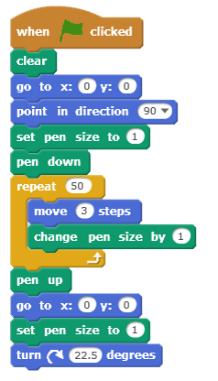




Rotating the cat
To draw our next petal, our cat has to turn a little bit and then we run the same script which we have made for one petal to draw the next petal, the next petal and so on. The number of times we do this depends on the total number of petals in our flower. In our project, the total number of petals are 16.
We use our understanding of geometry to draw the whole flower. To draw the whole flower, the cat has to rotate a full circle. To go a full circle we need to rotate by 360 degrees.
So, to draw each petal, the cat has to rotate 360 divided by 16 i.e 22.5 degrees each time in one direction (to its right or its left). For doing this in Scratch, we either use the or and add the argument 22.5 inside it. The turn blocks are available in the “motion” tab.
22.5
22.5 º
Our code will now look like this

Slide 12
Getting ready for next petal
Try running this code now:
Does it draw a flower?
No. Why?
Let us analyse the code and see what each block or set of blocks does and find out what is missing to complete drawing a flower.
We have to do to to complete drawing one petal and get ready to draw the next petal.
So, if we repeat this 16 times, we will be able to draw the complete flower.
1
2
3
4
5
Puts the pen down on the screen
6
The loop draws one petal
7
6
11
Withdraws the pen from the screen (but still has the pen)
8
Brings the cat back to the middle of the screen
9
Brings the pen size back to 1 from 51 when competing the loop
10
Turns the cat 22.5 degree to the right (getting ready to draw the next petal)
11
We now repeat blocks to 16 times inside a repeat loop to draw the complete flower.
6
11

Slide 13
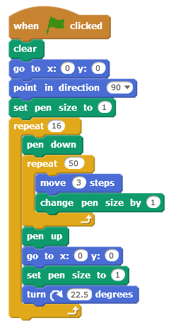
Understanding the set of codes
These blocks help set initial values before the functional code (i.e code that draws the flower) is executed. These values will change as the script is run. This is called “Initialisation” and is a very important concept in programming.
Blocks that puts pen down, draw one petal, pulls pen up, returns to initial position, resets size of pen and turns 22.5 degrees
Repeat block that repeats all that is done inside 16 times

Slide 14
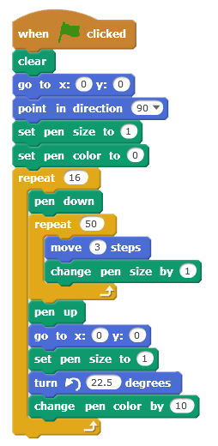


The Final code
Now our code draws a flower but not exactly what we intended. Our flower is single coloured but we had earlier decided to draw a multi-coloured flower with each petal having different colour.
To do this, we have to set an initial value for the pen colour and then change the value by a constant number as we change from one petal to another.
In Scratch, we can initialise the pen colour using
and change the colour every time inside the loop that draws a new petal (the outer loop that repeats 16 times) using the
block. In Scratch we can use colour in the range 0 to 200.
Let us set the initial value to 0 and change the pen colour by 10 every time a new petal is drawn.
Final code after adding colours will look like this
Initialised colour
Changing pen colour for each new petal

Slide 15
Exercise
Now that you know to draw a flower, try to do the following
Draw a single coloured flower with 8 petals
Draw different coloured flower with 5 petals which are thicker in size
Draw a flower with a fixed petal size of 5
Draw a flower which has petals that is thicker in the beginning and thinner at the end

