Slide 1
RL for Large State Spaces: Value Function Approximation
Alan Fern
* Based in part on slides by Daniel Weld

Slide 2
Large State Spaces
When a problem has a large state space we can not longer represent the V or Q functions as explicit tables
Even if we had enough memory
Never enough training data!
Learning takes too long
What to do??

Slide 3
Function Approximation
Never enough training data!
Must generalize what is learned from one situation to other “similar” new situations
Idea:
Instead of using large table to represent V or Q, use a parameterized function
The number of parameters should be small compared to number of states (generally exponentially fewer parameters)
Learn parameters from experience
When we update the parameters based on observations in one state, then our V or Q estimate will also change for other similar states
I.e. the parameterization facilitates generalization of experience

Slide 4
Linear Function Approximation
Define a set of state features f1(s), …, fn(s)
The features are used as our representation of states
States with similar feature values will be considered to be similar
A common approximation is to represent V(s) as a weighted sum of the features (i.e. a linear approximation)
The approximation accuracy is fundamentally limited by the information provided by the features
Can we always define features that allow for a perfect linear approximation?
Yes. Assign each state an indicator feature. (I.e. i’th feature is 1 iff i’th state is present and θ_{i} represents value of i’th state)
Of course this requires far too many features and gives no generalization.

Slide 5
Example
Grid with no obstacles, deterministic actions U/D/L/R, no discounting, -1 reward everywhere except +10 at goal
Features for state s=(x,y): f1(s)=x, f2(s)=y (just 2 features)
V(s) = θ₀ + θ₁ x + θ₂ y
Is there a good linear approximation?
Yes.
θ₀ =10, θ₁ = -1, θ₂ = -1
(note upper right is origin)
V(s) = 10 - x - y subtracts Manhattan dist. from goal reward
6
0
10
0
6

Slide 6
But What If We Change Reward …
V(s) = θ₀ + θ₁ x + θ₂ y
Is there a good linear approximation?
No.
0
0
10

Slide 7
But What If…
V(s) = θ₀ + θ₁ x + θ₂ y
+ θ₃ z
Include new feature z
z= |3-x| + |3-y|
z is dist. to goal location
Does this allow a good linear approx?
θ₀ =10, θ₁ = θ₂ = 0, θ₃ = -1
3
0
0
10
3

Slide 8
Linear Function Approximation
Define a set of features f₁(s), …, f_{n}(s)
The features are used as our representation of states
States with similar feature values will be treated similarly
More complex functions require more complex features
Our goal is to learn good parameter values (i.e. feature weights) that approximate the value function well
How can we do this?
Use TD-based RL and somehow update parameters based on each experience.

Slide 9
TD-based RL for Linear Approximators
Start with initial parameter values
Take action according to an explore/exploit policy (should converge to greedy policy, i.e. GLIE)
Update estimated model (if model is not available)
Perform TD update for each parameter
Goto 2
What is a “TD update” for a parameter?

Slide 10
Aside: Gradient Descent
Given a function E(θ₁,…, θ_{n}) of n real values θ=(θ₁,…, θ_{n}) suppose we want to minimize E with respect to θ
A common approach to doing this is gradient descent
The gradient of E at point θ, denoted by ∇_{θ} E(θ), is an n-dimensional vector that points in the direction where f increases most steeply at point θ
Vector calculus tells us that ∇_{θ} E(θ) is just a vector of partial derivatives where
Decrease E by moving θ in negative gradient direction

Slide 11
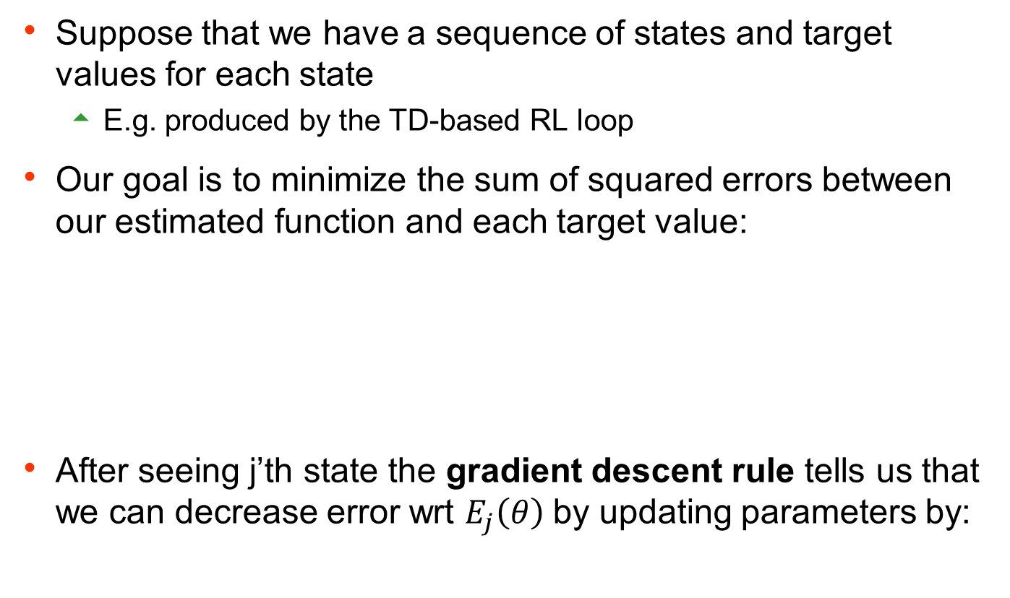
Aside: Gradient Descent for Squared Error
Suppose that we have a sequence of states and target values for each state
E.g. produced by the TD-based RL loop
Our goal is to minimize the sum of squared errors between our estimated function and each target value:
After seeing j’th state the gradient descent rule tells us that we can decrease error wrt $E_{j}\left(θ\right)$by updating parameters by:
squared error of example j
our estimated value for j’th state
target value for j’th state
learning rate

Slide 12
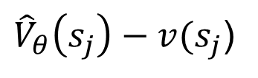
Aside: continued
${\hat{V}}_{θ}\left(s_{j}\right)−v(s_{j}$)
depends on form of approximator
For a linear approximation function:
Thus the update becomes:
For linear functions this update is guaranteed to converge to best approximation for suitable learning rate schedule

Slide 13
TD-based RL for Linear Approximators
Start with initial parameter values
Take action according to an explore/exploit policy (should converge to greedy policy, i.e. GLIE) Transition from s to s’
Update estimated model
Perform TD update for each parameter
Goto 2
What should we use for “target value” v(s)?
Use the TD prediction based on the next state s’
this is the same as previous TD method only with approximation

Slide 14
TD-based RL for Linear Approximators
Start with initial parameter values
Take action according to an explore/exploit policy (should converge to greedy policy, i.e. GLIE)
Update estimated model
Perform TD update for each parameter
Goto 2
Step 2 requires a model to select greedy action
For some applications (e.g. Backgammon ) it is easy to get a compact model representation (but not easy to get policy), so TD is appropriate.
For others it is difficult to small/compact model representation

Slide 15
Q-function Approximation
Define a set of features over state-action pairs: f₁(s,a), …, f_{n}(s,a)
State-action pairs with similar feature values will be treated similarly
More complex functions require more complex features
Just as for TD, we can generalize Q-learning to update the parameters of the Q-function approximation
Features are a function of states and actions.

Slide 16
Q-learning with Linear Approximators
Start with initial parameter values
Take action a according to an explore/exploit policy (should converge to greedy policy, i.e. GLIE) transitioning from s to s’
Perform TD update for each parameter
Goto 2
estimate of Q(s,a) based on observed transition
TD converges close to minimum error solution
Q-learning can diverge. Converges under some conditions.

Slide 17
Defining State-Action Features
Often it is straightforward to define features of state-action pairs (example to come)
In other cases it is easier and more natural to define features on states f₁(s), …, f_{n}(s)
Fortunately there is a generic way of deriving state-features from a set of state features
We construct a set of n x |A| state-action features

Slide 18
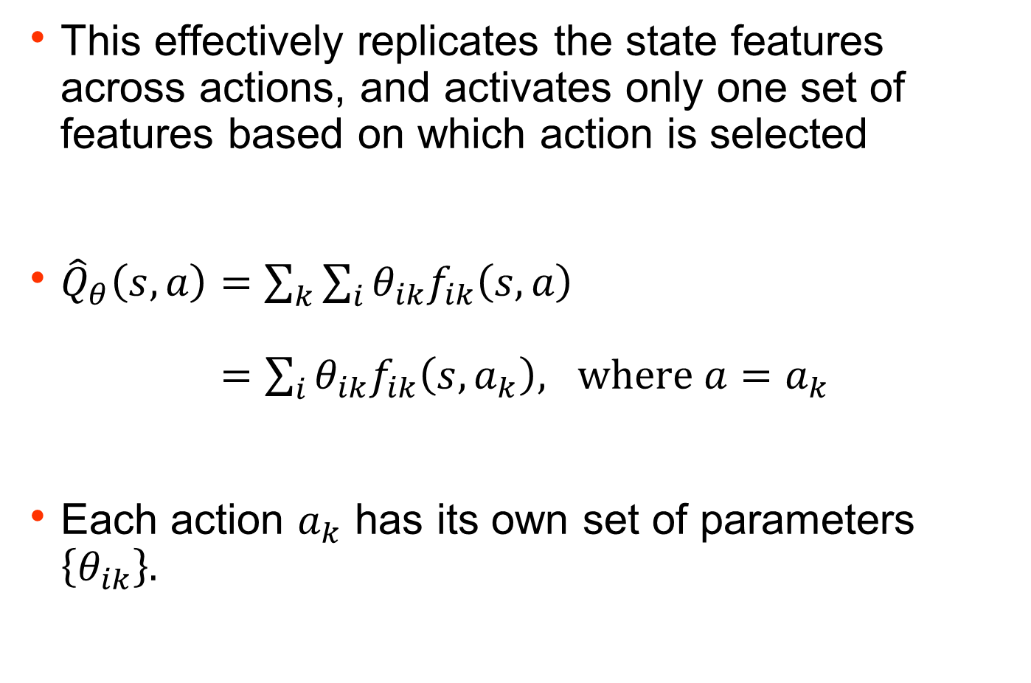
Defining State-Action Features
This effectively replicates the state features across actions, and activates only one set of features based on which action is selected
${\hat{Q}}_{θ}\left(s,a\right)=\sum_{k}{\sum_{i}{θ_{ik}f_{ik}\left(s, a\right)}}$ $=\sum_{i}{θ_{ik}f_{ik}\left(s, a_{k}\right), \text{where} a=a_{k}}$
Each action $a_{k}$ has its own set of parameters $\left\{θ_{ik}\right\}.$

Slide 20
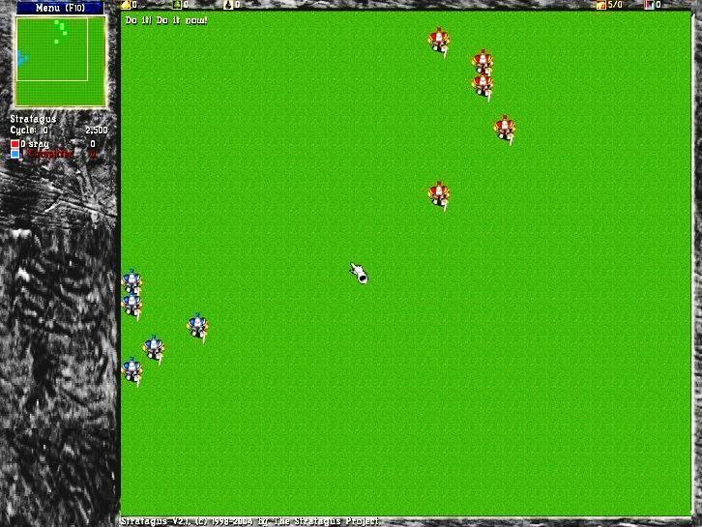
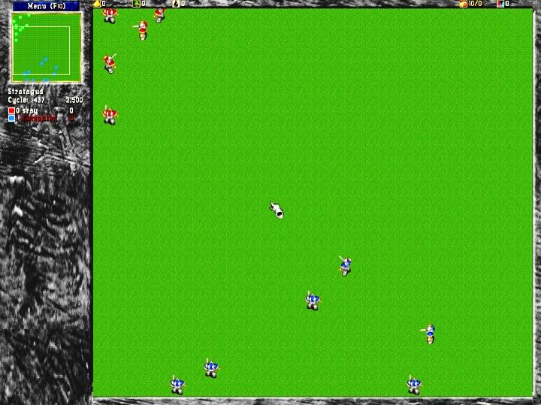
Example: Tactical Battles in Wargus
Wargus is real-time strategy (RTS) game
Tactical battles are a key aspect of the game
RL Task: learn a policy to control n friendly agents in a battle against m enemy agents
Policy should be applicable to tasks with different sets and numbers of agents
5 vs. 5
10 vs. 10
20

Slide 21
Example: Tactical Battles in Wargus
States: contain information about the locations, health, and current activity of all friendly and enemy agents
Actions: Attack(F,E)
causes friendly agent F to attack enemy E
Policy: represented via Q-function Q(s,Attack(F,E))
Each decision cycle loop through each friendly agent F and select enemy E to attack that maximizes Q(s,Attack(F,E))
Q(s,Attack(F,E)) generalizes over any friendly and enemy agents F and E
We used a linear function approximator with Q-learning
RL Task: learn a policy to control n friendly agents in a battle against m enemy agents
Policy should be applicable to tasks with different sets and numbers of agents
That is, policy should be relational
21

Slide 22
Example: Tactical Battles in Wargus
Engineered a set of relational features {f1(s,Attack(F,E)), …., fn(s,Attack(F,E))}
Example Features:
# of other friendly agents that are currently attacking E
Health of friendly agent F
Health of enemy agent E
Difference in health values
Walking distance between F and E
Is E the enemy agent that F is currently attacking?
Is F the closest friendly agent to E?
Is E the closest enemy agent to E?
…
Features are well defined for any number of agents
22

Slide 23
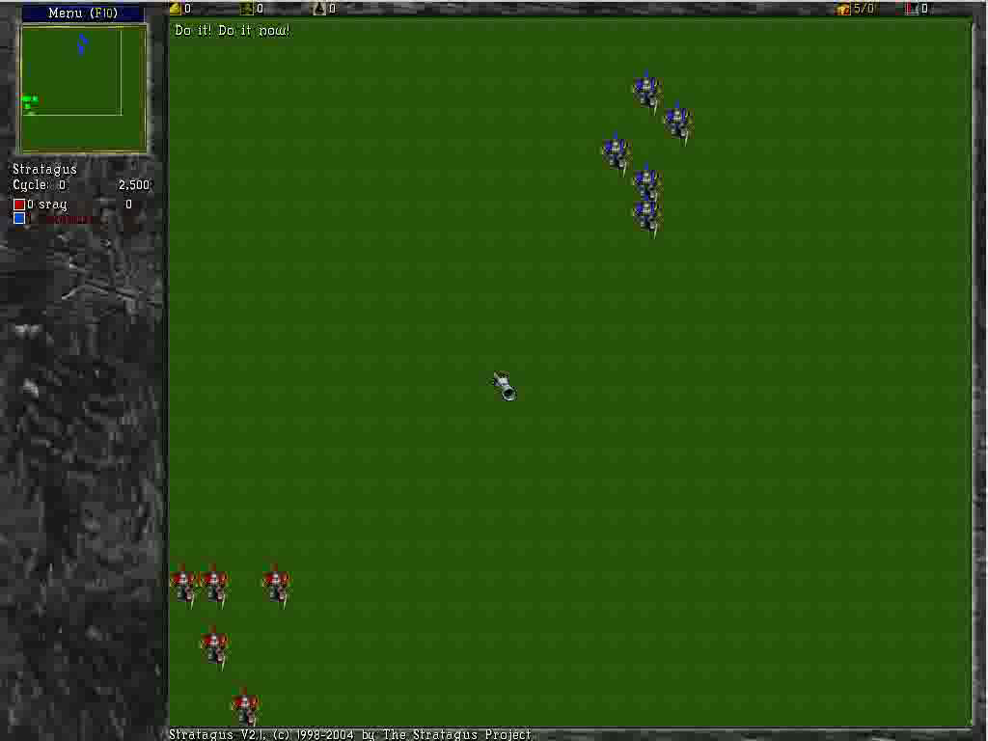
Example: Tactical Battles in Wargus
Initial random policy
23

Slide 24
Example: Tactical Battles in Wargus
Linear Q-learning in 5 vs. 5 battle
24

Slide 25
Example: Tactical Battles in Wargus
Learned Policy after 120 battles
25

Slide 26
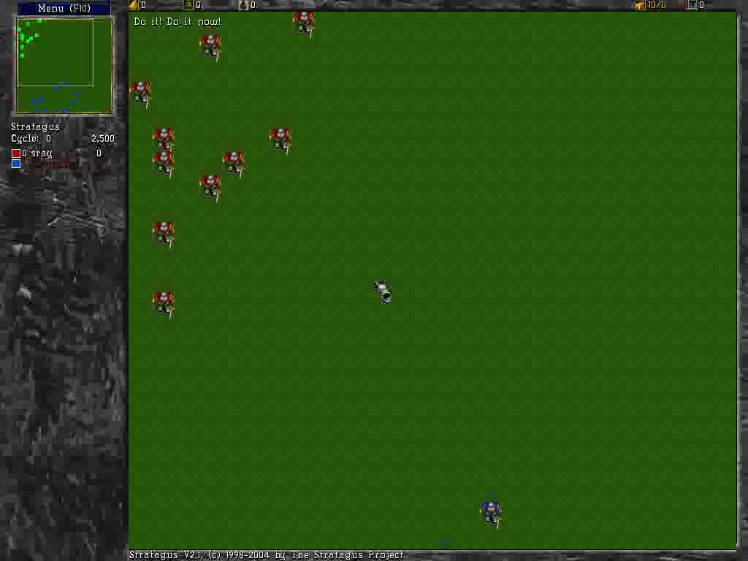
Example: Tactical Battles in Wargus
10 vs. 10 using policy learned on 5 vs. 5
26

Slide 27
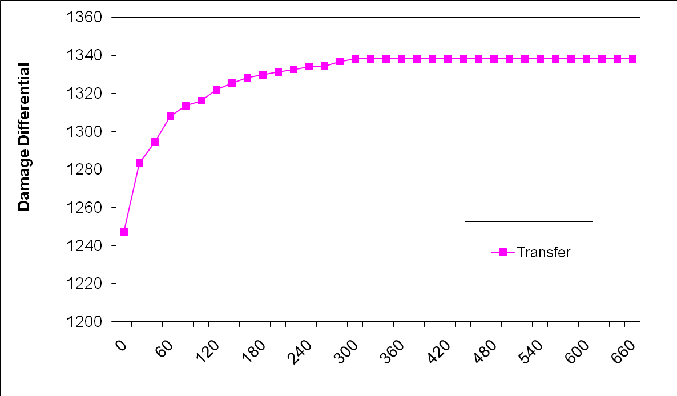
Example: Tactical Battles in Wargus
Initialize Q-function for 10 vs. 10 to one learned for 5 vs. 5
Initial performance is very good which demonstrates generalization from 5 vs. 5 to 10 vs. 10
27

Slide 28
Q-learning w/ Non-linear Approximators
is sometimes represented by a non-linear approximator such as a neural network
Start with initial parameter values
Take action according to an explore/exploit policy (should converge to greedy policy, i.e. GLIE)
Perform TD update for each parameter
Goto 2
calculate closed-form
Typically the space has many local minima and we no longer guarantee convergence
Often works well in practice

Slide 29
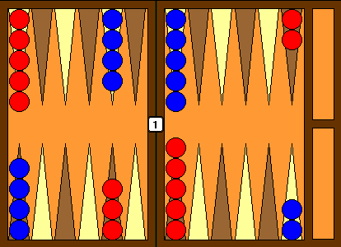
~Worlds Best Backgammon Player
Neural network with 80 hidden units
Used Reinforcement Learning for 300,000 games of self-play
One of the top (2 or 3) players in the world!

Slide 30
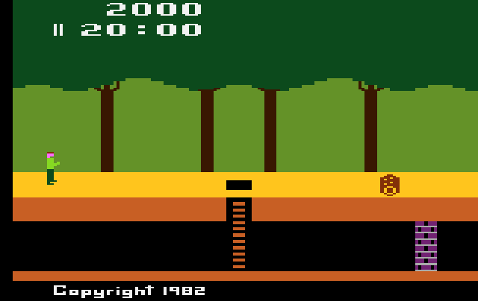
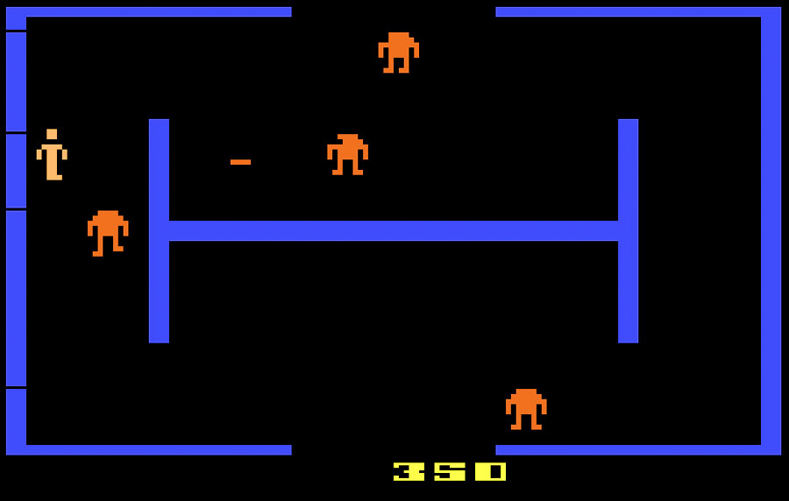
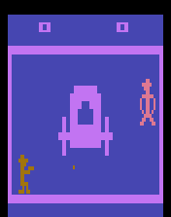
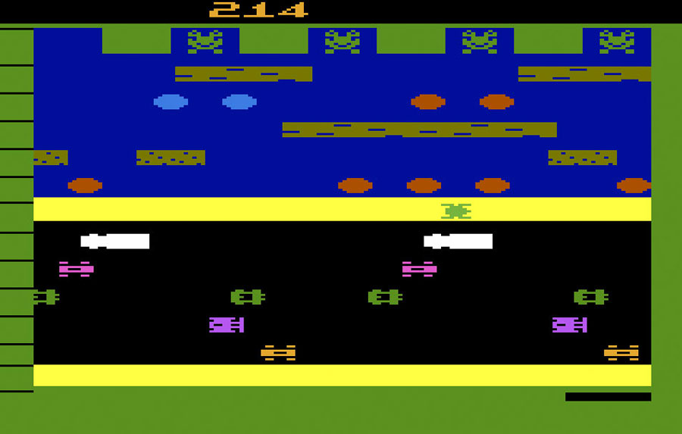
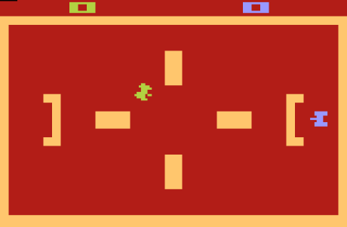
AI for General Atari 2600 Games
Playing Atari With Deep Reinforcement Learning NIPS Deep Learning Workshop, 2013.

Slide 31
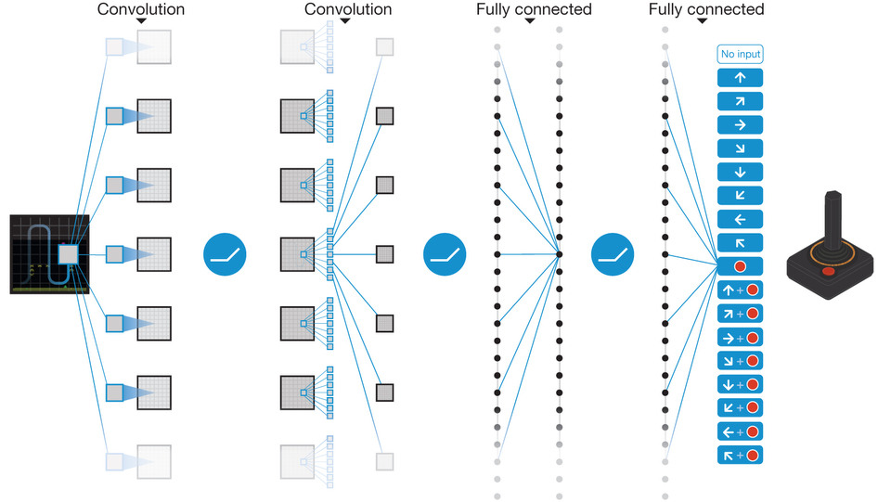
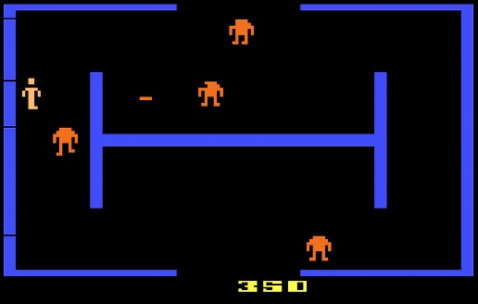
Deep Q-Networks for Policies: Atari
Network input = Observation history
Window of previous screen shots in Atari
Network output = One output node per action (returns Q-value)
Q-values
Previous w frames

Slide 32
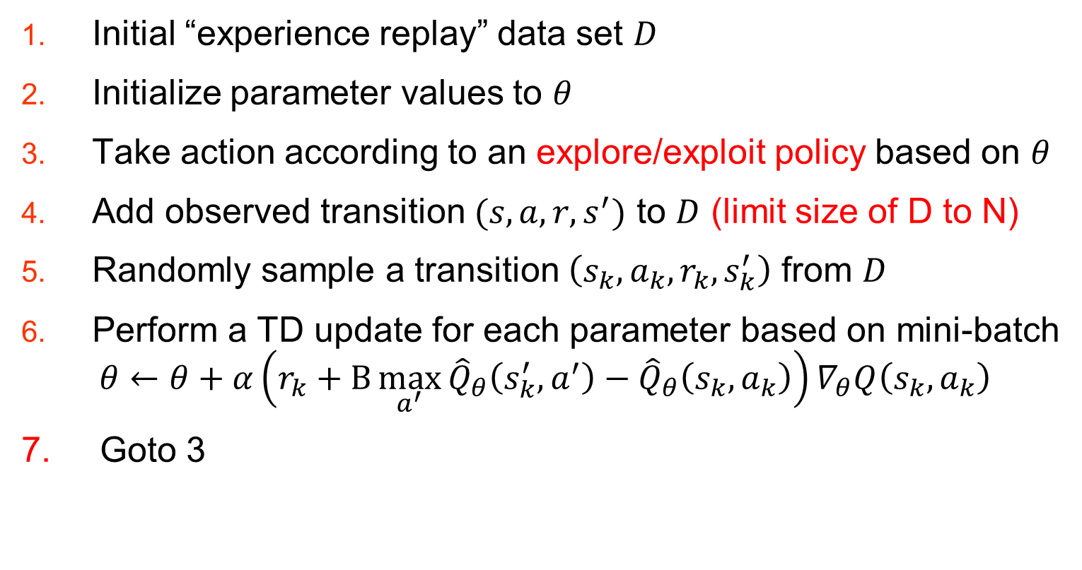
DQN : Q-Learning w/ Randomized Experience Replay
Initial “experience replay” data set $D$
Initialize parameter values to $θ$
Take action according to an explore/exploit policy based on $θ$
Add observed transition $(s,a,r,s^{′})$ to $D$ (limit size of D to N)
Randomly sample a transition $\left(s_{k},a_{k},r_{k},s_{k}^{′}\right)$ from $D$
Perform a TD update for each parameter based on mini-batch
$$θ←θ+α\left(r_{k}+Β\max_{a^{′}}{{\hat{Q}}_{θ}\left(s_{k}^{′},a^{′}\right)−{\hat{Q}}_{θ}\left(s_{k},a_{k}\right)}\right)∇_{θ}Q\left(s_{k},a_{k}\right)$$
7. Goto 3

Slide 33
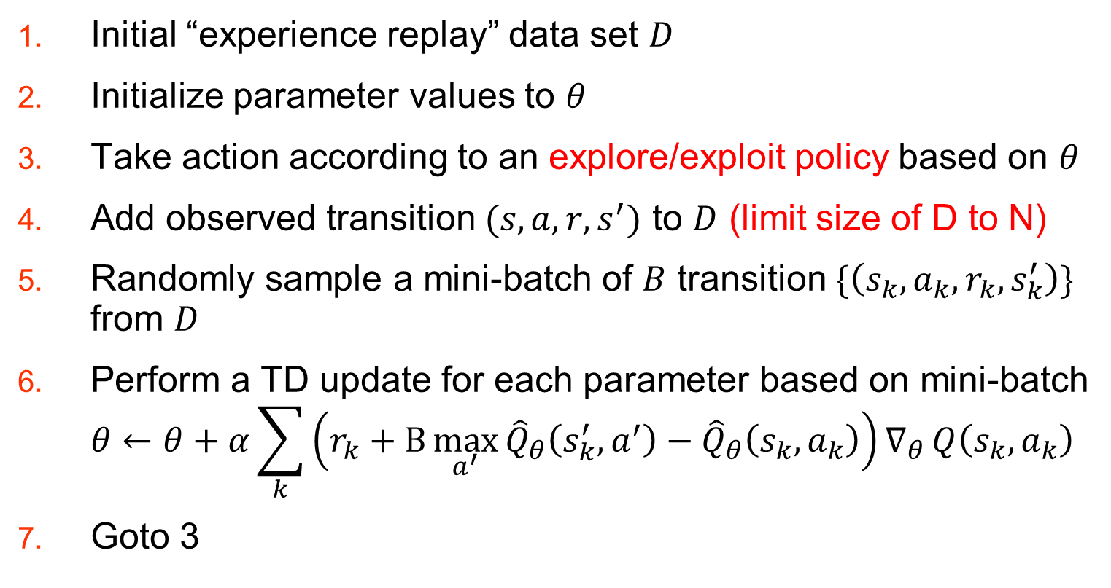
DQN : Mini-Batches
Initial “experience replay” data set $D$
Initialize parameter values to $θ$
Take action according to an explore/exploit policy based on $θ$
Add observed transition $(s,a,r,s^{′})$ to $D$ (limit size of D to N)
Randomly sample a mini-batch of $B$ transition $\{\left(s_{k},a_{k},r_{k},s_{k}^{′}\right)\}$ from $D$
Perform a TD update for each parameter based on mini-batch $θ←θ+α\sum_{k}{\left(r_{k}+Β\max_{a^{′}}{{\hat{Q}}_{θ}\left(s_{k}^{′},a^{′}\right)−{\hat{Q}}_{θ}\left(s_{k},a_{k}\right)}\right)∇_{θ}}Q\left(s_{k},a_{k}\right)$
Goto 3

Slide 34
DQN versus Traditional Q-learning
Experience replay allows for reuse of data
More efficient use of experience
Randomly sampling batches for updates versus updating on latest sample
Claim that this breaks correlation among updates which reduces variance
Quantize the rewards to be 1, 0, or -1 (depending on sign of true reward)
Helps limit impact of any one update
Helps selecting learning parameters that work across games
Could fundamentally change the optimal policy

Slide 35
DQN Results

