Slide 1
Deep Residual Learning for Image Recognition
Author : Kaiming He, Xiangyu Zhang, Shaoqing Ren, and Jian Sun
(accepted to CVPR 2016)
Presenter : Hyeongseok Son

Slide 2
The deeper, the better
The deeper network can cover more complex problems
Receptive field size ↑
Non-linearity ↑
However, training the deeper network is more difficult because of vanishing/exploding gradients problem

Slide 3
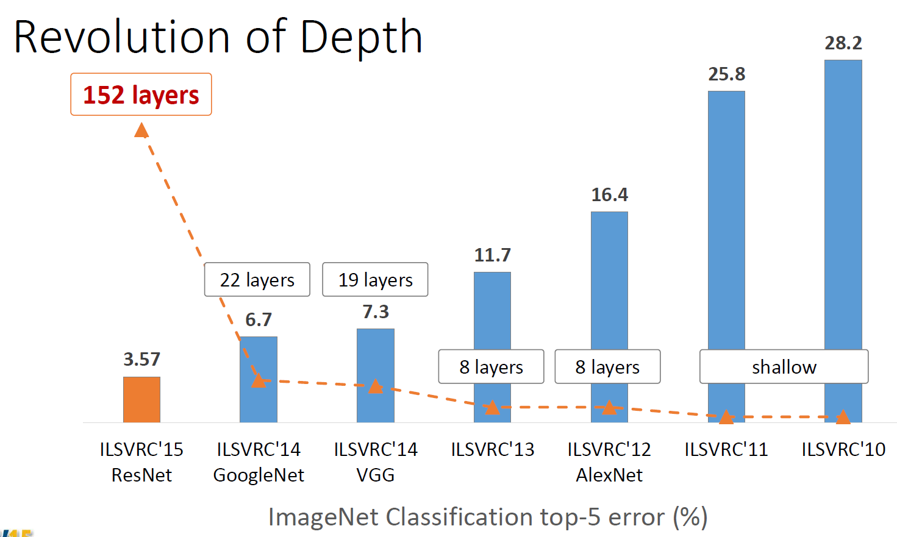
Deep Neural Network
Escape from few layers
ReLU for solving gradient vanishing problem
Dropout …

Slide 4
Deep Neural Network
Escape from 10 layers
Normalized initialization
Intermediate normalization layers

Slide 5
Deep Neural Network
Escape from 100 layers
Residual network

Slide 6

Kaiming He
Dehazing using dark channel prior
Guided image filter
Computer vision using machine learning…

Slide 7
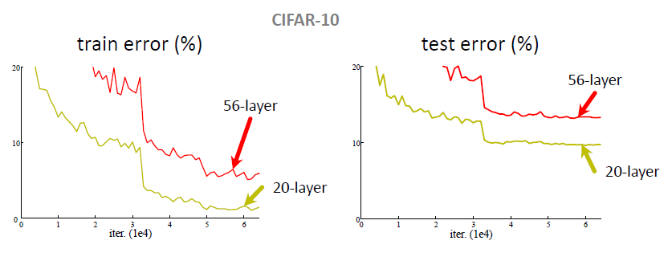
Plain Network
Plain nets: stacking 3x3 conv layers
56-layer net has higher training error and test error than 20-layers net

Slide 8
Plain Network
“Overly deep” plain nets have higher training error
A general phenomenon, observed in many datasets

Slide 9
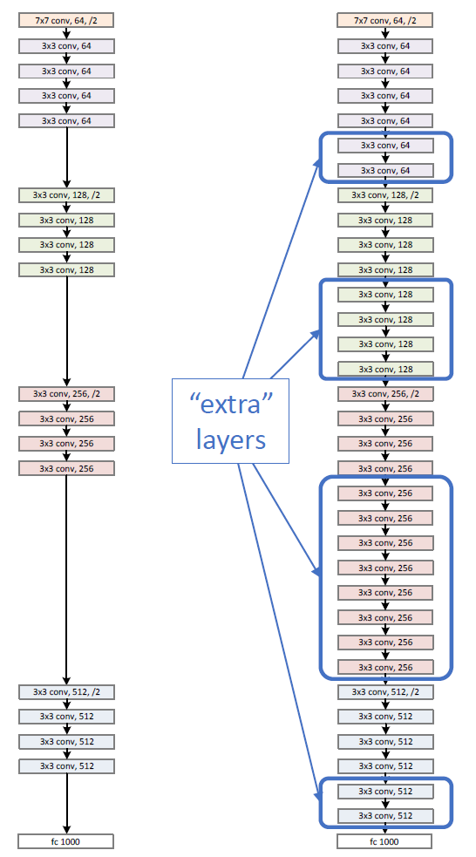
Residual Network
Naïve solution
If extra layers are an identity mapping, then a training errors does not increase

Slide 10
Residual Network
Deeper networks also maintain the tendency of results
Features in same level will be almost same
An amount of changes is fixed
Adding layers makes smaller differences
Optimal mappings are closer to an identity

Slide 11
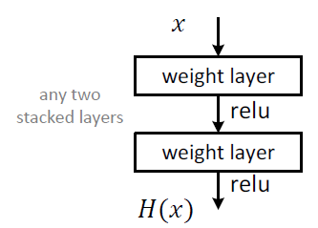
Residual Network
Plain block
Difficult to make identity mapping because of multiple non-linear layers

Slide 12
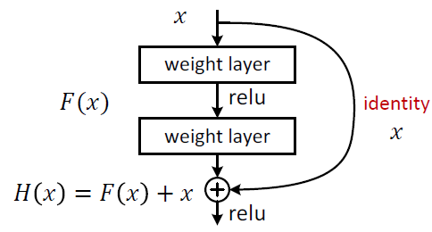
Residual Network
Residual block
If identity were optimal, easy to set weights as 0
If optimal mapping is closer to identity, easier to find small fluctuations
-> Appropriate for treating perturbation as keeping a base information

Slide 13

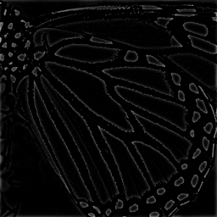

Residual Network
Difference between an original image and a changed image
Preserving base information
Some Network
residual
can treat perturbation

Slide 14
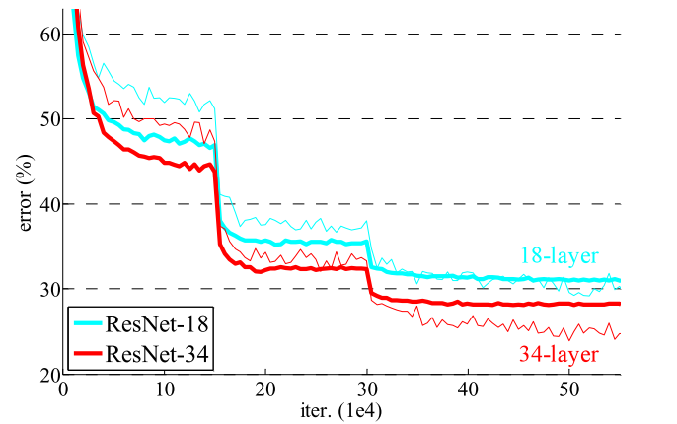
Residual Network
Deeper ResNets have lower training error

Slide 15
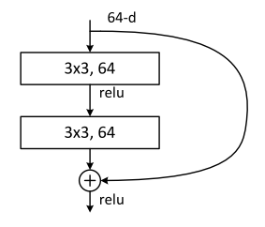
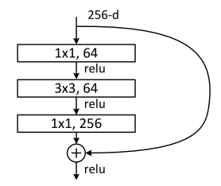
Residual Network
Residual block
Very simple
Parameter-free
A naïve residual block
“bottleneck” residual block
(for ResNet-50/101/152)

Slide 16


Residual Network
Shortcuts connections
Identity shortcuts
Projection shortcuts

Slide 17
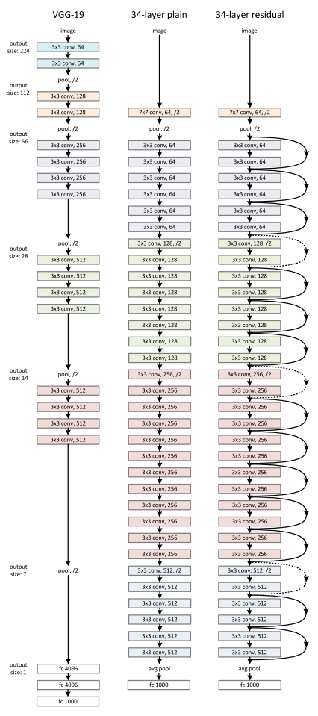
Network Design
Basic design (VGG-style)
All 3x3 conv (almost)
Spatial size/2 => #filters x2
Batch normalization
Simple design, just deep
Other remarks
No max pooling (almost)
No hidden fc
No dropout

Slide 18
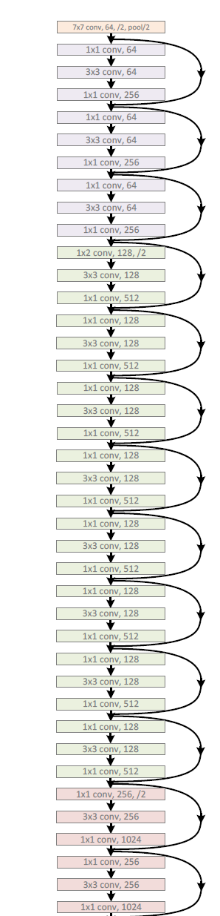
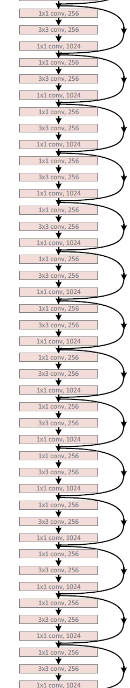
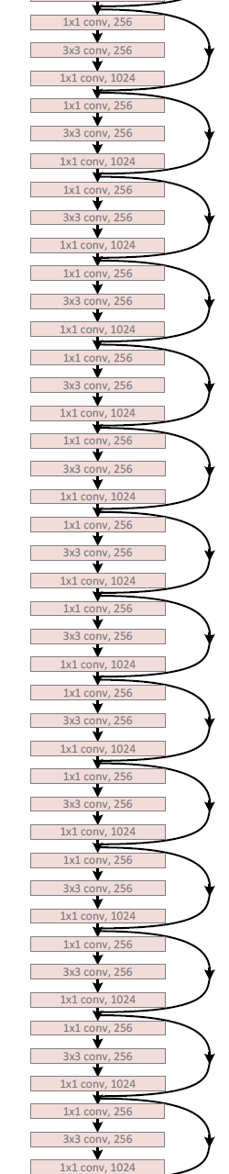
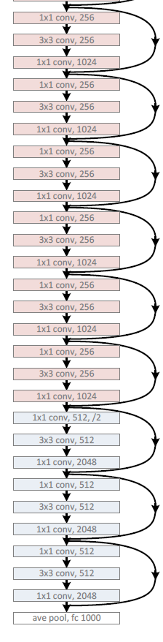
Network Design
ResNet-152
Use bottlenecks
ResNet-152(11.3 billion FLOPs) has lower complexity than VGG-16/19 nets (15.3/19.6 billion FLOPs)

Slide 19
Results
Deep Resnets can be trained without difficulties
Deeper ResNets have lower training error, and also lower test error

Slide 20
Results
Deep Resnets can be trained without difficulties
Deeper ResNets have lower training error, and also lower test error

Slide 21
Results
1st places in all five main tracks in “ILSVRC & COCO 2015 Competitions”
ImageNet Classification
ImageNet Detection
ImageNet Localization
COCO Detection
COCO Segmentation

Slide 22
Quantitative Results
ImageNet Classification

Slide 23
Result
Performances increase absolutely
Based on ResNet-101
Existing techniques can use residual networks or features from it

Slide 24
Qualitative Result
Object detection
Faster R-CNN + ResNet

Slide 25
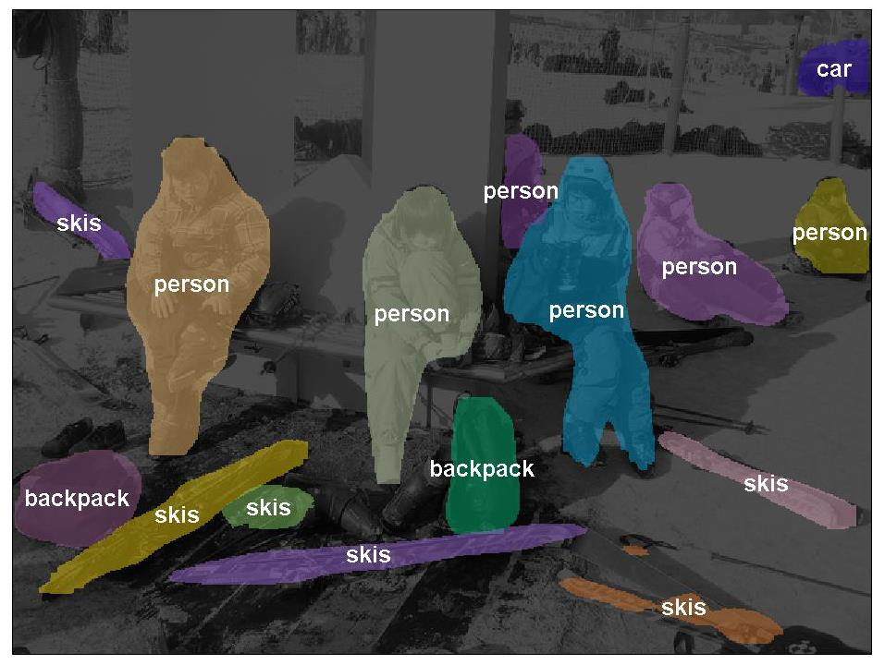
Qualitative Results
Instance Segmentation

Slide 26
Exploring over 1000 layers
Test 1202 layers
Training is finished
Training error is similar
Testing error is high because of over fitting

Slide 27
Conclusion
Deeper networks are better expectably
ResNet is very simple
We should use it from now on

Slide 28
Reference
Kaiming He, Xiangyu Zhang, Shaoqing Ren, & Jian Sun. “Deep Residual Learning for Image Recognition”. arXiv 2015.
Slides of Deep Residual Learning @ ILSVRC & COCO 2015 competitions

Slide 29
Thank You

