Slide 1
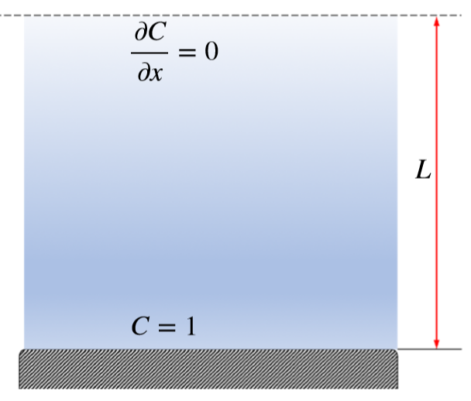



$$C_{end+1}$$
$$C_{end}$$
$$C_{end−1}$$

