Slide 1
MACHINE
LEARNING
GETTING STARTED WITH
- HRISHIKESH YADAV

Slide 2
TABLE OF CONTENTS
01
03
03
05
06
What are the Pre-requisite and Don’ts
What is ML?
Learning Path to Follow
How to think about the Problem Statement
07
02
08
Resource Sharing
Why there is a need to learn ML, Today ?
How to progress and participate in competitions
09
04
Categories in ML
03
Some Important Bookmarks
Real Life Use Cases of ML
10
11
Community Contribution

Slide 3
What is Machine Learning ?
01
A computer program is said to learn from experience E with respect to some class of tasks T and performance measure P, if its performance at tasks in T, as measured by P, improves with experience E.

Slide 4
Machine Learning is the training of a model from data that generalizes a decision against a performance measure.

Slide 5
Test Time !
Question No. 1
Let Suppose you have a lot of historical weather data to the learning algorithm, and have it learn to predict the weather. Then what is P according to you?
The process of the algorithm examining a large amount of historical weather data.
The task to predict the weather.
The probability of it correctly predicting the weather of future date’s.
Analysis of the historic weather data.

Slide 6
Test Time !
Question No. 2
Let Suppose you have a lot of historical weather data to the learning algorithm, and have it learn to predict the weather. Then what is E according to you?
The process of the algorithm examining a large amount of historical weather data.
The task to predict the weather.
The probability of it correctly predicting the weather of future date’s.
Analysis of the historic weather data.

Slide 7
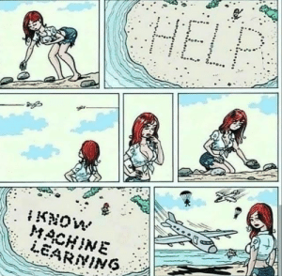

Slide 8
Why there is a need to learn ML, Today
03

Slide 9
Categories in ML
Input
Data With Labels
Data Without Labels
States + Actions
Supervised
Learning
Unsupervised
Learning
Reinforcement
Learning
Error
Targets
Mapping
CLasses
Action
Output

Slide 10
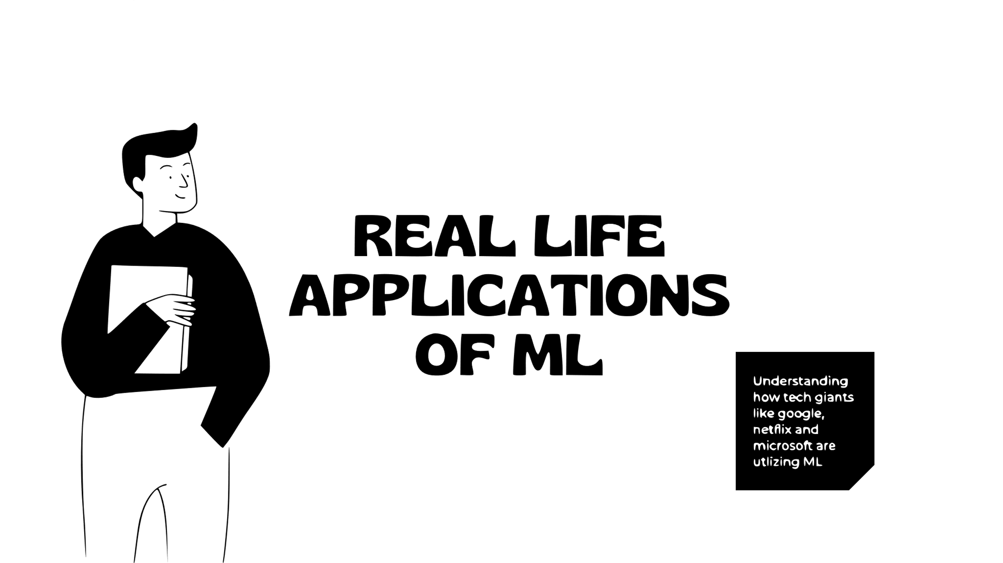

Slide 11
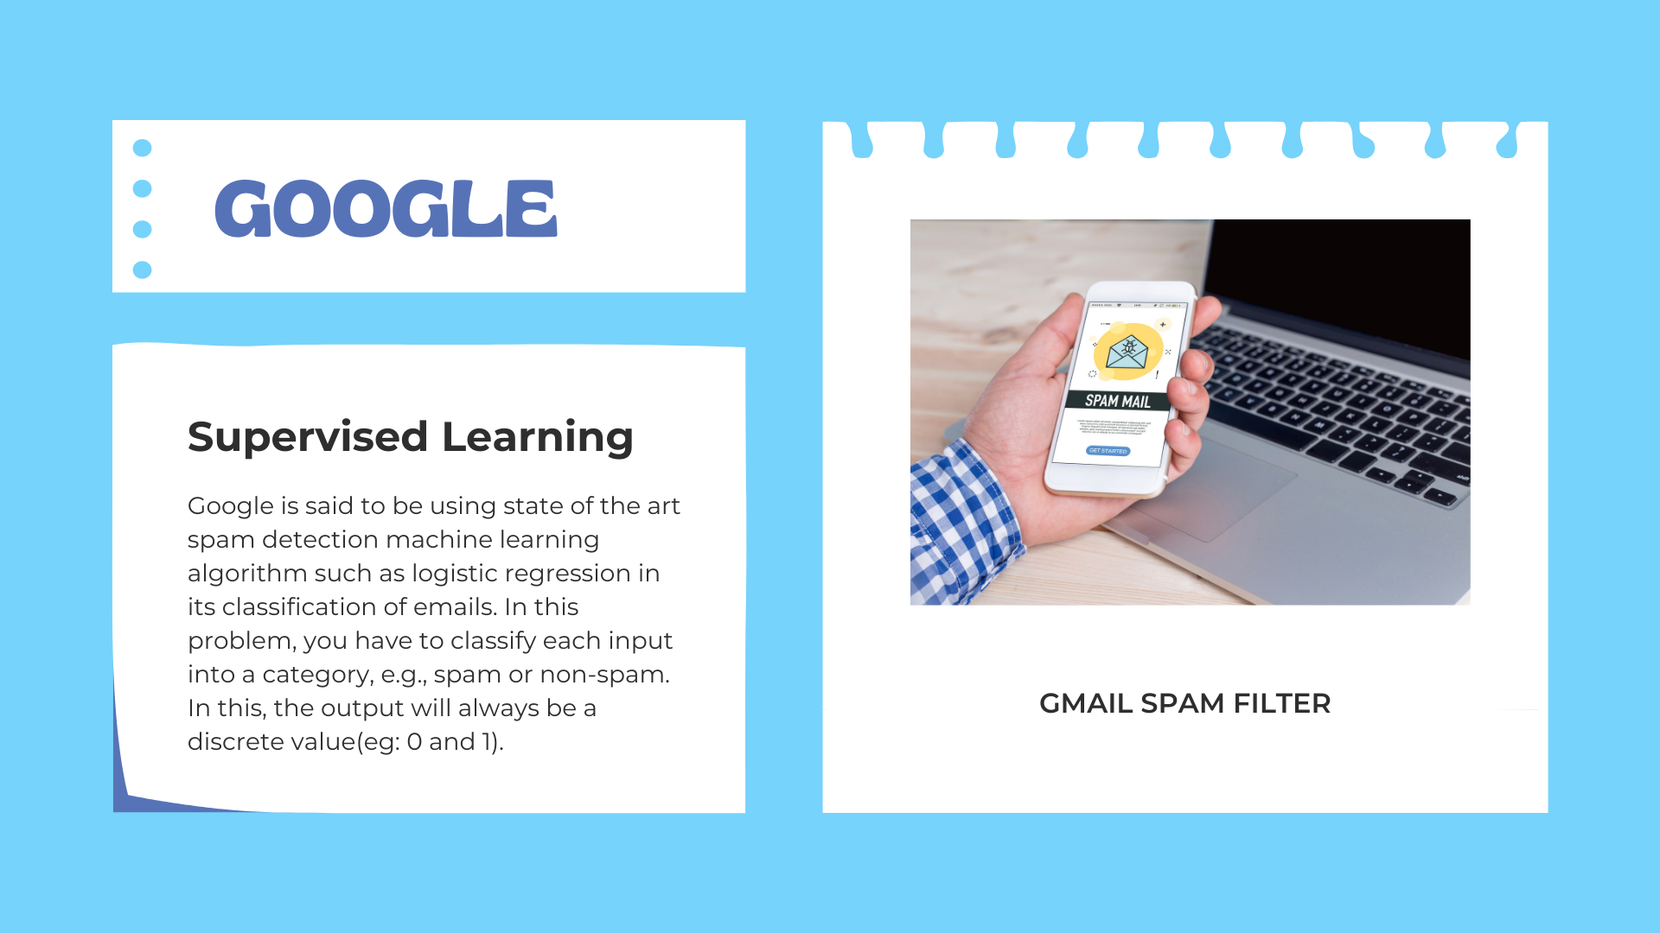
GOOGLE
Supervised Learning
Google is said to be using state of the art spam detection machine learning algorithm such as logistic regression in its classification of emails. In this problem, you have to classify each input into a category, e.g., spam or non-spam. In this, the output will always be a discrete value(e.g.: 0 and 1).
GMAIL SPAM FILTER

Slide 12

NETFLIX
Unsupervised Learning
Unsupervised Learning Netflix uses different unsupervised methods like clustering , filtering, association etc. Netflix uses clustering algorithms like K-means or hierarchical clustering. This sort of approach helps in customer segmentation and personalized recommendations.
NETFLIX RECOMMENDATION SYSTEM

Slide 13

MICROSOFT
Reinforcement Learning
Reinforcement Learning Microsoft has used Reinforcement Learning on their Azure Al platform. These models can learn from environmental cues, expert feedbacks or customer behavior in real time. They use this method internally across windows, edge. teams and Xbox. This has resulted in an overall growth.
MICROSOFT TEAMS`

Slide 14
Test Time !
Question No. 3
Details:
Room Count
Lot Size
Model
House
Value
What approach should be followed?
Regression Task
Classification Task
Reinforcement Task
Clustering Task

Slide 15
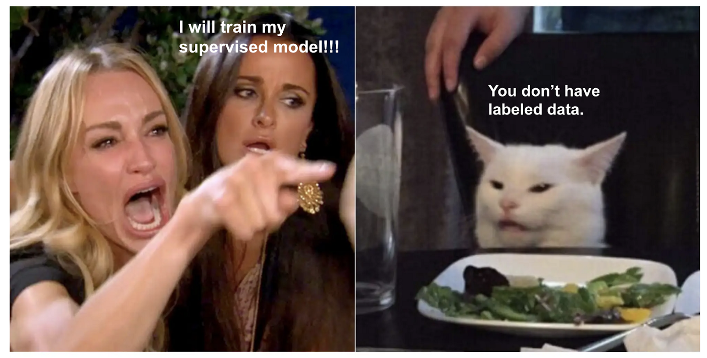

Slide 16
Test Time !
Question No. 4
Assume, you are working on the prediction of the temperature of future date’s on the basis of different features. So you will consider which type of task it lies in?
Regression Task
Classification Task
Reinforcement Task
Clustering Task

Slide 17
Test Time !
Question No. 5
Assume, you are working on the project of weather forecasting and you need to predict whether there will be rainfall or not on Monday. So you will consider which type of task it lies in?
Regression Task
Classification Task
Reinforcement Task
Clustering Task

Slide 18
Test Time !
Question No. 6
Assume, you're working with stakeholders on a music streaming app. You’re asked, "How can we increase the average number of minutes a customer spends listening on our app?“ There are many factors to decide how long a customer might spend listening to music.
How might you change the scope of the question to be more concise, for a ML task?
Will creating the custom playlist encourage customer to listen to music longer?
Will creating the artist podcast about their popular songs?
Will changing the playing of ads based on the user time spends listening to the music?
All of the above

Slide 19
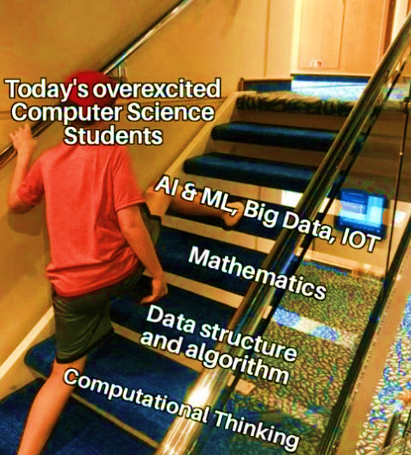
0

Slide 20
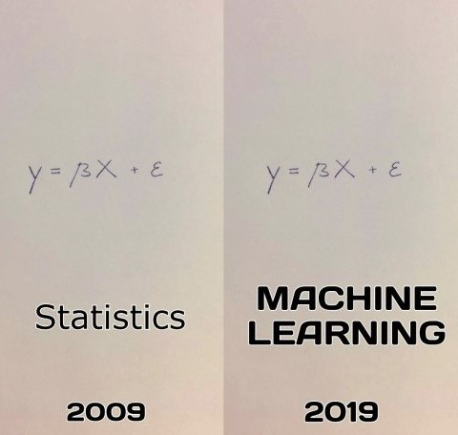
“Fancy frameworks (e.g. PyTorch, TensorFlow) are for the present, but math and statistics are for eternity!” - Code Basics

Slide 21
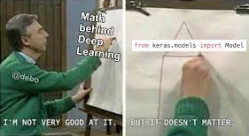
Importance of Mathematics in Machine Learning

Slide 22
STAGES TO FOLLOW FOR MACHINE LEARNING

Slide 23

COURSES

Slide 24

Best ML Resource:

Slide 25





YOUTUBE RESOURCES
Krish Naik
DeepLearning.AI
CodeBasics
Steve Bruton
3blue1brown

Slide 26



Having some Bookmarks is Good!
DataMahadev
Sky Towner
The Batch
Paper with Code
Analytics Vidhya
Towards Science
Medium
KDnuggets
Special Repository Mentions:
Applied ML

Slide 27




Websites for Competition
Machine Hack
DPhi
Vidhya Analytics
(DataHack)
Kaggle

Slide 28
Thank You

