Slide 1
MSCC# Topic 2
An introduction to classes and objects, and getting started with C#.

Slide 2
Object oriented programming was a paradigm shift
in the way programs were developed.
The basic concepts are grouped around the phrases
Object,
Class,
Encapsulation,
Inheritance
Polymorphism.
Objects model themselves on real-world things
(e.g. you could imagine a Person object)
and interact with each other.

Slide 3
What is an object, and what is a class?
Class
Account
Initial balance
£100
John's account
Jill's account
Jack's account
Account
Account
Account
current balance
current balance
current balance
£900
£1,304
£432
Individual objects

Slide 4
Terminology de-obfuscator.
encapsulation. Basically this means protecting the
information (data) within the object.
Inheritance Building on the properties of an existing class.
Very useful when trying to re-use software.
Abstraction.
Treating an entity as a whole, not worrying about the details.
We use abstraction without realising it
Treat a car as a single object without worrying
about the complex mechanics.
polymorphism. This literally means many forms.
A neat way of saving duplication of code.

Slide 5
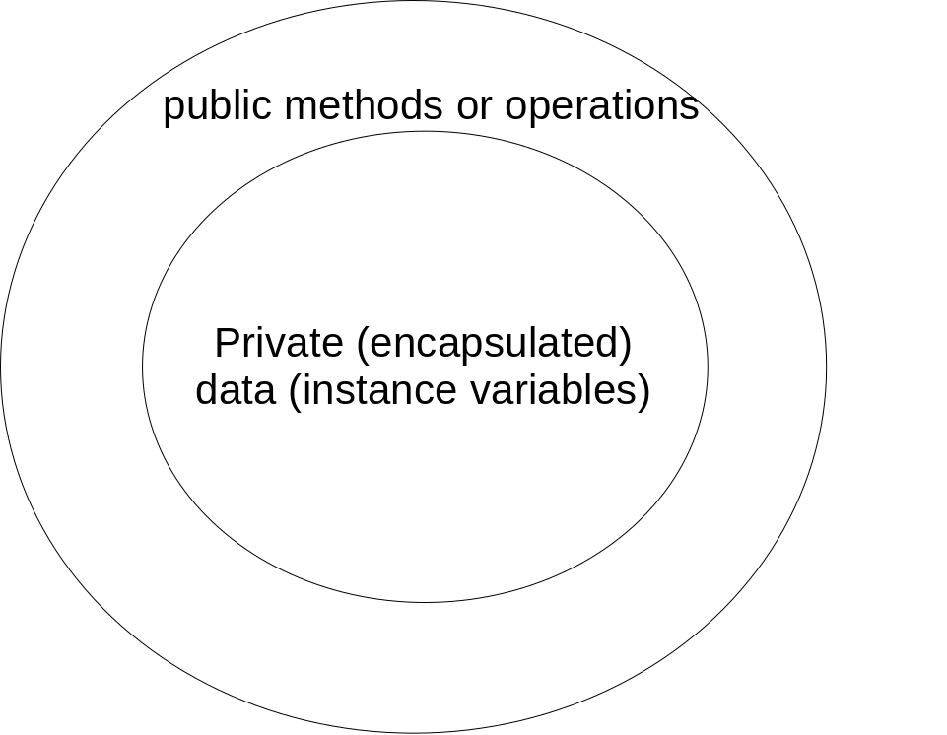
Encapsulation - protecting private data.
Retrieving data
Setting data

Slide 6
What are candidates for classes/objects
Basically anything that cannot be represented by a primitive type.
E.g. The number of students in a lecture theatre
can be represented by a single integer (int).
But can you represent all the information necessary to describe
a student by a simple integer?
We need a new type of data storage, which can be described as:
A set of values of any type (e.g. string, int, float)
A set of operations that are permitted on those values.

Slide 7
Now, for some C#
C# source code (e.g. Account.cs)
The compiler (clc) and the msil interpreter are automatically called by a typical IDE
clc Account.cs
Account (msil)
Second stage compilation
Account.exe

Slide 8
“public” means all users can see the class (when part of a namespace)
public class Account {
// Instance variable
private double balance = 100;
// One of the methods
public void Transaction(double amount) {
balance = balance + amount;
} // End of the method
public void Print() {
Console.WriteLine("The balance is "+balance);
}
}
Private means the data can’t be seen from outside
Java/C++ point.
Structures (struct) also exist in C# and they are subtly different from classes. – more later.
See week1 Account.cs for in the week1 folder for the complete source code.

Slide 9
Usually, the launching point for code is a ‘main’ method (found in one of the classes)…
static void Main(string[] args) {
Account jack = new Account(); // set up a new account “jack”
jack.Print();
Account jill = new Account(); // Set up a new account named “jill”
jill.Print(); //Print the balance in object Jill
Console.Read(); // wait for a key
}
Static keyword – means the following method or data can be used
without instantiating an object.
An array of command line parameters

Slide 10
Instantiating objects
Process of creating objects from classes is called instantiation
Each new object is given a new identity
Account jack = new Account();
Account jill = new Account();
Each new object can have its own state (by containing its own data/attributes)

Slide 11
More on instantiation of objects
Account jack = new Account();
Create a reference to an object
Create an object
Assign reference to object
A reference is analogous to a pointer in C/C++ - it refers or points to an object in memory somewhere.

Slide 12
External Libraries of code
The last example made use of Console.Read(), where did this come from?
Analogous to #include in C/C++ and import in Java
We add a ‘using’ statement to indicate the use of an external library of code (e.g. a dynamically linked library)
E.g. “using System” added as first program statement.

Slide 13
Data types
Like C, C++ and Java, C# also knows about two ways of declaring and accessing data. This is done by the use of Value and Reference types.
Value types - data is stored directly in a variable.
Reference types, the address of the data is kept in the variable.
Value types are primitive data types, e.g. int, char etc.
References are used to access objects.
In practice, with C#, even simple value types correspond to .NET structures (struct).
Therefore all data types can be manipulated with methods.

Slide 14
CTS data types
A .NET data type is sometimes referred to as a CTS data type (Common Type System). So called because all data types are common to all .net programming languages (VB, J#, C++, C#).
This is why cross language programming is possible on the .net platform.

Slide 15
CTS Data types (II)
Example data types are:
short (ushort) (System.Int16) 16 bit signed or unsigned integer
int (uint) (System.Int32 or UInt32) 32 bit signed or unsigned integer
long, ulong (System.Int64 or UInt64) 64 bit...
float (System.Single) 32 bit floating point number
double (System.Double) 64 bit double precision floating point.
bool (System.Boolean) boolean data type true or false.
char (Sytem.Char) a single 16 bit unicode character.
string – (System.String) – a string reference type.

Slide 16
CTS data types (III)
All CTS datatypes are structs, and hence value types (not like java).
In summary, a simple datatype, can be declared as follows:
int i;
System.Int16 j;
String s;
s=“this is a string”;
ComparisonExample.cs (attached to these notes) illustrates how to declare cts data types, and manipulate them.

Slide 17
Instance variables, local variables and variable scope
One of the powerful features of OO is the concept of instance variables and local variables.
An instance variable is declared outside any method (usually the top of the class) and can be seen & used by any method in the class
A local variable is declared inside a method, and can be used until the method finishes (this is its scope or lifetime). E.g.

Slide 18
class Class1{
private string s="instance string";
private int i = 10;
// a simple method, with no return type, and no parameters
public void Go() {
//Declare a couple of local variables
// These will 'hide' the instance variables
string s = "local string";
int i=5;
Console.WriteLine("local string s is "+s);
Console.WriteLine("local int i is "+i);
// We can still reference the instance variables however, using the 'this'
// object reference
Console.WriteLine("instance string s is "+this.s);
Console.WriteLine("instance int i is "+this.i);
}
}

Slide 19
static void Main(string[] args) {
Class1 c = new Class1();
c.Go();
Console.Read();
}

Slide 20
Public, private
Any class member (method or data) is visible from the outside (by users of the object) when public
Only usable within the class if declared private

