Slide 1
MSC OO Progrogramming in C#
Lecture 7 – Windows Forms

Slide 2
Topics
Creating Forms
Adding controls (buttons, text fields, labels, radio buttons, groups, list boxes).
Single document interfaces (SDI)
Multiple document interface (MDI)
Common dialogs.

Slide 3
Introduction
Graphical user interface
  Allow interaction with program visually
  Give program distinct look and feel
  Built from window components
  Is an object, accessed via keyboard or mouse
  Human Computer Interaction is a specialised subject – We will concentrate on tools and components rather than look of interface.

Slide 4
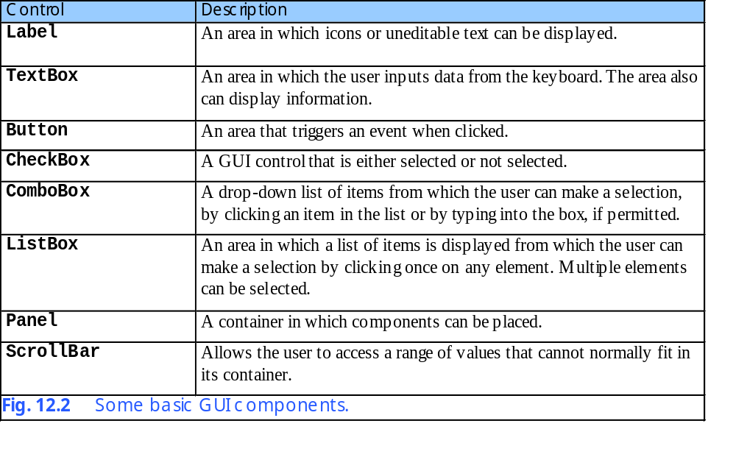
Some common controls

Slide 5
Windows Forms
In C#, the System.Windows.Forms namespace and classes of the .NET Framework provide a comprehensive set of components for windows forms development
  Displayed on the desktop
  Represented by:
    Dialog
    Window
    MDI window

Slide 6
Windows Forms
Component
  Base class
  Lacks visual parts
  Contains a minimum set of methods common to all controls.
Control
  Component with graphical part
    Such as button or label
  Are visible
Event
  Generated by movement from mouse or keyboard
  Event handlers performs action
    Specifics written by programmer

Slide 7
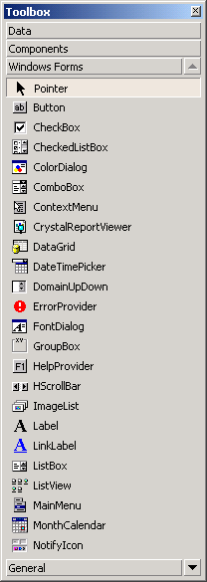
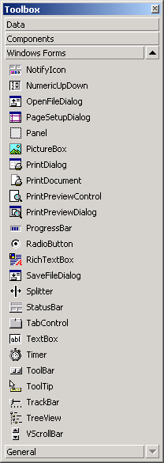
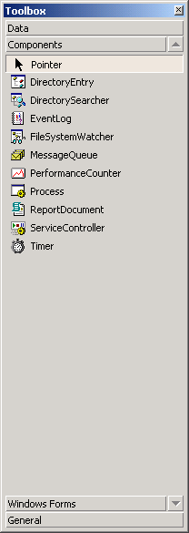
Windows Forms
Available Components and controls for Windows Forms.

Slide 8
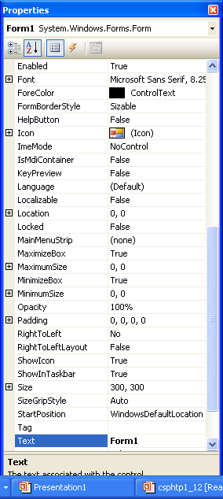
Features of components
All components have many properties, methods and events – some more useful than others.
Use the properties window to see all of them

Slide 9
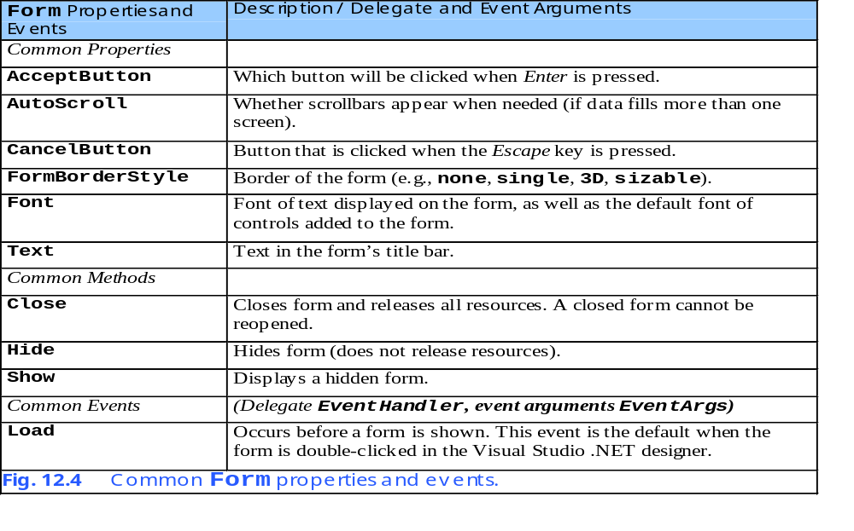
Some common Form properties, methods and events.

Slide 10
Creating and displaying a Form
Usually achieved by creating a Windows application using .NET Visual Studio
Creates MANAGED CODE – can be supplemented or replaced by own code
Separates same class across more than one file (yuk).
How?
By inheritance, from Form class.
By partial classes

Slide 11
Creating Form, part II
Partial keyword allows the implementation of the class to be split across several files.
using System;
using System.Windows.Forms;
namespace FormPropertiesExample
{
public partial class Form1 : Form
{
public Form1()
{
InitializeComponent();
}
private void Form1_Load(object sender, EventArgs e)
{
// Event handler called when form loads up
this.Text = "Hello";
}
}
}
Typical code created by Visual Studio
Managed code called here
Question:
How is Form1_Load event set as an event handler???

Slide 12
Because there is yet more to this class…
namespace FormPropertiesExample {
partial class Form1 {
…
#region Windows Form Designer generated code
private void InitializeComponent() {
this.SuspendLayout();
this.AutoScaleDimensions = new System.Drawing.SizeF(6F, 13F);
this.AutoScaleMode = System.Windows.Forms.AutoScaleMode.Font;
this.ClientSize = new System.Drawing.Size(292, 266);
this.Name = "Form1";
this.Text = "Form1";
this.Load += new System.EventHandler(this.Form1_Load);
this.ResumeLayout(false);
}
}
#endregion
}
The rest of the class Form1
All this code generated by the Windows Form Designer (no need to understand it too much)

Slide 13
Summary of Windows Forms designer generated code
Tends to split code across files – examine all .cs files.
Uses an InitializeComponent method to do most of the instantiation of components on the GUI – generally invoked in the constructor.
Perfectly possible to add own components outside auto-generated code
You will be asked to do this for your assignment.

Slide 14
Launching the Windows Form
using ….. etc etc
…
namespace FormPropertiesExample
{
static class Program
{
/// The main entry point for the application.
[STAThread]
static void Main()
{
Application.Run(new Form1());
}
}
}
The Application.Run() method registers Form1 as windows application so that it can receive event messages from the Windows Operating System.

Slide 15
A closer look at windows form designer generated code – generally don’t touch the code between the #region and #endregion
namespace FormPropertiesExample {
partial class Form1 {
…
#region Windows Form Designer generated code
private void InitializeComponent() {
this.SuspendLayout();
this.AutoScaleDimensions = new System.Drawing.SizeF(6F, 13F);
this.AutoScaleMode = System.Windows.Forms.AutoScaleMode.Font;
this.ClientSize = new System.Drawing.Size(292, 266);
this.Name = "Form1"; // Sets name of Form
this.Text = "Form1"; // Sets text in title bar
this.Load += new System.EventHandler(this.Form1_Load);
this.ResumeLayout(false);
}
#endregion
}
}
Sets event handler for form loading

Slide 16
Output from FormPropertiesExample

Slide 17
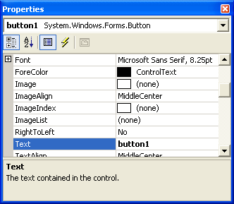
Setting Form and component properties
Easy to do at compile time & at run-time
this.Text = “A new title"; // Sets text in title bar

Slide 18
Control Properties and Layout
Common properties across different components
  Derive from class Control
  Text property
    Specifies the text that appears on a control
  Focus method
    Transfers the focus to a control
    Becomes active control
  TabIndex property
    Order in which controls are given focus
    Automatically set by Visual Studio .NET
  Enable property
    Indicate a control’s accessibility

Slide 19
Control Properties and Layout
Visibility control
  Hide control from user
    Use method Hide
Anchor property
  Anchoring control to specific location
    Constant distance from specified location
  Unanchored control moves relative to the position
  Docking allows control to spread itself along and entire side
  Both options refer to the parent container
Size structure
  Allow for specifying size range
    MinimumSize and MaximumSize property

Slide 20
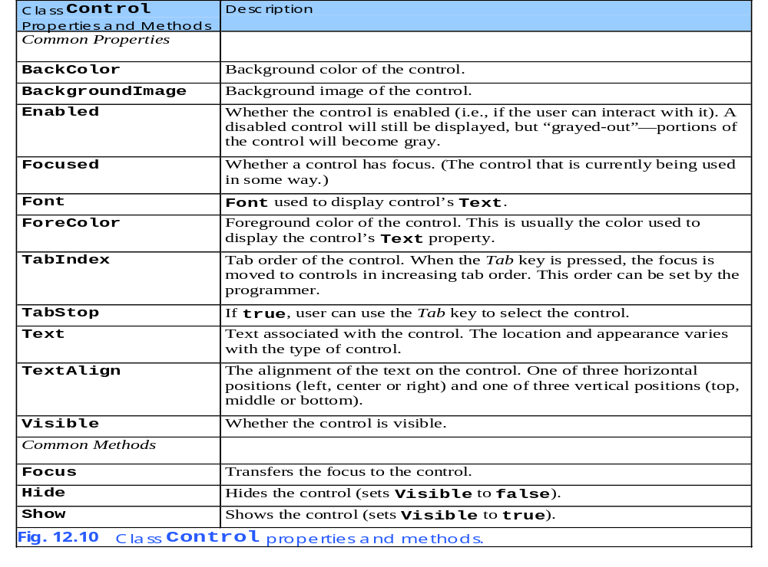

Slide 21
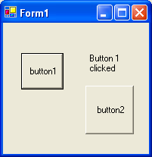
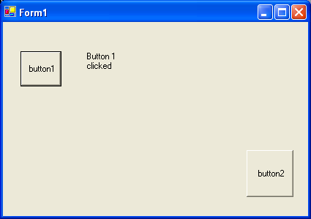
Anchoring Control Properties and applying Layouts
Before resize
After resize
Constant distance to left and top sides
Anchoring demonstration. – two buttons,
anchored to top left
and bottom right

Slide 22
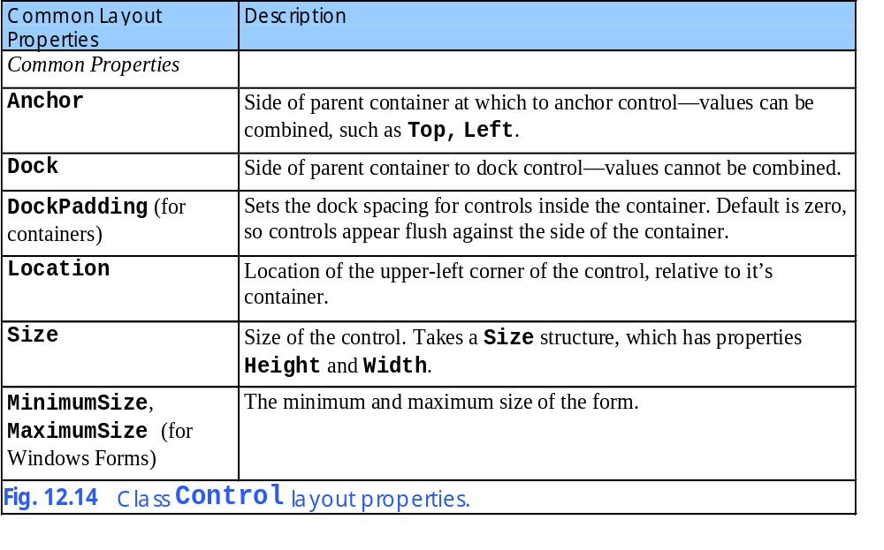
Control Properties and Layout

Slide 23
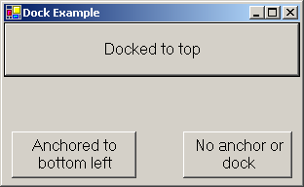
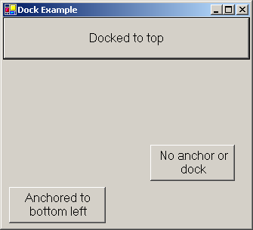
Docking components using Properties and Layout
Control expands along top portion of the form
Docking demonstration.

Slide 24
Labels, TextBoxes and Buttons
Labels
  Provide text instruction
    Read only text
  Defined with class Label1
    Derived from class Control
Textbox
  Class TextBox
  Area for text input
    Password textbox
Button
  Control to trigger a specific action
    Checkboxes or radio buttons
  Derived from ButtonBase – behaviour of all types of button is essentially the same, apart from the GROUPING capability of radio buttons.

