Slide 1
Networking: Streams-Based Sockets and Datagrams
Outline
Introduction
Establishing a Simple Server (Using Stream Sockets)
Establishing a Simple Client (Using Stream Sockets)
Client/Server Interaction with Stream-Socket Connections
Connectionless Client/Server Interaction with Datagrams

Slide 2
Introduction
Topics:
Networking technologies
  Client-server relationship
  Socket-based communications
    Stream sockets
  Packet-based communications
    Datagram sockets

Slide 3
Establishing a Simple Server (Using Stream Sockets)
Five step process:
  Create an object of TcpListener
    Binds server to port number
  Call Start method
    Begin connection request
  Make connection between server and client
    Returns a Socket object
    Plug socket object into a NetworkStream object
    NetworStream object only works with low level binary data
    No friendly methods to send/receive strings etc
    Plug NetworkStream object into something more friendly – e.g. BinaryReader/BinaryWriter or TextReader/TextWriter
  Processing phase
    Methods readString and Write to Receive and Send
  Connection-termination phase
    Method Close
  Multithreaded servers

Slide 4
Establishing a Simple Client (Using Stream Sockets)
Four step process:
  Create object of TcpClient
    Method Connect
  Get a NetworkStream
    Restricted to unfriendly WriteByte and ReadByte
  Get a BinaryReader/BinaryWriter
    Plug NetworkStream object into a BinaryReader/BinaryWriter – much more friendly methods
    Could use TextReader/TextWriter instead – for reading/writing text.
  Processing phase
    Client and server communicate
  Close connection
    Method Close

Slide 5
Client/Server Interaction with Steam-
Socket Connections
Example Client/server application
  Client requests a connection
  Server application sends array of bytes, or text, or by sending and receiving any type of data, or even “streamable objects” (hint – this could be used to send/receive pictures).
  Communicates visually via TextBoxes
  Uses threads to improve performance and separate out transmit/receive functions.

Slide 6
Create network socket
Thread 2 – listener
thread.
Thread1 – gui thread
Look for incoming
packets from client
Get characters
from a text field
and send to
network socket
Display message

Slide 7
Steps in opening a connection – code examples
Step 1:
TcpListener – class to Create a TCP network connection
// look on port 5000
TcpListener listener = new TcpListener( 5000 );
//TcpListener waits for connection request
listener.Start();
Step 2:
Create a socket connection – uses the TCPLISTENER OBJECT
// Implements the Berkeley sockets interface.
Socket connection;
connection = listener.AcceptSocket();

Slide 8
Next steps
Step 3
NetworkStream - Provides the underlying stream of data for network access.
// create NetworkStream object associated with socket
NetworkStream socketStream = new NetworkStream(connection);
Step 4
// create objects for transferring data across stream
BinaryWriter writer = new BinaryWriter( socketStream );
BinaryReader reader = new BinaryReader( socketStream );
Step 5
// get on with reading and writing
writer.Write( "SERVER>>> " + inputTextBox.Text );
string message = reader.ReadString();

Slide 9
Server.cs
1 // Fig. 22.1: Server.cs
2 // Set up a Server that will receive a connection from a client,
3 // send a string to the client, and close the connection.
4
5 using System;
6 using System.Drawing;
7 using System.Collections;
8 using System.ComponentModel;
9 using System.Windows.Forms;
10 using System.Threading;
11 using System.Net.Sockets;
12 using System.IO;
13
14 // server that awaits client connections (one at a time) and
15 // allows a conversation between client and server
16 public class Server : System.Windows.Forms.Form
17 {
18 private System.Windows.Forms.TextBox inputTextBox;
19 private System.Windows.Forms.TextBox displayTextBox;
20 private Socket connection;
21 private Thread readThread;
22
23 private System.ComponentModel.Container components = null;
24 private NetworkStream socketStream;
25 private BinaryWriter writer;
26 private BinaryReader reader;
27
28 // default constructor
29 public Server()
30 {
31 InitializeComponent();
32

Slide 10
Server.cs
33 // create a new thread from the server
34 readThread = new Thread( new ThreadStart( RunServer ) );
35 readThread.Start();
36 }
37
38 // Visual Studio .NET generated code
39
40 [STAThread]
41 static void Main()
42 {
43 Application.Run( new Server() );
44 }
45
46 protected void Server_Closing(
47 object sender, CancelEventArgs e )
48 {
49 System.Environment.Exit( System.Environment.ExitCode );
50 }
51
52 // sends the text typed at the server to the client
53 protected void inputTextBox_KeyDown(
54 object sender, KeyEventArgs e )
55 {
56 // sends the text to the client
57 try
58 {
59 if ( e.KeyCode == Keys.Enter && connection != null )
60 {
61 writer.Write( "SERVER>>> " + inputTextBox.Text );
62
63 displayTextBox.Text +=
64 "\r\nSERVER>>> " + inputTextBox.Text;
65
Will invoke method RunServer
Thread will accept connections from clients
Terminate all threads
Method Exit closes all thread associated with application
Read strings and send via method Write

Slide 11
Server.cs
66 // if the user at the server signaled termination
67 // sever the connection to the client
68 if ( inputTextBox.Text == "TERMINATE" )
69 connection.Close();
70
71 inputTextBox.Clear();
72 }
73 }
74 catch ( SocketException )
75 {
76 displayTextBox.Text += "\nError writing object";
77 }
78 } // inputTextBox_KeyDown
79
80 // allows a client to connect and displays the text it sends
81 public void RunServer()
82 {
83 TcpListener listener;
84 int counter = 1;
85
86 // wait for a client connection and display the text
87 // that the client sends
88 try
89 {
90 // Step 1: create TcpListener
91 listener = new TcpListener( 5000 );
92
93 // Step 2: TcpListener waits for connection request
94 listener.Start();
95
96 // Step 3: establish connection upon client request
97 while ( true )
98 {
99 displayTextBox.Text = "Waiting for connection\r\n";
100
TcpListener to pick request from user at port 5000
Gets TcpListener to begin waiting for requests
Infinite loop to establish connection request by clients

Slide 12
Server.cs
Returns a Socket upon successful connection
101 // accept an incoming connection
102 connection = listener.AcceptSocket();
103
104 // create NetworkStream object associated with socket
105 socketStream = new NetworkStream( connection );
106
107 // create objects for transferring data across stream
108 writer = new BinaryWriter( socketStream );
109 reader = new BinaryReader( socketStream );
110
111 displayTextBox.Text += "Connection " + counter +
112 " received.\r\n";
113
114 // inform client that connection was successfull
115 writer.Write( "SERVER>>> Connection successful" );
116
117 inputTextBox.ReadOnly = false;
118 string theReply = "";
119
120 // Step 4: read String data sent from client
121 do
122 {
123 try
124 {
125 // read the string sent to the server
126 theReply = reader.ReadString();
127
128 // display the message
129 displayTextBox.Text += "\r\n" + theReply;
130 }
131
Pass the new socket as argument to NetworkStream
For use with writing or reading data
Indicate that a connection was received
Execute until server receive connection termination

Slide 13
Server.cs
132 // handle exception if error reading data
133 catch ( Exception )
134 {
135 break;
136 }
137
138 } while ( theReply != "CLIENT>>> TERMINATE" &&
139 connection.Connected );
140
141 displayTextBox.Text +=
142 "\r\nUser terminated connection";
143
144 // Step 5: close connection
145 inputTextBox.ReadOnly = true;
146 writer.Close();
147 reader.Close();
148 socketStream.Close();
149 connection.Close();
150
151 ++counter;
152 }
153 } // end try
154
155 catch ( Exception error )
156 {
157 MessageBox.Show( error.ToString() );
158 }
159
160 } // end method RunServer
161
162 } // end class Server
Close connection between client and server and waits for next request

Slide 14
Client.cs
1 // Fig. 22.2: Client.cs
2 // Set up a Client that will read information sent from a Server
3 // and display the information.
4
5 using System;
6 using System.Drawing;
7 using System.Collections;
8 using System.ComponentModel;
9 using System.Windows.Forms;
10 using System.Threading;
11 using System.Net.Sockets;
12 using System.IO;
13
14 // connects to a chat server
15 public class Client : System.Windows.Forms.Form
16 {
17 private System.Windows.Forms.TextBox inputTextBox;
18 private System.Windows.Forms.TextBox displayTextBox;
19
20 private NetworkStream output;
21 private BinaryWriter writer;
22 private BinaryReader reader;
23
24 private string message = "";
25
26 private Thread readThread;
27
28 private System.ComponentModel.Container components = null;
29

Slide 15
Client.cs
30 // default constructor
31 public Client()
32 {
33 InitializeComponent();
34
35 readThread = new Thread( new ThreadStart( RunClient ) );
36 readThread.Start();
37 }
38
39 // Visual Studio .NET-generated code
40
41 [STAThread]
42 static void Main()
43 {
44 Application.Run( new Client() );
45 }
46
47 protected void Client_Closing(
48 object sender, CancelEventArgs e )
49 {
50 System.Environment.Exit( System.Environment.ExitCode );
51 }
52
53 // sends text the user typed to server
54 protected void inputTextBox_KeyDown (
55 object sender, KeyEventArgs e )
56 {
57 try
58 {
59 if ( e.KeyCode == Keys.Enter )
60 {
61 writer.Write( "CLIENT>>> " + inputTextBox.Text );
62
Like Server object, Client object creates Thread to handling incoming messages

Slide 16
Client.cs
63 displayTextBox.Text +=
64 "\r\nCLIENT>>> " + inputTextBox.Text;
65
66 inputTextBox.Clear();
67 }
68 }
69 catch ( SocketException ioe )
70 {
71 displayTextBox.Text += "\nError writing object";
72 }
73
74 } // end method inputTextBox_KeyDown
75
76 // connect to server and display server-generated text
77 public void RunClient()
78 {
79 TcpClient client;
80
81 // instantiate TcpClient for sending data to server
82 try
83 {
84 displayTextBox.Text += "Attempting connection\r\n";
85
86 // Step 1: create TcpClient and connect to server
87 client = new TcpClient();
88 client.Connect( "localhost", 5000 );
89
90 // Step 2: get NetworkStream associated with TcpClient
91 output = client.GetStream();
92
93 // create objects for writing and reading across stream
94 writer = new BinaryWriter( output );
95 reader = new BinaryReader( output );
96
Method to connect and receive data from the Server and send data to the Server
Port number must match port number set for connection on server
Method Connect used to establish connection
Also considered the loopback IP address
First argument is name of the server

Slide 17
Client.cs
97 displayTextBox.Text += "\r\nGot I/O streams\r\n";
98
99 inputTextBox.ReadOnly = false;
100
101 // loop until server signals termination
102 do
103 {
104
105 // Step 3: processing phase
106 try
107 {
108 // read message from server
109 message = reader.ReadString();
110 displayTextBox.Text += "\r\n" + message;
111 }
112
113 // handle exception if error in reading server data
114 catch ( Exception )
115 {
116 System.Environment.Exit(
117 System.Environment.ExitCode );
118 }
119 } while( message != "SERVER>>> TERMINATE" );
120
121 displayTextBox.Text += "\r\nClosing connection.\r\n";
122
123 // Step 4: close connection
124 writer.Close();
125 reader.Close();
126 output.Close();
127 client.Close();
128 Application.Exit();
129 }
130
Loop until client receive connection-terminate message
To obtain next message from the server

Slide 18
Client.cs
131 // handle exception if error in establishing connection
132 catch ( Exception error )
133 {
134 MessageBox.Show( error.ToString() );
135 }
136
137 } // end method RunClient
138
139 } // end class Client

Slide 19
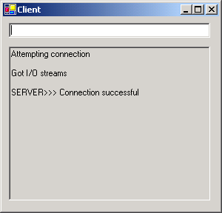
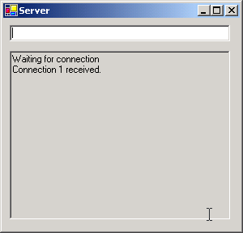
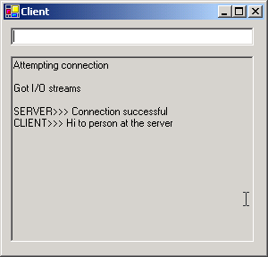
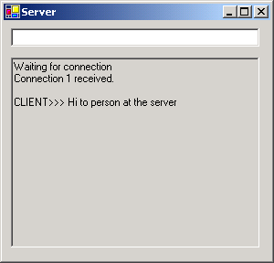
Client.cs
Program Output

Slide 20
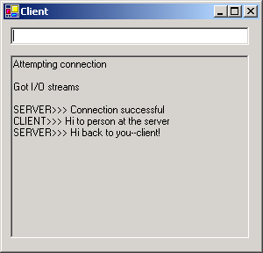
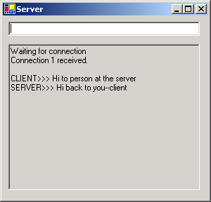
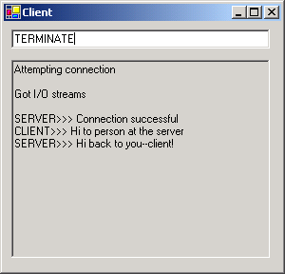
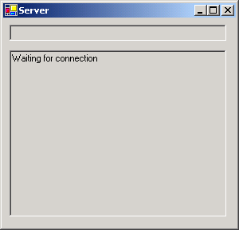
Client.cs
Program Output

Slide 21
Connectionless Client/Server Interaction with Datagram
Resembles postal services
  Bundles and sends information in packets

Slide 22
Server.cs
1 // Fig. 22.3: Server.cs
2 // Set up a Server that will receive packets from a
3 // client and send packets to a client.
4
5 using System;
6 using System.Drawing;
7 using System.Collections;
8 using System.ComponentModel;
9 using System.Windows.Forms;
10 using System.Data;
11 using System.Net;
12 using System.Net.Sockets;
13 using System.Threading;
14
15 // create the UDP server
16 public class Server : System.Windows.Forms.Form
17 {
18 private System.Windows.Forms.TextBox displayTextBox;
19 private UdpClient client;
20 private IPEndPoint receivePoint;
21 private System.ComponentModel.Container components = null;
22
23 // no-argument constructor
24 public Server()
25 {
26 InitializeComponent();
27
28 client = new UdpClient( 5000 );
29 receivePoint = new IPEndPoint( new IPAddress( 0 ), 0 );
30 Thread readThread = new Thread(
31 new ThreadStart( WaitForPackets ) );
32
Creates an instance of UdpClient class to receive data at port 5000
Instance of class IPEndPoint to hold IP address and port number of client
IPAddress object
Port number of the endpoint

Slide 23
Server.cs
33 readThread.Start();
34 }
35
36 // Visual Studio .NET generated code
37
38 [STAThread]
39 static void Main()
40 {
41 Application.Run( new Server() );
42 }
43
44 // shut down the server
45 protected void Server_Closing(
46 object sender, CancelEventArgs e )
47 {
48 System.Environment.Exit( System.Environment.ExitCode );
49 }
50
51 // wait for a packet to arrive
52 public void WaitForPackets()
53 {
54 while ( true )
55 {
56 // receive byte array from client
57 byte[] data = client.Receive( ref receivePoint );
58
59 // output packet data to TextBox
60 displayTextBox.Text += "\r\nPacket received:" +
61 "\r\nLength: " + data.Length + "\r\nContaining: " +
62 System.Text.Encoding.ASCII.GetString( data );
63
Infinite loop wait for data to arrive at the Server
Method Receive gets a byte array from the client
Update Server’s display to include packet’s information and content

Slide 24
Server.cs
64 displayTextBox.Text +=
65 "\r\n\r\nEcho data back to client...";
66
67 // echo information from packet back to client
68 client.Send( data, data.Length, receivePoint );
69 displayTextBox.Text += "\r\nPacket sent\r\n";
70 }
71
72 } // end method WaitForPackets
73
74 } // end class Server
Method Send takes three argument
IPEndPoint to send the data
recievePoint store IP address and port number of sender
Echo data back to the client
The byte array to send
The array’s length

Slide 25
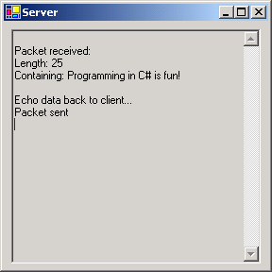
Server.cs
Program Output

Slide 26
Client.cs
1 // Fig. 22.4: Client.cs
2 // Set up a Client that sends packets to a server and receives
3 // packets from a server.
4
5 using System;
6 using System.Drawing;
7 using System.Collections;
8 using System.ComponentModel;
9 using System.Windows.Forms;
10 using System.Data;
11 using System.Net;
12 using System.Net.Sockets;
13 using System.Threading;
14
15 // run the UDP client
16 public class Client : System.Windows.Forms.Form
17 {
18 private System.Windows.Forms.TextBox inputTextBox;
19 private System.Windows.Forms.TextBox displayTextBox;
20
21 private UdpClient client;
22 private IPEndPoint receivePoint;
23
24 private System.ComponentModel.Container components = null;
25
26 // no-argument constructor
27 public Client()
28 {
29 InitializeComponent();
30

Slide 27
Client.cs
31 receivePoint = new IPEndPoint( new IPAddress( 0 ), 0 );
32 client = new UdpClient( 5001 );
33 Thread thread =
34 new Thread( new ThreadStart( WaitForPackets ) );
35 thread.Start();
36 }
37
38 // Visual Studio.NET generated code
39
40 [STAThread]
41 static void Main()
42 {
43 Application.Run( new Client() );
44 }
45
46 // shut down the client
47 protected void Client_Closing(
48 object sender, CancelEventArgs e )
49 {
50 System.Environment.Exit( System.Environment.ExitCode );
51 }
52
53 // send a packet
54 protected void inputTextBox_KeyDown(
55 object sender, KeyEventArgs e )
56 {
57 if ( e.KeyCode == Keys.Enter )
58 {
59 // create packet (datagram) as string
60 string packet = inputTextBox.Text;
61 displayTextBox.Text +=
62 "\r\nSending packet containing: " + packet;
63
Instantiate a UdpClient object with port 5001

Slide 28
Client.cs
64 // convert packet to byte array
65 byte[] data =
66 System.Text.Encoding.ASCII.GetBytes( packet );
67
68 // send packet to server on port 5000
69 client.Send( data, data.Length, "localhost", 5000 );
70 displayTextBox.Text += "\r\nPacket sent\r\n";
71 inputTextBox.Clear();
72 }
73 } // end method inputTextBox_KeyDown
74
75 // wait for packets to arrive
76 public void WaitForPackets()
77 {
78 while ( true )
79 {
80 // receive byte array from server
81 byte[] data = client.Receive( ref receivePoint );
82
83 // output packet data to TextBox
84 displayTextBox.Text += "\r\nPacket received:" +
85 "\r\nLength: " + data.Length + "\r\nContaining: " +
86 System.Text.Encoding.ASCII.GetString( data ) +
87 "\r\n";
88 }
89
90 } // end method WaitForPackets
91
92 } // end class Client
Convert the string that user entered in TextBox to a byte array
UdpClient method Send to send byte array to the Server
Port 5000 is the Server’s port
Method WaitForPacket is run on a separate thread
Infinite loop to wait for the packets
Receive blocks until a packet is received

Slide 29
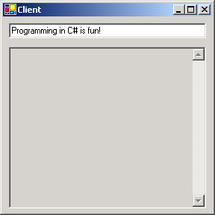
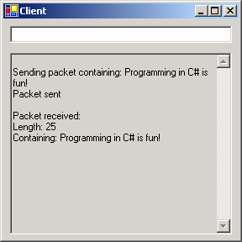
Client.cs
Program Output
The Client window after sending a packet to the server and receiving the packet back from the server
The Client window before sending a packet to the server

Slide 30
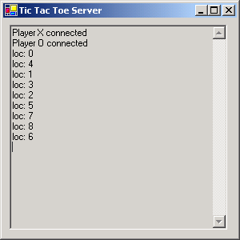
Client.cs
Program Output
Server output after(1.)
Server output after (2.)
Server output after (3.)
Server output after (4.)

Slide 31
For multi-user example of a network server/client see tic-tac-toe example

