Slide 1
Introduction to Java Programming
Inheritance

Slide 2
Inheritance
Java provides another way of code reuse named Inheritance
In inheritance, classes extend the properties/behavior of existing classes
In addition, they might override/redefine existing behavior

Slide 3
Inheritance: Definition
inheritance: a parent-child relationship between classes
allows sharing of the behavior of the parent class into its child classes
  one of the major benefits of object-oriented programming (OOP) is this code sharing between classes through inheritance
child class can add new behavior or override existing behavior from parent

Slide 4
Inheritance terms
superclass, base class, parent class: terms to describe the parent in the relationship, which shares its functionality
subclass, derived class, child class: terms to describe the child in the relationship, which accepts functionality from its parent
extend, inherit, derive: become a subclass of another class

Slide 5
Inheritance in Java
in Java, you specify another class as your parent by using the keyword extends
  public class CheckingAccount
  extends BankAccount {
  the objects of your class will now receive all of the state (fields) and behavior (methods) of the parent class
  constructors and static methods/fields are not inherited
  by default, a class's parent is Object
Java forces a class to have exactly one parent ("single inheritance")
  other languages (C++) allow multiple inheritance

Slide 6
Inheritance Example
class BankAccount {
private double myBal;
public BankAccount() { myBal = 0; }
public double getBalance() { return myBal; }
}
class CheckingAccount extends BankAccount {
private double myInterest;
public CheckingAccount(double interest) { }
public double getInterest() { return myInterest; }
public void applyInterest() { }
}
CheckingAccount objects have myBal and myInterest fields, and getBalance(), getInterest(), and applyInterest() methods

Slide 7
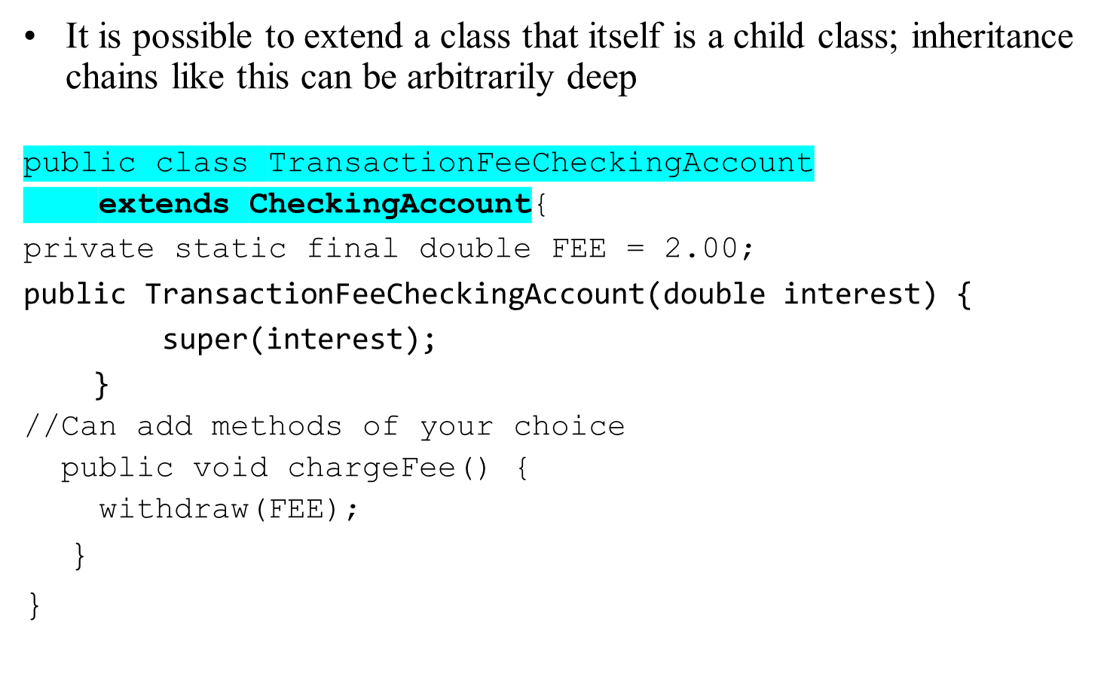
Multiple layers of inheritance

Slide 8
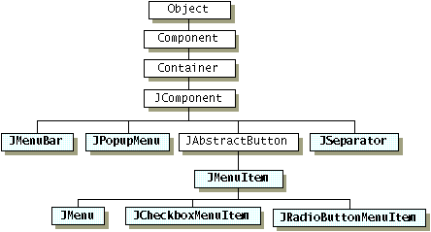
Inheritance Hierarchies
Deeper layered chain of classes, many children extending many layers of parents

Slide 9
Using the account classes
CheckingAccount inherits BankAccount's methods
CheckingAccount c = new CheckingAccount(0.10);
System.out.println(c.getBalance());
c.applyInterest();
a BankAccount variable can refer to a CheckingAccount object
BankAccount b2 = new CheckingAccount(0.06);
System.out.println(b2.getBalance());
an Object variable can point to either account type
Object o = new BankAccount();
Object o2 = new CheckingAccount(0.09);

Slide 10
Some code that won't compile
CheckingAccount variable can't refer to BankAccount
(not every BankAccount "is-a" CheckingAccount)
CheckingAccount c = new BankAccount();
cannot call a CheckingAccount method on a variable of type BankAccount (can only use BankAccount behavior)
BankAccount b = new CheckingAccount(0.10);
b.applyInterest();
cannot use any account behavior on an Object variable
Object o = new CheckingAccount(0.06);
System.out.println(o.getBalance());
o.applyInterest();

Slide 11
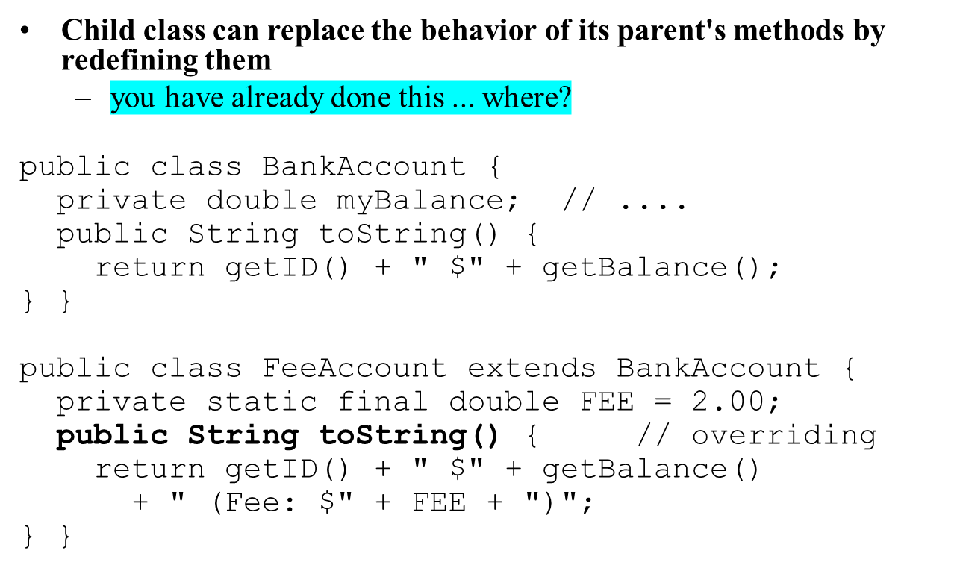
Overriding behavior
Notes:
note how it does the same as the super but adds more
the place they have done it before is when they've written toString

Slide 12
Overriding behavior example
BankAccount b = new BankAccount("Ed", 9.0);
FeeAccount f = new FeeAccount("Jen", 9.0);
System.out.println(b);
System.out.println(f);
Output:
Ed $9.0
Jen $9.0 (Fee: $2.0)

Slide 13
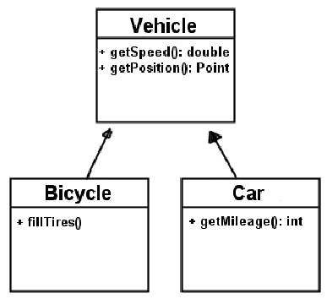
Class diagram: inheritance
inheritance relationships
  hierarchies drawn top-down with arrows from child to parent

Slide 14
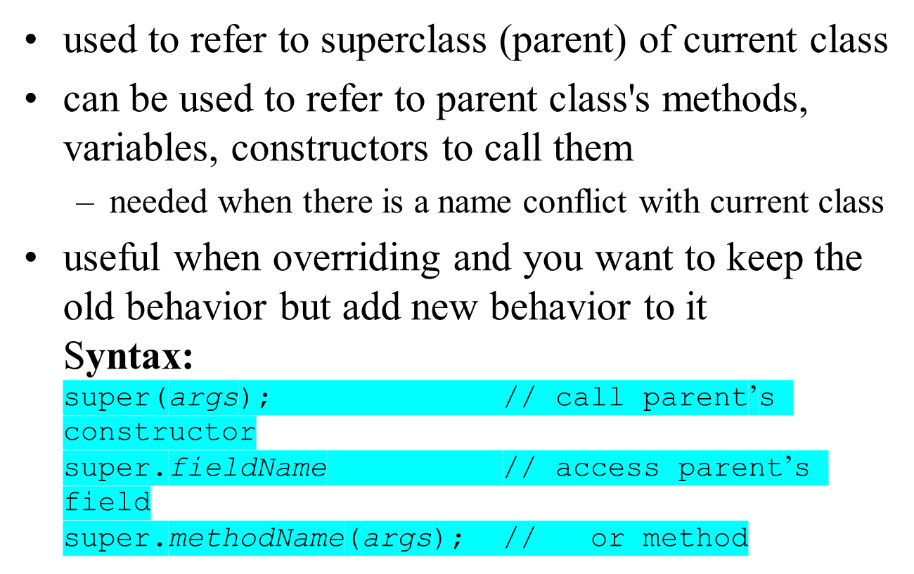
super keyword

Slide 15
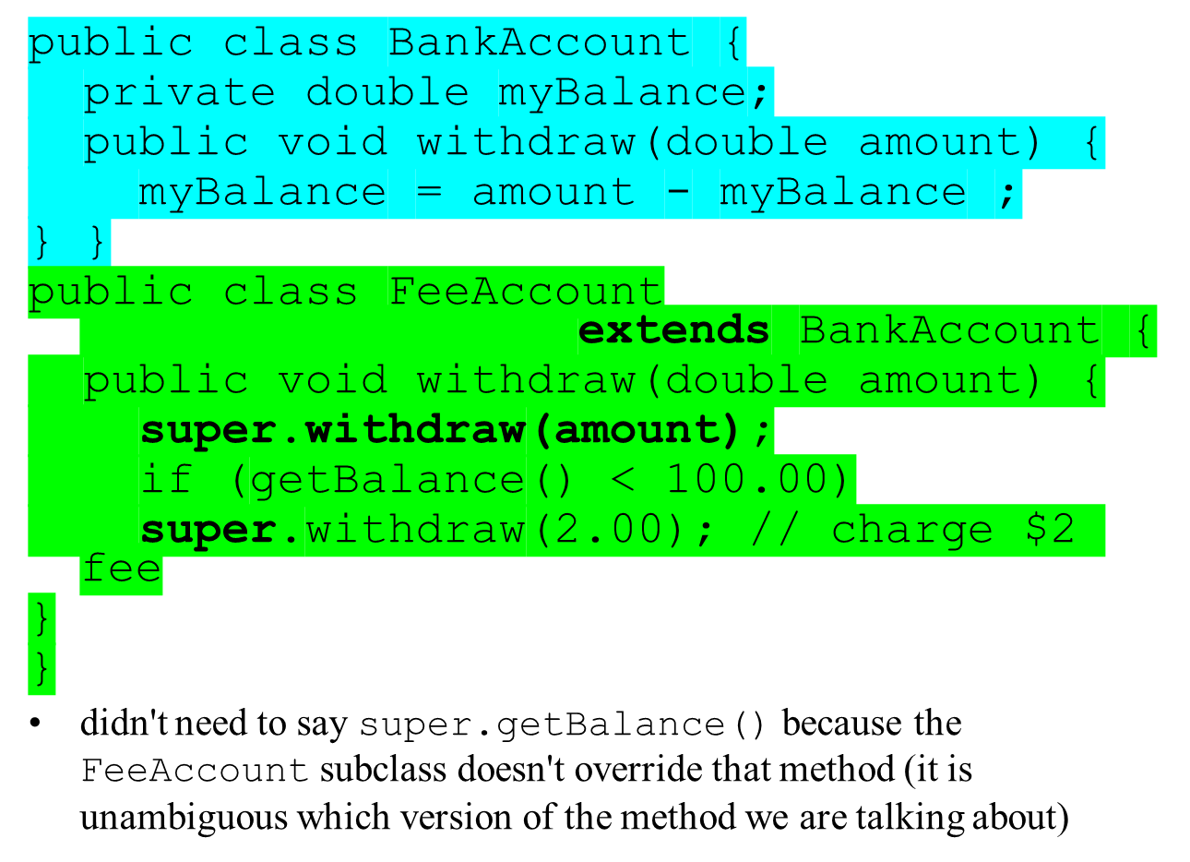
super example

Slide 16
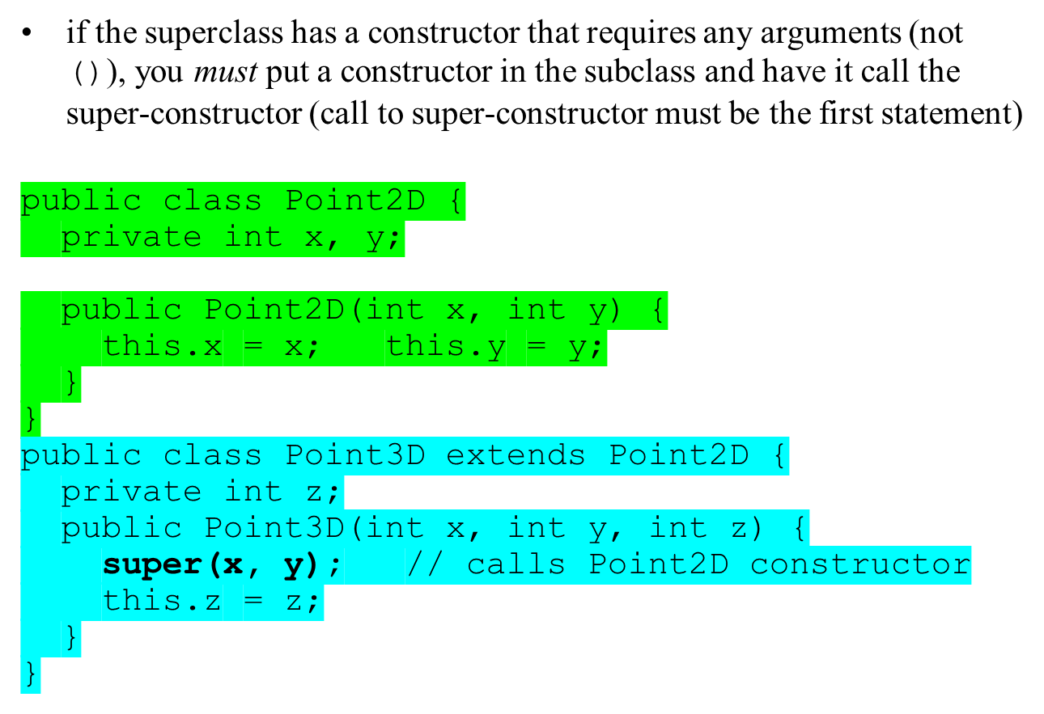
super and constructors
Notes:
calling super lets the point3d set the super class's fields

Slide 17
Which method gets called?
BankAccount b = new FeeAccount("Ed", 9.00);
b.withdraw(5.00);
System.out.println(b.getBalance());
Will it call the withdraw method in BankAccount, leaving Ed with $4?
Will it call the withdraw method in FeeAccount, leaving Ed with $2 (after his $2 fee)?

Slide 18
The answer: dynamic binding
The version of withdraw from FeeAccount will be called
The version of an object's method that gets executed is always determined by that object's type, not by the type of the variable
The variable should only be looked at to determine whether the code would compile; after that, all behavior is determined by the object itself

Slide 19
Static and Dynamic Binding
static binding: methods and types that are hard-wired at compile time
  static methods
  referring to instance variables
  the types of the reference variables you declare
dynamic binding: methods and types that are determined and checked as the program is running
  non-static (a.k.a virtual) methods that are called
  types of objects that your variables refer to

Slide 20
Inheritance Quick Recap
Inheritance defines parent-child relationships
  Base (or super) class, and derived (or sub-) class
Child inherits all functionality of its parent
  Typically add new methods and member variables
One of the basic features of all OO languages
You can extend almost any object
  With a couple of extensions as we’ll see…

Slide 21
Using Inheritance
Use the extends keyword in the class definition:
public class MyRobot extends Robot {
}
A class can only extend one base class
  Unlike C++ Java doesn’t allow multiple inheritance
All Java classes extend a common base class (java.lang.Object)
  Automatically assumed by the compiler, unless you say otherwise
  Provides some basic functionality, e.g. toString() and equals()
public class Calculator extends Object {
}

Slide 22
Inheritance and Encapsulation
Sub-classes inherit all their superclass member variables
  But may not be able to access them directly!
The visibility modifiers, public, protected, and private apply
  Only public and protected are accessible
  Private member variables of a base class cannot be altered by a sub-class (except via a method)
Tip: Try to avoid breaking encapsulation by making variables private, unless you’re expecting the class to “have children”

Slide 23
Inheritance and Encapsulation
public class Person
{
private String _name;
private String _email;
//can be access by sub-classes
protected int _salary;
public String getName() {…}
public String setName() {…}
}

Slide 24
Inheritance and Constructors
An class must ensure that its parent is properly initialised, by calling one of its constructors
  Use the super keyword
Even if a constructor isn’t explicitly called a call to the default constructor is added by compiler
Base class constructors are called first
  Inheritance happens from the top down
  …ancestors, parent, child…

Slide 25
Constructors
public class Parent {
private String msg;
public Parent() {}
public Parent(String message) {
msg = message;
}
}
public class Child extends Parent {
public Child()
{
super("Parent message");
}
}
public class OtherChild extends Parent {
}

Slide 26
Method Overloading
A Java class can define several methods with the same name, so long as
  the parameters are different, the return type is the same
  public int doSomething(String s, String s2);
  public int doSomething(String s);
  public int doSomething(int x, int y);
  Java determines the correct method to call by checking the parameters
Useful to provide variants of a method that work on different types of object
  Typically one method does all the work, and the others call it
  As with constructors, this collects common code into a single method

Slide 27
Method Overriding
A sub-class can define a method with the same name and parameters as as base class
  Known as overriding
Useful when some aspect of the base class behaviour must be altered
  To completely change the implementation, just define a new version (in the child)
  To partially change the implementation use the super keyword to refer to the parents original implementation

Slide 28
Inheritance and Methods
What happens when we call a method?
  The JVM tries to find the implementation of that method and then execute the code
  Starts searching with the objects class, then works upward to its parent…its parent’s parent…etc, etc.
Searching for methods works from the bottom-up
  Reverse of how constructors are called
Also explains how a sub-class can substitute its own behaviour for a base class
  JVM finds that first.

Slide 29
Controlling Inheritance – Restricting
Inheritance can be restricted using the final keyword
  Applies to both methods and classes
  A final class cannot be extended
  A final method cannot be overridden
public final class MyClass {
}
public class OtherClass {
public final int aMethod() { … }
}

Slide 30
Controlling Inheritance – Enforcing
Inheritance can be forced by using the abstract keyword
  Again applies to both methods and classes
  An abstract class must be extended, cannot be used to create objects
  An abstract method must be overrided by a sub-class
  A class with at least one abstract method must be declared abstract
public abstract class SomeOtherClass {
public int aMethod() { … }
public abstract void otherMethod();
}

