Slide 1

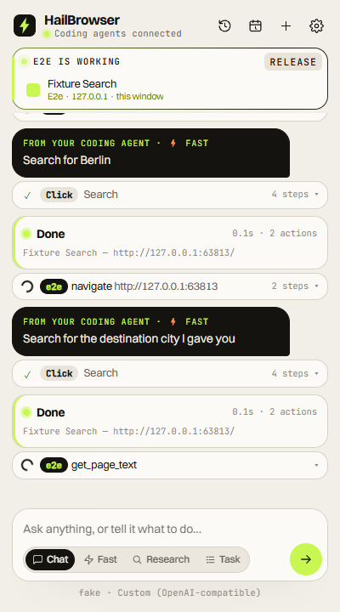
HailBrowser
PROJECT REPORT
An open-source AI browser agent and browser-use MCP server for the Chrome you are already signed into
PRESENTED BY
Shyamnath Sankar
Jai Samyukth B U
Manikandan S
Veerakumar R
Final Year, B.Tech Computer Science and Business Systems
VSB Engineering College
Notes:
Introduce HailBrowser: an open-source Chrome extension that turns the browser you already use into an AI agent, plus a local MCP server so coding agents can drive the same browser.

Slide 2
Abstract
01 / ABSTRACT
HailBrowser is a Chromium extension that turns the user's own, logged-in browser into an AI agent. A side panel lets people chat with a page, fill forms, research with citations and run long multi-step tasks.
A small local MCP server, hailbrowser-mcp, lets coding agents such as Claude Code, Cursor, OpenCode and Codex drive the same browser over a loopback-only hub.
Pages are read as an indexed snapshot of numbered elements, so a decision model picks one action per step instead of writing selectors or code. The Ultrafast mode passed 26 of 26 benchmark tasks at a 4.2 s average with zero false completions.
26/26
benchmark tasks passed in Ultrafast mode
4.2 s
average time per task, three full runs
18
browser tools exposed to agents over MCP
Notes:
Summarise the whole project in one breath: what it is, who it serves (everyday users and coding agents), the key technique (indexed page snapshot, one decision per step) and the headline result.

Slide 3




Problem statement
02 / PROBLEM STATEMENT
AI agents cannot quickly and safely use the browser people actually work in.
Signed-out, separate browsers
Switching browsers to get AI
Headless and cloud browsers lose the user's sessions, cookies and 2FA, so agents stall at every login.
AI browsers ask people to leave the Chrome profile, extensions and bookmarks they already rely on.
Slow, chatty agent loops
Trust and privacy gaps
Tool-calling agents spend a whole model conversation per step and sometimes claim “done” when they are not.
Keys and page data pass through third-party proxies, and page text can try to inject instructions.
Notes:
Four gaps motivate the project: agents run in browsers without the user's logins, AI browsers force a switch, agent loops are slow and over-claim success, and trust boundaries are unclear.

Slide 4
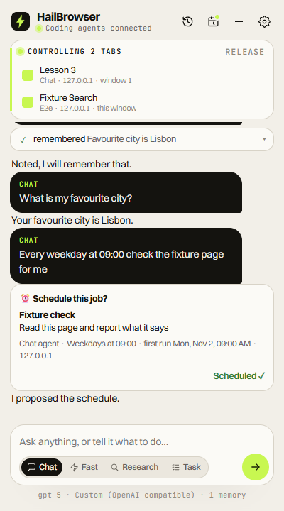




One browser, four modes
03 / PROPOSED SOLUTION
Chat
Fast (Ultrafast)
Tool-calling agent for the current tab: reads, clicks, types and hands off long jobs.
One decision per step: an operation plus an element index, never selectors or code.
Research
Tasks
Reads the best sources in background tabs; every claim in the report is cited.
Splits a long goal into 3 to 15 subtasks and saves progress after every step.
+ MCP server Claude Code, Cursor, OpenCode and Codex drive the same signed-in browser, each in its own window.
Notes:
The solution lives inside the user's existing Chrome as an extension. Four modes share the same tools and tab. The MCP server opens the same capability to coding agents.

Slide 5
System architecture
04 / SYSTEM ARCHITECTURE
Chrome extension
MCP clients
hailbrowser-mcp
Node.js hub
127.0.0.1:12306
first client hosts, others relay
Service worker
Claude Code
OpenCode
Cursor
Codex CLI
Claude Desktop
stdio
WebSocket
Tools: CDP + DOM
Normal agent
Ultrafast agent
Side panel UI ← you
Decision loop
Read page as numbered elements → model picks one action → executor re-checks the page → verify, repeat
LLM providers
Anthropic, OpenAI, Gemini, Ollama …
Notes:
MCP clients speak stdio; the extension speaks WebSocket. hailbrowser-mcp bridges the two on loopback port 12306. Inside Chrome, the service worker owns the tools (Chrome DevTools Protocol plus DOM), the two agents and the side panel. Model calls go straight to the provider the user configured.

Slide 6






Technology stack and security
05 / IMPLEMENTATION
Extension
Manifest V3 side panel and service worker, plain ES modules, no build step
Security by design
Browser control
Chrome DevTools Protocol plus DOM indexing of interactive elements
API keys stay in chrome.storage.local, sent only to the chosen provider
Hub listens on loopback only and rejects non-extension origins
Page text is treated as data, never as instructions
Every run is visible and stoppable
No account, no proxy, no telemetry
MCP server
Node.js 18+, stdio to WebSocket bridge, 20 tools in total
Models
Any provider with the user's own key, or local Ollama / LM Studio
Website
Astro static site, GSAP and Lenis motion, sitemap and llms.txt
Notes:
Implementation choices keep the extension dependency-free and let users bring their own model. The security model is explicit: keys never leave the extension except to the selected provider, and the hub is loopback-only.

Slide 7
Results: fast and reliable
06 / RESULTS
26/26
tasks passed in Ultrafast mode across three full runs
16/16
tasks on live sites (Wikipedia, GitHub, YouTube, MDN) at 8.2 s
0
false “done” claims in either mode
Notes:
Benchmarks come from the project's own scripts (bench-fast.mjs and bench-real.mjs). Ultrafast is about twice as fast as Chat on average and over three times as fast on the hardest multi-step tasks, without any false completions. Score improved from 10/17 before the upgrades to 26/26.

Slide 8



Deployment
07 / DEPLOYMENT
Browser extension
MCP server
Project website
1
git clone the repo, npm install
1
npm run setup prints each client's config
1
Astro static build: npm run build
2
Open chrome://extensions, enable Developer mode
2
Add hailbrowser-mcp to Claude Code, Cursor, OpenCode or Codex
2
Output in dist/ with sitemap, robots.txt, llms.txt
3
Load unpacked: the extension/ folder
3
Hub starts on 127.0.0.1:12306
3
Served at hailbrowser.genrecai.com
4
Alt+H opens the side panel; add a model key
4
Extension dials in; agent drives Chrome
4
Playwright and axe-core for QA
Requirements Chromium 116+ (Chrome, Edge, Brave) · Node 18+ · one model API key · no account, no store listing
Notes:
Deployment has three parts: the unpacked extension loaded into the user's own Chrome, the MCP server started by the coding agent's client, and the static Astro website that documents the project.

Slide 9


Conclusion and future scope
08 / CONCLUSION
Brings AI agents into the user's real, logged-in Chrome: no new browser and no account.
Future scope
The indexed snapshot and one-decision-per-step loop made Ultrafast both fast (4.2 s) and reliable (26/26).
Shadow DOM, cross-origin iframes and canvas apps
A file-upload tool for forms
PDF reading in Research
Scheduled jobs that run while Chrome is closed
Publish to npm and the Chrome Web Store
One loopback MCP hub lets any coding agent share the same browser safely.
Open source under MIT, with its limits documented openly.
Notes:
Close the technical part: what was achieved and what is next. Future work comes straight from the project's documented limits for version 0.1.0.

Slide 10
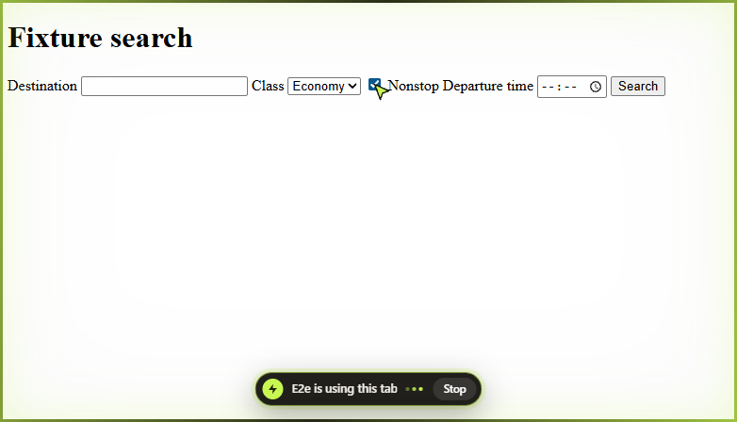

Thank you
Your browser, with hands.
Questions and discussion
github.com/Shyamnath-Sankar/project-hailbrowser
hailbrowser.genrecai.com
Notes:
Thank the audience and invite questions. Point to the repository and the website for the code, docs and benchmarks.

