Slide 1

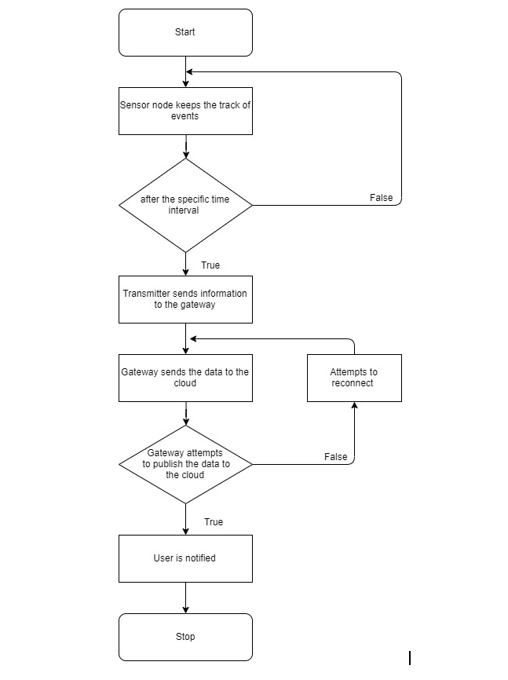
Sensor Tag
Students Team:ESDM-04
Guide: Dr.Saroja V.S
School of Electronics and Communication
prafulgk8@gmail.com
Problem statement
Methodology
Results
To develop an IoT framework based on a wireless control system that monitors physical or environmental situations with no physical interference and notify the user.
The following process was followed for the project:
1.Research on existing solutions
2.Design phase
3.Implementation
4.PCB soldering and casing the module
5.Testing
6.Documentation
We have successfully implemented the
complete loop of our design with the
required objectives.
Continuous monitoring of the temperature and humidity.
Low Power consumption.
We were able to monitor the system
through UART.
Objectives
1.To implement a Wireless data monitoring system with real time monitoring.
2.It should be compact in size, inexpensive, Portable, Low power consumption, battery powered and feasible.
Optimization
The nodes are optimized for low power.
Deep sleep mode is used to reduce power
consumption.
Global declaration.
Dead code elimination.
Contributions
Sensor Tag technology has been the milestone in military applications which has its greater influence on the detection of submarines, battlefield surveillance. It also has its huge applications in Environmental monitoring, Health monitoring, Traffic control and security.
Conclusions
We could meet the objectives and successfully build a Sensor Tag model according to the design. We did the coding part in Arduino IDE for the node and the gateway. The temperature and humidity sensor sends the data to the controller. LORA module transmits the data with the help of RF technology to the gateway. In the gateway, another LORA module receives the data and pass it to the controller to further publish the data to the cloud.
Literature survey
1. Nordic Thingy:52.
2. Texas Instruments SensorTag Kits
Mini Project-2019-20

