Slide 1
SENSOR TAG
Team members: G K Praful
Sonal Kumar
Project Guide: Dr. Saroja V.S.
KLE Technological University Vidyanagar, Hubballi-580031 Karnataka, India
December 27, 2019
Sensor Tag

Slide 2
Contents
Introduction System Design
Implementation details Discussion on optimization Results
Conclusion
Digi-Nest

Slide 3
Introduction
A Sensor Tag Network is a wireless network which comprises of several distributed devices such as a sensor to monitor environmental conditions, like pollutants, humidity, motion, temperature, vibration, sound, pressure at different places.
Hence, a Sensor Tag Network can be formed by combining these devices, or nodes with a gateway.
These nodes communicate wirelessly to a gateway through which the data is sent to another platform i.e, cloud where you can collect, process, analyze the data and notify the user.
The wireless sensor network scalable. It is software programmable, smart, reliable, also capable of fast data acquisition and accurate for a long period. They are cost-effective and easy to install with zero maintenance
Digi-Nest

Slide 4
Motivation
Physical intimidations which lead to infrastructure failure and menace usually can’t be envisaged. Considering the scenario of warehouses and industries, if there is any leakage of water or fire in the building, there will be a huge loss for the property and human beings.
If all the inmates of that place are alerted to the menace quickly then there will be less probability of risk and less vandalization to the property.
Sensor nodes are employed for different applications, extending from lifestyle and health to an automotive,modish building, predictive perpetuation, and RFID tags.
Further uses the same concept for military surveillance , smart sensors to detect and control manufacturing prerequisites, sensors networks to monitor habitat or weather, biosensors for health applications.
Digi-Nest

Slide 5
Objectives
Non-Invasive sensing.
Portable.
Wireless data monitoring with IoT technology.
User friendly mobile application.
Scalability to a large scale of establishment i.e., employment.
Effective hazard control.
Ease of use.
Digi-Nest

Slide 6
Literature Survey
Nordic semiconductor has designed a product as Nordic Semiconductor Thingy:52 Sensor Development Kit to build IoT prototype of a sensor tag without building any base for the development.
They base the development kit on NRF52832 Bluetooth 5.0 system on chips. It comprises multiple sensors like Temperature, Humidity, Air pressure,Air quality(CO2 and TVOC), color and light intensity, 9-axis motion sensors. They have included a built-in speaker and microphone to the kit which can play sound through it and also stream sound to the host through its microphone.
The Thingy:52 can be configured over-the-air via Bluetooth application programming interface and create demos and prototypes without programming
Thingy:52 has a lot of sensors on a single SoC which will increase the price of the product if some sensor is of no use. It uses Bluetooth technology for the transmission which does not give a long-range of transmission
Digi-Nest

Slide 7
Problem Statement
To develop an IoT framework based on a wireless control system that monitors physical or environmental situations with no physical interference and notify the user.
Digi-Nest

Slide 8
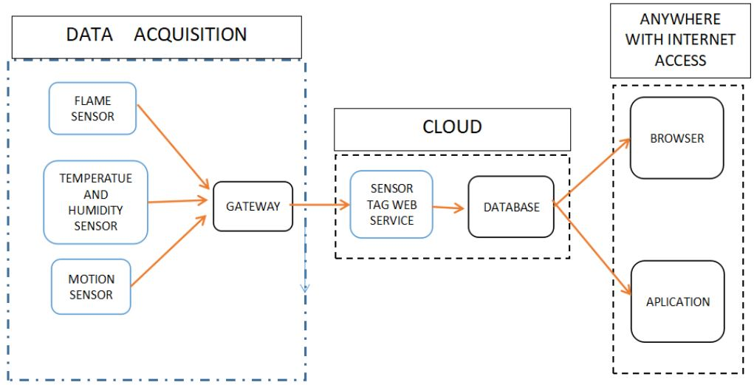
System Design
Digi-Nest

Slide 9
Design Alternative - 1
NODE
GATEWAY
Sensor
DHT11
Microcontroller
Transmitter
Receiver
Microcontroller
ESP 32
ble 5
NRF 51822
ESP32
Storage Analysis
AWS
Digi-Nest

Slide 10
Design Alternative - 2
NODE
GATEWAY
Sensor
HDC 2080
Microcontroller
Transmitter
Receiver
Microcontroller
ATMEGA 328P
HC-10
HC-10
ESP32
Storage Analysis
AWS
Digi-Nest

Slide 11
Design Alternative - 3
NODE
GATEWAY
Sensor
HDC 2080
Microcontroller
Transmitter
Receiver
Microcontroller
ESP 32
NRF 51822
NRF 51822
ESP32
Storage Analysis
AWS
Digi-Nest

Slide 12
Design Alternative - 4
NODE
GATEWAY
Sensor
HDC 2080
Microcontroller
Transmitter
Receiver
Microcontroller
ATMEGA 328P
RFM98
RFM98
ESP32
Storage Analysis
AWS
Digi-Nest

Slide 13
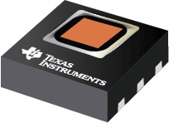
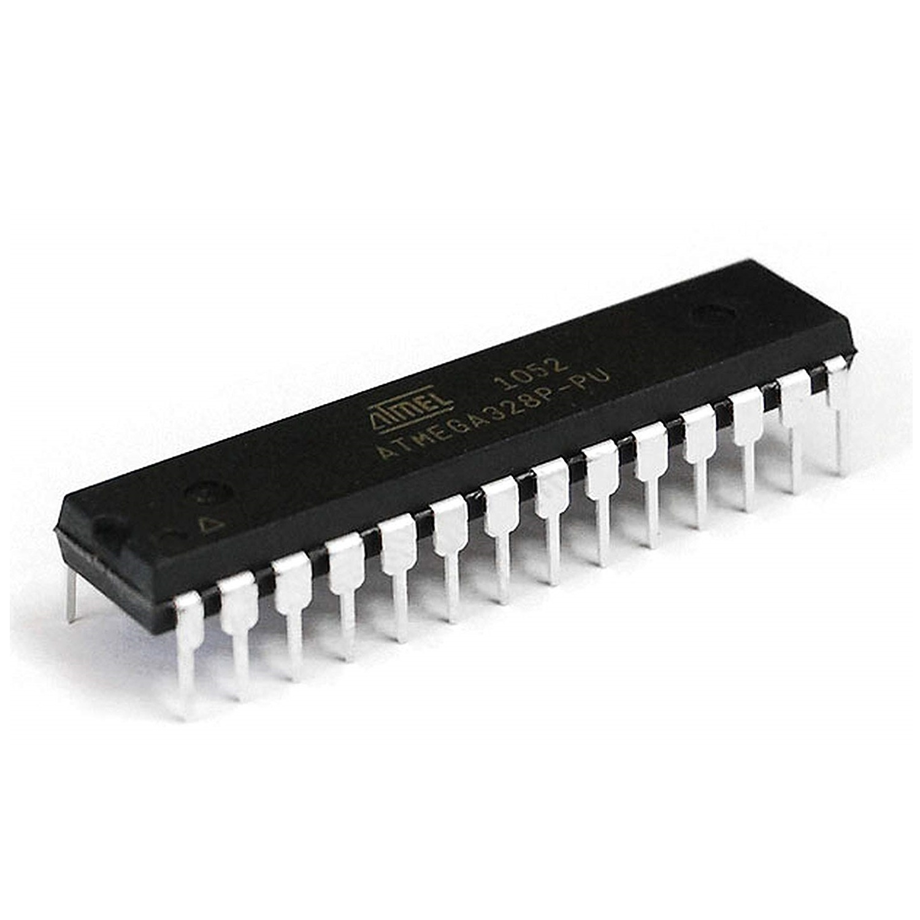
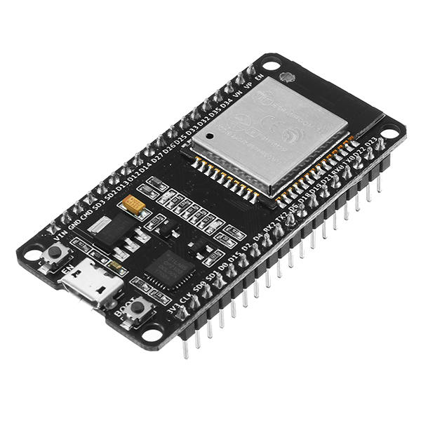
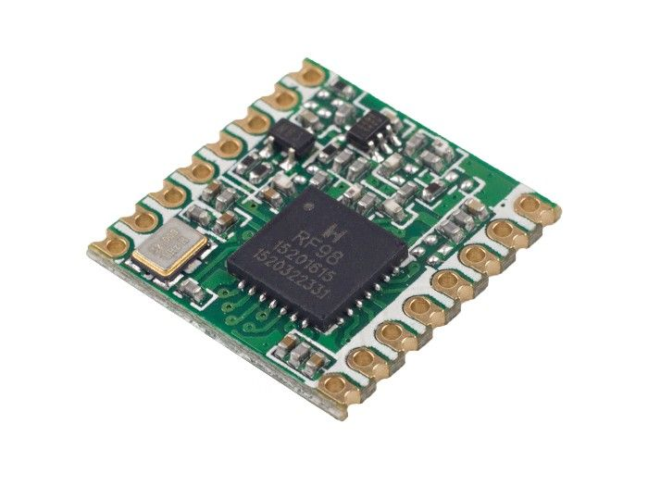

Final Design
NODE
GATEWAY
HDC 2080
ATMEGA
328P
ESP32
RFM98
RFM98
AWS
Digi-Nest

Slide 14
Implementation Details
The several events occurring in the surroundings are sensed using the sensors like humidity and temperature Sensor.
Whenever the anomalies occur, the sensor node senses the event and the particular data is sent to the gateway which is at some distance from the sensor nodes by using RF technology.
Then the gateway tries to connect to the cloud. If the connection is established, then the user is notified.
If the connection is failed at that moment, the data at the gateway is queued and whenever the connection is re-established, the event is notified.
Digi-Nest

Slide 15
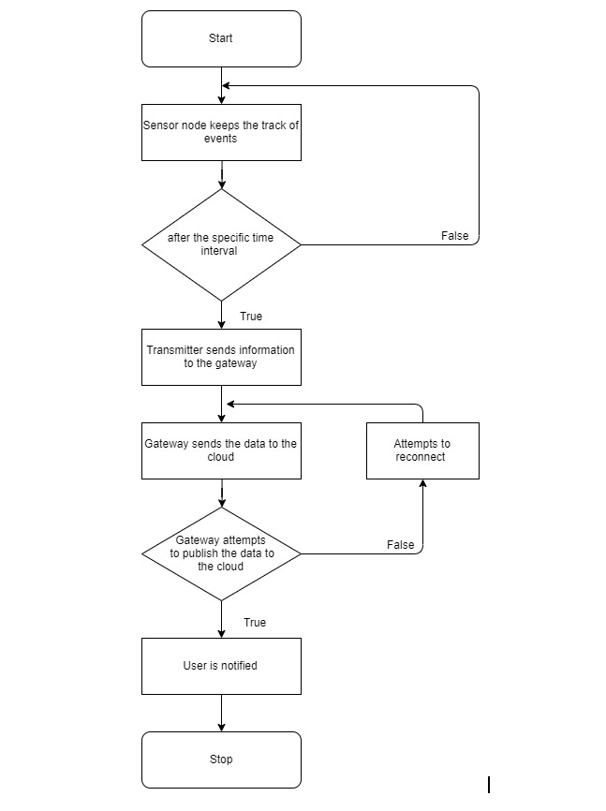
Algorithm
Digi-Nest

Slide 16
Hardware optimizations used:
Optimization
Choosing of low power sensors.
Deep sleep mode for power optimization.
Sl.no | Optimization parameter | Before optimization | After optimization
1 | Current Rating (Active mode) | 60mA | 10 mA
2 | Current Rating (sleep mode) | 20mA | 20uA
Digi-Nest

Slide 17
Discussion on results
We could meet the objectives and successfully build a Sensor Tag model according to the design. We did the coding part in Arduino IDE for the node and the gateway. The temperature and humidity sensor sends the data to the controller. LORA module transmits the data with the help of RF technology to the gateway. In the gateway, another LORA module receives the data and pass it to the controller to further publish the data to the cloud. The sensor node is programmed to push one sample of the data every 20th minute and go back to sleep for the next twenty minutes to reduce power consumption. By doing the above methodology the battery life is extended and gives a battery span of a year.

Slide 18
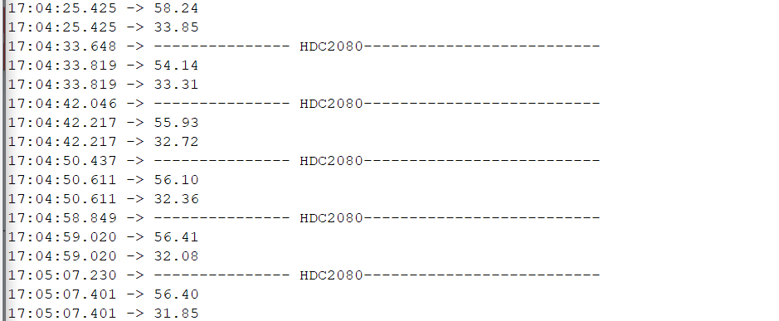
Results
Transmission
Digi-Nest

Slide 19
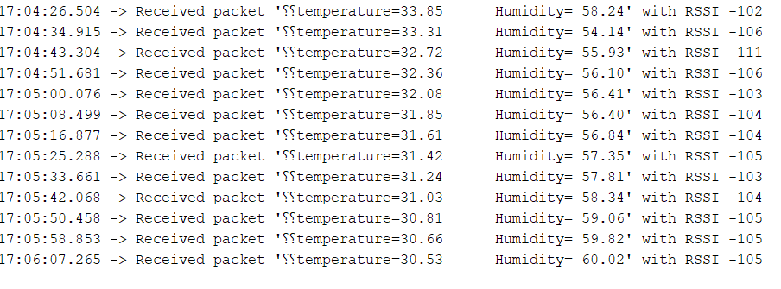
Results
Received data
Digi-Nest

Slide 20
Conclusion
We conclude that using the method of wireless sensor networks we can detect the hazardous things and notify the user about the event occurred. The usage of RF technology further increases the range of the system and by using low power devices the power consumption of the system is reduced and thereby increasing the life of the sensor node. The Low-cost PCB is designed considering the peripherals needed for the system and hence the size of the sensor node. It is smart, reliable, capable of fast data acquisition and accurate for a long period of time. It costs less, easy to install with zero maintenance and does not disturb the ambiance. Hence the specifications are met according to the objectives.
Digi-Nest

Slide 21
Future Scope
Presently there is one sensor node connected to the gateway. In the future, the number of sensor nodes can be increased. The data can be further sent directly through the push notification or the application. In future power consumption and cost can be reduced.
Digi-Nest

Slide 22
Thank-You
Thank-You
Digi-Nest

