Slide 1


Slide 2


Slide 3
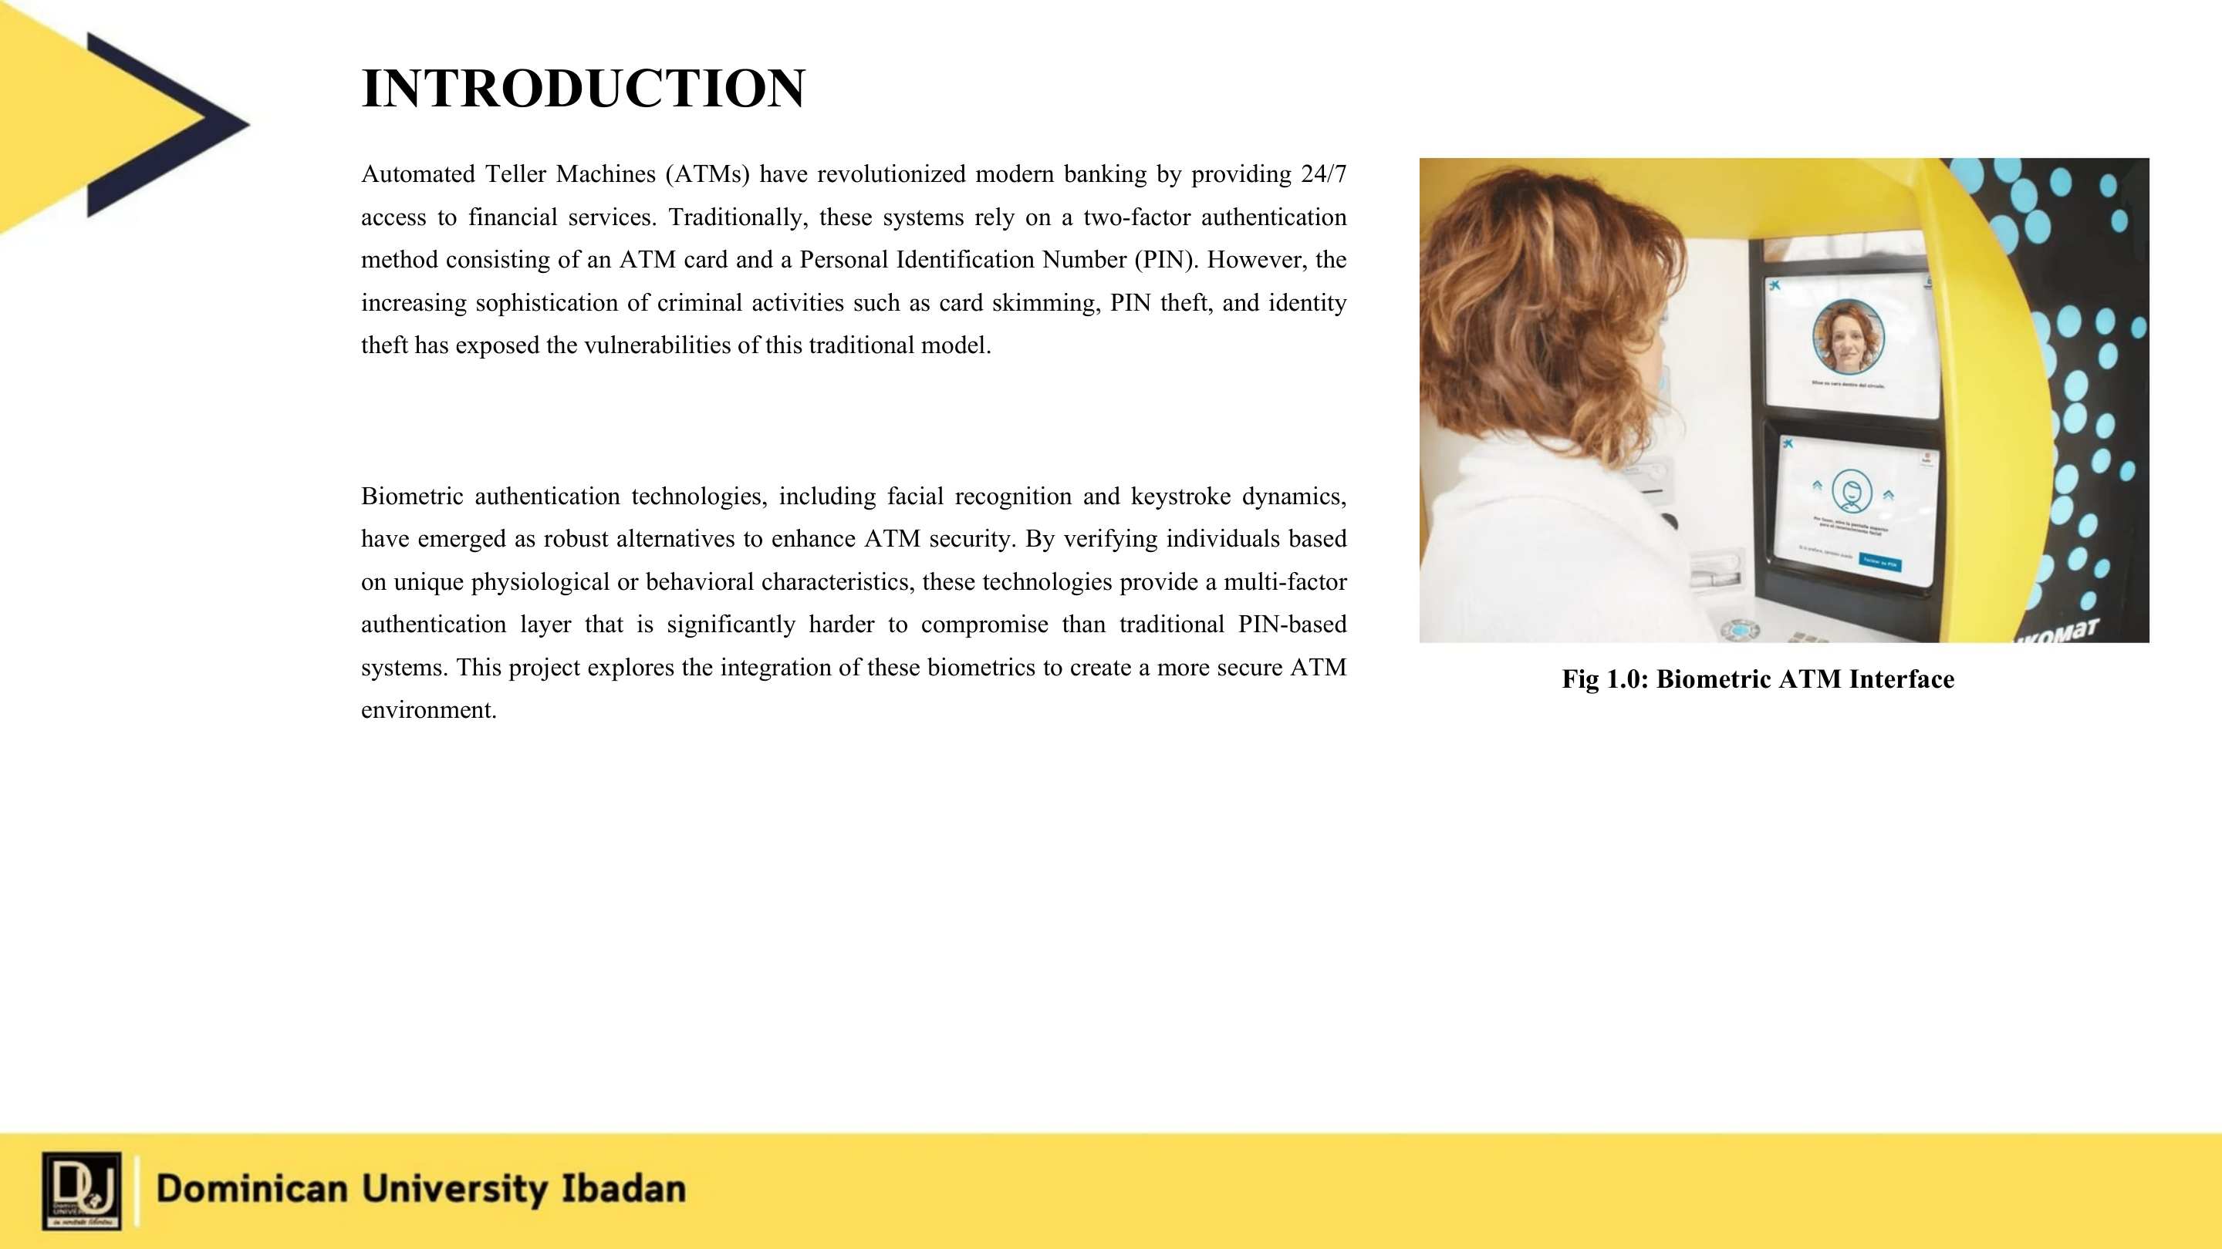

Slide 4
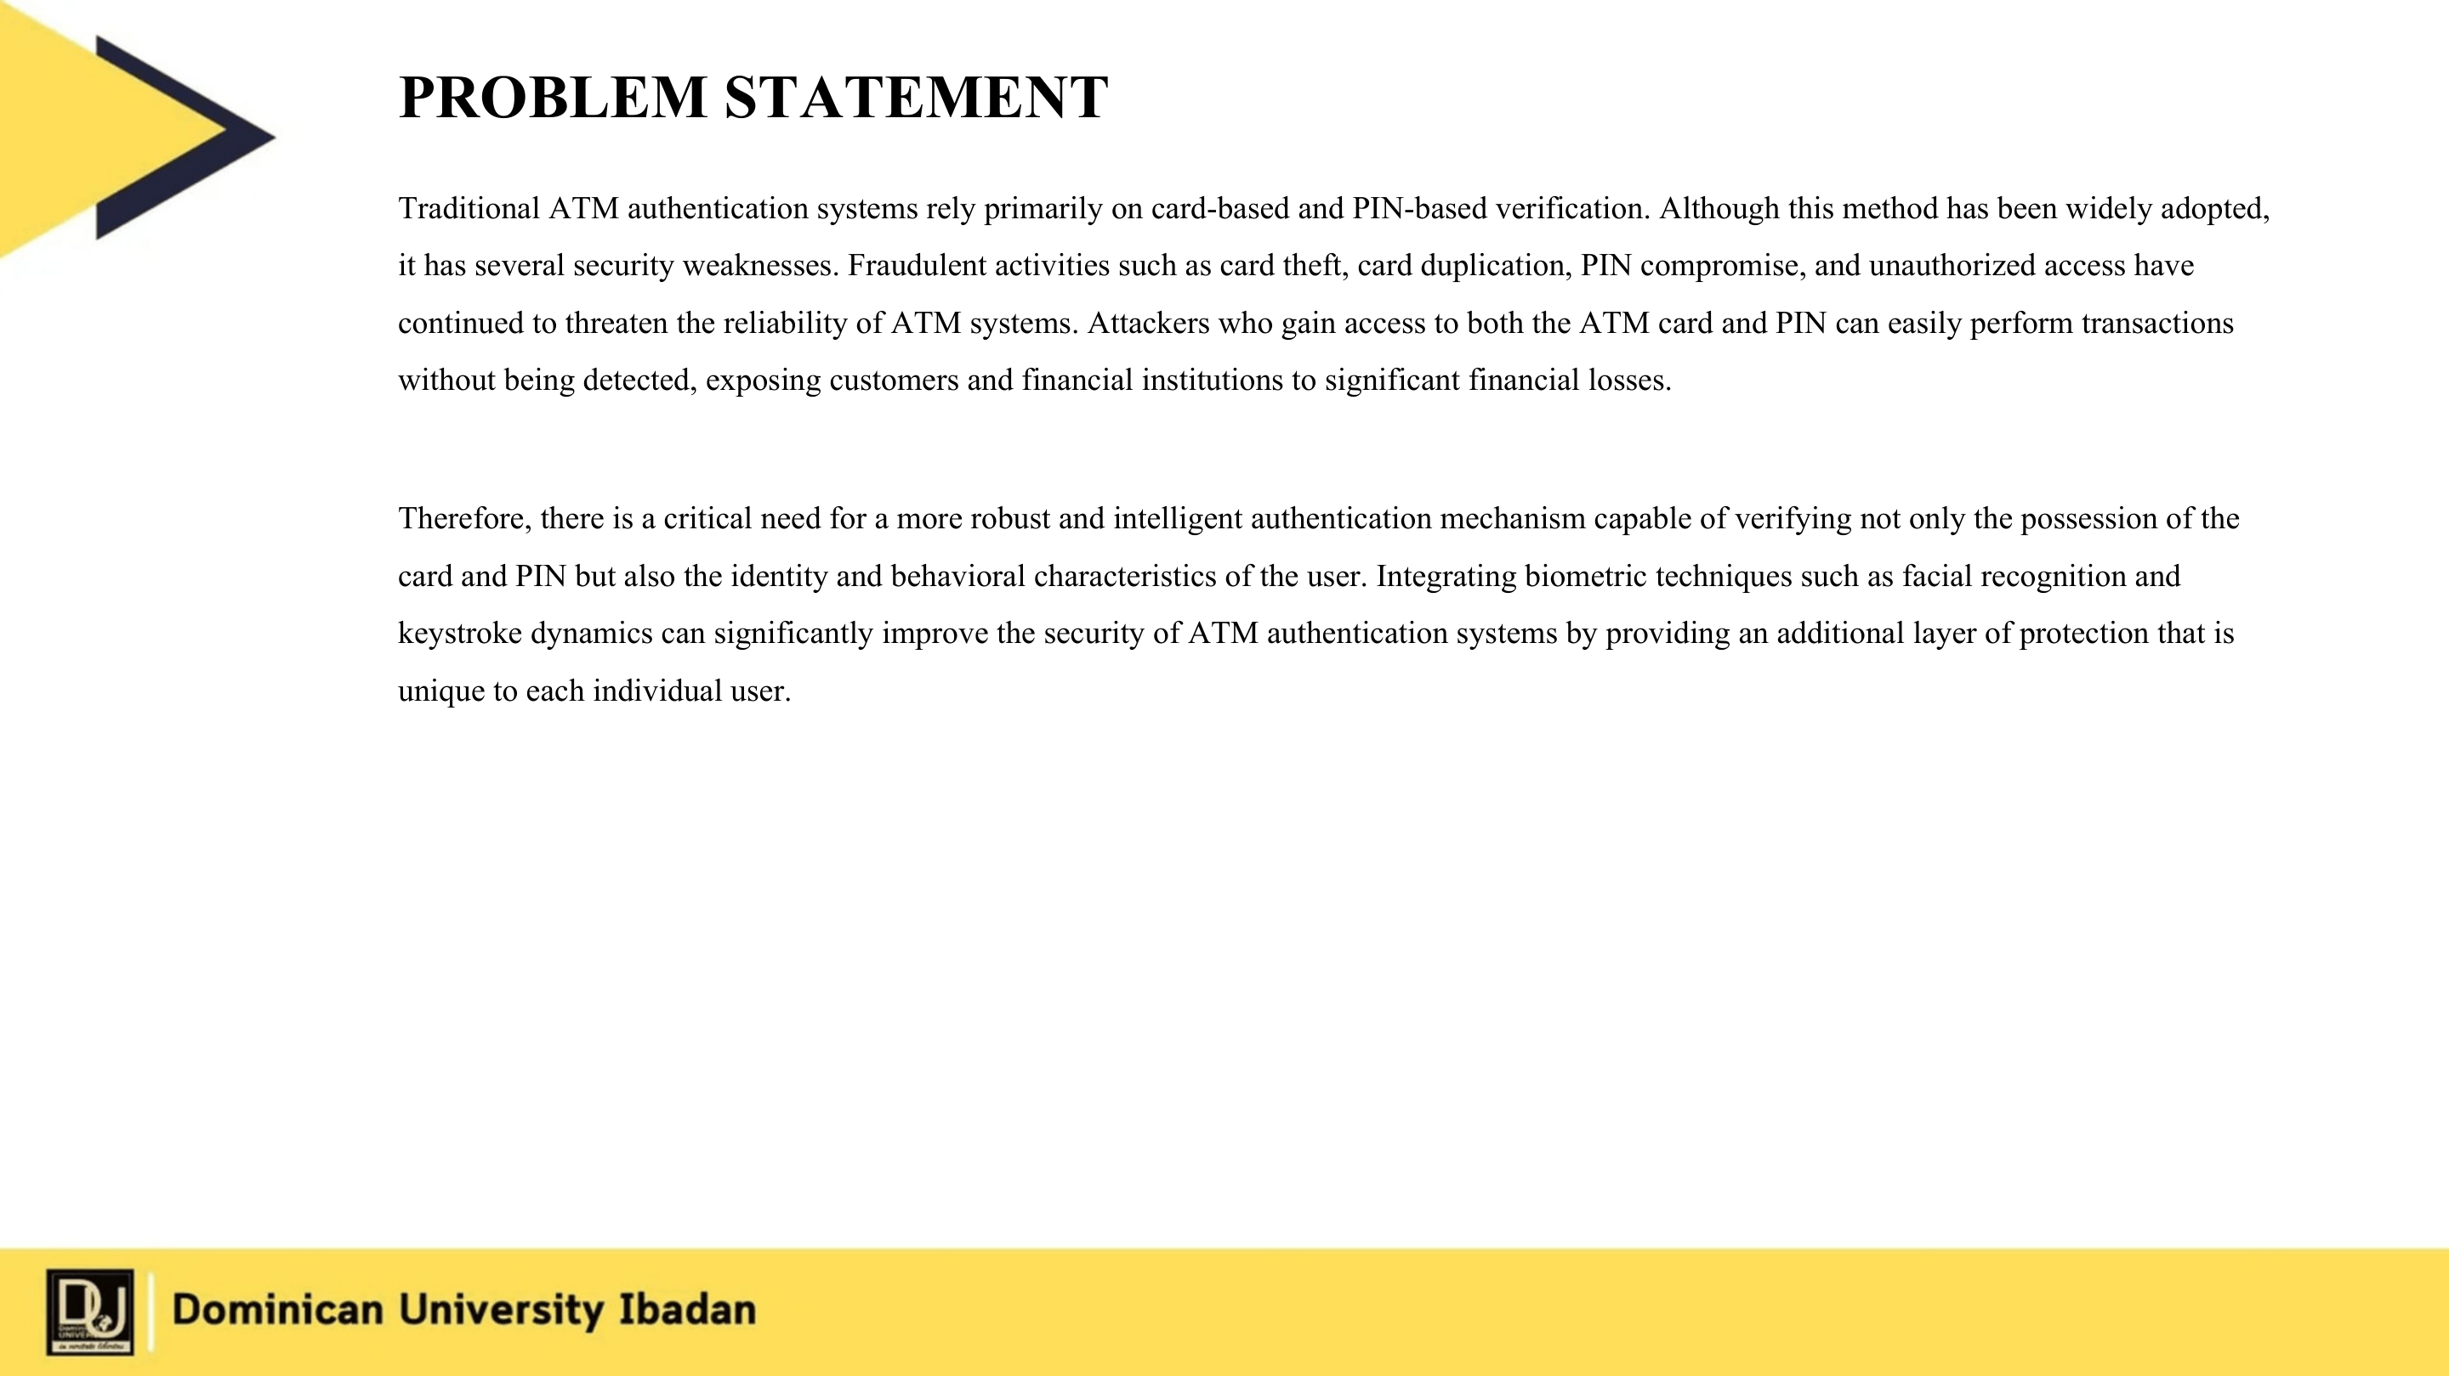

Slide 5
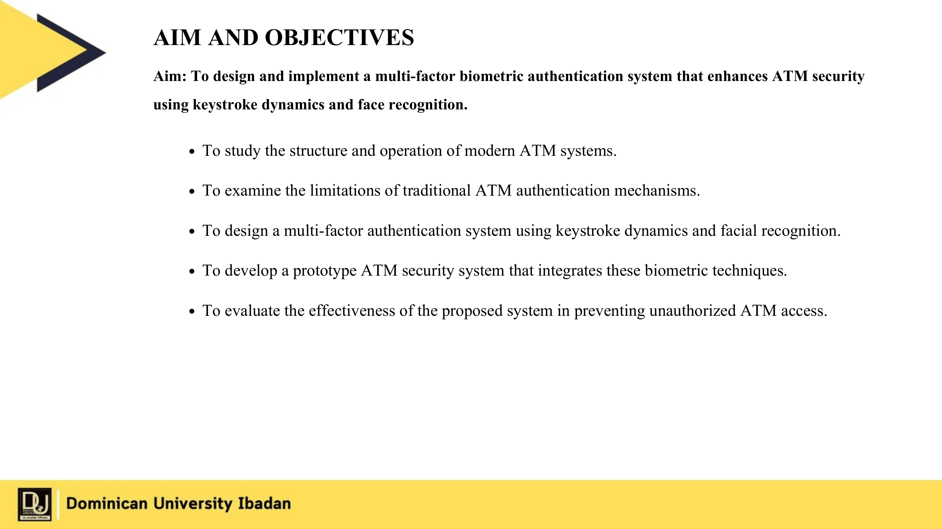

Slide 6
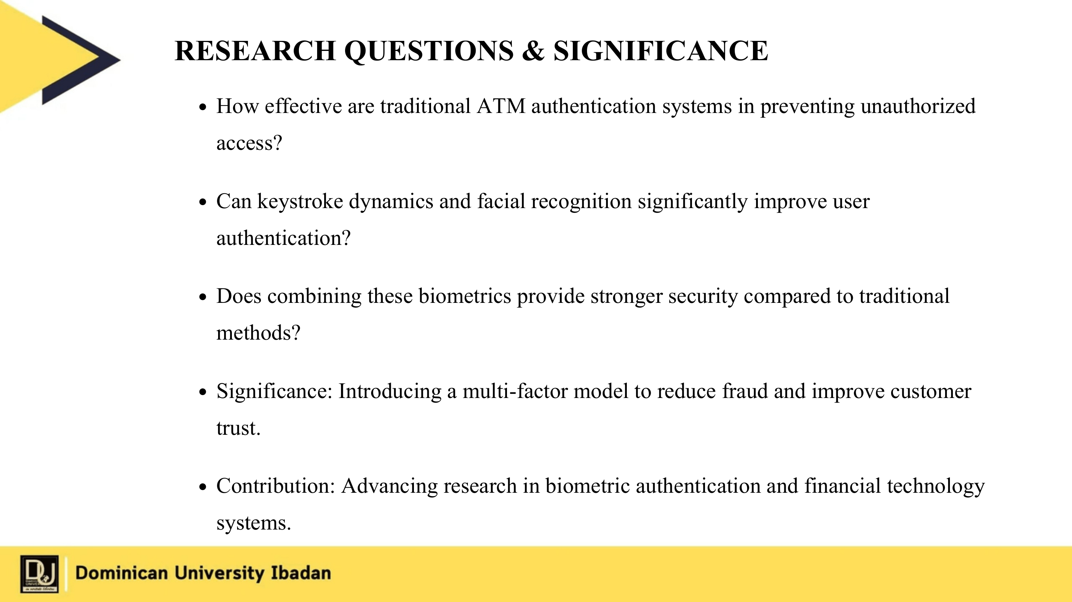

Slide 7


METHODOLOGY
Implementation Stages
1.
Requirement Analysis
- ATM risks and MFA requirements.
2.
System Design
- FastAPI, database, ATM and mobile screens.
3.
Biometric Enrollment
- PIN, voiceprint, and face reference.
4.
Authentication Workflow
- PIN + voice, SMS/QR link, face match.
5.
Testing & Documentation
- PIN, voice, SMS, Cloudflare, and face flow.
Secure System Integration
A systematic approach integrating PIN authentication, voice biometrics, SMS-based mobile handoff, and facial verification.

Slide 8
PROPOSED SYSTEM ARCHITECTURE AND WORKFLOW
User Inserts ATM Card
↓
PIN Verification
↓
Voice Biometric Verification
↓
Twilio SMS Link
+
ATM QR Fallback
↓
Mobile Face Verification
(Token expiry + face match)
↓
Multi-Factor Authentication Engine
↓
↓
Access Granted
Access Denied
Transaction Proceed
Alert / Retry

Slide 9
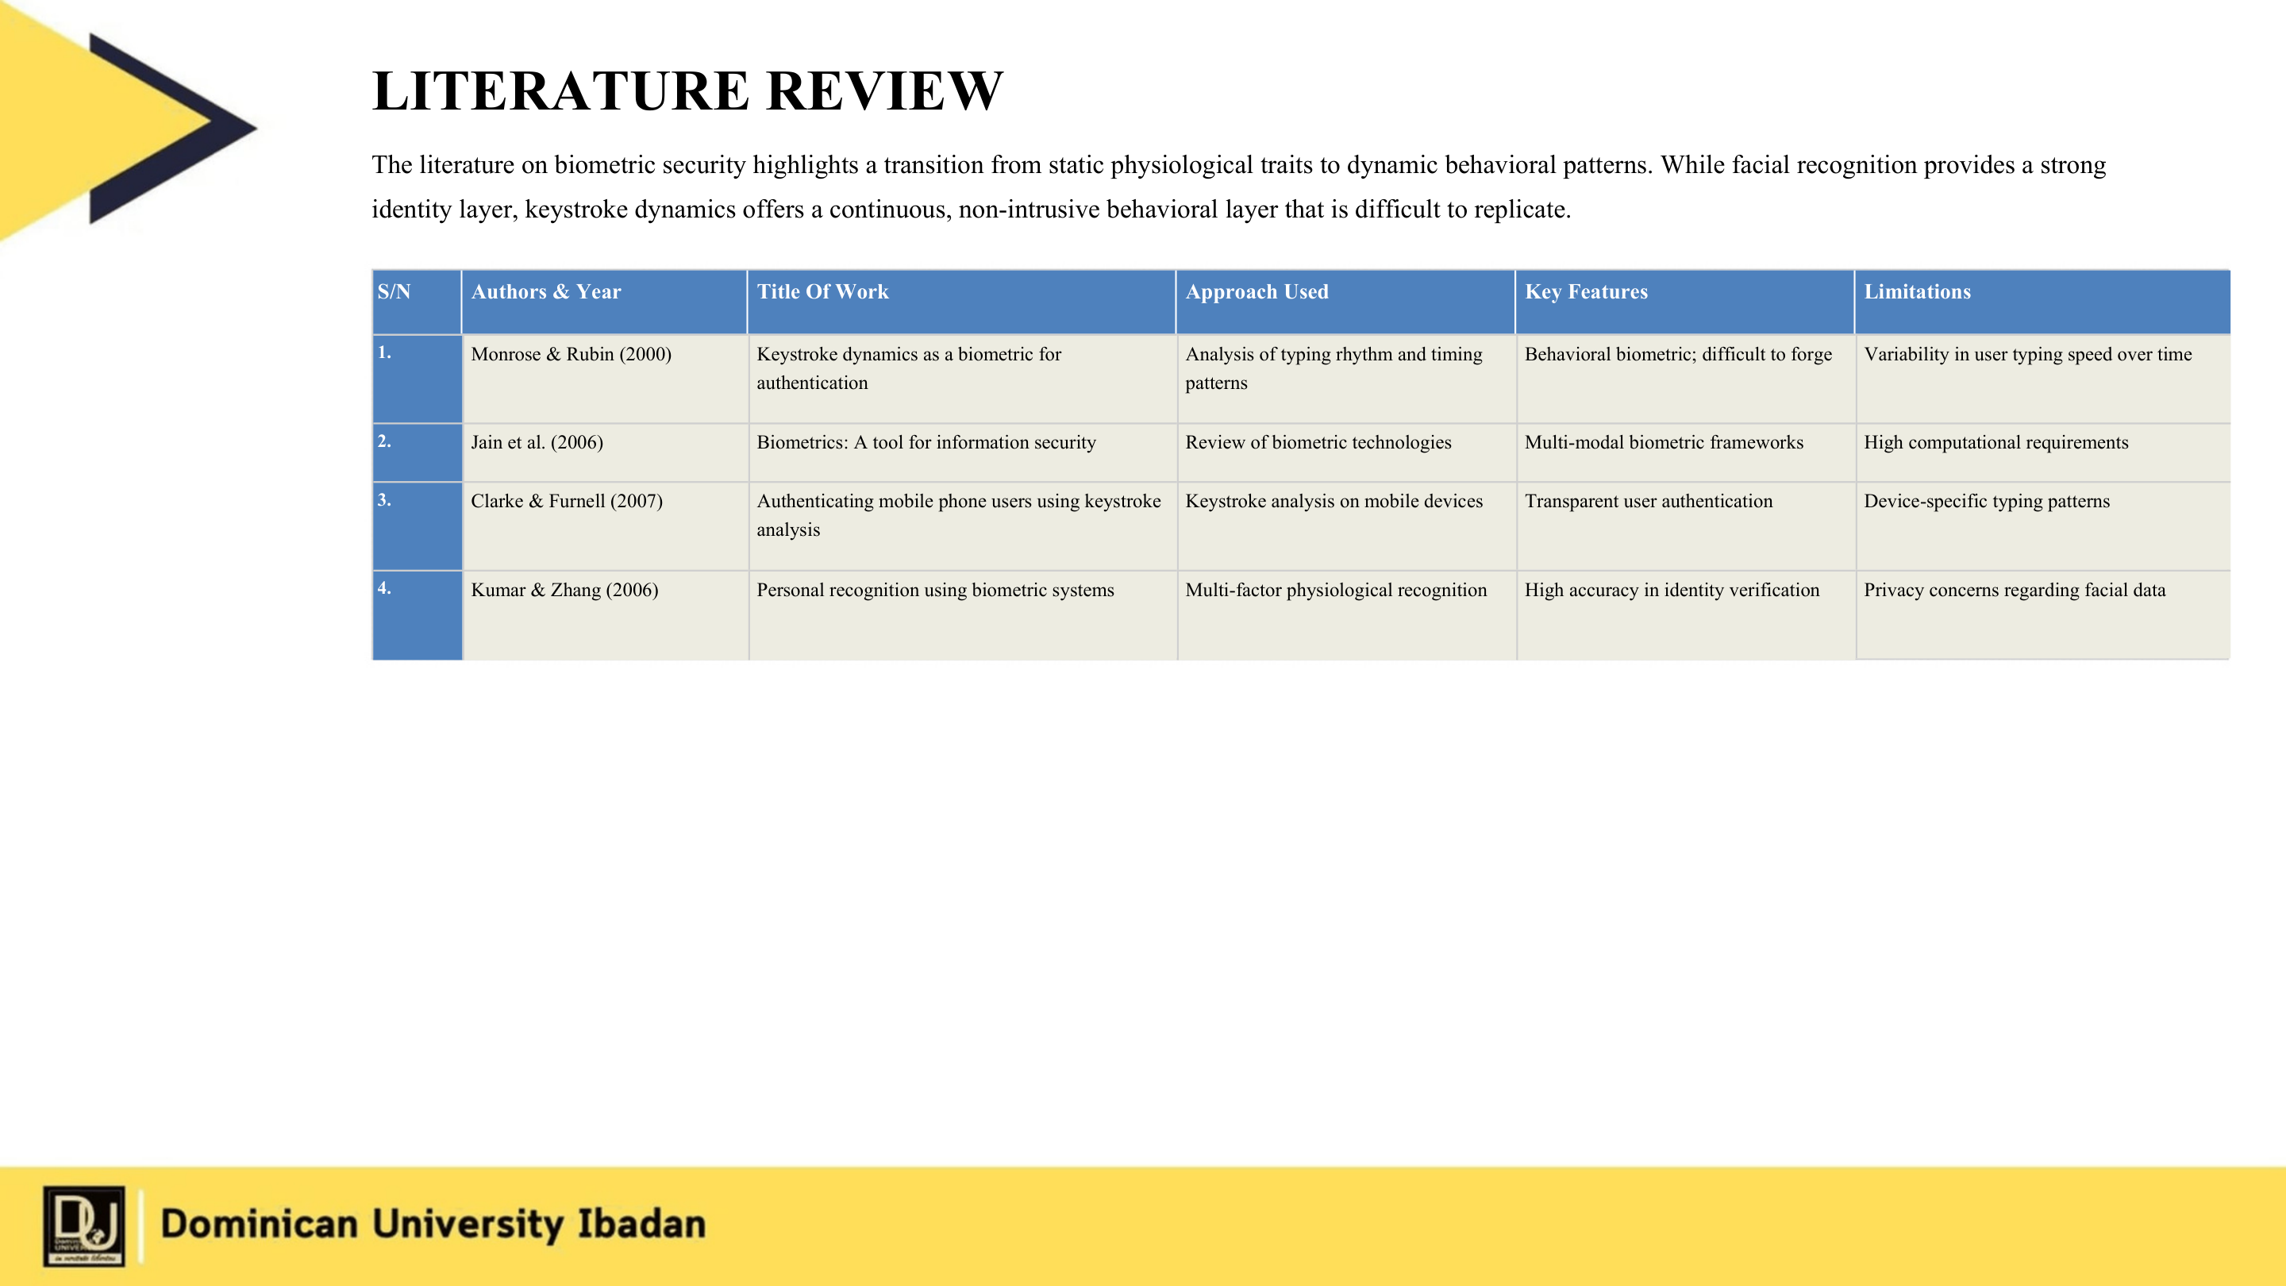

Slide 10
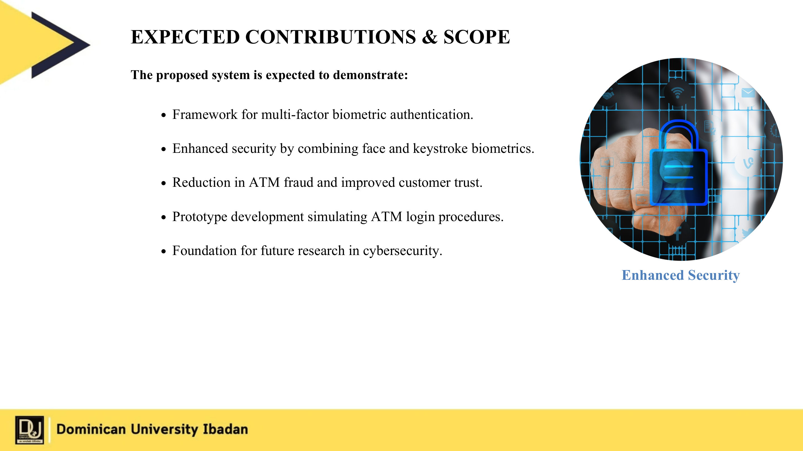

Slide 11
