Slide 1
Nanoscattering Software
February to July 2022
Neven Gentil supervised by Søren Raza
Nanomade Team
1

Slide 2
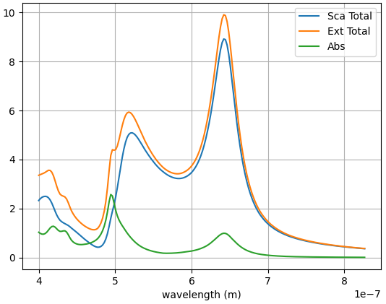
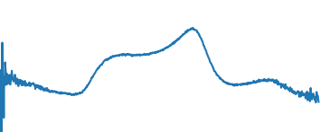
Working Principle
Mie Theorie
Experimental Spectrum (Optical Microscope)
Unique Particle Size (80 nm)
2

Slide 3
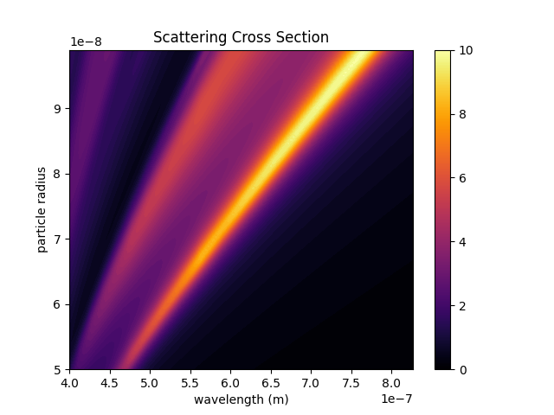
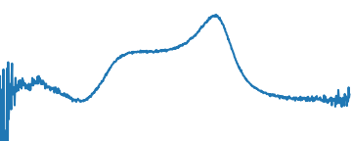
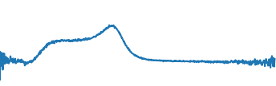
Working Principle
Comparison with each computed radius
Surface
Set of Radius (50 nm to 100 nm)
3

Slide 4
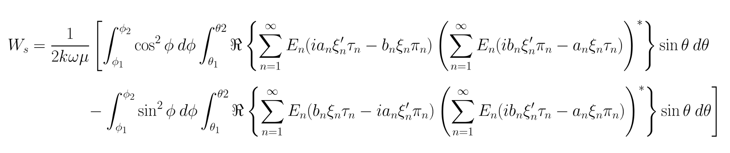
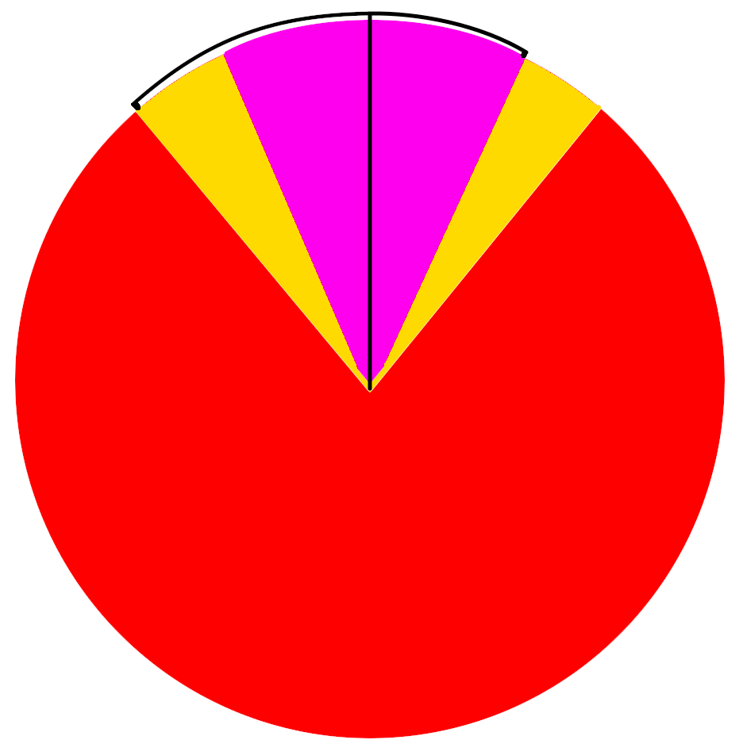
Compute Surface
Main Formula for simulation:
𝜙 and 𝜃 represent the spherical coordinates where the scattered light is collected
Experimental Collection Shape:
Incident
Collection
Particle
4

Slide 5
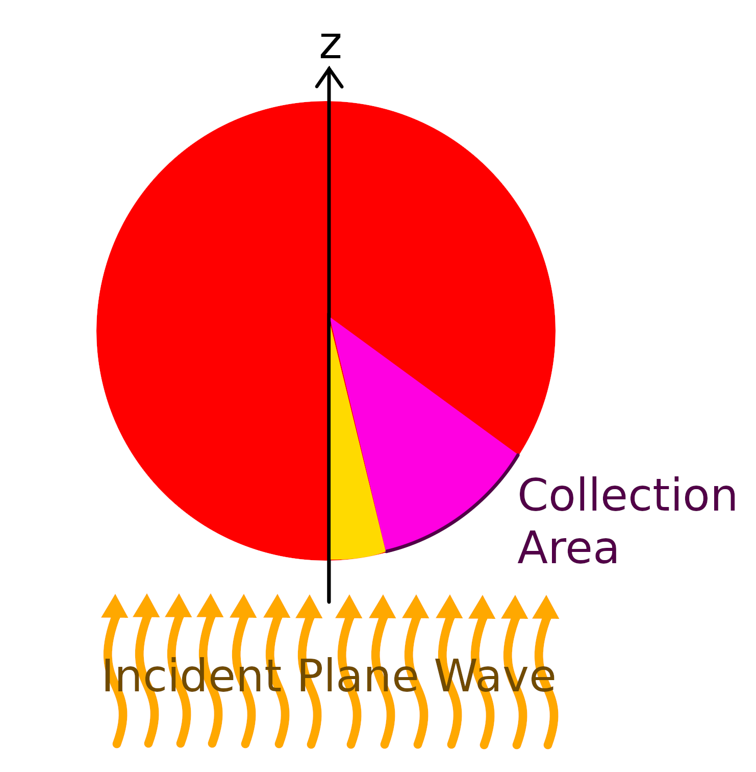
Compute Surface
Wished Shape Applied for the Simulation:
Problem:
Integration by variables (𝜙 and 𝜃) doesn’t support these kinds of shape: it’s mathematically impossible to parametrize these variables in order to obtain this specific disk shape.
Solution:
Numerical integration being equivalent to a summation, we compute each value of the main equation at (𝜙, 𝜃) then sum all of them in the wished shape.
Note: Due to the small size (nano scaled) of the particle, the shape of the incident light doesn’t matter. Only the collection shape is important here.
5

Slide 6
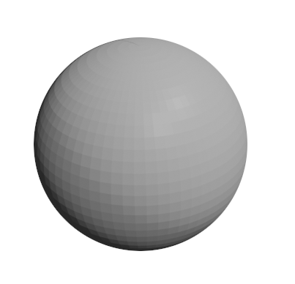
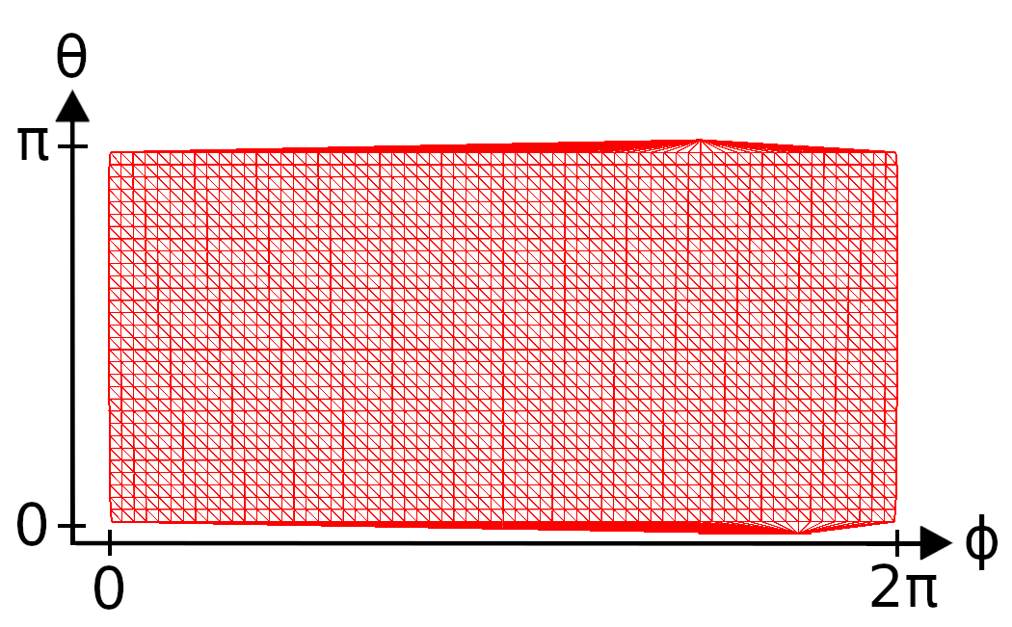
Compute Surface
Unwrap
6

Slide 7
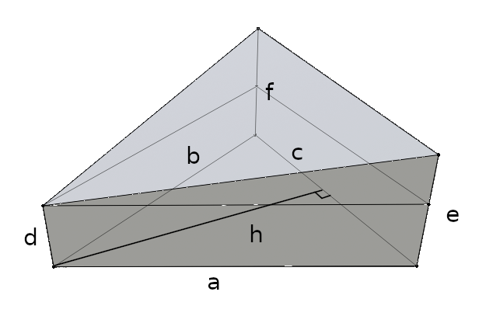
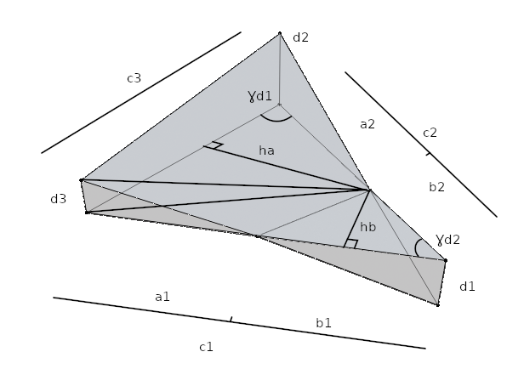









Compute Surface
7

Slide 8
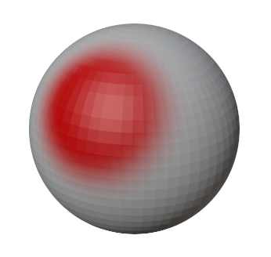
Selection
(by color)
Choose precision (blender)
Export “.ply”
particle-32x16-low.blend
particle-64x32-medium.blend
particle-128x64-high.blend
Colorize the wished surface
8

Slide 9
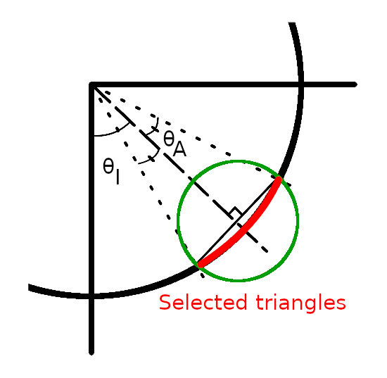
Selection
(by angle)
Choose precision
whole-low.ply
whole-medium.ply
whole-high.ply
Select proper angles
(inside the software)
9

Slide 10
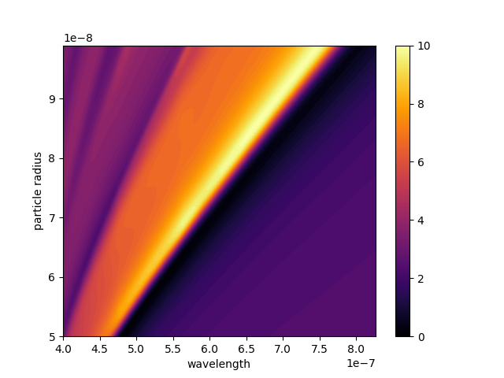
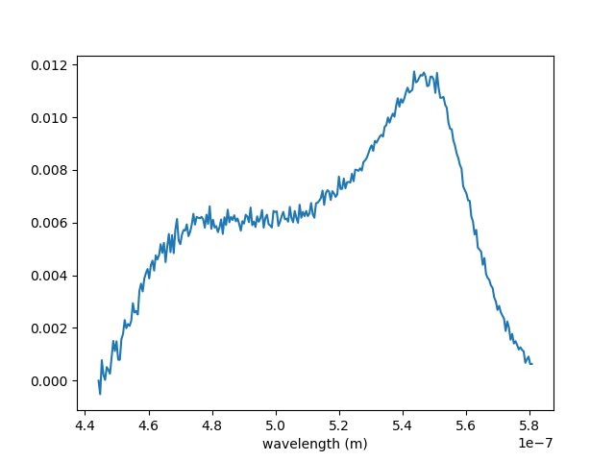
Find Radius
Challenge: Find the best theoretical spectrum fitting the experimental one
n_{a} = 0.2 x 𝜋 and n_{i} = 0.25 x 𝜋 with “whole-high.ply”
67 nm (radius) according to the AFM measurements
10

Slide 11
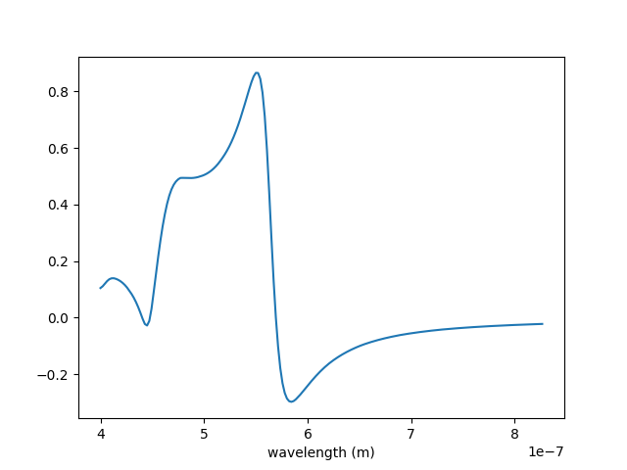
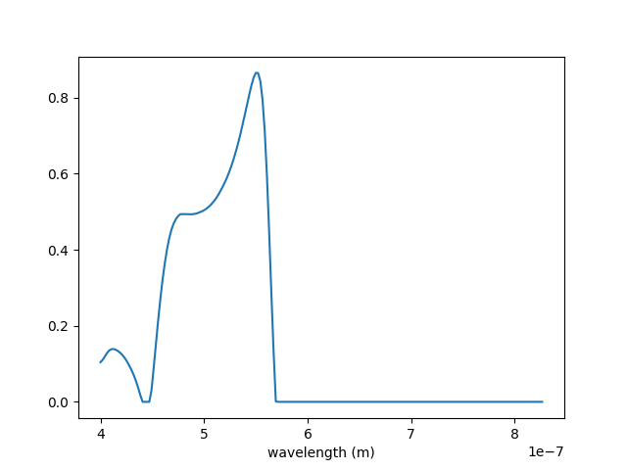
Find Radius
Transformation on each theoretical spectrum: remove negative values
11

Slide 12
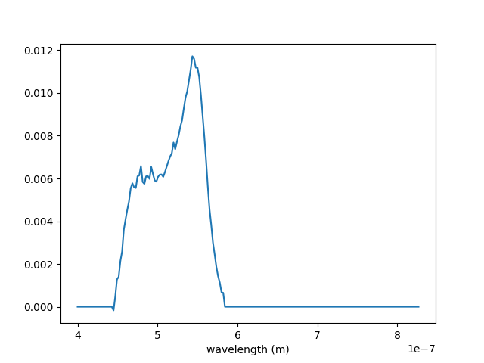
Find Radius
Transformation on the experimental spectrum: redistribute values in the same range of wavelength
12

Slide 13


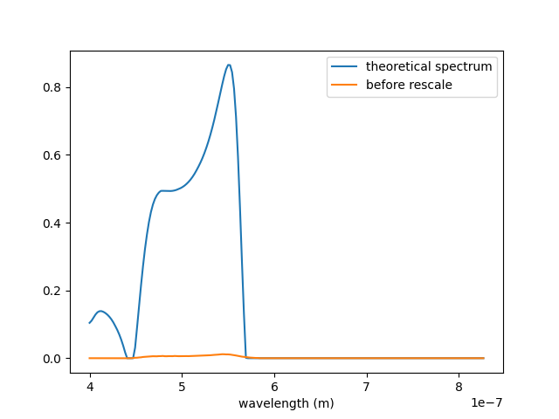
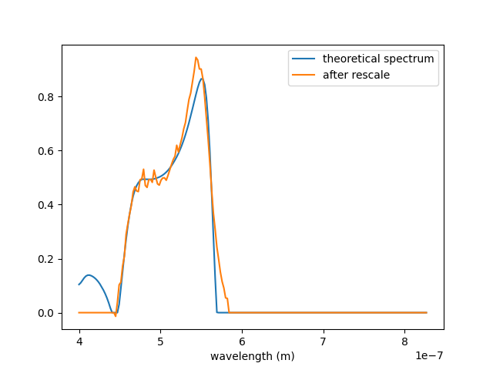
Find Radius
Rescale by area: g(x) = experimental spectrum ; f(x) = theoretical spectrum
13

Slide 14
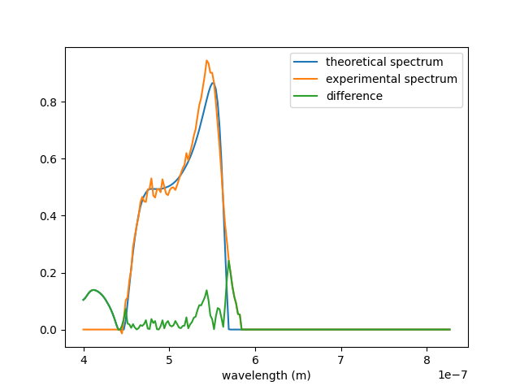
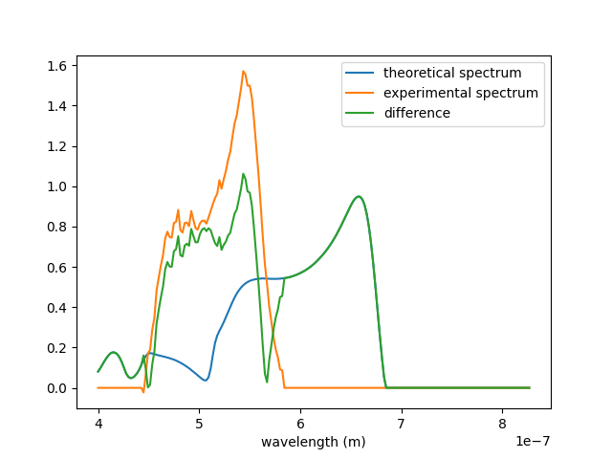
Find Radius
Compute the absolute difference in order to avoid negative compensations after integration
Best matching
Worst matching
We keep the lowest value of the area described by the green curve.
14

Slide 15
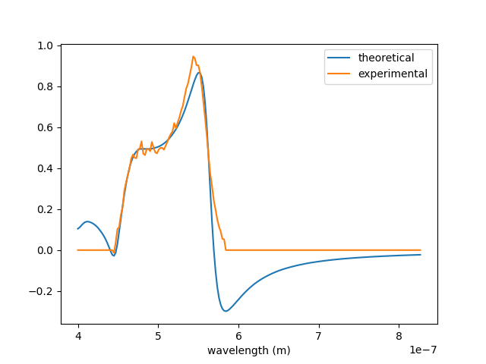
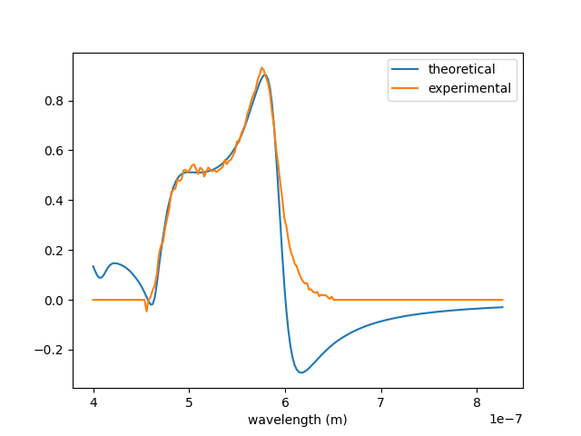
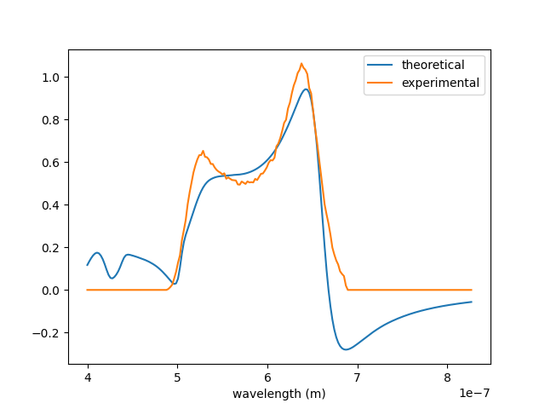
Find Radius
Some examples…
AFM radius: 67 nm
Software: 66.8 nm
AFM radius: 72 nm
Software: 71.7 nm
AFM radius: 82 nm
Software: 82.1 nm
15

Slide 16
THE END
16

